Slide 1
Sexually Transmitted Infections
Surveillance 2023
Adolescents and Young Adults​
Notes:
This slide set was prepared by the Division of STD Prevention, National Center for HIV, Viral Hepatitis, STD, and TB Prevention (NCHHSTP), Centers for Disease Control and Prevention (CDC). These slides display trends for STIs in the United States through 2023. Data presented include case notifications provided to CDC through the National Notifiable Diseases Surveillance System (NNDSS) and data collected through projects and programs that monitor STIs in various settings, including the STI Surveillance Network (SSuN).
For more information on data sources, data collection and reporting practices, and case definitions, please see the Technical Notes, available at https://www.cdc.gov/sti-statistics/annual/technical-notes.html.
All data points for figures presented in these slides are available at https://www.cdc.gov/sti-statistics/media/files/2024/11/2023-STI-Surveillance-Report-Data-Points.zip.
NOTE: This slide set is in the public domain. You may reproduce these slides without permission; however, citation as to source is appreciated.
Centers for Disease Control and Prevention. Sexually Transmitted Infections Surveillance 2023. Atlanta: U.S. Department of Health and Human Services; 2024.
You are also free to adapt and revise these slides; however, you must remove the CDC name and logo if changes are made.

Slide 2
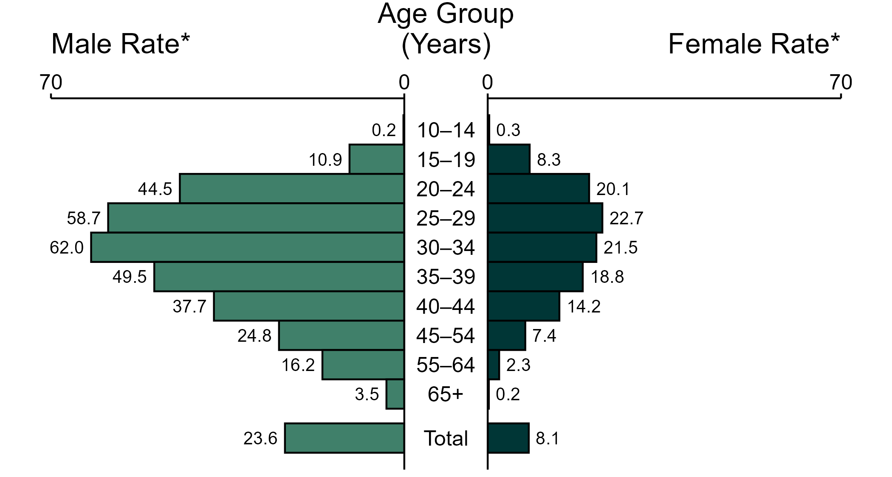
Primary and Secondary Syphilis — Rates of Reported Cases by Age Group and Sex, United States, 2023
* Per 100,000
NOTE: In 2023, five primary and secondary syphilis cases among men (<0.1%) and six cases among women (<0.1%) had missing or unknown age. These cases are included in the total rates.
Notes:
In 2023, the rate of reported primary and secondary (P&S) syphilis was higher among men (23.6 per 100,000) compared to women (8.1 per 100,000).
Among men, those aged 30 to 34 years had the highest rate of reported cases of P&S syphilis (62.0 per 100,000), followed by men aged 25 to 29 years (58.7 per 100,000) and men aged 35 to 39 years (49.5 per 100,000). Among women, those aged 25 to 29 years had the highest rate of reported cases of P&S syphilis (22.7 per 100,000), followed by women aged 30 to 34 years (21.5 per 100,000) and women aged 20 to 24 years (20.1 per 100,000).
This report includes data from years that coincide with the COVID-19 pandemic, which introduced uncertainty and difficulty in interpreting STI surveillance data. See Impact of COVID-19 on STIs (https://www.cdc.gov/sti-statistics/about/impact-of-covid-19.html) for more information.
See Technical Notes (https://www.cdc.gov/sti-statistics/annual/technical-notes.html) for information on STI case reporting formats and practices, including collected and derived variables displayed in this report. Table A (https://www.cdc.gov/sti-statistics/data-vis/table-selected-percunknown.html) provides information on unknown, missing, or invalid values of select variables.
Data for all figures are available at https://www.cdc.gov/sti-statistics/media/files/2024/11/2023-STI-Surveillance-Report-Data-Points.zip. The file “PS Syphilis - Rates by Age Group and Sex (US 2023).xlsx” contains the data for the figure presented on this slide.

Slide 3
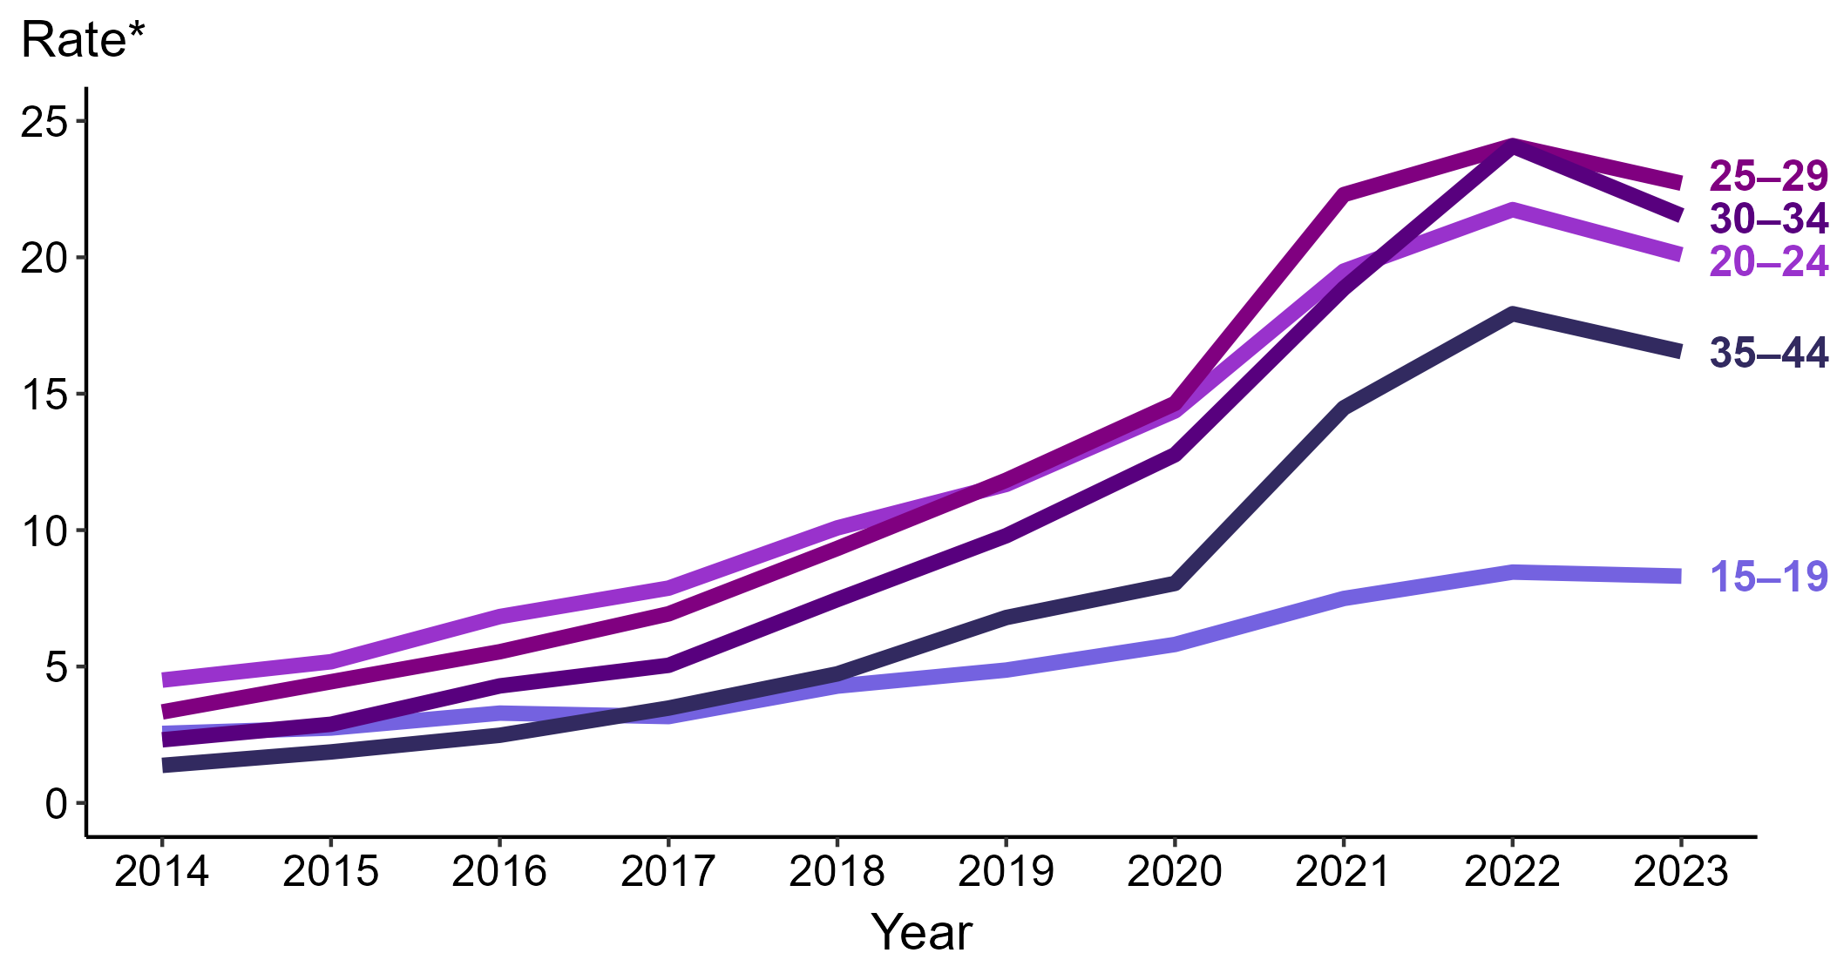
Primary and Secondary Syphilis — Rates of Reported Cases Among Women Aged 15–44 Years by Age Group and Year, United States, 2014–2023
* Per 100,000
Notes:
Among women aged 15 to 44 years in 2023, those aged 25 to 29 years had the highest rate of reported cases of primary and secondary syphilis (22.7 cases per 100,000; 5.8% decrease from 2022), followed by those aged 30 to 34 years (21.5 cases per 100,000; 10.8% decrease from 2022), those aged 20 to 24 years (20.1 cases per 100,000; 7.4% decrease from 2022), those aged 35 to 44 years (16.5 cases per 100,000; 7.8% decrease from 2022), and those aged 15 to 19 years (8.3 cases per 100,000; 2.4% decrease from 2022).
This report includes data from years that coincide with the COVID-19 pandemic, which introduced uncertainty and difficulty in interpreting STI surveillance data. See Impact of COVID-19 on STIs (https://www.cdc.gov/sti-statistics/about/impact-of-covid-19.html) for more information.
See Technical Notes (https://www.cdc.gov/sti-statistics/annual/technical-notes.html) for information on STI case reporting formats and practices, including collected and derived variables displayed in this report. Table A (https://www.cdc.gov/sti-statistics/data-vis/table-selected-percunknown.html) provides information on unknown, missing, or invalid values of select variables.
Data for all figures are available at https://www.cdc.gov/sti-statistics/media/files/2024/11/2023-STI-Surveillance-Report-Data-Points.zip. The file “PS Syphilis - Rates Women 15-44 Years by Age Group (US 2014-2023).xlsx” contains the data for the figure presented on this slide.

Slide 4
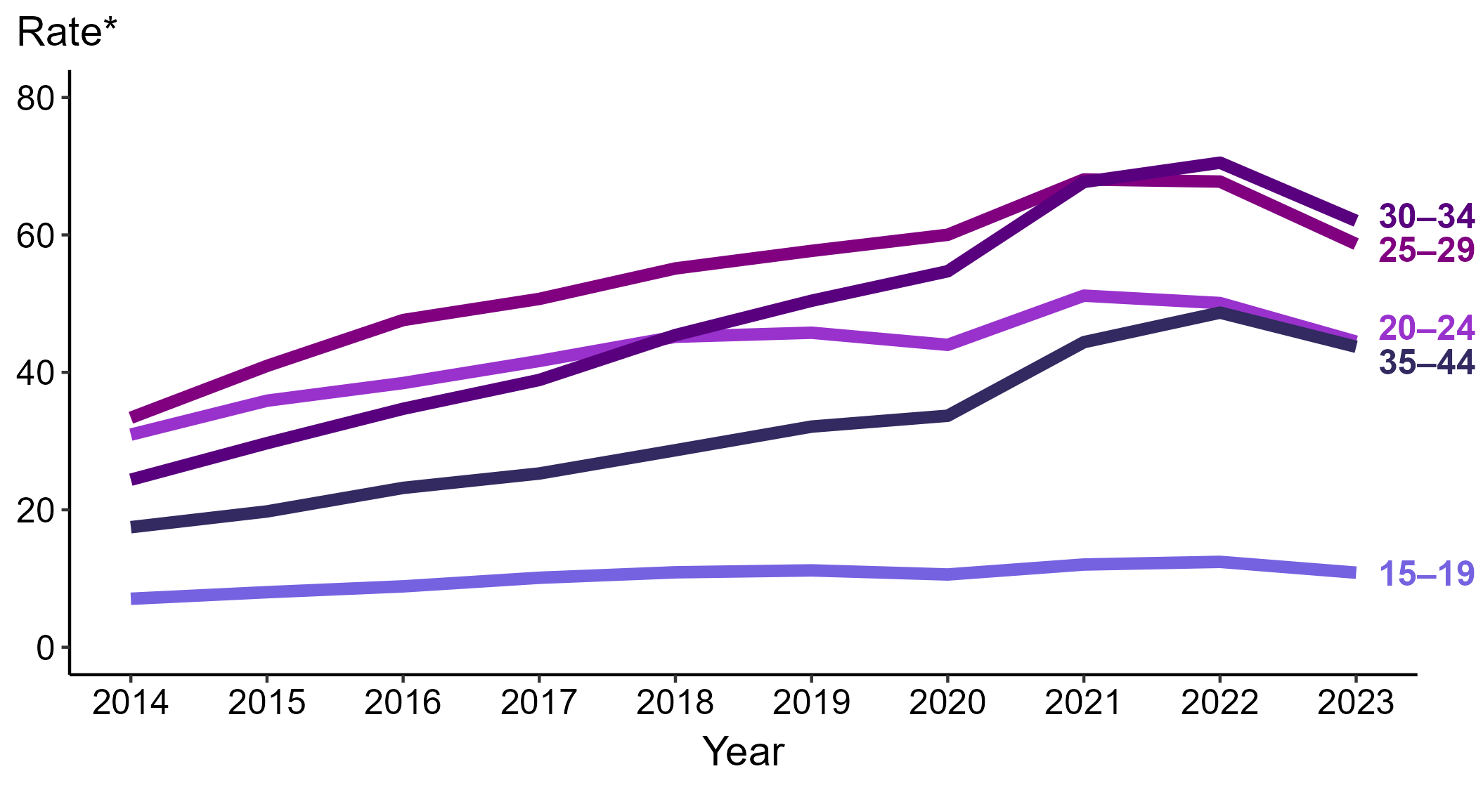
Primary and Secondary Syphilis — Rates of Reported Cases Among Men Aged 15–44 Years by Age Group and Year, United States, 2014–2023
* Per 100,000
Notes:
Among men aged 15 to 44 years in 2023, those aged 30 to 34 years had the highest rate of reported cases of primary and secondary syphilis (62.0 cases per 100,000; 12.1% decrease from 2022), followed by those aged 25 to 29 years (58.7 cases per 100,000; 13.4% decrease from 2022), those aged 20 to 24 years (44.5 cases per 100,000; 11.2% decrease from 2022), those aged 35 to 44 years (43.7 cases per 100,000; 10.3% decrease from 2022), and those aged 15 to 19 years (10.9 cases per 100,000; 12.1% decrease from 2022).
This report includes data from years that coincide with the COVID-19 pandemic, which introduced uncertainty and difficulty in interpreting STI surveillance data. See Impact of COVID-19 on STIs (https://www.cdc.gov/sti-statistics/about/impact-of-covid-19.html) for more information.
See Technical Notes (https://www.cdc.gov/sti-statistics/annual/technical-notes.html) for information on STI case reporting formats and practices, including collected and derived variables displayed in this report. Table A (https://www.cdc.gov/sti-statistics/data-vis/table-selected-percunknown.html) provides information on unknown, missing, or invalid values of select variables.
Data for all figures are available at https://www.cdc.gov/sti-statistics/media/files/2024/11/2023-STI-Surveillance-Report-Data-Points.zip. The file “PS Syphilis - Rates Men 15-44 Years by Age Group (US 2014-2023).xlsx” contains the data for the figure presented on this slide.

Slide 5
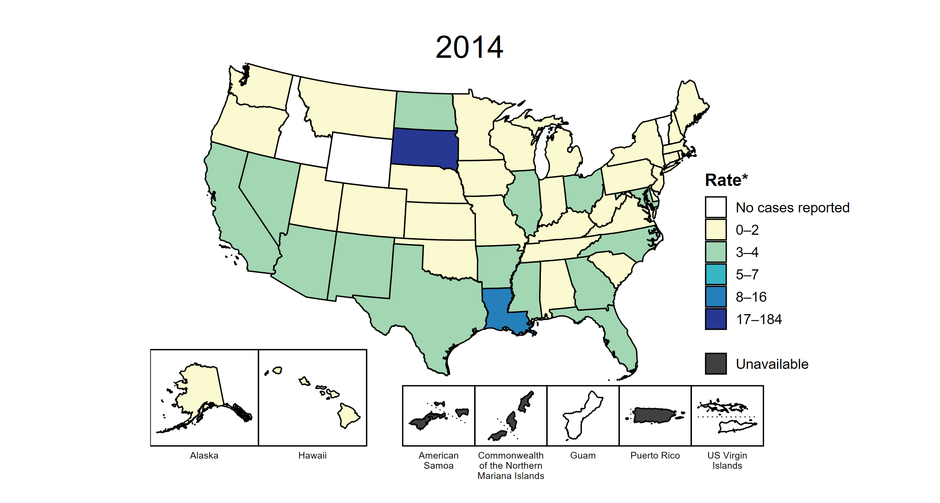
Primary and Secondary Syphilis — Rates of Reported Cases Among Women Aged 15–44 Years by Jurisdiction, United States and Territories, 2014–2023
* Per 100,000
Notes:
This slide contains an animated figure that will play when the slide is in presentation mode. A static version of the figure that displays maps from the first and last years of the range is available as a separate slide.
In 2014, two states (3.8% of areas with available data) had a rate of reported primary and secondary syphilis greater than or equal to 8 cases per 100,000 women aged 15 to 44 years. This increased to 41 states, the District of Columbia (DC), and one US territory (76.8% of areas with available data) in 2023. During 2022 to 2023, rates of reported primary and secondary syphilis among women aged 15 to 44 years increased in 16 states, DC, and one territory.
American Samoa and the Commonwealth of the Northern Mariana Islands began providing data on P&S syphilis cases to CDC in 2018; data are not available for those areas prior to that year. In addition, data on reported P&S syphilis cases in 2018 are not available for the US Virgin Islands. Furthermore, population estimates by age and sex were not available for all territories for all years. Due to a network security incident in December 2021, the Maryland Department of Health could not finalize their 2021 STI case notification data. Data for 2021 from Maryland have been suppressed for this figure; however, they are included in national and regional case counts and rates displayed in other figures. Tennessee transitioned STI surveillance information systems in September of 2023 which may have impacted the overall case counts. Caution should be applied in interpretation of these data.
This report includes data from years that coincide with the COVID-19 pandemic, which introduced uncertainty and difficulty in interpreting STI surveillance data. See Impact of COVID-19 on STIs (https://www.cdc.gov/sti-statistics/about/impact-of-covid-19.html) for more information.
See Technical Notes (https://www.cdc.gov/sti-statistics/annual/technical-notes.html) for information on STI case reporting formats and practices, including collected and derived variables displayed in this report. Table A (https://www.cdc.gov/sti-statistics/data-vis/table-selected-percunknown.html) provides information on unknown, missing, or invalid values of select variables.
Data for all figures are available at https://www.cdc.gov/sti-statistics/media/files/2024/11/2023-STI-Surveillance-Report-Data-Points.zip. The file “PS Syphilis - Rates Women 15-44 Years by Jurisdiction (US and Terr 2014-2023).xlsx” contains the data for the figure presented on this slide.

Slide 6
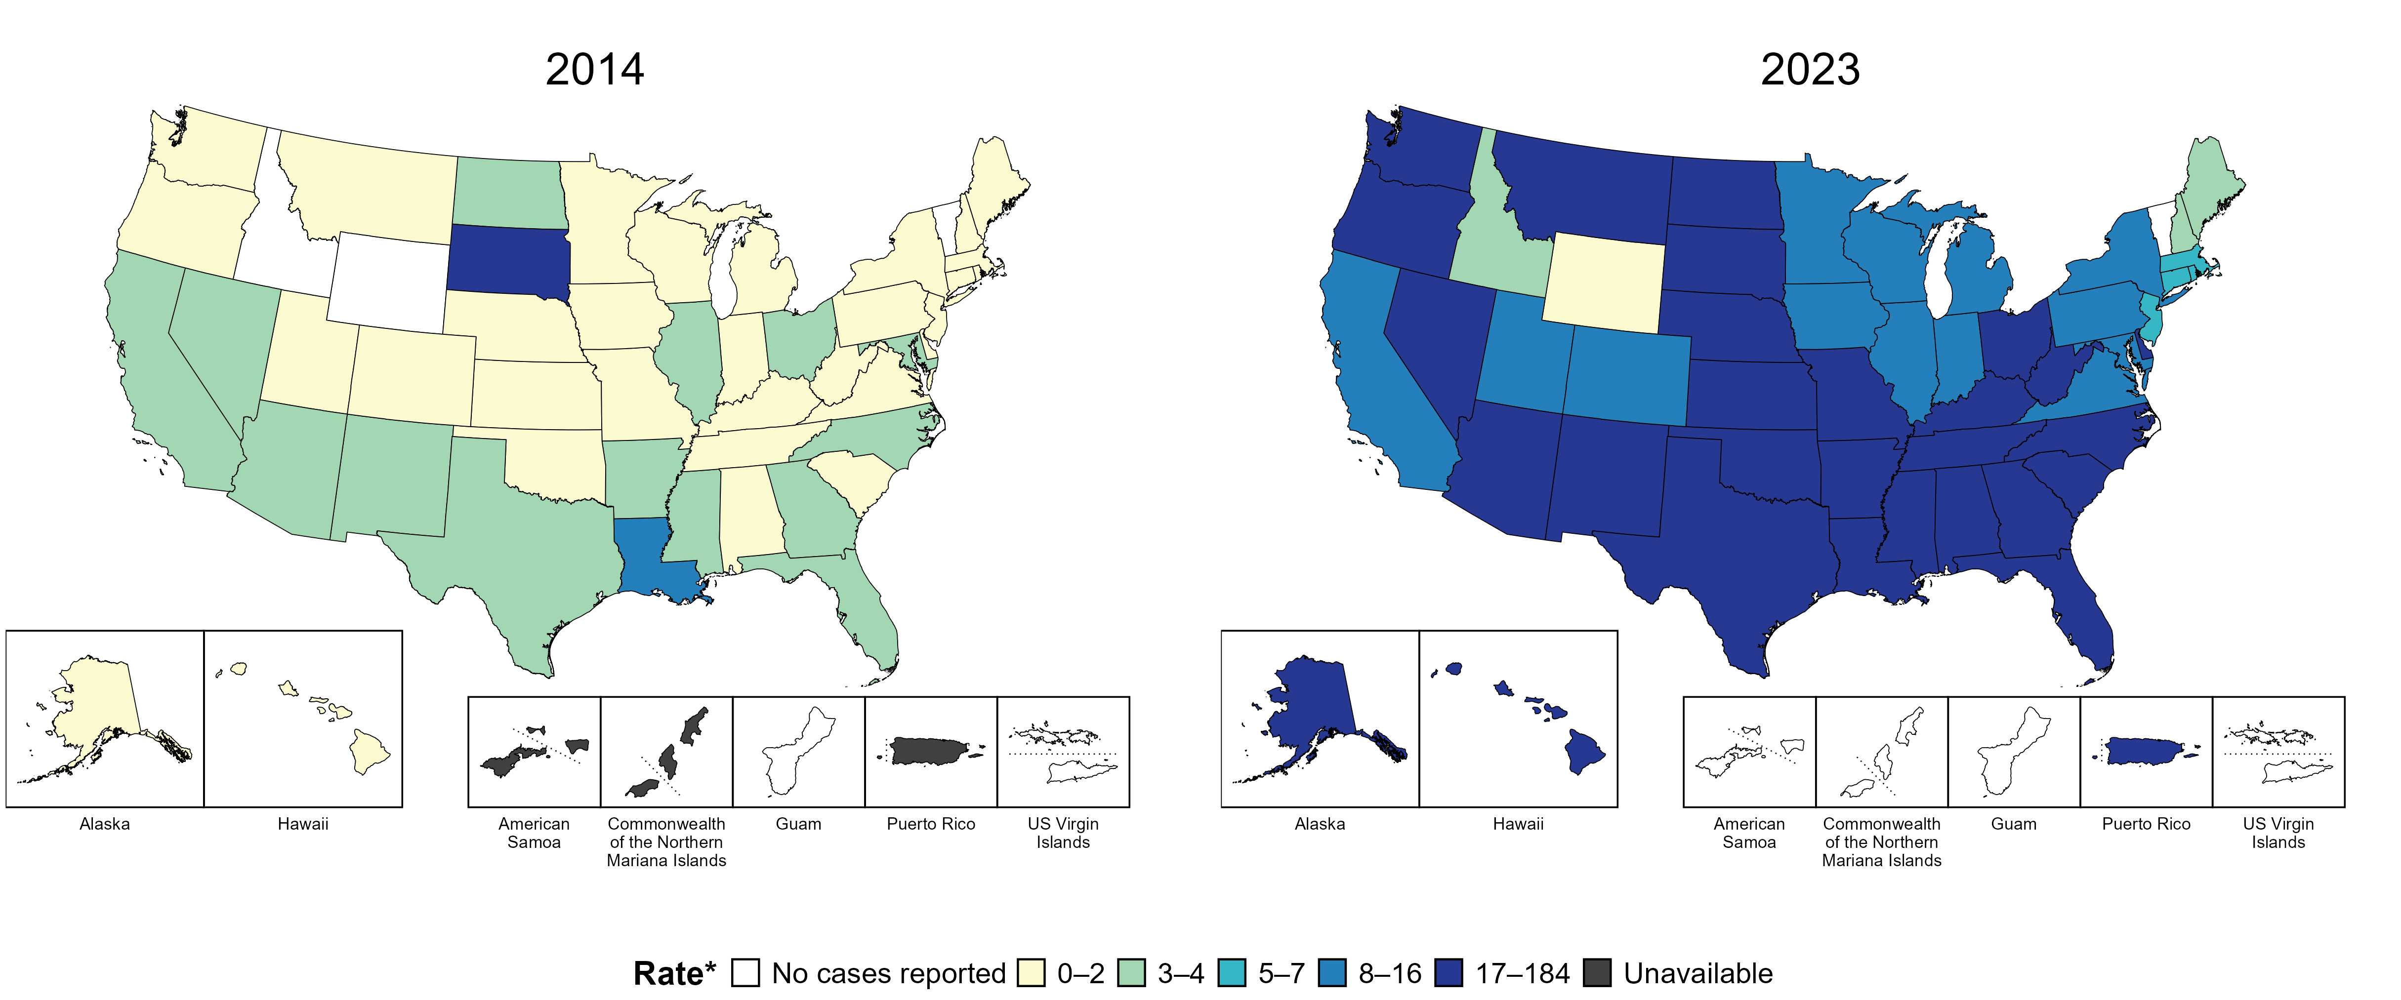
Primary and Secondary Syphilis — Rates of Reported Cases Among Women Aged 15–44 Years by Jurisdiction, United States and Territories, 2014 and 2023
* Per 100,000
Notes:
In 2014, two states (3.8% of areas with available data) had a rate of reported primary and secondary syphilis greater than or equal to 8 cases per 100,000 women aged 15 to 44 years. This increased to 41 states, the District of Columbia, and one US territory (76.8% of areas with available data) in 2023.
American Samoa and the Commonwealth of the Northern Mariana Islands began providing data on P&S syphilis cases to CDC in 2018; data are not available for those areas prior to that year. Additionally, population estimates by age and sex were not available for all territories for both years. Tennessee transitioned STI surveillance information systems in September of 2023 which may have impacted the overall case counts. Caution should be applied in interpretation of these data.
This report includes data from years that coincide with the COVID-19 pandemic, which introduced uncertainty and difficulty in interpreting STI surveillance data. See Impact of COVID-19 on STIs (https://www.cdc.gov/sti-statistics/about/impact-of-covid-19.html) for more information.
See Technical Notes (https://www.cdc.gov/sti-statistics/annual/technical-notes.html) for information on STI case reporting formats and practices, including collected and derived variables displayed in this report. Table A (https://www.cdc.gov/sti-statistics/data-vis/table-selected-percunknown.html) provides information on unknown, missing, or invalid values of select variables.
Data for all figures are available at https://www.cdc.gov/sti-statistics/media/files/2024/11/2023-STI-Surveillance-Report-Data-Points.zip. The file “PS Syphilis - Rates Women 15-44 Years by Jurisdiction (US and Terr 2014 and 2023).xlsx” contains the data for the figure presented on this slide.

Slide 7
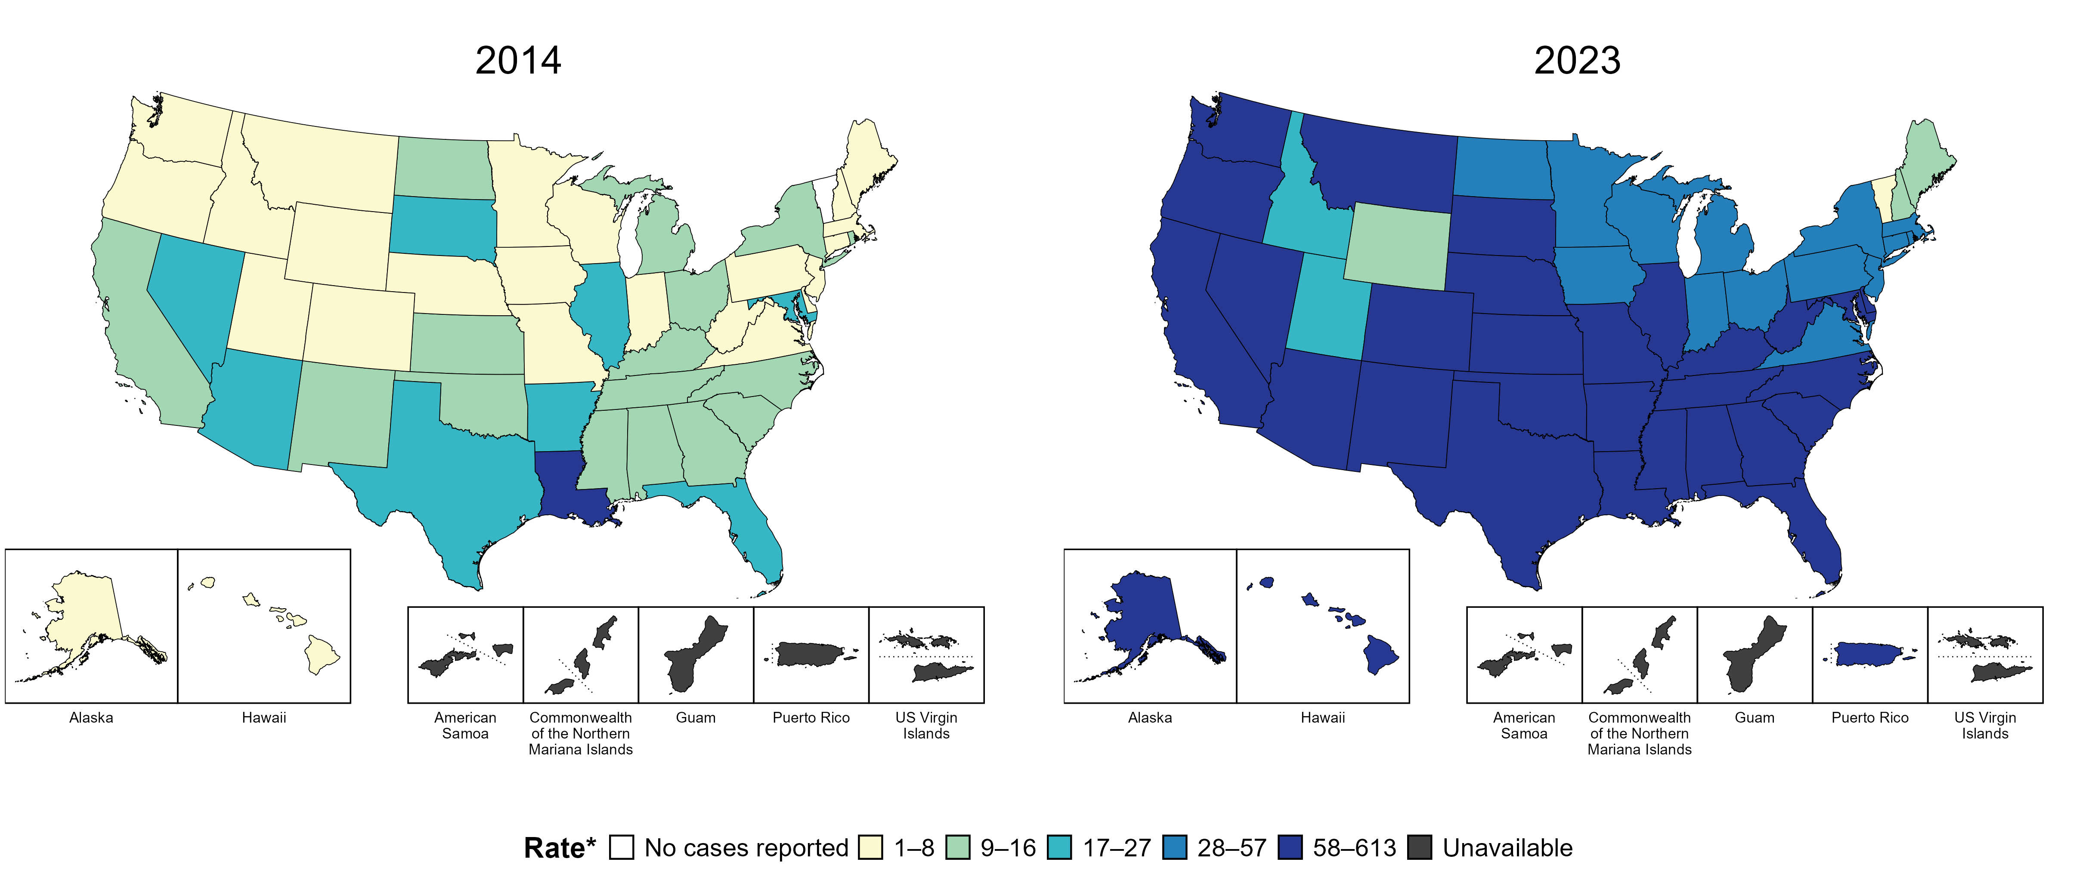
Syphilis (All Stages) — Rates of Reported Cases Among Women Aged 15–44 Years by Jurisdiction, United States and Territories, 2014 and 2023
* Per 100,000
Notes:
In 2014, one state (2.0% of areas with available data) had a rate of reported syphilis (all stages) greater than or equal to 28 cases per 100,000 women aged 15 to 44 years. This increased to 44 states, the District of Columbia, and one US territory (88.5% of areas with available data) in 2023.
Data on reported cases of syphilis other than primary and secondary syphilis are not available by age and sex for American Samoa, the Commonwealth of the Northern Mariana Islands, Guam, and the US Virgin Islands. Additionally, population estimates by age and sex were not available for all territories for both years. Tennessee transitioned STI surveillance information systems in September of 2023 which may have impacted the overall case counts. Caution should be applied in interpretation of these data.
This report includes data from years that coincide with the COVID-19 pandemic, which introduced uncertainty and difficulty in interpreting STI surveillance data. See Impact of COVID-19 on STIs (https://www.cdc.gov/sti-statistics/about/impact-of-covid-19.html) for more information.
See Technical Notes (https://www.cdc.gov/sti-statistics/annual/technical-notes.html) for information on STI case reporting formats and practices, including collected and derived variables displayed in this report. Table A (https://www.cdc.gov/sti-statistics/data-vis/table-selected-percunknown.html) provides information on unknown, missing, or invalid values of select variables.
Data for all figures are available at https://www.cdc.gov/sti-statistics/media/files/2024/11/2023-STI-Surveillance-Report-Data-Points.zip. The file “Syphilis - Rates Women 15-44 Years by Jurisdiction (US and Terr 2014 and 2023).xlsx” contains the data for the figure presented on this slide.

Slide 8
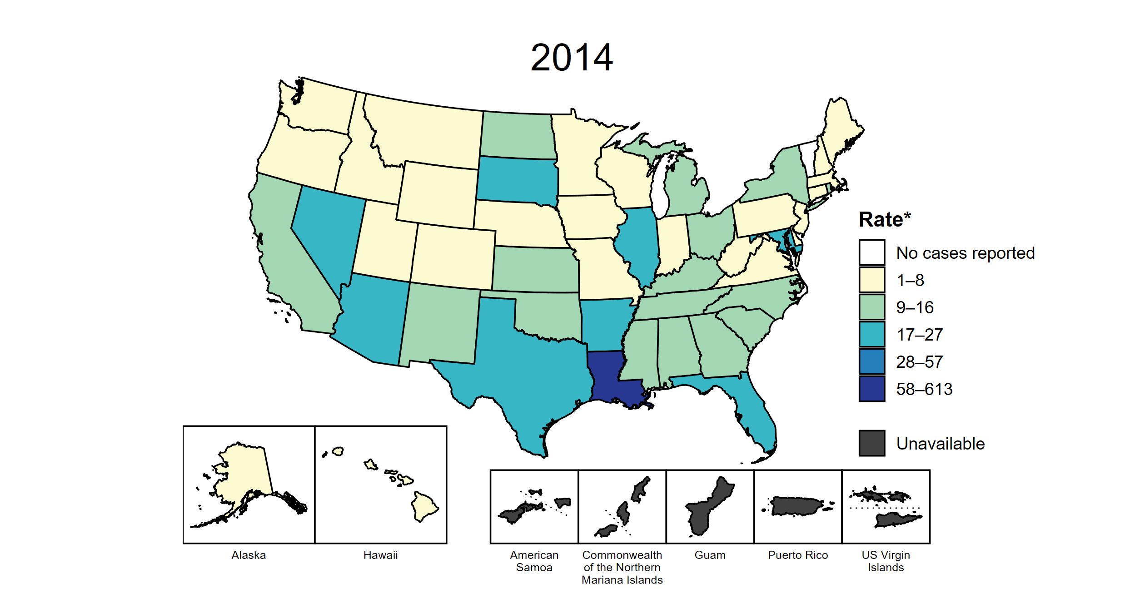
Syphilis (All Stages) — Rates of Reported Cases Among Women Aged 15–44 Years by Jurisdiction, United States and Territories, 2014–2023
* Per 100,000
Notes:
This slide contains an animated figure that will play when the slide is in presentation mode. A static version of the figure that displays maps from the first and last years of the range is available as a separate slide.
In 2014, one state (2.0% of areas with available data) had a rate of reported syphilis (all stages) greater than or equal to 28 cases per 100,000 women aged 15 to 44 years. This increased to 44 states, the District of Columbia (DC), and one US territory (88.5% of areas with available data) in 2023. During 2022 to 2023, rates of reported syphilis (all stages) among women aged 15 to 44 years increased in 39 states, DC, and one territory.
Data on reported cases of syphilis other than primary and secondary syphilis are not available by age and sex for American Samoa, the Commonwealth of the Northern Mariana Islands, Guam, and the US Virgin Islands. Additionally, population estimates by age and sex were not available for all territories for all years. Due to a network security incident in December 2021, the Maryland Department of Health could not finalize their 2021 STI case notification data. Data for 2021 from Maryland have been suppressed for this figure; however, they are included in national and regional case counts and rates displayed in other figures. Tennessee transitioned STI surveillance information systems in September of 2023 which may have impacted the overall case counts. Caution should be applied in interpretation of these data.
This report includes data from years that coincide with the COVID-19 pandemic, which introduced uncertainty and difficulty in interpreting STI surveillance data. See Impact of COVID-19 on STIs (https://www.cdc.gov/sti-statistics/about/impact-of-covid-19.html) for more information.
See Technical Notes (https://www.cdc.gov/sti-statistics/annual/technical-notes.html) for information on STI case reporting formats and practices, including collected and derived variables displayed in this report. Table A (https://www.cdc.gov/sti-statistics/data-vis/table-selected-percunknown.html) provides information on unknown, missing, or invalid values of select variables.
Data for all figures are available at https://www.cdc.gov/sti-statistics/media/files/2024/11/2023-STI-Surveillance-Report-Data-Points.zip. The file “Syphilis - Rates Women 15-44 Years by Jurisdiction (US and Terr 2014-2023).xlsx” contains the data for the figure presented on this slide.

Slide 9
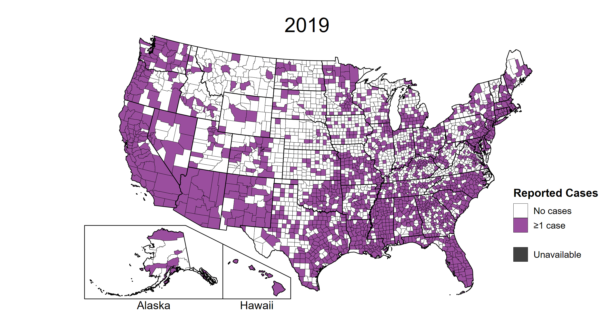
Syphilis (All Stages) — Reported Cases Among Women Aged 15–44 Years by County, United States, 2019–2023
Notes:
This slide contains an animated figure that will play when the slide is in presentation mode. A static version of the figure that displays maps from the first and last years of the range is available as a separate slide.
In 2019, 1,568 (49.9%) of US counties and county equivalents with available data reported at least one case of syphilis (all stages) among women of reproductive age (15–44 years), increasing to 2,227 (70.8%) of counties and county equivalents with available data in 2023.
During 2022 to 2023, the number of counties and county equivalents increased from 2,132 (68.0% of counties and county equivalents with available data) in 2022 to 2,227 (70.8% of counties and county equivalents with available data) in 2023.
Due to a network security incident in December 2021, the Maryland Department of Health could not finalize their 2021 STI case notification data. Data for 2021 from Maryland have been suppressed for this figure; however, they are included in national and regional case counts and rates displayed in other figures. In 2022, Connecticut adopted nine planning regions as county-equivalent geographic units; as STI case notification data were not available in the new county-equivalent units for 2022, data for Connecticut have been suppressed for this figure. Tennessee transitioned STI surveillance information systems in September of 2023 which may have impacted the overall case counts. Caution should be applied in interpretation of these data.
Note that boundaries for counties and county-equivalent areas change over time and may differ between years depicted in this figure.
This report includes data from years that coincide with the COVID-19 pandemic, which introduced uncertainty and difficulty in interpreting STI surveillance data. See Impact of COVID-19 on STIs (https://www.cdc.gov/sti-statistics/about/impact-of-covid-19.html) for more information.
See Technical Notes (https://www.cdc.gov/sti-statistics/annual/technical-notes.html) for information on STI case reporting formats and practices, including collected and derived variables displayed in this report. Table A (https://www.cdc.gov/sti-statistics/data-vis/table-selected-percunknown.html) provides information on unknown, missing, or invalid values of select variables.
Data for all figures are available at https://www.cdc.gov/sti-statistics/media/files/2024/11/2023-STI-Surveillance-Report-Data-Points.zip. The file “Syphilis - Cases Women 15-44 Years by County (US 2019-2023).xlsx” contains the data for the figure presented on this slide.

Slide 10
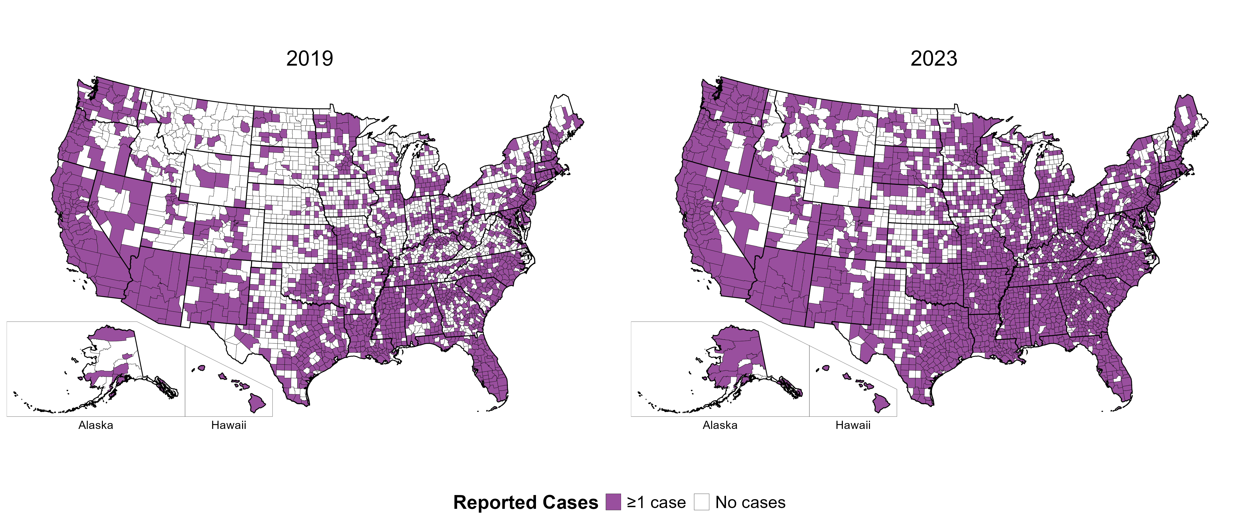
Syphilis (All Stages) — Reported Cases Among Women Aged 15–44 Years by County, United States, 2019 and 2023
Notes:
In 2019, 1,568 (49.9%) of US counties and county equivalents with available data reported at least one case of syphilis (all stages) among women of reproductive age (15–44 years), increasing to 2,227 (70.8%) of counties and county equivalents with available data in 2023.
Tennessee transitioned STI surveillance information systems in September of 2023 which may have impacted the overall case counts. Caution should be applied in interpretation of these data.
Note that boundaries for counties and county-equivalent areas change over time and may differ between years depicted in this figure.
This report includes data from years that coincide with the COVID-19 pandemic, which introduced uncertainty and difficulty in interpreting STI surveillance data. See Impact of COVID-19 on STIs (https://www.cdc.gov/sti-statistics/about/impact-of-covid-19.html) for more information.
See Technical Notes (https://www.cdc.gov/sti-statistics/annual/technical-notes.html) for information on STI case reporting formats and practices, including collected and derived variables displayed in this report. Table A (https://www.cdc.gov/sti-statistics/data-vis/table-selected-percunknown.html) provides information on unknown, missing, or invalid values of select variables.
Data for all figures are available at https://www.cdc.gov/sti-statistics/media/files/2024/11/2023-STI-Surveillance-Report-Data-Points.zip. The file “Syphilis - Cases Women 15-44 Years by County (US 2019 and 2023).xlsx” contains the data for the figure presented on this slide.

Slide 11
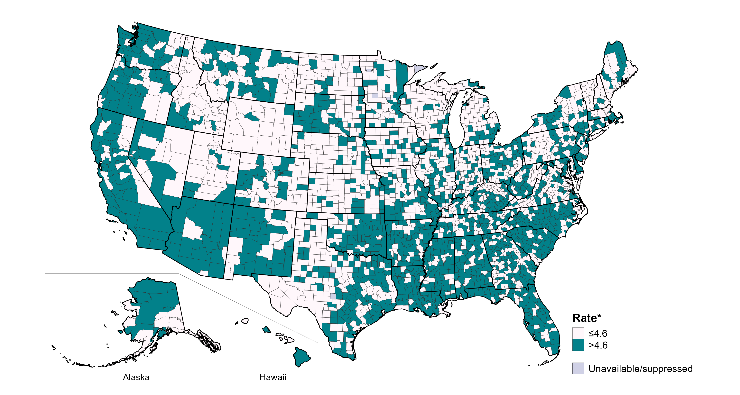
Primary and Secondary Syphilis — Rates of Reported Cases Among Women Aged 15–44 Years by County, United States, 2023
* Per 100,000
NOTE: The target for the Healthy People 2030 goal to reduce the rate of syphilis in women is 4.6 per 100,000.
Notes:
One goal of Healthy People 2030 is to reduce the rate of syphilis in women to 4.6 per 100,000. In 2023, 1,415 counties and county equivalents (45.1% of counties and county equivalents with available data) had a rate of primary and secondary syphilis among 15-44 year old women greater than 4.6 per 100,000. During the same year, 76.6% of the US population resided in these counties and county equivalents.
Tennessee transitioned STI surveillance information systems in September of 2023 which may have impacted the overall case counts. Caution should be applied in interpretation of these data. Per current re-release guidelines for county-level syphilis case notification data, data have been suppressed for counties and county equivalents where display could identify the age, race, and sex of cases in strata with a population of <100 people.
Per current re-release guidelines for county-level syphilis case notification data, data have been suppressed for counties where display could identify the age, race, and sex of cases in strata with a population of <100 people.
This report includes data from years that coincide with the COVID-19 pandemic, which introduced uncertainty and difficulty in interpreting STI surveillance data. See Impact of COVID-19 on STIs (https://www.cdc.gov/sti-statistics/about/impact-of-covid-19.html) for more information.
See Technical Notes (https://www.cdc.gov/sti-statistics/annual/technical-notes.html) for information on STI case reporting formats and practices, including collected and derived variables displayed in this report. Table A (https://www.cdc.gov/sti-statistics/data-vis/table-selected-percunknown.html) provides information on unknown, missing, or invalid values of select variables.
Data for all figures are available at https://www.cdc.gov/sti-statistics/media/files/2024/11/2023-STI-Surveillance-Report-Data-Points.zip. The file “PS Syphilis - Rates Women 15-44 Years by County (US 2023).xlsx” contains the data for the figure presented on this slide.

Slide 12
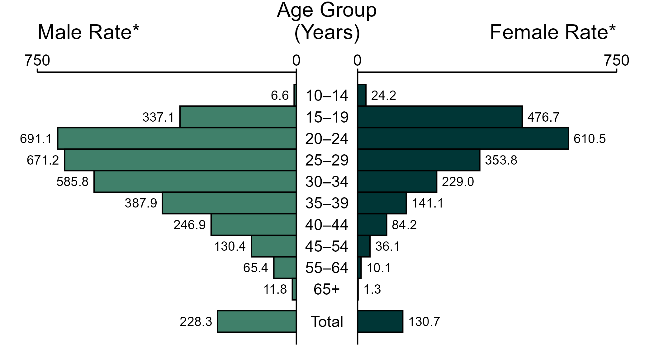
Gonorrhea — Rates of Reported Cases by Age Group and Sex, United States, 2023
* Per 100,000
NOTE: In 2023, 4,005 gonorrhea cases among men (1.1%) and 2,293 cases among women (1.0%) had missing or unknown age. These cases are included in the total rates.
Notes:
In 2023, the rate of reported gonorrhea was higher among men (228.3 per 100,000) compared to women (130.7 per 100,000).
Among men, those aged 20 to 24 years had the highest rate of reported cases of gonorrhea (691.1 per 100,000), followed by men aged 25 to 29 years (671.2 per 100,000) and men aged 30 to 34 years (585.8 per 100,000). Among women, those aged 20 to 24 years also had the highest rate of reported cases of gonorrhea (610.5 per 100,000), followed by women aged 15 to 19 years (476.7 per 100,000) and women aged 25 to 29 years (353.8 per 100,000).
This report includes data from years that coincide with the COVID-19 pandemic, which introduced uncertainty and difficulty in interpreting STI surveillance data. See Impact of COVID-19 on STIs (https://www.cdc.gov/sti-statistics/about/impact-of-covid-19.html) for more information.
See Technical Notes (https://www.cdc.gov/sti-statistics/annual/technical-notes.html) for information on gonorrhea case reporting. Table A (https://www.cdc.gov/sti-statistics/data-vis/table-selected-percunknown.html) provides information on unknown, missing, or invalid values of select variables.
Data for all figures are available at https://www.cdc.gov/sti-statistics/media/files/2024/11/2023-STI-Surveillance-Report-Data-Points.zip. The file “GC - Rates by Age Group and Sex (US 2023).xlsx” contains the data for the figure presented on this slide.

Slide 13
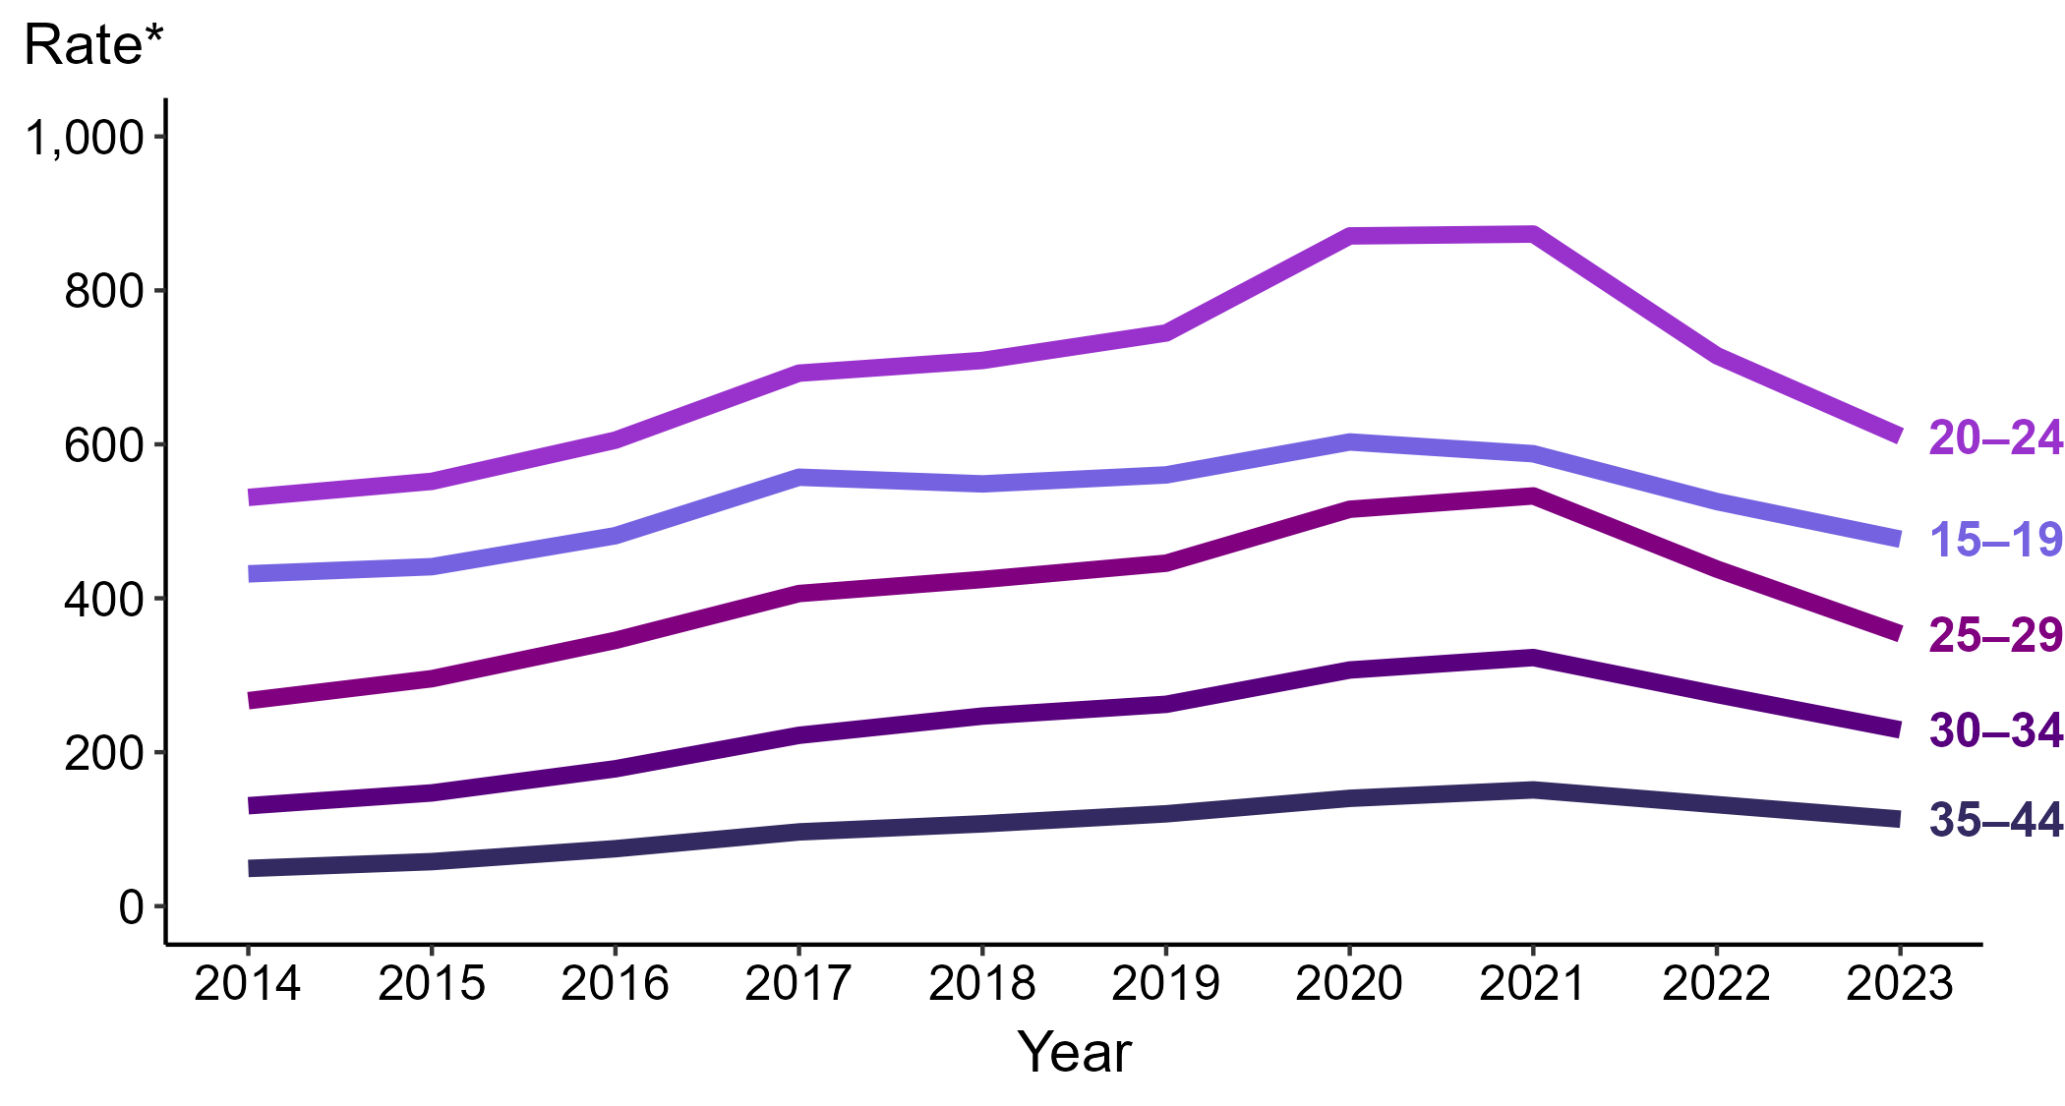
Gonorrhea — Rates of Reported Cases Among Women Aged 15–44 Years by Age Group and Year, United States, 2014–2023
* Per 100,000
Notes:
Among women aged 15 to 44 years in 2023, those aged 20 to 24 years had the highest rate of reported cases of gonorrhea (610.5 cases per 100,000; 14.6% decrease from 2022), followed by those aged 15 to 19 years (476.7 cases per 100,000; 9.3% decrease from 2022), those aged 25 to 29 years (353.8 cases per 100,000; 19.2% decrease from 2022), those aged 30 to 34 years (229.0 cases per 100,000; 16.8% decrease from 2022), and those aged 35 to 44 years (113.0 cases per 100,000; 14.3% decrease from 2022).
This report includes data from years that coincide with the COVID-19 pandemic, which introduced uncertainty and difficulty in interpreting STI surveillance data. See Impact of COVID-19 on STIs (https://www.cdc.gov/sti-statistics/about/impact-of-covid-19.html) for more information.
See Technical Notes (https://www.cdc.gov/sti-statistics/annual/technical-notes.html) for information on STI case reporting formats and practices, including collected and derived variables displayed in this report. Table A (https://www.cdc.gov/sti-statistics/data-vis/table-selected-percunknown.html) provides information on unknown, missing, or invalid values of select variables.
Data for all figures are available at https://www.cdc.gov/sti-statistics/media/files/2024/11/2023-STI-Surveillance-Report-Data-Points.zip. The file “GC - Rates Women 15-44 Years by Age Group (US 2014-2023).xlsx” contains the data for the figure presented on this slide.

Slide 14
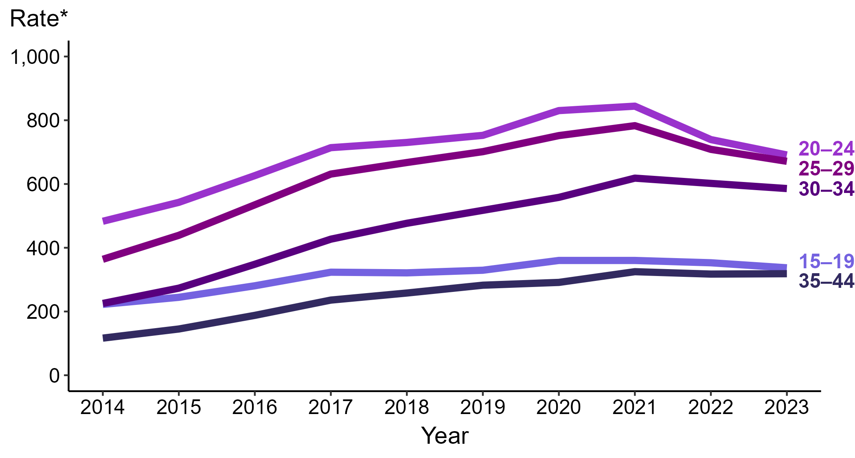
Gonorrhea — Rates of Reported Cases Among Men Aged 15–44 Years by Age Group and Year, United States, 2014–2023
* Per 100,000
Notes:
Among men aged 15 to 44 years in 2023, those aged 20 to 24 years had the highest rate of reported cases of gonorrhea (691.1 cases per 100,000; 6.5% decrease from 2022), followed by those aged 25 to 29 years (671.2 cases per 100,000; 5.3% decrease from 2022), those aged 30 to 34 years (585.8 cases per 100,000; 2.7% decrease from 2022), those aged 15 to 19 years (337.1 cases per 100,000; 4.5% decrease from 2022), and those aged 35 to 44 years (318.6 cases per 100,000; <1.0% change from 2022).
This report includes data from years that coincide with the COVID-19 pandemic, which introduced uncertainty and difficulty in interpreting STI surveillance data. See Impact of COVID-19 on STIs (https://www.cdc.gov/sti-statistics/about/impact-of-covid-19.html) for more information.
See Technical Notes (https://www.cdc.gov/sti-statistics/annual/technical-notes.html) for information on STI case reporting formats and practices, including collected and derived variables displayed in this report. Table A (https://www.cdc.gov/sti-statistics/data-vis/table-selected-percunknown.html) provides information on unknown, missing, or invalid values of select variables.
Data for all figures are available at https://www.cdc.gov/sti-statistics/media/files/2024/11/2023-STI-Surveillance-Report-Data-Points.zip. The file “GC - Rates Men 15-44 Years by Age Group (US 2014-2023).xlsx” contains the data for the figure presented on this slide.

Slide 15
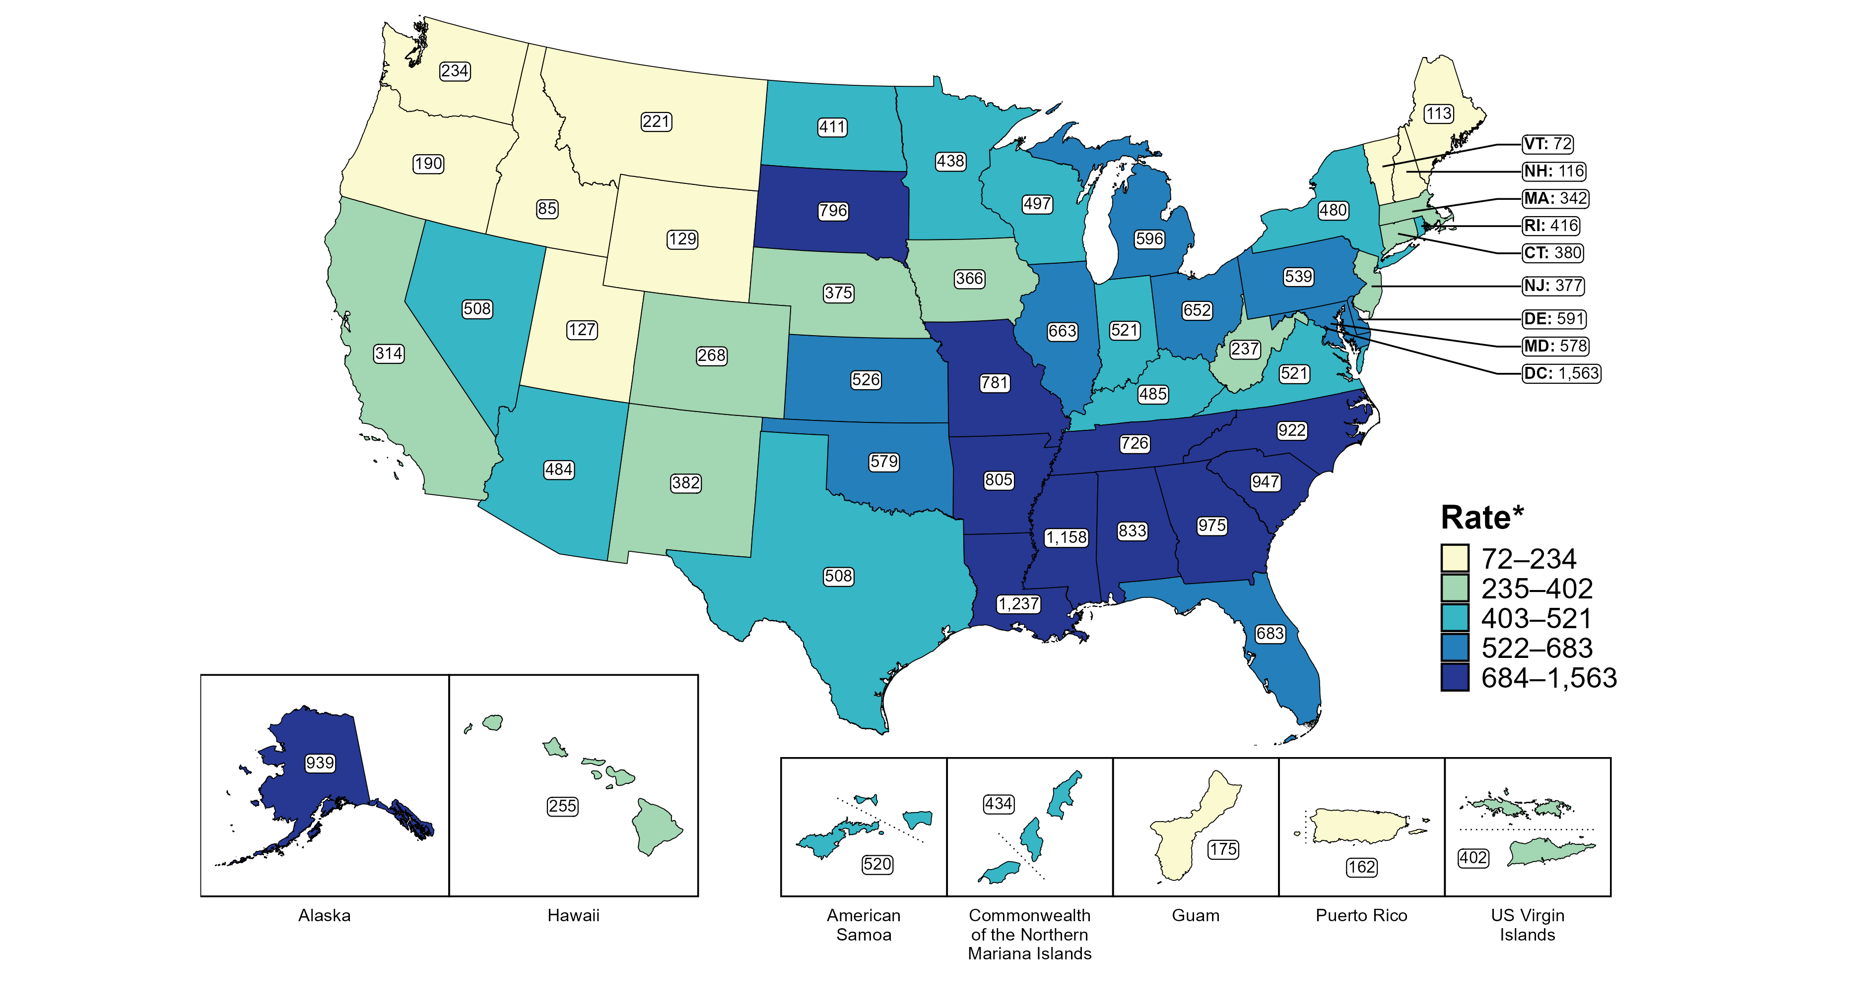
Gonorrhea — Rates of Reported Cases Among Women Aged 15–24 Years by Jurisdiction, United States and Territories, 2023
* Per 100,000
Notes:
In 2023, rates of reported gonorrhea among women aged 15 to 24 years ranged by state from 72 cases per 100,000 women aged 15 to 24 years in Vermont to 1,237 cases per 100,000 women aged 15 to 24 years in Louisiana. The rate of reported gonorrhea in the District of Columbia was 1,563 per 100,000 women aged 15 to 24 years.
Among US territories, rates of reported gonorrhea ranged from 162 cases per 100,000 women aged 15 to 24 years in Puerto Rico to 520 cases per 100,000 women aged 15 to 24 years in American Samoa.
Tennessee transitioned STI surveillance information systems in September of 2023 which may have impacted the overall case counts. Caution should be applied in interpretation of these data.
This report includes data from years that coincide with the COVID-19 pandemic, which introduced uncertainty and difficulty in interpreting STI surveillance data. See Impact of COVID-19 on STIs (https://www.cdc.gov/sti-statistics/about/impact-of-covid-19.html) for more information.
See Technical Notes (https://www.cdc.gov/sti-statistics/annual/technical-notes.html) for information on STI case reporting formats and practices, including collected and derived variables displayed in this report. Table A (https://www.cdc.gov/sti-statistics/data-vis/table-selected-percunknown.html) provides information on unknown, missing, or invalid values of select variables.
Data for all figures are available at https://www.cdc.gov/sti-statistics/media/files/2024/11/2023-STI-Surveillance-Report-Data-Points.zip. The file “GC - Rates Women 15-24 Years by Jurisdiction (US and Terr 2023).xlsx” contains the data for the figure presented on this slide.

Slide 16
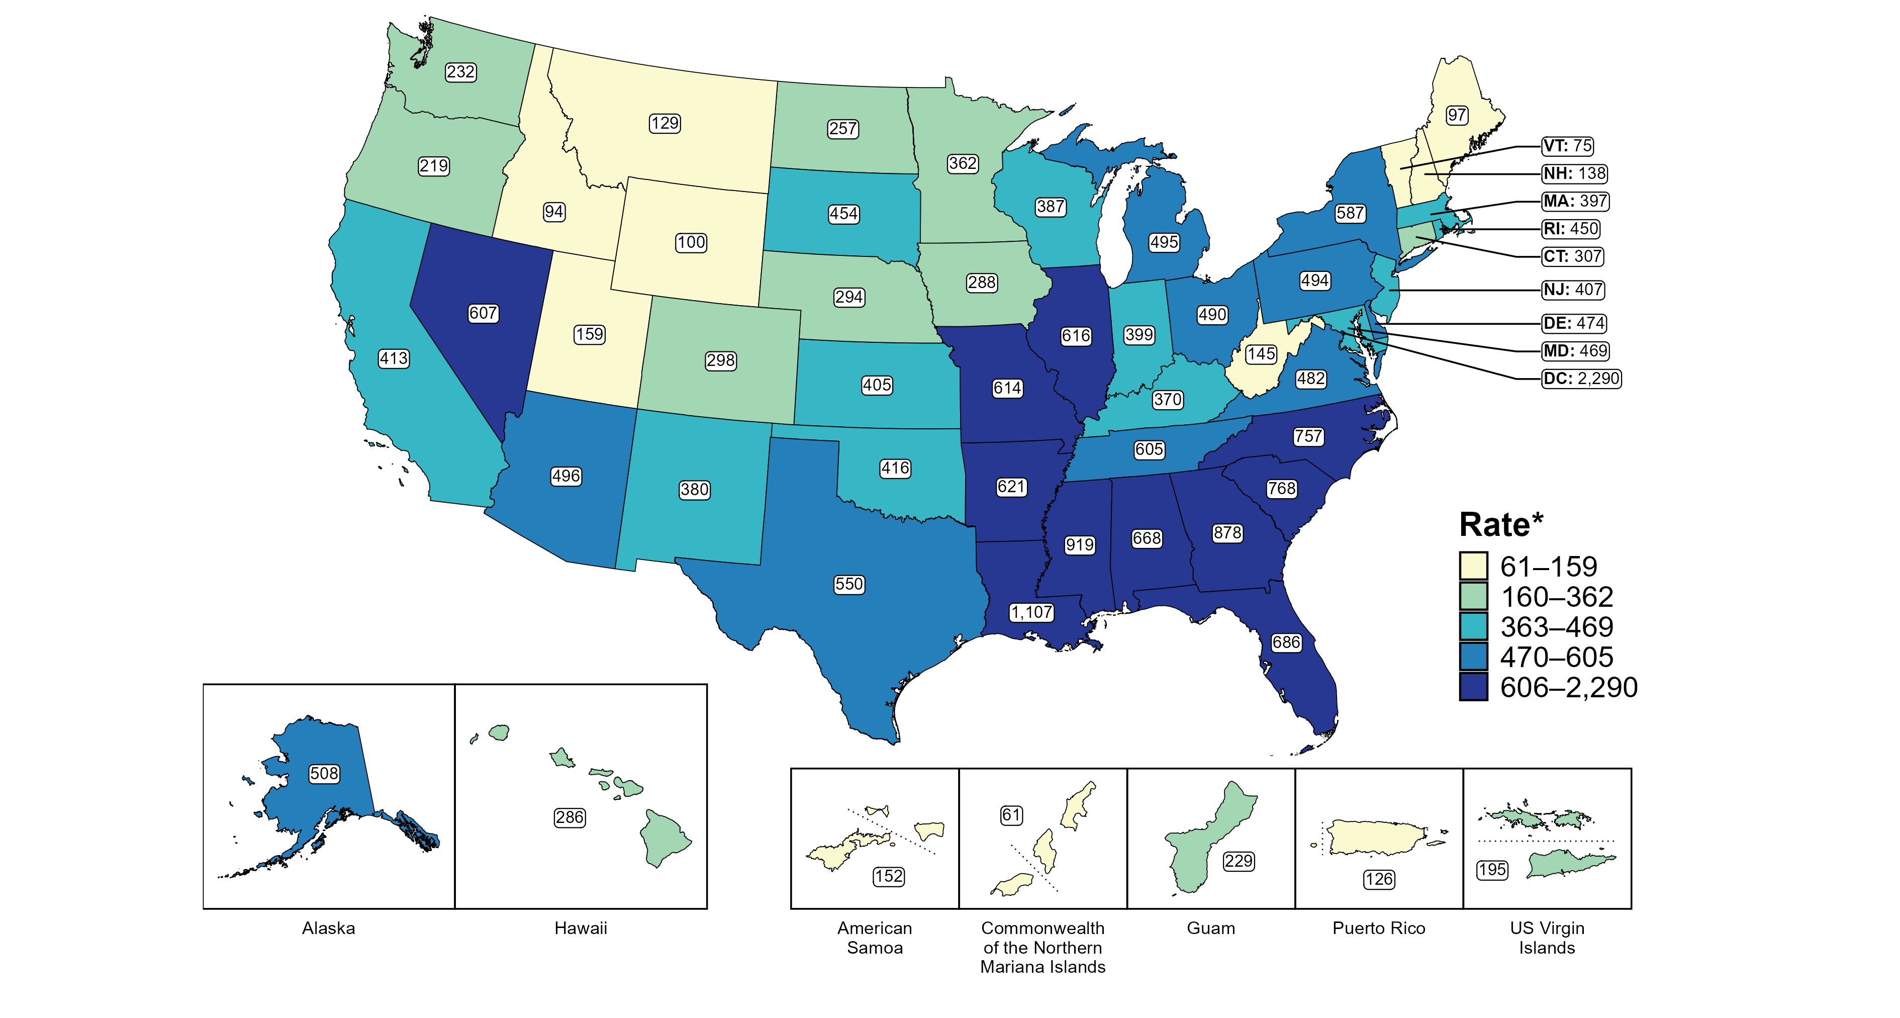
Gonorrhea — Rates of Reported Cases Among Men Aged 15–24 Years by Jurisdiction, United States and Territories, 2023
* Per 100,000
Notes:
In 2023, rates of reported gonorrhea among men aged 15 to 24 years ranged by state from 75 cases per 100,000 men aged 15 to 24 years in Vermont to 1,107 cases per 100,000 men aged 15 to 24 years in Louisiana. The rate of reported gonorrhea in the District of Columbia was 2,290 per 100,000 men aged 15 to 24 years.
Among US territories, rates of reported gonorrhea ranged from 61 cases per 100,000 men aged 15 to 24 years in the Commonwealth of the Northern Mariana Islands to 229 cases per 100,000 men aged 15 to 24 years in Guam.
Tennessee transitioned STI surveillance information systems in September of 2023 which may have impacted the overall case counts. Caution should be applied in interpretation of these data.
This report includes data from years that coincide with the COVID-19 pandemic, which introduced uncertainty and difficulty in interpreting STI surveillance data. See Impact of COVID-19 on STIs (https://www.cdc.gov/sti-statistics/about/impact-of-covid-19.html) for more information.
See Technical Notes (https://www.cdc.gov/sti-statistics/annual/technical-notes.html) for information on STI case reporting formats and practices, including collected and derived variables displayed in this report. Table A (https://www.cdc.gov/sti-statistics/data-vis/table-selected-percunknown.html) provides information on unknown, missing, or invalid values of select variables.
Data for all figures are available at https://www.cdc.gov/sti-statistics/media/files/2024/11/2023-STI-Surveillance-Report-Data-Points.zip. The file “GC - Rates Men 15-24 Years by Jurisdiction (US and Terr 2023).xlsx” contains the data for the figure presented on this slide.

Slide 17
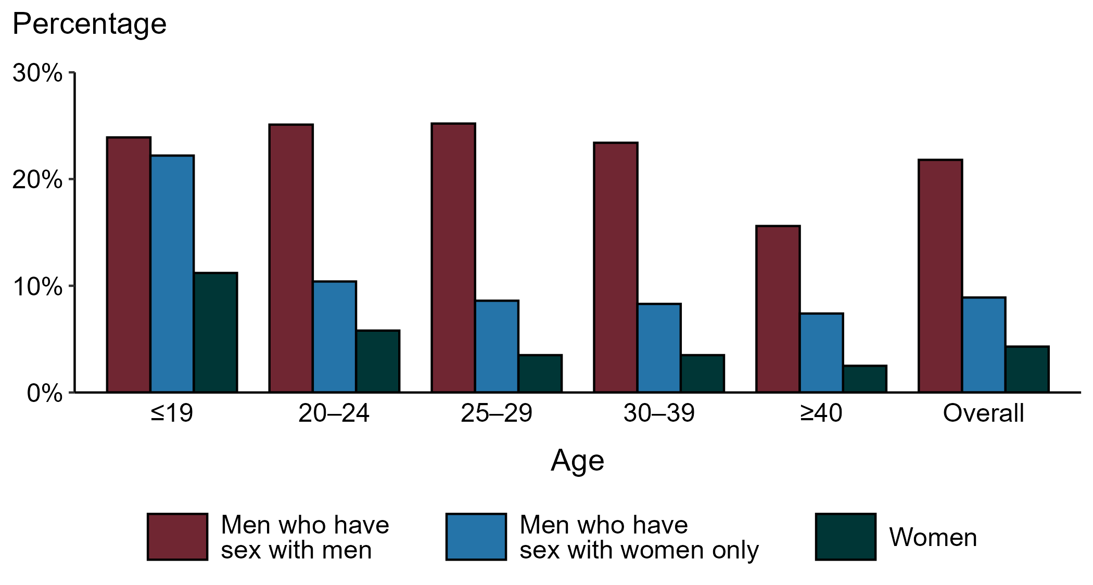
Gonorrhea — Proportion of STD Clinic Patients Testing Positive by Age Group, Sex, and Sex of Sex Partners, STI Surveillance Network (SSuN), 2023
NOTE: Results are based on 52,956 unique patients in 11 participating jurisdictions with known sex of sex partners attending SSuN STI clinics who were tested ≥1 times for gonorrhea in 2023.
Notes:
Among patients accessing care in participating STI clinics in the STI Surveillance Network (SSuN) who were tested for gonorrhea in 2023, 21.8% of gay, bisexual, and other men who have sex with men (MSM), 8.9% of men who have sex with women only (MSW), and 4.3% of women were positive. The proportion of STI clinic patients who tested positive for gonorrhea varied by sex and sex of sex partners, as well as by age group. MSM were noted to have higher proportions of testing positive in all age groups when compared to women and MSW.
This report includes data from years that coincide with the COVID-19 pandemic, which introduced uncertainty and difficulty in interpreting STI surveillance data. See Impact of COVID-19 on STIs (https://www.cdc.gov/sti-statistics/about/impact-of-covid-19.html) for more information.
See Technical Notes (https://www.cdc.gov/sti-statistics/annual/technical-notes.html) for information on SSuN methodology. Table A (https://www.cdc.gov/sti-statistics/data-vis/table-selected-percunknown.html) provides information on unknown, missing, or invalid values of select variables.

Slide 18
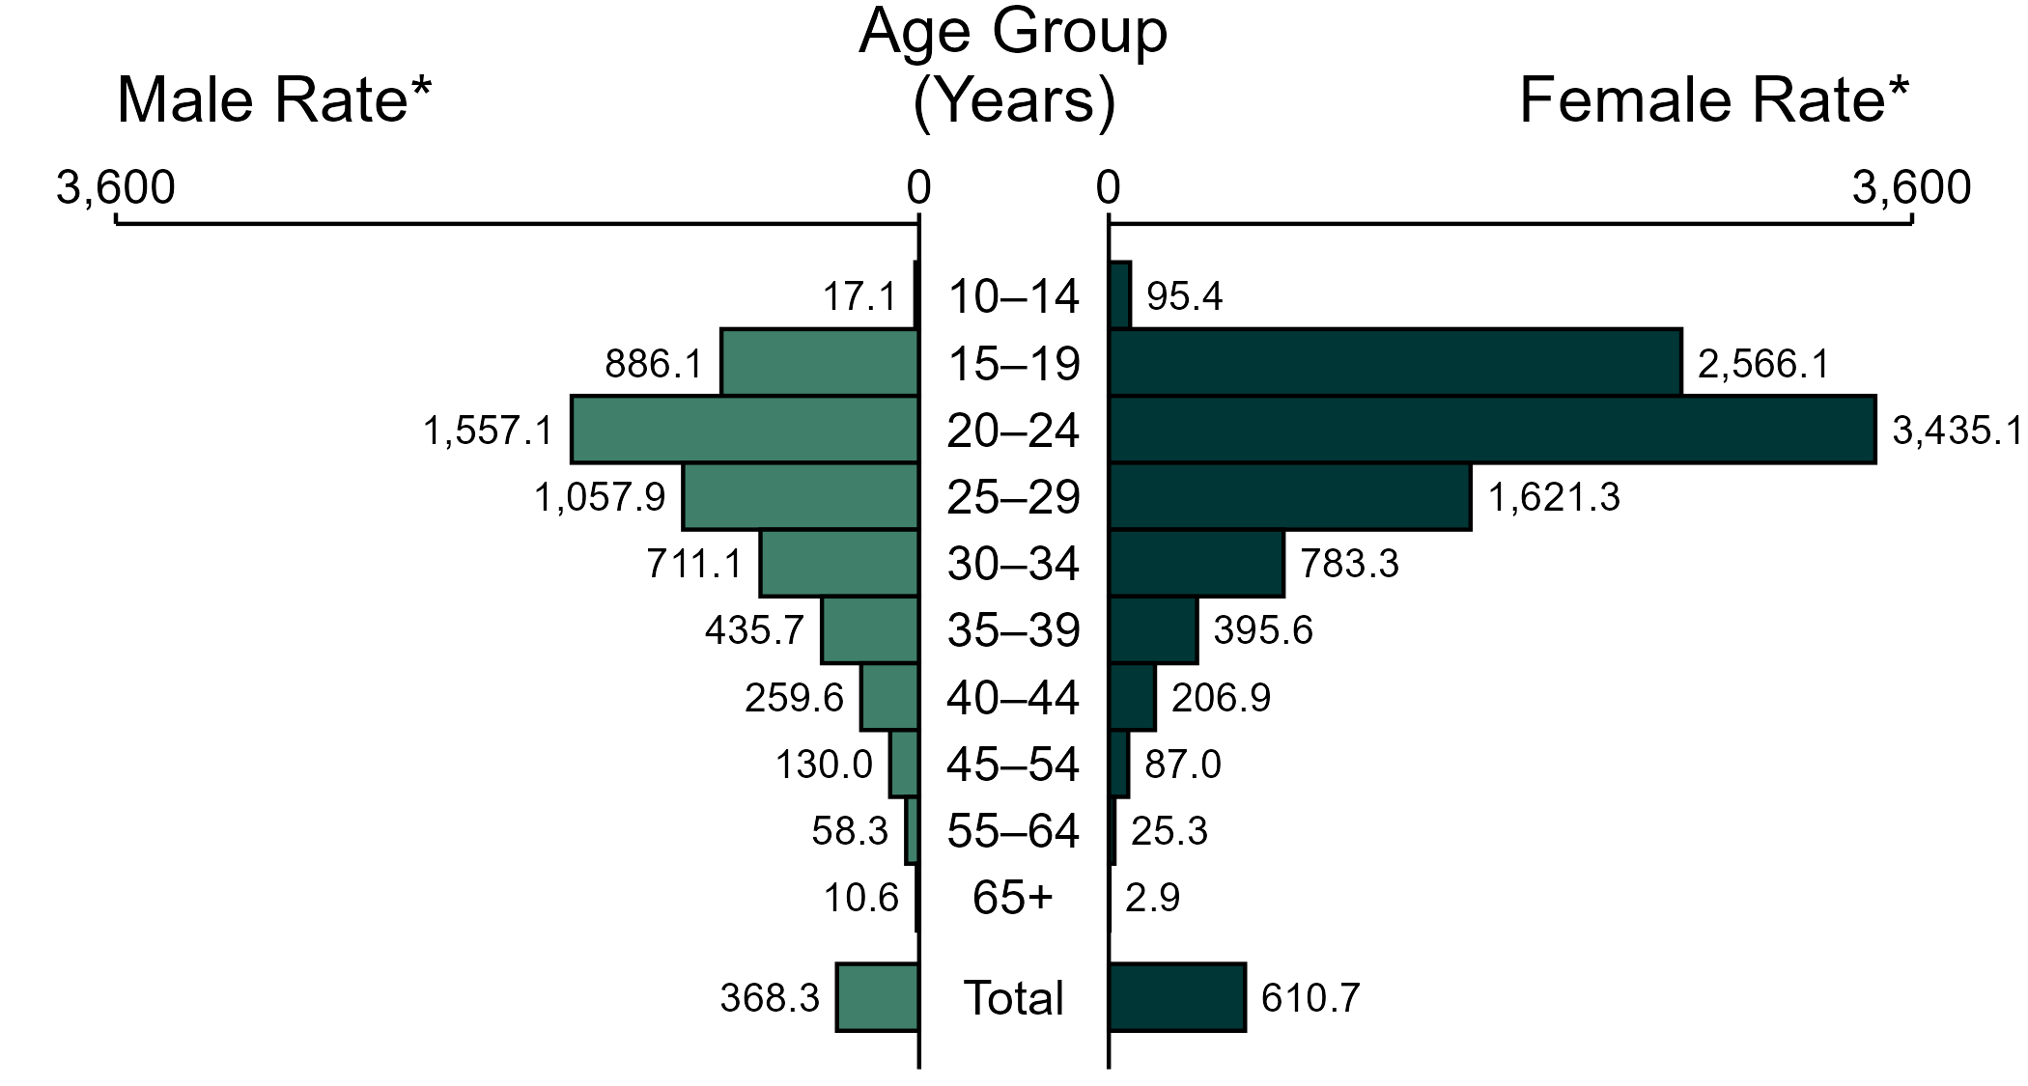
Chlamydia — Rates of Reported Cases by Age Group and Sex, United States, 2023
* Per 100,000
NOTE: In 2023, 13,417 chlamydia cases among men (2.2%) and 22,139 cases among women (2.1%) had missing or unknown age. These cases are included in the total rates.
Notes:
In 2023, the rate of reported chlamydia was higher among women (610.7 per 100,000) compared to men (368.3 per 100,000).
Among women, those aged 20 to 24 years had the highest rate of reported cases of chlamydia (3,435.1 per 100,000), followed by women aged 15 to 19 years (2,566.1 per 100,000) and women aged 25 to 29 years (1,621.3 per 100,000). Among men, those aged 20 to 24 years also had the highest rate of reported cases of chlamydia (1,557.1 per 100,000), followed by men aged 25 to 29 years (1,057.9 per 100,000) and men aged 15 to 19 years (886.1 per 100,000).
This report includes data from years that coincide with the COVID-19 pandemic, which introduced uncertainty and difficulty in interpreting STI surveillance data. See Impact of COVID-19 on STIs (https://www.cdc.gov/sti-statistics/about/impact-of-covid-19.html) for more information.
See Technical Notes (https://www.cdc.gov/sti-statistics/annual/technical-notes.html) for information on STI case reporting formats and practices, including collected and derived variables displayed in this report. Table A (https://www.cdc.gov/sti-statistics/data-vis/table-selected-percunknown.html) provides information on unknown, missing, or invalid values of select variables.
Data for all figures are available at https://www.cdc.gov/sti-statistics/media/files/2024/11/2023-STI-Surveillance-Report-Data-Points.zip. The file “CT - Rates by Age Group and Sex (US 2023).xlsx” contains the data for the figure presented on this slide.

Slide 19
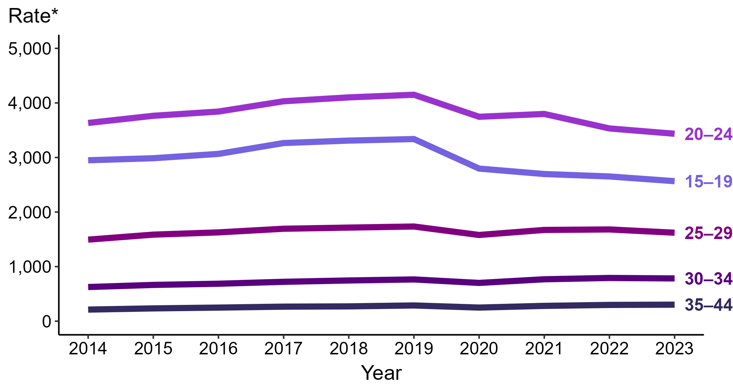
Chlamydia — Rates of Reported Cases Among Women Aged 15–44 Years by Age Group and Year, United States, 2014–2023
* Per 100,000
Notes:
Among women aged 15 to 44 years in 2023, those aged 20 to 24 years had the highest rate of reported cases of chlamydia (3,435.1 cases per 100,000; 2.8% decrease from 2022), followed by those aged 15 to 19 years (2,566.1 cases per 100,000; 3.3% decrease from 2022), those aged 25 to 29 years (1,621.3 cases per 100,000; 3.6% decrease from 2022), those aged 30 to 34 years (783.3 cases per 100,000; 1.1% decrease from 2022), and those aged 35 to 44 years (302.4 cases per 100,000; 1.6% increase from 2022).
This report includes data from years that coincide with the COVID-19 pandemic, which introduced uncertainty and difficulty in interpreting STI surveillance data. See Impact of COVID-19 on STIs (https://www.cdc.gov/sti-statistics/about/impact-of-covid-19.html) for more information.
See Technical Notes (https://www.cdc.gov/sti-statistics/annual/technical-notes.html) for information on STI case reporting formats and practices, including collected and derived variables displayed in this report. Table A (https://www.cdc.gov/sti-statistics/data-vis/table-selected-percunknown.html) provides information on unknown, missing, or invalid values of select variables.
Data for all figures are available at https://www.cdc.gov/sti-statistics/media/files/2024/11/2023-STI-Surveillance-Report-Data-Points.zip. The file “CT - Rates Women 15-44 Years by Age Group (US 2014-2023).xlsx” contains the data for the figure presented on this slide.

Slide 20
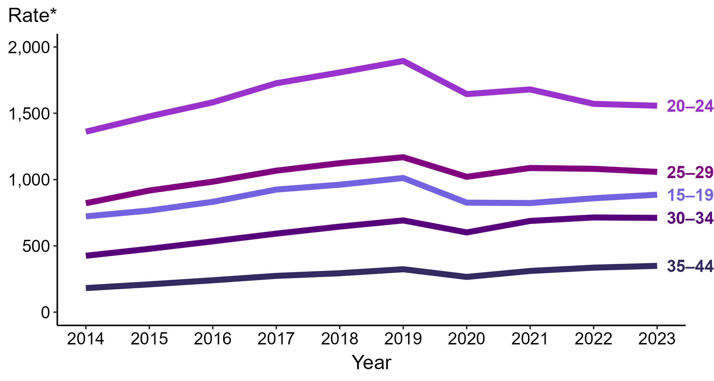
Chlamydia — Rates of Reported Cases Among Men Aged 15–44 Years by Age Group, United States, 2014–2023
* Per 100,000
Notes:
Among men aged 15 to 44 years in 2023, those aged 20 to 24 years had the highest rate of reported cases of chlamydia (1,557.1 cases per 100,000; <1.0% change from 2022), followed by those aged 25 to 29 years (1,057.9 cases per 100,000; 2.2% decrease from 2022), those aged 15 to 19 years (886.1 cases per 100,000; 3.2% increase from 2022), those aged 30 to 34 years (711.1 cases per 100,000; <1.0% change from 2022), and those aged 35 to 44 years (349.1 cases per 100,000; 4.0% increase from 2022).
This report includes data from years that coincide with the COVID-19 pandemic, which introduced uncertainty and difficulty in interpreting STI surveillance data. See Impact of COVID-19 on STIs (https://www.cdc.gov/sti-statistics/about/impact-of-covid-19.html) for more information.
See Technical Notes (https://www.cdc.gov/sti-statistics/annual/technical-notes.html) for information on STI case reporting formats and practices, including collected and derived variables displayed in this report. Table A (https://www.cdc.gov/sti-statistics/data-vis/table-selected-percunknown.html) provides information on unknown, missing, or invalid values of select variables.
Data for all figures are available at https://www.cdc.gov/sti-statistics/media/files/2024/11/2023-STI-Surveillance-Report-Data-Points.zip. The file “CT - Rates Men 15-44 Years by Age Group (US 2014-2023).xlsx” contains the data for the figure presented on this slide.

Slide 21
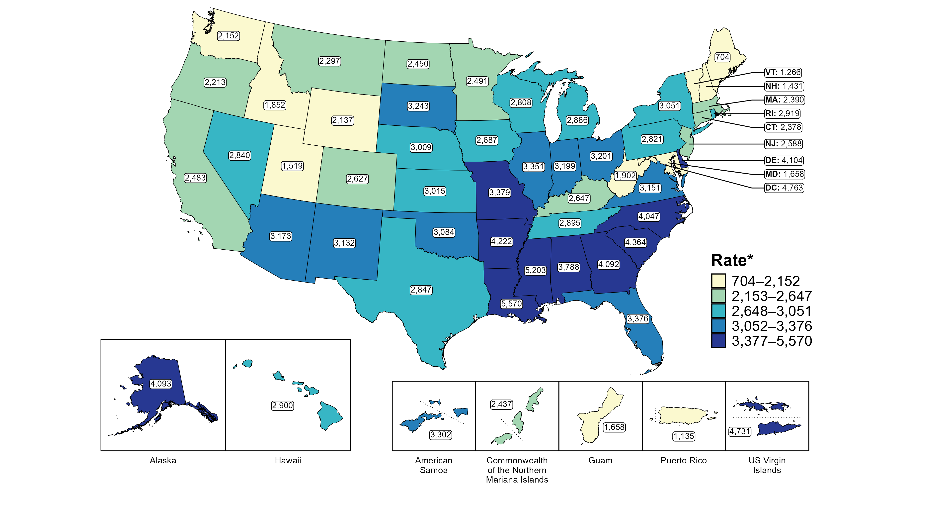
Chlamydia — Rates of Reported Cases Among Women Aged 15–24 Years by Jurisdiction, United States and Territories, 2023
* Per 100,000
Notes:
In 2023, rates of reported chlamydia among women aged 15 to 24 years ranged by state from 704 cases per 100,000 women aged 15 to 24 years in Maine to 5,570 cases per 100,000 women aged 15 to 24 years in Louisiana. The rate of reported chlamydia in the District of Columbia was 4,763 per 100,000 women aged 15 to 24 years.
Among US territories, rates of reported chlamydia ranged from 1,135 cases per 100,000 women aged 15 to 24 years in Puerto Rico to 4,731 cases per 100,000 women aged 15 to 24 years in the US Virgin Islands.
Tennessee transitioned STI surveillance information systems in September of 2023 which may have impacted the overall case counts. Caution should be applied in interpretation of these data.
This report includes data from years that coincide with the COVID-19 pandemic, which introduced uncertainty and difficulty in interpreting STI surveillance data. See Impact of COVID-19 on STIs (https://www.cdc.gov/sti-statistics/about/impact-of-covid-19.html) for more information.
See Technical Notes (https://www.cdc.gov/sti-statistics/annual/technical-notes.html) for information on STI case reporting formats and practices, including collected and derived variables displayed in this report. Table A (https://www.cdc.gov/sti-statistics/data-vis/table-selected-percunknown.html) provides information on unknown, missing, or invalid values of select variables.
Data for all figures are available at https://www.cdc.gov/sti-statistics/media/files/2024/11/2023-STI-Surveillance-Report-Data-Points.zip. The file “CT - Rates Women 15-24 Years by Jurisdiction (US and Terr 2023).xlsx” contains the data for the figure presented on this slide.

Slide 22
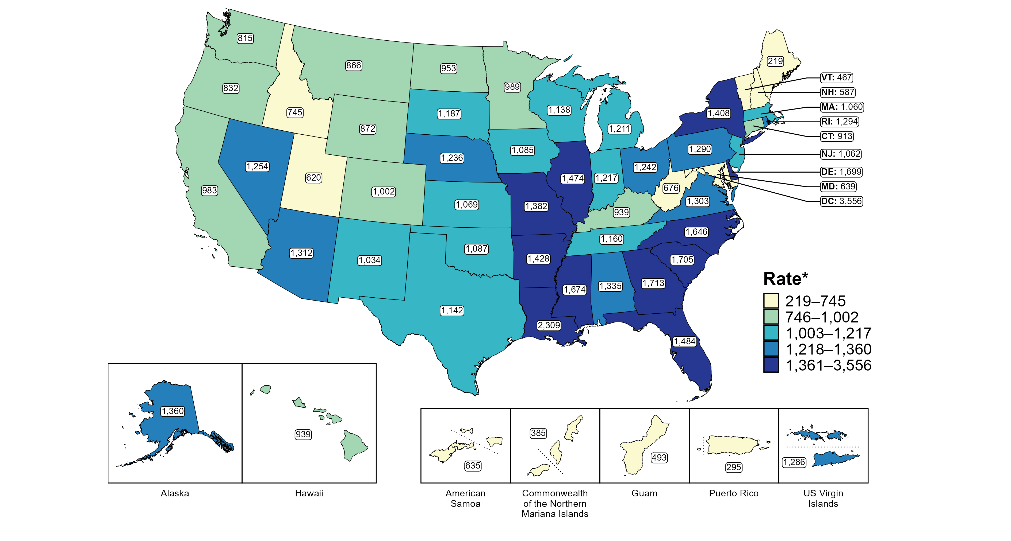
Chlamydia — Rates of Reported Cases Among Men Aged 15–24 Years by Jurisdiction, United States and Territories, 2023
* Per 100,000
Notes:
In 2023, rates of reported chlamydia among men aged 15 to 24 years ranged by state from 219 cases per 100,000 men aged 15 to 24 years in Maine to 2,309 cases per 100,000 men aged 15 to 24 years in Louisiana. The rate of reported chlamydia in the District of Columbia was 3,556 per 100,000 men aged 15 to 24 years.
Among US territories, rates of reported chlamydia ranged from 295 cases per 100,000 men aged 15 to 24 years in Puerto Rico to 1,286 cases per 100,000 men aged 15 to 24 years in the US Virgin Islands.
Tennessee transitioned STI surveillance information systems in September of 2023 which may have impacted the overall case counts. Caution should be applied in interpretation of these data.
This report includes data from years that coincide with the COVID-19 pandemic, which introduced uncertainty and difficulty in interpreting STI surveillance data. See Impact of COVID-19 on STIs (https://www.cdc.gov/sti-statistics/about/impact-of-covid-19.html) for more information.
See Technical Notes (https://www.cdc.gov/sti-statistics/annual/technical-notes.html) for information on STI case reporting formats and practices, including collected and derived variables displayed in this report. Table A (https://www.cdc.gov/sti-statistics/data-vis/table-selected-percunknown.html) provides information on unknown, missing, or invalid values of select variables.
Data for all figures are available at https://www.cdc.gov/sti-statistics/media/files/2024/11/2023-STI-Surveillance-Report-Data-Points.zip. The file “CT - Rates Men 15-24 Years by Jurisdiction (US and Terr 2023).xlsx” contains the data for the figure presented on this slide.

Slide 23
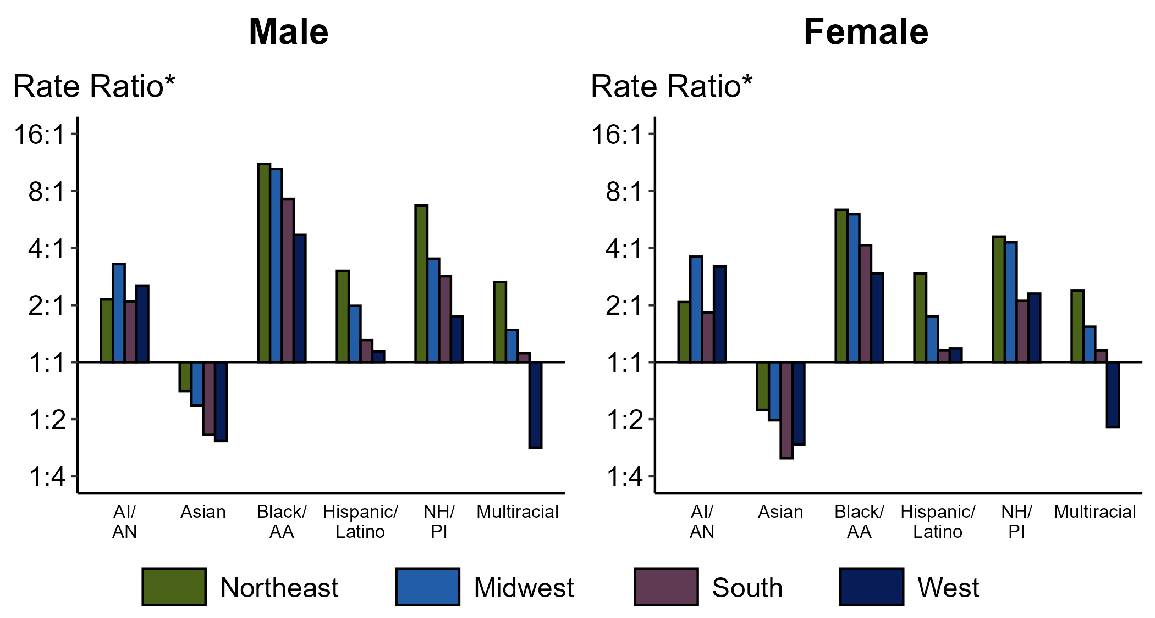
Chlamydia — Ratios of Rates of Reported Cases Among Persons Aged 15–24 Years by Sex, Race/Hispanic Ethnicity, and Region, United States, 2023
* For the rate ratios, non-Hispanic White persons are the referent population. Y-axis is log scale.
ACRONYMS: AI/AN = American Indian or Alaska Native; Black/AA = Black or African American; NH/PI = Native Hawaiian or other Pacific Islander
Notes:
Among men and women, rate ratios of rates of reported chlamydia by race/Hispanic ethnicity (using non-Hispanic White persons as the referent population) varied by region in 2023. Among men, the greatest rate ratio was in the Northeast where the rate of reported chlamydia among non-Hispanic Black or African American men was 11.1 times the rate among non-Hispanic White men. Among women, the greatest rate ratio was in the Northeast where the rate of reported chlamydia among non-Hispanic Black or African American women was 6.4 times the rate among non-Hispanic White women.
This report includes data from years that coincide with the COVID-19 pandemic, which introduced uncertainty and difficulty in interpreting STI surveillance data. See Impact of COVID-19 on STIs (https://www.cdc.gov/sti-statistics/about/impact-of-covid-19.html) for more information.
See Technical Notes (https://www.cdc.gov/sti-statistics/annual/technical-notes.html) for information on STI case reporting formats and practices, including collected and derived variables displayed in this report. Table A (https://www.cdc.gov/sti-statistics/data-vis/table-selected-percunknown.html) provides information on unknown, missing, or invalid values of select variables..
Data for all figures are available at https://www.cdc.gov/sti-statistics/media/files/2024/11/2023-STI-Surveillance-Report-Data-Points.zip. The file “CT - Ratios of Rates Persons 15-24 Years by Sex Race Hispanic Ethnicity and Region (US 2023).xlsx” contains the data for the figure presented on this slide.

Slide 24
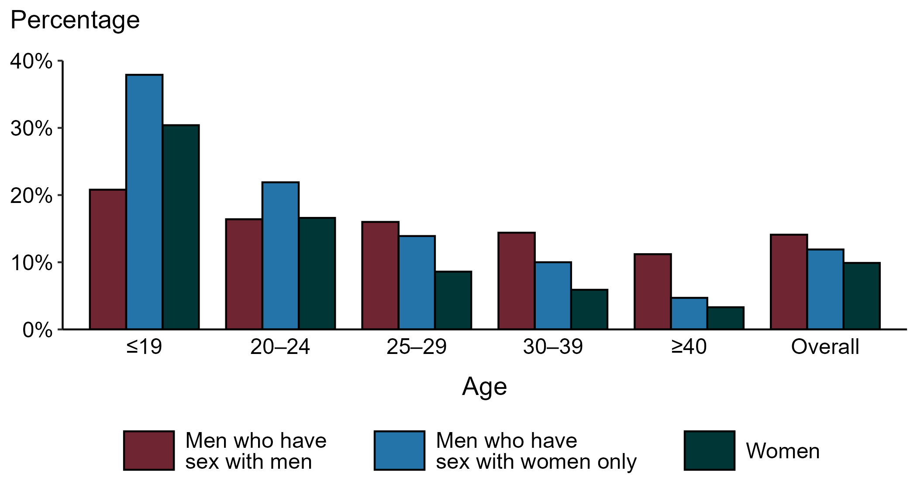
Chlamydia — Proportion of STD Clinic Patients Testing Positive by Age Group, Sex, and Sex of Sex Partners, STI Surveillance Network (SSuN), 2023
NOTE: Results are based on 50,808 unique patients in 11 participating jurisdictions with known sex of sex partners attending SSuN STI clinics who were tested ≥1 times for chlamydia in 2023.
Notes:
Among patients accessing care in participating STI clinics in the STI Surveillance Network (SSuN) who were tested for chlamydia in 2023 and had known sexual orientation or sex of sex partners, 14.1% of gay, bisexual and other men who have sex with men (MSM), 11.9% of men who have sex with women only (MSW), and 9.9% of women were found to be positive. The proportion testing positive for chlamydia varied by sex and sex of sex partners, as well as by age group. The highest proportion of patients testing positive were MSW aged 19 years and younger (37.9%).
This report includes data from years that coincide with the COVID-19 pandemic, which introduced uncertainty and difficulty in interpreting STI surveillance data. See Impact of COVID-19 on STIs (https://www.cdc.gov/sti-statistics/about/impact-of-covid-19.html) for more information.
See Technical Notes (https://www.cdc.gov/sti-statistics/annual/technical-notes.html) for information on SSuN methodology. Table A (https://www.cdc.gov/sti-statistics/data-vis/table-selected-percunknown.html) provides information on unknown, missing, or invalid values of select variables.

Slide 25
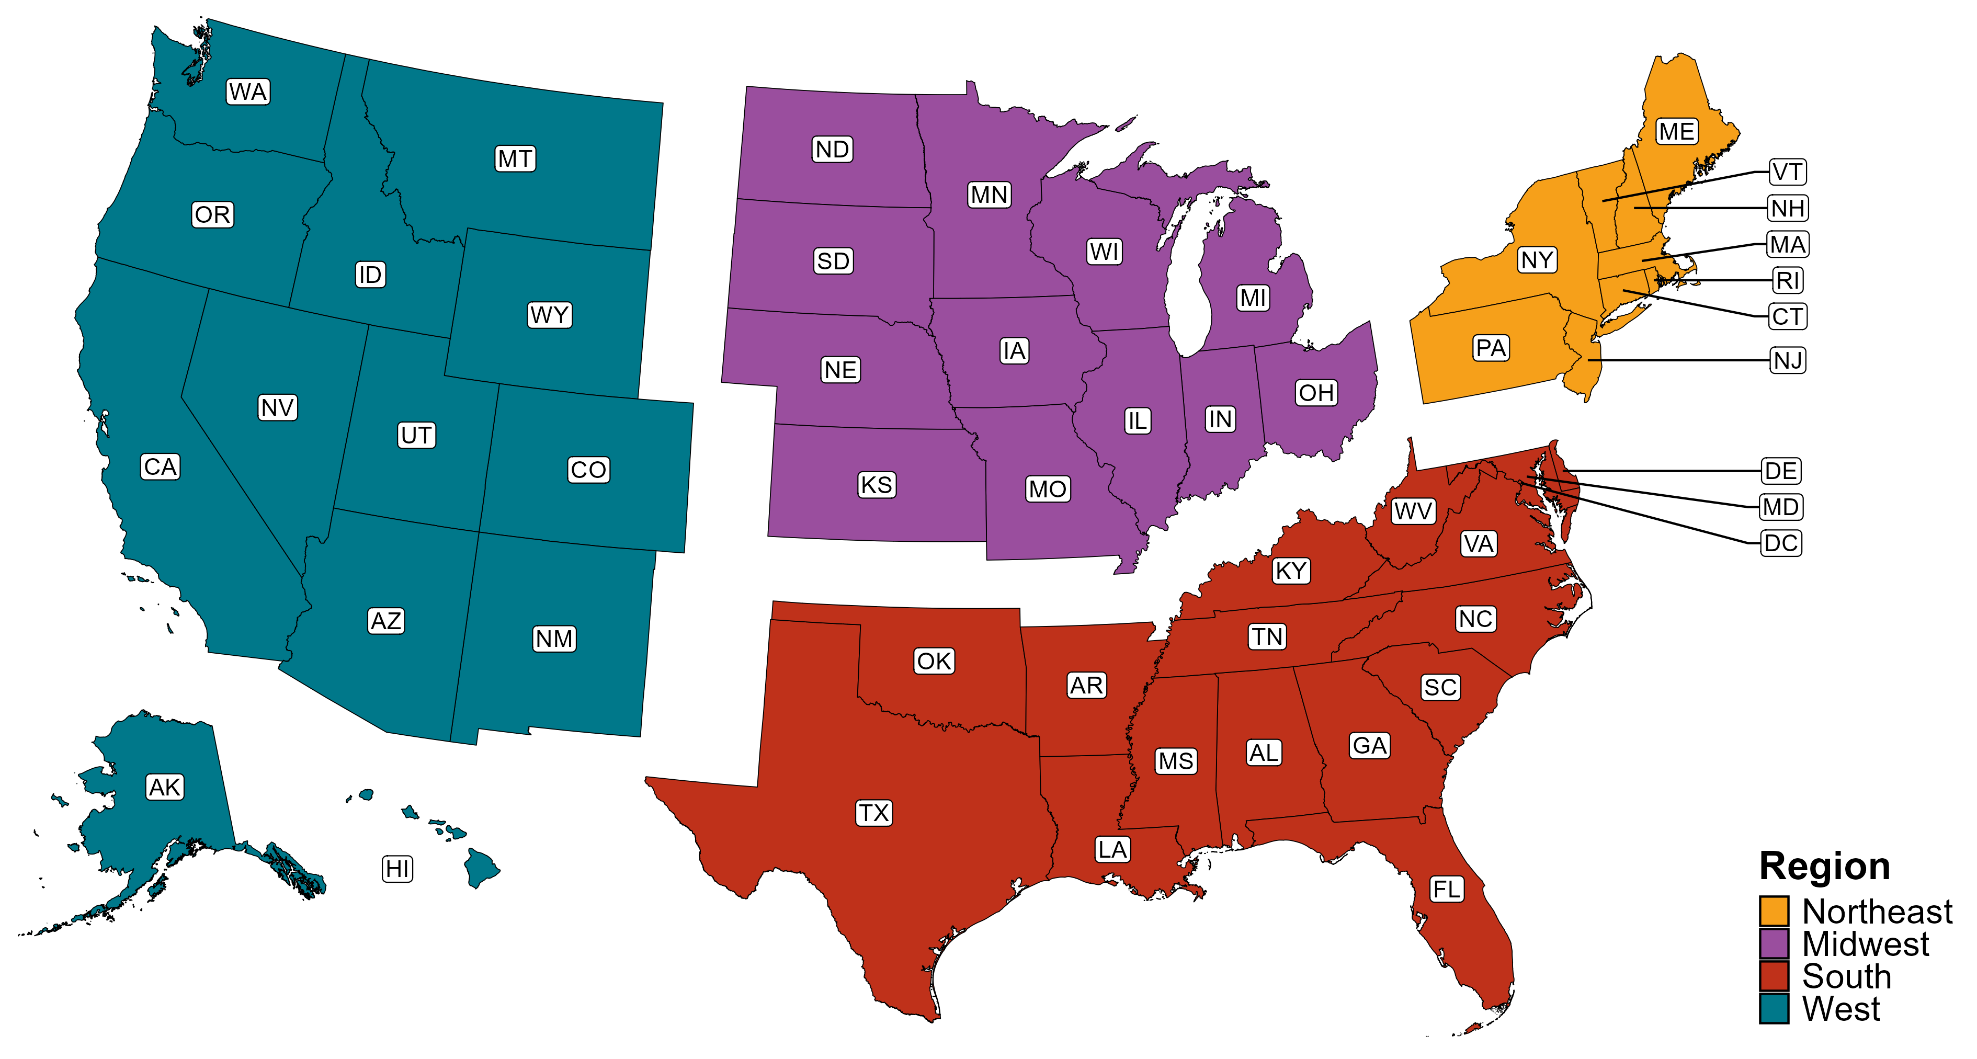
Reference Map of US Census Regions

