Slide 1
Sexually Transmitted Infections
Surveillance 2023
Gonorrhea
Notes:
This slide set was prepared by the Division of STD Prevention, National Center for HIV, Viral Hepatitis, STD, and TB Prevention (NCHHSTP), Centers for Disease Control and Prevention (CDC). These slides display trends for STIs in the United States through 2023. Data presented include case notifications provided to CDC through the National Notifiable Diseases Surveillance System (NNDSS) and data collected through projects and programs that monitor STIs in various settings, including the STI Surveillance Network (SSuN).
For more information on data sources, data collection and reporting practices, and case definitions, please see the Technical Notes, available at https://www.cdc.gov/sti-statistics/annual/technical-notes.html.
All data points for figures presented in these slides are available at https://www.cdc.gov/sti-statistics/media/files/2024/11/2023-STI-Surveillance-Report-Data-Points.zip.
NOTE: This slide set is in the public domain. You may reproduce these slides without permission; however, citation as to source is appreciated.
Centers for Disease Control and Prevention. Sexually Transmitted Infections Surveillance 2023. Atlanta: U.S. Department of Health and Human Services; 2024.
You are also free to adapt and revise these slides; however, you must remove the CDC name and logo if changes are made.

Slide 2
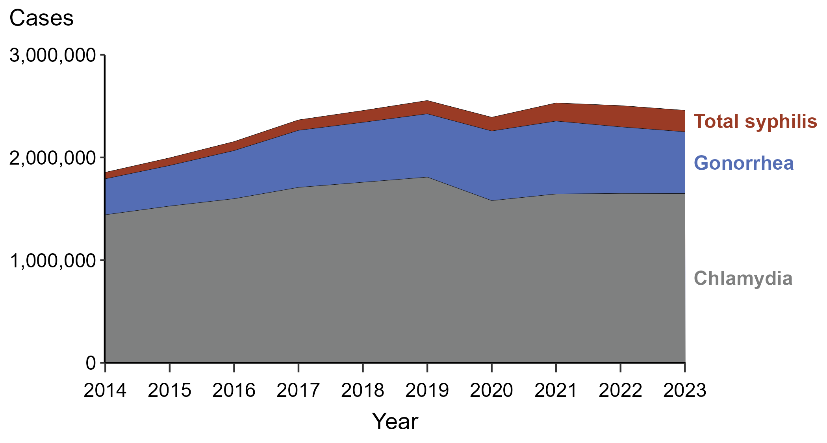
Sexually Transmitted Infections (STIs) — Reported Cases by STI and Year, United States, 2014–2023
NOTE: “Total syphilis” includes all stages of syphilis and congenital syphilis.
Notes:
In 2023, there were 2,459,140 cases of syphilis (including congenital syphilis), gonorrhea, and chlamydia reported in the United States. The over 2.4 million cases reflect a 1.8% decrease from 2022, a 3.7% decrease from 2019, and a 32.5% increase from 2014.
Case definitions are periodically revised using CSTE’s Position Statements and provide uniform criteria of nationally notifiable conditions for reporting purposes. Prior to 2018, syphilis cases identified as “early non-primary non-secondary syphilis” were classified as “early latent syphilis.” Prior to 2018, cases in the “unknown duration or late syphilis” category included cases classified as “late latent syphilis,” “latent syphilis of unknown duration,” “late syphilis with clinical manifestations,” and “neurosyphilis.” Please see the NNDSS website (https://ndc.services.cdc.gov/) for historical case definitions and for the case definitions in use for the current calendar year.
This report includes data from years that coincide with the COVID-19 pandemic, which introduced uncertainty and difficulty in interpreting STI surveillance data. See Impact of COVID-19 on STIs (https://www.cdc.gov/sti-statistics/about/impact-of-covid-19.html) for more information.
See Technical Notes (https://www.cdc.gov/sti-statistics/annual/technical-notes.html) for information on STI case reporting formats and practices, including collected and derived variables displayed in this report. Table A (https://www.cdc.gov/sti-statistics/data-vis/table-selected-percunknown.html) provides information on unknown, missing, or invalid values of select variables.
Data for all figures are available at https://www.cdc.gov/sti-statistics/media/files/2024/11/2023-STI-Surveillance-Report-Data-Points.zip. The file “STI - Cases by Year (US 2014-2023).xlsx” contains the data for the figure presented on this slide.

Slide 3
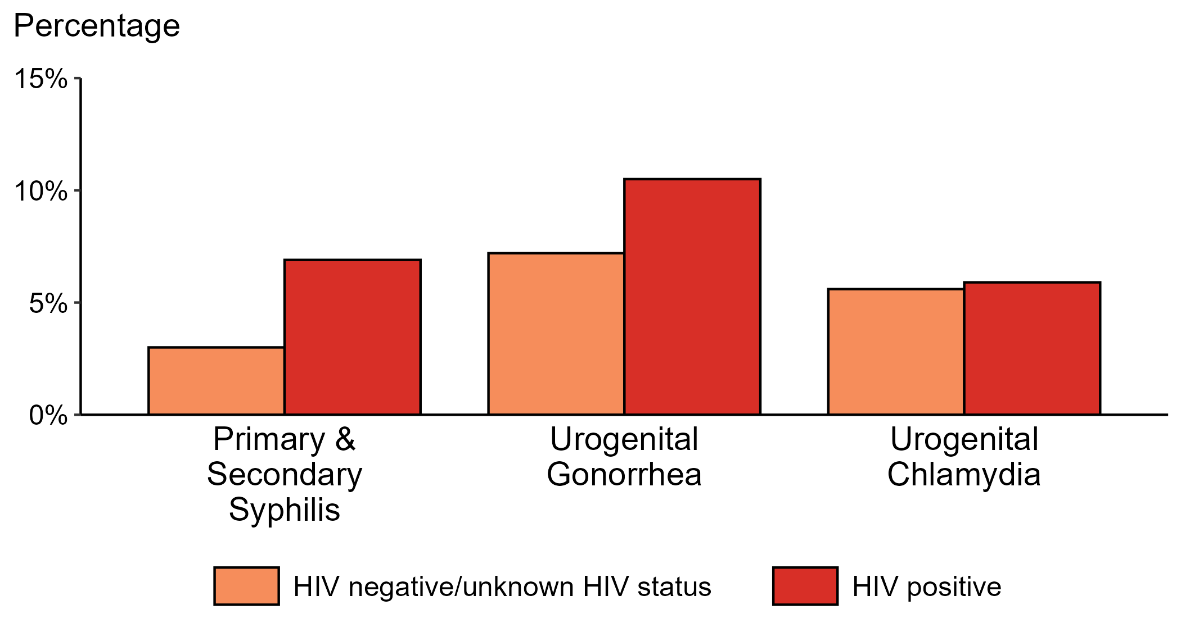
Proportion of MSM with Primary and Secondary Syphilis, Urogenital Gonorrhea, or Urogenital Chlamydia by HIV Status, STI Surveillance Network (SSuN), 2023
ACRONYMS: MSM = Gay, bisexual, and other men who have sex with men
NOTE: Results are based on data obtained from patients attending a participating STI clinic in 11 jurisdictions.
Notes:
Among gay, bisexual, and other men who have sex with men (MSM) attending participating STI clinics in the STI Surveillance Network in 2023, the portion diagnosed with primary and secondary syphilis was higher for those that were HIV positive compared with those not known to be HIV positive (6.9% versus 3.0%). The pattern was similar for urogenital gonorrhea, with the proportion of testing positive higher among HIV-positive MSM compared with MSM not known to be HIV positive (10.5% versus 7.2%); however, the proportion testing positive for urogenital chlamydia was similar (5.9% among HIV-positive MSM and 5.6% among MSM not known to be HIV positive).
For this figure, information of HIV status was ascertained from patient self-report of most recent HIV test result or from documentation in the jurisdiction’s HIV surveillance registry.
This report includes data from years that coincide with the COVID-19 pandemic, which introduced uncertainty and difficulty in interpreting STI surveillance data. See Impact of COVID-19 on STIs (https://www.cdc.gov/sti-statistics/about/impact-of-covid-19.html) for more information.
See Technical Notes (https://www.cdc.gov/sti-statistics/annual/technical-notes.html) for information on SSuN methodology. Table A (https://www.cdc.gov/sti-statistics/data-vis/table-selected-percunknown.html) provides information on unknown, missing, or invalid values of select variables.

Slide 4
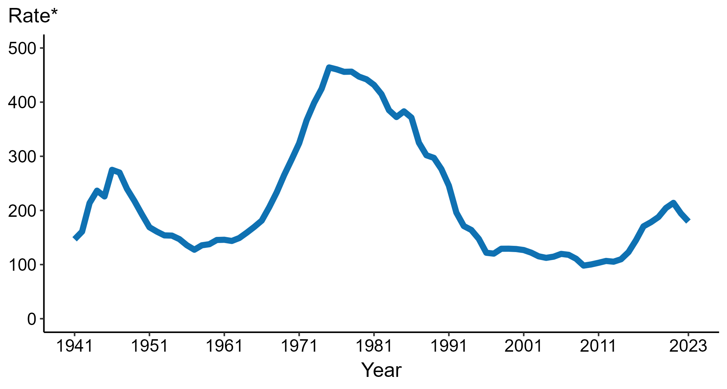
Gonorrhea — Rates of Reported Cases by Year, United States, 1941–2023
* Per 100,000
Notes:
Data collection for gonorrhea began in 1941 and gonorrhea was made a nationally notifiable condition in 1944. Steep declines in case rates in the 1940s and 1950s likely reflect expanded use of penicillin to treat infection.
In 2023, a total of 601,319 cases of gonorrhea were reported in the United States. During 2022 to 2023, the rate of reported gonorrhea decreased 7.7% (from 194.4 to 179.5 per 100,000).
This report includes data from years that coincide with the COVID-19 pandemic, which introduced uncertainty and difficulty in interpreting STI surveillance data. See Impact of COVID-19 on STIs (https://www.cdc.gov/sti-statistics/about/impact-of-covid-19.html) for more information.
See Technical Notes (https://www.cdc.gov/sti-statistics/annual/technical-notes.html) for information on STI case reporting formats and practices, including collected and derived variables displayed in this report. Table A (https://www.cdc.gov/sti-statistics/data-vis/table-selected-percunknown.html) provides information on unknown, missing, or invalid values of select variables.
Data for all figures are available at https://www.cdc.gov/sti-statistics/media/files/2024/11/2023-STI-Surveillance-Report-Data-Points.zip. The file “GC - Rates by Year (US 1941-2023).xlsx” contains the data for the figure presented on this slide.

Slide 5
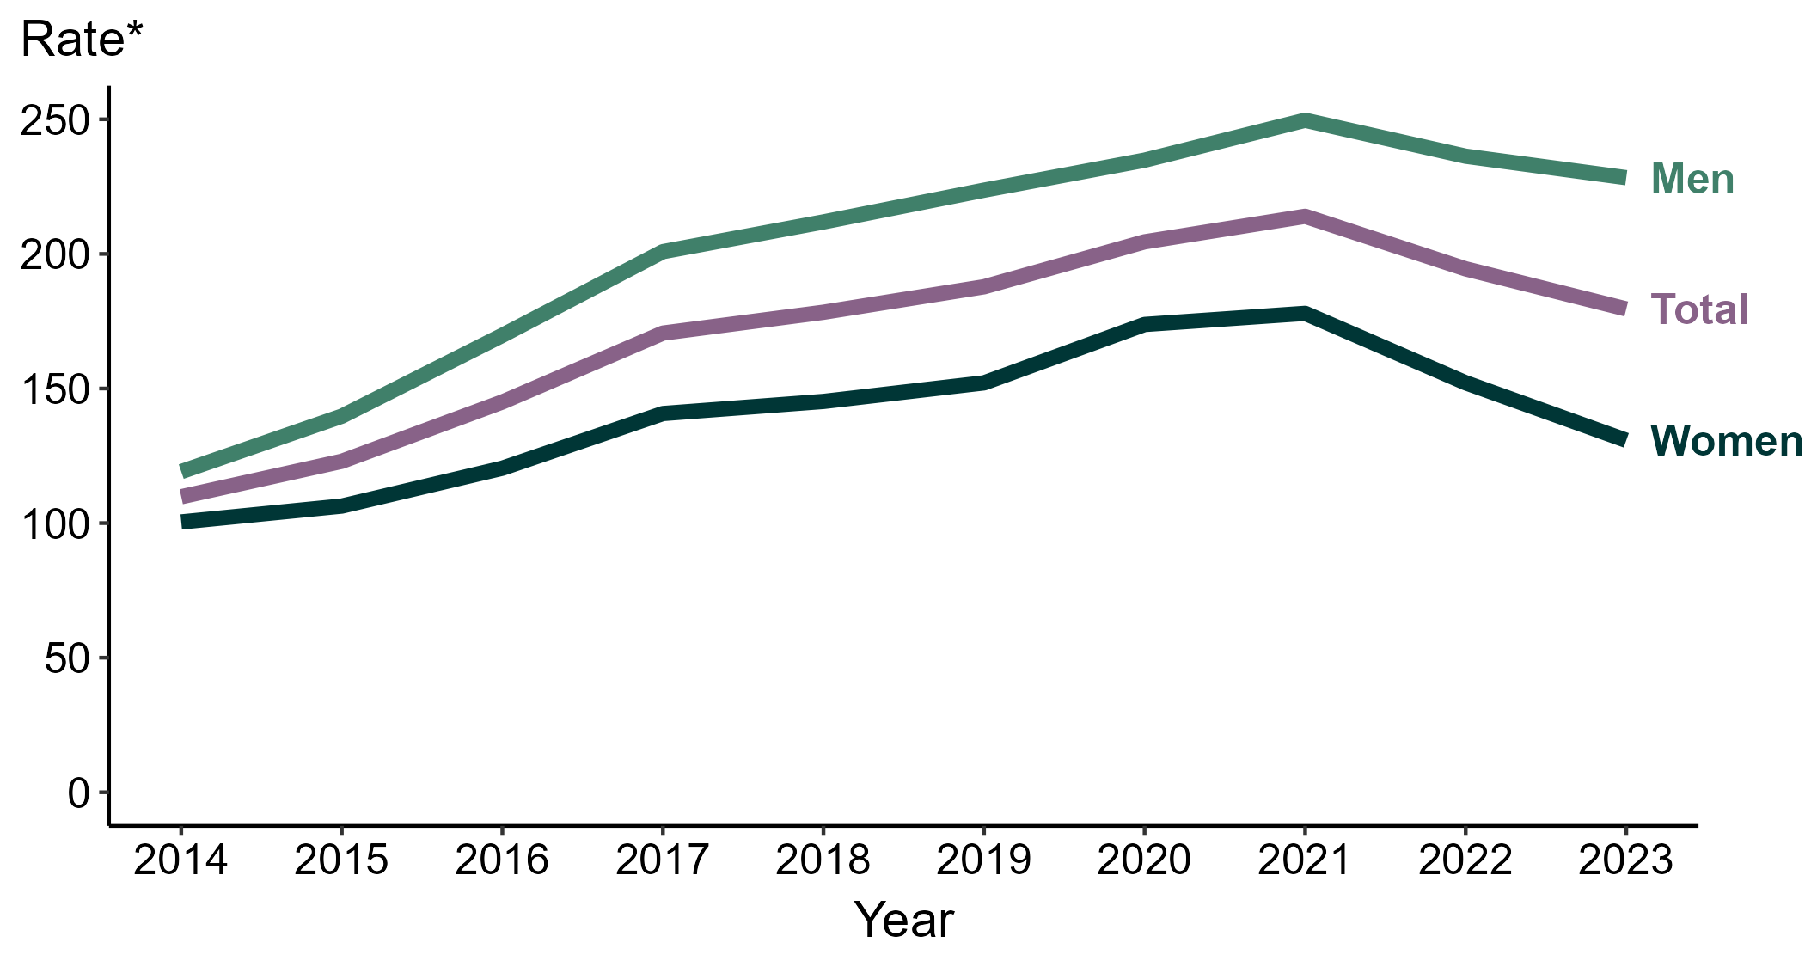
Gonorrhea — Rates of Reported Cases by Sex and Year, United States, 2014–2023
* Per 100,000
Notes:
During 2022 to 2023, the rate of reported gonorrhea among men decreased 3.4% (from 236.3 to 228.3 per 100,000) and the rate among women decreased 14.1% (from 152.1 to 130.7 per 100,000).
During 2019 to 2023, the rate of reported gonorrhea among men increased 2.1% (from 223.7 to 228.3 per 100,000) and the rate among women decreased 14.1% (from 152.1 to 130.7 per 100,000). During 2014 to 2023, the rate among men increased 91.7% (from 119.1 to 228.3 per 100,000) and the rate among women increased 30.2% (from 100.4 to 130.7 per 100,000).
This report includes data from years that coincide with the COVID-19 pandemic, which introduced uncertainty and difficulty in interpreting STI surveillance data. See Impact of COVID-19 on STIs (https://www.cdc.gov/sti-statistics/about/impact-of-covid-19.html) for more information.
See Technical Notes (https://www.cdc.gov/sti-statistics/annual/technical-notes.html) for information on STI case reporting formats and practices, including collected and derived variables displayed in this report. Table A (https://www.cdc.gov/sti-statistics/data-vis/table-selected-percunknown.html) provides information on unknown, missing, or invalid values of select variables.
Data for all figures are available at https://www.cdc.gov/sti-statistics/media/files/2024/11/2023-STI-Surveillance-Report-Data-Points.zip. The file “GC - Rates by Sex (US 2014-2023).xlsx” contains the data for the figure presented on this slide.

Slide 6
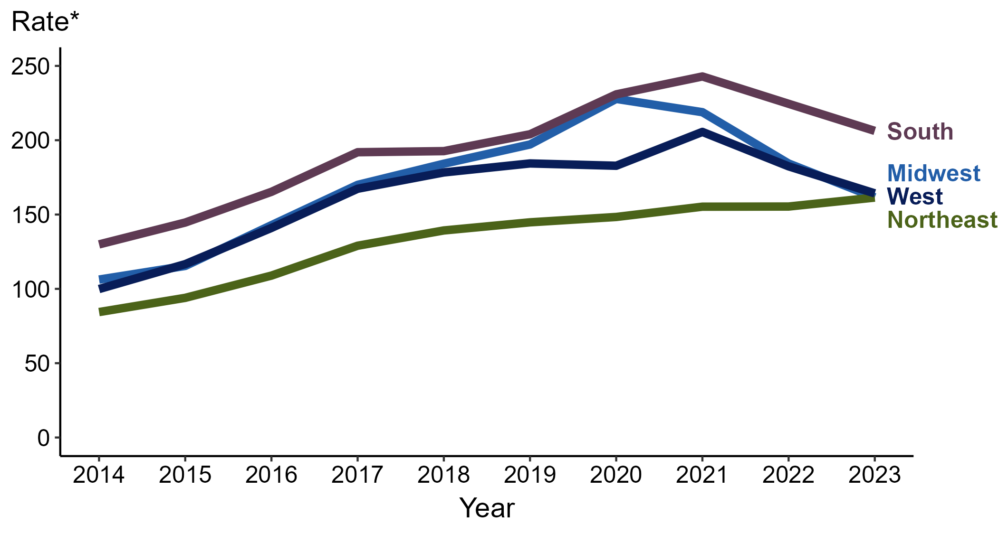
Gonorrhea — Rates of Reported Cases by Region and Year, United States, 2014–2023
* Per 100,000
Notes:
In 2023, the South had the highest rate of reported gonorrhea (206.3 cases per 100,000; 8.1% decrease from 2022), followed by the West (164.3 cases per 100,000; 9.9% decrease from 2022), the Midwest (161.6 cases per 100,000; 12.3% decrease from 2022), and the Northeast (161.4 cases per 100,000; 3.9% increase from 2022).
The Northeast had the greatest five-year increase in rates of reported cases of gonorrhea (144.8 to 161.4 per 100,000; 11.5% increase from 2019). The Northeast also had the greatest 10-year increase in rates of reported cases of gonorrhea (84.4 to 161.4 per 100,000; 91.2% increase from 2014).
This report includes data from years that coincide with the COVID-19 pandemic, which introduced uncertainty and difficulty in interpreting STI surveillance data. See Impact of COVID-19 on STIs (https://www.cdc.gov/sti-statistics/about/impact-of-covid-19.html) for more information.
See Technical Notes (https://www.cdc.gov/sti-statistics/annual/technical-notes.html) for information on gonorrhea case reporting. Table A (https://www.cdc.gov/sti-statistics/data-vis/table-selected-percunknown.html) provides information on unknown, missing, or invalid values of select variables.
Data for all figures are available at https://www.cdc.gov/sti-statistics/media/files/2024/11/2023-STI-Surveillance-Report-Data-Points.zip. The file “GC - Rates by Region (US 2014-2023).xlsx” contains the data for the figure presented on this slide.

Slide 7
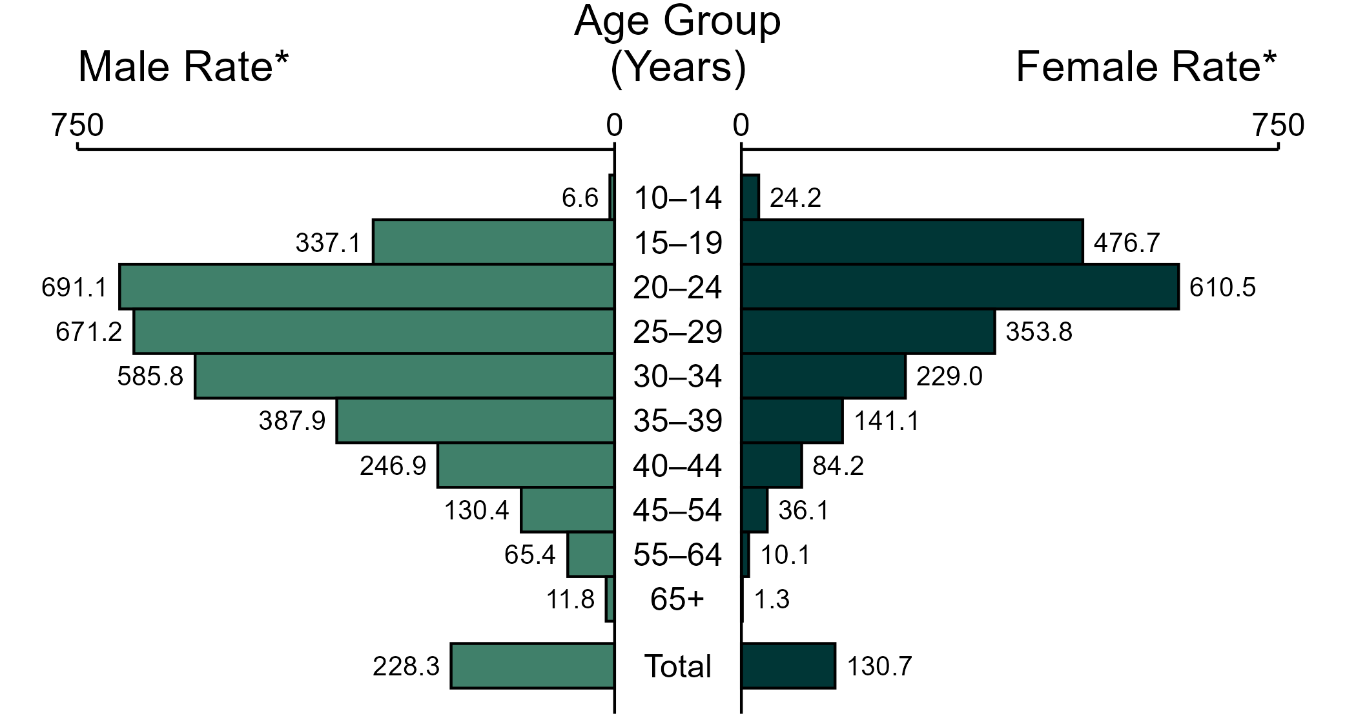
Gonorrhea — Rates of Reported Cases by Age Group and Sex, United States, 2023
* Per 100,000
NOTE: In 2023, 4,005 gonorrhea cases among men (1.1%) and 2,293 cases among women (1.0%) had missing or unknown age. These cases are included in the total rates.
Notes:
In 2023, the rate of reported gonorrhea was higher among men (228.3 per 100,000) compared to women (130.7 per 100,000).
Among men, those aged 20 to 24 years had the highest rate of reported cases of gonorrhea (691.1 per 100,000), followed by men aged 25 to 29 years (671.2 per 100,000) and men aged 30 to 34 years (585.8 per 100,000). Among women, those aged 20 to 24 years also had the highest rate of reported cases of gonorrhea (610.5 per 100,000), followed by women aged 15 to 19 years (476.7 per 100,000) and women aged 25 to 29 years (353.8 per 100,000).
This report includes data from years that coincide with the COVID-19 pandemic, which introduced uncertainty and difficulty in interpreting STI surveillance data. See Impact of COVID-19 on STIs (https://www.cdc.gov/sti-statistics/about/impact-of-covid-19.html) for more information.
See Technical Notes (https://www.cdc.gov/sti-statistics/annual/technical-notes.html) for information on gonorrhea case reporting. Table A (https://www.cdc.gov/sti-statistics/data-vis/table-selected-percunknown.html) provides information on unknown, missing, or invalid values of select variables.
Data for all figures are available at https://www.cdc.gov/sti-statistics/media/files/2024/11/2023-STI-Surveillance-Report-Data-Points.zip. The file “GC - Rates by Age Group and Sex (US 2023).xlsx” contains the data for the figure presented on this slide.

Slide 8
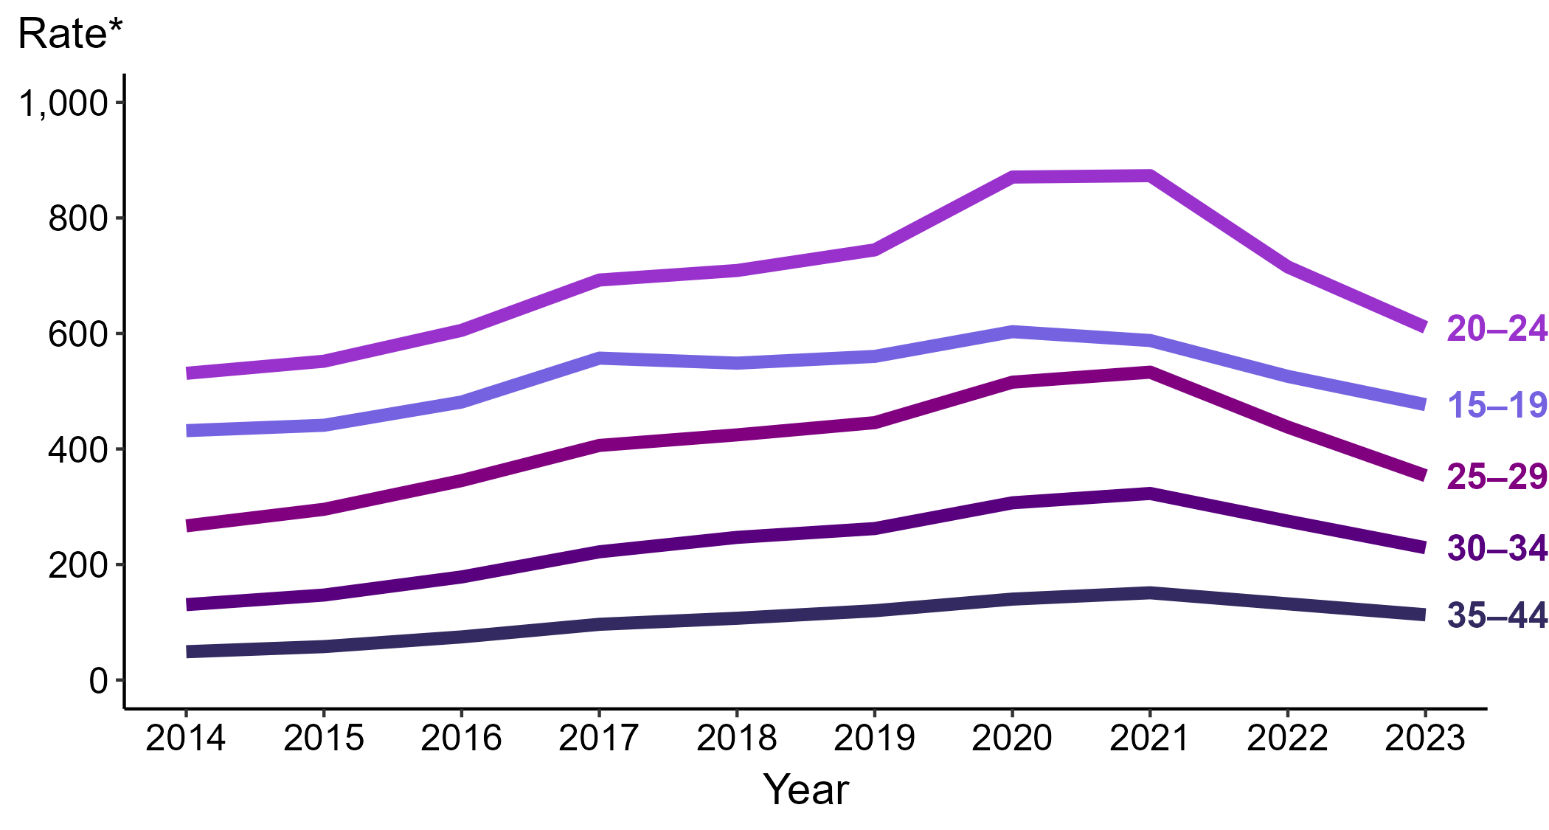
Gonorrhea — Rates of Reported Cases Among Women Aged 15–44 Years by Age Group and Year, United States, 2014–2023
* Per 100,000
Notes:
Among women aged 15 to 44 years in 2023, those aged 20 to 24 years had the highest rate of reported cases of gonorrhea (610.5 cases per 100,000; 14.6% decrease from 2022), followed by those aged 15 to 19 years (476.7 cases per 100,000; 9.3% decrease from 2022), those aged 25 to 29 years (353.8 cases per 100,000; 19.2% decrease from 2022), those aged 30 to 34 years (229.0 cases per 100,000; 16.8% decrease from 2022), and those aged 35 to 44 years (113.0 cases per 100,000; 14.3% decrease from 2022).
This report includes data from years that coincide with the COVID-19 pandemic, which introduced uncertainty and difficulty in interpreting STI surveillance data. See Impact of COVID-19 on STIs (https://www.cdc.gov/sti-statistics/about/impact-of-covid-19.html) for more information.
See Technical Notes (https://www.cdc.gov/sti-statistics/annual/technical-notes.html) for information on STI case reporting formats and practices, including collected and derived variables displayed in this report. Table A (https://www.cdc.gov/sti-statistics/data-vis/table-selected-percunknown.html) provides information on unknown, missing, or invalid values of select variables.
Data for all figures are available at https://www.cdc.gov/sti-statistics/media/files/2024/11/2023-STI-Surveillance-Report-Data-Points.zip. The file “GC - Rates Women 15-44 Years by Age Group (US 2014-2023).xlsx” contains the data for the figure presented on this slide.

Slide 9
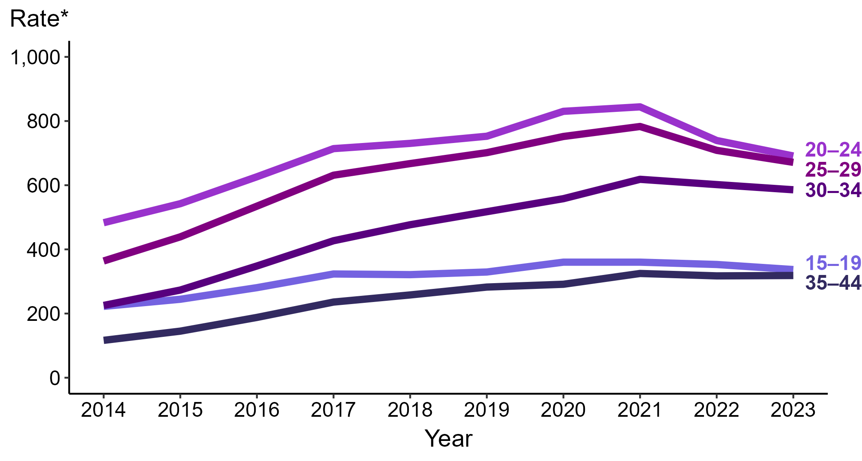
Gonorrhea — Rates of Reported Cases Among Men Aged 15–44 Years by Age Group and Year, United States, 2014–2023
* Per 100,000
Notes:
Among men aged 15 to 44 years in 2023, those aged 20 to 24 years had the highest rate of reported cases of gonorrhea (691.1 cases per 100,000; 6.5% decrease from 2022), followed by those aged 25 to 29 years (671.2 cases per 100,000; 5.3% decrease from 2022), those aged 30 to 34 years (585.8 cases per 100,000; 2.7% decrease from 2022), those aged 15 to 19 years (337.1 cases per 100,000; 4.5% decrease from 2022), and those aged 35 to 44 years (318.6 cases per 100,000; <1.0% change from 2022).
This report includes data from years that coincide with the COVID-19 pandemic, which introduced uncertainty and difficulty in interpreting STI surveillance data. See Impact of COVID-19 on STIs (https://www.cdc.gov/sti-statistics/about/impact-of-covid-19.html) for more information.
See Technical Notes (https://www.cdc.gov/sti-statistics/annual/technical-notes.html) for information on STI case reporting formats and practices, including collected and derived variables displayed in this report. Table A (https://www.cdc.gov/sti-statistics/data-vis/table-selected-percunknown.html) provides information on unknown, missing, or invalid values of select variables.
Data for all figures are available at https://www.cdc.gov/sti-statistics/media/files/2024/11/2023-STI-Surveillance-Report-Data-Points.zip. The file “GC - Rates Men 15-44 Years by Age Group (US 2014-2023).xlsx” contains the data for the figure presented on this slide.

Slide 10
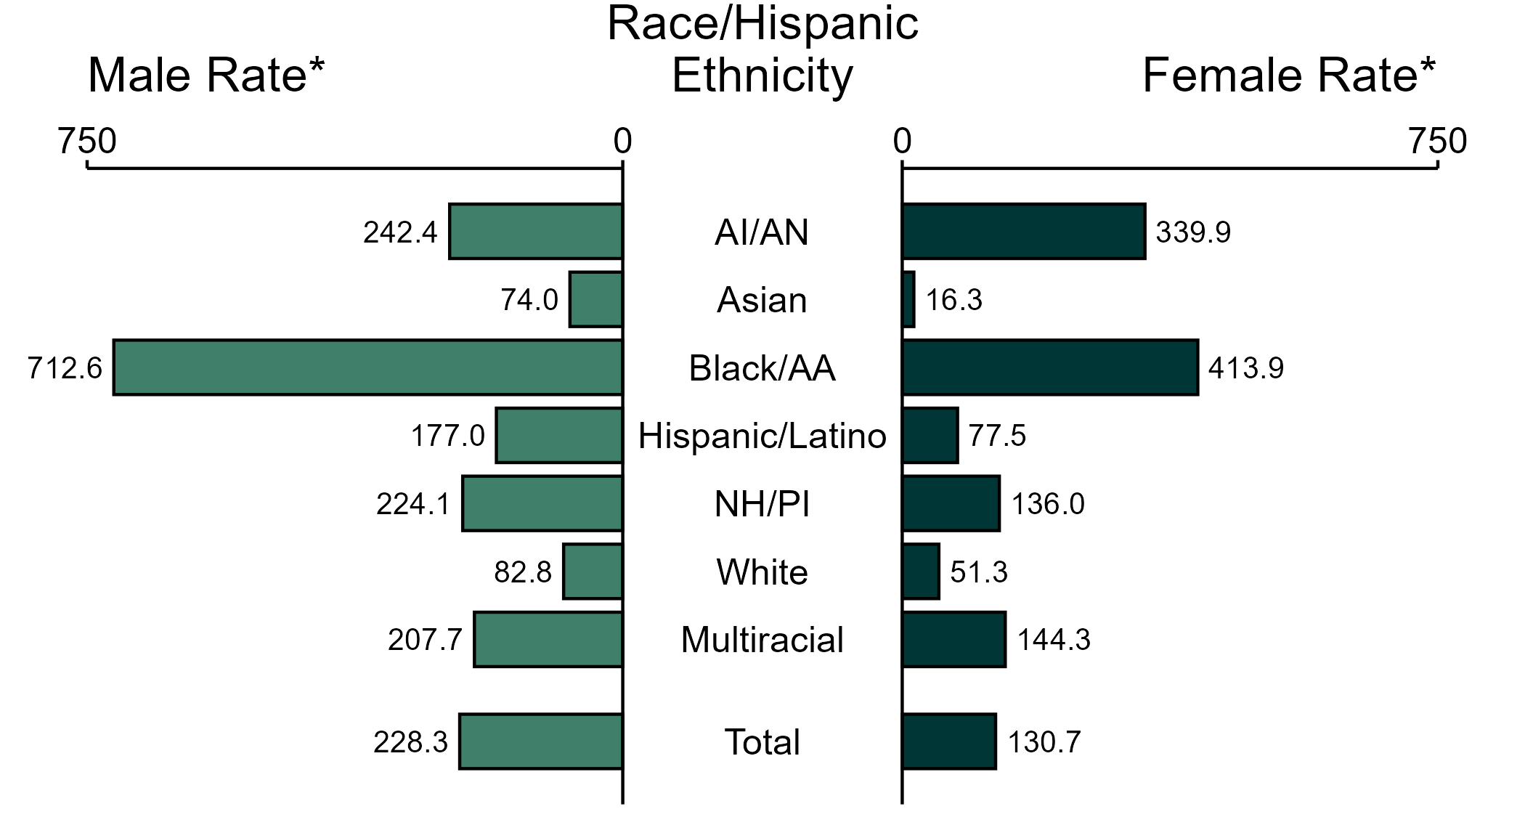
Gonorrhea — Rates of Reported Cases by Race/Hispanic Ethnicity and Sex, United States, 2023
* Per 100,000
ACRONYMS: AI/AN = American Indian or Alaska Native; Black/AA = Black or African American; NH/PI = Native Hawaiian or other Pacific Islander
NOTE: In 2023, 75,705 gonorrhea cases among men (20.0%) and 42,245 cases among women (19.1%) had missing, unknown, or other race and were not reported to be of Hispanic ethnicity. These cases are included in the total rates.
Notes:
In 2023, the rate of reported gonorrhea was higher among men (228.3 per 100,000) compared to women (130.7 per 100,000).
Among men, non-Hispanic Black or African American men had the highest rate of reported cases of gonorrhea (712.6 per 100,000), followed by non-Hispanic American Indian or Alaska Native men (242.4 per 100,000) and non-Hispanic Native Hawaiian or other Pacific Islander men (224.1 per 100,000). Among women, non-Hispanic Black or African American women also had the highest rate of reported cases of gonorrhea (413.9 per 100,000), followed by non-Hispanic American Indian or Alaska Native women (339.9 per 100,000) and non-Hispanic women of multiple races (144.3 per 100,000).
Using non-Hispanic White persons as the referent category, the greatest relative disparity in rates of reported gonorrhea by race and Hispanic ethnicity across both sexes was observed among non-Hispanic Black or African American men, with a rate ratio of 8.6 times that of non-Hispanic White men. Among women, the greatest relative disparity was observed among non-Hispanic Black or African American women as well, with a rate 8.1 times that of non-Hispanic White women.
This report includes data from years that coincide with the COVID-19 pandemic, which introduced uncertainty and difficulty in interpreting STI surveillance data. See Impact of COVID-19 on STIs (https://www.cdc.gov/sti-statistics/about/impact-of-covid-19.html) for more information.
See Technical Notes (https://www.cdc.gov/sti-statistics/annual/technical-notes.html) for information on STI case reporting formats and practices, including collected and derived variables displayed in this report. Table A (https://www.cdc.gov/sti-statistics/data-vis/table-selected-percunknown.html) provides information on unknown, missing, or invalid values of select variables.
Data for all figures are available at https://www.cdc.gov/sti-statistics/media/files/2024/11/2023-STI-Surveillance-Report-Data-Points.zip. The file “GC - Rates by Race Hispanic Ethnicity and Sex (US 2023).xlsx” contains the data for the figure presented on this slide.

Slide 11
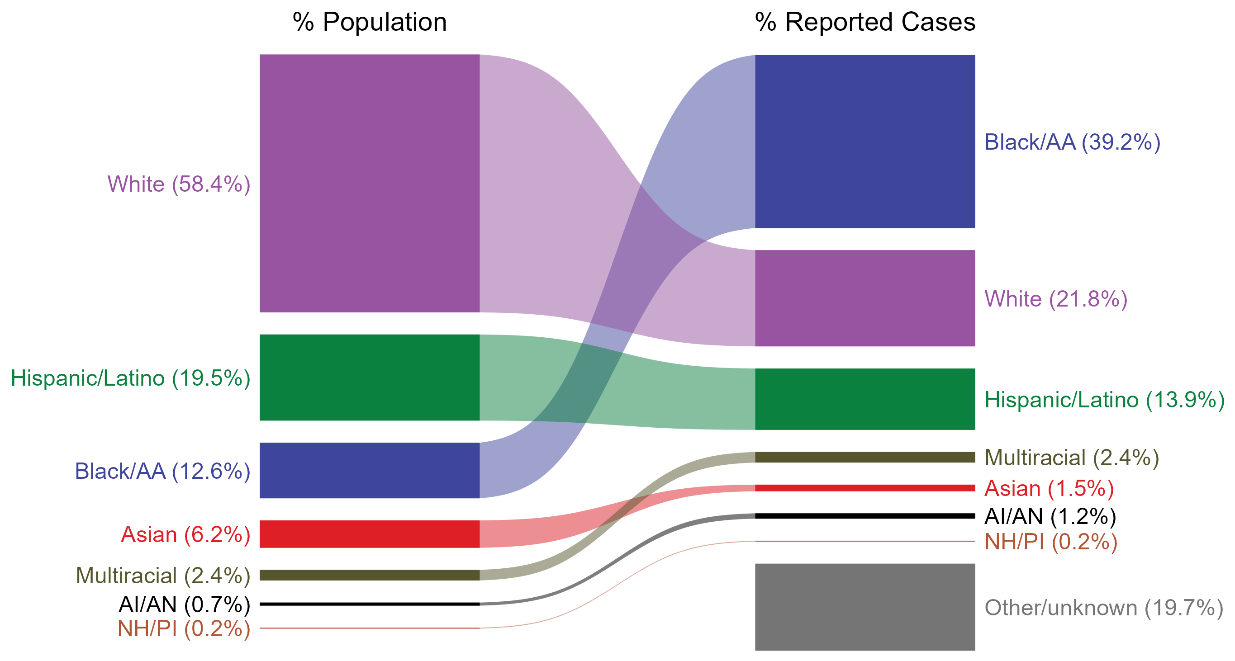
Gonorrhea — Total Population and Reported Cases by Race/Hispanic Ethnicity, United States, 2023
ACRONYMS: AI/AN = American Indian or Alaska Native; Black/AA = Black or African American; NH/PI = Native Hawaiian or other Pacific Islander
NOTE: In 2023, a total of 118,750 gonorrhea cases (19.7%) had missing, unknown, or other race and were not reported to be of Hispanic ethnicity. These cases are included in the “other/unknown” category.
Notes:
The percentages of gonorrhea cases by race and Hispanic ethnicity were disproportionate to the percentages among the total population of the United States in 2023. The greatest absolute and relative disparities were observed among non-Hispanic Black or African American persons, who represented 39.2% of reported gonorrhea cases (n = 236,011; 48.9% of gonorrhea cases with reported race or Hispanic ethnicity) despite being 12.6% of the US population. This means that the burden of gonorrhea among non-Hispanic Black or African American persons was 26.6% greater than — or 3.1 times — what would be expected based on their proportion of the population. Additionally, non-Hispanic American Indian or Alaska Native persons were also overrepresented among gonorrhea cases relative to their proportion of the population.
This report includes data from years that coincide with the COVID-19 pandemic, which introduced uncertainty and difficulty in interpreting STI surveillance data. See Impact of COVID-19 on STIs (https://www.cdc.gov/sti-statistics/about/impact-of-covid-19.html) for more information.
See Technical Notes (https://www.cdc.gov/sti-statistics/annual/technical-notes.html) for information on STI case reporting formats and practices, including collected and derived variables displayed in this report. Table A (https://www.cdc.gov/sti-statistics/data-vis/table-selected-percunknown.html) provides information on unknown, missing, or invalid values of select variables.
Data for all figures are available at https://www.cdc.gov/sti-statistics/media/files/2024/11/2023-STI-Surveillance-Report-Data-Points.zip. The file “GC - Population and Cases by Race Hispanic Ethnicity (US 2023).xlsx” contains the data for the figure presented on this slide.

Slide 12
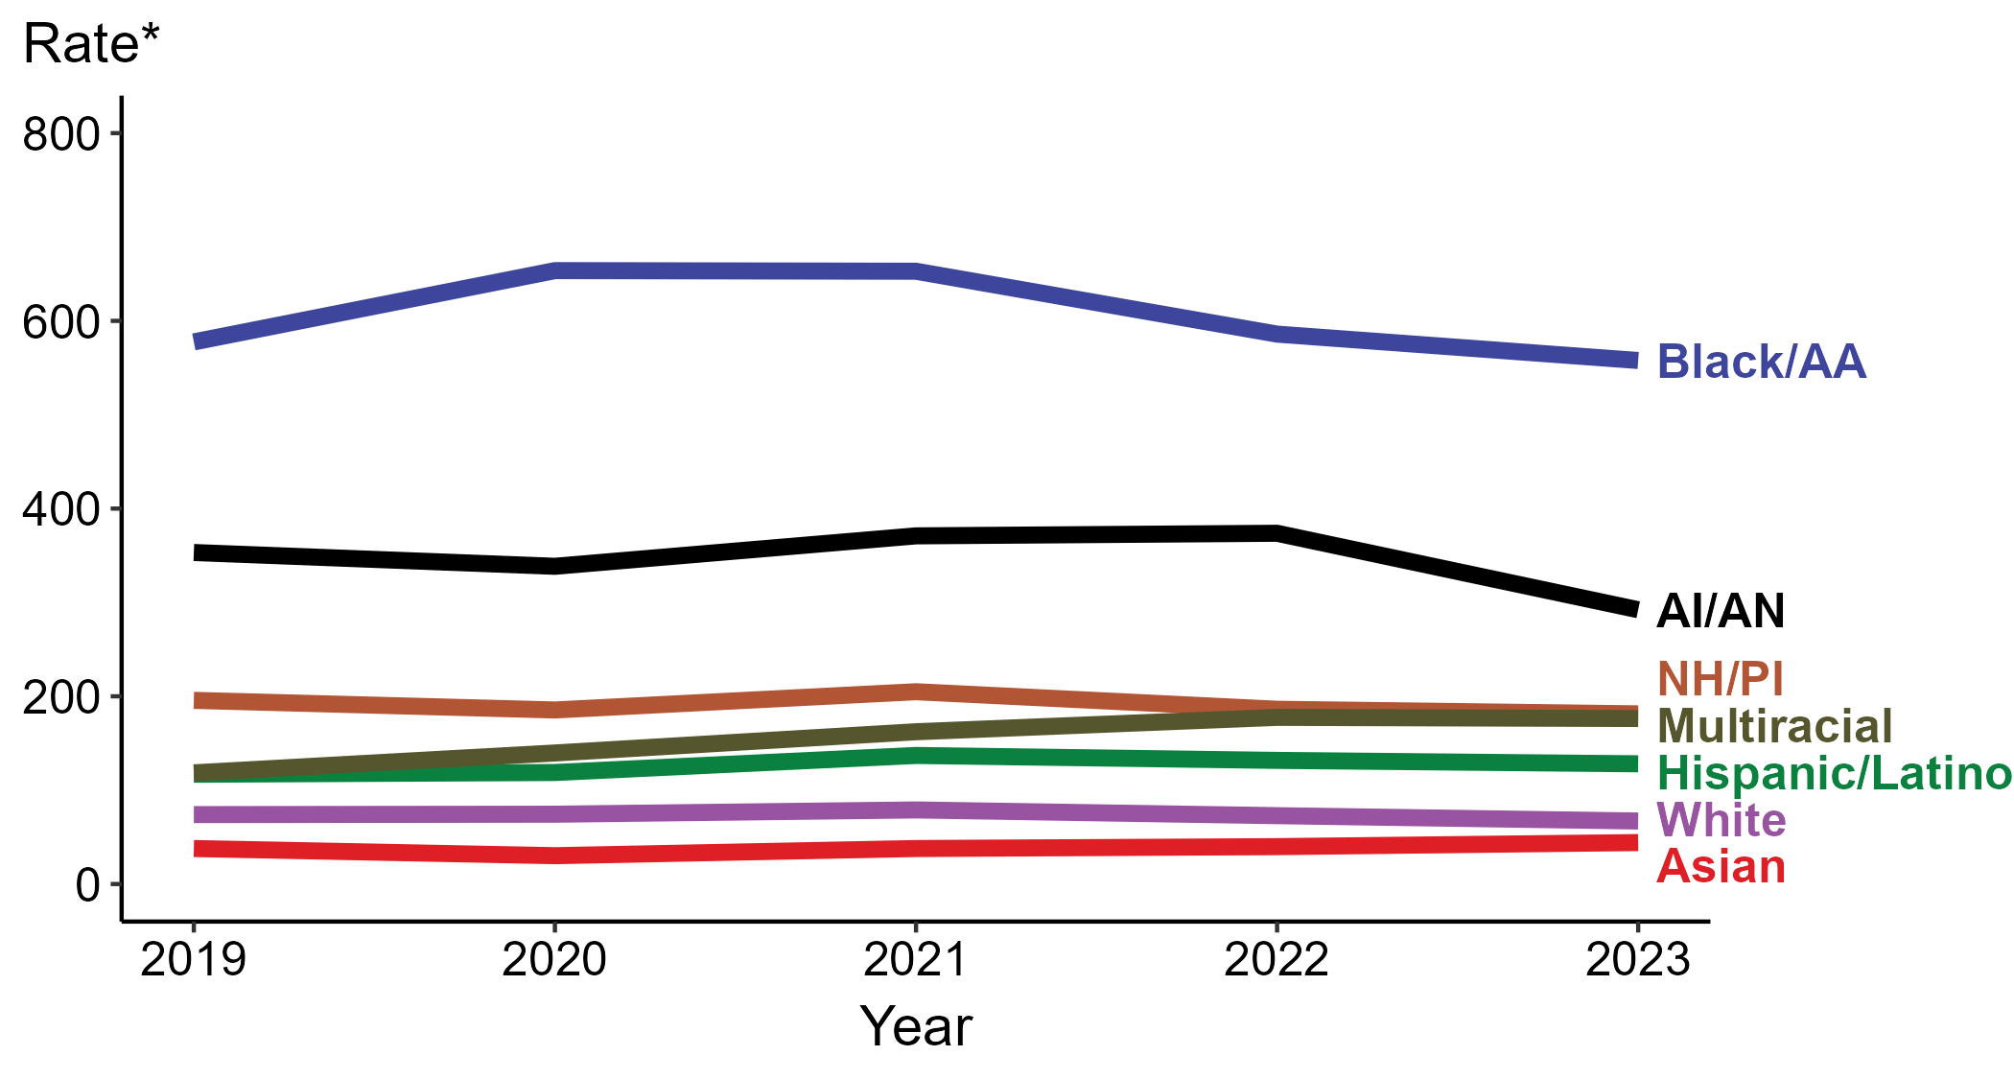
Gonorrhea — Rates of Reported Cases by Race/Hispanic Ethnicity, United States, 2019–2023
* Per 100,000
ACRONYMS: AI/AN = American Indian or Alaska Native; Black/AA = Black or African American; NH/PI = Native Hawaiian or other Pacific Islander
NOTE: During 2019 to 2023, the percentage of all gonorrhea cases with missing, unknown, or other race and not reported to be of Hispanic ethnicity was 22.2%, from a low of 19.7% (n = 118,750) in 2023 to a high of 23.4% (n = 158,822) in 2020. These cases are not shown in this figure.
Notes:
In 2023, the highest rate of reported gonorrhea cases was among non-Hispanic Black or African American persons (557.8 per 100,000), followed by non-Hispanic American Indian or Alaska Native persons (292.2 per 100,000).
During 2022 to 2023, the only increase in rate of reported gonorrhea cases was among non-Hispanic Asian persons (39.8 to 44.2 per 100,000; 11.1% increase). Non-Hispanic persons of multiple races had the greatest five-year increase in rate of reported gonorrhea (118.4 to 176.3 per 100,000; 48.9% increase from 2019).
During 2022 to 2023, the greatest decrease in rate of reported gonorrhea cases was among non-Hispanic American Indian or Alaska Native persons (373.7 to 292.2 per 100,000; 21.8% decrease). Non-Hispanic American Indian or Alaska Native persons also had the greatest five-year decrease in rate of reported gonorrhea (353.2 to 292.2 per 100,000; 17.3% decrease from 2019).
This report includes data from years that coincide with the COVID-19 pandemic, which introduced uncertainty and difficulty in interpreting STI surveillance data. See Impact of COVID-19 on STIs (https://www.cdc.gov/sti-statistics/about/impact-of-covid-19.html) for more information.
See Technical Notes (https://www.cdc.gov/sti-statistics/annual/technical-notes.html) for information on STI case reporting formats and practices, including collected and derived variables displayed in this report. Table A (https://www.cdc.gov/sti-statistics/data-vis/table-selected-percunknown.html) provides information on unknown, missing, or invalid values of select variables.
Data for all figures are available at https://www.cdc.gov/sti-statistics/media/files/2024/11/2023-STI-Surveillance-Report-Data-Points.zip. The file “GC - Rates by Race Hispanic Ethnicity (US 2019-2023).xlsx” contains the data for the figure presented on this slide.

Slide 13
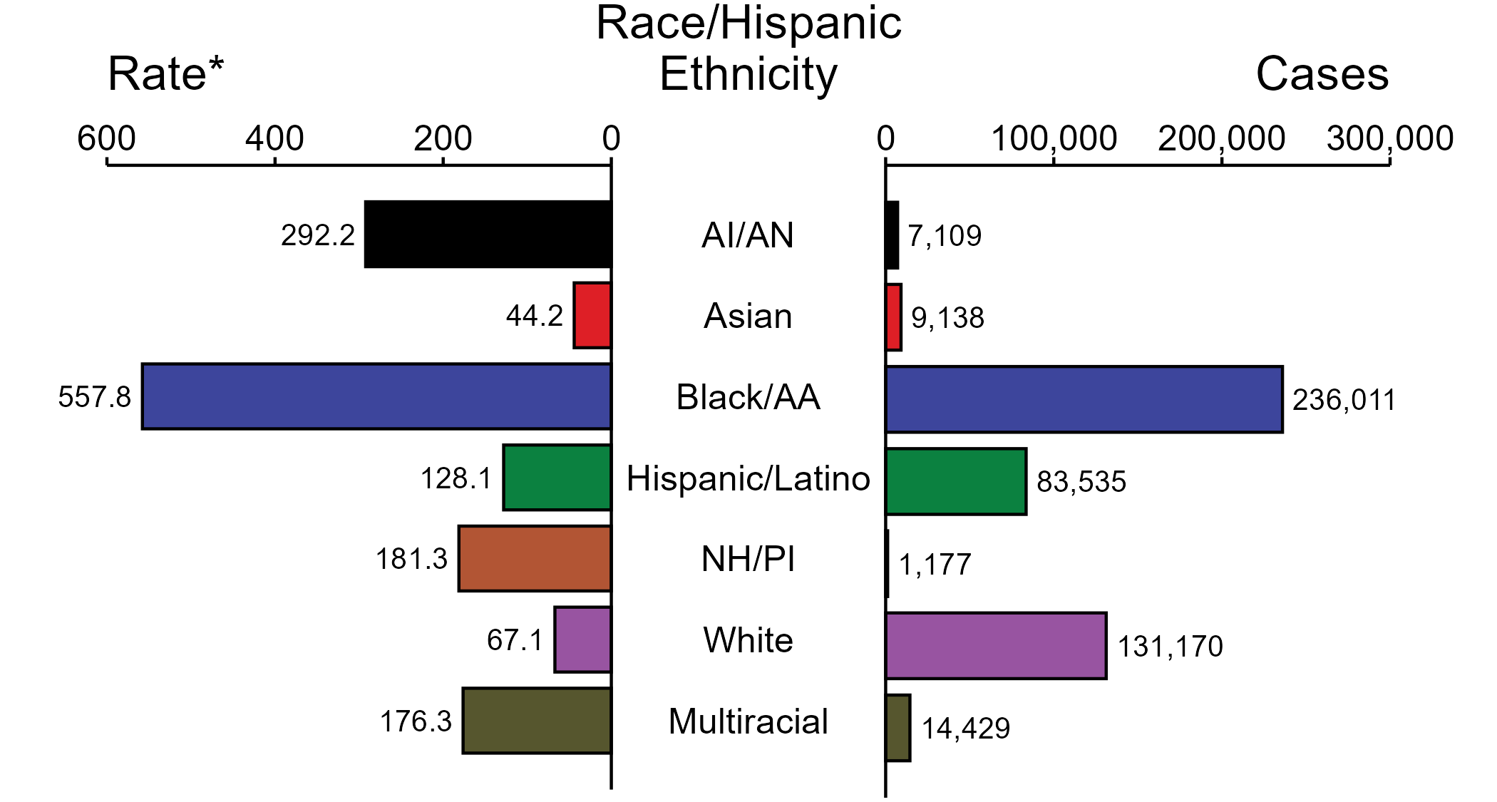
Gonorrhea — Case Counts and Rates of Reported Cases by Race/Hispanic Ethnicity and Year, United States, 2023
* Per 100,000
ACRONYMS: AI/AN = American Indian or Alaska Native; Black/AA = Black or African American; NH/PI = Native Hawaiian or other Pacific Islander
NOTE: In 2023, a total of 118,750 gonorrhea cases (19.7%) had missing, unknown, or other race and were not reported to be of Hispanic ethnicity. These cases are not shown in this figure. Including these cases, there were a total of 601,319 cases of gonorrhea reported among states and the District of Columbia for a rate of 179.5 per 100,000 persons.
Notes:
In 2023, rates of gonorrhea were highest among non-Hispanic Black or African American persons (557.8 per 100,000), followed by non-Hispanic American Indian or Alaska Native persons (292.2 per 100,000) and non-Hispanic Native Hawaiian or other Pacific Islander persons (181.3 per 100,000). The greatest number of reported gonorrhea cases was among non-Hispanic Black or African American persons (236,011 cases), followed by non-Hispanic White persons (131,170 cases) and Hispanic or Latino persons of any race(s) (83,535 cases).
This report includes data from years that coincide with the COVID-19 pandemic, which introduced uncertainty and difficulty in interpreting STI surveillance data. See Impact of COVID-19 on STIs (https://www.cdc.gov/sti-statistics/about/impact-of-covid-19.html) for more information.
See Technical Notes (https://www.cdc.gov/sti-statistics/annual/technical-notes.html) for information on STI case reporting formats and practices, including collected and derived variables displayed in this report. Table A (https://www.cdc.gov/sti-statistics/data-vis/table-selected-percunknown.html) provides information on unknown, missing, or invalid values of select variables.
Data for all figures are available at https://www.cdc.gov/sti-statistics/media/files/2024/11/2023-STI-Surveillance-Report-Data-Points.zip. The file “GC - Cases and Rates by Race Hispanic Ethnicity (US 2023).xlsx” contains the data for the figure presented on this slide.

Slide 14
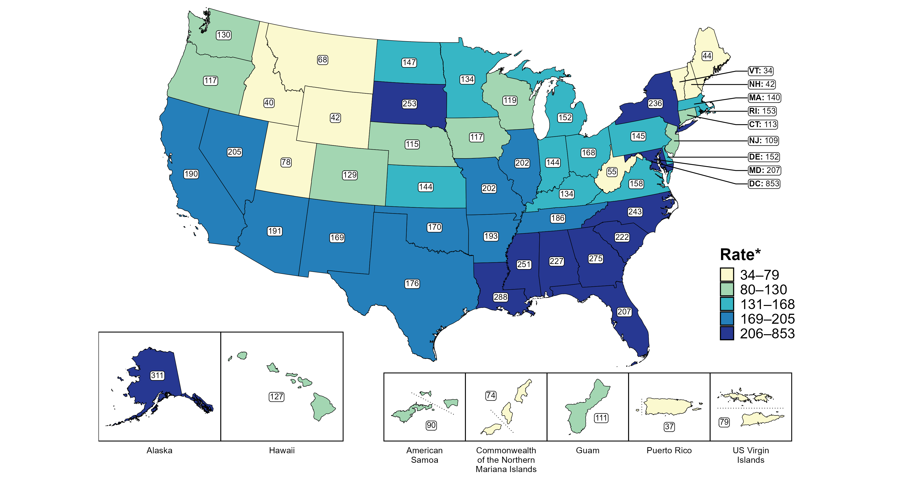
Gonorrhea — Rates of Reported Cases by Jurisdiction, United States and Territories, 2023
* Per 100,000
Notes:
In 2023, rates of reported gonorrhea ranged by state from 34 cases per 100,000 persons in Vermont to 311 cases per 100,000 persons in Alaska. The rate of reported gonorrhea in the District of Columbia was 853 per 100,000 persons.
Among US territories, rates of reported gonorrhea ranged from 37 cases per 100,000 persons in Puerto Rico to 111 cases per 100,000 persons in Guam.
Tennessee transitioned STI surveillance information systems in September of 2023 which may have impacted the overall case counts. Caution should be applied in interpretation of these data.
This report includes data from years that coincide with the COVID-19 pandemic, which introduced uncertainty and difficulty in interpreting STI surveillance data. See Impact of COVID-19 on STIs (https://www.cdc.gov/sti-statistics/about/impact-of-covid-19.html) for more information.
See Technical Notes (https://www.cdc.gov/sti-statistics/annual/technical-notes.html) for information on STI case reporting formats and practices, including collected and derived variables displayed in this report. Table A (https://www.cdc.gov/sti-statistics/data-vis/table-selected-percunknown.html) provides information on unknown, missing, or invalid values of select variables.
Data for all figures are available at https://www.cdc.gov/sti-statistics/media/files/2024/11/2023-STI-Surveillance-Report-Data-Points.zip. The file “GC - Rates by Jurisdiction (US and Terr 2023).xlsx” contains the data for the figure presented on this slide.

Slide 15
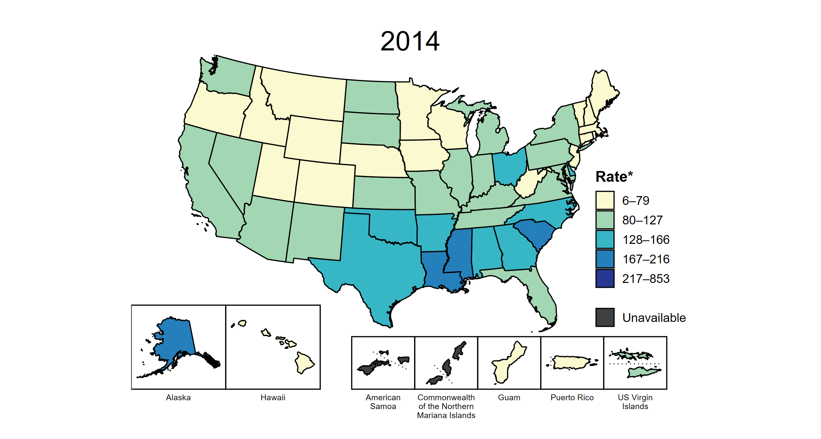
Gonorrhea — Rates of Reported Cases by Jurisdiction, United States and Territories, 2014–2023
* Per 100,000
Notes:
This slide contains an animated figure that will play when the slide is in presentation mode. A static version of the figure that displays maps from the first and last years of the range is available as a separate slide.
In 2014, four states and the District of Columbia (DC; 9.3% of areas with available data) had a rate of reported gonorrhea greater than or equal to 167 cases per 100,000 persons. This increased to 22 states and DC (41.1% of areas with available data) in 2023. During 2022 to 2023, rates of reported gonorrhea increased in 10 states, DC, and four territories.
American Samoa and the Commonwealth of the Northern Mariana Islands began providing data on gonorrhea cases to CDC in 2018; data are not available for those areas prior to that year. In addition, data on reported gonorrhea cases in 2018 are not available for the US Virgin Islands. Due to a network security incident in December 2021, the Maryland Department of Health could not finalize their 2021 STI case notification data. Data for 2021 from Maryland have been suppressed for this figure; however, they are included in national and regional case counts and rates displayed in other figures. Tennessee transitioned STI surveillance information systems in September of 2023 which may have impacted the overall case counts. Caution should be applied in interpretation of these data.
This report includes data from years that coincide with the COVID-19 pandemic, which introduced uncertainty and difficulty in interpreting STI surveillance data. See Impact of COVID-19 on STIs (https://www.cdc.gov/sti-statistics/about/impact-of-covid-19.html) for more information.
See Technical Notes (https://www.cdc.gov/sti-statistics/annual/technical-notes.html) for information on STI case reporting formats and practices, including collected and derived variables displayed in this report. Table A (https://www.cdc.gov/sti-statistics/data-vis/table-selected-percunknown.html) provides information on unknown, missing, or invalid values of select variables.
Data for all figures are available at https://www.cdc.gov/sti-statistics/media/files/2024/11/2023-STI-Surveillance-Report-Data-Points.zip. The file “GC - Rates by Jurisdiction (US and Terr 2014-2023).xlsx” contains the data for the figure presented on this slide.

Slide 16
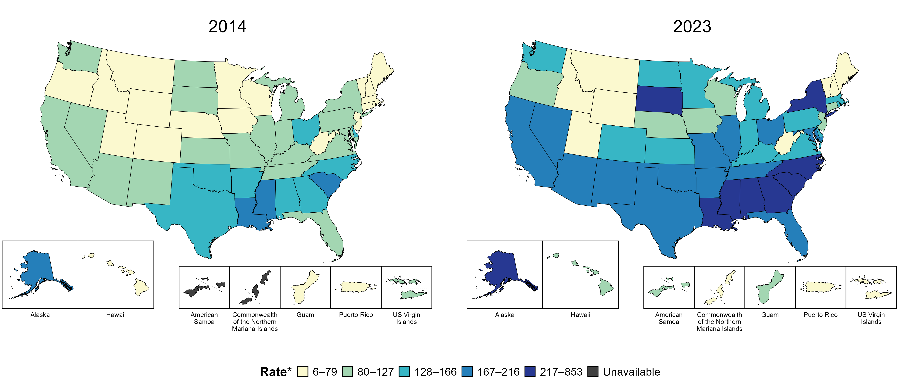
Gonorrhea — Rates of Reported Cases by Jurisdiction, United States and Territories, 2014 and 2023
* Per 100,000
Notes:
In 2014, four states and the District of Columbia (DC; 9.3% of areas with available data) had a rate of reported gonorrhea greater than or equal to 167 cases per 100,000 persons. This increased to 22 states and DC (41.1% of areas with available data) in 2023.
American Samoa and the Commonwealth of the Northern Mariana Islands began providing data on gonorrhea cases to CDC in 2018; data are not available for those areas prior to that year. Tennessee transitioned STI surveillance information systems in September of 2023 which may have impacted the overall case counts. Caution should be applied in interpretation of these data.
This report includes data from years that coincide with the COVID-19 pandemic, which introduced uncertainty and difficulty in interpreting STI surveillance data. See Impact of COVID-19 on STIs (https://www.cdc.gov/sti-statistics/about/impact-of-covid-19.html) for more information.
See Technical Notes (https://www.cdc.gov/sti-statistics/annual/technical-notes.html) for information on STI case reporting formats and practices, including collected and derived variables displayed in this report. Table A (https://www.cdc.gov/sti-statistics/data-vis/table-selected-percunknown.html) provides information on unknown, missing, or invalid values of select variables.
Data for all figures are available at https://www.cdc.gov/sti-statistics/media/files/2024/11/2023-STI-Surveillance-Report-Data-Points.zip. The file “GC - Rates by Jurisdiction (US and Terr 2014 and 2023).xlsx” contains the data for the figure presented on this slide.

Slide 17
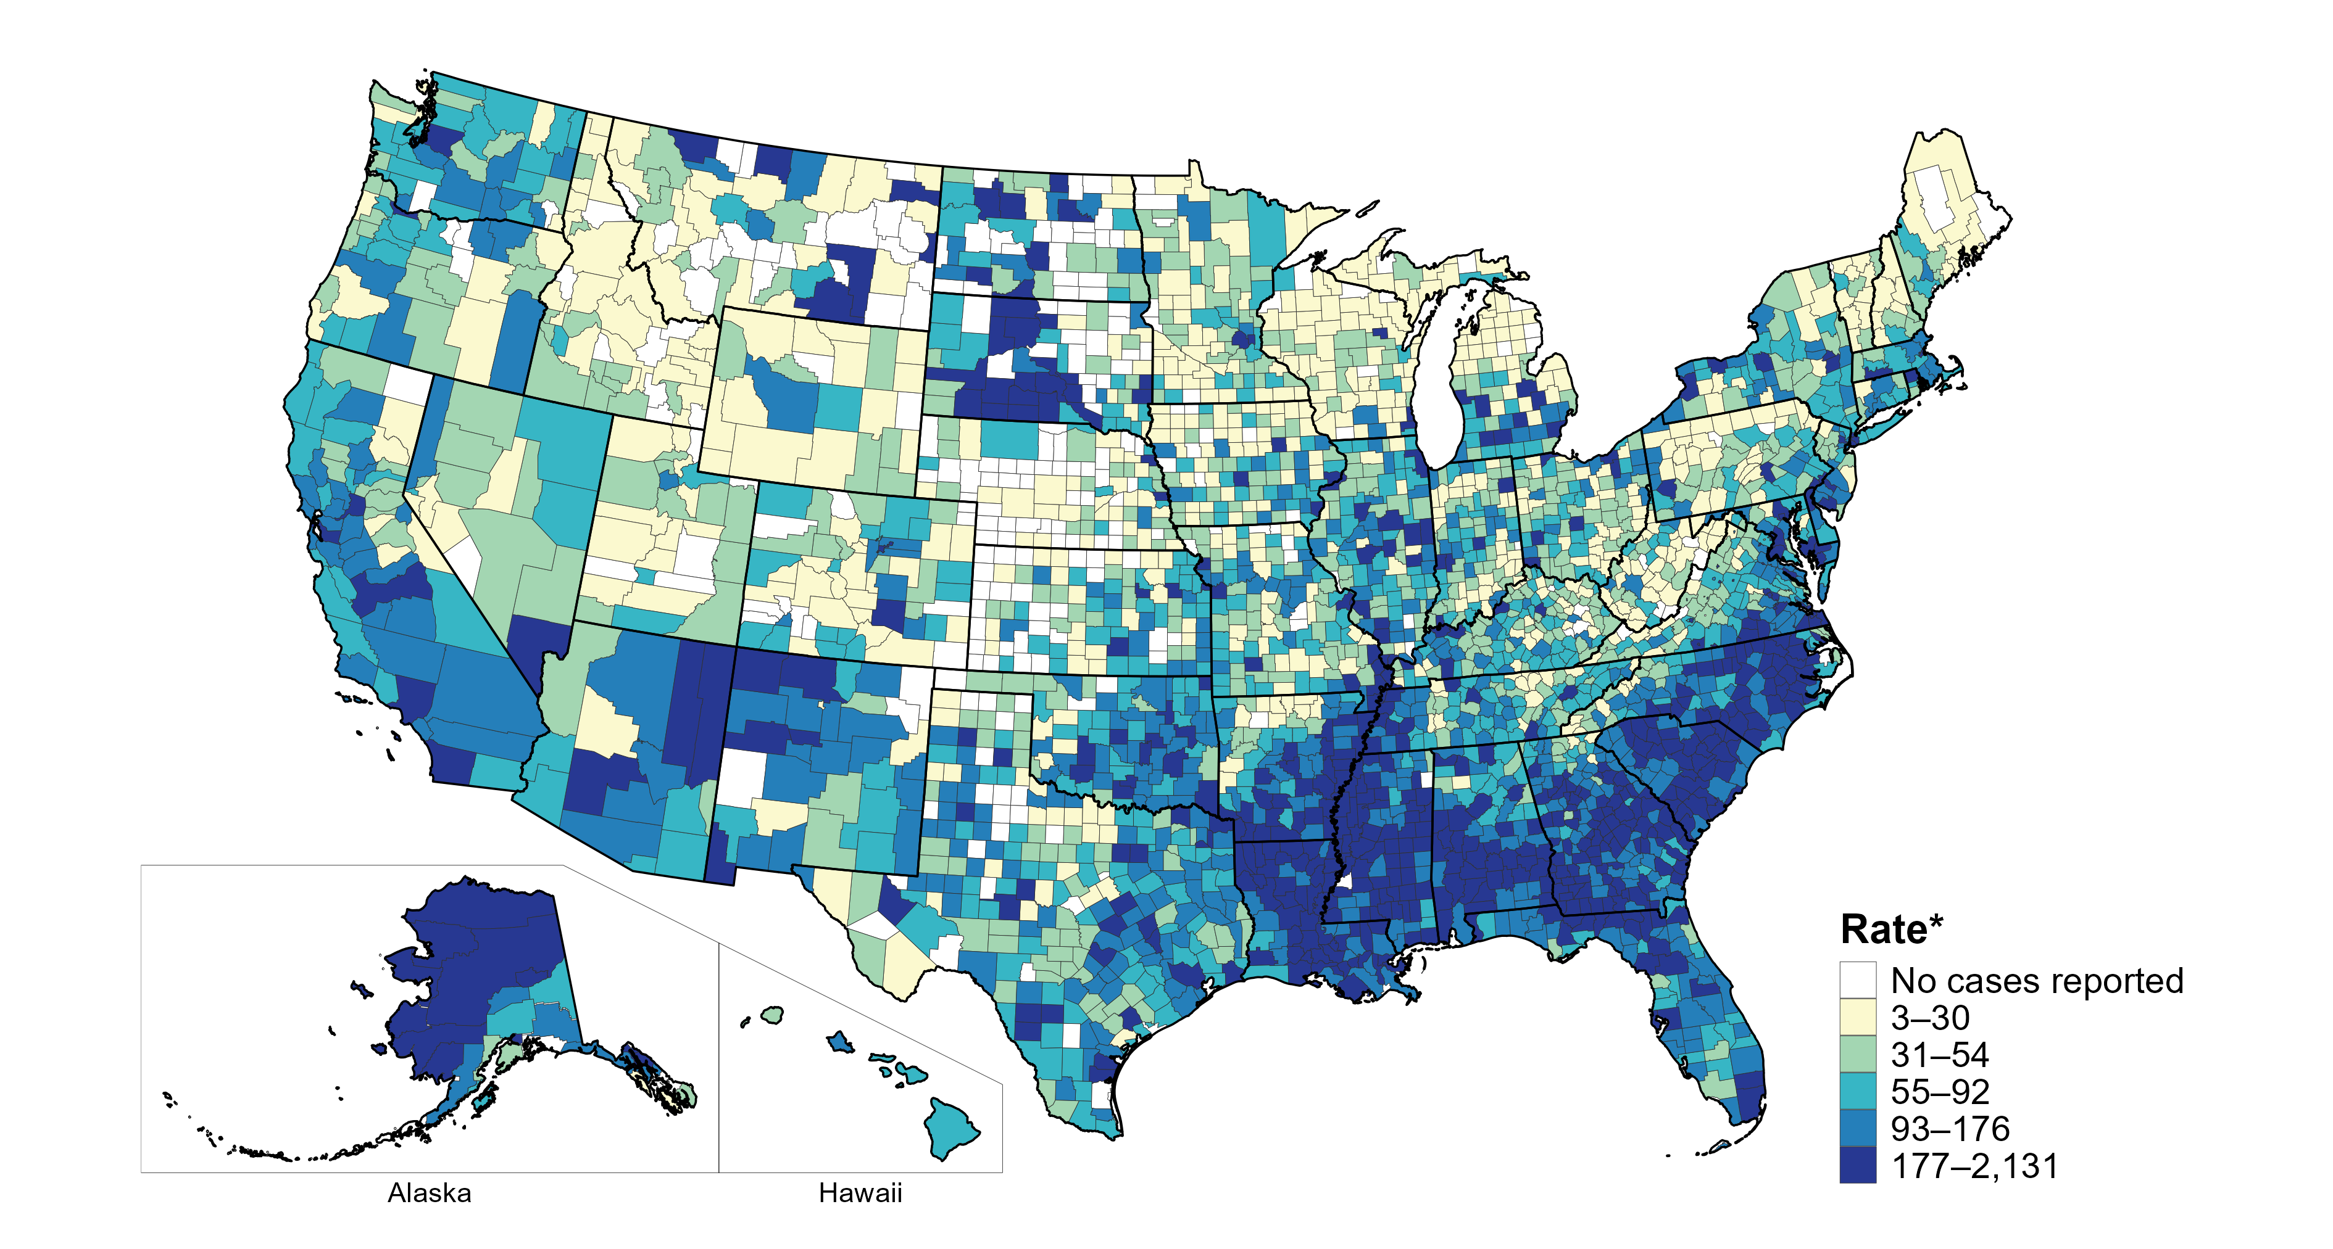
Gonorrhea — Rates of Reported Cases by County, United States, 2023
* Per 100,000
Notes:
In 2023, 91.8% of all counties and county equivalents in the United States reported at least one case of gonorrhea. Out of 3,144 counties and county equivalents, 60 counties or county equivalents (1.9%) reported over half of all cases of gonorrhea (301,375 of 599,193 total cases).
Tennessee transitioned STI surveillance information systems in September of 2023 which may have impacted the overall case counts. Caution should be applied in interpretation of these data.
This report includes data from years that coincide with the COVID-19 pandemic, which introduced uncertainty and difficulty in interpreting STI surveillance data. See Impact of COVID-19 on STIs (https://www.cdc.gov/sti-statistics/about/impact-of-covid-19.html) for more information.
See Technical Notes (https://www.cdc.gov/sti-statistics/annual/technical-notes.html) for information on STI case reporting formats and practices, including collected and derived variables displayed in this report. Table A (https://www.cdc.gov/sti-statistics/data-vis/table-selected-percunknown.html) provides information on unknown, missing, or invalid values of select variables.
Data for all figures are available at https://www.cdc.gov/sti-statistics/media/files/2024/11/2023-STI-Surveillance-Report-Data-Points.zip. The file “GC - Rates by County (US 2023).xlsx” contains the data for the figure presented on this slide.

Slide 18
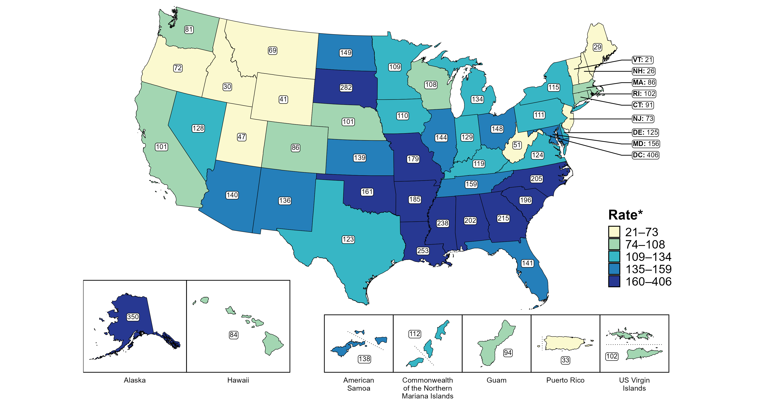
Gonorrhea — Rates of Reported Cases Among Women by Jurisdiction, United States and Territories, 2023
* Per 100,000
Notes:
In 2023, rates of reported gonorrhea among women ranged by state from 21 cases per 100,000 women in Vermont to 350 cases per 100,000 women in Alaska. The rate of reported gonorrhea in the District of Columbia was 406 per 100,000 women.
Among US territories, rates of reported gonorrhea ranged from 33 cases per 100,000 women in Puerto Rico to 138 cases per 100,000 women in American Samoa.
Tennessee transitioned STI surveillance information systems in September of 2023 which may have impacted the overall case counts. Caution should be applied in interpretation of these data.
This report includes data from years that coincide with the COVID-19 pandemic, which introduced uncertainty and difficulty in interpreting STI surveillance data. See Impact of COVID-19 on STIs (https://www.cdc.gov/sti-statistics/about/impact-of-covid-19.html) for more information.
See Technical Notes (https://www.cdc.gov/sti-statistics/annual/technical-notes.html) for information on STI case reporting formats and practices, including collected and derived variables displayed in this report. Table A (https://www.cdc.gov/sti-statistics/data-vis/table-selected-percunknown.html) provides information on unknown, missing, or invalid values of select variables.
Data for all figures are available at https://www.cdc.gov/sti-statistics/media/files/2024/11/2023-STI-Surveillance-Report-Data-Points.zip. The file “GC - Rates Women by Jurisdiction (US and Terr 2023).xlsx” contains the data for the figure presented on this slide.

Slide 19
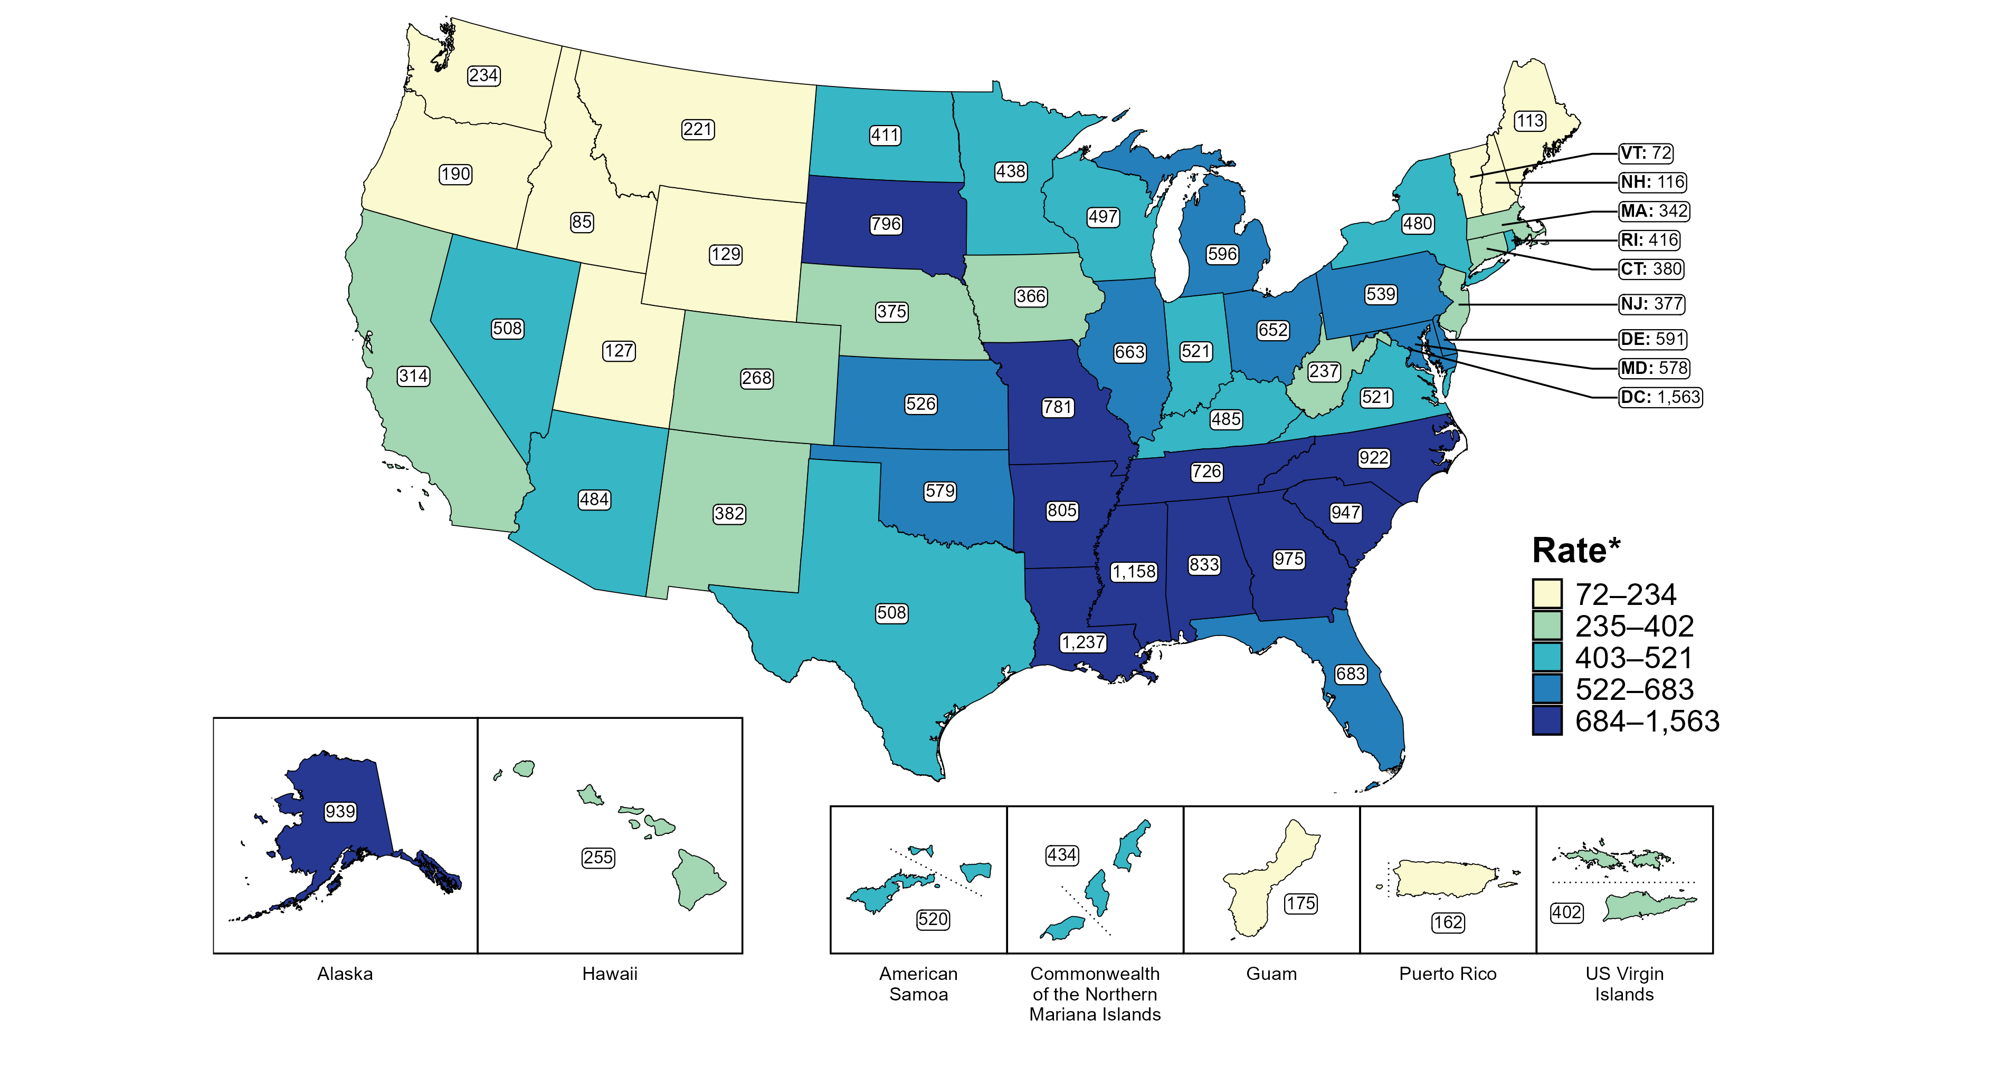
Gonorrhea — Rates of Reported Cases Among Women Aged 15–24 Years by Jurisdiction, United States and Territories, 2023
* Per 100,000
Notes:
In 2023, rates of reported gonorrhea among women aged 15 to 24 years ranged by state from 72 cases per 100,000 women aged 15 to 24 years in Vermont to 1,237 cases per 100,000 women aged 15 to 24 years in Louisiana. The rate of reported gonorrhea in the District of Columbia was 1,563 per 100,000 women aged 15 to 24 years.
Among US territories, rates of reported gonorrhea ranged from 162 cases per 100,000 women aged 15 to 24 years in Puerto Rico to 520 cases per 100,000 women aged 15 to 24 years in American Samoa.
Tennessee transitioned STI surveillance information systems in September of 2023 which may have impacted the overall case counts. Caution should be applied in interpretation of these data.
This report includes data from years that coincide with the COVID-19 pandemic, which introduced uncertainty and difficulty in interpreting STI surveillance data. See Impact of COVID-19 on STIs (https://www.cdc.gov/sti-statistics/about/impact-of-covid-19.html) for more information.
See Technical Notes (https://www.cdc.gov/sti-statistics/annual/technical-notes.html) for information on STI case reporting formats and practices, including collected and derived variables displayed in this report. Table A (https://www.cdc.gov/sti-statistics/data-vis/table-selected-percunknown.html) provides information on unknown, missing, or invalid values of select variables.
Data for all figures are available at https://www.cdc.gov/sti-statistics/media/files/2024/11/2023-STI-Surveillance-Report-Data-Points.zip. The file “GC - Rates Women 15-24 Years by Jurisdiction (US and Terr 2023).xlsx” contains the data for the figure presented on this slide.

Slide 20
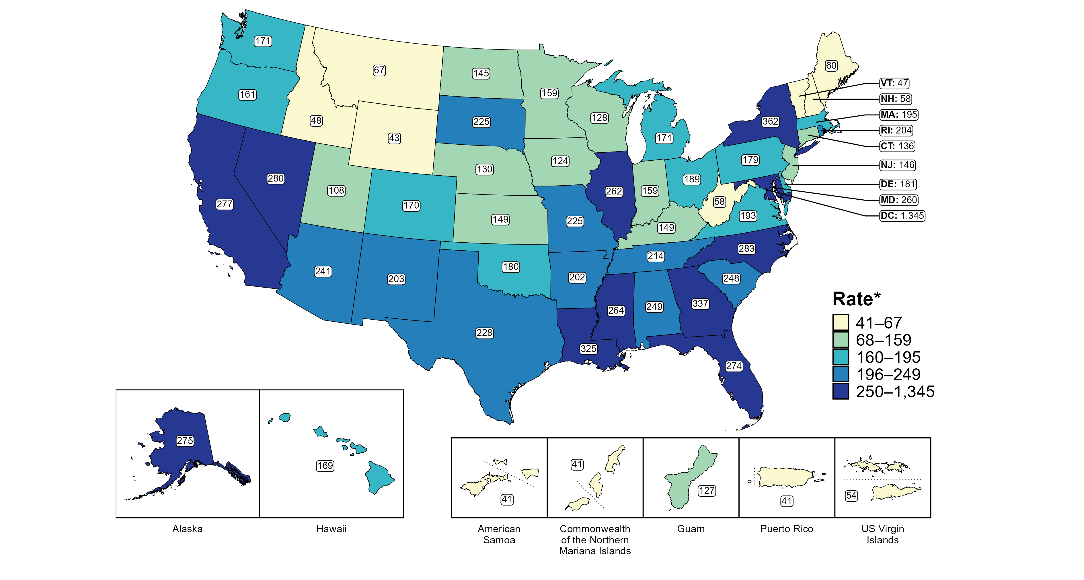
Gonorrhea — Rates of Reported Cases Among Men by Jurisdiction, United States and Territories, 2023
* Per 100,000
Notes:
In 2023, rates of reported gonorrhea among men ranged by state from 43 cases per 100,000 men in Wyoming to 362 cases per 100,000 men in New York. The rate of reported gonorrhea in the District of Columbia was 1,345 per 100,000 men.
Among US territories, rates of reported gonorrhea ranged from 41 cases per 100,000 men in American Samoa, the Commonwealth of the Northern Mariana Islands, and Puerto Rico to 127 cases per 100,000 men in Guam.
Tennessee transitioned STI surveillance information systems in September of 2023 which may have impacted the overall case counts. Caution should be applied in interpretation of these data.
This report includes data from years that coincide with the COVID-19 pandemic, which introduced uncertainty and difficulty in interpreting STI surveillance data. See Impact of COVID-19 on STIs (https://www.cdc.gov/sti-statistics/about/impact-of-covid-19.html) for more information.
See Technical Notes (https://www.cdc.gov/sti-statistics/annual/technical-notes.html) for information on STI case reporting formats and practices, including collected and derived variables displayed in this report. Table A (https://www.cdc.gov/sti-statistics/data-vis/table-selected-percunknown.html) provides information on unknown, missing, or invalid values of select variables.
Data for all figures are available at https://www.cdc.gov/sti-statistics/media/files/2024/11/2023-STI-Surveillance-Report-Data-Points.zip. The file “GC - Rates Men by Jurisdiction (US and Terr 2023).xlsx” contains the data for the figure presented on this slide.

Slide 21
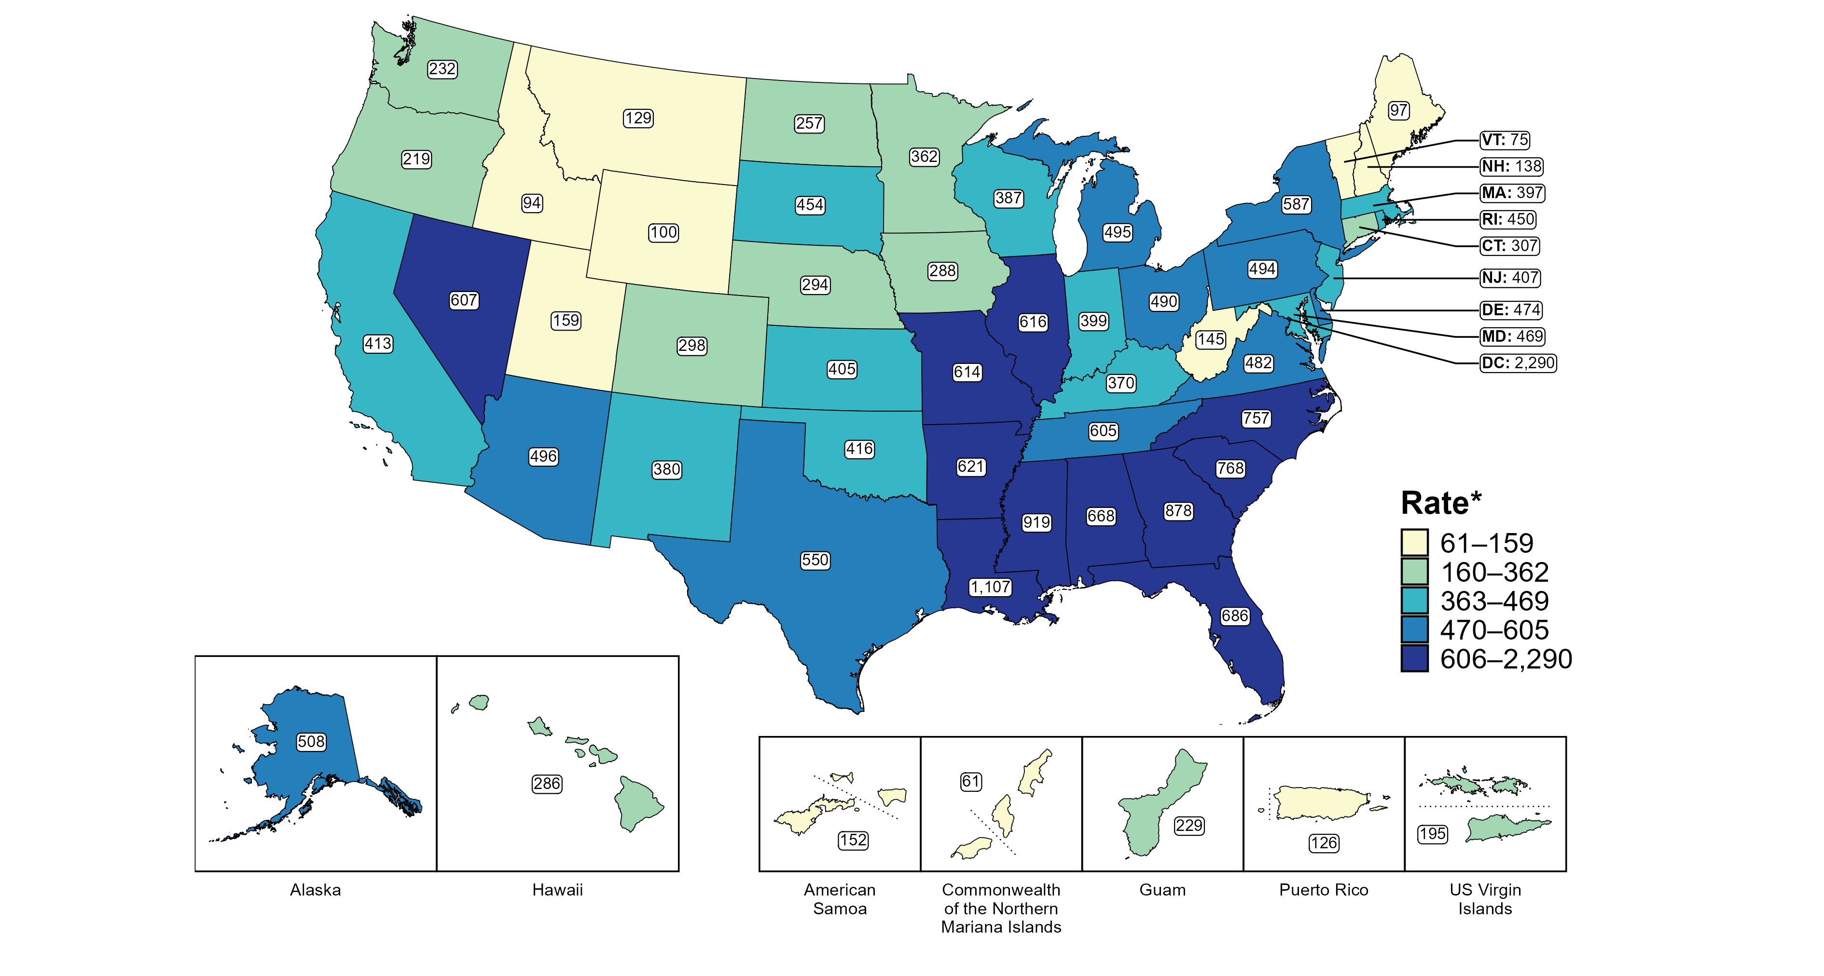
Gonorrhea — Rates of Reported Cases Among Men Aged 15–24 Years by Jurisdiction, United States and Territories, 2023
* Per 100,000
Notes:
In 2023, rates of reported gonorrhea among men aged 15 to 24 years ranged by state from 75 cases per 100,000 men aged 15 to 24 years in Vermont to 1,107 cases per 100,000 men aged 15 to 24 years in Louisiana. The rate of reported gonorrhea in the District of Columbia was 2,290 per 100,000 men aged 15 to 24 years.
Among US territories, rates of reported gonorrhea ranged from 61 cases per 100,000 men aged 15 to 24 years in the Commonwealth of the Northern Mariana Islands to 229 cases per 100,000 men aged 15 to 24 years in Guam.
Tennessee transitioned STI surveillance information systems in September of 2023 which may have impacted the overall case counts. Caution should be applied in interpretation of these data.
This report includes data from years that coincide with the COVID-19 pandemic, which introduced uncertainty and difficulty in interpreting STI surveillance data. See Impact of COVID-19 on STIs (https://www.cdc.gov/sti-statistics/about/impact-of-covid-19.html) for more information.
See Technical Notes (https://www.cdc.gov/sti-statistics/annual/technical-notes.html) for information on STI case reporting formats and practices, including collected and derived variables displayed in this report. Table A (https://www.cdc.gov/sti-statistics/data-vis/table-selected-percunknown.html) provides information on unknown, missing, or invalid values of select variables.
Data for all figures are available at https://www.cdc.gov/sti-statistics/media/files/2024/11/2023-STI-Surveillance-Report-Data-Points.zip. The file “GC - Rates Men 15-24 Years by Jurisdiction (US and Terr 2023).xlsx” contains the data for the figure presented on this slide.

Slide 22
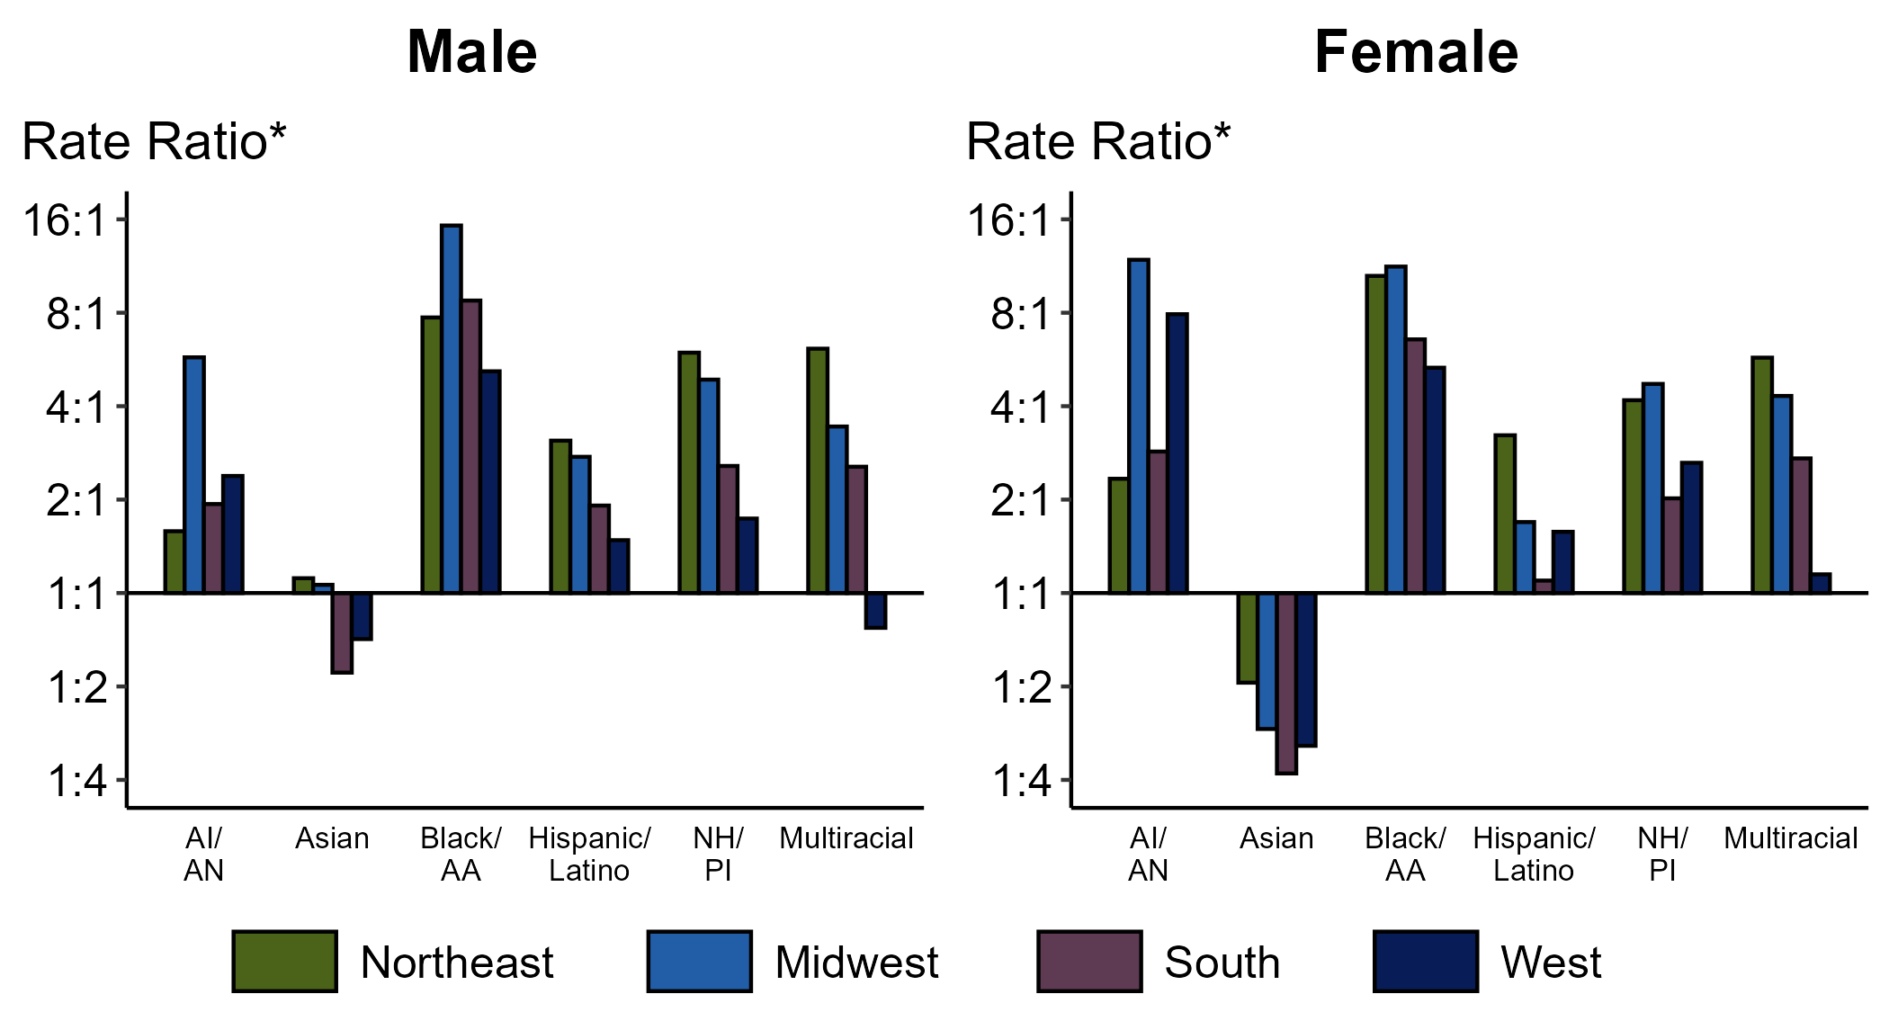
Gonorrhea — Ratios of Rates of Reported Cases by Sex, Race/Hispanic Ethnicity, and Region, United States, 2023
* For the rate ratios, non-Hispanic White persons are the referent population. Y-axis is log scale.
ACRONYMS: AI/AN = American Indian or Alaska Native; Black/AA = Black or African American; NH/PI = Native Hawaiian or other Pacific Islander
Notes:
Among men and women, rate ratios of rates of reported gonorrhea by race/Hispanic ethnicity (using non-Hispanic White persons as the referent population) varied by region in 2023. Among men, the greatest rate ratio was in the Midwest where the rate of reported gonorrhea among non-Hispanic Black or African American men was 15.3 times the rate among non-Hispanic White men. Among women, the greatest rate ratio was in the Midwest where the rate of reported gonorrhea among non-Hispanic American Indian or Alaska Native women was 11.9 times the rate among non-Hispanic White women.
This report includes data from years that coincide with the COVID-19 pandemic, which introduced uncertainty and difficulty in interpreting STI surveillance data. See Impact of COVID-19 on STIs (https://www.cdc.gov/sti-statistics/about/impact-of-covid-19.html) for more information.
See Technical Notes (https://www.cdc.gov/sti-statistics/annual/technical-notes.html) for information on STI case reporting formats and practices, including collected and derived variables displayed in this report. Table A (https://www.cdc.gov/sti-statistics/data-vis/table-selected-percunknown.html) provides information on unknown, missing, or invalid values of select variables.
Data for all figures are available at https://www.cdc.gov/sti-statistics/media/files/2024/11/2023-STI-Surveillance-Report-Data-Points.zip. The file “GC - Ratios of Rates by Sex Race Hispanic Ethnicity and Region (US 2023).xlsx” contains the data for the figure presented on this slide.

Slide 23
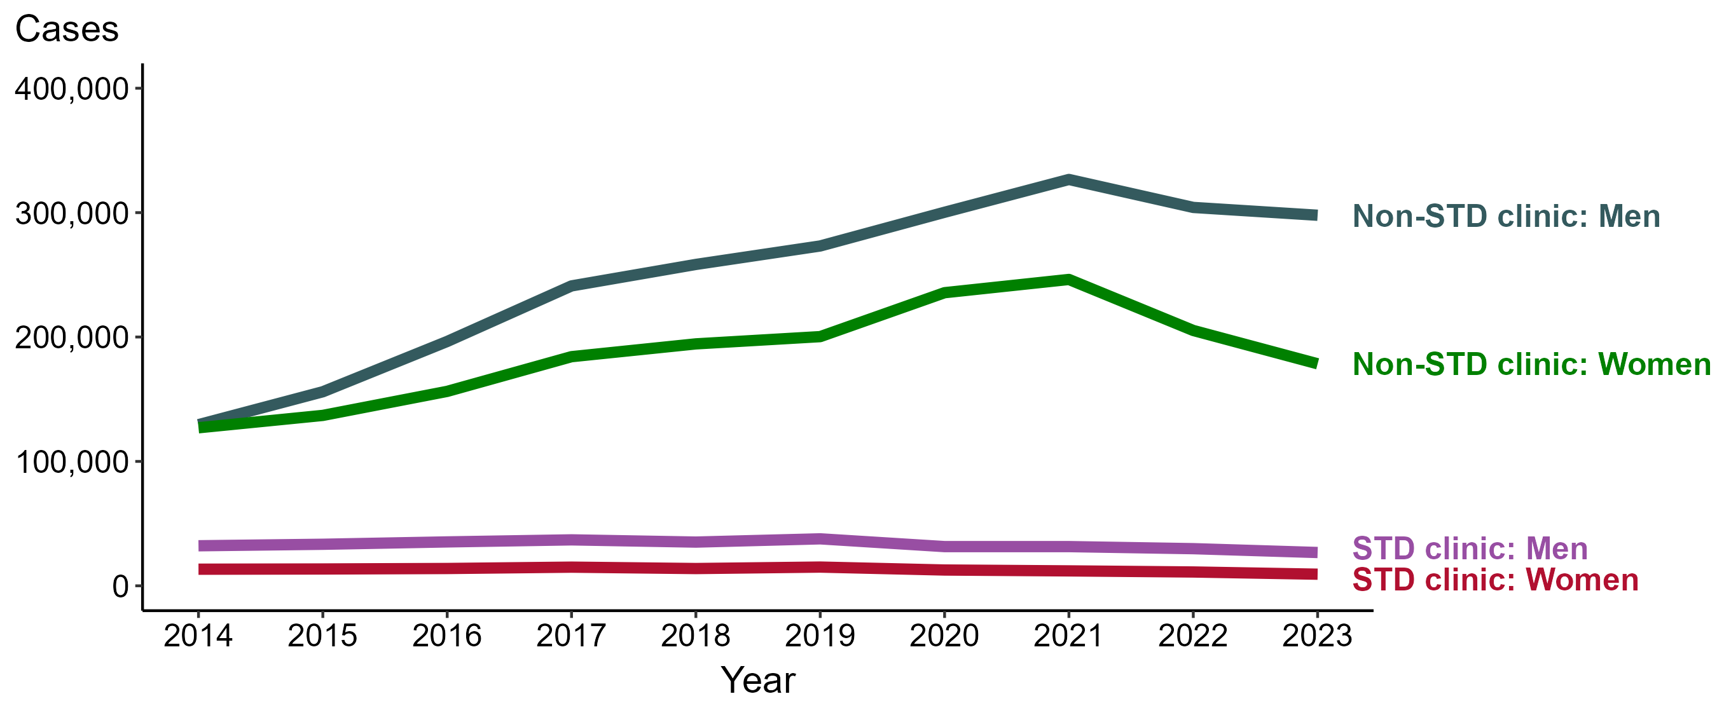
Gonorrhea — Reported Cases by Reporting Source and Sex and Year, United States, 2014–2023
NOTE: During 2014 to 2023, the percentage of all cases with unknown reporting source was 14.1%, from a low of 13.0% (n = 92,354) in 2021 to a high of 14.8% (n = 96,035) in 2022.
Notes:
During 2022 to 2023, the number of gonorrhea cases reported from STD clinics decreased 10.3% among men (29,849 to 26,763 cases) and decreased 15.9% among women (11,104 to 9,337 cases), while the number of cases reported from non-STD clinics decreased 2.1% among men (304,166 to 297,889 cases) and decreased 13.0% among women (205,253 to 178,476 cases).
During 2014 to 2023, the number of gonorrhea cases reported from STD clinics decreased 16.8% among men (32,179 to 26,763 cases) and decreased 30.0% among women (13,347 to 9,337 cases), while the number of cases reported from non-STD clinics increased 130.0% among men (129,526 to 297,889 cases) and increased 40.5% among women (127,043 to 178,476 cases).
This report includes data from years that coincide with the COVID-19 pandemic, which introduced uncertainty and difficulty in interpreting STI surveillance data. See Impact of COVID-19 on STIs (https://www.cdc.gov/sti-statistics/about/impact-of-covid-19.html) for more information.
See Technical Notes (https://www.cdc.gov/sti-statistics/annual/technical-notes.html) for information on STI case reporting formats and practices, including collected and derived variables displayed in this report. Table A (https://www.cdc.gov/sti-statistics/data-vis/table-selected-percunknown.html) provides information on unknown, missing, or invalid values of select variables.
Data for all figures are available at https://www.cdc.gov/sti-statistics/media/files/2024/11/2023-STI-Surveillance-Report-Data-Points.zip. The file “GC - Cases by Reporting Source and Sex (US 2014-2023).xlsx” contains the data for the figure presented on this slide.

Slide 24
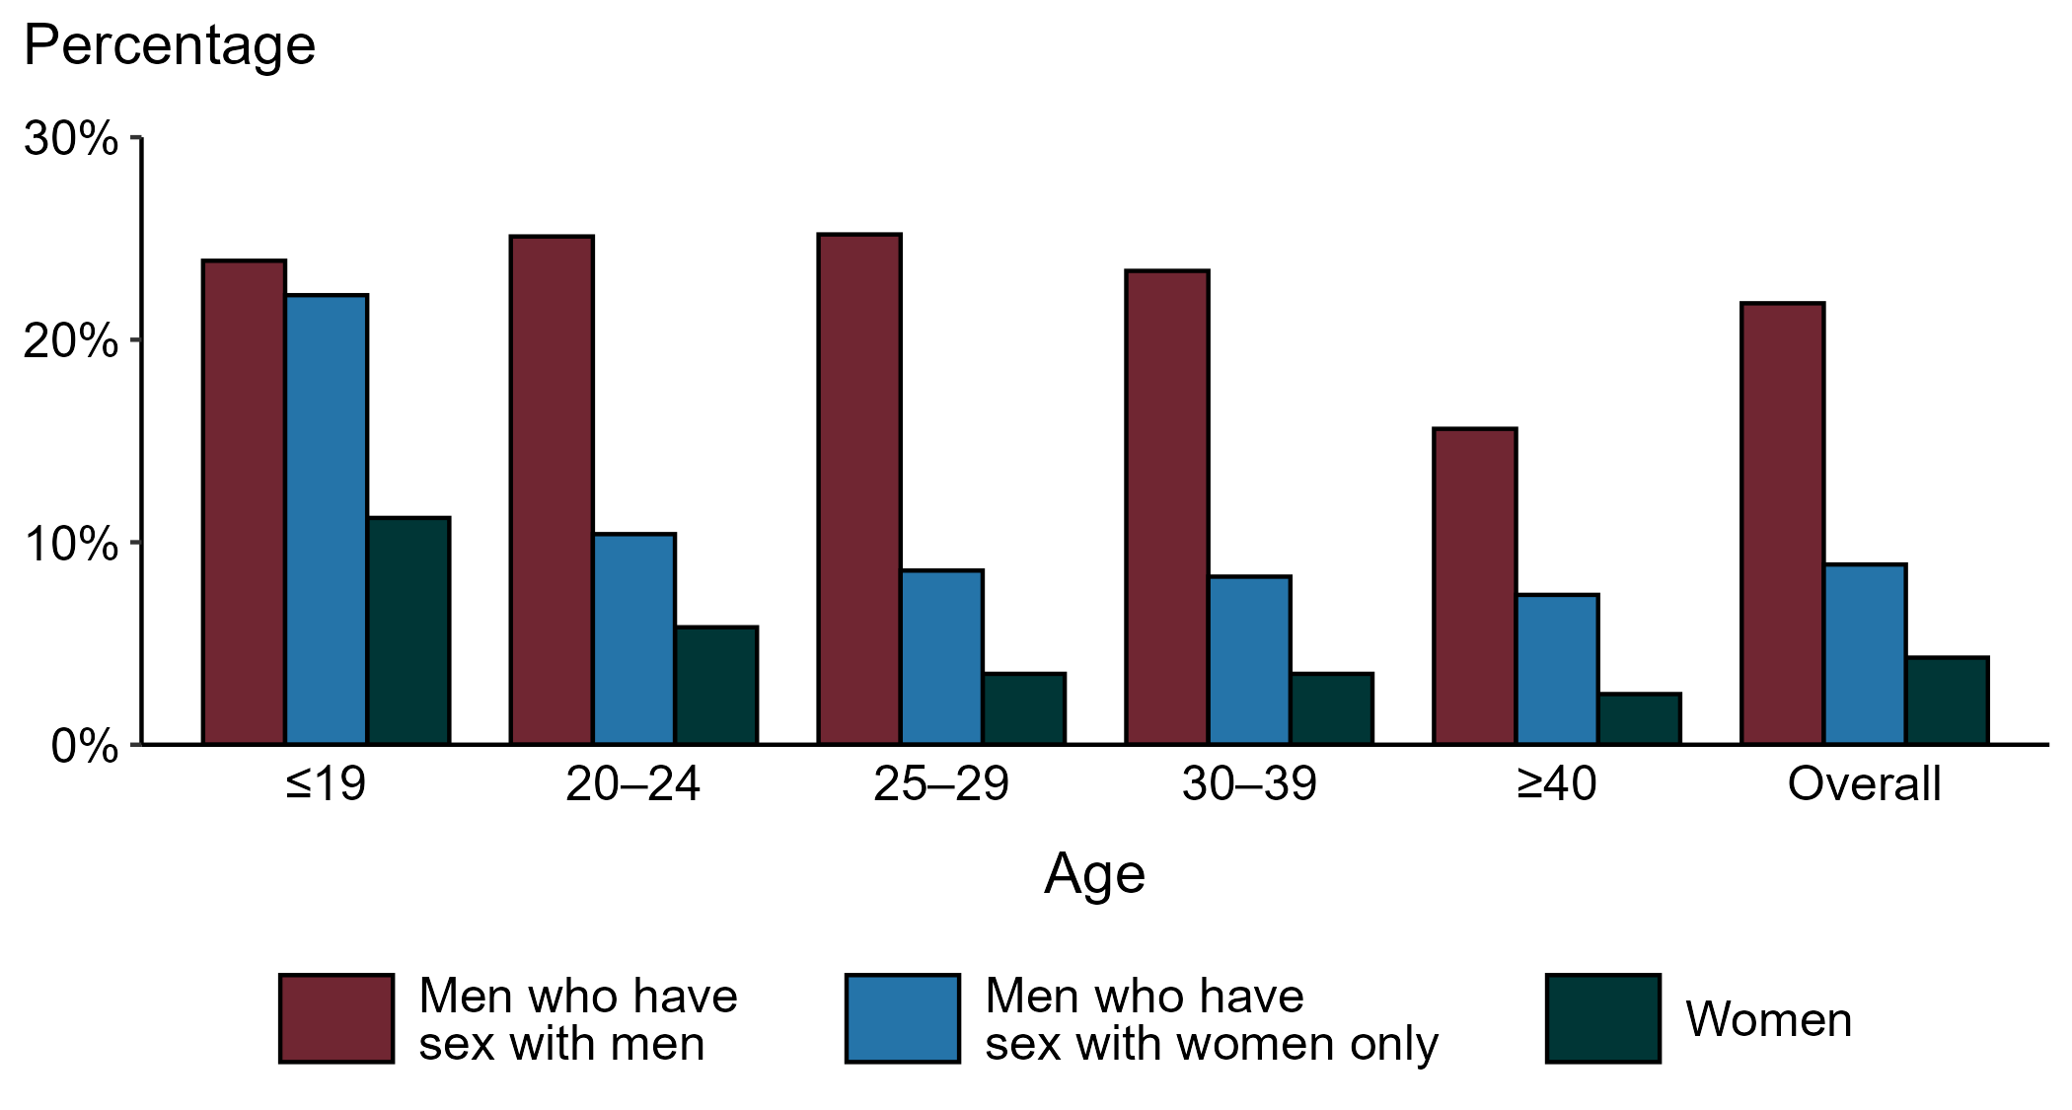
Gonorrhea — Proportion of STD Clinic Patients Testing Positive by Age Group, Sex, and Sex of Sex Partners, STI Surveillance Network (SSuN), 2023
NOTE: Results are based on 52,956 unique patients in 11 participating jurisdictions with known sex of sex partners attending SSuN STI clinics who were tested ≥1 times for gonorrhea in 2023.
Notes:
Among patients accessing care in participating STI clinics in the STI Surveillance Network (SSuN) who were tested for gonorrhea in 2023, 21.8% of gay, bisexual, and other men who have sex with men (MSM), 8.9% of men who have sex with women only (MSW), and 4.3% of women were positive. The proportion of STI clinic patients who tested positive for gonorrhea varied by sex and sex of sex partners, as well as by age group. MSM were noted to have higher proportions of testing positive in all age groups when compared to women and MSW.
This report includes data from years that coincide with the COVID-19 pandemic, which introduced uncertainty and difficulty in interpreting STI surveillance data. See Impact of COVID-19 on STIs (https://www.cdc.gov/sti-statistics/about/impact-of-covid-19.html) for more information.
See Technical Notes (https://www.cdc.gov/sti-statistics/annual/technical-notes.html) for information on SSuN methodology. Table A (https://www.cdc.gov/sti-statistics/data-vis/table-selected-percunknown.html) provides information on unknown, missing, or invalid values of select variables.

Slide 25
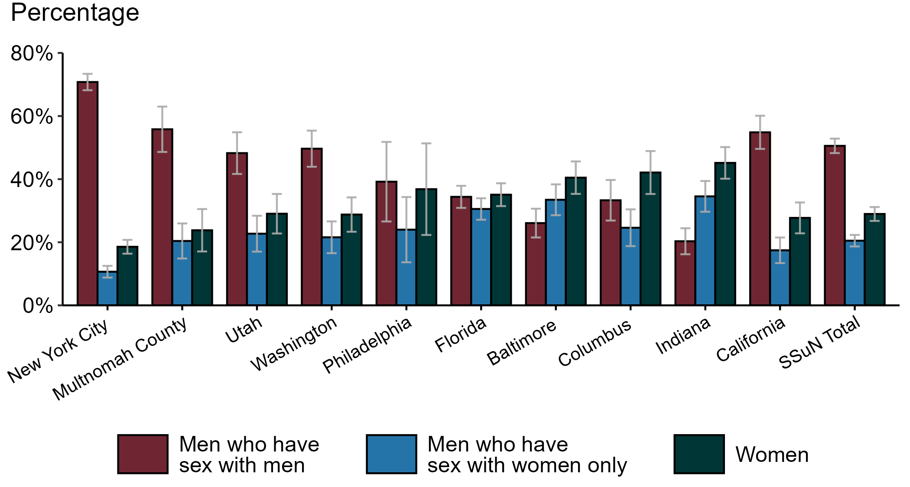
Gonorrhea — Estimated Proportion of Cases by Sex and Sex of Sex Partners and Jurisdiction, STI Surveillance Network (SSuN), 2023
NOTE: Estimate based on weighted analysis of data on sex of sex partners obtained from interviews (n=5,705) conducted among a random sample of gonorrhea cases reported to participating SSuN jurisdictions during January to December 2023. Includes ten SSuN sites reporting completed case investigations in 2023 for at least 1% of all reported cases.
Notes:
In 2023, New York City had the highest proportion of gonorrhea cases reported among gay, bisexual, and other men who have sex with men (MSM) among SSuN jurisdictions meeting the inclusion threshold, Indiana had the highest proportion of gonorrhea cases reported among women, and Indiana had the highest proportion of gonorrhea cases reported among men who have sex with women only. Overall, the proportion of gonorrhea estimated to be attributed to MSM was 50.5% in 2023.
This report includes data from years that coincide with the COVID-19 pandemic, which introduced uncertainty and difficulty in interpreting STI surveillance data. See Impact of COVID-19 on STIs (https://www.cdc.gov/sti-statistics/about/impact-of-covid-19.html) for more information.
See Technical Notes (https://www.cdc.gov/sti-statistics/annual/technical-notes.html) for information on SSuN methodology. Table A (https://www.cdc.gov/sti-statistics/data-vis/table-selected-percunknown.html) provides information on unknown, missing, or invalid values of select variables.

Slide 26
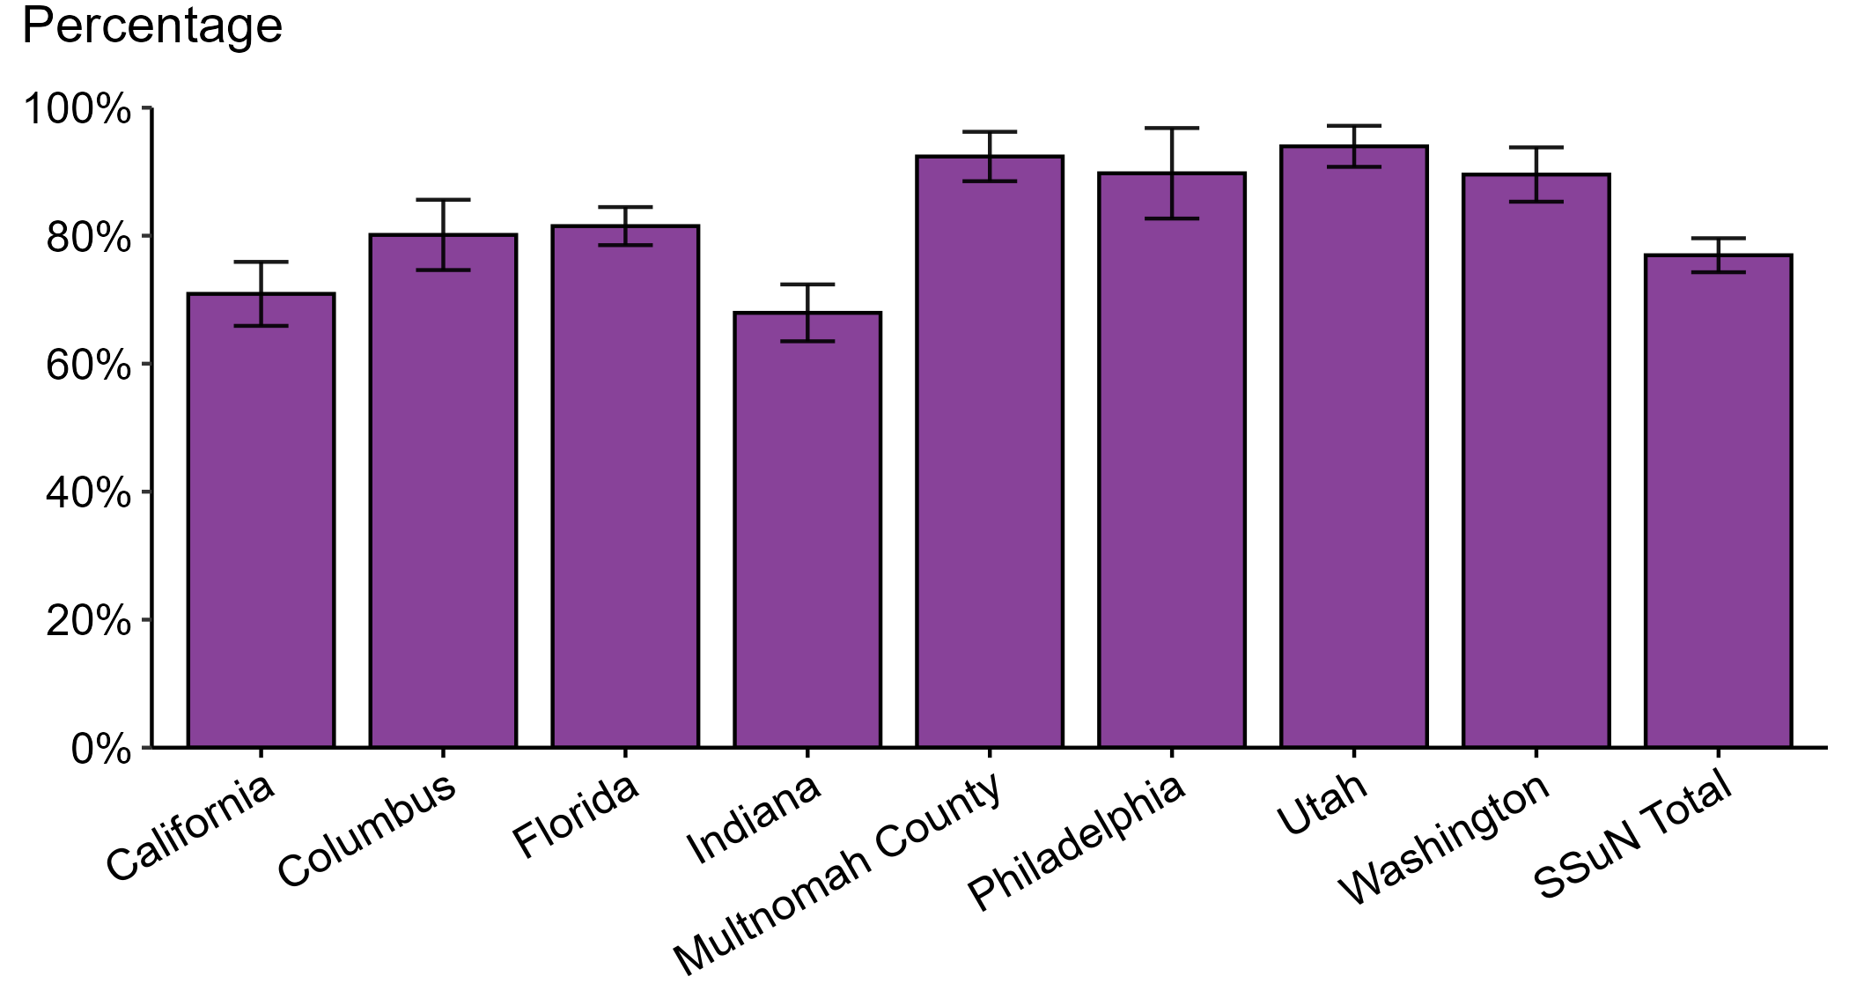
Gonorrhea — Estimated Proportion of Cases Treated with Recommended Regimen by Jurisdiction, STI Surveillance Network (SSuN), 2023
NOTE: Includes SSuN jurisdictions with treatment and dosage data ascertained for at least 80% of sampled, investigated cases. In 2023, the recommended treatment for uncomplicated gonorrhea was ceftriaxone 500 mg, intramuscular.
Notes:
In 2023, Utah reported the highest estimated proportion of gonorrhea cases treated with the recommended regimen and Indiana reported the lowest proportion of cases treated with the recommended regimen among jurisdictions participating in SSuN that met the inclusion criteria. Overall, the proportion of cases treated with the recommended regimen was 76.9% in 2023.
This report includes data from years that coincide with the COVID-19 pandemic, which introduced uncertainty and difficulty in interpreting STI surveillance data. See Impact of COVID-19 on STIs (https://www.cdc.gov/sti-statistics/about/impact-of-covid-19.html) for more information.
See Technical Notes (https://www.cdc.gov/sti-statistics/annual/technical-notes.html) for information on SSuN methodology. Table A (https://www.cdc.gov/sti-statistics/data-vis/table-selected-percunknown.html) provides information on unknown, missing, or invalid values of select variables.

Slide 27
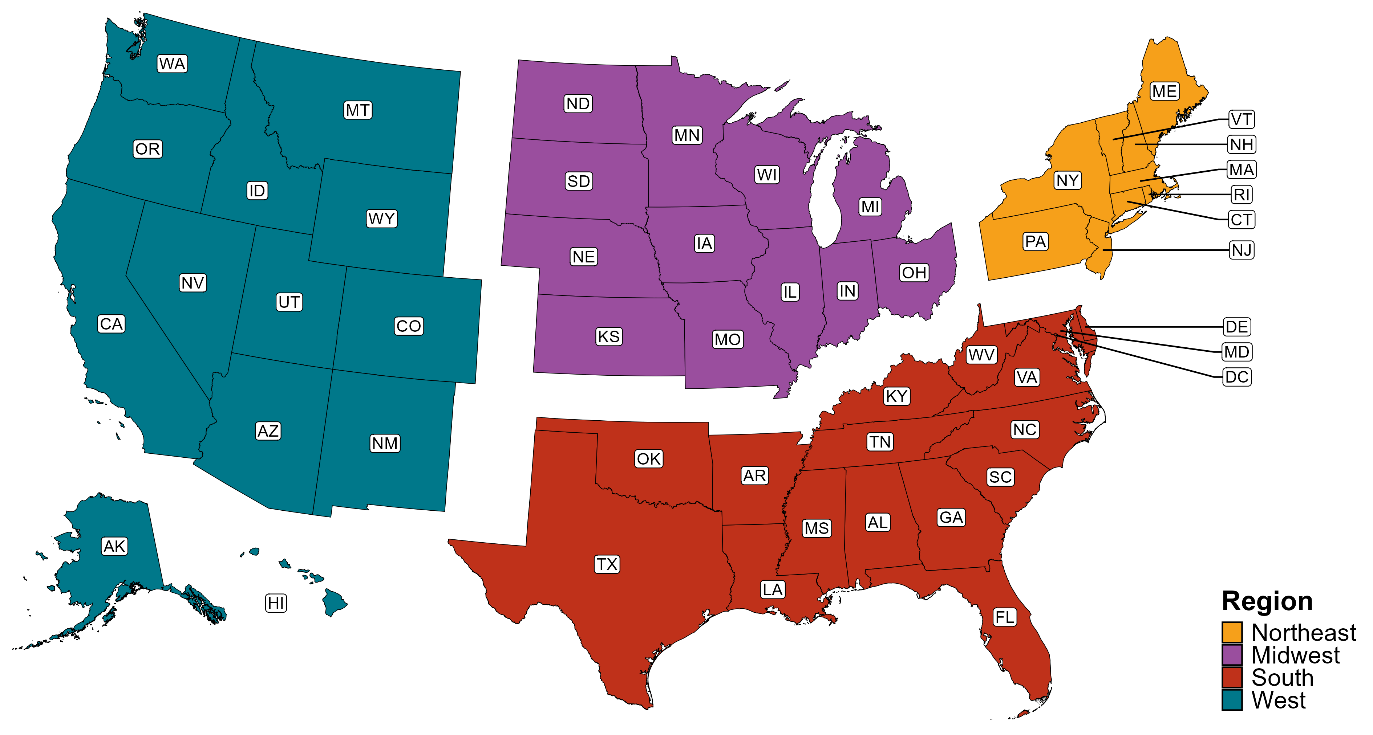
Reference Map of US Census Regions

