Slide 1
Sexually Transmitted Infections
Surveillance 2023
Notes:
This slide set was prepared by the Division of STD Prevention, National Center for HIV, Viral Hepatitis, STD, and TB Prevention (NCHHSTP), Centers for Disease Control and Prevention (CDC). These slides display trends for STIs in the United States through 2023. Data presented include case notifications provided to CDC through the National Notifiable Diseases Surveillance System (NNDSS) and data collected through projects and programs that monitor STIs in various settings, including the STD Surveillance Network (SSuN).
For more information on data sources, data collection and reporting practices, and case definitions, please see the Technical Notes, available at https://www.cdc.gov/sti-statistics/annual/technical-notes.html.
All data points for figures presented in these slides are available at https://www.cdc.gov/sti-statistics/media/files/2024/11/2023-STI-Surveillance-Report-Data-Points.zip.
NOTE: This slide set is in the public domain. You may reproduce these slides without permission; however, citation as to source is appreciated.
Centers for Disease Control and Prevention. Sexually Transmitted Infections Surveillance 2023. Atlanta: U.S. Department of Health and Human Services; 2024.
You are also free to adapt and revise these slides; however, you must remove the CDC name and logo if changes are made.

Slide 2
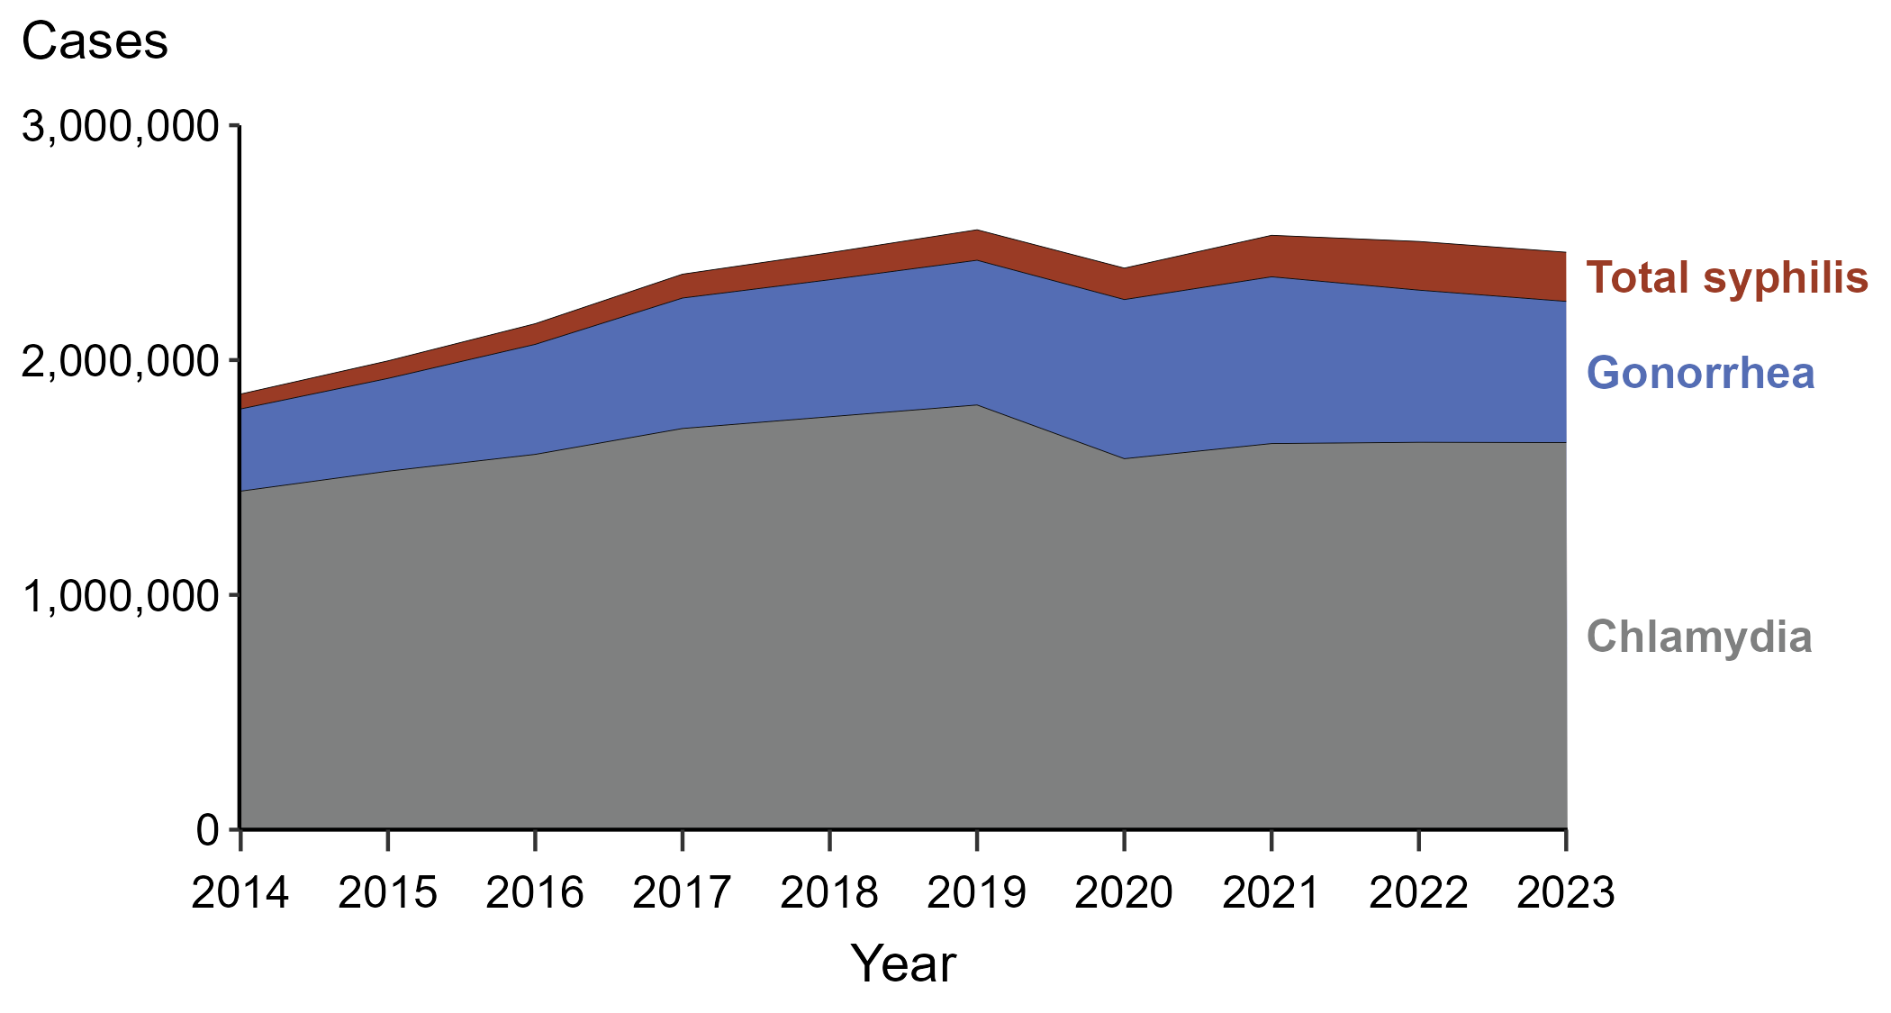
Sexually Transmitted Infections (STIs) — Reported Cases by STI and Year, United States, 2014–2023
NOTE: “Total syphilis” includes all stages of syphilis and congenital syphilis.
Notes:
In 2023, there were 2,459,140 cases of syphilis (including congenital syphilis), gonorrhea, and chlamydia reported in the United States. The over 2.4 million cases reflect a 1.8% decrease from 2022, a 3.7% decrease from 2019, and a 32.5% increase from 2014.
Case definitions are periodically revised using CSTE’s Position Statements and provide uniform criteria of nationally notifiable conditions for reporting purposes. Prior to 2018, syphilis cases identified as “early non-primary non-secondary syphilis” were classified as “early latent syphilis.” Prior to 2018, cases in the “unknown duration or late syphilis” category included cases classified as “late latent syphilis,” “latent syphilis of unknown duration,” “late syphilis with clinical manifestations,” and “neurosyphilis.” Please see the NNDSS website (https://ndc.services.cdc.gov/) for historical case definitions and for the case definitions in use for the current calendar year.
This report includes data from years that coincide with the COVID-19 pandemic, which introduced uncertainty and difficulty in interpreting STI surveillance data. See Impact of COVID-19 on STIs (https://www.cdc.gov/sti-statistics/about/impact-of-covid-19.html) for more information.
See Technical Notes (https://www.cdc.gov/sti-statistics/annual/technical-notes.html) for information on STI case reporting formats and practices, including collected and derived variables displayed in this report. Table A (https://www.cdc.gov/sti-statistics/data-vis/table-selected-percunknown.html) provides information on unknown, missing, or invalid values of select variables.
Data for all figures are available at https://www.cdc.gov/sti-statistics/media/files/2024/11/2023-STI-Surveillance-Report-Data-Points.zip. The file “STI - Cases by Year (US 2014-2023).xlsx” contains the data for the figure presented on this slide.

Slide 3
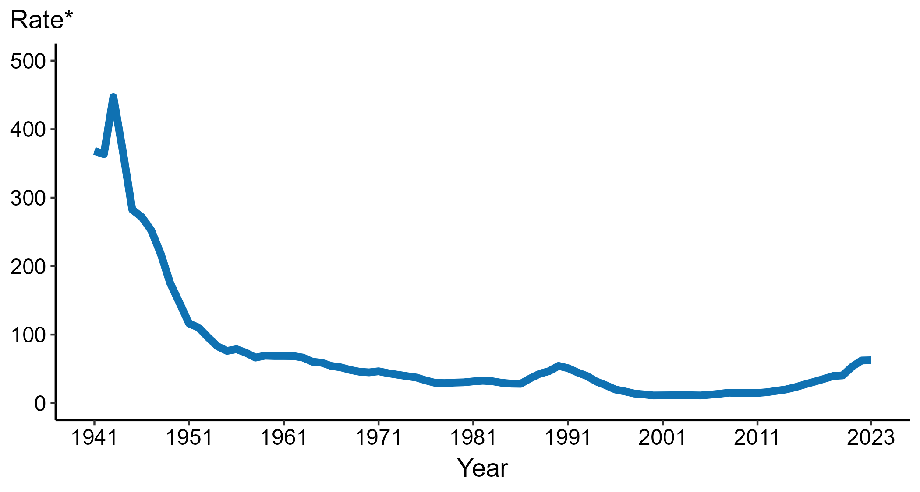
Syphilis — Rates of Reported Cases by Year, United States, 1941–2023
* Per 100,000
NOTE: Includes all stages of syphilis and congenital syphilis.
Notes:
Data collection for syphilis began in 1941, and syphilis was made a nationally notifiable condition in 1944. Rates of total syphilis include syphilis of all stages and congenital syphilis. Steep declines in case rates in the 1940s and 1950s likely reflect expanded use of penicillin to treat infection.
In 2023, a total of 209,253 cases of syphilis were reported in the United States. During 2022 to 2023, the rate of reported total syphilis did not change substantially (<1.0% change; from 62.2 to 62.5 per 100,000).
This report includes data from years that coincide with the COVID-19 pandemic, which introduced uncertainty and difficulty in interpreting STI surveillance data. See Impact of COVID-19 on STIs (https://www.cdc.gov/sti-statistics/about/impact-of-covid-19.html) for more information.
See Technical Notes (https://www.cdc.gov/sti-statistics/annual/technical-notes.html) for information on STI case reporting formats and practices, including collected and derived variables displayed in this report. Table A (https://www.cdc.gov/sti-statistics/data-vis/table-selected-percunknown.html) provides information on unknown, missing, or invalid values of select variables.
Data for all figures are available at https://www.cdc.gov/sti-statistics/media/files/2024/11/2023-STI-Surveillance-Report-Data-Points.zip. The file “Syphilis - Rates by Year (US 1941-2023).xlsx” contains the data for the figure presented on this slide.

Slide 4
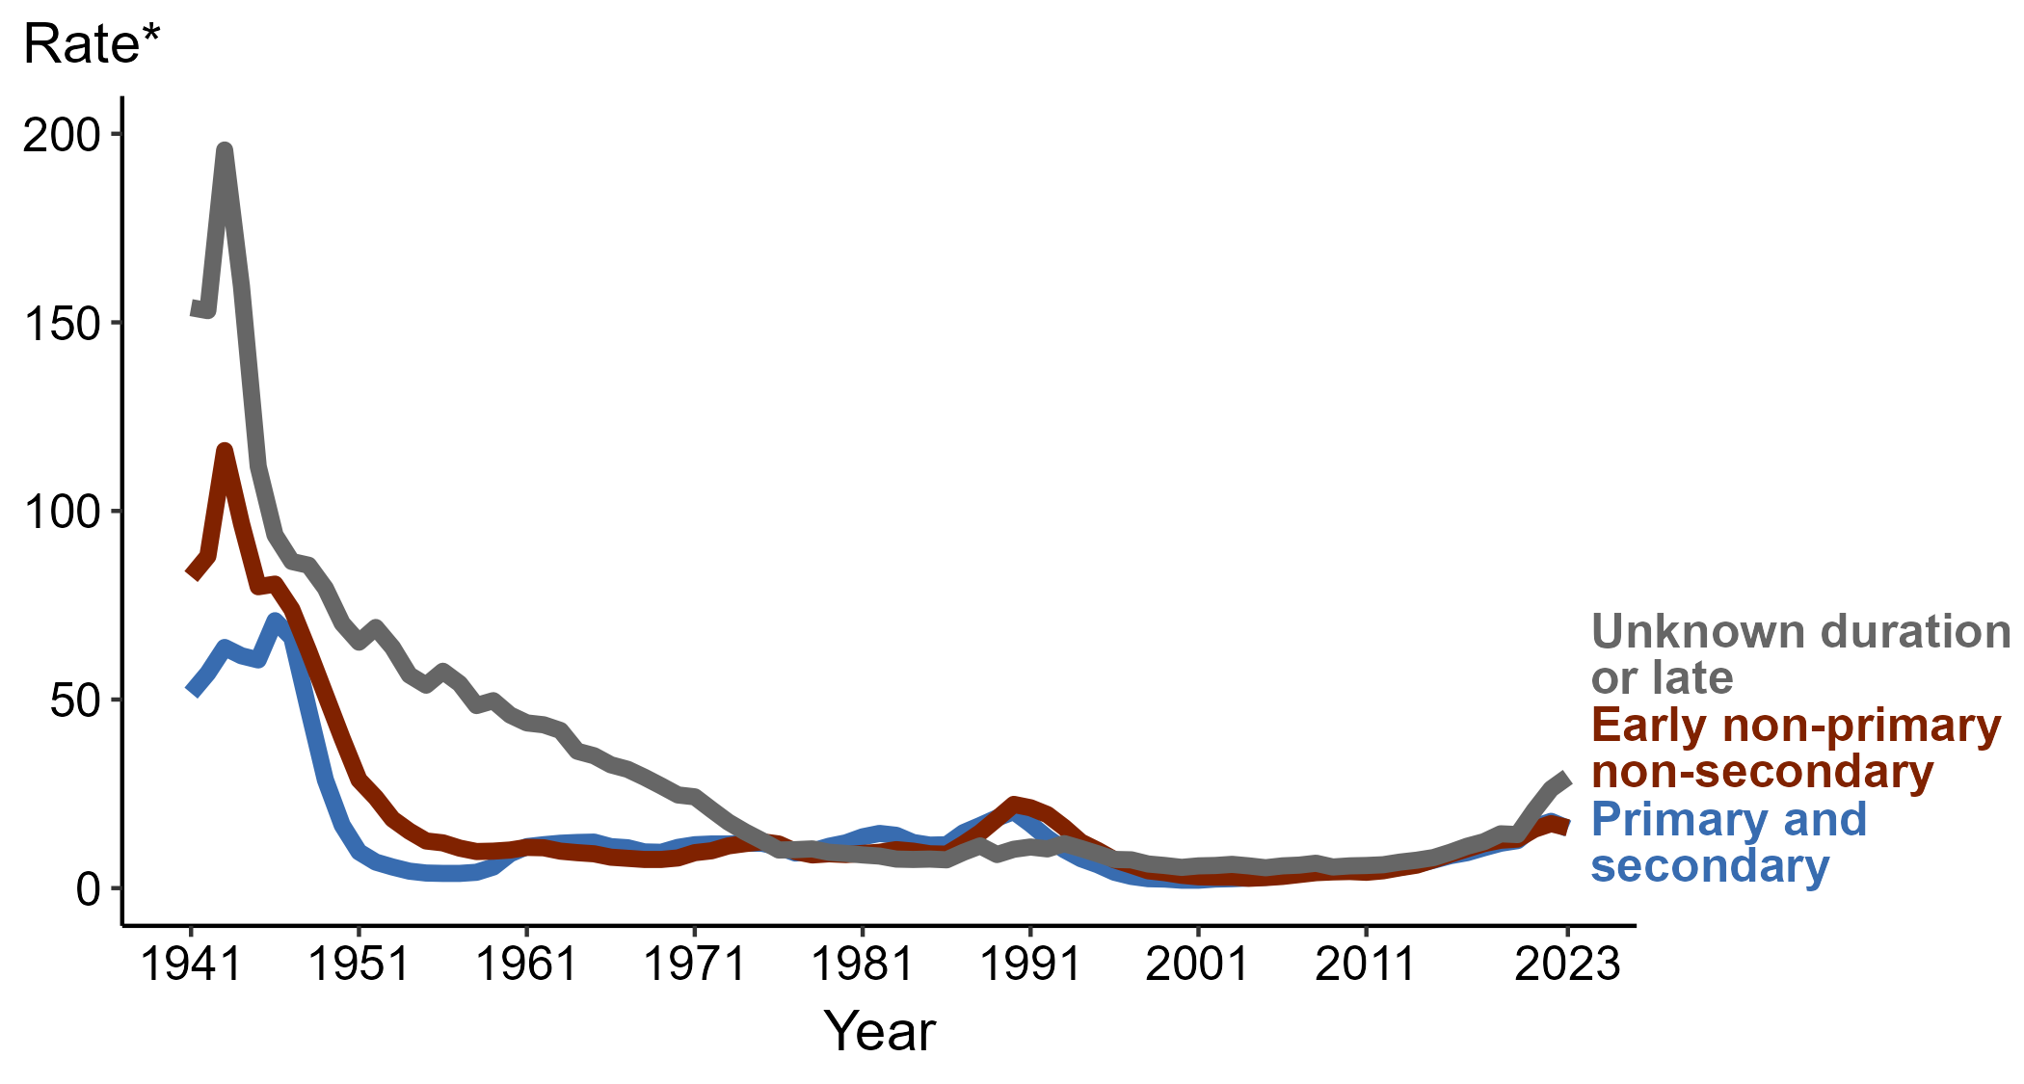
Syphilis — Rates of Reported Cases by Stage of Infection and Year, United States, 1941–2023
* Per 100,000
Notes:
Data collection for syphilis began in 1941, and syphilis was made a nationally notifiable condition in 1944. Steep declines in case rates in the 1940s and 1950s likely reflect expanded use of penicillin to treat infection.
In 2023, 53,007 cases of primary and secondary (P&S) syphilis, 53,573 cases of early non-primary non-secondary (ENPNS) syphilis, and 98,791 cases of unknown duration or late syphilis were reported in the United States. During 2022 to 2023, the rate of P&S syphilis decreased 10.7% (from 17.7 to 15.8 per 100,000), the rate of ENPNS syphilis decreased 6.4% (from 17.1 to 16.0 per 100,000), and the rate of unknown duration or late syphilis increased 12.2% (from 26.3 to 29.5 per 100,000).
Case definitions are periodically revised using CSTE’s Position Statements and provide uniform criteria of nationally notifiable conditions for reporting purposes. Prior to 2018, syphilis cases identified as “early non-primary non-secondary syphilis” were classified as “early latent syphilis.” Prior to 2018, cases in the “unknown duration or late syphilis” category included cases classified as “late latent syphilis,” “latent syphilis of unknown duration,” “late syphilis with clinical manifestations,” and “neurosyphilis.” Please see the NNDSS website (https://ndc.services.cdc.gov/) for historical and current case definitions.
This report includes data from years that coincide with the COVID-19 pandemic, which introduced uncertainty and difficulty in interpreting STI surveillance data. See Impact of COVID-19 on STIs (https://www.cdc.gov/sti-statistics/about/impact-of-covid-19.html) for more information.
See Technical Notes (https://www.cdc.gov/sti-statistics/annual/technical-notes.html) for information on STI case reporting formats and practices, including collected and derived variables displayed in this report. Table A (https://www.cdc.gov/sti-statistics/data-vis/table-selected-percunknown.html) provides information on unknown, missing, or invalid values of select variables.
Data for all figures are available at https://www.cdc.gov/sti-statistics/media/files/2024/11/2023-STI-Surveillance-Report-Data-Points.zip. The file “Syphilis - Rates by Stage of Infection (US 1941-2023).xlsx” contains the data for the figure presented on this slide.

Slide 5
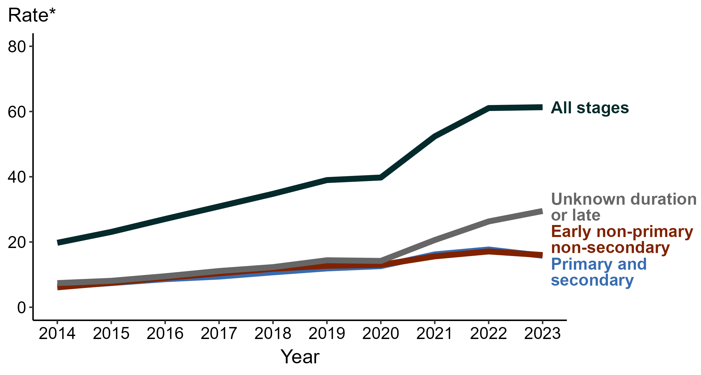
Syphilis — Rates of Reported Cases by Stage of Infection and Year, United States, 2014–2023
* Per 100,000
NOTE: “All stages” includes cases of syphilis reported as primary, secondary, early non-primary non-secondary, or unknown duration or late.
Notes:
In 2023, 205,371 cases of syphilis (all stages) — 53,007 cases of primary and secondary (P&S) syphilis, 53,573 cases of early non-primary non-secondary (ENPNS) syphilis, and 98,791 cases of unknown duration or late syphilis — were reported in the United States.
During 2022 to 2023, the rate of syphilis (all stages) did not change substantially (<1.0% change; from 61.1 to 61.3 per 100,000). By stage, the rate of P&S syphilis decreased 10.7% (from 17.7 to 15.8 per 100,000), the rate of ENPNS syphilis decreased 6.4% (from 17.1 to 16.0 per 100,000), and the rate of unknown duration or late syphilis increased 12.2% (from 26.3 to 29.5 per 100,000).
During 2019 to 2023, the rate of syphilis (all stages) increased 57.2% (from 39.0 to 61.3 per 100,000). By stage, the rate of P&S syphilis increased 32.8% (from 11.9 to 15.8 per 100,000), the rate of ENPNS syphilis increased 26.0% (from 12.7 to 16.0 per 100,000), and the rate of unknown duration or late syphilis increased 104.9% (from 14.4 to 29.5 per 100,000).
Case definitions are periodically revised using CSTE’s Position Statements and provide uniform criteria of nationally notifiable conditions for reporting purposes. Prior to 2018, syphilis cases identified as “early non-primary non-secondary syphilis” were classified as “early latent syphilis.” Prior to 2018, cases in the “unknown duration or late syphilis” category included cases classified as “late latent syphilis,” “latent syphilis of unknown duration,” “late syphilis with clinical manifestations,” and “neurosyphilis.” Please see the NNDSS website (https://ndc.services.cdc.gov/) for historical and current case definitions.
This report includes data from years that coincide with the COVID-19 pandemic, which introduced uncertainty and difficulty in interpreting STI surveillance data. See Impact of COVID-19 on STIs (https://www.cdc.gov/sti-statistics/about/impact-of-covid-19.html) for more information.
See Technical Notes (https://www.cdc.gov/sti-statistics/annual/technical-notes.html) for information on STI case reporting formats and practices, including collected and derived variables displayed in this report. Table A (https://www.cdc.gov/sti-statistics/data-vis/table-selected-percunknown.html) provides information on unknown, missing, or invalid values of select variables.
Data for all figures are available at https://www.cdc.gov/sti-statistics/media/files/2024/11/2023-STI-Surveillance-Report-Data-Points.zip. The file “Syphilis - Rates by Stage of Infection (US 2014-2023).xlsx” contains the data for the figure presented on this slide.

Slide 6
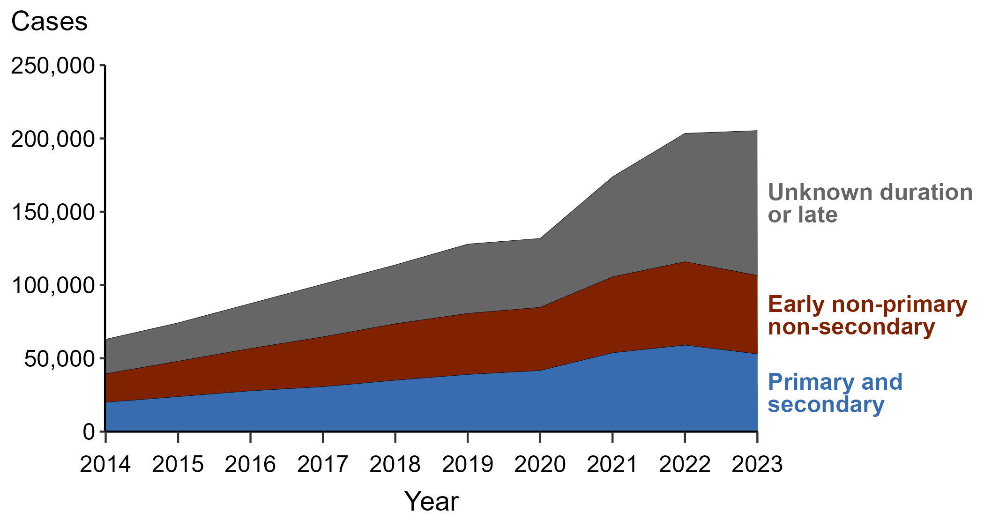
Syphilis — Reported Cases by Stage and Year, United States, 2014–2023
Notes:
In 2023, there were 205,371 cases of syphilis (all stages) reported in the United States, representing a <1.0% change from 2022. This overall change reflects a 10.2% decrease in the number of primary and secondary syphilis (P&S) cases (59,016 to 53,007), a 5.9% decrease in the number of early non-primary non-secondary (ENPNS) syphilis cases (56,913 to 53,573), and a 12.8% increase in the number of unknown duration or late syphilis cases (87,571 to 98,791).
In 2023, the largest percentage of syphilis cases were staged as unknown duration or late (48.1%), followed by ENPNS (26.1%), and P&S (25.8%).
Case definitions are periodically revised using CSTE’s Position Statements and provide uniform criteria of nationally notifiable conditions for reporting purposes. Prior to 2018, syphilis cases identified as “early non-primary non-secondary syphilis” were classified as “early latent syphilis.” Prior to 2018, cases in the “unknown duration or late syphilis” category included cases classified as “late latent syphilis,” “latent syphilis of unknown duration,” “late syphilis with clinical manifestations,” and “neurosyphilis.” Please see the NNDSS website (https://ndc.services.cdc.gov/) for historical and current case definitions.
This report includes data from years that coincide with the COVID-19 pandemic, which introduced uncertainty and difficulty in interpreting STI surveillance data.
See Technical Notes (https://www.cdc.gov/sti-statistics/annual/technical-notes.html) for information on STI case reporting formats and practices, including collected and derived variables displayed in this report. Table A (https://www.cdc.gov/sti-statistics/data-vis/table-selected-percunknown.html) provides information on unknown, missing, or invalid values of select variables.
Data for all figures are available at https://www.cdc.gov/sti-statistics/media/files/2024/11/2023-STI-Surveillance-Report-Data-Points.zip. The file “Syphilis — Cases by Stage and Year (US 2014-2023).xlsx” contains the data for the figure presented on this slide.

Slide 7
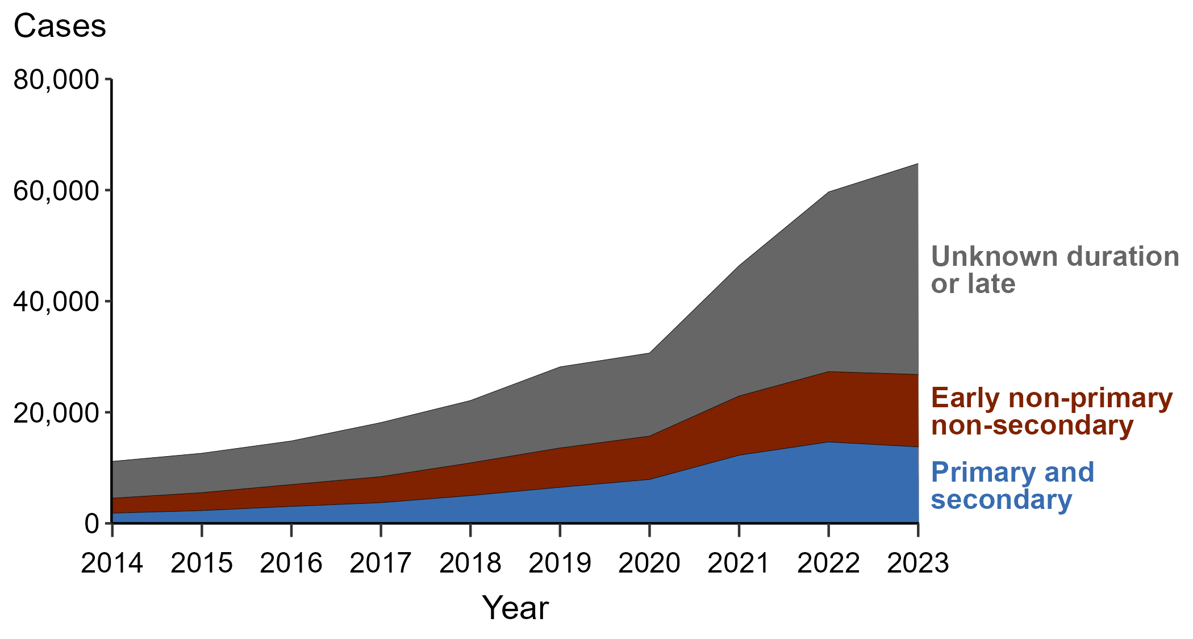
Syphilis — Reported Cases Among Women by Stage and Year, United States, 2014–2023
Notes:
In 2023, there were 64,795 cases of syphilis (all stages) among women reported in the United States, representing an 8.6% increase from 2022. This overall increase among women reflects a 6.1% decrease in the number of primary and secondary syphilis (P&S) cases (14,652 to 13,763), a 2.9% increase in the number of early non-primary non-secondary (ENPNS) syphilis cases (12,674 to 13,036), and a 17.5% increase in the number of unknown duration or late syphilis cases (32,347 to 37,996).
In 2023, the majority of syphilis cases among women were staged as unknown duration or late (58.6%), followed by P&S (21.2%), and ENPNS (20.1%).
Case definitions are periodically revised using CSTE’s Position Statements and provide uniform criteria of nationally notifiable conditions for reporting purposes. Prior to 2018, syphilis cases identified as “early non-primary non-secondary syphilis” were classified as “early latent syphilis.” Prior to 2018, cases in the “unknown duration or late syphilis” category included cases classified as “late latent syphilis,” “latent syphilis of unknown duration,” “late syphilis with clinical manifestations,” and “neurosyphilis.” Please see the NNDSS website (https://ndc.services.cdc.gov/) for historical and current case definitions.
This report includes data from years that coincide with the COVID-19 pandemic, which introduced uncertainty and difficulty in interpreting STI surveillance data.
See Technical Notes (https://www.cdc.gov/sti-statistics/annual/technical-notes.html) for information on STI case reporting formats and practices, including collected and derived variables displayed in this report. Table A (https://www.cdc.gov/sti-statistics/data-vis/table-selected-percunknown.html) provides information on unknown, missing, or invalid values of select variables.
Data for all figures are available at https://www.cdc.gov/sti-statistics/media/files/2024/11/2023-STI-Surveillance-Report-Data-Points.zip. The file “Syphilis — Cases Women by Stage and Year (US 2014-2023).xlsx” contains the data for the figure presented on this slide.

Slide 8
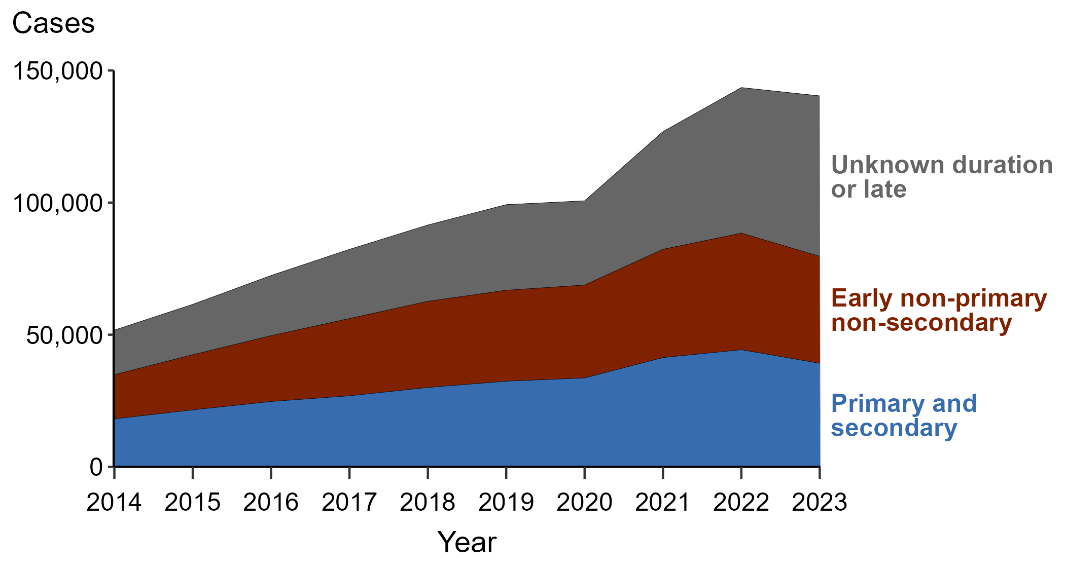
Syphilis — Reported Cases Among Men by Stage and Year, United States, 2014–2023
Notes:
In 2023, there were 140,392 cases of syphilis (all stages) among men reported in the United States, representing a 2.2% decrease from 2022. This overall decrease among men reflects an 11.6% decrease in the number of primary and secondary syphilis (P&S) cases (44,309 to 39,188), an 8.3% decrease in the number of early non-primary non-secondary (ENPNS) syphilis cases (44,143 to 40,486), and a 10.2% increase in the number of unknown duration or late syphilis cases (55,094 to 60,718).
In 2023, the largest percentage of syphilis cases among men were staged as unknown duration or late (43.2%), followed by ENPNS (28.8%), and P&S (27.9%).
Case definitions are periodically revised using CSTE’s Position Statements and provide uniform criteria of nationally notifiable conditions for reporting purposes. Prior to 2018, syphilis cases identified as “early non-primary non-secondary syphilis” were classified as “early latent syphilis.” Prior to 2018, cases in the “unknown duration or late syphilis” category included cases classified as “late latent syphilis,” “latent syphilis of unknown duration,” “late syphilis with clinical manifestations,” and “neurosyphilis.” Please see the NNDSS website (https://ndc.services.cdc.gov/) for historical and current case definitions.
This report includes data from years that coincide with the COVID-19 pandemic, which introduced uncertainty and difficulty in interpreting STI surveillance data.
See Technical Notes (https://www.cdc.gov/sti-statistics/annual/technical-notes.html) for information on STI case reporting formats and practices, including collected and derived variables displayed in this report. Table A (https://www.cdc.gov/sti-statistics/data-vis/table-selected-percunknown.html) provides information on unknown, missing, or invalid values of select variables.
Data for all figures are available at https://www.cdc.gov/sti-statistics/media/files/2024/11/2023-STI-Surveillance-Report-Data-Points.zip. The file “Syphilis — Cases Men by Stage and Year (US 2014-2023).xlsx” contains the data for the figure presented on this slide.

Slide 9
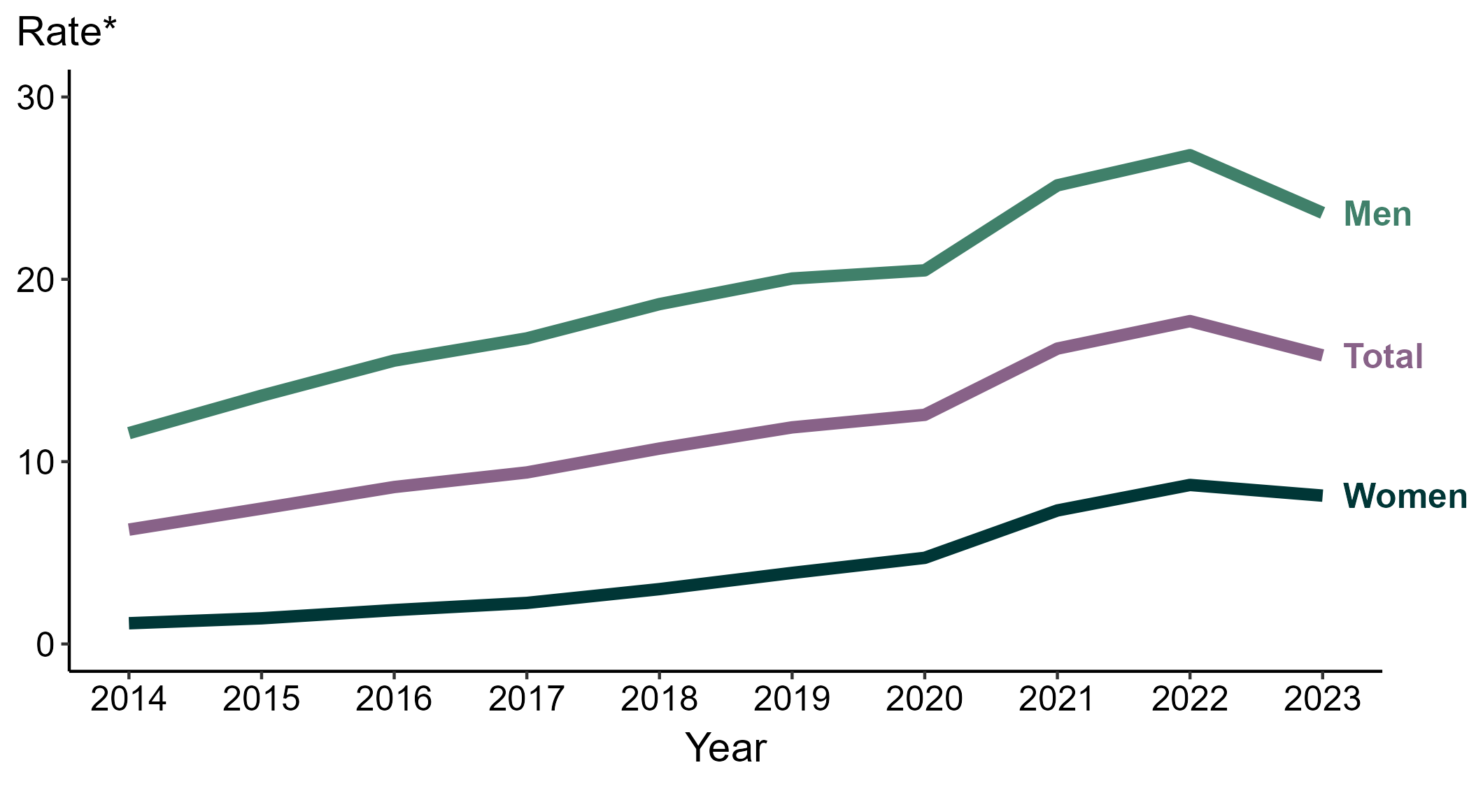
Primary and Secondary Syphilis — Rates of Reported Cases by Sex and Year, United States, 2014–2023
* Per 100,000
Notes:
During 2022 to 2023, the rate of reported primary and secondary (P&S) syphilis among women decreased 6.9% (from 8.7 to 8.1 per 100,000) and the rate among men decreased 11.9% (from 26.8 to 23.6 per 100,000).
During 2019 to 2023, the rate of reported P&S syphilis among women increased 107.7% (from 3.9 to 8.1 per 100,000) and the rate among men increased 18.0% (from 20.0 to 23.6 per 100,000). During 2014 to 2023, the rate among women increased 636.4% (from 1.1 to 8.1 per 100,000) and the rate among men increased 103.4% (from 11.6 to 23.6 per 100,000).
This report includes data from years that coincide with the COVID-19 pandemic, which introduced uncertainty and difficulty in interpreting STI surveillance data. See Impact of COVID-19 on STIs (https://www.cdc.gov/sti-statistics/about/impact-of-covid-19.html) for more information.
See Technical Notes (https://www.cdc.gov/sti-statistics/annual/technical-notes.html) for information on STI case reporting formats and practices, including collected and derived variables displayed in this report. Table A (https://www.cdc.gov/sti-statistics/data-vis/table-selected-percunknown.html) provides information on unknown, missing, or invalid values of select variables.
Data for all figures are available at https://www.cdc.gov/sti-statistics/media/files/2024/11/2023-STI-Surveillance-Report-Data-Points.zip. The file “PS Syphilis - Rates by Sex (US 2014-2023).xlsx” contains the data for the figure presented on this slide.

Slide 10
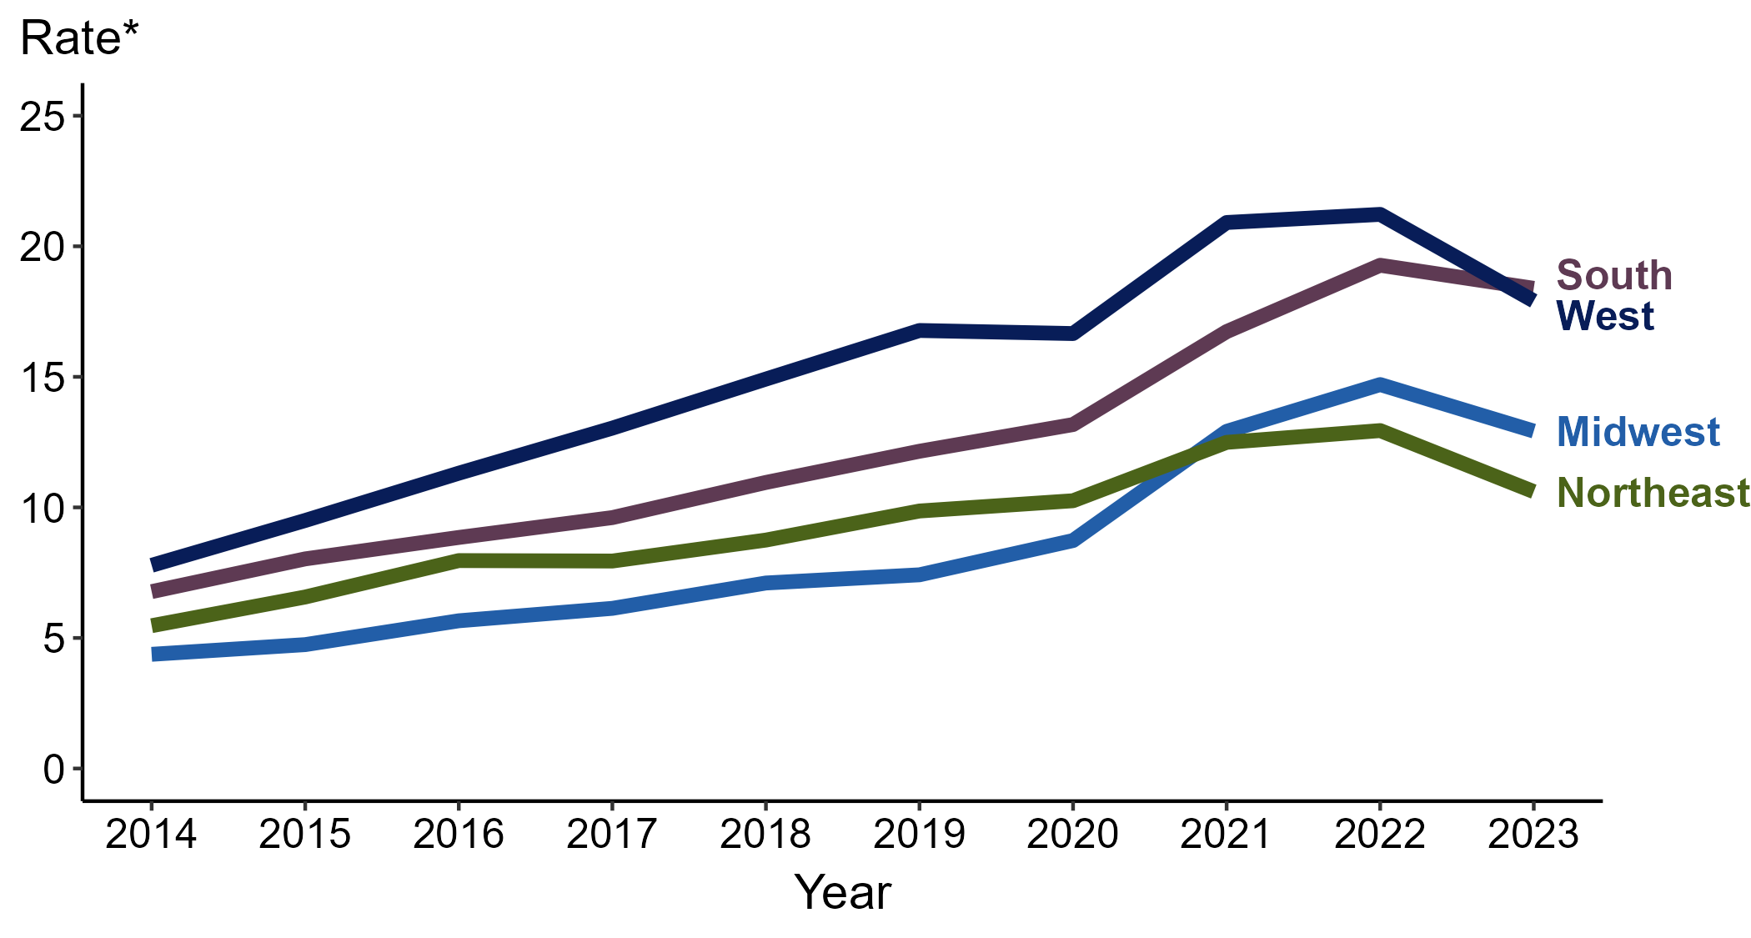
Primary and Secondary Syphilis — Rates of Reported Cases by Region and Year, United States, 2014–2023
* Per 100,000
Notes:
In 2023, the South had the highest rate of reported primary and secondary (P&S) syphilis (18.4 cases per 100,000; 4.7% decrease from 2022), followed by the West (17.9 cases per 100,000; 15.6% decrease from 2022), the Midwest (12.9 cases per 100,000; 12.2% decrease from 2022), and the Northeast (10.6 cases per 100,000; 17.8% decrease from 2022).
The Midwest had the greatest five-year increase in rates of reported cases of P&S syphilis (7.4 to 12.9 per 100,000; 74.3% increase from 2019). The Midwest also had the greatest 10-year increase in rates of reported cases of P&S syphilis (4.4 to 12.9 per 100,000; 193.2% increase from 2014).
This report includes data from years that coincide with the COVID-19 pandemic, which introduced uncertainty and difficulty in interpreting STI surveillance data. See Impact of COVID-19 on STIs (https://www.cdc.gov/sti-statistics/about/impact-of-covid-19.html) for more information.
See Technical Notes (https://www.cdc.gov/sti-statistics/annual/technical-notes.html) for information on STI case reporting formats and practices, including collected and derived variables displayed in this report. Table A (https://www.cdc.gov/sti-statistics/data-vis/table-selected-percunknown.html) provides information on unknown, missing, or invalid values of select variables.
Data for all figures are available at https://www.cdc.gov/sti-statistics/media/files/2024/11/2023-STI-Surveillance-Report-Data-Points.zip. The file “PS Syphilis - Rates by Region (US 2014-2023).xlsx” contains the data for the figure presented on this slide.

Slide 11
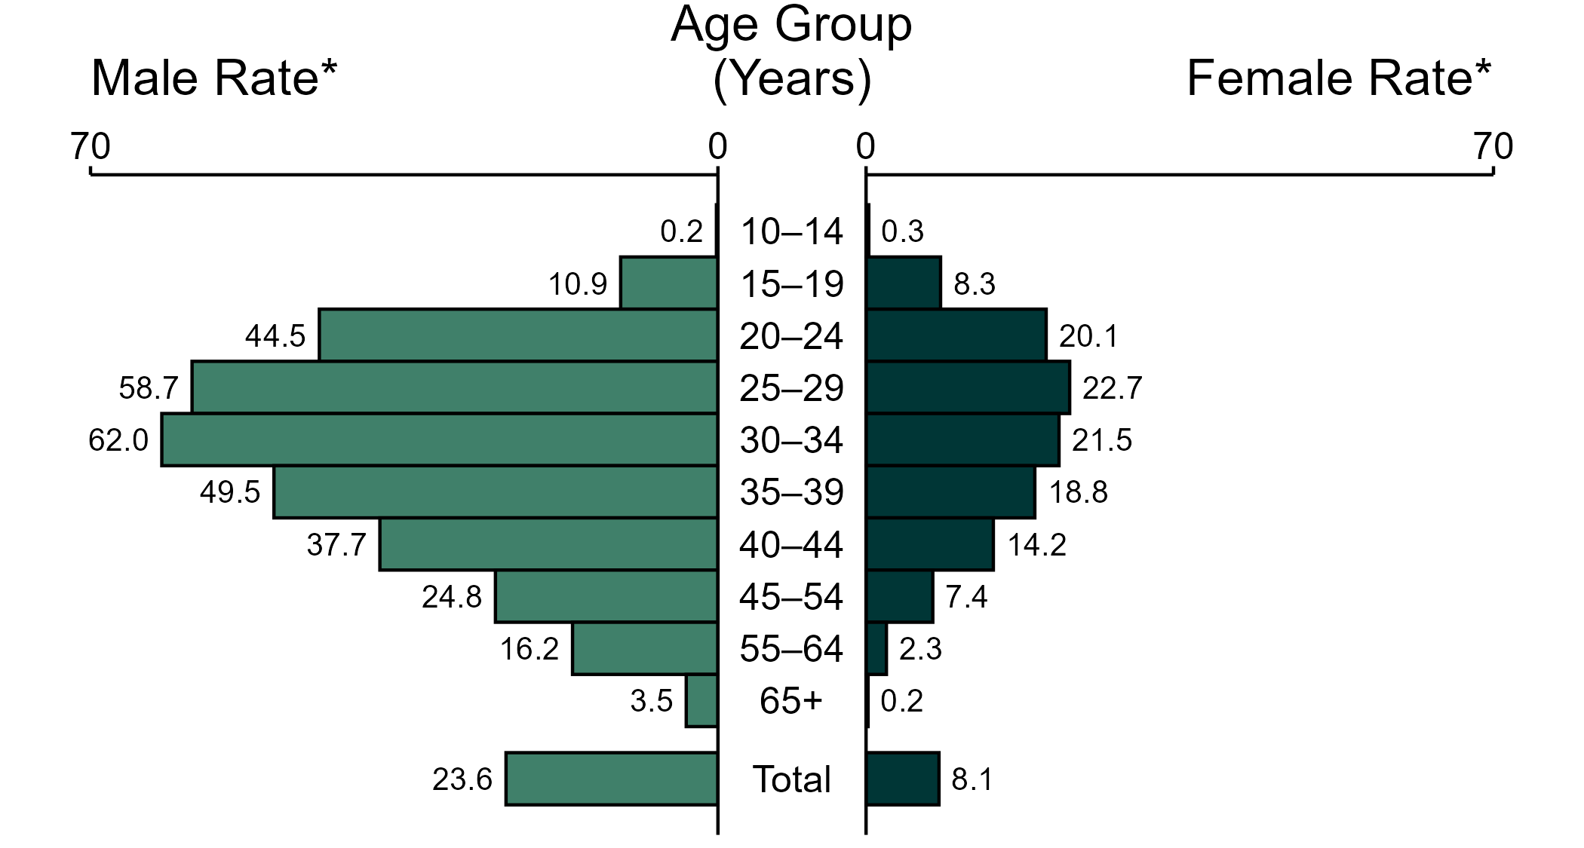
Primary and Secondary Syphilis — Rates of Reported Cases by Age Group and Sex, United States, 2023
* Per 100,000
NOTE: In 2023, five primary and secondary syphilis cases among men (<0.1%) and six cases among women (<0.1%) had missing or unknown age. These cases are included in the total rates.
Notes:
In 2023, the rate of reported primary and secondary (P&S) syphilis was higher among men (23.6 per 100,000) compared to women (8.1 per 100,000).
Among men, those aged 30 to 34 years had the highest rate of reported cases of P&S syphilis (62.0 per 100,000), followed by men aged 25 to 29 years (58.7 per 100,000) and men aged 35 to 39 years (49.5 per 100,000). Among women, those aged 25 to 29 years had the highest rate of reported cases of P&S syphilis (22.7 per 100,000), followed by women aged 30 to 34 years (21.5 per 100,000) and women aged 20 to 24 years (20.1 per 100,000).
This report includes data from years that coincide with the COVID-19 pandemic, which introduced uncertainty and difficulty in interpreting STI surveillance data. See Impact of COVID-19 on STIs (https://www.cdc.gov/sti-statistics/about/impact-of-covid-19.html) for more information.
See Technical Notes (https://www.cdc.gov/sti-statistics/annual/technical-notes.html) for information on STI case reporting formats and practices, including collected and derived variables displayed in this report. Table A (https://www.cdc.gov/sti-statistics/data-vis/table-selected-percunknown.html) provides information on unknown, missing, or invalid values of select variables.
Data for all figures are available at https://www.cdc.gov/sti-statistics/media/files/2024/11/2023-STI-Surveillance-Report-Data-Points.zip. The file “PS Syphilis - Rates by Age Group and Sex (US 2023).xlsx” contains the data for the figure presented on this slide.

Slide 12
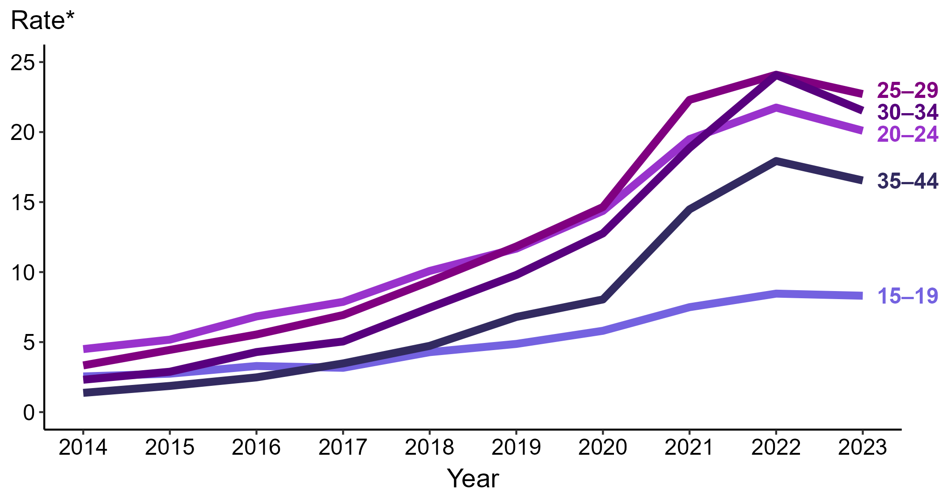
Primary and Secondary Syphilis — Rates of Reported Cases Among Women Aged 15–44 Years by Age Group and Year, United States, 2014–2023
* Per 100,000
Notes:
Among women aged 15 to 44 years in 2023, those aged 25 to 29 years had the highest rate of reported cases of primary and secondary syphilis (22.7 cases per 100,000; 5.8% decrease from 2022), followed by those aged 30 to 34 years (21.5 cases per 100,000; 10.8% decrease from 2022), those aged 20 to 24 years (20.1 cases per 100,000; 7.4% decrease from 2022), those aged 35 to 44 years (16.5 cases per 100,000; 7.8% decrease from 2022), and those aged 15 to 19 years (8.3 cases per 100,000; 2.4% decrease from 2022).
This report includes data from years that coincide with the COVID-19 pandemic, which introduced uncertainty and difficulty in interpreting STI surveillance data. See Impact of COVID-19 on STIs (https://www.cdc.gov/sti-statistics/about/impact-of-covid-19.html) for more information.
See Technical Notes (https://www.cdc.gov/sti-statistics/annual/technical-notes.html) for information on STI case reporting formats and practices, including collected and derived variables displayed in this report. Table A (https://www.cdc.gov/sti-statistics/data-vis/table-selected-percunknown.html) provides information on unknown, missing, or invalid values of select variables.
Data for all figures are available at https://www.cdc.gov/sti-statistics/media/files/2024/11/2023-STI-Surveillance-Report-Data-Points.zip. The file “PS Syphilis - Rates Women 15-44 Years by Age Group (US 2014-2023).xlsx” contains the data for the figure presented on this slide.

Slide 13
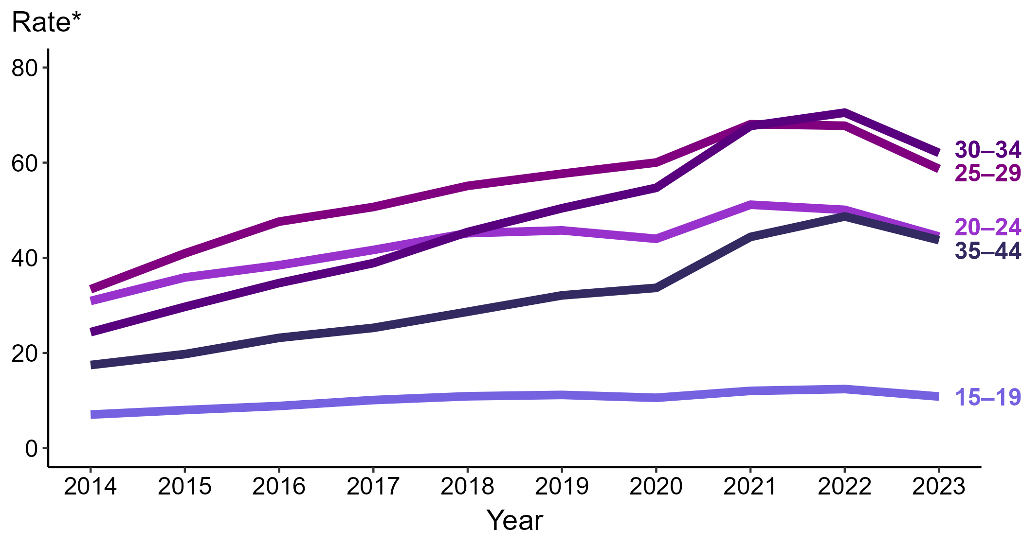
Primary and Secondary Syphilis — Rates of Reported Cases Among Men Aged 15–44 Years by Age Group and Year, United States, 2014–2023
* Per 100,000
Notes:
Among men aged 15 to 44 years in 2023, those aged 30 to 34 years had the highest rate of reported cases of primary and secondary syphilis (62.0 cases per 100,000; 12.1% decrease from 2022), followed by those aged 25 to 29 years (58.7 cases per 100,000; 13.4% decrease from 2022), those aged 20 to 24 years (44.5 cases per 100,000; 11.2% decrease from 2022), those aged 35 to 44 years (43.7 cases per 100,000; 10.3% decrease from 2022), and those aged 15 to 19 years (10.9 cases per 100,000; 12.1% decrease from 2022).
This report includes data from years that coincide with the COVID-19 pandemic, which introduced uncertainty and difficulty in interpreting STI surveillance data. See Impact of COVID-19 on STIs (https://www.cdc.gov/sti-statistics/about/impact-of-covid-19.html) for more information.
See Technical Notes (https://www.cdc.gov/sti-statistics/annual/technical-notes.html) for information on STI case reporting formats and practices, including collected and derived variables displayed in this report. Table A (https://www.cdc.gov/sti-statistics/data-vis/table-selected-percunknown.html) provides information on unknown, missing, or invalid values of select variables.
Data for all figures are available at https://www.cdc.gov/sti-statistics/media/files/2024/11/2023-STI-Surveillance-Report-Data-Points.zip. The file “PS Syphilis - Rates Men 15-44 Years by Age Group (US 2014-2023).xlsx” contains the data for the figure presented on this slide.

Slide 14
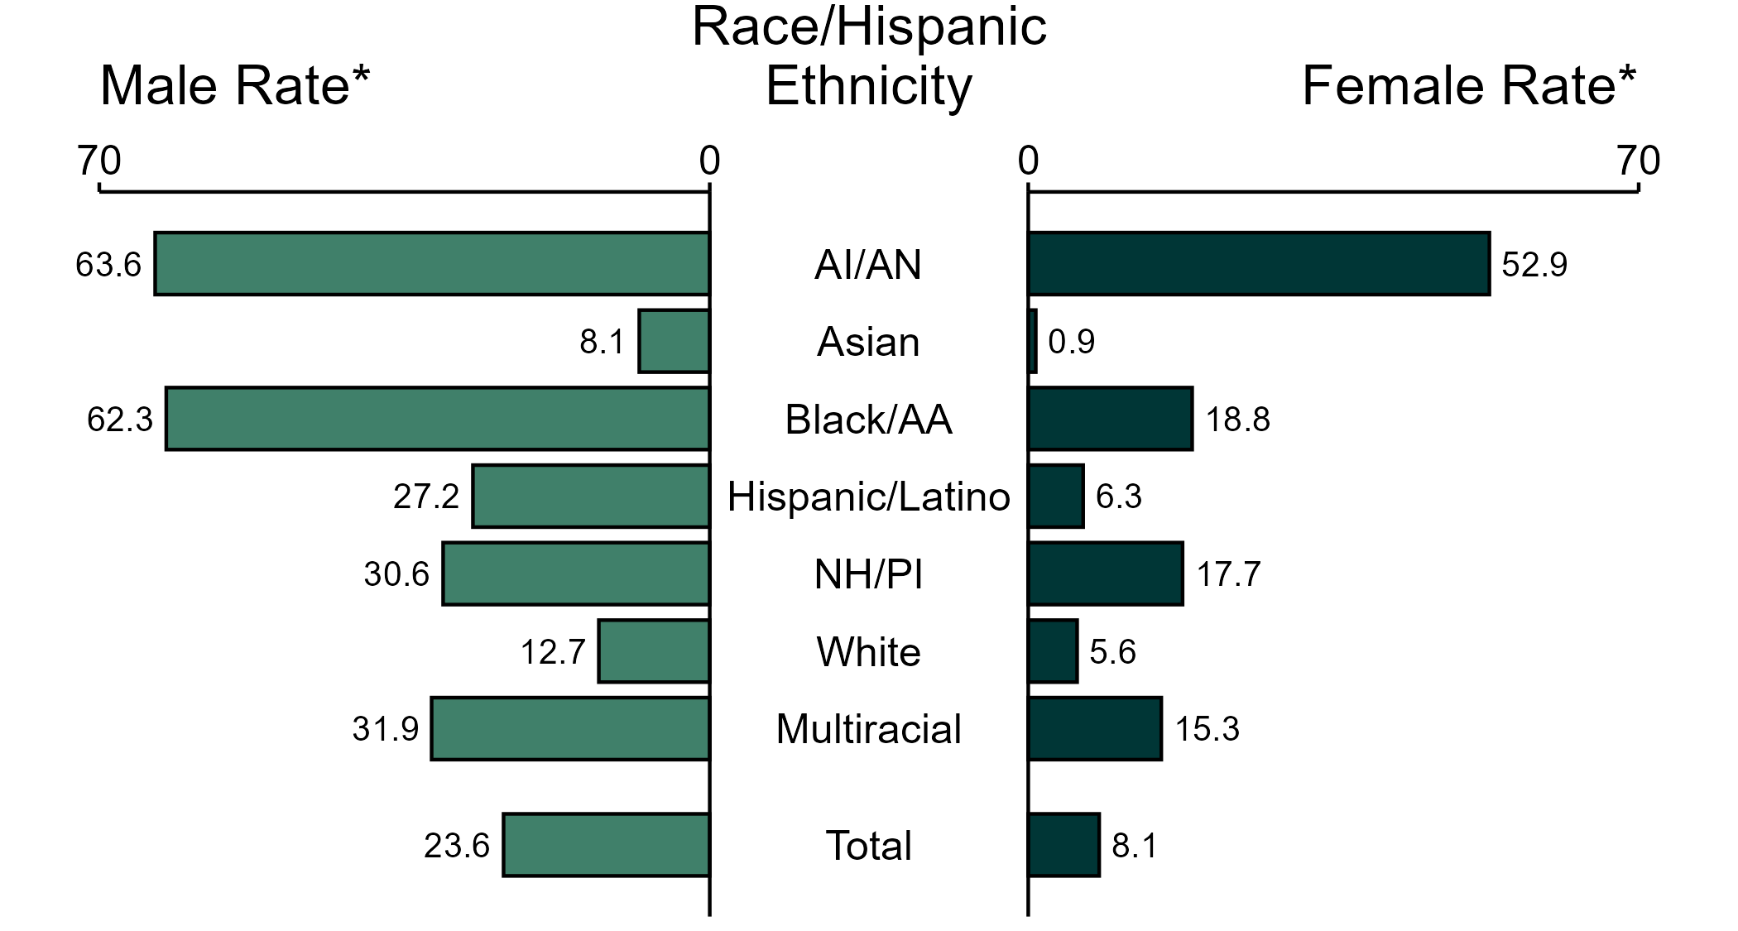
Primary and Secondary Syphilis — Rates of Reported Cases by Race/Hispanic Ethnicity and Sex, United States, 2023
* Per 100,000
ACRONYMS: AI/AN = American Indian or Alaska Native; Black/AA = Black or African American; NH/PI = Native Hawaiian or other Pacific Islander
NOTE: In 2023, 2,292 primary and secondary syphilis cases among men (5.8%) and 647 cases among women (4.7%) had missing, unknown, or other race and were not reported to be of Hispanic ethnicity. These cases are included in the total rates.
Notes:
In 2023, the rate of reported primary and secondary syphilis was higher among men (23.6 per 100,000) compared to women (8.1 per 100,000).
Among men, non-Hispanic American Indian or Alaska Native men had the highest rate of reported cases of primary and secondary syphilis (63.6 per 100,000), followed by non-Hispanic Black or African American men (62.3 per 100,000) and non-Hispanic men of multiple races (31.9 per 100,000). Among women, non-Hispanic American Indian or Alaska Native women also had the highest rate of reported cases of primary and secondary syphilis (52.9 per 100,000), followed by non-Hispanic Black or African American women (18.8 per 100,000) and non-Hispanic Native Hawaiian or other Pacific Islander women (17.7 per 100,000).
Using non-Hispanic White persons as the referent category, the greatest relative disparity in rates of reported primary and secondary syphilis by race and Hispanic ethnicity across both sexes was observed among non-Hispanic American Indian or Alaska Native women, with a rate ratio of 9.4 times that of non-Hispanic White women. Among men, the greatest relative disparity was observed among non-Hispanic American Indian or Alaska Native men as well, with a rate 5.0 times that of non-Hispanic White men.
This report includes data from years that coincide with the COVID-19 pandemic, which introduced uncertainty and difficulty in interpreting STI surveillance data. See Impact of COVID-19 on STIs (https://www.cdc.gov/sti-statistics/about/impact-of-covid-19.html) for more information.
See Technical Notes (https://www.cdc.gov/sti-statistics/annual/technical-notes.html) for information on STI case reporting formats and practices, including collected and derived variables displayed in this report. Table A (https://www.cdc.gov/sti-statistics/data-vis/table-selected-percunknown.html) provides information on unknown, missing, or invalid values of select variables.
Data for all figures are available at https://www.cdc.gov/sti-statistics/media/files/2024/11/2023-STI-Surveillance-Report-Data-Points.zip. The file “PS Syphilis - Rates by Race Hispanic Ethnicity and Sex (US 2023).xlsx” contains the data for the figure presented on this slide.

Slide 15
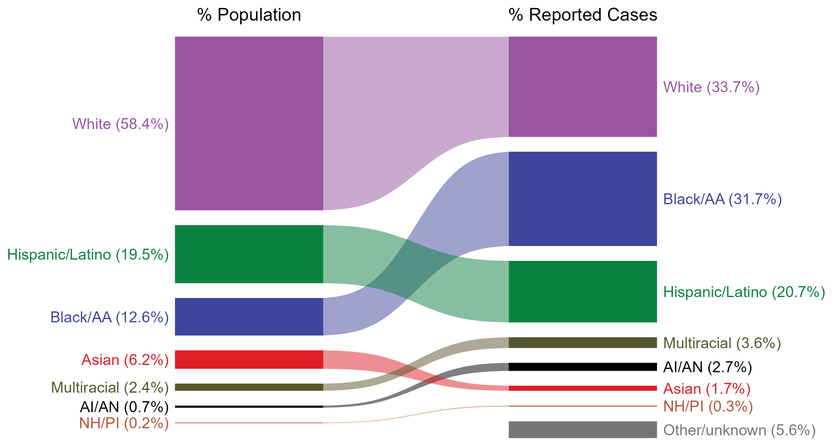
Primary and Secondary Syphilis — Total Population and Reported Cases by Race/Hispanic Ethnicity, United States, 2023
ACRONYMS: AI/AN = American Indian or Alaska Native; Black/AA = Black or African American; NH/PI = Native Hawaiian or other Pacific Islander
NOTE: In 2023, a total of 2,947 primary and secondary (P&S) syphilis cases (5.6%) had missing, unknown, or other race and were not reported to be of Hispanic ethnicity. These cases are included in the “other/unknown” category.
Notes:
The percentages of primary and secondary (P&S) syphilis cases by race and Hispanic ethnicity were disproportionate to the percentages among the total population of the United States in 2023. The greatest absolute disparity was observed among non-Hispanic Black or African American persons, who represented 31.7% of reported P&S syphilis cases (n = 16,793; 33.5% of P&S syphilis cases with reported race or Hispanic ethnicity) despite being 12.6% of the US population, or 19.1% more cases than would be expected based on their proportion of the population. The greatest relative disparity was among non-Hispanic American Indian or Alaska Native persons, who represented 2.7% of reported P&S syphilis cases (n = 1,415; 2.8% of P&S syphilis cases with reported race or Hispanic ethnicity) despite being 0.7% of the US population, or a burden 3.9 times what would be expected based on their proportion of the population. Additionally, non-Hispanic Native Hawaiian or other Pacific Islander persons, non-Hispanic persons of multiple races, and Hispanic or Latino persons of any race(s) were also overrepresented among P&S syphilis cases relative to their proportion of the population.
This report includes data from years that coincide with the COVID-19 pandemic, which introduced uncertainty and difficulty in interpreting STI surveillance data. See Impact of COVID-19 on STIs (https://www.cdc.gov/sti-statistics/about/impact-of-covid-19.html) for more information.
See Technical Notes (https://www.cdc.gov/sti-statistics/annual/technical-notes.html) for information on STI case reporting formats and practices, including collected and derived variables displayed in this report. Table A (https://www.cdc.gov/sti-statistics/data-vis/table-selected-percunknown.html) provides information on unknown, missing, or invalid values of select variables.
Data for all figures are available at https://www.cdc.gov/sti-statistics/media/files/2024/11/2023-STI-Surveillance-Report-Data-Points.zip. The file “PS Syphilis - Population and Cases by Race Hispanic Ethnicity (US 2023).xlsx” contains the data for the figure presented on this slide.

Slide 16
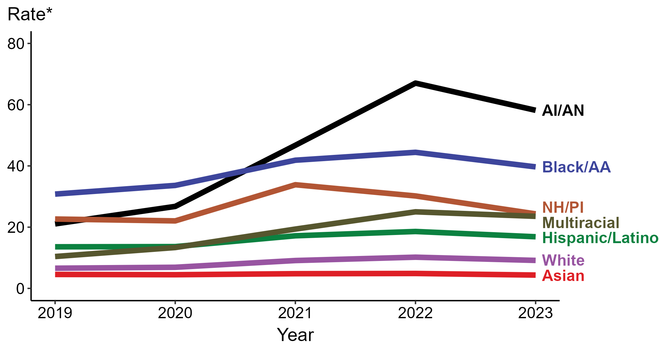
Primary and Secondary Syphilis — Rates of Reported Cases by Race/Hispanic Ethnicity and Year, United States, 2019–2023
* Per 100,000
ACRONYMS: AI/AN = American Indian or Alaska Native; Black/AA = Black or African American; NH/PI = Native Hawaiian or other Pacific Islander
NOTE: During 2019 to 2023, the percentage of all primary and secondary syphilis cases with missing, unknown, or other race and not reported to be of Hispanic ethnicity was 6.5%, from a low of 5.6% (n = 2,947) in 2023 to a high of 7.2% (n = 2,822) in 2019. These cases are not shown in this figure.
Notes:
In 2023, the highest rate of reported primary and secondary (P&S) syphilis cases was among non-Hispanic American Indian or Alaska Native persons (58.2 per 100,000), followed by non-Hispanic Black or African American persons (39.7 per 100,000).
There were no increases in the rate of reported P&S syphilis cases among any race or Hispanic ethnicity group during 2022 to 2023. Non-Hispanic American Indian or Alaska Native persons had the greatest five-year increase in rate of reported P&S syphilis (21.1 to 58.2 per 100,000; 175.8% increase from 2019).
During 2022 to 2023, the greatest decrease in rate of reported P&S syphilis cases was among non-Hispanic Native Hawaiian or other Pacific Islander persons (30.2 to 24.3 per 100,000; 19.5% decrease). Non-Hispanic Asian persons had the only five-year decrease in rate of reported P&S syphilis (4.6 to 4.4 per 100,000; 4.3% decrease from 2019).
This report includes data from years that coincide with the COVID-19 pandemic, which introduced uncertainty and difficulty in interpreting STI surveillance data. See Impact of COVID-19 on STIs (https://www.cdc.gov/sti-statistics/about/impact-of-covid-19.html) for more information.
See Technical Notes (https://www.cdc.gov/sti-statistics/annual/technical-notes.html) for information on STI case reporting formats and practices, including collected and derived variables displayed in this report. Table A (https://www.cdc.gov/sti-statistics/data-vis/table-selected-percunknown.html) provides information on unknown, missing, or invalid values of select variables.
Data for all figures are available at https://www.cdc.gov/sti-statistics/media/files/2024/11/2023-STI-Surveillance-Report-Data-Points.zip. The file “PS Syphilis - Rates by Race Hispanic Ethnicity (US 2019-2023).xlsx” contains the data for the figure presented on this slide.

Slide 17
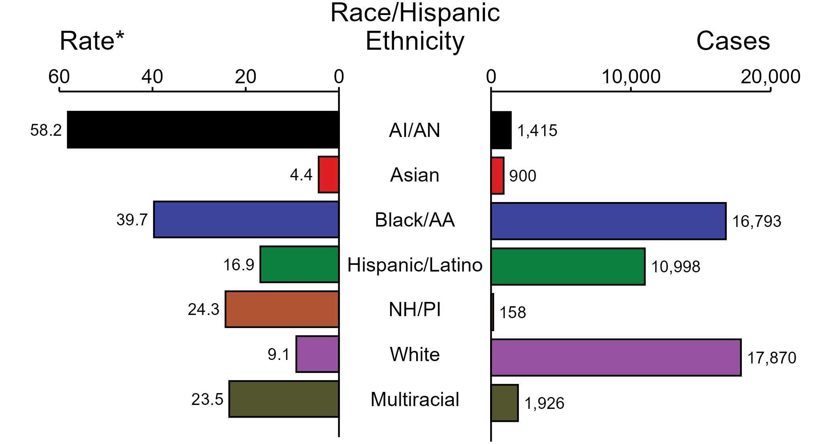
Primary and Secondary Syphilis — Case Counts and Rates of Reported Cases by Race/Hispanic Ethnicity, United States, 2023
* Per 100,000
ACRONYMS: AI/AN = American Indian or Alaska Native; Black/AA = Black or African American; NH/PI = Native Hawaiian or other Pacific Islander
NOTE: In 2023, a total of 2,947 primary and secondary (P&S) syphilis cases (5.6%) had missing, unknown, or other race and were not reported to be of Hispanic ethnicity. These cases are not shown in this figure. Including these cases, there were a total of 53,007 cases of P&S syphilis reported among states and the District of Columbia for a rate of 15.8 per 100,000 persons.
Notes:
In 2023, rates of primary and secondary (P&S) syphilis were highest among non-Hispanic American Indian or Alaska Native persons (58.2 per 100,000), followed by non-Hispanic Black or African American persons (39.7 per 100,000) and non-Hispanic Native Hawaiian or other Pacific Islander persons (24.3 per 100,000). The greatest number of reported P&S syphilis cases was among non-Hispanic White persons (17,870 cases), followed by non-Hispanic Black or African American persons (16,793 cases) and Hispanic or Latino persons of any race(s) (10,998 cases).
This report includes data from years that coincide with the COVID-19 pandemic, which introduced uncertainty and difficulty in interpreting STI surveillance data. See Impact of COVID-19 on STIs (https://www.cdc.gov/sti-statistics/about/impact-of-covid-19.html) for more information.
See Technical Notes (https://www.cdc.gov/sti-statistics/annual/technical-notes.html) for information on STI case reporting formats and practices, including collected and derived variables displayed in this report. Table A (https://www.cdc.gov/sti-statistics/data-vis/table-selected-percunknown.html) provides information on unknown, missing, or invalid values of select variables.
Data for all figures are available at https://www.cdc.gov/sti-statistics/media/files/2024/11/2023-STI-Surveillance-Report-Data-Points.zip. The file “PS Syphilis - Cases and Rates by Race Hispanic Ethnicity (US 2023).xlsx” contains the data for the figure presented on this slide.

Slide 18
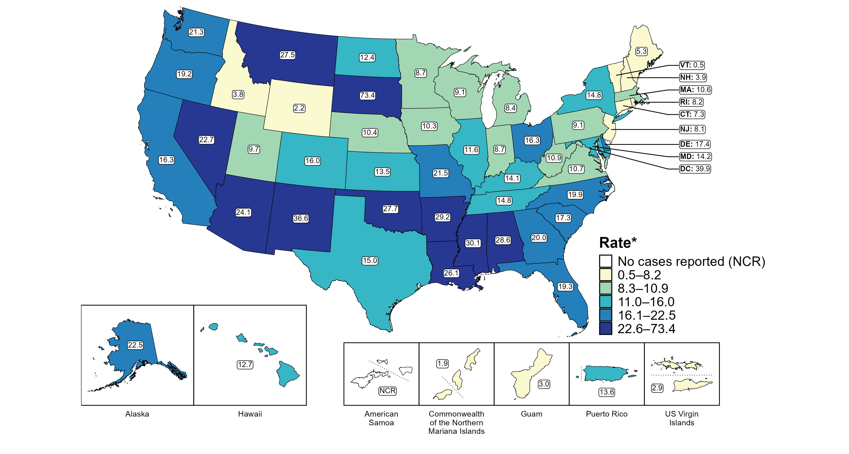
Primary and Secondary Syphilis — Rates of Reported Cases by Jurisdiction, United States and Territories, 2023
* Per 100,000
Notes:
In 2023, rates of reported primary and secondary (P&S) syphilis ranged by state from 0.5 cases per 100,000 persons in Vermont to 73.4 cases per 100,000 persons in South Dakota. The rate of reported P&S syphilis in the District of Columbia was 39.9 per 100,000 persons.
Among US territories reporting any cases, rates of reported P&S syphilis ranged from 1.9 cases per 100,000 persons in the Commonwealth of the Northern Mariana Islands to 13.6 cases per 100,000 persons in Puerto Rico. No cases of P&S syphilis were reported in American Samoa.
Tennessee transitioned STI surveillance information systems in September of 2023 which may have impacted the overall case counts. Caution should be applied in interpretation of these data.
This report includes data from years that coincide with the COVID-19 pandemic, which introduced uncertainty and difficulty in interpreting STI surveillance data. See Impact of COVID-19 on STIs (https://www.cdc.gov/sti-statistics/about/impact-of-covid-19.html) for more information.
See Technical Notes (https://www.cdc.gov/sti-statistics/annual/technical-notes.html) for information on STI case reporting formats and practices, including collected and derived variables displayed in this report. Table A (https://www.cdc.gov/sti-statistics/data-vis/table-selected-percunknown.html) provides information on unknown, missing, or invalid values of select variables.
Data for all figures are available at https://www.cdc.gov/sti-statistics/media/files/2024/11/2023-STI-Surveillance-Report-Data-Points.zip. The file “PS Syphilis - Rates by Jurisdiction (US and Terr 2023).xlsx” contains the data for the figure presented on this slide.

Slide 19
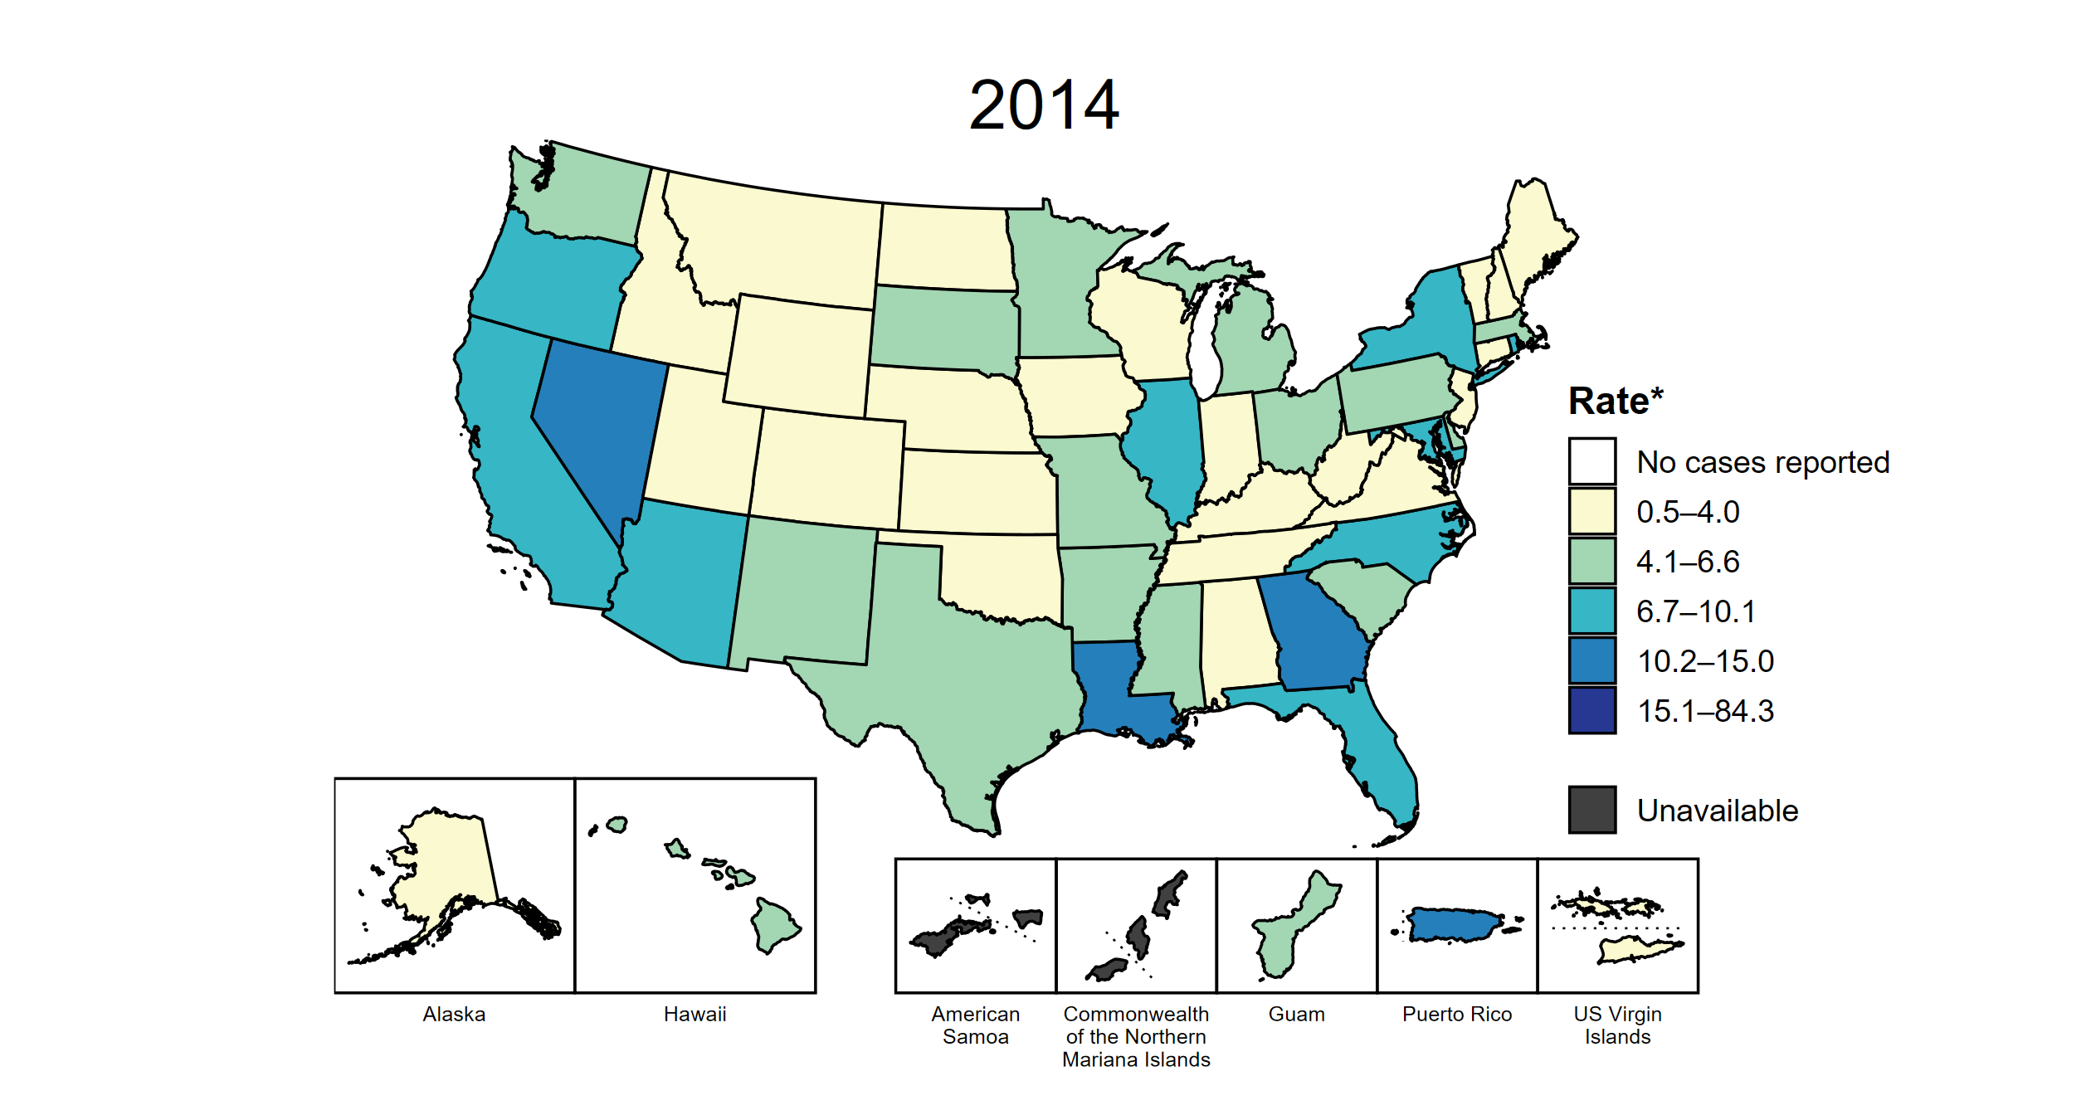
Primary and Secondary Syphilis — Rates of Reported Cases by Jurisdiction, United States and Territories, 2014–2023
* Per 100,000
Notes:
This slide contains an animated figure that will play when the slide is in presentation mode. A static version of the figure that displays maps from the first and last years of the range is available as a separate slide.
In 2014, three states, the District of Columbia (DC), and one US territory (9.3% of areas with available data) had a rate of reported primary and secondary syphilis greater than or equal to 10.2 cases per 100,000 persons. This increased to 36 states, DC, and one US territory (67.9% of areas with available data) in 2023. During 2022 to 2023, rates of reported primary and secondary syphilis increased in nine states and three territories.
American Samoa and the Commonwealth of the Northern Mariana Islands began providing data on P&S syphilis cases to CDC in 2018; data are not available for those areas prior to that year. In addition, data on reported P&S syphilis cases in 2018 are not available for the US Virgin Islands. Due to a network security incident in December 2021, the Maryland Department of Health could not finalize their 2021 STI case notification data. Data for 2021 from Maryland have been suppressed for this figure; however, they are included in national and regional case counts and rates displayed in other figures. Tennessee transitioned STI surveillance information systems in September of 2023 which may have impacted the overall case counts. Caution should be applied in interpretation of these data.
This report includes data from years that coincide with the COVID-19 pandemic, which introduced uncertainty and difficulty in interpreting STI surveillance data. See Impact of COVID-19 on STIs (https://www.cdc.gov/sti-statistics/about/impact-of-covid-19.html) for more information.
See Technical Notes (https://www.cdc.gov/sti-statistics/annual/technical-notes.html) for information on STI case reporting formats and practices, including collected and derived variables displayed in this report. Table A (https://www.cdc.gov/sti-statistics/data-vis/table-selected-percunknown.html) provides information on unknown, missing, or invalid values of select variables.
Data for all figures are available at https://www.cdc.gov/sti-statistics/media/files/2024/11/2023-STI-Surveillance-Report-Data-Points.zip. The file “PS Syphilis - Rates by Jurisdiction (US and Terr 2014-2023).xlsx” contains the data for the figure presented on this slide.

Slide 20
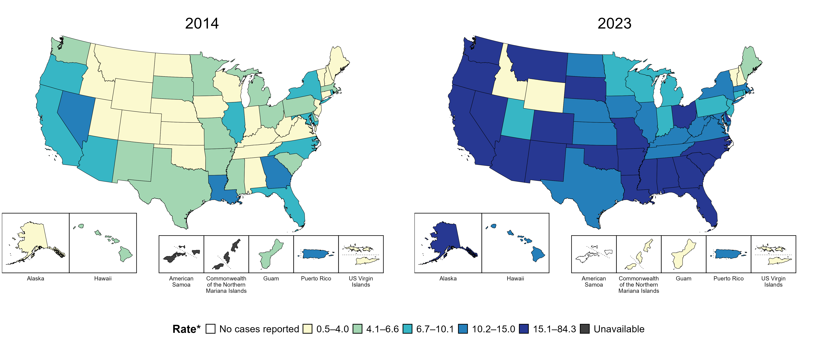
Primary and Secondary Syphilis — Rates of Reported Cases by Jurisdiction, United States and Territories, 2014 and 2023
* Per 100,000
Notes:
In 2014, three states, the District of Columbia (DC), and one US territory (9.3% of areas with available data) had a rate of reported primary and secondary syphilis greater than or equal to 10.2 cases per 100,000 persons. This increased to 36 states, DC, and one US territory (67.9% of areas with available data) in 2023.
American Samoa and the Commonwealth of the Northern Mariana Islands began providing data on P&S syphilis cases to CDC in 2018; data are not available for those areas prior to that year. Tennessee transitioned STI surveillance information systems in September of 2023 which may have impacted the overall case counts. Caution should be applied in interpretation of these data.
This report includes data from years that coincide with the COVID-19 pandemic, which introduced uncertainty and difficulty in interpreting STI surveillance data. See Impact of COVID-19 on STIs (https://www.cdc.gov/sti-statistics/about/impact-of-covid-19.html) for more information.
See Technical Notes (https://www.cdc.gov/sti-statistics/annual/technical-notes.html) for information on STI case reporting formats and practices, including collected and derived variables displayed in this report. Table A (https://www.cdc.gov/sti-statistics/data-vis/table-selected-percunknown.html) provides information on unknown, missing, or invalid values of select variables.
Data for all figures are available at https://www.cdc.gov/sti-statistics/media/files/2024/11/2023-STI-Surveillance-Report-Data-Points.zip. The file “PS Syphilis - Rates by Jurisdiction (US and Terr 2014 and 2023).xlsx” contains the data for the figure presented on this slide.

Slide 21
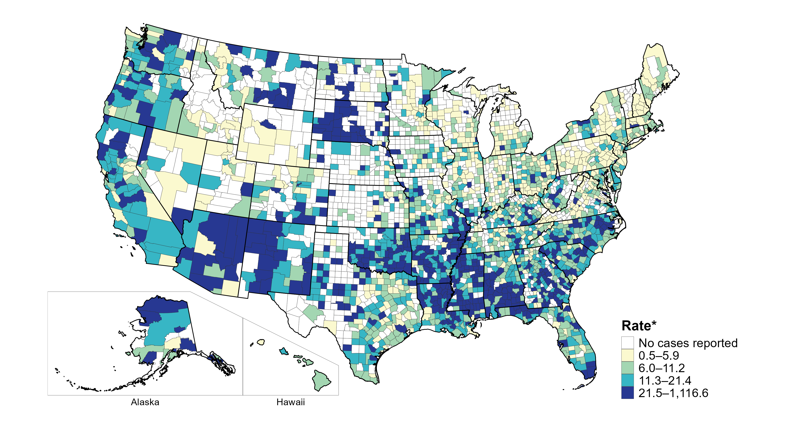
Primary and Secondary Syphilis — Rates of Reported Cases by County, United States, 2023
* Per 100,000
Notes:
In 2023, 69.9% of all counties and county equivalents in the United States reported at least one case of primary and secondary (P&S) syphilis. Out of 3,144 counties and county equivalents, 78 counties or county equivalents (2.5%) reported over half of all cases of P&S syphilis (26,530 of 52,986 total cases).
Tennessee transitioned STI surveillance information systems in September of 2023 which may have impacted the overall case counts. Caution should be applied in interpretation of these data.
This report includes data from years that coincide with the COVID-19 pandemic, which introduced uncertainty and difficulty in interpreting STI surveillance data. See Impact of COVID-19 on STIs (https://www.cdc.gov/sti-statistics/about/impact-of-covid-19.html) for more information.
See Technical Notes (https://www.cdc.gov/sti-statistics/annual/technical-notes.html) for information on STI case reporting formats and practices, including collected and derived variables displayed in this report. Table A (https://www.cdc.gov/sti-statistics/data-vis/table-selected-percunknown.html) provides information on unknown, missing, or invalid values of select variables.
Data for all figures are available at https://www.cdc.gov/sti-statistics/media/files/2024/11/2023-STI-Surveillance-Report-Data-Points.zip. The file “PS Syphilis - Rates by County (US 2023).xlsx” contains the data for the figure presented on this slide.

Slide 22
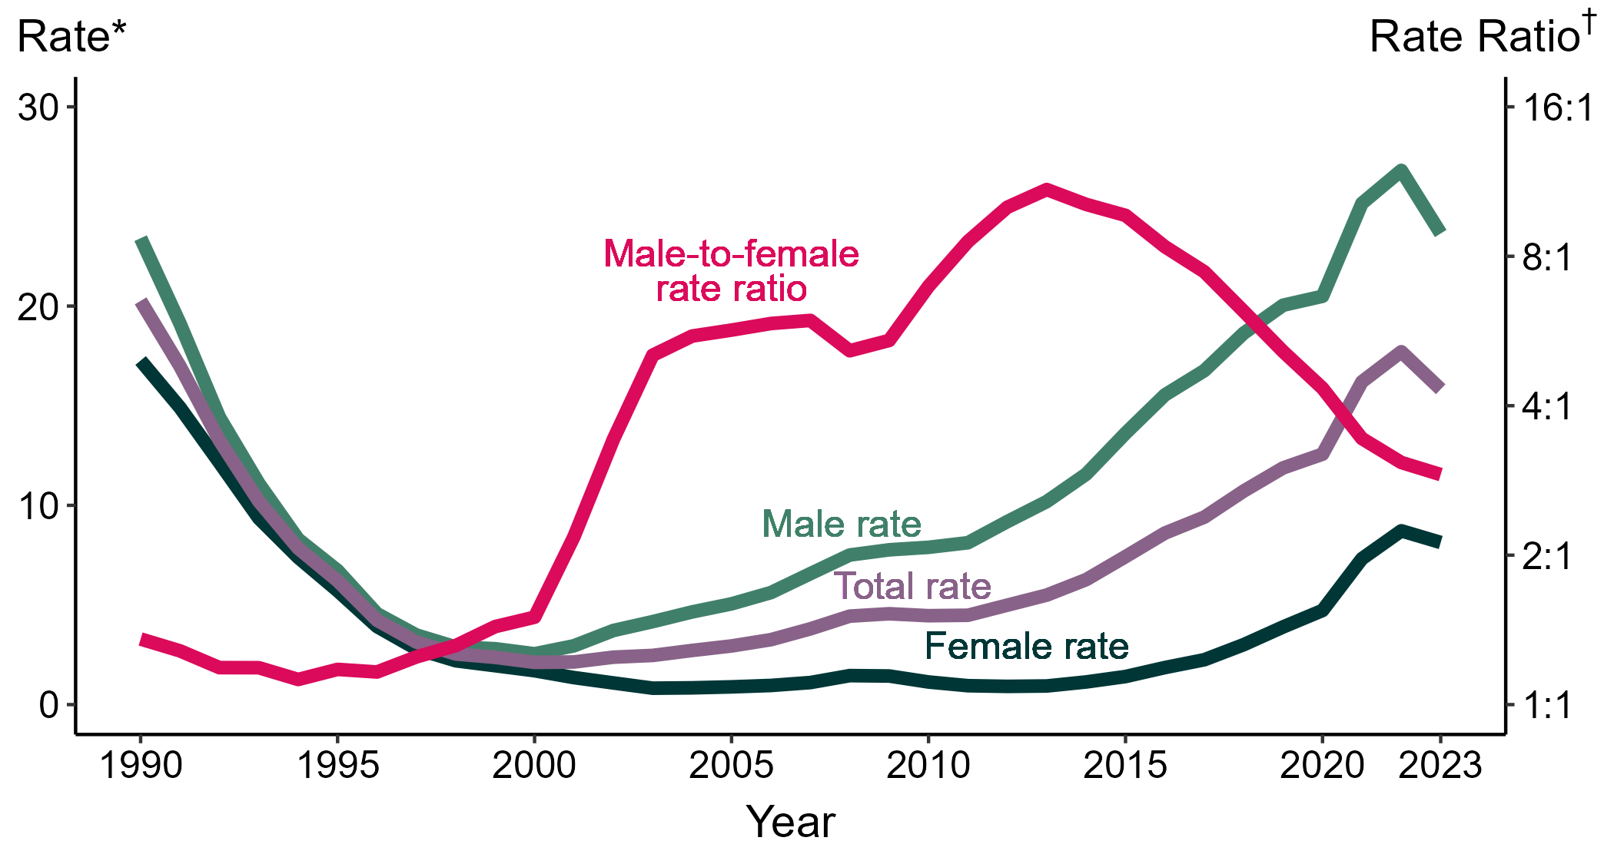
Primary and Secondary Syphilis — Rates of Reported Cases by Sex and Male-to-Female Rate Ratios, by Year, United States, 1990–2023
* Per 100,000
† Log scale
Notes:
Although the male-to-female rate ratio for primary and secondary syphilis increased from 1990 to 2013, the rate ratio has declined in recent years due to the increasing rate of syphilis among women. During 2019 to 2023, the rate of primary and secondary syphilis among women more than doubled (3.9 to 8.1 per 100,000).
This report includes data from years that coincide with the COVID-19 pandemic, which introduced uncertainty and difficulty in interpreting STI surveillance data. See Impact of COVID-19 on STIs (https://www.cdc.gov/sti-statistics/about/impact-of-covid-19.html) for more information.
See Technical Notes (https://www.cdc.gov/sti-statistics/annual/technical-notes.html) for information on STI case reporting formats and practices, including collected and derived variables displayed in this report. Table A (https://www.cdc.gov/sti-statistics/data-vis/table-selected-percunknown.html) provides information on unknown, missing, or invalid values of select variables.
Data for all figures are available at https://www.cdc.gov/sti-statistics/media/files/2024/11/2023-STI-Surveillance-Report-Data-Points.zip. The file “PS Syphilis - Rates by Sex and Male-to-Female Rate Ratios (US 1990-2023).xlsx” contains the data for the figure presented on this slide.

Slide 23
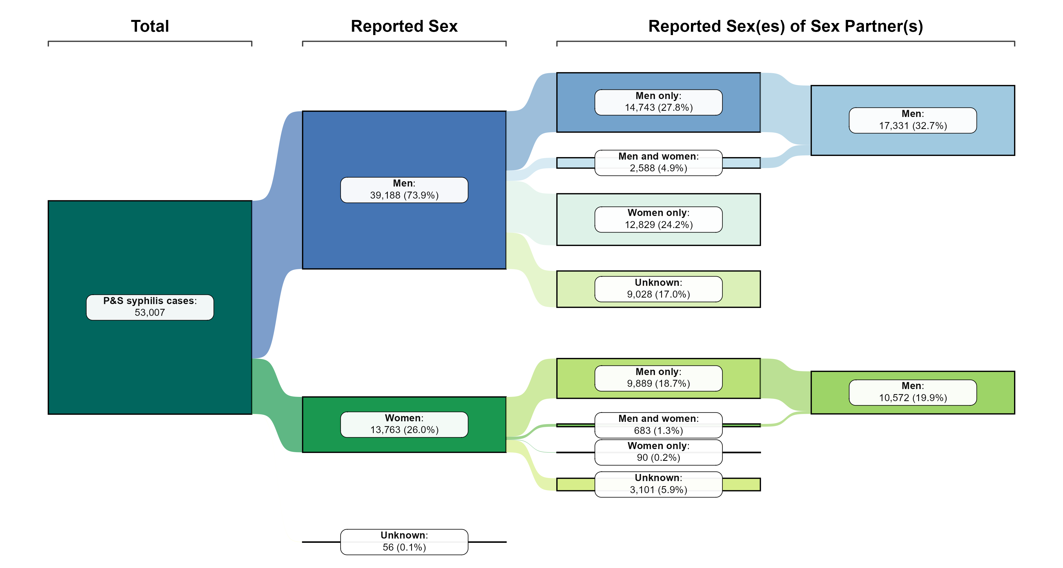
Primary and Secondary Syphilis — Distribution of Cases by Sex and Sex of Sex Partners, United States, 2023
NOTE: Percentages represent the number of primary and secondary (P&S) syphilis cases among the 53,007 total P&S syphilis cases reported in 2023.
Notes:
Of 53,007 reported primary and secondary syphilis cases in 2023, 73.9% were among men and 26.0% were among women.
By sex and sex(es) of sex partners, the largest percentage of cases (27.8%) were among men who have sex with men only.
Men who have sex with men — including men who have sex with men and women — represented 32.7% of cases overall and 44.2% of cases among men (57.5% of cases among men with known sex of sex partners).
Women who have sex with men — including women who have sex with women and men — represented 19.9% of cases overall and 76.8% of cases among women (99.2% of cases among women with known sex of sex partners).
Note that percentages in figure and text may not sum as expected due to rounding.
This report includes data from years that coincide with the COVID-19 pandemic, which introduced uncertainty and difficulty in interpreting STI surveillance data. See Impact of COVID-19 on STIs (https://www.cdc.gov/sti-statistics/about/impact-of-covid-19.html) for more information.
See Technical Notes (https://www.cdc.gov/sti-statistics/annual/technical-notes.html) for information on STI case reporting formats and practices, including collected and derived variables displayed in this report. Table A (https://www.cdc.gov/sti-statistics/data-vis/table-selected-percunknown.html) provides information on unknown, missing, or invalid values of select variables.
Data for all figures are available at https://www.cdc.gov/sti-statistics/media/files/2024/11/2023-STI-Surveillance-Report-Data-Points.zip. The file “PS Syphilis - Distribution by Sex and Sex of Sex Partners (US 2023).xlsx” contains the data for the figure presented on this slide.

Slide 24
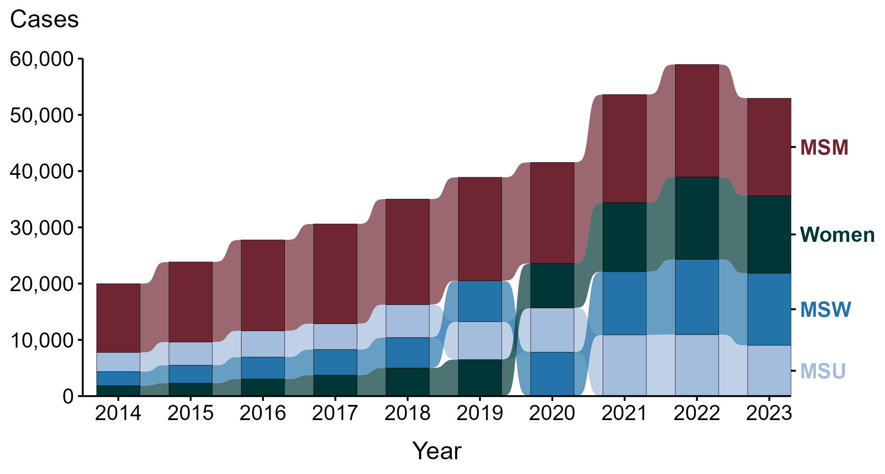
Primary and Secondary Syphilis — Reported Cases by Sex and Sex of Sex Partners and Year, United States, 2014–2023
ACRONYMS: MSM = Men who have sex with men; MSU = Men with unknown sex of sex partners; MSW = Men who have sex with women only
Notes:
During the period from 2014 to 2023, the largest percentage (44.9%) of primary and secondary syphilis cases were among men who have sex with men (MSM; 172,019 cases).
During 2022 to 2023, the number of cases among MSM decreased 13.4% (20,004 to 17,331), while the number of cases decreased 4.0% among men who have sex with women only (MSW; 13,359 to 12,829), 6.1% among women (14,652 to 13,763), and 17.5% among men with unknown sex of sex partners (MSU; 10,946 to 9,028).
During the five-year period from 2019 to 2023, the number of cases among MSM decreased 5.7% (18,381 to 17,331), while the number of cases increased 76.0% among MSW (7,289 to 12,829), 112.0% among women (6,493 to 13,763), and 34.1% among MSU (6,732 to 9,028).
During the 10-year period from 2014 to 2023, the number of cases among MSM increased 41.8% (12,226 to 17,331), while the number of cases increased 410.5% among MSW (2,513 to 12,829), 648.0% among women (1,840 to 13,763), and 165.0% among MSU (3,407 to 9,028).
This report includes data from years that coincide with the COVID-19 pandemic, which introduced uncertainty and difficulty in interpreting STI surveillance data. See Impact of COVID-19 on STIs (https://www.cdc.gov/sti-statistics/about/impact-of-covid-19.html) for more information.
See Technical Notes (https://www.cdc.gov/sti-statistics/annual/technical-notes.html) for information on STI case reporting formats and practices, including collected and derived variables displayed in this report. Table A (https://www.cdc.gov/sti-statistics/data-vis/table-selected-percunknown.html) provides information on unknown, missing, or invalid values of select variables.
Data for all figures are available at https://www.cdc.gov/sti-statistics/media/files/2024/11/2023-STI-Surveillance-Report-Data-Points.zip. The file “PS Syphilis - Cases by Sex and Sex of Sex Partners (US 2014-2023).xlsx” contains the data for the figure presented on this slide.

Slide 25
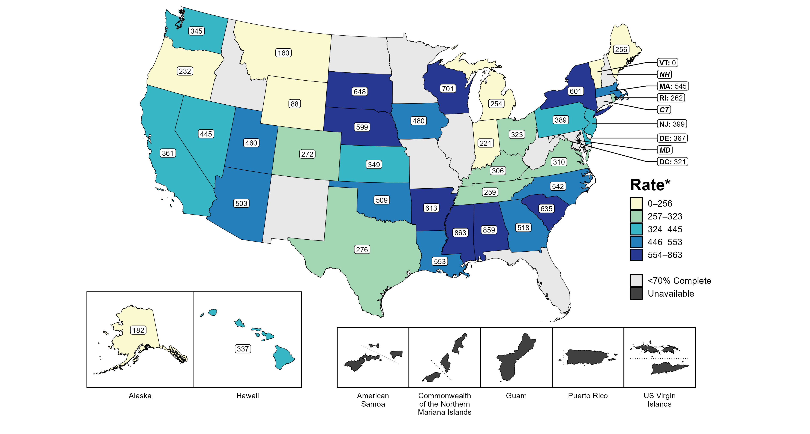
Primary and Secondary Syphilis — Estimated Rates of Reported Cases Among MSM by Jurisdiction, 39 States and the District of Columbia, 2023
* Per 100,000
ACRONYMS: MSM = Men who have sex with men
NOTE: Figure displays rates for jurisdictions reporting ≥70% completeness of sex of sex partners data for male primary and secondary syphilis cases in 2023. Population estimates for MSM in US territories are unavailable.
Notes:
In 2023, 39 states and the District of Columbia (DC) provided data to classify at least 70% of male primary and secondary syphilis cases as men who have sex with men (MSM) or men who have sex with women only. Among the states, estimated rates of primary and secondary syphilis cases in MSM ranged from 0 per 100,000 in Vermont to 863 per 100,000 in Mississippi. The estimated rate in DC was 321 per 100,000.
Tennessee transitioned STI surveillance information systems in September of 2023 which may have impacted the overall case counts. Caution should be applied in interpretation of these data.
This report includes data from years that coincide with the COVID-19 pandemic, which introduced uncertainty and difficulty in interpreting STI surveillance data. See Impact of COVID-19 on STIs (https://www.cdc.gov/sti-statistics/about/impact-of-covid-19.html) for more information.
See Technical Notes (https://www.cdc.gov/sti-statistics/annual/technical-notes.html) for information on STI case reporting formats and practices, including collected and derived variables displayed in this report. Table A (https://www.cdc.gov/sti-statistics/data-vis/table-selected-percunknown.html) provides information on unknown, missing, or invalid values of select variables.
Data for all figures are available at https://www.cdc.gov/sti-statistics/media/files/2024/11/2023-STI-Surveillance-Report-Data-Points.zip. The file “PS Syphilis - Rates MSM by Jurisdiction (US 2023).xlsx” contains the data for the figure presented on this slide.

Slide 26
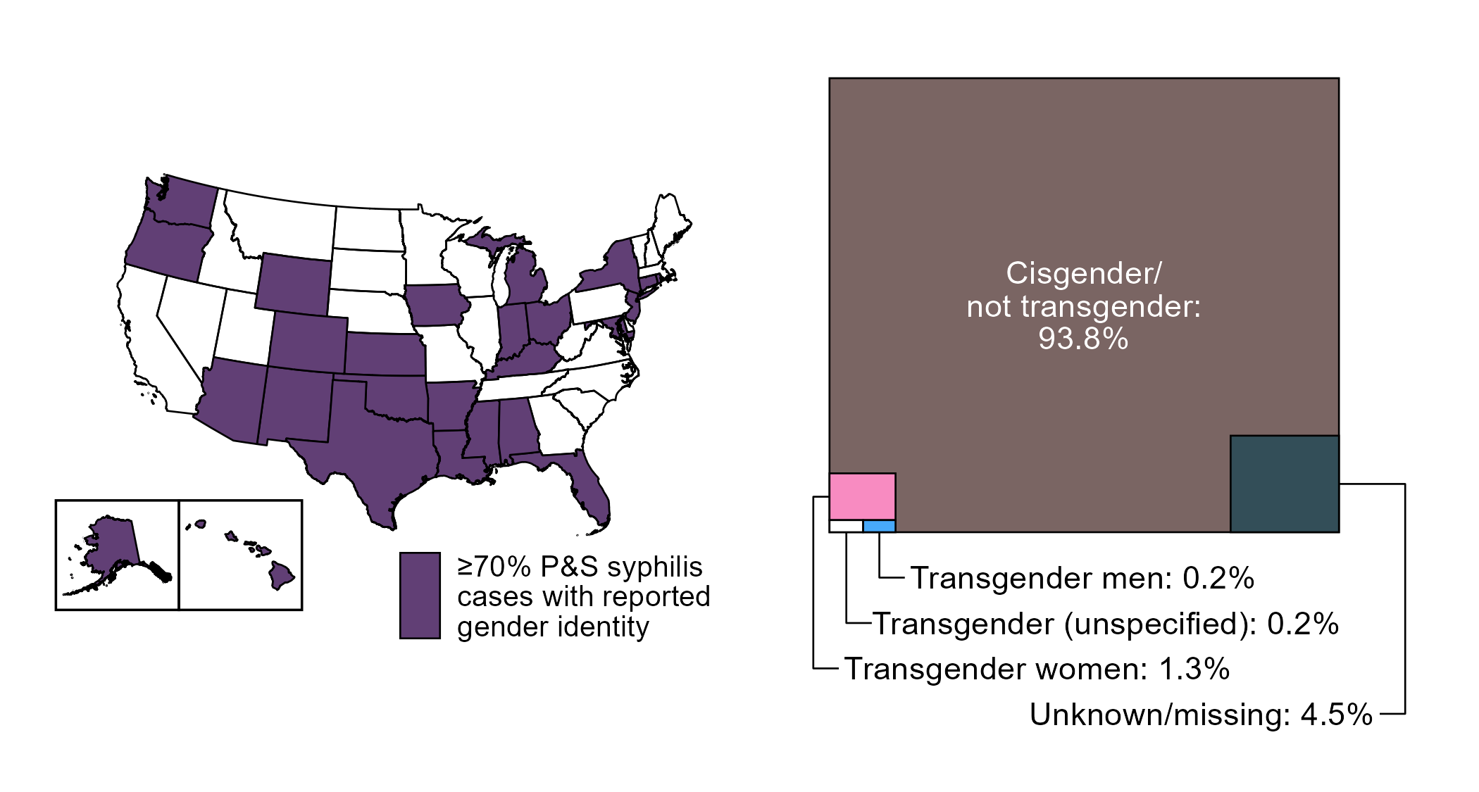
Primary and Secondary Syphilis — Distribution of Cases by Gender Identity, 26 States* and the District of Columbia, 2023
* Jurisdictions reporting gender identity for ≥70% reported primary and secondary syphilis cases in 2023; in 2023, 35 states and the District of Columbia reported on gender identity for primary and secondary syphilis cases
ACRONYMS: P&S syphilis = Primary and secondary syphilis
Notes:
Starting in 2018, jurisdictions were able to provide gender identity for reported cases of primary and secondary syphilis; however, not all jurisdictions have been able to report complete data. To minimize bias due to missing data, this figure displays data from jurisdictions with ≥70% complete information on gender identity for primary and secondary syphilis cases. As reporting of gender identity improves, case counts and distribution of cases by gender identity will become more representative of the US.
In 2023, 26 states and the District of Columbia reported gender identity for ≥70% of reported primary and secondary syphilis cases. In those areas, 30,704 total cases were reported, of which 93.8% were reported with cisgender (i.e., not transgender) identity, 4.5% were reported with missing or unknown gender identity, and 1.7% were reported with transgender identity, specifically as transgender women (1.3%), transgender men (0.2%), and unspecified transgender identity (0.2%).
This report includes data from years that coincide with the COVID-19 pandemic, which introduced uncertainty and difficulty in interpreting STI surveillance data. See Impact of COVID-19 on STIs (https://www.cdc.gov/sti-statistics/about/impact-of-covid-19.html) for more information.
See Technical Notes (https://www.cdc.gov/sti-statistics/annual/technical-notes.html) for information on STI case reporting formats and practices, including collected and derived variables displayed in this report. Table A (https://www.cdc.gov/sti-statistics/data-vis/table-selected-percunknown.html) provides information on unknown, missing, or invalid values of select variables.
Data for all figures are available at https://www.cdc.gov/sti-statistics/media/files/2024/11/2023-STI-Surveillance-Report-Data-Points.zip. The file “PS Syphilis - Distribution by Gender Identity in Reporting Jurisdictions (US 2023).xlsx” contains the data for the figure presented on this slide.

Slide 27
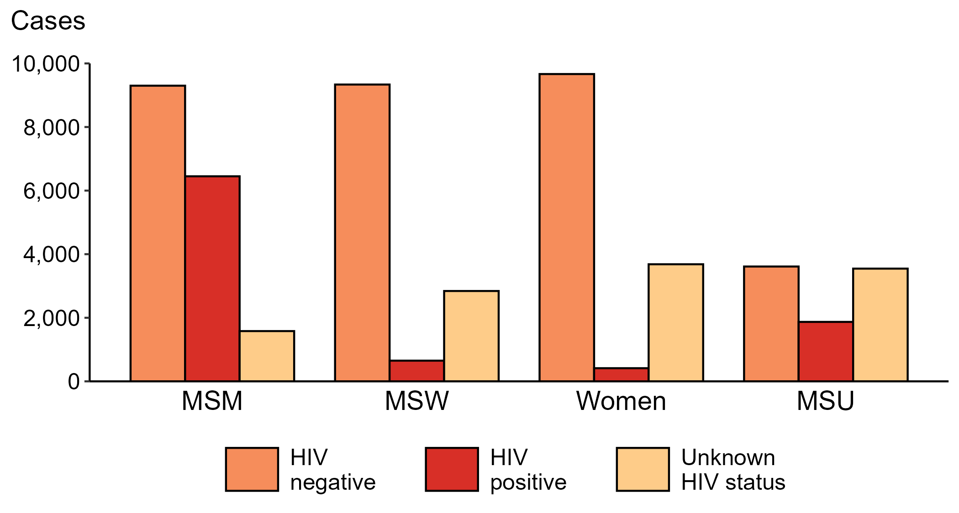
Primary and Secondary Syphilis — Reported Cases by Sex, Sex of Sex Partners, and HIV Status, United States, 2023
ACRONYMS: MSM = Men who have sex with men; MSW = Men who have sex with women only; MSU = Men with unknown sex of sex partners
Notes:
Among primary and secondary syphilis cases with reported HIV status, 41.0% of cases among men who have sex with men were HIV positive, compared with 34.1% of cases among men with unknown sex of sex partners, 6.5% of cases among men who have sex with women only, and 4.1% of cases among women.
For this figure, HIV status is categorized as reported by jurisdictions. Jurisdictions determine HIV status using multiple sources, including self-report, match with HIV registry, and available HIV test results. Cases reported with a missing or unknown status are categorized as having an unknown HIV status.
This report includes data from years that coincide with the COVID-19 pandemic, which introduced uncertainty and difficulty in interpreting STI surveillance data. See Impact of COVID-19 on STIs (https://www.cdc.gov/sti-statistics/about/impact-of-covid-19.html) for more information.
See Technical Notes (https://www.cdc.gov/sti-statistics/annual/technical-notes.html) for information on STI case reporting formats and practices, including collected and derived variables displayed in this report. Table A (https://www.cdc.gov/sti-statistics/data-vis/table-selected-percunknown.html) provides information on unknown, missing, or invalid values of select variables.
Data for all figures are available at https://www.cdc.gov/sti-statistics/media/files/2024/11/2023-STI-Surveillance-Report-Data-Points.zip. The file “PS Syphilis - Cases by Sex Sex of Sex Partners and HIV Status (US 2023).xlsx” contains the data for the figure presented on this slide.

Slide 28
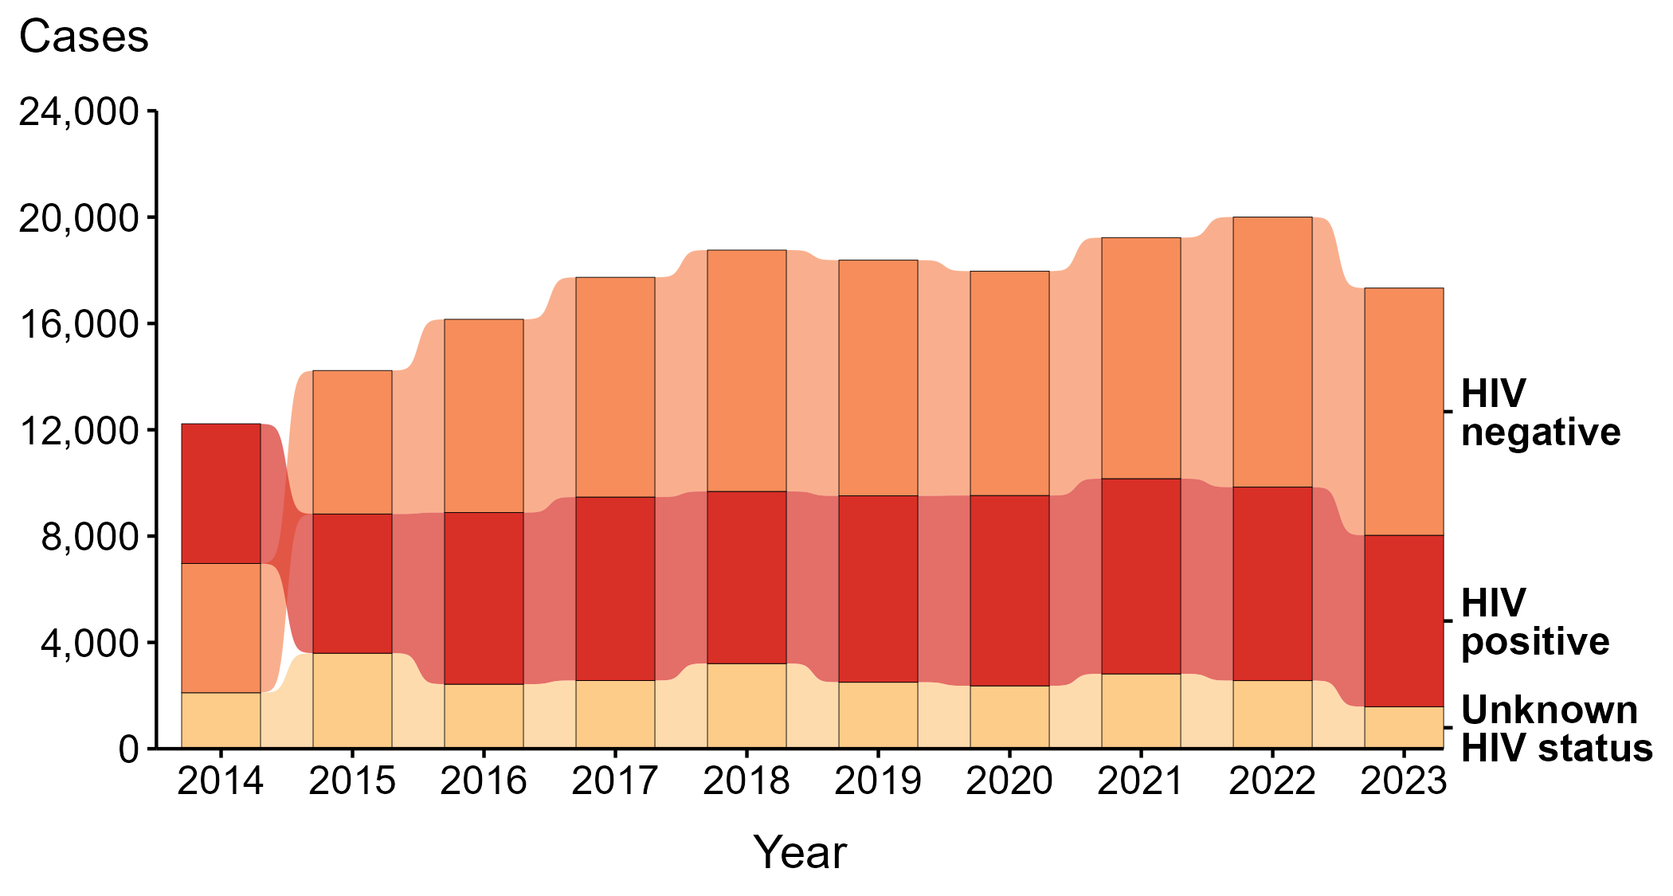
Primary and Secondary Syphilis — Reported Cases Among Men Who Have Sex with Men by HIV Status and Year, United States, 2014–2023
Notes:
During 2014 to 2023, the largest percentage (46.9%) of primary and secondary (P&S) syphilis cases among men who have sex with men (MSM) were among persons reported as HIV negative. Among only those reported as either HIV negative or HIV positive (i.e., with a known status), 55.2% were among persons reported as HIV negative.
During 2022 to 2023, the number of P&S syphilis cases among MSM who were reported as HIV negative decreased 8.5% (from 10,161 to 9,300), the number who were reported as HIV positive decreased 11.4% (from 7,281 to 6,450), and the number who were reported with unknown HIV status decreased 38.3% (from 2,562 to 1,581).
During 2014 to 2023, the number of P&S syphilis cases among MSM who were reported as HIV negative increased 91.2% (from 4,863 to 9,300), the number who were reported as HIV positive increased 22.7% (from 5,257 to 6,450), and the number who were reported with unknown HIV status decreased 24.9% (from 2,106 to 1,581).
Since 2015, the number of primary and secondary syphilis cases among MSM who are HIV negative has surpassed the number of cases among those who are HIV positive.
For this figure, HIV status is categorized as reported by jurisdictions. Jurisdictions determine HIV status using multiple sources, including self-report, match with HIV registry, and available HIV test results. Cases reported with a missing or unknown status are categorized as having an unknown HIV status.
This report includes data from years that coincide with the COVID-19 pandemic, which introduced uncertainty and difficulty in interpreting STI surveillance data. See Impact of COVID-19 on STIs (https://www.cdc.gov/sti-statistics/about/impact-of-covid-19.html) for more information.
See Technical Notes (https://www.cdc.gov/sti-statistics/annual/technical-notes.html) for information on STI case reporting formats and practices, including collected and derived variables displayed in this report. Table A (https://www.cdc.gov/sti-statistics/data-vis/table-selected-percunknown.html) provides information on unknown, missing, or invalid values of select variables.
Data for all figures are available at https://www.cdc.gov/sti-statistics/media/files/2024/11/2023-STI-Surveillance-Report-Data-Points.zip. The file “PS Syphilis - Cases MSM by HIV Status (US 2014-2023).xlsx” contains the data for the figure presented on this slide.

Slide 29
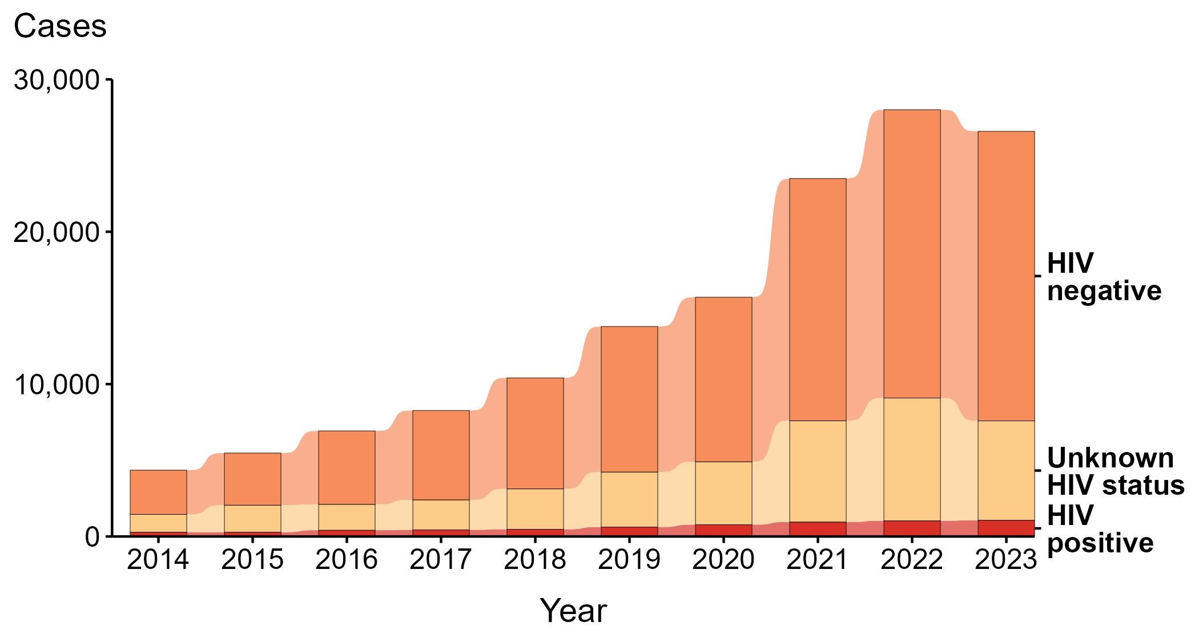
Primary and Secondary Syphilis — Reported Cases Among Women and Men Who Have Sex with Women Only by HIV Status and Year, United States, 2014–2023
Notes:
During 2014 to 2023, the majority (68.9%) of primary and secondary (P&S) syphilis cases among women and men who have sex with women only (MSW) were among persons reported as HIV negative. Among only those reported as either HIV negative or HIV positive (i.e., with a known status), 94.0% were among persons reported as HIV negative.
During 2022 to 2023, the number of P&S syphilis cases among women and MSW who were reported as HIV negative did not change substantially (<1.0% change; from 18,927 to 19,002), the number who were reported with unknown HIV status decreased 19.0% (from 8,055 to 6,525), and the number who were reported as HIV positive increased 3.5% (from 1,029 to 1,065).
During 2014 to 2023, the number of P&S syphilis cases among women and MSW who were reported as HIV negative increased 555.0% (from 2,901 to 19,002), the number who were reported with unknown HIV status increased 457.2% (from 1,171 to 6,525), and the number who were reported as HIV positive increased 279.0% (from 281 to 1,065).
For this figure, HIV status is categorized as reported by jurisdictions. Jurisdictions determine HIV status using multiple sources, including self-report, match with HIV registry, and available HIV test results. Cases reported with a missing or unknown status are categorized as having an unknown HIV status.
This report includes data from years that coincide with the COVID-19 pandemic, which introduced uncertainty and difficulty in interpreting STI surveillance data. See Impact of COVID-19 on STIs (https://www.cdc.gov/sti-statistics/about/impact-of-covid-19.html) for more information.
See Technical Notes (https://www.cdc.gov/sti-statistics/annual/technical-notes.html) for information on STI case reporting formats and practices, including collected and derived variables displayed in this report. Table A (https://www.cdc.gov/sti-statistics/data-vis/table-selected-percunknown.html) provides information on unknown, missing, or invalid values of select variables.
Data for all figures are available at https://www.cdc.gov/sti-statistics/media/files/2024/11/2023-STI-Surveillance-Report-Data-Points.zip. The file “PS Syphilis - Cases Women and MSW by HIV Status (US 2014-2023).xlsx” contains the data for the figure presented on this slide.

Slide 30
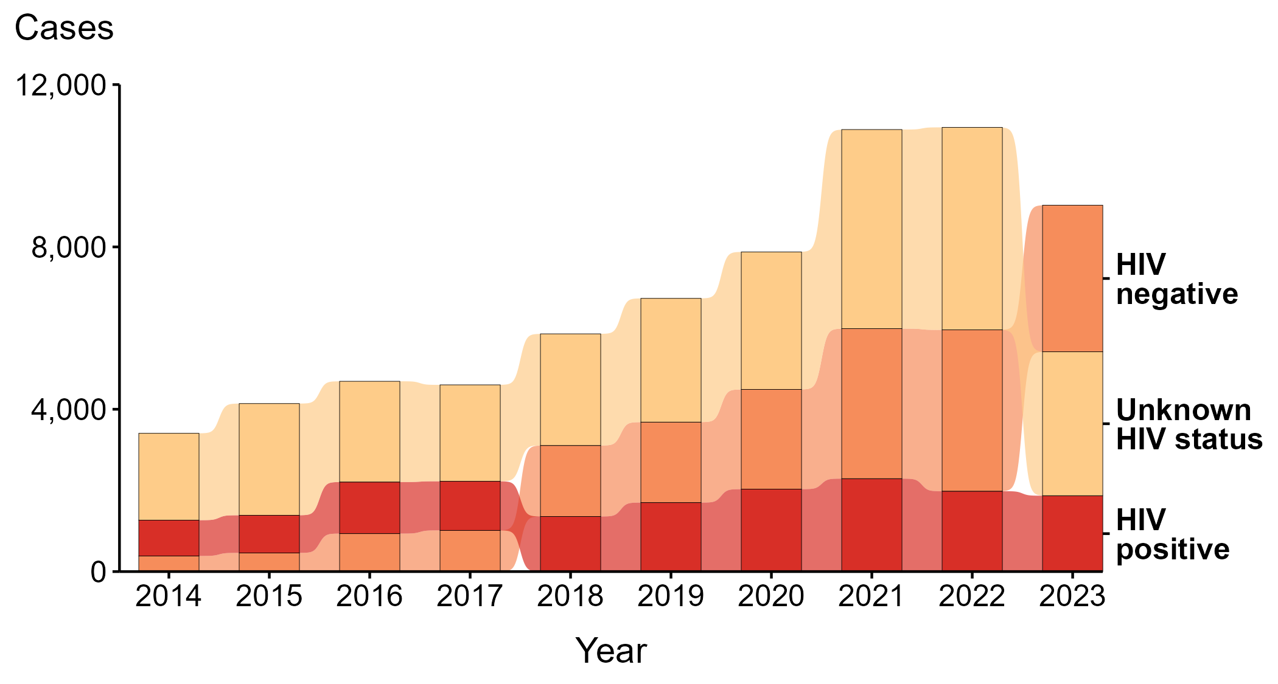
Primary and Secondary Syphilis — Reported Cases Among Men with Unknown Sex of Sex Partners by HIV Status and Year, United States, 2014–2023
Notes:
During 2014 to 2023, the largest percentage (47.5%) of primary and secondary (P&S) syphilis cases among men with unknown sex of sex partners (MSU) were among persons reported with unknown HIV status. Among only those reported as either HIV negative or HIV positive (i.e., with a known status), 56.6% were among persons reported as HIV negative.
During 2022 to 2023, the number of P&S syphilis cases among MSU who were reported with unknown HIV status decreased 28.9% (from 4,990 to 3,546), the number who were reported as HIV negative decreased 9.1% (from 3,975 to 3,612), and the number who were reported as HIV positive decreased 5.6% (from 1,981 to 1,870).
During 2014 to 2023, the number of P&S syphilis cases among MSU who were reported with unknown HIV status increased 65.7% (from 2,140 to 3,546), the number who were reported as HIV negative increased 838.2% (from 385 to 3,612), and the number who were reported as HIV positive increased 112.0% (from 882 to 1,870).
For this figure, HIV status is categorized as reported by jurisdictions. Jurisdictions determine HIV status using multiple sources, including self-report, match with HIV registry, and available HIV test results. Cases reported with a missing or unknown status are categorized as having an unknown HIV status.
This report includes data from years that coincide with the COVID-19 pandemic, which introduced uncertainty and difficulty in interpreting STI surveillance data. See Impact of COVID-19 on STIs (https://www.cdc.gov/sti-statistics/about/impact-of-covid-19.html) for more information.
See Technical Notes (https://www.cdc.gov/sti-statistics/annual/technical-notes.html) for information on STI case reporting formats and practices, including collected and derived variables displayed in this report. Table A (https://www.cdc.gov/sti-statistics/data-vis/table-selected-percunknown.html) provides information on unknown, missing, or invalid values of select variables.
Data for all figures are available at https://www.cdc.gov/sti-statistics/media/files/2024/11/2023-STI-Surveillance-Report-Data-Points.zip. The file “PS Syphilis - Cases MSU by HIV Status (US 2014-2023).xlsx” contains the data for the figure presented on this slide.

Slide 31
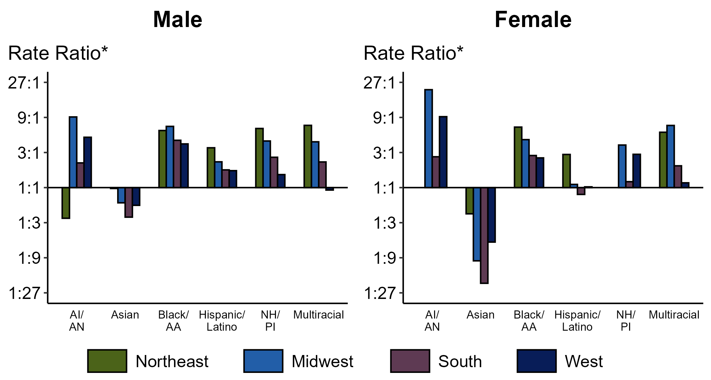
Primary and Secondary Syphilis — Ratios of Rates of Reported Cases by Sex, Race/Hispanic Ethnicity, and Region, United States, 2023
* For the rate ratios, non-Hispanic White persons are the referent population. Y-axis is log scale.
ACRONYMS: AI/AN = American Indian or Alaska Native; Black/AA = Black or African American; NH/PI = Native Hawaiian or other Pacific Islander
Notes:
Among men and women, rate ratios of rates of reported primary and secondary (P&S) syphilis by race/Hispanic ethnicity (using non-Hispanic White persons as the referent population) varied by region in 2023. Among men, the greatest rate ratio was in the Midwest where the rate of reported P&S syphilis among non-Hispanic American Indian or Alaska Native men was 9.1 times the rate among non-Hispanic White men. Among women, the greatest rate ratio was in the Midwest where the rate of reported P&S syphilis among non-Hispanic American Indian or Alaska Native women was 21.5 times the rate among non-Hispanic White women.
This report includes data from years that coincide with the COVID-19 pandemic, which introduced uncertainty and difficulty in interpreting STI surveillance data. See Impact of COVID-19 on STIs (https://www.cdc.gov/sti-statistics/about/impact-of-covid-19.html) for more information.
See Technical Notes (https://www.cdc.gov/sti-statistics/annual/technical-notes.html) for information on syphilis case reporting, race/Hispanic ethnicity categorization, and reporting of race/Hispanic ethnicity for STI cases. Table A (https://www.cdc.gov/sti-statistics/data-vis/table-selected-percunknown.html) provides information on unknown, missing, or invalid values of select variables.
Data for all figures are available at https://www.cdc.gov/sti-statistics/media/files/2024/11/2023-STI-Surveillance-Report-Data-Points.zip. The file “PS Syphilis - Ratios by Sex Race Hispanic Ethnicity and Region (US 2023).xlsx” contains the data for the figure presented on this slide.

Slide 32
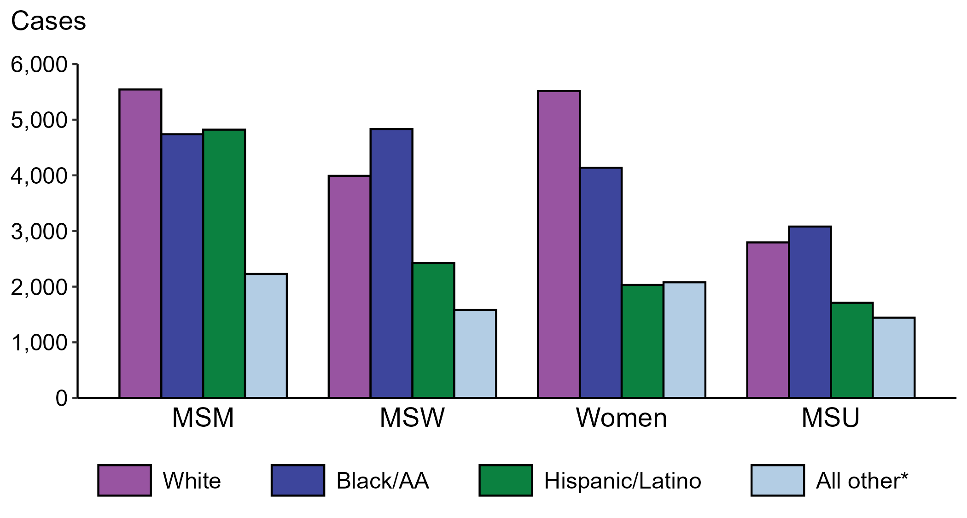
Primary and Secondary Syphilis — Reported Cases by Sex, Sex of Sex Partners, and Race/Hispanic Ethnicity, United States, 2023
* Includes persons with missing or unknown race who were not reported with Hispanic ethnicity.
ACRONYMS: MSM = Men who have sex with men; MSW = Men who have sex with women only; MSU = Men with unknown sex of sex partners
Notes:
The largest percentage of all primary and secondary (P&S) syphilis cases were reported to be men who have sex with men (MSM; 32.7%). When looking within categories of sex and sex of sex partners, P&S syphilis cases reported as non-Hispanic White were the largest percentage among women (40.1%) and MSM (32.0%). P&S syphilis cases reported as non-Hispanic Black or African American were the largest percentage among men who have sex with women only (MSW; 37.7%) and men with unknown sex of sex partners (MSU; 34.1%).
This report includes data from years that coincide with the COVID-19 pandemic, which introduced uncertainty and difficulty in interpreting STI surveillance data. See Impact of COVID-19 on STIs (https://www.cdc.gov/sti-statistics/about/impact-of-covid-19.html) for more information.
See Technical Notes (https://www.cdc.gov/sti-statistics/annual/technical-notes.html) for information on STI case reporting formats and practices, including collected and derived variables displayed in this report. Table A (https://www.cdc.gov/sti-statistics/data-vis/table-selected-percunknown.html) provides information on unknown, missing, or invalid values of select variables.
Data for all figures are available at https://www.cdc.gov/sti-statistics/media/files/2024/11/2023-STI-Surveillance-Report-Data-Points.zip. The file “PS Syphilis - Cases by Sex Sex of Sex Partners and Race Hispanic Ethnicity (US 2023) .xlsx” contains the data for the figure presented on this slide.

Slide 33
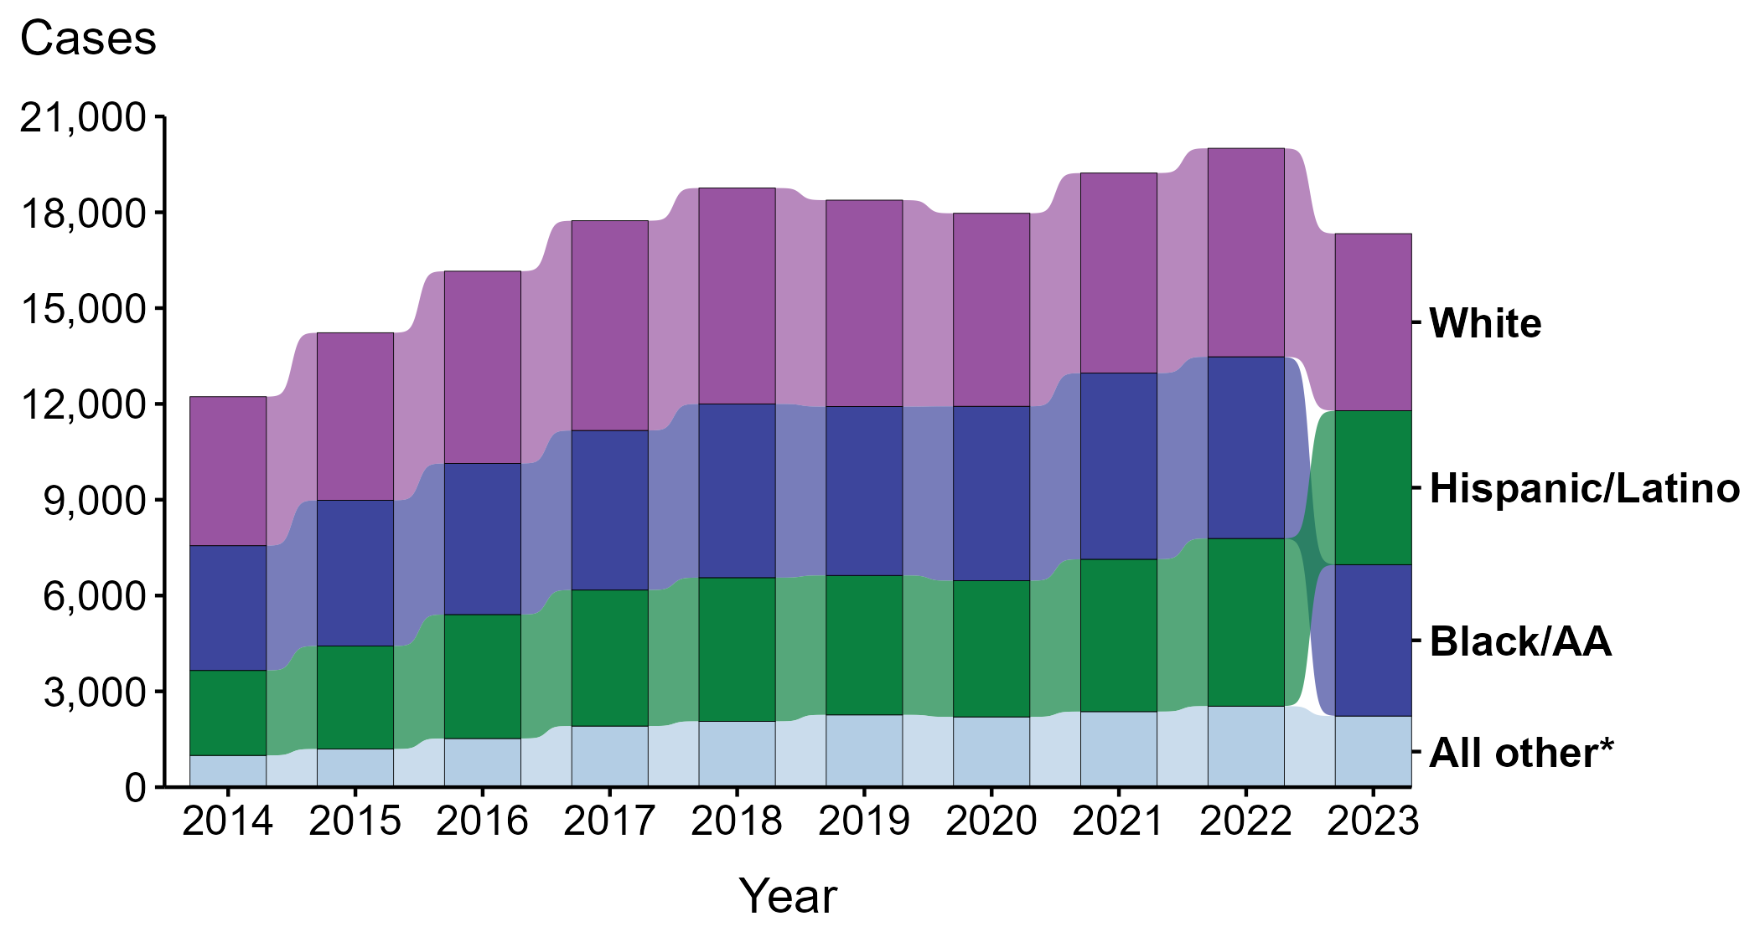
Primary and Secondary Syphilis — Reported Cases Among Men Who Have Sex with Men by Race and Hispanic Ethnicity, United States, 2014–2023
* Includes all cases not captured in the labeled race and Hispanic ethnicity categories, including those with unknown or missing race and Hispanic ethnicity. This category is intended to show the balance of primary and secondary (P&S) syphilis cases among men who have sex with men (MSM) and should not be interpreted independently.
Notes:
During 2014 to 2023, the largest percentage (34.9%) of primary and secondary (P&S) syphilis cases among men who have sex with men (MSM) were reported to be non-Hispanic White.
During 2022 to 2023, case counts decreased among non-Hispanic Black or African American MSM (16.7% decrease; 5,689 to 4,739 cases), non-Hispanic White MSM (15.1% decrease; 6,528 to 5,543 cases), and Hispanic or Latino MSM of any race(s) (8.2% decrease; 5,250 to 4,821 cases).
During 2014 to 2023, case counts increased among Hispanic or Latino MSM of any race(s) (81.2% increase; 2,660 to 4,821 cases), non-Hispanic Black or African American MSM (21.3% increase; 3,907 to 4,739 cases), and non-Hispanic White MSM (18.8% increase; 4,664 to 5,543 cases).
This report includes data from years that coincide with the COVID-19 pandemic, which introduced uncertainty and difficulty in interpreting STI surveillance data. See Impact of COVID-19 on STIs (https://www.cdc.gov/sti-statistics/about/impact-of-covid-19.html) for more information.
See Technical Notes (https://www.cdc.gov/sti-statistics/annual/technical-notes.html) for information on STI case reporting formats and practices, including collected and derived variables displayed in this report. Table A (https://www.cdc.gov/sti-statistics/data-vis/table-selected-percunknown.html) provides information on unknown, missing, or invalid values of select variables.
Data for all figures are available at https://www.cdc.gov/sti-statistics/media/files/2024/11/2023-STI-Surveillance-Report-Data-Points.zip. The file “PS Syphilis - Cases MSM by Race Hispanic Ethnicity (US 2014-2023) .xlsx” contains the data for the figure presented on this slide.

Slide 34
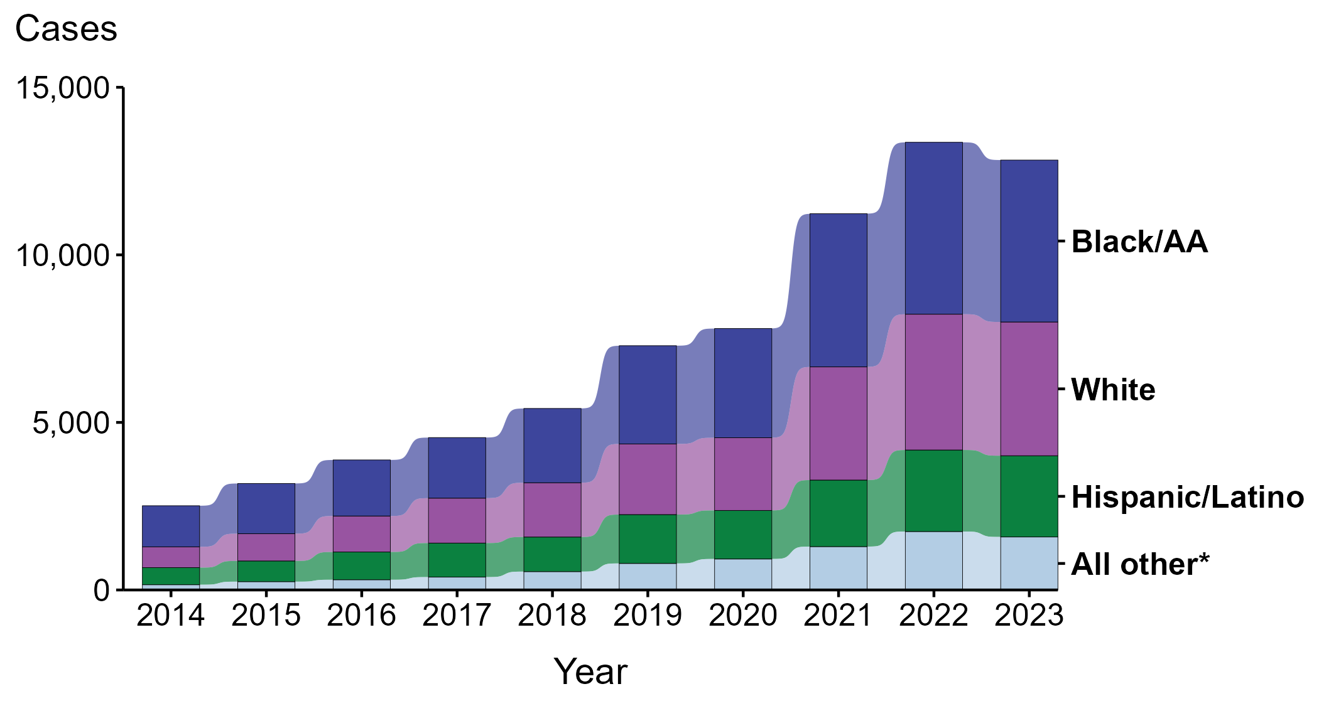
Primary and Secondary Syphilis — Reported Cases Among Men Who Have Sex with Women Only by Race and Hispanic Ethnicity, United States, 2014–2023
* Includes all cases not captured in the labeled race and Hispanic ethnicity categories, including those with unknown or missing race and Hispanic ethnicity. This category is intended to show the balance of primary and secondary (P&S) syphilis cases among men who have sex with women only (MSW) and should not be interpreted independently.
Notes:
During 2014 to 2023, the largest percentage (40.5%) of primary and secondary (P&S) syphilis cases among men who have sex with women only (MSW) were reported to be non-Hispanic Black or African American.
During 2022 to 2023, case counts decreased among non-Hispanic Black or African American MSW (5.8% decrease; 5,130 to 4,832 cases) and non-Hispanic White MSW (1.5% decrease; 4,052 to 3,991 cases). Case counts did not change substantially among Hispanic or Latino MSW of any race(s) (<1.0% change; 2,433 to 2,424 cases).
During 2014 to 2023, case counts increased among non-Hispanic White MSW (543.7% increase; 620 to 3,991 cases), Hispanic or Latino MSW of any race(s) (375.3% increase; 510 to 2,424 cases), and non-Hispanic Black or African American MSW (294.1% increase; 1,226 to 4,832 cases).
This report includes data from years that coincide with the COVID-19 pandemic, which introduced uncertainty and difficulty in interpreting STI surveillance data. See Impact of COVID-19 on STIs (https://www.cdc.gov/sti-statistics/about/impact-of-covid-19.html) for more information.
See Technical Notes (https://www.cdc.gov/sti-statistics/annual/technical-notes.html) for information on STI case reporting formats and practices, including collected and derived variables displayed in this report. Table A (https://www.cdc.gov/sti-statistics/data-vis/table-selected-percunknown.html) provides information on unknown, missing, or invalid values of select variables.
Data for all figures are available at https://www.cdc.gov/sti-statistics/media/files/2024/11/2023-STI-Surveillance-Report-Data-Points.zip. The file “PS Syphilis - Cases MSW and Race Hispanic Ethnicity (US 2014-2023) .xlsx” contains the data for the figure presented on this slide.

Slide 35
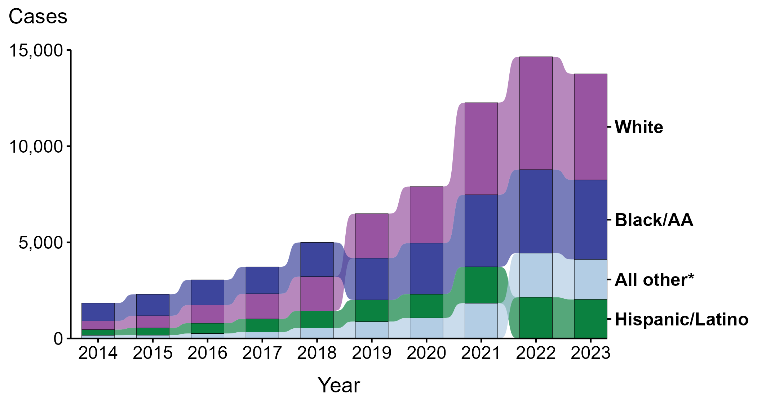
Primary and Secondary Syphilis — Reported Cases Among Women by Race and Hispanic Ethnicity, United States, 2014–2023
* Includes all cases not captured in the labeled race and Hispanic ethnicity categories, including those with unknown or missing race and Hispanic ethnicity. This category is intended to show the balance of primary and secondary (P&S) syphilis cases among women and should not be interpreted independently.
Notes:
During 2014 to 2023, the largest percentage (37.4%) of primary and secondary (P&S) syphilis cases among women were reported to be non-Hispanic White.
During 2022 to 2023, case counts decreased among non-Hispanic White women (6.0% decrease; 5,869 to 5,518 cases), Hispanic or Latino women of any race(s) (5.2% decrease; 2,142 to 2,030 cases), and non-Hispanic Black or African American women (4.7% decrease; 4,339 to 4,137 cases).
During 2014 to 2023, case counts increased among non-Hispanic White women (1,115.4% increase; 454 to 5,518 cases), Hispanic or Latino women of any race(s) (585.8% increase; 296 to 2,030 cases), and non-Hispanic Black or African American women (345.8% increase; 928 to 4,137 cases).
This report includes data from years that coincide with the COVID-19 pandemic, which introduced uncertainty and difficulty in interpreting STI surveillance data. See Impact of COVID-19 on STIs (https://www.cdc.gov/sti-statistics/about/impact-of-covid-19.html) for more information.
See Technical Notes (https://www.cdc.gov/sti-statistics/annual/technical-notes.html) for information on STI case reporting formats and practices, including collected and derived variables displayed in this report. Table A (https://www.cdc.gov/sti-statistics/data-vis/table-selected-percunknown.html) provides information on unknown, missing, or invalid values of select variables.
Data for all figures are available at https://www.cdc.gov/sti-statistics/media/files/2024/11/2023-STI-Surveillance-Report-Data-Points.zip. The file “PS Syphilis - Cases Women by Race Hispanic Ethnicity (US 2014-2023) .xlsx” contains the data for the figure presented on this slide.

Slide 36
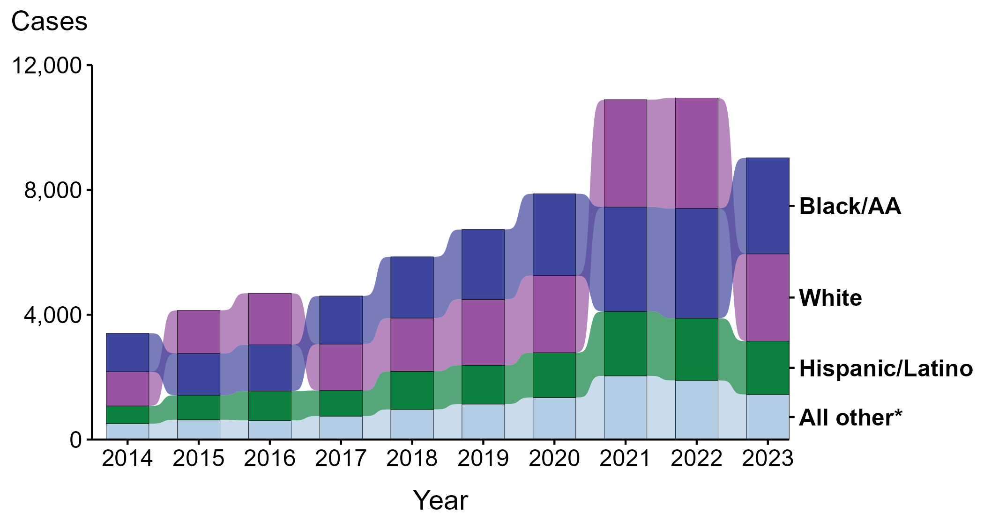
Primary and Secondary Syphilis — Reported Cases Among Men with Unknown Sex of Sex Partners by Race and Hispanic Ethnicity, United States, 2014–2023
* Includes all cases not captured in the labeled race and Hispanic ethnicity categories, including those with unknown or missing race and Hispanic ethnicity. This category is intended to show the balance of primary and secondary (P&S) syphilis cases among men with unknown sex of sex partners (MSU) and should not be interpreted independently.
Notes:
During 2014 to 2023, the largest percentage (32.8%) of primary and secondary (P&S) syphilis cases among men with unknown sex of sex partners (MSU) were reported to be non-Hispanic Black or African American.
During 2022 to 2023, case counts decreased among non-Hispanic White MSU (21.1% decrease; 3,541 to 2,795 cases), Hispanic or Latino MSU of any race(s) (14.2% decrease; 1,993 to 1,710 cases), and non-Hispanic Black or African American MSU (12.5% decrease; 3,519 to 3,080 cases).
During 2014 to 2023, case counts increased among Hispanic or Latino MSU of any race(s) (201.1% increase; 568 to 1,710 cases), non-Hispanic White MSU (154.8% increase; 1,097 to 2,795 cases), and non-Hispanic Black or African American MSU (149.8% increase; 1,233 to 3,080 cases).
This report includes data from years that coincide with the COVID-19 pandemic, which introduced uncertainty and difficulty in interpreting STI surveillance data. See Impact of COVID-19 on STIs (https://www.cdc.gov/sti-statistics/about/impact-of-covid-19.html) for more information.
See Technical Notes (https://www.cdc.gov/sti-statistics/annual/technical-notes.html) for information on STI case reporting formats and practices, including collected and derived variables displayed in this report. Table A (https://www.cdc.gov/sti-statistics/data-vis/table-selected-percunknown.html) provides information on unknown, missing, or invalid values of select variables.
Data for all figures are available at https://www.cdc.gov/sti-statistics/media/files/2024/11/2023-STI-Surveillance-Report-Data-Points.zip. The file “PS Syphilis - Cases MSU by Race Hispanic Ethnicity (US 2014-2023) .xlsx” contains the data for the figure presented on this slide.

Slide 37
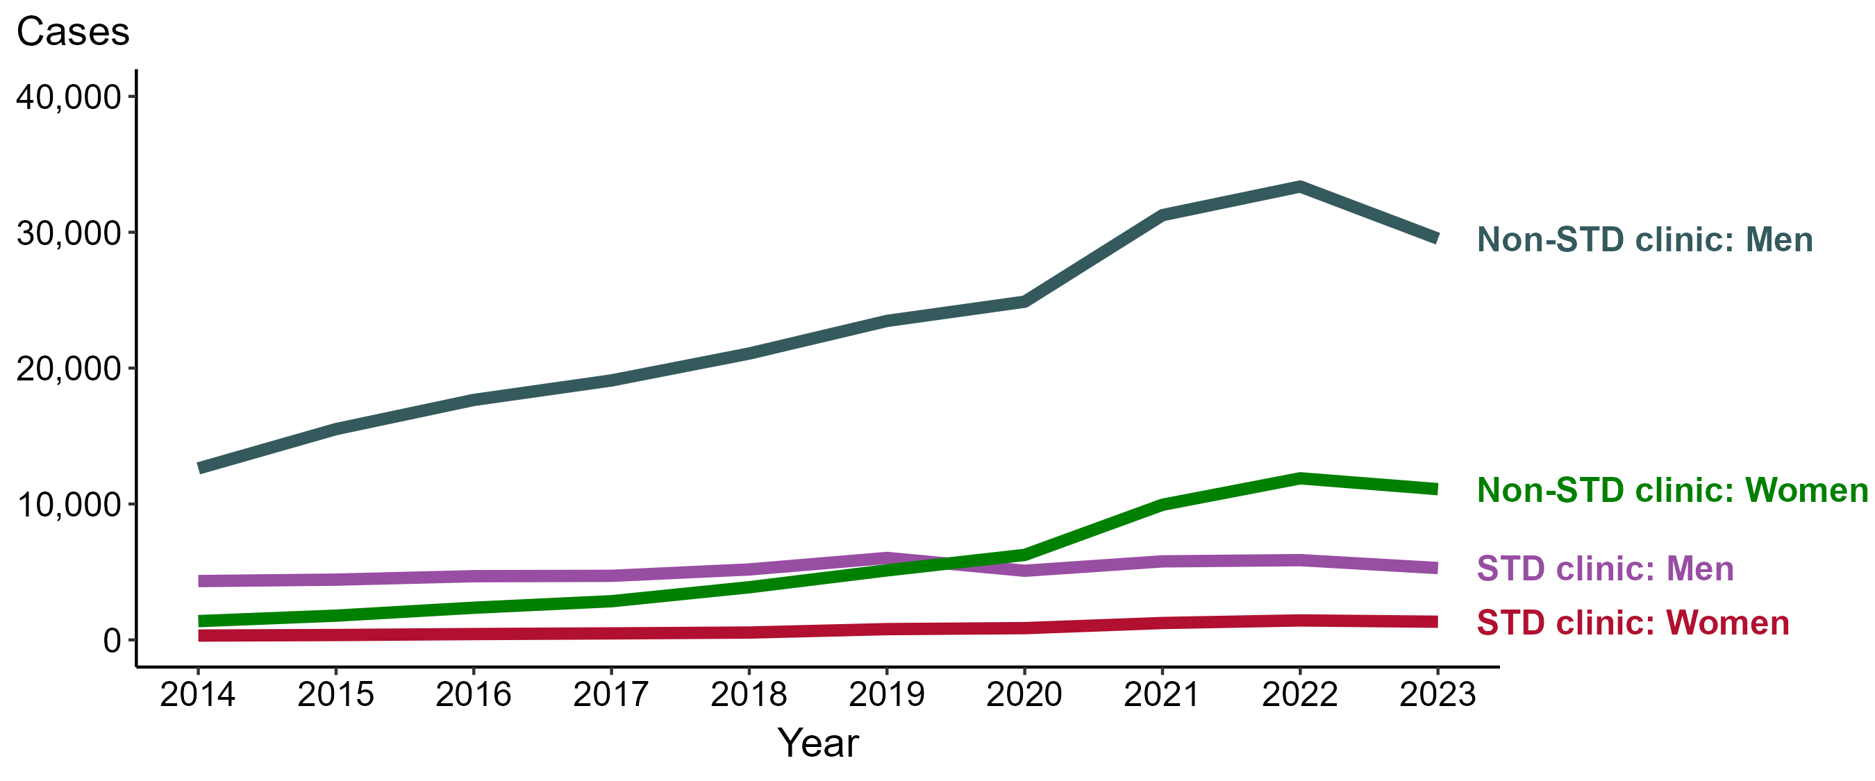
Primary and Secondary Syphilis — Reported Cases by Reporting Source and Sex and Year, United States, 2014–2023
NOTE: During 2014 to 2023, the percentage of all cases with unknown reporting source was 10.2%, from a low of 6.8% (n = 1,350) in 2014 to a high of 12.5% (n = 4,386) in 2018.
Notes:
During 2022 to 2023, the number of primary and secondary (P&S) syphilis cases reported from STD clinics decreased 10.0% among men (5,869 to 5,285 cases) and decreased 6.8% among women (1,432 to 1,335 cases), while the number of cases reported from non-STD clinics decreased 11.5% among men (33,365 to 29,526 cases) and decreased 6.7% among women (11,891 to 11,093 cases).
During 2014 to 2023, the number of P&S syphilis cases reported from STD clinics increased 22.1% among men (4,328 to 5,285 cases) and increased 319.8% among women (318 to 1,335 cases), while the number of cases reported from non-STD clinics increased 134.0% among men (12,617 to 29,526 cases) and increased 704.4% among women (1,379 to 11,093 cases).
This report includes data from years that coincide with the COVID-19 pandemic, which introduced uncertainty and difficulty in interpreting STI surveillance data. See Impact of COVID-19 on STIs (https://www.cdc.gov/sti-statistics/about/impact-of-covid-19.html) for more information.
See Technical Notes (https://www.cdc.gov/sti-statistics/annual/technical-notes.html) for information on STI case reporting formats and practices, including collected and derived variables displayed in this report. Table A (https://www.cdc.gov/sti-statistics/data-vis/table-selected-percunknown.html) provides information on unknown, missing, or invalid values of select variables.
Data for all figures are available at https://www.cdc.gov/sti-statistics/media/files/2024/11/2023-STI-Surveillance-Report-Data-Points.zip. The file “PS Syphilis - Cases by Reporting Source and Sex (US 2014-2023).xlsx” contains the data for the figure presented on this slide.

Slide 38
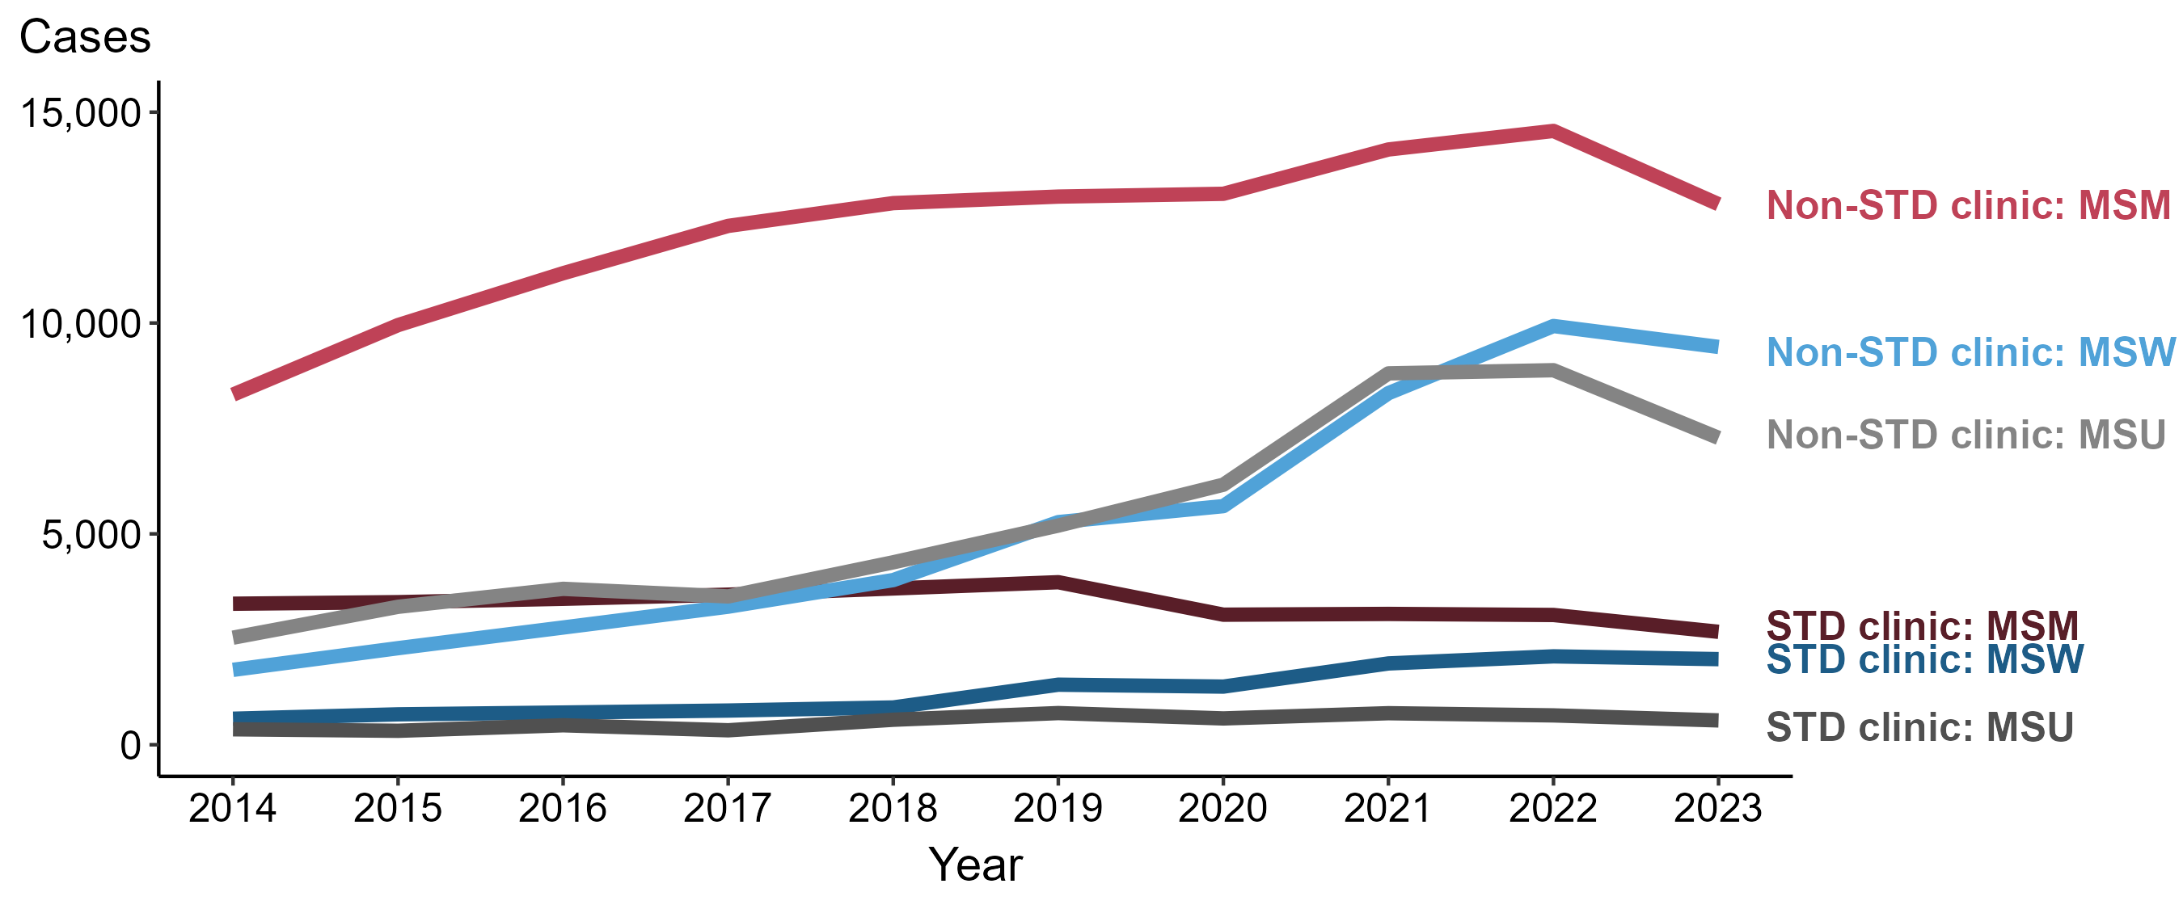
Primary and Secondary Syphilis — Reported Cases among Men by Reporting Source and Sex of Sex Partners and Year, United States, 2014–2023
ACRONYMS: MSM = Men who have sex with men; MSW = Men who have sex with women only; MSU = Men with unknown sex of sex partners
NOTE: During 2014 to 2023, the percentage of all male cases with unknown reporting source was 10.4%, from a low of 6.6% (n = 1,201) in 2014 to a high of 12.6% (n = 3,777) in 2018.
Notes:
During 2022 to 2023, the number of primary and secondary (P&S) syphilis cases reported from STD clinics decreased 13.0% among men who have sex with men (MSM; 3,077 to 2,678 cases), 3.1% among men who have sex with women only (MSW; 2,096 to 2,030 cases), and 17.1% among men with unknown sex of sex partners (MSU; 696 to 577 cases). Concurrently, the number of cases reported from non-STD clinics decreased 11.9% among MSM (14,555 to 12,817 cases), 5.0% among MSW (9,929 to 9,433 cases), and 18.1% among MSU (8,881 to 7,276 cases).
During 2014 to 2023, the number of P&S syphilis cases reported from STD clinics decreased 19.9% among MSM (3,344 to 2,678 cases), increased 229.0% among MSW (617 to 2,030 cases), and increased 57.2% among MSU (367 to 577 cases). Over the same period, the number of cases reported from non-STD clinics increased 54.4% among MSM (8,302 to 12,817 cases), 431.1% among MSW (1,776 to 9,433 cases), and 186.6% among MSU (2,539 to 7,276 cases).
This report includes data from years that coincide with the COVID-19 pandemic, which introduced uncertainty and difficulty in interpreting STI surveillance data. See Impact of COVID-19 on STIs (https://www.cdc.gov/sti-statistics/about/impact-of-covid-19.html) for more information.
See Technical Notes (https://www.cdc.gov/sti-statistics/annual/technical-notes.html) for information on STI case reporting formats and practices, including collected and derived variables displayed in this report. Table A (https://www.cdc.gov/sti-statistics/data-vis/table-selected-percunknown.html) provides information on unknown, missing, or invalid values of select variables.
Data for all figures are available at https://www.cdc.gov/sti-statistics/media/files/2024/11/2023-STI-Surveillance-Report-Data-Points.zip. The file “PS Syphilis - Cases Men by Reporting Source and Sex of Sex Partners (US 2014-2023).xlsx” contains the data for the figure presented on this slide.

Slide 39
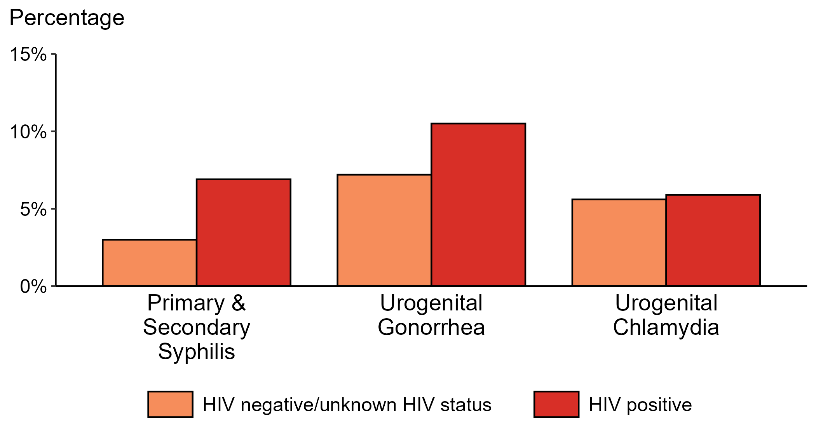
Proportion of MSM with Primary and Secondary Syphilis, Urogenital Gonorrhea, or Urogenital Chlamydia by HIV Status, STI Surveillance Network (SSuN), 2023
ACRONYMS: MSM = Gay, bisexual, and other men who have sex with men
NOTE: Results are based on data obtained from patients attending a participating STI clinic in 11 jurisdictions.
Notes:
Among gay, bisexual, and other men who have sex with men (MSM) attending participating STI clinics in the STI Surveillance Network in 2023, the portion diagnosed with primary and secondary syphilis was higher for those that were HIV positive compared with those not known to be HIV positive (6.9% versus 3.0%). The pattern was similar for urogenital gonorrhea, with the proportion of testing positive higher among HIV-positive MSM compared with MSM not known to be HIV positive (10.5% versus 7.2%); however, the proportion testing positive for urogenital chlamydia was similar (5.9% among HIV-positive MSM and 5.6% among MSM not known to be HIV positive).
For this figure, information of HIV status was ascertained from patient self-report of most recent HIV test result or from documentation in the jurisdiction’s HIV surveillance registry.
This report includes data from years that coincide with the COVID-19 pandemic, which introduced uncertainty and difficulty in interpreting STI surveillance data. See Impact of COVID-19 on STIs (https://www.cdc.gov/sti-statistics/about/impact-of-covid-19.html) for more information.
See Technical Notes (https://www.cdc.gov/sti-statistics/annual/technical-notes.html) for information on SSuN methodology. Table A (https://www.cdc.gov/sti-statistics/data-vis/table-selected-percunknown.html) provides information on unknown, missing, or invalid values of select variables.

Slide 40
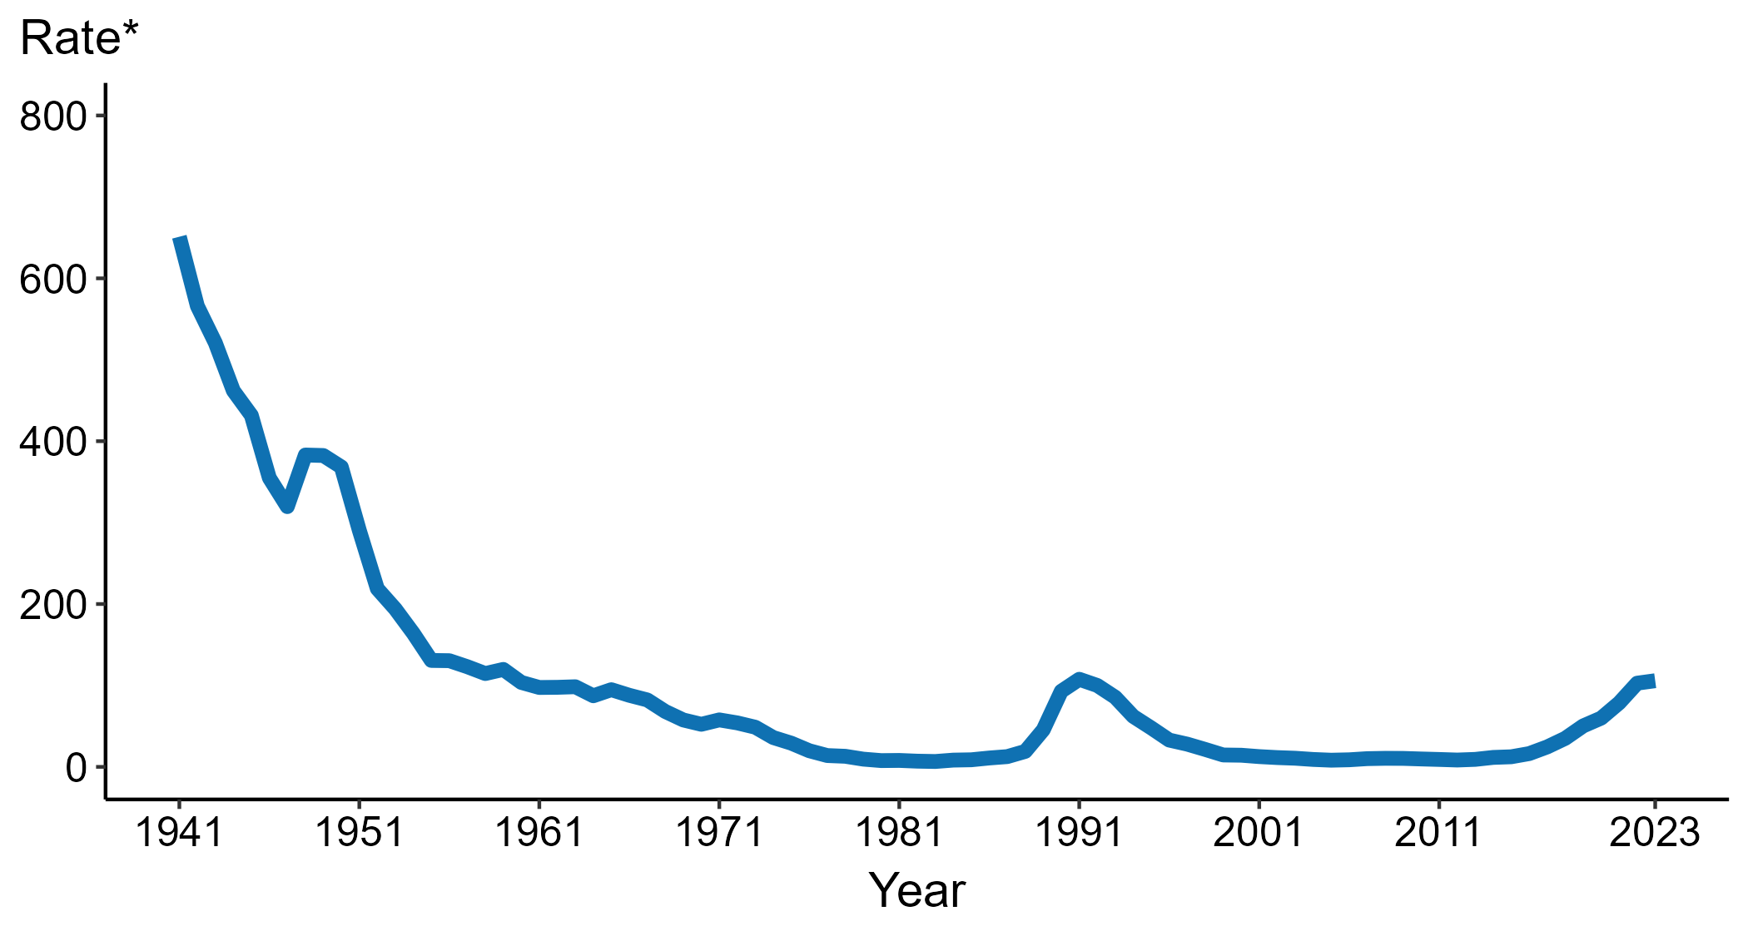
Congenital Syphilis — Rates of Reported Cases by Year of Birth, United States, 1941–2023
* Per 100,000 live births
Notes:
Data collection for congenital syphilis (CS) began in 1941, and CS was made a nationally notifiable condition in 1944. There was a significant change in the CS case definition in the 1990s and rates before versus after the case definition change should be interpreted with caution.
In 2023, there were a total of 3,882 cases of CS reported among states and the District of Columbia for a rate of 105.8 per 100,000 live births.
During 2022 to 2023, the rate of reported CS increased 2.9% (from 102.8 to 105.8 per 100,000 live births).
This report includes data from years that coincide with the COVID-19 pandemic, which introduced uncertainty and difficulty in interpreting STI surveillance data. See Impact of COVID-19 on STIs (https://www.cdc.gov/sti-statistics/about/impact-of-covid-19.html) for more information.
See Technical Notes (https://www.cdc.gov/sti-statistics/annual/technical-notes.html) for information on STI case reporting formats and practices, including collected and derived variables displayed in this report. Table A (https://www.cdc.gov/sti-statistics/data-vis/table-selected-percunknown.html) provides information on unknown, missing, or invalid values of select variables.
Data for all figures are available at https://www.cdc.gov/sti-statistics/media/files/2024/11/2023-STI-Surveillance-Report-Data-Points.zip. The file “CS - Rates by Year of Birth (US 1941-2023).xlsx” contains the data for the figure presented on this slide.

Slide 41
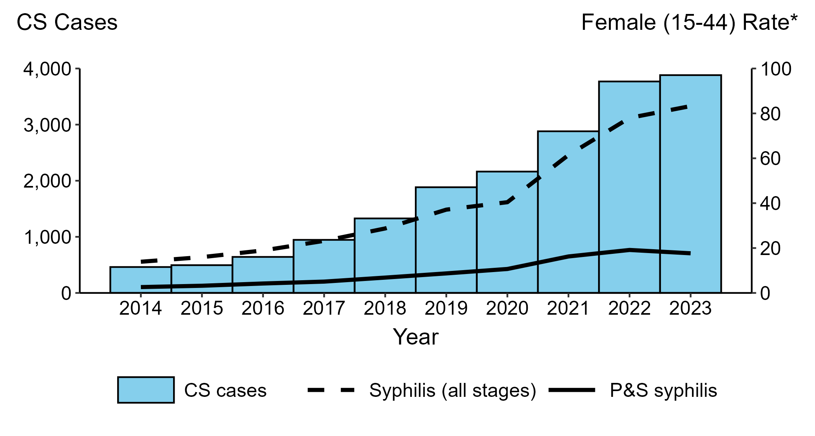
Congenital Syphilis — Reported Cases by Year of Birth and Rates of Reported Cases of Primary and Secondary Syphilis and Syphilis (All Stages) Among Women Aged 15–44 Years, United States, 2014–2023
* Per 100,000
ACRONYMS: CS = Congenital syphilis; P&S Syphilis = Primary and secondary syphilis
Notes:
In 2023, there were a total of 3,882 cases of congenital syphilis (CS) reported among states and the District of Columbia for a rate of 105.8 per 100,000 live births.
During 2022 to 2023, the number of cases of CS increased 3.0% (3,769 to 3,882 cases), concurrent with a 6.8% increase (78.0 to 83.3 per 100,000) in the rate of syphilis (all stages) among women aged 15 to 44 years and a 7.3% decrease (19.1 to 17.7 per 100,000) in the rate of primary and secondary (P&S) syphilis among women aged 15 to 44 years.
During 2014 to 2023, the number of cases of CS increased 740.3% (462 to 3,882 cases), concurrent with a 499.3% increase (13.9 to 83.3 per 100,000) in the rate of syphilis (all stages) among women aged 15 to 44 years and a 580.8% increase (2.6 to 17.7 per 100,000) in the rate of P&S syphilis among women aged 15 to 44 years.
This report includes data from years that coincide with the COVID-19 pandemic, which introduced uncertainty and difficulty in interpreting STI surveillance data. See Impact of COVID-19 on STIs (https://www.cdc.gov/sti-statistics/about/impact-of-covid-19.html) for more information.
See Technical Notes (https://www.cdc.gov/sti-statistics/annual/technical-notes.html) for information on STI case reporting formats and practices, including collected and derived variables displayed in this report. Table A (https://www.cdc.gov/sti-statistics/data-vis/table-selected-percunknown.html) provides information on unknown, missing, or invalid values of select variables.
Data for all figures are available at https://www.cdc.gov/sti-statistics/media/files/2024/11/2023-STI-Surveillance-Report-Data-Points.zip. The file “CS - Cases by Year of Birth and Syphilis Rates Women 15-44 (US 2014-2023).xlsx” contains the data for the figure presented on this slide.

Slide 42
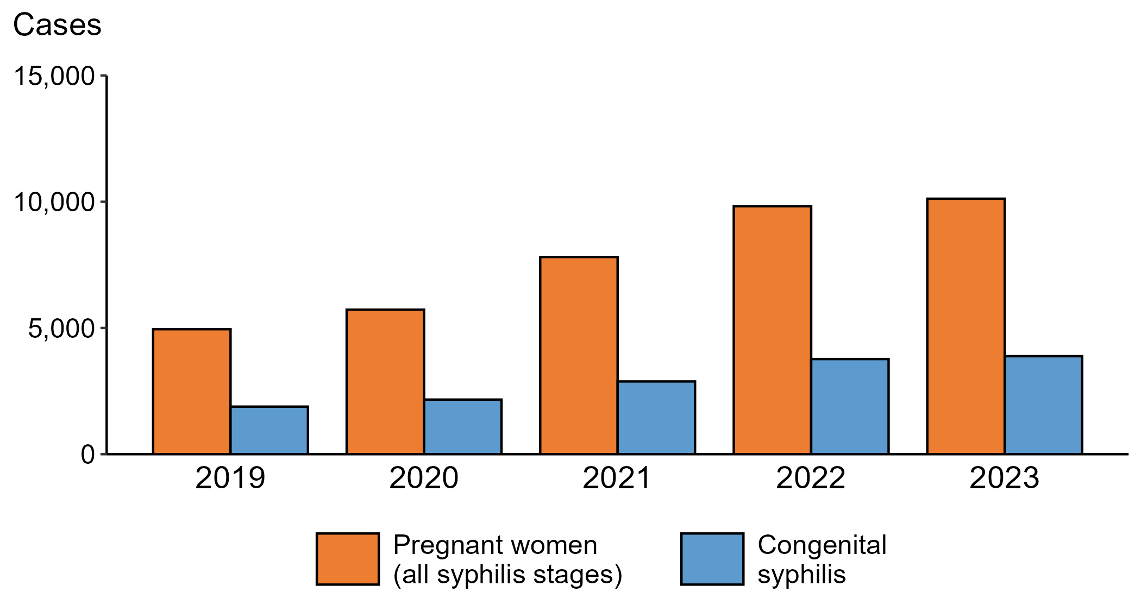
Syphilis — Reported Cases of Syphilis (All Stages) among Pregnant Women and Reported Cases of Congenital Syphilis by Year of Birth, United States, 2019–2023
Notes:
In 2023, there were a total of 3,882 cases of congenital syphilis (CS) reported among states and the District of Columbia for a rate of 105.8 per 100,000 live births.
During 2022 to 2023, the number of women reported with syphilis (all stages) who were pregnant increased 3.0% (from 9,823 to 10,121). During the same time period, the number of reported cases of CS increased 3.0% (from 3,769 to 3,882).
During 2019 to 2023, the number of women reported with syphilis (all stages) who were pregnant increased 104.4% (from 4,951 to 10,121). During the same time period, the number of reported cases of CS increased 106.1% (from 1,884 to 3,882).
This report includes data from years that coincide with the COVID-19 pandemic, which introduced uncertainty and difficulty in interpreting STI surveillance data. See Impact of COVID-19 on STIs (https://www.cdc.gov/sti-statistics/about/impact-of-covid-19.html) for more information.
See Technical Notes (https://www.cdc.gov/sti-statistics/annual/technical-notes.html) for information on STI case reporting formats and practices, including collected and derived variables displayed in this report. Table A (https://www.cdc.gov/sti-statistics/data-vis/table-selected-percunknown.html) provides information on unknown, missing, or invalid values of select variables.
Data for all figures are available at https://www.cdc.gov/sti-statistics/media/files/2024/11/2023-STI-Surveillance-Report-Data-Points.zip. The file “CS and Syphilis - Cases Pregnant Women and CS Cases by Year of Birth (US 2019-2023).xlsx” contains the data for the figure presented on this slide.

Slide 43
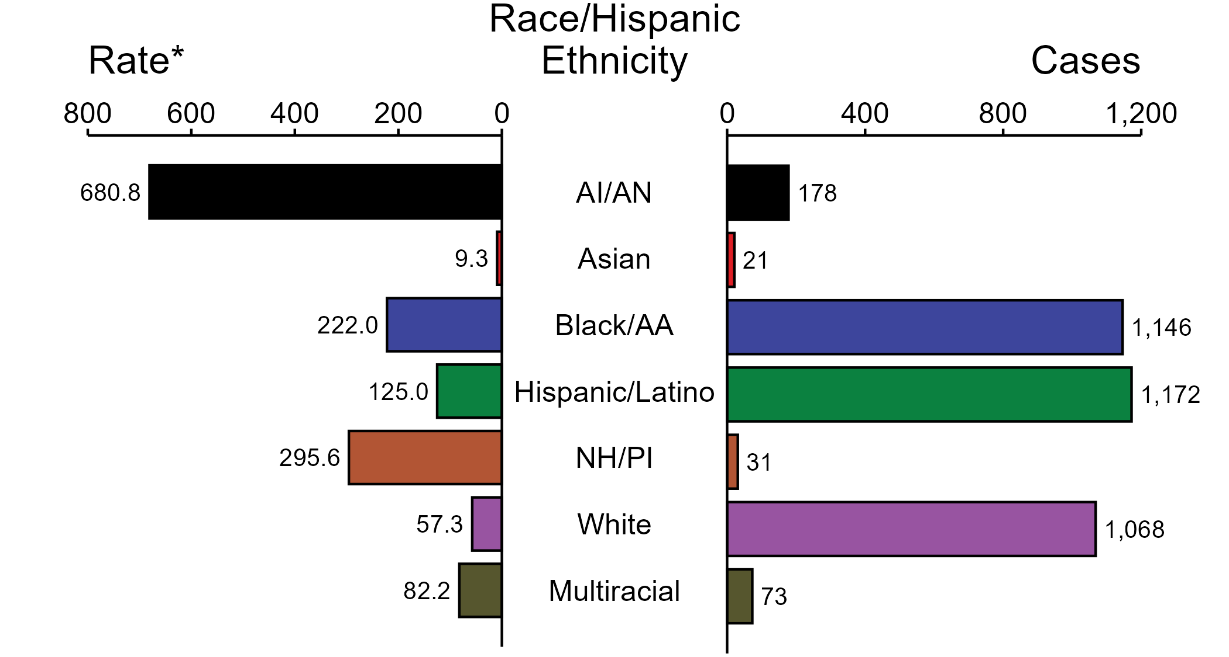
Congenital Syphilis — Case Counts and Rates of Reported Cases by Race/Hispanic Ethnicity of Birth Parent, United States, 2023
* Per 100,000 live births
ACRONYMS: AI/AN = American Indian or Alaska Native; Black/AA = Black or African American; NH/PI = Native Hawaiian or other Pacific Islander
NOTE: In 2023, a total of 193 congenital syphilis (CS) cases (5.0%) had missing, unknown, or other race and were not reported to be of Hispanic ethnicity. These cases are not shown in this figure. Including these cases, there were a total of 3,882 cases of CS reported among states and the District of Columbia for a rate of 105.8 per 100,000 live births.
Notes:
In 2023, there were a total of 3,882 cases of congenital syphilis (CS) reported among states and the District of Columbia for a rate of 105.8 per 100,000 live births.
In 2023, rates of CS were highest among birth parents who were non-Hispanic American Indian or Alaska Native (680.8 per 100,000 live births), followed by birth parents who were non-Hispanic Native Hawaiian or other Pacific Islander (295.6 per 100,000 live births) and birth parents who were non-Hispanic Black or African American (222.0 per 100,000 live births). The greatest number of reported CS cases was among birth parents who were Hispanic or Latino and of any race(s) (1,172 cases), followed by birth parents who were non-Hispanic Black or African American (1,146 cases) and birth parents who were non-Hispanic White (1,068 cases).
This report includes data from years that coincide with the COVID-19 pandemic, which introduced uncertainty and difficulty in interpreting STI surveillance data. See Impact of COVID-19 on STIs (https://www.cdc.gov/sti-statistics/about/impact-of-covid-19.html) for more information.
See Technical Notes (https://www.cdc.gov/sti-statistics/annual/technical-notes.html) for information on STI case reporting formats and practices, including collected and derived variables displayed in this report. Table A (https://www.cdc.gov/sti-statistics/data-vis/table-selected-percunknown.html) provides information on unknown, missing, or invalid values of select variables.
Data for all figures are available at https://www.cdc.gov/sti-statistics/media/files/2024/11/2023-STI-Surveillance-Report-Data-Points.zip. The file “CS - Counts and Rates by Race Hispanic Ethnicity of Birth Parent (US 2023).xlsx” contains the data for the figure presented on this slide.

Slide 44
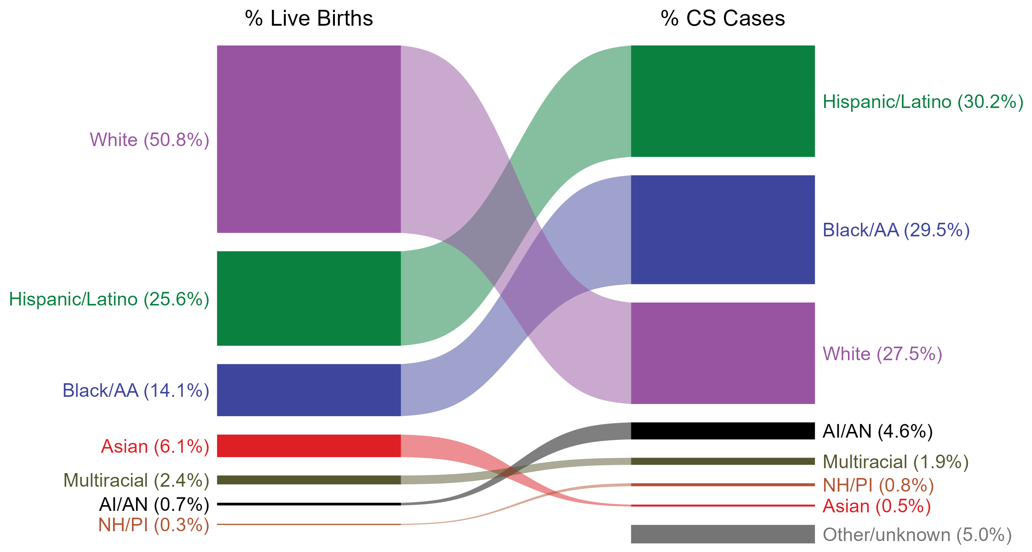
Congenital Syphilis — Total Live Births and Reported Cases by Race/Hispanic Ethnicity of Birth Parent, United States, 2023
NOTE: In 2023, a total of 193 congenital syphilis cases (5.0%) had missing, unknown, or other race and were not reported to be of Hispanic ethnicity. These cases are included in the “other/unknown” category.
ACRONYMS: AI/AN = American Indian or Alaska Native; Black/AA = Black or African American; NH/PI = Native Hawaiian or other Pacific Islander
Notes:
In 2023, there were a total of 3,882 cases of congenital syphilis (CS) reported among states and the District of Columbia for a rate of 105.8 per 100,000 live births.
The percentages of CS cases by race/Hispanic ethnicity of birth parent were disproportionate to the percentages among live births in the United States in 2023. The greatest absolute disparity was observed among non-Hispanic Black or African American birth parents, who represented 29.5% of reported CS cases (n = 1,146; 29.5% of CS cases with reported race or Hispanic ethnicity of birth parent) despite being 14.1% of the live births, or 15.4% more cases than would be expected based on their proportion of live births. The greatest relative disparity was among non-Hispanic American Indian or Alaska Native birth parents, who represented 4.6% of reported CS cases (n = 178; 4.6% of CS cases with reported race or Hispanic ethnicity of birth parent) despite being 0.7% of live births, or a burden 6.6 times what would be expected based on their proportion of live births. Additionally, Hispanic or Latino birth parents of any race(s) and non-Hispanic Native Hawaiian or other Pacific Islander birth parents were also overrepresented among CS cases relative to their proportion of live births.
This report includes data from years that coincide with the COVID-19 pandemic, which introduced uncertainty and difficulty in interpreting STI surveillance data. See Impact of COVID-19 on STIs (https://www.cdc.gov/sti-statistics/about/impact-of-covid-19.html) for more information.
See Technical Notes (https://www.cdc.gov/sti-statistics/annual/technical-notes.html) for information on STI case reporting formats and practices, including collected and derived variables displayed in this report. Table A (https://www.cdc.gov/sti-statistics/data-vis/table-selected-percunknown.html) provides information on unknown, missing, or invalid values of select variables.
Data for all figures are available at https://www.cdc.gov/sti-statistics/media/files/2024/11/2023-STI-Surveillance-Report-Data-Points.zip. The file “CS - Live Births and Cases by Race Hispanic Ethnicity of Birth Parent (US 2023).xlsx” contains the data for the figure presented on this slide.

Slide 45
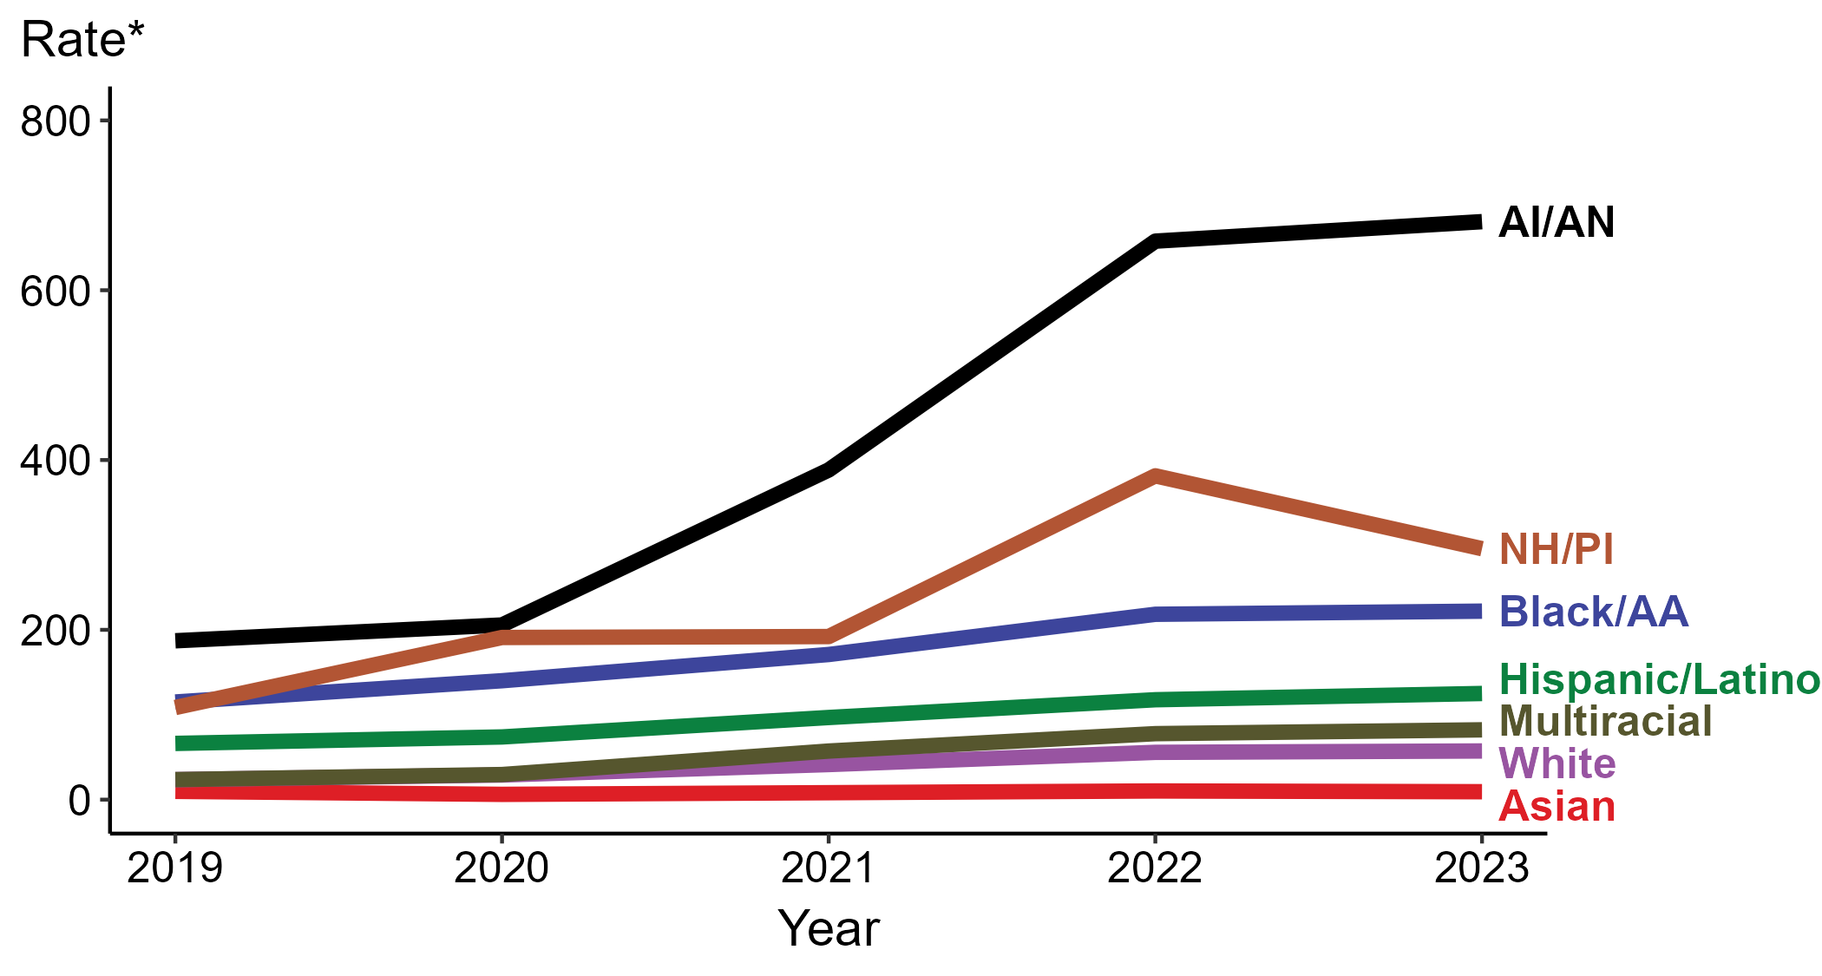
Congenital Syphilis — Rates of Reported Cases by Race/Hispanic Ethnicity of Birth Parent and Year of Birth, United States, 2019–2023
* Per 100,000 live births
ACRONYMS: AI/AN = American Indian or Alaska Native; Black/AA = Black or African American; NH/PI = Native Hawaiian or other Pacific Islander
NOTE: During 2019 to 2023, the percentage of all congenital syphilis cases with missing, unknown, or other race and not reported to be of Hispanic ethnicity was 5.2%, from a low of 5.0% (n = 193) in 2023 and 2019 to a high of 5.5% (n = 119) in 2020. These cases are not shown in this figure.
Notes:
In 2023, there were a total of 3,882 cases of congenital syphilis (CS) reported among states and the District of Columbia for a rate of 105.8 per 100,000 live births.
In 2023, the highest rate of reported cases of CS per 100,000 live births was among birth parents who were non-Hispanic American Indian or Alaska Native (680.8), followed by birth parents who were non-Hispanic Native Hawaiian or other Pacific Islander (295.6).
During 2022 to 2023, the greatest increase in rate of reported cases of CS per 100,000 live births was among birth parents who were Hispanic or Latino and of any race(s) (117.7 to 125.0; 6.2% increase). Birth parents who were non-Hispanic American Indian or Alaska Native had the greatest five-year increase in rate of CS (187.1 to 680.8; 263.9% increase from 2019).
During 2022 to 2023, the greatest decrease in rate of reported cases of CS per 100,000 live births was among birth parents who were non-Hispanic Native Hawaiian or other Pacific Islander (381.4 to 295.6; 22.5% decrease). Birth parents who were non-Hispanic Asian had the only five-year decrease in rate of CS (9.8 to 9.3; 5.1% decrease from 2019).
This report includes data from years that coincide with the COVID-19 pandemic, which introduced uncertainty and difficulty in interpreting STI surveillance data. See Impact of COVID-19 on STIs (https://www.cdc.gov/sti-statistics/about/impact-of-covid-19.html) for more information.
See Technical Notes (https://www.cdc.gov/sti-statistics/annual/technical-notes.html) for information on STI case reporting formats and practices, including collected and derived variables displayed in this report. Table A (https://www.cdc.gov/sti-statistics/data-vis/table-selected-percunknown.html) provides information on unknown, missing, or invalid values of select variables.
Data for all figures are available at https://www.cdc.gov/sti-statistics/media/files/2024/11/2023-STI-Surveillance-Report-Data-Points.zip. The file “CS - Rates by Race Hispanic Ethnicity of Birth Parent (US 2019-2023).xlsx” contains the data for the figure presented on this slide.

Slide 46
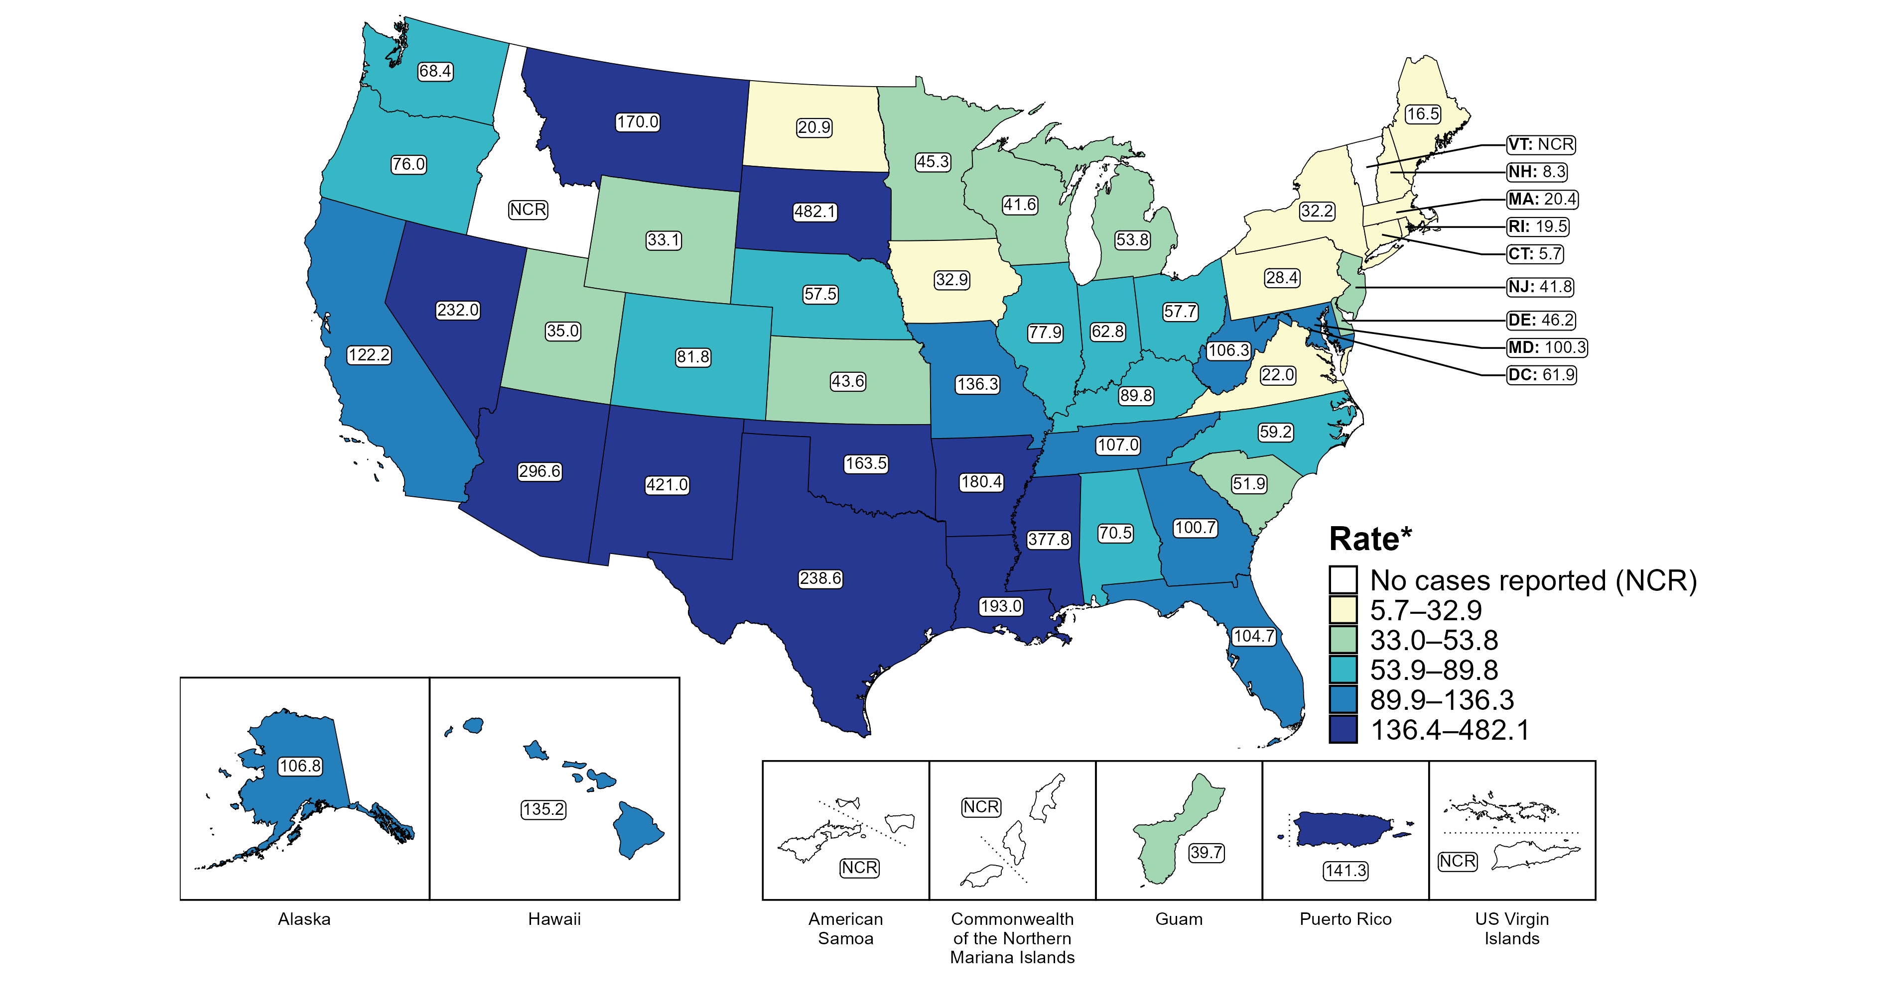
Congenital Syphilis — Rates of Reported Cases by Jurisdiction, United States and Territories, 2023
* Per 100,000 live births
Notes:
In 2023, there were a total of 3,882 cases of congenital syphilis (CS) reported among states and the District of Columbia (DC) for a rate of 105.8 per 100,000 live births. Rates of reported CS among states reporting any cases ranged from 5.7 cases per 100,000 live births in Connecticut to 482.1 cases per 100,000 live births in South Dakota. No cases of CS were reported in Idaho and Vermont. The rate of reported CS in DC was 61.9 per 100,000 live births.
Including data from US territories, there were a total of 3,910 cases of CS reported for a rate of 105.9 per 100,000 live births in 2023. Among US territories reporting any cases, rates of reported CS ranged from 39.7 cases per 100,000 live births in Guam to 141.3 cases per 100,000 live births in Puerto Rico. No cases of CS were reported in American Samoa, the Commonwealth of the Northern Mariana Islands, or the US Virgin Islands.
Tennessee transitioned STI surveillance information systems in September of 2023 which may have impacted the overall case counts. Caution should be applied in interpretation of these data.
This report includes data from years that coincide with the COVID-19 pandemic, which introduced uncertainty and difficulty in interpreting STI surveillance data. See Impact of COVID-19 on STIs (https://www.cdc.gov/sti-statistics/about/impact-of-covid-19.html) for more information.
See Technical Notes (https://www.cdc.gov/sti-statistics/annual/technical-notes.html) for information on syphilis case reporting and on interpreting reported rates in US territories. Table A (https://www.cdc.gov/sti-statistics/data-vis/table-selected-percunknown.html) provides information on unknown, missing, or invalid values of select variables.
Data for all figures are available at https://www.cdc.gov/sti-statistics/media/files/2024/11/2023-STI-Surveillance-Report-Data-Points.zip. The file “CS - Rates by Jurisdiction (US and Terr 2023).xlsx” contains the data for the figure presented on this slide.

Slide 47
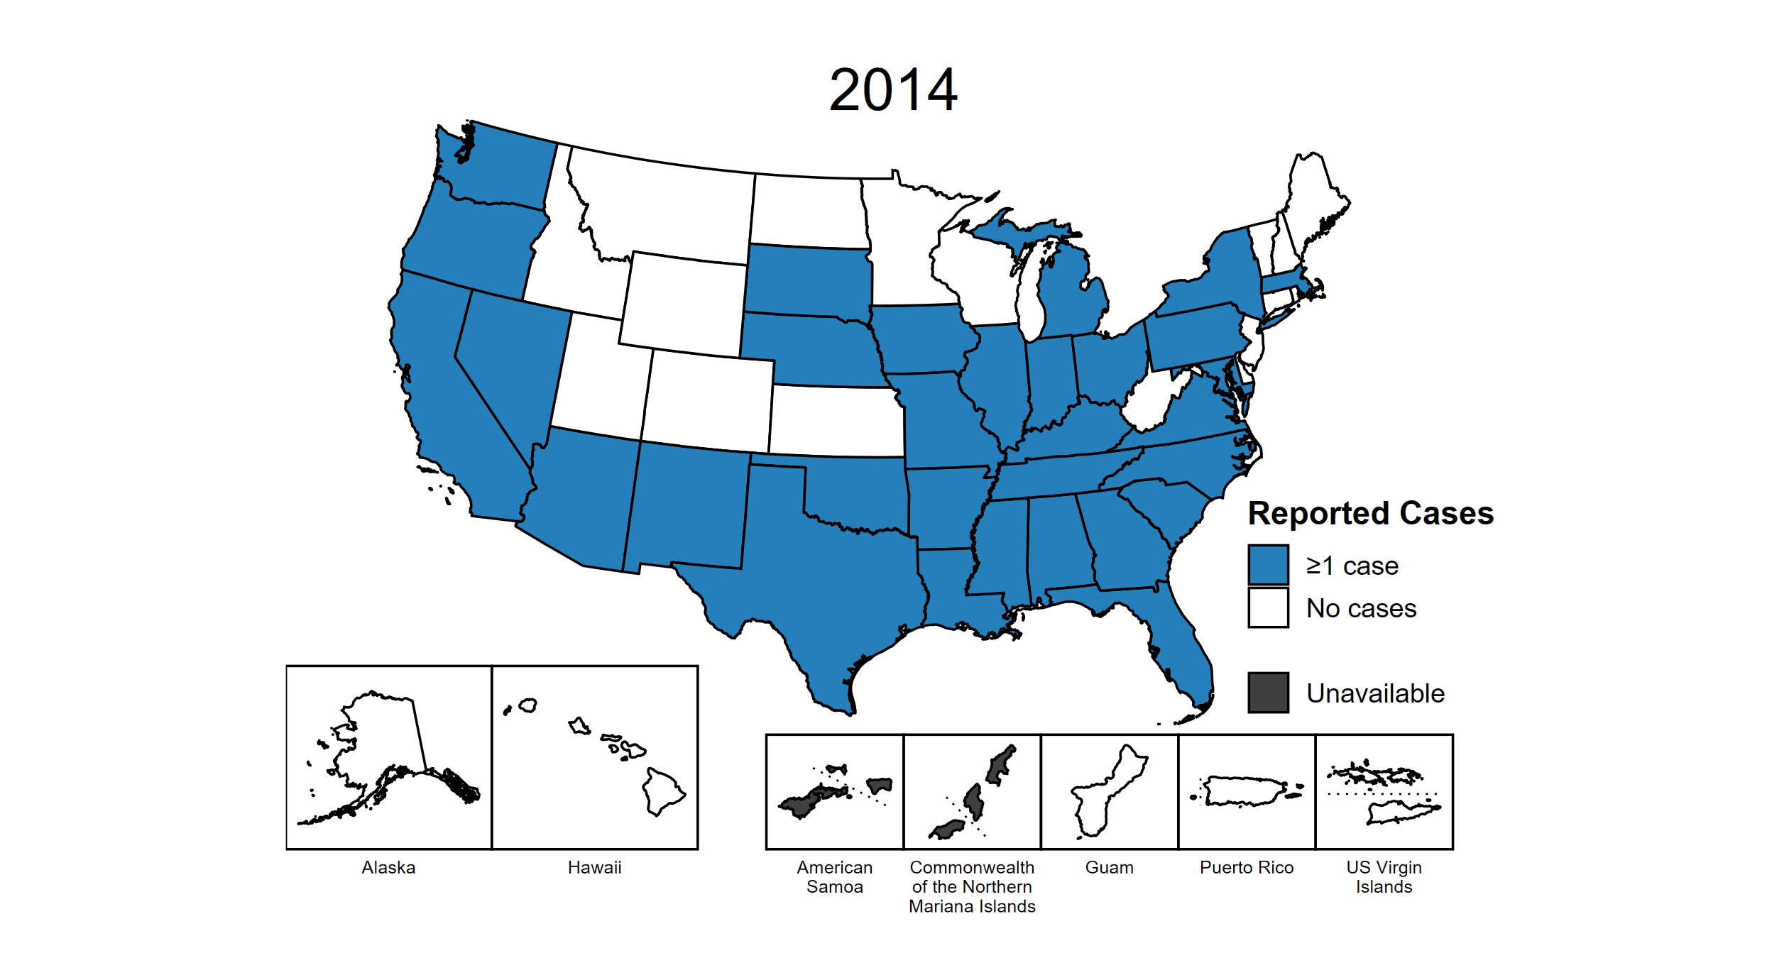
Congenital Syphilis — Reported Cases by Year of Birth and Jurisdiction, United States and Territories, 2014–2023
Notes:
This slide contains an animated figure that will play when the slide is in presentation mode. A static version of the figure that displays maps from the first and last years of the range is available as a separate slide.
In 2023, there were a total of 3,882 cases of congenital syphilis (CS) reported among states and the District of Columbia (DC) for a rate of 105.8 per 100,000 live births. Including data from US territories, there were a total of 3,910 cases of CS reported for a rate of 105.9 per 100,000 live births.
In 2014, 31 states and no US territories (57.4% of areas with available data) reported one or more cases of CS. This increased to 48 states, DC, and two US territories (91.1% of areas with available data) in 2023.
American Samoa and the Commonwealth of the Northern Mariana Islands began providing data on CS cases to CDC in 2018; data are not available for those areas prior to that year. In addition, data on reported CS cases in 2018 are not available for the US Virgin Islands. Due to a network security incident in December 2021, the Maryland Department of Health could not finalize their 2021 STI case notification data. Data for 2021 from Maryland have been suppressed for this figure; however, they are included in national and regional case counts and rates displayed in other figures. Tennessee transitioned STI surveillance information systems in September of 2023 which may have impacted the overall case counts. Caution should be applied in interpretation of these data.
This report includes data from years that coincide with the COVID-19 pandemic, which introduced uncertainty and difficulty in interpreting STI surveillance data. See Impact of COVID-19 on STIs (https://www.cdc.gov/sti-statistics/about/impact-of-covid-19.html) for more information.
See Technical Notes (https://www.cdc.gov/sti-statistics/annual/technical-notes.html) for information on STI case reporting formats and practices, including collected and derived variables displayed in this report. Table A (https://www.cdc.gov/sti-statistics/data-vis/table-selected-percunknown.html) provides information on unknown, missing, or invalid values of select variables.
Data for all figures are available at https://www.cdc.gov/sti-statistics/media/files/2024/11/2023-STI-Surveillance-Report-Data-Points.zip. The file “CS - Cases by Year of Birth and Jurisdiction (US and Terr, 2014-2023).xlsx” contains the data for the figure presented on this slide.

Slide 48
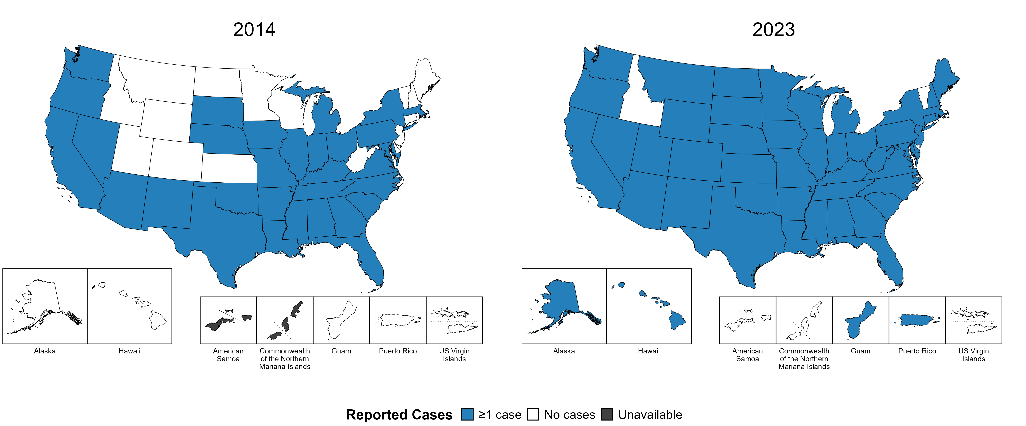
Congenital Syphilis — Reported Cases by Year of Birth and Jurisdiction, United States and Territories, 2014 and 2023
Notes:
In 2023, there were a total of 3,882 cases of congenital syphilis (CS) reported among states and the District of Columbia (DC) for a rate of 105.8 per 100,000 live births. Including data from US territories, there were a total of 3,910 cases of CS reported for a rate of 105.9 per 100,000 live births.
In 2014, 31 states and no US territories (57.4% of areas with available data) reported one or more cases of CS. This increased to 48 states, DC, and two US territories (91.1% of areas with available data) in 2023.
American Samoa and the Commonwealth of the Northern Mariana Islands began providing data on CS cases to CDC in 2018; data are not available for those areas prior to that year. Tennessee transitioned STI surveillance information systems in September of 2023 which may have impacted the overall case counts. Caution should be applied in interpretation of these data.
This report includes data from years that coincide with the COVID-19 pandemic, which introduced uncertainty and difficulty in interpreting STI surveillance data. See Impact of COVID-19 on STIs (https://www.cdc.gov/sti-statistics/about/impact-of-covid-19.html) for more information.
See Technical Notes (https://www.cdc.gov/sti-statistics/annual/technical-notes.html) for information on STI case reporting formats and practices, including collected and derived variables displayed in this report. Table A (https://www.cdc.gov/sti-statistics/data-vis/table-selected-percunknown.html) provides information on unknown, missing, or invalid values of select variables.
Data for all figures are available at https://www.cdc.gov/sti-statistics/media/files/2024/11/2023-STI-Surveillance-Report-Data-Points.zip. The file “CS - Cases by Year of Birth and Jurisdiction (US and Terr, 2014 and 2023).xlsx” contains the data for the figure presented on this slide.

Slide 49
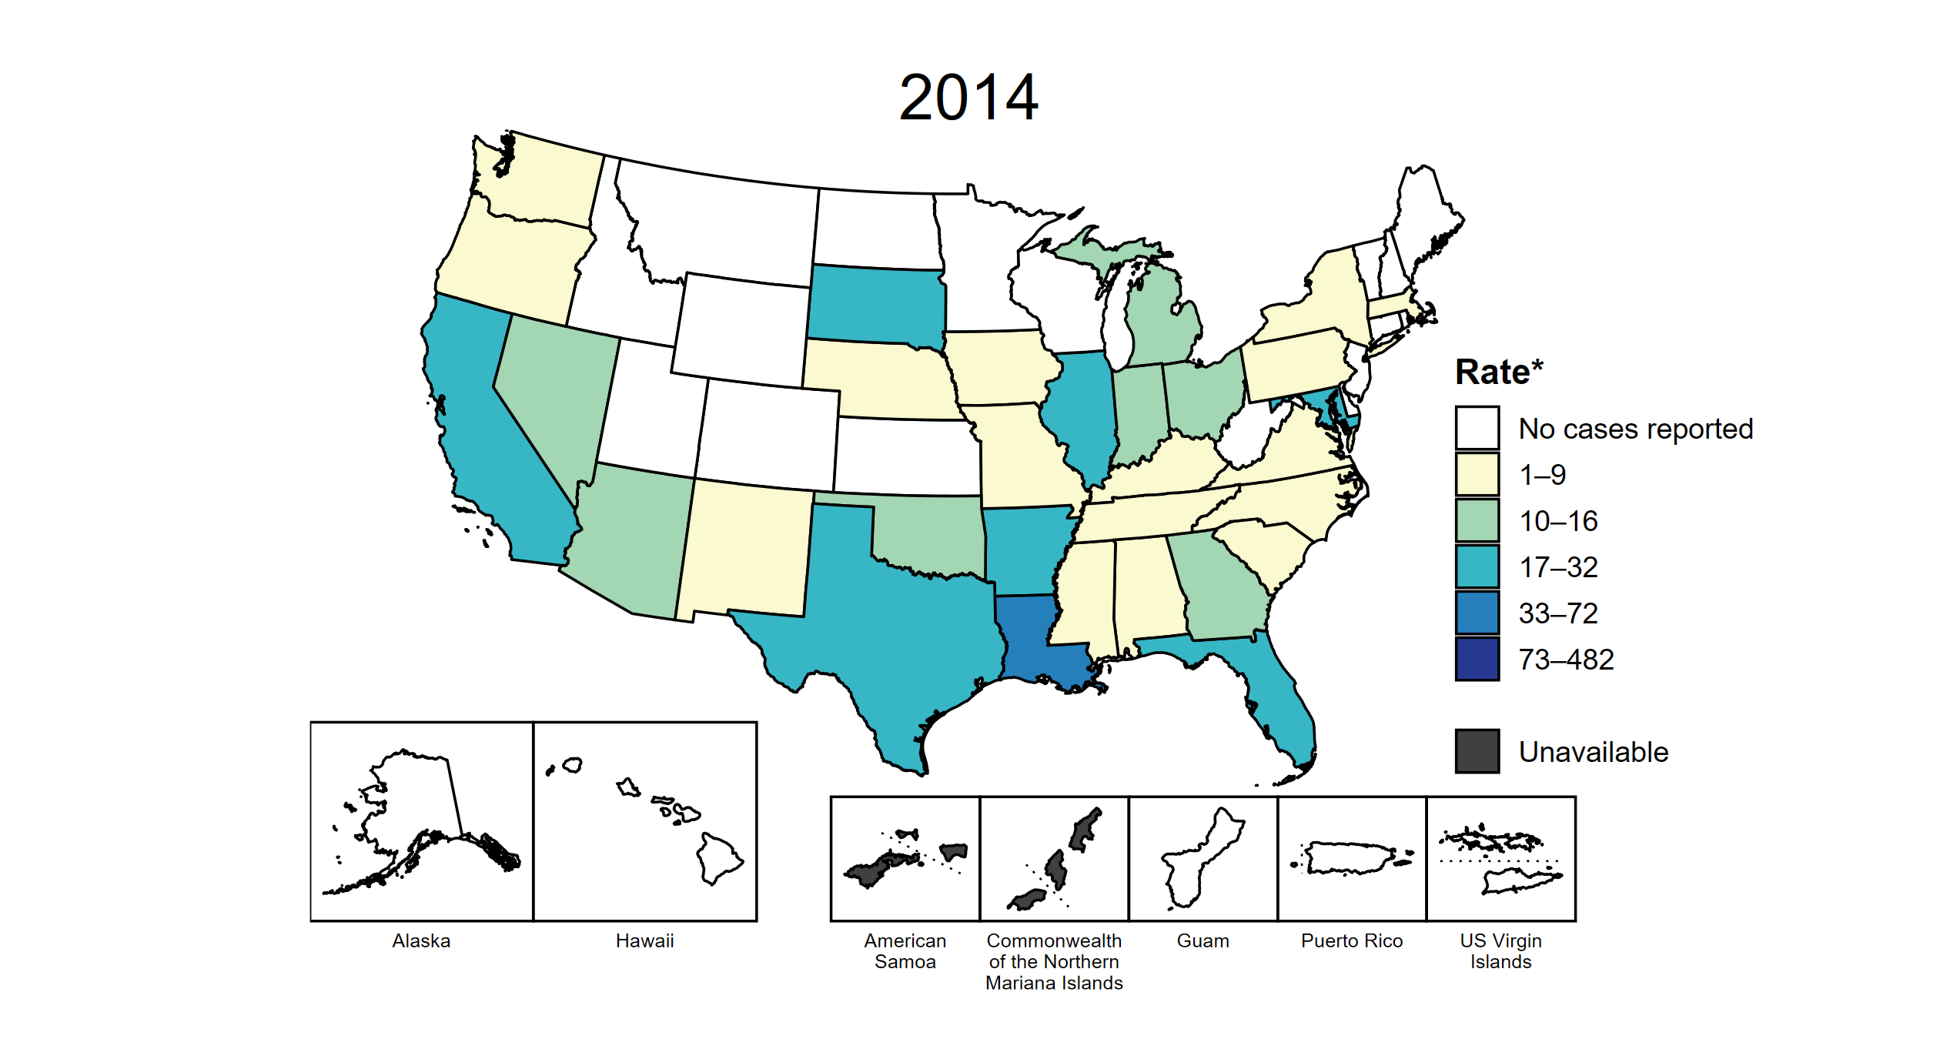
Congenital Syphilis — Rates of Reported Cases by Year of Birth and Jurisdiction, United States and Territories, 2014–2023
* Per 100,000 live births
Notes:
This slide contains an animated figure that will play when the slide is in presentation mode. A static version of the figure that displays maps from the first and last years of the range is available as a separate slide.
In 2023, there were a total of 3,882 cases of congenital syphilis (CS) reported among states and the District of Columbia (DC) for a rate of 105.8 per 100,000 live births. Including data from US territories, there were a total of 3,910 cases of CS reported for a rate of 105.9 per 100,000 live births.
In 2014, one state (1.9% of areas with available data) had a rate of reported CS greater than or equal to 33 cases per 100,000 live births. This increased to 39 states, DC, and two US territories (75.0% of areas with available data) in 2023. During 2022 to 2023, rates of reported CS among live births increased in 30 states and two territories.
American Samoa and the Commonwealth of the Northern Mariana Islands began providing data on CS cases to CDC in 2018; data are not available for those areas prior to that year. In addition, data on reported CS cases in 2018 are not available for the US Virgin Islands. Due to a network security incident in December 2021, the Maryland Department of Health could not finalize their 2021 STI case notification data. Data for 2021 from Maryland have been suppressed for this figure; however, they are included in national and regional case counts and rates displayed in other figures. Tennessee transitioned STI surveillance information systems in September of 2023 which may have impacted the overall case counts. Caution should be applied in interpretation of these data.
This report includes data from years that coincide with the COVID-19 pandemic, which introduced uncertainty and difficulty in interpreting STI surveillance data. See Impact of COVID-19 on STIs (https://www.cdc.gov/sti-statistics/about/impact-of-covid-19.html) for more information.
See Technical Notes (https://www.cdc.gov/sti-statistics/annual/technical-notes.html) for information on STI case reporting formats and practices, including collected and derived variables displayed in this report. Table A (https://www.cdc.gov/sti-statistics/data-vis/table-selected-percunknown.html) provides information on unknown, missing, or invalid values of select variables.
Data for all figures are available at https://www.cdc.gov/sti-statistics/media/files/2024/11/2023-STI-Surveillance-Report-Data-Points.zip. The file “CS - Rates by Year of Birth and Jurisdiction (US and Terr, 2014-2023).xlsx” contains the data for the figure presented on this slide.

Slide 50
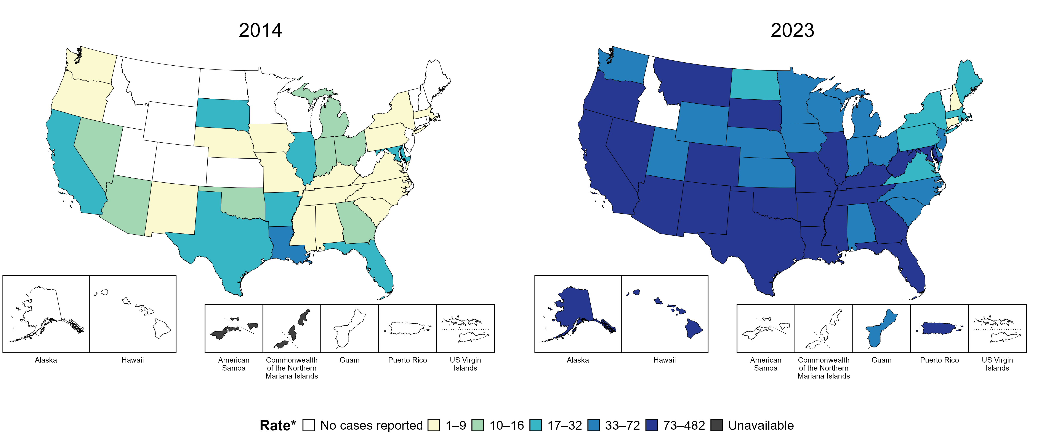
Congenital Syphilis — Rates of Reported Cases by Year of Birth and Jurisdiction, United States and Territories, 2014 and 2023
* Per 100,000 live births
Notes:
In 2023, there were a total of 3,882 cases of congenital syphilis (CS) reported among states and the District of Columbia (DC) for a rate of 105.8 per 100,000 live births. Including data from US territories, there were a total of 3,910 cases of CS reported for a rate of 105.9 per 100,000 live births.
In 2014, one state (1.9% of areas with available data) had a rate of reported CS greater than or equal to 33 cases per 100,000 live births. This increased to 39 states, DC, and two US territories (75.0% of areas with available data) in 2023.
American Samoa and the Commonwealth of the Northern Mariana Islands began providing data on CS cases to CDC in 2018; data are not available for those areas prior to that year. Tennessee transitioned STI surveillance information systems in September of 2023 which may have impacted the overall case counts. Caution should be applied in interpretation of these data.
This report includes data from years that coincide with the COVID-19 pandemic, which introduced uncertainty and difficulty in interpreting STI surveillance data. See Impact of COVID-19 on STIs (https://www.cdc.gov/sti-statistics/about/impact-of-covid-19.html) for more information.
See Technical Notes (https://www.cdc.gov/sti-statistics/annual/technical-notes.html) for information on STI case reporting formats and practices, including collected and derived variables displayed in this report. Table A (https://www.cdc.gov/sti-statistics/data-vis/table-selected-percunknown.html) provides information on unknown, missing, or invalid values of select variables.
Data for all figures are available at https://www.cdc.gov/sti-statistics/media/files/2024/11/2023-STI-Surveillance-Report-Data-Points.zip. The file “CS - Rates by Year of Birth and Jurisdiction (US and Terr 2014 and 2023).xlsx” contains the data for the figure presented on this slide.

Slide 51
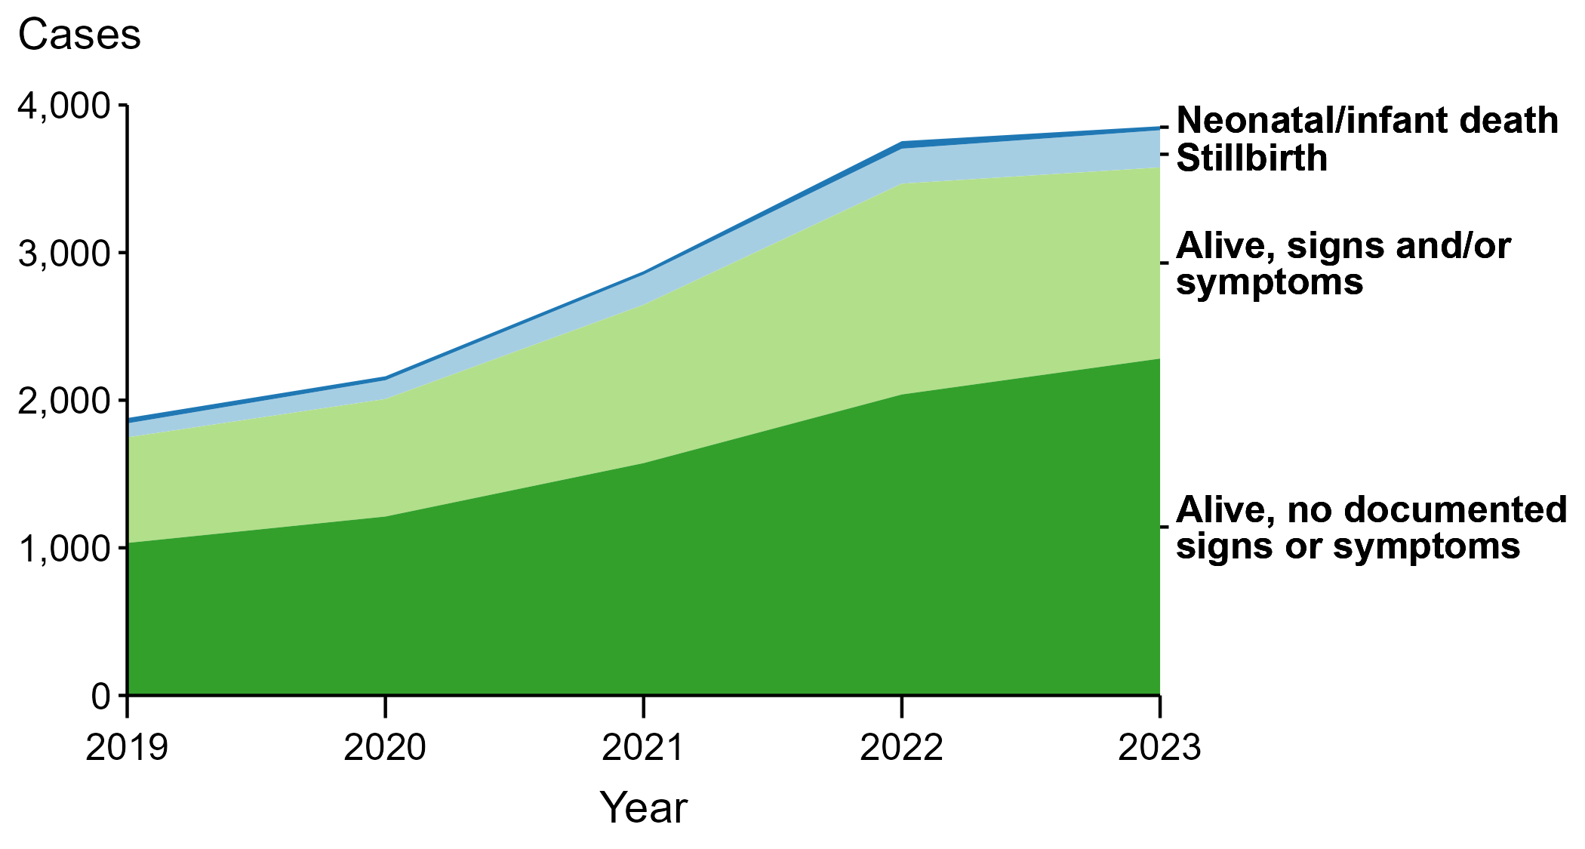
Congenital Syphilis — Reported Cases by Vital Status and Clinical Signs and Symptoms* of Infection and Year, United States, 2019–2023
* Neonates/infants with signs and/or symptoms of congenital syphilis (CS) have documentation of at least one of the following: long bone changes consistent with CS, snuffles, condylomata lata, syphilitic skin rash, pseudoparalysis, hepatosplenomegaly, edema, jaundice due to syphilitic hepatitis, reactive CSF-VDRL, elevated CSF WBC or protein values, or evidence of direct detection of T. pallidum.
NOTE: Of the 14,579 congenital syphilis cases reported during 2019 to 2023, 53 (0.4%) did not have sufficient information to be categorized.
Notes:
In 2023, there were a total of 3,882 cases of congenital syphilis (CS) reported among states and the District of Columbia for a rate of 105.8 per 100,000 live births.
In 2023, 27 cases (0.7%) were neonatal/infant deaths, 252 cases (6.5%) were stillbirths, 1,295 cases (33.4%) were born alive with CS-related signs or symptoms, 2,282 cases (58.8%) were born alive with no documented CS-related signs or symptoms, and 26 cases (0.7%) were missing information on vital status.
In 2023, there were 279 CS-related deaths (252 stillbirths and 27 neonatal/infant deaths), a decrease of 3.1% from 2022 (288 to 279) and an increase of 113.0% from 2019 (131 to 279).
The number of infants reported with CS who were born alive with CS-related signs and symptoms decreased 9.3% from 2022 to 2023 (1,428 to 1,295) and increased 81.1% from 2019 to 2023 (715 to 1,295).
This report includes data from years that coincide with the COVID-19 pandemic, which introduced uncertainty and difficulty in interpreting STI surveillance data. See Impact of COVID-19 on STIs (https://www.cdc.gov/sti-statistics/about/impact-of-covid-19.html) for more information.
See Technical Notes (https://www.cdc.gov/sti-statistics/annual/technical-notes.html) for information on STI case reporting formats and practices, including collected and derived variables displayed in this report. Table A (https://www.cdc.gov/sti-statistics/data-vis/table-selected-percunknown.html) provides information on unknown, missing, or invalid values of select variables.
Data for all figures are available at https://www.cdc.gov/sti-statistics/media/files/2024/11/2023-STI-Surveillance-Report-Data-Points.zip. The file “CS - Cases by Vital Status and Clinical Signs and Symptoms (US 2019-2023).xlsx” contains the data for the figure presented on this slide.

Slide 52
Congenital Syphilis — Reported Stillbirths and Neonatal/Infant Deaths by Year, United States, 2014–2023
Notes:
In 2023, there were a total of 3,882 cases of congenital syphilis (CS) reported among states and the District of Columbia for a rate of 105.8 per 100,000 live births.
In 2023, 252 CS-related stillbirths were reported, an increase of 6.3% since 2022 and an increase of 800.0% since 2014.
In 2023, 27 CS-related neonatal/infant deaths were reported, a decrease of 47.1% since 2022 and an increase of 237.5% since 2014.
This report includes data from years that coincide with the COVID-19 pandemic, which introduced uncertainty and difficulty in interpreting STI surveillance data. See Impact of COVID-19 on STIs (https://www.cdc.gov/sti-statistics/about/impact-of-covid-19.html) for more information.
See Technical Notes (https://www.cdc.gov/sti-statistics/annual/technical-notes.html) for information on STI case reporting formats and practices, including collected and derived variables displayed in this report. Table A (https://www.cdc.gov/sti-statistics/data-vis/table-selected-percunknown.html) provides information on unknown, missing, or invalid values of select variables.
Data for all figures are available at https://www.cdc.gov/sti-statistics/media/files/2024/11/2023-STI-Surveillance-Report-Data-Points.zip. The file “CS - Reported Stillbirths and Neonatal/Infant Deaths (US 2014-2023).xlsx” contains the data for the figure presented on this slide.

Slide 53
Congenital Syphilis — Distribution of Receipt of Testing and Treatment by Pregnant Persons with a Congenital Syphilis Outcome, United States, 2023
* Cases with insufficient data to assign a likely missed opportunity were due to missing or incomplete data in case notification data at CDC. More complete data on these cases may be available at the jurisdictional level, allowing for ascertainment of the likely missed opportunity.
NOTE: Percentages represent the number of congenital syphilis (CS) cases among the 3,882 total CS cases reported among states and the District of Columbia in 2023.
Notes:
In 2023, there were a total of 3,882 cases of congenital syphilis (CS) reported among states and the District of Columbia for a rate of 105.8 per 100,000 live births.
In 2023, the most common missed prevention opportunity among birth parents of infants with CS was no documented timely test (n = 1,648; 42.5%), followed by no treatment or non-documented treatment (n = 872; 22.5%).
These “missed opportunities” for prevention of CS correspond to critical elements in the cascade of care for syphilis in pregnancy, including timely screening and adequate and timely treatment. Barriers at each step are multifactorial and are frequently related to structural and systematic issues such as housing status and healthcare access, along with syndemics such as substance use disorder. These issues are often beyond the capacity of individual providers to address, and require focused, multi-stakeholder policy interventions.
This report includes data from years that coincide with the COVID-19 pandemic, which introduced uncertainty and difficulty in interpreting STI surveillance data. See Impact of COVID-19 on STIs (https://www.cdc.gov/sti-statistics/about/impact-of-covid-19.html) for more information.
See Technical Notes (https://www.cdc.gov/sti-statistics/annual/technical-notes.html) for information on STI case reporting formats and practices, including collected and derived variables displayed in this report. Table A (https://www.cdc.gov/sti-statistics/data-vis/table-selected-percunknown.html) provides information on unknown, missing, or invalid values of select variables.
Data for all figures are available at https://www.cdc.gov/sti-statistics/media/files/2024/11/2023-STI-Surveillance-Report-Data-Points.zip. The file “CS - Receipt of Testing and Treatment by Pregnant Person with CS Outcome (US 2023).xlsx” contains the data for the figure presented on this slide.

Slide 54
Primary and Secondary Syphilis — Rates of Reported Cases Among Women by Jurisdiction, United States and Territories, 2023
* Per 100,000
Notes:
In 2023, rates of reported primary and secondary (P&S) syphilis among states reporting any cases among women ranged from 0.7 cases per 100,000 women in Wyoming to 72.6 cases per 100,000 women in South Dakota. No cases of P&S syphilis among women were reported in Vermont. The rate of reported P&S syphilis in the District of Columbia was 10.9 per 100,000 women.
Among US territories reporting any cases, rates of reported P&S syphilis ranged from 2.4 cases per 100,000 women in Guam to 6.9 cases per 100,000 women in Puerto Rico. No cases of P&S syphilis among women were reported in American Samoa, the Commonwealth of the Northern Mariana Islands, or the US Virgin Islands.
Tennessee transitioned STI surveillance information systems in September of 2023 which may have impacted the overall case counts. Caution should be applied in interpretation of these data.
This report includes data from years that coincide with the COVID-19 pandemic, which introduced uncertainty and difficulty in interpreting STI surveillance data. See Impact of COVID-19 on STIs (https://www.cdc.gov/sti-statistics/about/impact-of-covid-19.html) for more information.
See Technical Notes (https://www.cdc.gov/sti-statistics/annual/technical-notes.html) for information on STI case reporting formats and practices, including collected and derived variables displayed in this report. Table A (https://www.cdc.gov/sti-statistics/data-vis/table-selected-percunknown.html) provides information on unknown, missing, or invalid values of select variables.
Data for all figures are available at https://www.cdc.gov/sti-statistics/media/files/2024/11/2023-STI-Surveillance-Report-Data-Points.zip. The file “PS Syphilis - Rates Women by Jurisdiction (US and Terr 2023).xlsx” contains the data for the figure presented on this slide.

Slide 55
Primary and Secondary Syphilis — Rates of Reported Cases Among Women Aged 15–44 Years by Jurisdiction, United States and Territories, 2014–2023
* Per 100,000
Notes:
This slide contains an animated figure that will play when the slide is in presentation mode. A static version of the figure that displays maps from the first and last years of the range is available as a separate slide.
In 2014, two states (3.8% of areas with available data) had a rate of reported primary and secondary syphilis greater than or equal to 8 cases per 100,000 women aged 15 to 44 years. This increased to 41 states, the District of Columbia (DC), and one US territory (76.8% of areas with available data) in 2023. During 2022 to 2023, rates of reported primary and secondary syphilis among women aged 15 to 44 years increased in 16 states, DC, and one territory.
American Samoa and the Commonwealth of the Northern Mariana Islands began providing data on P&S syphilis cases to CDC in 2018; data are not available for those areas prior to that year. In addition, data on reported P&S syphilis cases in 2018 are not available for the US Virgin Islands. Furthermore, population estimates by age and sex were not available for all territories for all years. Due to a network security incident in December 2021, the Maryland Department of Health could not finalize their 2021 STI case notification data. Data for 2021 from Maryland have been suppressed for this figure; however, they are included in national and regional case counts and rates displayed in other figures. Tennessee transitioned STI surveillance information systems in September of 2023 which may have impacted the overall case counts. Caution should be applied in interpretation of these data.
This report includes data from years that coincide with the COVID-19 pandemic, which introduced uncertainty and difficulty in interpreting STI surveillance data. See Impact of COVID-19 on STIs (https://www.cdc.gov/sti-statistics/about/impact-of-covid-19.html) for more information.
See Technical Notes (https://www.cdc.gov/sti-statistics/annual/technical-notes.html) for information on STI case reporting formats and practices, including collected and derived variables displayed in this report. Table A (https://www.cdc.gov/sti-statistics/data-vis/table-selected-percunknown.html) provides information on unknown, missing, or invalid values of select variables.
Data for all figures are available at https://www.cdc.gov/sti-statistics/media/files/2024/11/2023-STI-Surveillance-Report-Data-Points.zip. The file “PS Syphilis - Rates Women 15-44 Years by Jurisdiction (US and Terr 2014-2023).xlsx” contains the data for the figure presented on this slide.

Slide 56
Primary and Secondary Syphilis — Rates of Reported Cases Among Women Aged 15–44 Years by Jurisdiction, United States and Territories, 2014 and 2023
* Per 100,000
Notes:
In 2014, two states (3.8% of areas with available data) had a rate of reported primary and secondary syphilis greater than or equal to 8 cases per 100,000 women aged 15 to 44 years. This increased to 41 states, the District of Columbia, and one US territory (76.8% of areas with available data) in 2023.
American Samoa and the Commonwealth of the Northern Mariana Islands began providing data on P&S syphilis cases to CDC in 2018; data are not available for those areas prior to that year. Additionally, population estimates by age and sex were not available for all territories for both years. Tennessee transitioned STI surveillance information systems in September of 2023 which may have impacted the overall case counts. Caution should be applied in interpretation of these data.
This report includes data from years that coincide with the COVID-19 pandemic, which introduced uncertainty and difficulty in interpreting STI surveillance data. See Impact of COVID-19 on STIs (https://www.cdc.gov/sti-statistics/about/impact-of-covid-19.html) for more information.
See Technical Notes (https://www.cdc.gov/sti-statistics/annual/technical-notes.html) for information on STI case reporting formats and practices, including collected and derived variables displayed in this report. Table A (https://www.cdc.gov/sti-statistics/data-vis/table-selected-percunknown.html) provides information on unknown, missing, or invalid values of select variables.
Data for all figures are available at https://www.cdc.gov/sti-statistics/media/files/2024/11/2023-STI-Surveillance-Report-Data-Points.zip. The file “PS Syphilis - Rates Women 15-44 Years by Jurisdiction (US and Terr 2014 and 2023).xlsx” contains the data for the figure presented on this slide.

Slide 57
Syphilis (All Stages) — Rates of Reported Cases Among Women Aged 15–44 Years by Jurisdiction, United States and Territories, 2014 and 2023
* Per 100,000
Notes:
In 2014, one state (2.0% of areas with available data) had a rate of reported syphilis (all stages) greater than or equal to 28 cases per 100,000 women aged 15 to 44 years. This increased to 44 states, the District of Columbia, and one US territory (88.5% of areas with available data) in 2023.
Data on reported cases of syphilis other than primary and secondary syphilis are not available by age and sex for American Samoa, the Commonwealth of the Northern Mariana Islands, Guam, and the US Virgin Islands. Additionally, population estimates by age and sex were not available for all territories for both years. Tennessee transitioned STI surveillance information systems in September of 2023 which may have impacted the overall case counts. Caution should be applied in interpretation of these data.
This report includes data from years that coincide with the COVID-19 pandemic, which introduced uncertainty and difficulty in interpreting STI surveillance data. See Impact of COVID-19 on STIs (https://www.cdc.gov/sti-statistics/about/impact-of-covid-19.html) for more information.
See Technical Notes (https://www.cdc.gov/sti-statistics/annual/technical-notes.html) for information on STI case reporting formats and practices, including collected and derived variables displayed in this report. Table A (https://www.cdc.gov/sti-statistics/data-vis/table-selected-percunknown.html) provides information on unknown, missing, or invalid values of select variables.
Data for all figures are available at https://www.cdc.gov/sti-statistics/media/files/2024/11/2023-STI-Surveillance-Report-Data-Points.zip. The file “Syphilis - Rates Women 15-44 Years by Jurisdiction (US and Terr 2014 and 2023).xlsx” contains the data for the figure presented on this slide.

Slide 58
Syphilis (All Stages) — Rates of Reported Cases Among Women Aged 15–44 Years by Jurisdiction, United States and Territories, 2014–2023
* Per 100,000
Notes:
This slide contains an animated figure that will play when the slide is in presentation mode. A static version of the figure that displays maps from the first and last years of the range is available as a separate slide.
In 2014, one state (2.0% of areas with available data) had a rate of reported syphilis (all stages) greater than or equal to 28 cases per 100,000 women aged 15 to 44 years. This increased to 44 states, the District of Columbia (DC), and one US territory (88.5% of areas with available data) in 2023. During 2022 to 2023, rates of reported syphilis (all stages) among women aged 15 to 44 years increased in 39 states, DC, and one territory.
Data on reported cases of syphilis other than primary and secondary syphilis are not available by age and sex for American Samoa, the Commonwealth of the Northern Mariana Islands, Guam, and the US Virgin Islands. Additionally, population estimates by age and sex were not available for all territories for all years. Due to a network security incident in December 2021, the Maryland Department of Health could not finalize their 2021 STI case notification data. Data for 2021 from Maryland have been suppressed for this figure; however, they are included in national and regional case counts and rates displayed in other figures. Tennessee transitioned STI surveillance information systems in September of 2023 which may have impacted the overall case counts. Caution should be applied in interpretation of these data.
This report includes data from years that coincide with the COVID-19 pandemic, which introduced uncertainty and difficulty in interpreting STI surveillance data. See Impact of COVID-19 on STIs (https://www.cdc.gov/sti-statistics/about/impact-of-covid-19.html) for more information.
See Technical Notes (https://www.cdc.gov/sti-statistics/annual/technical-notes.html) for information on STI case reporting formats and practices, including collected and derived variables displayed in this report. Table A (https://www.cdc.gov/sti-statistics/data-vis/table-selected-percunknown.html) provides information on unknown, missing, or invalid values of select variables.
Data for all figures are available at https://www.cdc.gov/sti-statistics/media/files/2024/11/2023-STI-Surveillance-Report-Data-Points.zip. The file “Syphilis - Rates Women 15-44 Years by Jurisdiction (US and Terr 2014-2023).xlsx” contains the data for the figure presented on this slide.

Slide 59
Syphilis (All Stages) — Reported Cases Among Women Aged 15–44 Years by County, United States, 2019–2023
Notes:
This slide contains an animated figure that will play when the slide is in presentation mode. A static version of the figure that displays maps from the first and last years of the range is available as a separate slide.
In 2019, 1,568 (49.9%) of US counties and county equivalents with available data reported at least one case of syphilis (all stages) among women of reproductive age (15–44 years), increasing to 2,227 (70.8%) of counties and county equivalents with available data in 2023.
During 2022 to 2023, the number of counties and county equivalents increased from 2,132 (68.0% of counties and county equivalents with available data) in 2022 to 2,227 (70.8% of counties and county equivalents with available data) in 2023.
Due to a network security incident in December 2021, the Maryland Department of Health could not finalize their 2021 STI case notification data. Data for 2021 from Maryland have been suppressed for this figure; however, they are included in national and regional case counts and rates displayed in other figures. In 2022, Connecticut adopted nine planning regions as county-equivalent geographic units; as STI case notification data were not available in the new county-equivalent units for 2022, data for Connecticut have been suppressed for this figure. Tennessee transitioned STI surveillance information systems in September of 2023 which may have impacted the overall case counts. Caution should be applied in interpretation of these data.
Note that boundaries for counties and county-equivalent areas change over time and may differ between years depicted in this figure.
This report includes data from years that coincide with the COVID-19 pandemic, which introduced uncertainty and difficulty in interpreting STI surveillance data. See Impact of COVID-19 on STIs (https://www.cdc.gov/sti-statistics/about/impact-of-covid-19.html) for more information.
See Technical Notes (https://www.cdc.gov/sti-statistics/annual/technical-notes.html) for information on STI case reporting formats and practices, including collected and derived variables displayed in this report. Table A (https://www.cdc.gov/sti-statistics/data-vis/table-selected-percunknown.html) provides information on unknown, missing, or invalid values of select variables.
Data for all figures are available at https://www.cdc.gov/sti-statistics/media/files/2024/11/2023-STI-Surveillance-Report-Data-Points.zip. The file “Syphilis - Cases Women 15-44 Years by County (US 2019-2023).xlsx” contains the data for the figure presented on this slide.

Slide 60
Syphilis (All Stages) — Reported Cases Among Women Aged 15–44 Years by County, United States, 2019 and 2023
Notes:
In 2019, 1,568 (49.9%) of US counties and county equivalents with available data reported at least one case of syphilis (all stages) among women of reproductive age (15–44 years), increasing to 2,227 (70.8%) of counties and county equivalents with available data in 2023.
Tennessee transitioned STI surveillance information systems in September of 2023 which may have impacted the overall case counts. Caution should be applied in interpretation of these data.
Note that boundaries for counties and county-equivalent areas change over time and may differ between years depicted in this figure.
This report includes data from years that coincide with the COVID-19 pandemic, which introduced uncertainty and difficulty in interpreting STI surveillance data. See Impact of COVID-19 on STIs (https://www.cdc.gov/sti-statistics/about/impact-of-covid-19.html) for more information.
See Technical Notes (https://www.cdc.gov/sti-statistics/annual/technical-notes.html) for information on STI case reporting formats and practices, including collected and derived variables displayed in this report. Table A (https://www.cdc.gov/sti-statistics/data-vis/table-selected-percunknown.html) provides information on unknown, missing, or invalid values of select variables.
Data for all figures are available at https://www.cdc.gov/sti-statistics/media/files/2024/11/2023-STI-Surveillance-Report-Data-Points.zip. The file “Syphilis - Cases Women 15-44 Years by County (US 2019 and 2023).xlsx” contains the data for the figure presented on this slide.

Slide 61
Primary and Secondary Syphilis — Rates of Reported Cases Among Women Aged 15–44 Years by County, United States, 2023
* Per 100,000
NOTE: The target for the Healthy People 2030 goal to reduce the rate of syphilis in women is 4.6 per 100,000.
Notes:
One goal of Healthy People 2030 is to reduce the rate of syphilis in women to 4.6 per 100,000. In 2023, 1,415 counties and county equivalents (45.1% of counties and county equivalents with available data) had a rate of primary and secondary syphilis among 15-44 year old women greater than 4.6 per 100,000. During the same year, 76.6% of the US population resided in these counties and county equivalents.
Tennessee transitioned STI surveillance information systems in September of 2023 which may have impacted the overall case counts. Caution should be applied in interpretation of these data. Per current re-release guidelines for county-level syphilis case notification data, data have been suppressed for counties and county equivalents where display could identify the age, race, and sex of cases in strata with a population of <100 people.
Per current re-release guidelines for county-level syphilis case notification data, data have been suppressed for counties where display could identify the age, race, and sex of cases in strata with a population of <100 people.
This report includes data from years that coincide with the COVID-19 pandemic, which introduced uncertainty and difficulty in interpreting STI surveillance data. See Impact of COVID-19 on STIs (https://www.cdc.gov/sti-statistics/about/impact-of-covid-19.html) for more information.
See Technical Notes (https://www.cdc.gov/sti-statistics/annual/technical-notes.html) for information on STI case reporting formats and practices, including collected and derived variables displayed in this report. Table A (https://www.cdc.gov/sti-statistics/data-vis/table-selected-percunknown.html) provides information on unknown, missing, or invalid values of select variables.
Data for all figures are available at https://www.cdc.gov/sti-statistics/media/files/2024/11/2023-STI-Surveillance-Report-Data-Points.zip. The file “PS Syphilis - Rates Women 15-44 Years by County (US 2023).xlsx” contains the data for the figure presented on this slide.

Slide 62
Gonorrhea — Rates of Reported Cases by Year, United States, 1941–2023
* Per 100,000
Notes:
Data collection for gonorrhea began in 1941 and gonorrhea was made a nationally notifiable condition in 1944. Steep declines in case rates in the 1940s and 1950s likely reflect expanded use of penicillin to treat infection.
In 2023, a total of 601,319 cases of gonorrhea were reported in the United States. During 2022 to 2023, the rate of reported gonorrhea decreased 7.7% (from 194.4 to 179.5 per 100,000).
This report includes data from years that coincide with the COVID-19 pandemic, which introduced uncertainty and difficulty in interpreting STI surveillance data. See Impact of COVID-19 on STIs (https://www.cdc.gov/sti-statistics/about/impact-of-covid-19.html) for more information.
See Technical Notes (https://www.cdc.gov/sti-statistics/annual/technical-notes.html) for information on STI case reporting formats and practices, including collected and derived variables displayed in this report. Table A (https://www.cdc.gov/sti-statistics/data-vis/table-selected-percunknown.html) provides information on unknown, missing, or invalid values of select variables.
Data for all figures are available at https://www.cdc.gov/sti-statistics/media/files/2024/11/2023-STI-Surveillance-Report-Data-Points.zip. The file “GC - Rates by Year (US 1941-2023).xlsx” contains the data for the figure presented on this slide.

Slide 63
Gonorrhea — Rates of Reported Cases by Sex and Year, United States, 2014–2023
* Per 100,000
Notes:
During 2022 to 2023, the rate of reported gonorrhea among men decreased 3.4% (from 236.3 to 228.3 per 100,000) and the rate among women decreased 14.1% (from 152.1 to 130.7 per 100,000).
During 2019 to 2023, the rate of reported gonorrhea among men increased 2.1% (from 223.7 to 228.3 per 100,000) and the rate among women decreased 14.1% (from 152.1 to 130.7 per 100,000). During 2014 to 2023, the rate among men increased 91.7% (from 119.1 to 228.3 per 100,000) and the rate among women increased 30.2% (from 100.4 to 130.7 per 100,000).
This report includes data from years that coincide with the COVID-19 pandemic, which introduced uncertainty and difficulty in interpreting STI surveillance data. See Impact of COVID-19 on STIs (https://www.cdc.gov/sti-statistics/about/impact-of-covid-19.html) for more information.
See Technical Notes (https://www.cdc.gov/sti-statistics/annual/technical-notes.html) for information on STI case reporting formats and practices, including collected and derived variables displayed in this report. Table A (https://www.cdc.gov/sti-statistics/data-vis/table-selected-percunknown.html) provides information on unknown, missing, or invalid values of select variables.
Data for all figures are available at https://www.cdc.gov/sti-statistics/media/files/2024/11/2023-STI-Surveillance-Report-Data-Points.zip. The file “GC - Rates by Sex (US 2014-2023).xlsx” contains the data for the figure presented on this slide.

Slide 64
Gonorrhea — Rates of Reported Cases by Region and Year, United States, 2014–2023
* Per 100,000
Notes:
In 2023, the South had the highest rate of reported gonorrhea (206.3 cases per 100,000; 8.1% decrease from 2022), followed by the West (164.3 cases per 100,000; 9.9% decrease from 2022), the Midwest (161.6 cases per 100,000; 12.3% decrease from 2022), and the Northeast (161.4 cases per 100,000; 3.9% increase from 2022).
The Northeast had the greatest five-year increase in rates of reported cases of gonorrhea (144.8 to 161.4 per 100,000; 11.5% increase from 2019). The Northeast also had the greatest 10-year increase in rates of reported cases of gonorrhea (84.4 to 161.4 per 100,000; 91.2% increase from 2014).
This report includes data from years that coincide with the COVID-19 pandemic, which introduced uncertainty and difficulty in interpreting STI surveillance data. See Impact of COVID-19 on STIs (https://www.cdc.gov/sti-statistics/about/impact-of-covid-19.html) for more information.
See Technical Notes (https://www.cdc.gov/sti-statistics/annual/technical-notes.html) for information on gonorrhea case reporting. Table A (https://www.cdc.gov/sti-statistics/data-vis/table-selected-percunknown.html) provides information on unknown, missing, or invalid values of select variables.
Data for all figures are available at https://www.cdc.gov/sti-statistics/media/files/2024/11/2023-STI-Surveillance-Report-Data-Points.zip. The file “GC - Rates by Region (US 2014-2023).xlsx” contains the data for the figure presented on this slide.

Slide 65
Gonorrhea — Rates of Reported Cases by Age Group and Sex, United States, 2023
* Per 100,000
NOTE: In 2023, 4,005 gonorrhea cases among men (1.1%) and 2,293 cases among women (1.0%) had missing or unknown age. These cases are included in the total rates.
Notes:
In 2023, the rate of reported gonorrhea was higher among men (228.3 per 100,000) compared to women (130.7 per 100,000).
Among men, those aged 20 to 24 years had the highest rate of reported cases of gonorrhea (691.1 per 100,000), followed by men aged 25 to 29 years (671.2 per 100,000) and men aged 30 to 34 years (585.8 per 100,000). Among women, those aged 20 to 24 years also had the highest rate of reported cases of gonorrhea (610.5 per 100,000), followed by women aged 15 to 19 years (476.7 per 100,000) and women aged 25 to 29 years (353.8 per 100,000).
This report includes data from years that coincide with the COVID-19 pandemic, which introduced uncertainty and difficulty in interpreting STI surveillance data. See Impact of COVID-19 on STIs (https://www.cdc.gov/sti-statistics/about/impact-of-covid-19.html) for more information.
See Technical Notes (https://www.cdc.gov/sti-statistics/annual/technical-notes.html) for information on gonorrhea case reporting. Table A (https://www.cdc.gov/sti-statistics/data-vis/table-selected-percunknown.html) provides information on unknown, missing, or invalid values of select variables.
Data for all figures are available at https://www.cdc.gov/sti-statistics/media/files/2024/11/2023-STI-Surveillance-Report-Data-Points.zip. The file “GC - Rates by Age Group and Sex (US 2023).xlsx” contains the data for the figure presented on this slide.

Slide 66
Gonorrhea — Rates of Reported Cases Among Women Aged 15–44 Years by Age Group and Year, United States, 2014–2023
* Per 100,000
Notes:
Among women aged 15 to 44 years in 2023, those aged 20 to 24 years had the highest rate of reported cases of gonorrhea (610.5 cases per 100,000; 14.6% decrease from 2022), followed by those aged 15 to 19 years (476.7 cases per 100,000; 9.3% decrease from 2022), those aged 25 to 29 years (353.8 cases per 100,000; 19.2% decrease from 2022), those aged 30 to 34 years (229.0 cases per 100,000; 16.8% decrease from 2022), and those aged 35 to 44 years (113.0 cases per 100,000; 14.3% decrease from 2022).
This report includes data from years that coincide with the COVID-19 pandemic, which introduced uncertainty and difficulty in interpreting STI surveillance data. See Impact of COVID-19 on STIs (https://www.cdc.gov/sti-statistics/about/impact-of-covid-19.html) for more information.
See Technical Notes (https://www.cdc.gov/sti-statistics/annual/technical-notes.html) for information on STI case reporting formats and practices, including collected and derived variables displayed in this report. Table A (https://www.cdc.gov/sti-statistics/data-vis/table-selected-percunknown.html) provides information on unknown, missing, or invalid values of select variables.
Data for all figures are available at https://www.cdc.gov/sti-statistics/media/files/2024/11/2023-STI-Surveillance-Report-Data-Points.zip. The file “GC - Rates Women 15-44 Years by Age Group (US 2014-2023).xlsx” contains the data for the figure presented on this slide.

Slide 67
Gonorrhea — Rates of Reported Cases Among Men Aged 15–44 Years by Age Group and Year, United States, 2014–2023
* Per 100,000
Notes:
Among men aged 15 to 44 years in 2023, those aged 20 to 24 years had the highest rate of reported cases of gonorrhea (691.1 cases per 100,000; 6.5% decrease from 2022), followed by those aged 25 to 29 years (671.2 cases per 100,000; 5.3% decrease from 2022), those aged 30 to 34 years (585.8 cases per 100,000; 2.7% decrease from 2022), those aged 15 to 19 years (337.1 cases per 100,000; 4.5% decrease from 2022), and those aged 35 to 44 years (318.6 cases per 100,000; <1.0% change from 2022).
This report includes data from years that coincide with the COVID-19 pandemic, which introduced uncertainty and difficulty in interpreting STI surveillance data. See Impact of COVID-19 on STIs (https://www.cdc.gov/sti-statistics/about/impact-of-covid-19.html) for more information.
See Technical Notes (https://www.cdc.gov/sti-statistics/annual/technical-notes.html) for information on STI case reporting formats and practices, including collected and derived variables displayed in this report. Table A (https://www.cdc.gov/sti-statistics/data-vis/table-selected-percunknown.html) provides information on unknown, missing, or invalid values of select variables.
Data for all figures are available at https://www.cdc.gov/sti-statistics/media/files/2024/11/2023-STI-Surveillance-Report-Data-Points.zip. The file “GC - Rates Men 15-44 Years by Age Group (US 2014-2023).xlsx” contains the data for the figure presented on this slide.

Slide 68
Gonorrhea — Rates of Reported Cases by Race/Hispanic Ethnicity and Sex, United States, 2023
* Per 100,000
ACRONYMS: AI/AN = American Indian or Alaska Native; Black/AA = Black or African American; NH/PI = Native Hawaiian or other Pacific Islander
NOTE: In 2023, 75,705 gonorrhea cases among men (20.0%) and 42,245 cases among women (19.1%) had missing, unknown, or other race and were not reported to be of Hispanic ethnicity. These cases are included in the total rates.
Notes:
In 2023, the rate of reported gonorrhea was higher among men (228.3 per 100,000) compared to women (130.7 per 100,000).
Among men, non-Hispanic Black or African American men had the highest rate of reported cases of gonorrhea (712.6 per 100,000), followed by non-Hispanic American Indian or Alaska Native men (242.4 per 100,000) and non-Hispanic Native Hawaiian or other Pacific Islander men (224.1 per 100,000). Among women, non-Hispanic Black or African American women also had the highest rate of reported cases of gonorrhea (413.9 per 100,000), followed by non-Hispanic American Indian or Alaska Native women (339.9 per 100,000) and non-Hispanic women of multiple races (144.3 per 100,000).
Using non-Hispanic White persons as the referent category, the greatest relative disparity in rates of reported gonorrhea by race and Hispanic ethnicity across both sexes was observed among non-Hispanic Black or African American men, with a rate ratio of 8.6 times that of non-Hispanic White men. Among women, the greatest relative disparity was observed among non-Hispanic Black or African American women as well, with a rate 8.1 times that of non-Hispanic White women.
This report includes data from years that coincide with the COVID-19 pandemic, which introduced uncertainty and difficulty in interpreting STI surveillance data. See Impact of COVID-19 on STIs (https://www.cdc.gov/sti-statistics/about/impact-of-covid-19.html) for more information.
See Technical Notes (https://www.cdc.gov/sti-statistics/annual/technical-notes.html) for information on STI case reporting formats and practices, including collected and derived variables displayed in this report. Table A (https://www.cdc.gov/sti-statistics/data-vis/table-selected-percunknown.html) provides information on unknown, missing, or invalid values of select variables.
Data for all figures are available at https://www.cdc.gov/sti-statistics/media/files/2024/11/2023-STI-Surveillance-Report-Data-Points.zip. The file “GC - Rates by Race Hispanic Ethnicity and Sex (US 2023).xlsx” contains the data for the figure presented on this slide.

Slide 69
Gonorrhea — Total Population and Reported Cases by Race/Hispanic Ethnicity, United States, 2023
ACRONYMS: AI/AN = American Indian or Alaska Native; Black/AA = Black or African American; NH/PI = Native Hawaiian or other Pacific Islander
NOTE: In 2023, a total of 118,750 gonorrhea cases (19.7%) had missing, unknown, or other race and were not reported to be of Hispanic ethnicity. These cases are included in the “other/unknown” category.
Notes:
The percentages of gonorrhea cases by race and Hispanic ethnicity were disproportionate to the percentages among the total population of the United States in 2023. The greatest absolute and relative disparities were observed among non-Hispanic Black or African American persons, who represented 39.2% of reported gonorrhea cases (n = 236,011; 48.9% of gonorrhea cases with reported race or Hispanic ethnicity) despite being 12.6% of the US population. This means that the burden of gonorrhea among non-Hispanic Black or African American persons was 26.6% greater than — or 3.1 times — what would be expected based on their proportion of the population. Additionally, non-Hispanic American Indian or Alaska Native persons were also overrepresented among gonorrhea cases relative to their proportion of the population.
This report includes data from years that coincide with the COVID-19 pandemic, which introduced uncertainty and difficulty in interpreting STI surveillance data. See Impact of COVID-19 on STIs (https://www.cdc.gov/sti-statistics/about/impact-of-covid-19.html) for more information.
See Technical Notes (https://www.cdc.gov/sti-statistics/annual/technical-notes.html) for information on STI case reporting formats and practices, including collected and derived variables displayed in this report. Table A (https://www.cdc.gov/sti-statistics/data-vis/table-selected-percunknown.html) provides information on unknown, missing, or invalid values of select variables.
Data for all figures are available at https://www.cdc.gov/sti-statistics/media/files/2024/11/2023-STI-Surveillance-Report-Data-Points.zip. The file “GC - Population and Cases by Race Hispanic Ethnicity (US 2023).xlsx” contains the data for the figure presented on this slide.

Slide 70
Gonorrhea — Rates of Reported Cases by Race/Hispanic Ethnicity, United States, 2019–2023
* Per 100,000
ACRONYMS: AI/AN = American Indian or Alaska Native; Black/AA = Black or African American; NH/PI = Native Hawaiian or other Pacific Islander
NOTE: During 2019 to 2023, the percentage of all gonorrhea cases with missing, unknown, or other race and not reported to be of Hispanic ethnicity was 22.2%, from a low of 19.7% (n = 118,750) in 2023 to a high of 23.4% (n = 158,822) in 2020. These cases are not shown in this figure.
Notes:
In 2023, the highest rate of reported gonorrhea cases was among non-Hispanic Black or African American persons (557.8 per 100,000), followed by non-Hispanic American Indian or Alaska Native persons (292.2 per 100,000).
During 2022 to 2023, the only increase in rate of reported gonorrhea cases was among non-Hispanic Asian persons (39.8 to 44.2 per 100,000; 11.1% increase). Non-Hispanic persons of multiple races had the greatest five-year increase in rate of reported gonorrhea (118.4 to 176.3 per 100,000; 48.9% increase from 2019).
During 2022 to 2023, the greatest decrease in rate of reported gonorrhea cases was among non-Hispanic American Indian or Alaska Native persons (373.7 to 292.2 per 100,000; 21.8% decrease). Non-Hispanic American Indian or Alaska Native persons also had the greatest five-year decrease in rate of reported gonorrhea (353.2 to 292.2 per 100,000; 17.3% decrease from 2019).
This report includes data from years that coincide with the COVID-19 pandemic, which introduced uncertainty and difficulty in interpreting STI surveillance data. See Impact of COVID-19 on STIs (https://www.cdc.gov/sti-statistics/about/impact-of-covid-19.html) for more information.
See Technical Notes (https://www.cdc.gov/sti-statistics/annual/technical-notes.html) for information on STI case reporting formats and practices, including collected and derived variables displayed in this report. Table A (https://www.cdc.gov/sti-statistics/data-vis/table-selected-percunknown.html) provides information on unknown, missing, or invalid values of select variables.
Data for all figures are available at https://www.cdc.gov/sti-statistics/media/files/2024/11/2023-STI-Surveillance-Report-Data-Points.zip. The file “GC - Rates by Race Hispanic Ethnicity (US 2019-2023).xlsx” contains the data for the figure presented on this slide.

Slide 71
Gonorrhea — Case Counts and Rates of Reported Cases by Race/Hispanic Ethnicity and Year, United States, 2023
* Per 100,000
ACRONYMS: AI/AN = American Indian or Alaska Native; Black/AA = Black or African American; NH/PI = Native Hawaiian or other Pacific Islander
NOTE: In 2023, a total of 118,750 gonorrhea cases (19.7%) had missing, unknown, or other race and were not reported to be of Hispanic ethnicity. These cases are not shown in this figure. Including these cases, there were a total of 601,319 cases of gonorrhea reported among states and the District of Columbia for a rate of 179.5 per 100,000 persons.
Notes:
In 2023, rates of gonorrhea were highest among non-Hispanic Black or African American persons (557.8 per 100,000), followed by non-Hispanic American Indian or Alaska Native persons (292.2 per 100,000) and non-Hispanic Native Hawaiian or other Pacific Islander persons (181.3 per 100,000). The greatest number of reported gonorrhea cases was among non-Hispanic Black or African American persons (236,011 cases), followed by non-Hispanic White persons (131,170 cases) and Hispanic or Latino persons of any race(s) (83,535 cases).
This report includes data from years that coincide with the COVID-19 pandemic, which introduced uncertainty and difficulty in interpreting STI surveillance data. See Impact of COVID-19 on STIs (https://www.cdc.gov/sti-statistics/about/impact-of-covid-19.html) for more information.
See Technical Notes (https://www.cdc.gov/sti-statistics/annual/technical-notes.html) for information on STI case reporting formats and practices, including collected and derived variables displayed in this report. Table A (https://www.cdc.gov/sti-statistics/data-vis/table-selected-percunknown.html) provides information on unknown, missing, or invalid values of select variables.
Data for all figures are available at https://www.cdc.gov/sti-statistics/media/files/2024/11/2023-STI-Surveillance-Report-Data-Points.zip. The file “GC - Cases and Rates by Race Hispanic Ethnicity (US 2023).xlsx” contains the data for the figure presented on this slide.

Slide 72
Gonorrhea — Rates of Reported Cases by Jurisdiction, United States and Territories, 2023
* Per 100,000
Notes:
In 2023, rates of reported gonorrhea ranged by state from 34 cases per 100,000 persons in Vermont to 311 cases per 100,000 persons in Alaska. The rate of reported gonorrhea in the District of Columbia was 853 per 100,000 persons.
Among US territories, rates of reported gonorrhea ranged from 37 cases per 100,000 persons in Puerto Rico to 111 cases per 100,000 persons in Guam.
Tennessee transitioned STI surveillance information systems in September of 2023 which may have impacted the overall case counts. Caution should be applied in interpretation of these data.
This report includes data from years that coincide with the COVID-19 pandemic, which introduced uncertainty and difficulty in interpreting STI surveillance data. See Impact of COVID-19 on STIs (https://www.cdc.gov/sti-statistics/about/impact-of-covid-19.html) for more information.
See Technical Notes (https://www.cdc.gov/sti-statistics/annual/technical-notes.html) for information on STI case reporting formats and practices, including collected and derived variables displayed in this report. Table A (https://www.cdc.gov/sti-statistics/data-vis/table-selected-percunknown.html) provides information on unknown, missing, or invalid values of select variables.
Data for all figures are available at https://www.cdc.gov/sti-statistics/media/files/2024/11/2023-STI-Surveillance-Report-Data-Points.zip. The file “GC - Rates by Jurisdiction (US and Terr 2023).xlsx” contains the data for the figure presented on this slide.

Slide 73
Gonorrhea — Rates of Reported Cases by Jurisdiction, United States and Territories, 2014–2023
* Per 100,000
Notes:
This slide contains an animated figure that will play when the slide is in presentation mode. A static version of the figure that displays maps from the first and last years of the range is available as a separate slide.
In 2014, four states and the District of Columbia (DC; 9.3% of areas with available data) had a rate of reported gonorrhea greater than or equal to 167 cases per 100,000 persons. This increased to 22 states and DC (41.1% of areas with available data) in 2023. During 2022 to 2023, rates of reported gonorrhea increased in 10 states, DC, and four territories.
American Samoa and the Commonwealth of the Northern Mariana Islands began providing data on gonorrhea cases to CDC in 2018; data are not available for those areas prior to that year. In addition, data on reported gonorrhea cases in 2018 are not available for the US Virgin Islands. Due to a network security incident in December 2021, the Maryland Department of Health could not finalize their 2021 STI case notification data. Data for 2021 from Maryland have been suppressed for this figure; however, they are included in national and regional case counts and rates displayed in other figures. Tennessee transitioned STI surveillance information systems in September of 2023 which may have impacted the overall case counts. Caution should be applied in interpretation of these data.
This report includes data from years that coincide with the COVID-19 pandemic, which introduced uncertainty and difficulty in interpreting STI surveillance data. See Impact of COVID-19 on STIs (https://www.cdc.gov/sti-statistics/about/impact-of-covid-19.html) for more information.
See Technical Notes (https://www.cdc.gov/sti-statistics/annual/technical-notes.html) for information on STI case reporting formats and practices, including collected and derived variables displayed in this report. Table A (https://www.cdc.gov/sti-statistics/data-vis/table-selected-percunknown.html) provides information on unknown, missing, or invalid values of select variables.
Data for all figures are available at https://www.cdc.gov/sti-statistics/media/files/2024/11/2023-STI-Surveillance-Report-Data-Points.zip. The file “GC - Rates by Jurisdiction (US and Terr 2014-2023).xlsx” contains the data for the figure presented on this slide.

Slide 74
Gonorrhea — Rates of Reported Cases by Jurisdiction, United States and Territories, 2014 and 2023
* Per 100,000
Notes:
In 2014, four states and the District of Columbia (DC; 9.3% of areas with available data) had a rate of reported gonorrhea greater than or equal to 167 cases per 100,000 persons. This increased to 22 states and DC (41.1% of areas with available data) in 2023.
American Samoa and the Commonwealth of the Northern Mariana Islands began providing data on gonorrhea cases to CDC in 2018; data are not available for those areas prior to that year. Tennessee transitioned STI surveillance information systems in September of 2023 which may have impacted the overall case counts. Caution should be applied in interpretation of these data.
This report includes data from years that coincide with the COVID-19 pandemic, which introduced uncertainty and difficulty in interpreting STI surveillance data. See Impact of COVID-19 on STIs (https://www.cdc.gov/sti-statistics/about/impact-of-covid-19.html) for more information.
See Technical Notes (https://www.cdc.gov/sti-statistics/annual/technical-notes.html) for information on STI case reporting formats and practices, including collected and derived variables displayed in this report. Table A (https://www.cdc.gov/sti-statistics/data-vis/table-selected-percunknown.html) provides information on unknown, missing, or invalid values of select variables.
Data for all figures are available at https://www.cdc.gov/sti-statistics/media/files/2024/11/2023-STI-Surveillance-Report-Data-Points.zip. The file “GC - Rates by Jurisdiction (US and Terr 2014 and 2023).xlsx” contains the data for the figure presented on this slide.

Slide 75
Gonorrhea — Rates of Reported Cases by County, United States, 2023
* Per 100,000
Notes:
In 2023, 91.8% of all counties and county equivalents in the United States reported at least one case of gonorrhea. Out of 3,144 counties and county equivalents, 60 counties or county equivalents (1.9%) reported over half of all cases of gonorrhea (301,375 of 599,193 total cases).
Tennessee transitioned STI surveillance information systems in September of 2023 which may have impacted the overall case counts. Caution should be applied in interpretation of these data.
This report includes data from years that coincide with the COVID-19 pandemic, which introduced uncertainty and difficulty in interpreting STI surveillance data. See Impact of COVID-19 on STIs (https://www.cdc.gov/sti-statistics/about/impact-of-covid-19.html) for more information.
See Technical Notes (https://www.cdc.gov/sti-statistics/annual/technical-notes.html) for information on STI case reporting formats and practices, including collected and derived variables displayed in this report. Table A (https://www.cdc.gov/sti-statistics/data-vis/table-selected-percunknown.html) provides information on unknown, missing, or invalid values of select variables.
Data for all figures are available at https://www.cdc.gov/sti-statistics/media/files/2024/11/2023-STI-Surveillance-Report-Data-Points.zip. The file “GC - Rates by County (US 2023).xlsx” contains the data for the figure presented on this slide.

Slide 76
Gonorrhea — Rates of Reported Cases Among Women by Jurisdiction, United States and Territories, 2023
* Per 100,000
Notes:
In 2023, rates of reported gonorrhea among women ranged by state from 21 cases per 100,000 women in Vermont to 350 cases per 100,000 women in Alaska. The rate of reported gonorrhea in the District of Columbia was 406 per 100,000 women.
Among US territories, rates of reported gonorrhea ranged from 33 cases per 100,000 women in Puerto Rico to 138 cases per 100,000 women in American Samoa.
Tennessee transitioned STI surveillance information systems in September of 2023 which may have impacted the overall case counts. Caution should be applied in interpretation of these data.
This report includes data from years that coincide with the COVID-19 pandemic, which introduced uncertainty and difficulty in interpreting STI surveillance data. See Impact of COVID-19 on STIs (https://www.cdc.gov/sti-statistics/about/impact-of-covid-19.html) for more information.
See Technical Notes (https://www.cdc.gov/sti-statistics/annual/technical-notes.html) for information on STI case reporting formats and practices, including collected and derived variables displayed in this report. Table A (https://www.cdc.gov/sti-statistics/data-vis/table-selected-percunknown.html) provides information on unknown, missing, or invalid values of select variables.
Data for all figures are available at https://www.cdc.gov/sti-statistics/media/files/2024/11/2023-STI-Surveillance-Report-Data-Points.zip. The file “GC - Rates Women by Jurisdiction (US and Terr 2023).xlsx” contains the data for the figure presented on this slide.

Slide 77
Gonorrhea — Rates of Reported Cases Among Women Aged 15–24 Years by Jurisdiction, United States and Territories, 2023
* Per 100,000
Notes:
In 2023, rates of reported gonorrhea among women aged 15 to 24 years ranged by state from 72 cases per 100,000 women aged 15 to 24 years in Vermont to 1,237 cases per 100,000 women aged 15 to 24 years in Louisiana. The rate of reported gonorrhea in the District of Columbia was 1,563 per 100,000 women aged 15 to 24 years.
Among US territories, rates of reported gonorrhea ranged from 162 cases per 100,000 women aged 15 to 24 years in Puerto Rico to 520 cases per 100,000 women aged 15 to 24 years in American Samoa.
Tennessee transitioned STI surveillance information systems in September of 2023 which may have impacted the overall case counts. Caution should be applied in interpretation of these data.
This report includes data from years that coincide with the COVID-19 pandemic, which introduced uncertainty and difficulty in interpreting STI surveillance data. See Impact of COVID-19 on STIs (https://www.cdc.gov/sti-statistics/about/impact-of-covid-19.html) for more information.
See Technical Notes (https://www.cdc.gov/sti-statistics/annual/technical-notes.html) for information on STI case reporting formats and practices, including collected and derived variables displayed in this report. Table A (https://www.cdc.gov/sti-statistics/data-vis/table-selected-percunknown.html) provides information on unknown, missing, or invalid values of select variables.
Data for all figures are available at https://www.cdc.gov/sti-statistics/media/files/2024/11/2023-STI-Surveillance-Report-Data-Points.zip. The file “GC - Rates Women 15-24 Years by Jurisdiction (US and Terr 2023).xlsx” contains the data for the figure presented on this slide.

Slide 78
Gonorrhea — Rates of Reported Cases Among Men by Jurisdiction, United States and Territories, 2023
* Per 100,000
Notes:
In 2023, rates of reported gonorrhea among men ranged by state from 43 cases per 100,000 men in Wyoming to 362 cases per 100,000 men in New York. The rate of reported gonorrhea in the District of Columbia was 1,345 per 100,000 men.
Among US territories, rates of reported gonorrhea ranged from 41 cases per 100,000 men in American Samoa, the Commonwealth of the Northern Mariana Islands, and Puerto Rico to 127 cases per 100,000 men in Guam.
Tennessee transitioned STI surveillance information systems in September of 2023 which may have impacted the overall case counts. Caution should be applied in interpretation of these data.
This report includes data from years that coincide with the COVID-19 pandemic, which introduced uncertainty and difficulty in interpreting STI surveillance data. See Impact of COVID-19 on STIs (https://www.cdc.gov/sti-statistics/about/impact-of-covid-19.html) for more information.
See Technical Notes (https://www.cdc.gov/sti-statistics/annual/technical-notes.html) for information on STI case reporting formats and practices, including collected and derived variables displayed in this report. Table A (https://www.cdc.gov/sti-statistics/data-vis/table-selected-percunknown.html) provides information on unknown, missing, or invalid values of select variables.
Data for all figures are available at https://www.cdc.gov/sti-statistics/media/files/2024/11/2023-STI-Surveillance-Report-Data-Points.zip. The file “GC - Rates Men by Jurisdiction (US and Terr 2023).xlsx” contains the data for the figure presented on this slide.

Slide 79
Gonorrhea — Rates of Reported Cases Among Men Aged 15–24 Years by Jurisdiction, United States and Territories, 2023
* Per 100,000
Notes:
In 2023, rates of reported gonorrhea among men aged 15 to 24 years ranged by state from 75 cases per 100,000 men aged 15 to 24 years in Vermont to 1,107 cases per 100,000 men aged 15 to 24 years in Louisiana. The rate of reported gonorrhea in the District of Columbia was 2,290 per 100,000 men aged 15 to 24 years.
Among US territories, rates of reported gonorrhea ranged from 61 cases per 100,000 men aged 15 to 24 years in the Commonwealth of the Northern Mariana Islands to 229 cases per 100,000 men aged 15 to 24 years in Guam.
Tennessee transitioned STI surveillance information systems in September of 2023 which may have impacted the overall case counts. Caution should be applied in interpretation of these data.
This report includes data from years that coincide with the COVID-19 pandemic, which introduced uncertainty and difficulty in interpreting STI surveillance data. See Impact of COVID-19 on STIs (https://www.cdc.gov/sti-statistics/about/impact-of-covid-19.html) for more information.
See Technical Notes (https://www.cdc.gov/sti-statistics/annual/technical-notes.html) for information on STI case reporting formats and practices, including collected and derived variables displayed in this report. Table A (https://www.cdc.gov/sti-statistics/data-vis/table-selected-percunknown.html) provides information on unknown, missing, or invalid values of select variables.
Data for all figures are available at https://www.cdc.gov/sti-statistics/media/files/2024/11/2023-STI-Surveillance-Report-Data-Points.zip. The file “GC - Rates Men 15-24 Years by Jurisdiction (US and Terr 2023).xlsx” contains the data for the figure presented on this slide.

Slide 80
Gonorrhea — Ratios of Rates of Reported Cases by Sex, Race/Hispanic Ethnicity, and Region, United States, 2023
* For the rate ratios, non-Hispanic White persons are the referent population. Y-axis is log scale.
ACRONYMS: AI/AN = American Indian or Alaska Native; Black/AA = Black or African American; NH/PI = Native Hawaiian or other Pacific Islander
Notes:
Among men and women, rate ratios of rates of reported gonorrhea by race/Hispanic ethnicity (using non-Hispanic White persons as the referent population) varied by region in 2023. Among men, the greatest rate ratio was in the Midwest where the rate of reported gonorrhea among non-Hispanic Black or African American men was 15.3 times the rate among non-Hispanic White men. Among women, the greatest rate ratio was in the Midwest where the rate of reported gonorrhea among non-Hispanic American Indian or Alaska Native women was 11.9 times the rate among non-Hispanic White women.
This report includes data from years that coincide with the COVID-19 pandemic, which introduced uncertainty and difficulty in interpreting STI surveillance data. See Impact of COVID-19 on STIs (https://www.cdc.gov/sti-statistics/about/impact-of-covid-19.html) for more information.
See Technical Notes (https://www.cdc.gov/sti-statistics/annual/technical-notes.html) for information on STI case reporting formats and practices, including collected and derived variables displayed in this report. Table A (https://www.cdc.gov/sti-statistics/data-vis/table-selected-percunknown.html) provides information on unknown, missing, or invalid values of select variables.
Data for all figures are available at https://www.cdc.gov/sti-statistics/media/files/2024/11/2023-STI-Surveillance-Report-Data-Points.zip. The file “GC - Ratios of Rates by Sex Race Hispanic Ethnicity and Region (US 2023).xlsx” contains the data for the figure presented on this slide.

Slide 81
Gonorrhea — Reported Cases by Reporting Source and Sex and Year, United States, 2014–2023
NOTE: During 2014 to 2023, the percentage of all cases with unknown reporting source was 14.1%, from a low of 13.0% (n = 92,354) in 2021 to a high of 14.8% (n = 96,035) in 2022.
Notes:
During 2022 to 2023, the number of gonorrhea cases reported from STD clinics decreased 10.3% among men (29,849 to 26,763 cases) and decreased 15.9% among women (11,104 to 9,337 cases), while the number of cases reported from non-STD clinics decreased 2.1% among men (304,166 to 297,889 cases) and decreased 13.0% among women (205,253 to 178,476 cases).
During 2014 to 2023, the number of gonorrhea cases reported from STD clinics decreased 16.8% among men (32,179 to 26,763 cases) and decreased 30.0% among women (13,347 to 9,337 cases), while the number of cases reported from non-STD clinics increased 130.0% among men (129,526 to 297,889 cases) and increased 40.5% among women (127,043 to 178,476 cases).
This report includes data from years that coincide with the COVID-19 pandemic, which introduced uncertainty and difficulty in interpreting STI surveillance data. See Impact of COVID-19 on STIs (https://www.cdc.gov/sti-statistics/about/impact-of-covid-19.html) for more information.
See Technical Notes (https://www.cdc.gov/sti-statistics/annual/technical-notes.html) for information on STI case reporting formats and practices, including collected and derived variables displayed in this report. Table A (https://www.cdc.gov/sti-statistics/data-vis/table-selected-percunknown.html) provides information on unknown, missing, or invalid values of select variables.
Data for all figures are available at https://www.cdc.gov/sti-statistics/media/files/2024/11/2023-STI-Surveillance-Report-Data-Points.zip. The file “GC - Cases by Reporting Source and Sex (US 2014-2023).xlsx” contains the data for the figure presented on this slide.

Slide 82
Gonorrhea — Proportion of STD Clinic Patients Testing Positive by Age Group, Sex, and Sex of Sex Partners, STI Surveillance Network (SSuN), 2023
NOTE: Results are based on 52,956 unique patients in 11 participating jurisdictions with known sex of sex partners attending SSuN STI clinics who were tested ≥1 times for gonorrhea in 2023.
Notes:
Among patients accessing care in participating STI clinics in the STI Surveillance Network (SSuN) who were tested for gonorrhea in 2023, 21.8% of gay, bisexual, and other men who have sex with men (MSM), 8.9% of men who have sex with women only (MSW), and 4.3% of women were positive. The proportion of STI clinic patients who tested positive for gonorrhea varied by sex and sex of sex partners, as well as by age group. MSM were noted to have higher proportions of testing positive in all age groups when compared to women and MSW.
This report includes data from years that coincide with the COVID-19 pandemic, which introduced uncertainty and difficulty in interpreting STI surveillance data. See Impact of COVID-19 on STIs (https://www.cdc.gov/sti-statistics/about/impact-of-covid-19.html) for more information.
See Technical Notes (https://www.cdc.gov/sti-statistics/annual/technical-notes.html) for information on SSuN methodology. Table A (https://www.cdc.gov/sti-statistics/data-vis/table-selected-percunknown.html) provides information on unknown, missing, or invalid values of select variables.

Slide 83
Gonorrhea — Estimated Proportion of Cases by Sex and Sex of Sex Partners and Jurisdiction, STI Surveillance Network (SSuN), 2023
NOTE: Estimate based on weighted analysis of data on sex of sex partners obtained from interviews (n=5,705) conducted among a random sample of gonorrhea cases reported to participating SSuN jurisdictions during January to December 2023. Includes ten SSuN sites reporting completed case investigations in 2023 for at least 1% of all reported cases.
Notes:
In 2023, New York City had the highest proportion of gonorrhea cases reported among gay, bisexual, and other men who have sex with men (MSM) among SSuN jurisdictions meeting the inclusion threshold, Indiana had the highest proportion of gonorrhea cases reported among women, and Indiana had the highest proportion of gonorrhea cases reported among men who have sex with women only. Overall, the proportion of gonorrhea estimated to be attributed to MSM was 50.5% in 2023.
This report includes data from years that coincide with the COVID-19 pandemic, which introduced uncertainty and difficulty in interpreting STI surveillance data. See Impact of COVID-19 on STIs (https://www.cdc.gov/sti-statistics/about/impact-of-covid-19.html) for more information.
See Technical Notes (https://www.cdc.gov/sti-statistics/annual/technical-notes.html) for information on SSuN methodology. Table A (https://www.cdc.gov/sti-statistics/data-vis/table-selected-percunknown.html) provides information on unknown, missing, or invalid values of select variables.

Slide 84
Gonorrhea — Estimated Proportion of Cases Treated with Recommended Regimen by Jurisdiction, STI Surveillance Network (SSuN), 2023
NOTE: Includes SSuN jurisdictions with treatment and dosage data ascertained for at least 80% of sampled, investigated cases. In 2023, the recommended treatment for uncomplicated gonorrhea was ceftriaxone 500 mg, intramuscular.
Notes:
In 2023, Utah reported the highest estimated proportion of gonorrhea cases treated with the recommended regimen and Indiana reported the lowest proportion of cases treated with the recommended regimen among jurisdictions participating in SSuN that met the inclusion criteria. Overall, the proportion of cases treated with the recommended regimen was 76.9% in 2023.
This report includes data from years that coincide with the COVID-19 pandemic, which introduced uncertainty and difficulty in interpreting STI surveillance data. See Impact of COVID-19 on STIs (https://www.cdc.gov/sti-statistics/about/impact-of-covid-19.html) for more information.
See Technical Notes (https://www.cdc.gov/sti-statistics/annual/technical-notes.html) for information on SSuN methodology. Table A (https://www.cdc.gov/sti-statistics/data-vis/table-selected-percunknown.html) provides information on unknown, missing, or invalid values of select variables.

Slide 85
Chlamydia — Rates of Reported Cases by Year, United States, 1984–2023
* Per 100,000
Notes:
Data collection for chlamydia began in 1984 and chlamydia was made a nationally notifiable condition in 1995; however, chlamydia was not reportable in all 50 states and the District of Columbia until 2000. Steady increases in chlamydia case rates beginning in 1996 are due, in part, to improved reporting, increased screening, and the use of more sensitive diagnostic tests.
In 2023, a total of 1,648,568 cases of chlamydia were reported in the United States. During 2022 to 2023, the rate of reported chlamydia did not change substantially (<1.0% change; from 495.0 to 492.2 per 100,000).
This report includes data from years that coincide with the COVID-19 pandemic, which introduced uncertainty and difficulty in interpreting STI surveillance data. See Impact of COVID-19 on STIs (https://www.cdc.gov/sti-statistics/about/impact-of-covid-19.html) for more information.
See Technical Notes (https://www.cdc.gov/sti-statistics/annual/technical-notes.html) for information on STI case reporting formats and practices, including collected and derived variables displayed in this report. Table A (https://www.cdc.gov/sti-statistics/data-vis/table-selected-percunknown.html) provides information on unknown, missing, or invalid values of select variables.
Data for all figures are available at https://www.cdc.gov/sti-statistics/media/files/2024/11/2023-STI-Surveillance-Report-Data-Points.zip. The file “CT - Rates by Year (US 1984-2023).xlsx” contains the data for the figure presented on this slide.

Slide 86
Chlamydia — Rates of Reported Cases by Sex and Year, United States, 2014–2023
* Per 100,000
Notes:
During 2022 to 2023, the rate of reported chlamydia among men increased 1.3% (from 363.7 to 368.3 per 100,000) and the rate among women decreased 1.7% (from 621.2 to 610.7 per 100,000).
During 2019 to 2023, the rate of reported chlamydia among men decreased 7.6% (from 398.6 to 368.3 per 100,000) and the rate among women decreased 12.3% (from 696.6 to 610.7 per 100,000). During 2014 to 2023, the rate among men increased 33.4% (from 276.1 to 368.3 per 100,000) and the rate among women decreased 1.8% (from 621.6 to 610.7 per 100,000).
This report includes data from years that coincide with the COVID-19 pandemic, which introduced uncertainty and difficulty in interpreting STI surveillance data. See Impact of COVID-19 on STIs (https://www.cdc.gov/sti-statistics/about/impact-of-covid-19.html) for more information.
See Technical Notes (https://www.cdc.gov/sti-statistics/annual/technical-notes.html) for information on STI case reporting formats and practices, including collected and derived variables displayed in this report. Table A (https://www.cdc.gov/sti-statistics/data-vis/table-selected-percunknown.html) provides information on unknown, missing, or invalid values of select variables.
Data for all figures are available at https://www.cdc.gov/sti-statistics/media/files/2024/11/2023-STI-Surveillance-Report-Data-Points.zip. The file “CT - Rates by Sex (US and Terr 2014-2023).xlsx” contains the data for the figure presented on this slide.

Slide 87
Chlamydia — Rates of Reported Cases by Region and Year, United States, 2014–2023
* Per 100,000
Notes:
In 2023, the South had the highest rate of reported chlamydia (545.3 cases per 100,000; 1.1% decrease from 2022), followed by the Midwest (469.4 cases per 100,000; 2.1% decrease from 2022), the West (458.2 cases per 100,000; 1.2% decrease from 2022), and the Northeast (445.8 cases per 100,000; 3.8% increase from 2022).
There were no substantial increases (≥1.0%) in the rate of reported cases of chlamydia in any region during the five-year period from 2019 to 2023. The South had the greatest 10-year increase in rates of reported cases of chlamydia (486.6 to 545.3 per 100,000; 12.1% increase from 2014).
This report includes data from years that coincide with the COVID-19 pandemic, which introduced uncertainty and difficulty in interpreting STI surveillance data. See Impact of COVID-19 on STIs (https://www.cdc.gov/sti-statistics/about/impact-of-covid-19.html) for more information.
See Technical Notes (https://www.cdc.gov/sti-statistics/annual/technical-notes.html) for information on STI case reporting formats and practices, including collected and derived variables displayed in this report. Table A (https://www.cdc.gov/sti-statistics/data-vis/table-selected-percunknown.html) provides information on unknown, missing, or invalid values of select variables.
Data for all figures are available at https://www.cdc.gov/sti-statistics/media/files/2024/11/2023-STI-Surveillance-Report-Data-Points.zip. The file “CT - Rates by Region (US 2014-2023).xlsx” contains the data for the figure presented on this slide.

Slide 88
Chlamydia — Rates of Reported Cases by Age Group and Sex, United States, 2023
* Per 100,000
NOTE: In 2023, 13,417 chlamydia cases among men (2.2%) and 22,139 cases among women (2.1%) had missing or unknown age. These cases are included in the total rates.
Notes:
In 2023, the rate of reported chlamydia was higher among women (610.7 per 100,000) compared to men (368.3 per 100,000).
Among women, those aged 20 to 24 years had the highest rate of reported cases of chlamydia (3,435.1 per 100,000), followed by women aged 15 to 19 years (2,566.1 per 100,000) and women aged 25 to 29 years (1,621.3 per 100,000). Among men, those aged 20 to 24 years also had the highest rate of reported cases of chlamydia (1,557.1 per 100,000), followed by men aged 25 to 29 years (1,057.9 per 100,000) and men aged 15 to 19 years (886.1 per 100,000).
This report includes data from years that coincide with the COVID-19 pandemic, which introduced uncertainty and difficulty in interpreting STI surveillance data. See Impact of COVID-19 on STIs (https://www.cdc.gov/sti-statistics/about/impact-of-covid-19.html) for more information.
See Technical Notes (https://www.cdc.gov/sti-statistics/annual/technical-notes.html) for information on STI case reporting formats and practices, including collected and derived variables displayed in this report. Table A (https://www.cdc.gov/sti-statistics/data-vis/table-selected-percunknown.html) provides information on unknown, missing, or invalid values of select variables.
Data for all figures are available at https://www.cdc.gov/sti-statistics/media/files/2024/11/2023-STI-Surveillance-Report-Data-Points.zip. The file “CT - Rates by Age Group and Sex (US 2023).xlsx” contains the data for the figure presented on this slide.

Slide 89
Chlamydia — Rates of Reported Cases Among Women Aged 15–44 Years by Age Group and Year, United States, 2014–2023
* Per 100,000
Notes:
Among women aged 15 to 44 years in 2023, those aged 20 to 24 years had the highest rate of reported cases of chlamydia (3,435.1 cases per 100,000; 2.8% decrease from 2022), followed by those aged 15 to 19 years (2,566.1 cases per 100,000; 3.3% decrease from 2022), those aged 25 to 29 years (1,621.3 cases per 100,000; 3.6% decrease from 2022), those aged 30 to 34 years (783.3 cases per 100,000; 1.1% decrease from 2022), and those aged 35 to 44 years (302.4 cases per 100,000; 1.6% increase from 2022).
This report includes data from years that coincide with the COVID-19 pandemic, which introduced uncertainty and difficulty in interpreting STI surveillance data. See Impact of COVID-19 on STIs (https://www.cdc.gov/sti-statistics/about/impact-of-covid-19.html) for more information.
See Technical Notes (https://www.cdc.gov/sti-statistics/annual/technical-notes.html) for information on STI case reporting formats and practices, including collected and derived variables displayed in this report. Table A (https://www.cdc.gov/sti-statistics/data-vis/table-selected-percunknown.html) provides information on unknown, missing, or invalid values of select variables.
Data for all figures are available at https://www.cdc.gov/sti-statistics/media/files/2024/11/2023-STI-Surveillance-Report-Data-Points.zip. The file “CT - Rates Women 15-44 Years by Age Group (US 2014-2023).xlsx” contains the data for the figure presented on this slide.

Slide 90
Chlamydia — Rates of Reported Cases Among Men Aged 15–44 Years by Age Group, United States, 2014–2023
* Per 100,000
Notes:
Among men aged 15 to 44 years in 2023, those aged 20 to 24 years had the highest rate of reported cases of chlamydia (1,557.1 cases per 100,000; <1.0% change from 2022), followed by those aged 25 to 29 years (1,057.9 cases per 100,000; 2.2% decrease from 2022), those aged 15 to 19 years (886.1 cases per 100,000; 3.2% increase from 2022), those aged 30 to 34 years (711.1 cases per 100,000; <1.0% change from 2022), and those aged 35 to 44 years (349.1 cases per 100,000; 4.0% increase from 2022).
This report includes data from years that coincide with the COVID-19 pandemic, which introduced uncertainty and difficulty in interpreting STI surveillance data. See Impact of COVID-19 on STIs (https://www.cdc.gov/sti-statistics/about/impact-of-covid-19.html) for more information.
See Technical Notes (https://www.cdc.gov/sti-statistics/annual/technical-notes.html) for information on STI case reporting formats and practices, including collected and derived variables displayed in this report. Table A (https://www.cdc.gov/sti-statistics/data-vis/table-selected-percunknown.html) provides information on unknown, missing, or invalid values of select variables.
Data for all figures are available at https://www.cdc.gov/sti-statistics/media/files/2024/11/2023-STI-Surveillance-Report-Data-Points.zip. The file “CT - Rates Men 15-44 Years by Age Group (US 2014-2023).xlsx” contains the data for the figure presented on this slide.

Slide 91
Chlamydia — Rates of Reported Cases by Race/Hispanic Ethnicity and Sex, United States, 2023
* Per 100,000
ACRONYMS: AI/AN = American Indian or Alaska Native; Black/AA = Black or African American; NH/PI = Native Hawaiian or other Pacific Islander
NOTE: In 2023, 177,355 chlamydia cases among men (29.1%) and 293,445 cases among women (28.4%) had missing, unknown, or other race and were not reported to be of Hispanic ethnicity. These cases are included in the total rates.
Notes:
In 2023, the rate of reported chlamydia was higher among women (610.7 per 100,000) compared to men (368.3 per 100,000).
Among women, non-Hispanic Black or African American women had the highest rate of reported cases of chlamydia (1,342.2 per 100,000), followed by non-Hispanic American Indian or Alaska Native women (1,007.5 per 100,000) and non-Hispanic Native Hawaiian or other Pacific Islander women (812.1 per 100,000). Among men, non-Hispanic Black or African American men also had the highest rate of reported cases of chlamydia (974.7 per 100,000), followed by non-Hispanic American Indian or Alaska Native men (403.8 per 100,000) and non-Hispanic Native Hawaiian or other Pacific Islander men (359.9 per 100,000).
Using non-Hispanic White persons as the referent category, the greatest relative disparity in rates of reported chlamydia by race and Hispanic ethnicity across both sexes was observed among non-Hispanic Black or African American men, with a rate ratio of 7.7 times that of non-Hispanic White men. Among women, the greatest relative disparity was observed among non-Hispanic Black or African American women as well, with a rate 5.7 times that of non-Hispanic White women.
This report includes data from years that coincide with the COVID-19 pandemic, which introduced uncertainty and difficulty in interpreting STI surveillance data. See Impact of COVID-19 on STIs (https://www.cdc.gov/sti-statistics/about/impact-of-covid-19.html) for more information.
See Technical Notes (https://www.cdc.gov/sti-statistics/annual/technical-notes.html) for information on STI case reporting formats and practices, including collected and derived variables displayed in this report. Table A (https://www.cdc.gov/sti-statistics/data-vis/table-selected-percunknown.html) provides information on unknown, missing, or invalid values of select variables.
Data for all figures are available at https://www.cdc.gov/sti-statistics/media/files/2024/11/2023-STI-Surveillance-Report-Data-Points.zip. The file “CT - Rates by Race Hispanic Ethnicity and Sex (US 2023).xlsx” contains the data for the figure presented on this slide.

Slide 92
Chlamydia — Total Population and Reported Cases by Race/Hispanic Ethnicity, United States, 2023
ACRONYMS: AI/AN = American Indian or Alaska Native; Black/AA = Black or African American; NH/PI = Native Hawaiian or other Pacific Islander
NOTE: In 2023, a total of 474,218 chlamydia cases (28.8%) had missing, unknown, or other race and were not reported to be of Hispanic ethnicity. These cases are included in the “other/unknown” category.
Notes:
The percentages of chlamydia cases by race and Hispanic ethnicity were disproportionate to the percentages among the total population of the United States in 2023. The greatest absolute and relative disparities were observed among non-Hispanic Black or African American persons, who represented 30.0% of reported chlamydia cases (n = 493,754; 42.0% of chlamydia cases with reported race or Hispanic ethnicity) despite being 12.6% of the US population. This means that the burden of chlamydia among non-Hispanic Black or African American persons was 17.4% greater than — or 2.4 times — what would be expected based on their proportion of the population. Additionally, non-Hispanic American Indian or Alaska Native persons were also overrepresented among chlamydia cases relative to their proportion of the population.
This report includes data from years that coincide with the COVID-19 pandemic, which introduced uncertainty and difficulty in interpreting STI surveillance data. See Impact of COVID-19 on STIs (https://www.cdc.gov/sti-statistics/about/impact-of-covid-19.html) for more information.
See Technical Notes (https://www.cdc.gov/sti-statistics/annual/technical-notes.html) for information on STI case reporting formats and practices, including collected and derived variables displayed in this report. Table A (https://www.cdc.gov/sti-statistics/data-vis/table-selected-percunknown.html) provides information on unknown, missing, or invalid values of select variables.
Data for all figures are available at https://www.cdc.gov/sti-statistics/media/files/2024/11/2023-STI-Surveillance-Report-Data-Points.zip. The file “CT - Population and Cases by Race Hispanic Ethnicity (US 2023).xlsx” contains the data for the figure presented on this slide.

Slide 93
Chlamydia — Rates of Reported Cases by Race/Hispanic Ethnicity and Year, United States, 2019–2023
* Per 100,000
ACRONYMS: AI/AN = American Indian or Alaska Native; Black/AA = Black or African American; NH/PI = Native Hawaiian or other Pacific Islander
NOTE: During 2019 to 2023, the percentage of all chlamydia cases with missing, unknown, or other race and not reported to be of Hispanic ethnicity was 32.1%, from a low of 28.8% (n = 474,218) in 2023 to a high of 34.1% (n = 538,834) in 2020. These cases are not shown in this figure.
Notes:
In 2023, the highest rate of reported chlamydia cases was among non-Hispanic Black or African American persons (1,166.9 per 100,000), followed by non-Hispanic American Indian or Alaska Native persons (711.3 per 100,000).
During 2022 to 2023, the greatest increase in rate of reported chlamydia cases was among Hispanic or Latino persons of any race(s) (368.0 to 387.7 per 100,000; 5.4% increase). Non-Hispanic persons of multiple races had the greatest five-year increase in rate of reported chlamydia (226.0 to 353.0 per 100,000; 56.2% increase from 2019).
During 2022 to 2023, the only decrease in rate of reported chlamydia cases was among non-Hispanic White persons (184.3 to 182.1 per 100,000; 1.2% decrease). Non-Hispanic Native Hawaiian or other Pacific Islander persons had the greatest five-year decrease in rate of reported chlamydia (721.6 to 586.7 per 100,000; 18.7% decrease from 2019).
This report includes data from years that coincide with the COVID-19 pandemic, which introduced uncertainty and difficulty in interpreting STI surveillance data. See Impact of COVID-19 on STIs (https://www.cdc.gov/sti-statistics/about/impact-of-covid-19.html) for more information.
See Technical Notes (https://www.cdc.gov/sti-statistics/annual/technical-notes.html) for information on STI case reporting formats and practices, including collected and derived variables displayed in this report. Table A (https://www.cdc.gov/sti-statistics/data-vis/table-selected-percunknown.html) provides information on unknown, missing, or invalid values of select variables.
Data for all figures are available at https://www.cdc.gov/sti-statistics/media/files/2024/11/2023-STI-Surveillance-Report-Data-Points.zip. The file “CT - Rates by Race Hispanic Ethnicity (US 2019-2023).xlsx” contains the data for the figure presented on this slide.

Slide 94
Chlamydia — Case Counts and Rates of Reported Cases by Race/Hispanic Ethnicity, United States, 2023
* Per 100,000
ACRONYMS: AI/AN = American Indian or Alaska Native; Black/AA = Black or African American; NH/PI = Native Hawaiian or other Pacific Islander
NOTE: In 2023, a total of 474,218 chlamydia cases (28.8%) had missing, unknown, or other race and were not reported to be of Hispanic ethnicity. These cases are not shown in this figure. Including these cases, there were a total of 1,648,568 cases of chlamydia reported among states and the District of Columbia for a rate of 492.2 per 100,000 persons.
Notes:
In 2023, rates of chlamydia were highest among non-Hispanic Black or African American persons (1,166.9 per 100,000), followed by non-Hispanic American Indian or Alaska Native persons (711.3 per 100,000) and non-Hispanic Native Hawaiian or other Pacific Islander persons (586.7 per 100,000). The greatest number of reported chlamydia cases was among non-Hispanic Black or African American persons (493,754 cases), followed by non-Hispanic White persons (355,937 cases) and Hispanic or Latino persons of any race(s) (252,869 cases).
This report includes data from years that coincide with the COVID-19 pandemic, which introduced uncertainty and difficulty in interpreting STI surveillance data. See Impact of COVID-19 on STIs (https://www.cdc.gov/sti-statistics/about/impact-of-covid-19.html) for more information.
See Technical Notes (https://www.cdc.gov/sti-statistics/annual/technical-notes.html) for information on STI case reporting formats and practices, including collected and derived variables displayed in this report. Table A (https://www.cdc.gov/sti-statistics/data-vis/table-selected-percunknown.html) provides information on unknown, missing, or invalid values of select variables.
Data for all figures are available at https://www.cdc.gov/sti-statistics/media/files/2024/11/2023-STI-Surveillance-Report-Data-Points.zip. The file “CT - Cases and Rates by Race Hispanic Ethnicity (US 2023).xlsx” contains the data for the figure presented on this slide.

Slide 95
Chlamydia — Rates of Reported Cases by Jurisdiction, United States and Territories, 2023
* Per 100,000
Notes:
In 2023, rates of reported chlamydia ranged by state from 197 cases per 100,000 persons in New Hampshire to 792 cases per 100,000 persons in Louisiana. The rate of reported chlamydia in the District of Columbia was 1,228 per 100,000 persons.
Among US territories, rates of reported chlamydia ranged from 162 cases per 100,000 persons in Puerto Rico to 771 cases per 100,000 persons in American Samoa.
Tennessee transitioned STI surveillance information systems in September of 2023 which may have impacted the overall case counts. Caution should be applied in interpretation of these data.
This report includes data from years that coincide with the COVID-19 pandemic, which introduced uncertainty and difficulty in interpreting STI surveillance data. See Impact of COVID-19 on STIs (https://www.cdc.gov/sti-statistics/about/impact-of-covid-19.html) for more information.
See Technical Notes (https://www.cdc.gov/sti-statistics/annual/technical-notes.html) for information on STI case reporting formats and practices, including collected and derived variables displayed in this report. Table A (https://www.cdc.gov/sti-statistics/data-vis/table-selected-percunknown.html) provides information on unknown, missing, or invalid values of select variables.
Data for all figures are available at https://www.cdc.gov/sti-statistics/media/files/2024/11/2023-STI-Surveillance-Report-Data-Points.zip. The file “CT - Rates by Jurisdiction (US and Terr 2023).xlsx” contains the data for the figure presented on this slide.

Slide 96
Chlamydia — Rates of Reported Cases by Jurisdiction, United States and Territories, 2014–2023
* Per 100,000
Notes:
This slide contains an animated figure that will play when the slide is in presentation mode. A static version of the figure that displays maps from the first and last years of the range is available as a separate slide.
In 2014, 10 states, the District of Columbia (DC), and two US territories (24.1% of areas with available data) had a rate of reported chlamydia greater than or equal to 503 cases per 100,000 persons. This increased to 16 states, DC, and two US territories (33.9% of areas with available data) in 2023. During 2022 to 2023, rates of reported chlamydia increased in 16 states, DC, and four territories.
American Samoa and the Commonwealth of the Northern Mariana Islands began providing data on chlamydia cases to CDC in 2018; data are not available for those areas prior to that year. In addition, data on reported chlamydia cases in 2018 are not available for the US Virgin Islands. Due to a network security incident in December 2021, the Maryland Department of Health could not finalize their 2021 STI case notification data. Data for 2021 from Maryland have been suppressed for this figure; however, they are included in national and regional case counts and rates displayed in other figures. Tennessee transitioned STI surveillance information systems in September of 2023 which may have impacted the overall case counts. Caution should be applied in interpretation of these data.
This report includes data from years that coincide with the COVID-19 pandemic, which introduced uncertainty and difficulty in interpreting STI surveillance data. See Impact of COVID-19 on STIs (https://www.cdc.gov/sti-statistics/about/impact-of-covid-19.html) for more information.
See Technical Notes (https://www.cdc.gov/sti-statistics/annual/technical-notes.html) for information on STI case reporting formats and practices, including collected and derived variables displayed in this report. Table A (https://www.cdc.gov/sti-statistics/data-vis/table-selected-percunknown.html) provides information on unknown, missing, or invalid values of select variables.
Data for all figures are available at https://www.cdc.gov/sti-statistics/media/files/2024/11/2023-STI-Surveillance-Report-Data-Points.zip. The file “CT - Rates by Jurisdiction (US and Terr 2014-2023).xlsx” contains the data for the figure presented on this slide.

Slide 97
Chlamydia — Rates of Reported Cases by Jurisdiction, United States and Territories, 2014 and 2023
* Per 100,000
Notes:
In 2014, 10 states, the District of Columbia (DC), and two US territories (24.1% of areas with available data) had a rate of reported chlamydia greater than or equal to 503 cases per 100,000 persons. This increased to 16 states, DC, and two US territories (33.9% of areas with available data) in 2023.
American Samoa and the Commonwealth of the Northern Mariana Islands began providing data on chlamydia cases to CDC in 2018; data are not available for those areas prior to that year. Tennessee transitioned STI surveillance information systems in September of 2023 which may have impacted the overall case counts. Caution should be applied in interpretation of these data.
This report includes data from years that coincide with the COVID-19 pandemic, which introduced uncertainty and difficulty in interpreting STI surveillance data. See Impact of COVID-19 on STIs (https://www.cdc.gov/sti-statistics/about/impact-of-covid-19.html) for more information.
See Technical Notes (https://www.cdc.gov/sti-statistics/annual/technical-notes.html) for information on STI case reporting formats and practices, including collected and derived variables displayed in this report. Table A (https://www.cdc.gov/sti-statistics/data-vis/table-selected-percunknown.html) provides information on unknown, missing, or invalid values of select variables.
Data for all figures are available at https://www.cdc.gov/sti-statistics/media/files/2024/11/2023-STI-Surveillance-Report-Data-Points.zip. The file “CT - Rates by Jurisdiction (US and Terr 2014 and 2023).xlsx” contains the data for the figure presented on this slide.

Slide 98
Chlamydia — Rates of Reported Cases by County, United States, 2023
* Per 100,000
Notes:
In 2023, 98.6% of all counties and county equivalents in the United States reported at least one case of chlamydia. Out of 3,144 counties and county equivalents, 92 counties or county equivalents (2.9%) reported over half of all cases of chlamydia (821,839 of 1,639,237 total cases).
Tennessee transitioned STI surveillance information systems in September of 2023 which may have impacted the overall case counts. Caution should be applied in interpretation of these data.
This report includes data from years that coincide with the COVID-19 pandemic, which introduced uncertainty and difficulty in interpreting STI surveillance data. See Impact of COVID-19 on STIs (https://www.cdc.gov/sti-statistics/about/impact-of-covid-19.html) for more information.
See Technical Notes (https://www.cdc.gov/sti-statistics/annual/technical-notes.html) for information on STI case reporting formats and practices, including collected and derived variables displayed in this report. Table A (https://www.cdc.gov/sti-statistics/data-vis/table-selected-percunknown.html) provides information on unknown, missing, or invalid values of select variables.
Data for all figures are available at https://www.cdc.gov/sti-statistics/media/files/2024/11/2023-STI-Surveillance-Report-Data-Points.zip. The file “CT - Rates by County (US 2023).xlsx” contains the data for the figure presented on this slide.

Slide 99
Chlamydia — Rates of Reported Cases Among Women by Jurisdiction, United States and Territories, 2023
* Per 100,000
Notes:
In 2023, rates of reported chlamydia among women ranged by state from 242 cases per 100,000 women in New Hampshire to 1,031 cases per 100,000 women in Louisiana. The rate of reported chlamydia in the District of Columbia was 1,046 per 100,000 women.
Among US territories, rates of reported chlamydia ranged from 227 cases per 100,000 women in Puerto Rico to 1,199 cases per 100,000 women in American Samoa.
Tennessee transitioned STI surveillance information systems in September of 2023 which may have impacted the overall case counts. Caution should be applied in interpretation of these data.
This report includes data from years that coincide with the COVID-19 pandemic, which introduced uncertainty and difficulty in interpreting STI surveillance data. See Impact of COVID-19 on STIs (https://www.cdc.gov/sti-statistics/about/impact-of-covid-19.html) for more information.
See Technical Notes (https://www.cdc.gov/sti-statistics/annual/technical-notes.html) for information on STI case reporting formats and practices, including collected and derived variables displayed in this report. Table A (https://www.cdc.gov/sti-statistics/data-vis/table-selected-percunknown.html) provides information on unknown, missing, or invalid values of select variables.
Data for all figures are available at https://www.cdc.gov/sti-statistics/media/files/2024/11/2023-STI-Surveillance-Report-Data-Points.zip. The file “CT - Rates Women by Jurisdiction (US and Terr 2023).xlsx” contains the data for the figure presented on this slide.

Slide 100
Chlamydia — Rates of Reported Cases Among Women Aged 15–24 Years by Jurisdiction, United States and Territories, 2023
* Per 100,000
Notes:
In 2023, rates of reported chlamydia among women aged 15 to 24 years ranged by state from 704 cases per 100,000 women aged 15 to 24 years in Maine to 5,570 cases per 100,000 women aged 15 to 24 years in Louisiana. The rate of reported chlamydia in the District of Columbia was 4,763 per 100,000 women aged 15 to 24 years.
Among US territories, rates of reported chlamydia ranged from 1,135 cases per 100,000 women aged 15 to 24 years in Puerto Rico to 4,731 cases per 100,000 women aged 15 to 24 years in the US Virgin Islands.
Tennessee transitioned STI surveillance information systems in September of 2023 which may have impacted the overall case counts. Caution should be applied in interpretation of these data.
This report includes data from years that coincide with the COVID-19 pandemic, which introduced uncertainty and difficulty in interpreting STI surveillance data. See Impact of COVID-19 on STIs (https://www.cdc.gov/sti-statistics/about/impact-of-covid-19.html) for more information.
See Technical Notes (https://www.cdc.gov/sti-statistics/annual/technical-notes.html) for information on STI case reporting formats and practices, including collected and derived variables displayed in this report. Table A (https://www.cdc.gov/sti-statistics/data-vis/table-selected-percunknown.html) provides information on unknown, missing, or invalid values of select variables.
Data for all figures are available at https://www.cdc.gov/sti-statistics/media/files/2024/11/2023-STI-Surveillance-Report-Data-Points.zip. The file “CT - Rates Women 15-24 Years by Jurisdiction (US and Terr 2023).xlsx” contains the data for the figure presented on this slide.

Slide 101
Chlamydia — Rates of Reported Cases Among Men by Jurisdiction, United States and Territories, 2023
*Per 100,000
Notes:
In 2023, rates of reported chlamydia among men ranged by state from 143 cases per 100,000 men in Vermont to 540 cases per 100,000 men in Louisiana. The rate of reported chlamydia in the District of Columbia was 1,413 per 100,000 men.
Among US territories, rates of reported chlamydia ranged from 90 cases per 100,000 men in Puerto Rico to 338 cases per 100,000 men in American Samoa.
Tennessee transitioned STI surveillance information systems in September of 2023 which may have impacted the overall case counts. Caution should be applied in interpretation of these data.
This report includes data from years that coincide with the COVID-19 pandemic, which introduced uncertainty and difficulty in interpreting STI surveillance data. See Impact of COVID-19 on STIs (https://www.cdc.gov/sti-statistics/about/impact-of-covid-19.html) for more information.
See Technical Notes (https://www.cdc.gov/sti-statistics/annual/technical-notes.html) for information on STI case reporting formats and practices, including collected and derived variables displayed in this report. Table A (https://www.cdc.gov/sti-statistics/data-vis/table-selected-percunknown.html) provides information on unknown, missing, or invalid values of select variables.
Data for all figures are available at https://www.cdc.gov/sti-statistics/media/files/2024/11/2023-STI-Surveillance-Report-Data-Points.zip. The file “CT - Rates Men by Jurisdiction (US and Terr 2023).xlsx” contains the data for the figure presented on this slide.

Slide 102
Chlamydia — Rates of Reported Cases Among Men Aged 15–24 Years by Jurisdiction, United States and Territories, 2023
* Per 100,000
Notes:
In 2023, rates of reported chlamydia among men aged 15 to 24 years ranged by state from 219 cases per 100,000 men aged 15 to 24 years in Maine to 2,309 cases per 100,000 men aged 15 to 24 years in Louisiana. The rate of reported chlamydia in the District of Columbia was 3,556 per 100,000 men aged 15 to 24 years.
Among US territories, rates of reported chlamydia ranged from 295 cases per 100,000 men aged 15 to 24 years in Puerto Rico to 1,286 cases per 100,000 men aged 15 to 24 years in the US Virgin Islands.
Tennessee transitioned STI surveillance information systems in September of 2023 which may have impacted the overall case counts. Caution should be applied in interpretation of these data.
This report includes data from years that coincide with the COVID-19 pandemic, which introduced uncertainty and difficulty in interpreting STI surveillance data. See Impact of COVID-19 on STIs (https://www.cdc.gov/sti-statistics/about/impact-of-covid-19.html) for more information.
See Technical Notes (https://www.cdc.gov/sti-statistics/annual/technical-notes.html) for information on STI case reporting formats and practices, including collected and derived variables displayed in this report. Table A (https://www.cdc.gov/sti-statistics/data-vis/table-selected-percunknown.html) provides information on unknown, missing, or invalid values of select variables.
Data for all figures are available at https://www.cdc.gov/sti-statistics/media/files/2024/11/2023-STI-Surveillance-Report-Data-Points.zip. The file “CT - Rates Men 15-24 Years by Jurisdiction (US and Terr 2023).xlsx” contains the data for the figure presented on this slide.

Slide 103
Chlamydia — Ratios of Rates of Reported Cases Among Persons Aged 15–24 Years by Sex, Race/Hispanic Ethnicity, and Region, United States, 2023
* For the rate ratios, non-Hispanic White persons are the referent population. Y-axis is log scale.
ACRONYMS: AI/AN = American Indian or Alaska Native; Black/AA = Black or African American; NH/PI = Native Hawaiian or other Pacific Islander
Notes:
Among men and women, rate ratios of rates of reported chlamydia by race/Hispanic ethnicity (using non-Hispanic White persons as the referent population) varied by region in 2023. Among men, the greatest rate ratio was in the Northeast where the rate of reported chlamydia among non-Hispanic Black or African American men was 11.1 times the rate among non-Hispanic White men. Among women, the greatest rate ratio was in the Northeast where the rate of reported chlamydia among non-Hispanic Black or African American women was 6.4 times the rate among non-Hispanic White women.
This report includes data from years that coincide with the COVID-19 pandemic, which introduced uncertainty and difficulty in interpreting STI surveillance data. See Impact of COVID-19 on STIs (https://www.cdc.gov/sti-statistics/about/impact-of-covid-19.html) for more information.
See Technical Notes (https://www.cdc.gov/sti-statistics/annual/technical-notes.html) for information on STI case reporting formats and practices, including collected and derived variables displayed in this report. Table A (https://www.cdc.gov/sti-statistics/data-vis/table-selected-percunknown.html) provides information on unknown, missing, or invalid values of select variables..
Data for all figures are available at https://www.cdc.gov/sti-statistics/media/files/2024/11/2023-STI-Surveillance-Report-Data-Points.zip. The file “CT - Ratios of Rates Persons 15-24 Years by Sex Race Hispanic Ethnicity and Region (US 2023).xlsx” contains the data for the figure presented on this slide.

Slide 104
Chlamydia — Reported Cases by Reporting Source and Sex and Year, United States, 2014–2023
NOTE: During 2014 to 2023, the percentage of all cases with unknown reporting source was 15.6%, from a low of 13.9% (n = 199,982) in 2014 to a high of 17.9% (n = 295,170) in 2022.
Notes:
During 2022 to 2023, the number of chlamydia cases reported from STD clinics decreased 2.5% among men (36,135 to 35,233 cases) and increased 2.2% among women (27,930 to 28,551 cases), while the number of cases reported from non-STD clinics increased 4.5% among men (457,559 to 478,339 cases) and increased 1.5% among women (828,629 to 841,186 cases).
During 2014 to 2023, the number of chlamydia cases reported from STD clinics decreased 45.4% among men (64,479 to 35,233 cases) and decreased 42.6% among women (49,702 to 28,551 cases), while the number of cases reported from non-STD clinics increased 55.4% among men (307,841 to 478,339 cases) and increased 2.8% among women (818,242 to 841,186 cases).
This report includes data from years that coincide with the COVID-19 pandemic, which introduced uncertainty and difficulty in interpreting STI surveillance data. See Impact of COVID-19 on STIs (https://www.cdc.gov/sti-statistics/about/impact-of-covid-19.html) for more information.
See Technical Notes (https://www.cdc.gov/sti-statistics/annual/technical-notes.html) for information on STI case reporting formats and practices, including collected and derived variables displayed in this report. Table A (https://www.cdc.gov/sti-statistics/data-vis/table-selected-percunknown.html) provides information on unknown, missing, or invalid values of select variables.
Data for all figures are available at https://www.cdc.gov/sti-statistics/media/files/2024/11/2023-STI-Surveillance-Report-Data-Points.zip. The file “CT - Cases by Reporting Source and Sex (US 2014-2023).xlsx” contains the data for the figure presented on this slide.

Slide 105
Chlamydia — Proportion of STD Clinic Patients Testing Positive by Age Group, Sex, and Sex of Sex Partners, STI Surveillance Network (SSuN), 2023
NOTE: Results are based on 50,808 unique patients in 11 participating jurisdictions with known sex of sex partners attending SSuN STI clinics who were tested ≥1 times for chlamydia in 2023.
Notes:
Among patients accessing care in participating STI clinics in the STI Surveillance Network (SSuN) who were tested for chlamydia in 2023 and had known sexual orientation or sex of sex partners, 14.1% of gay, bisexual and other men who have sex with men (MSM), 11.9% of men who have sex with women only (MSW), and 9.9% of women were found to be positive. The proportion testing positive for chlamydia varied by sex and sex of sex partners, as well as by age group. The highest proportion of patients testing positive were MSW aged 19 years and younger (37.9%).
This report includes data from years that coincide with the COVID-19 pandemic, which introduced uncertainty and difficulty in interpreting STI surveillance data. See Impact of COVID-19 on STIs (https://www.cdc.gov/sti-statistics/about/impact-of-covid-19.html) for more information.
See Technical Notes (https://www.cdc.gov/sti-statistics/annual/technical-notes.html) for information on SSuN methodology. Table A (https://www.cdc.gov/sti-statistics/data-vis/table-selected-percunknown.html) provides information on unknown, missing, or invalid values of select variables.

Slide 106
Reference Map of US Census Regions

