Slide 1
Division of STD Prevention
Syphilis Surveillance Supplemental Slides
2018–2022
January 2024
Notes:
This slide set was prepared by the Division of STD Prevention, National Center for HIV, Viral Hepatitis, STD, and TB Prevention (NCHHSTP), Centers for Disease Control and Prevention (CDC). Using syphilis case notification data provided to CDC through the National Notifiable Diseases Surveillance System (NNDSS), these slides display trends in selected reported behaviors among cases of primary and secondary syphilis in the United States during 2018-2022.
Data points for the figures presented in these slides as well as Technical Notes about data sources, data collection and reporting practices, and case definitions are available at https://www.cdc.gov/std/statistics/syphilis-supplement/default.htm.
NOTE: This slide set is in the public domain. You may reproduce these slides without permission; however, citation as to source is appreciated.
Centers for Disease Control and Prevention. Syphilis Surveillance Supplemental Slides, 2018–2022. Atlanta: U.S. Department of Health and Human Services; 2024.
You are also free to adapt and revise these slides; however, you must remove the CDC name and logo if changes are made.

Slide 2
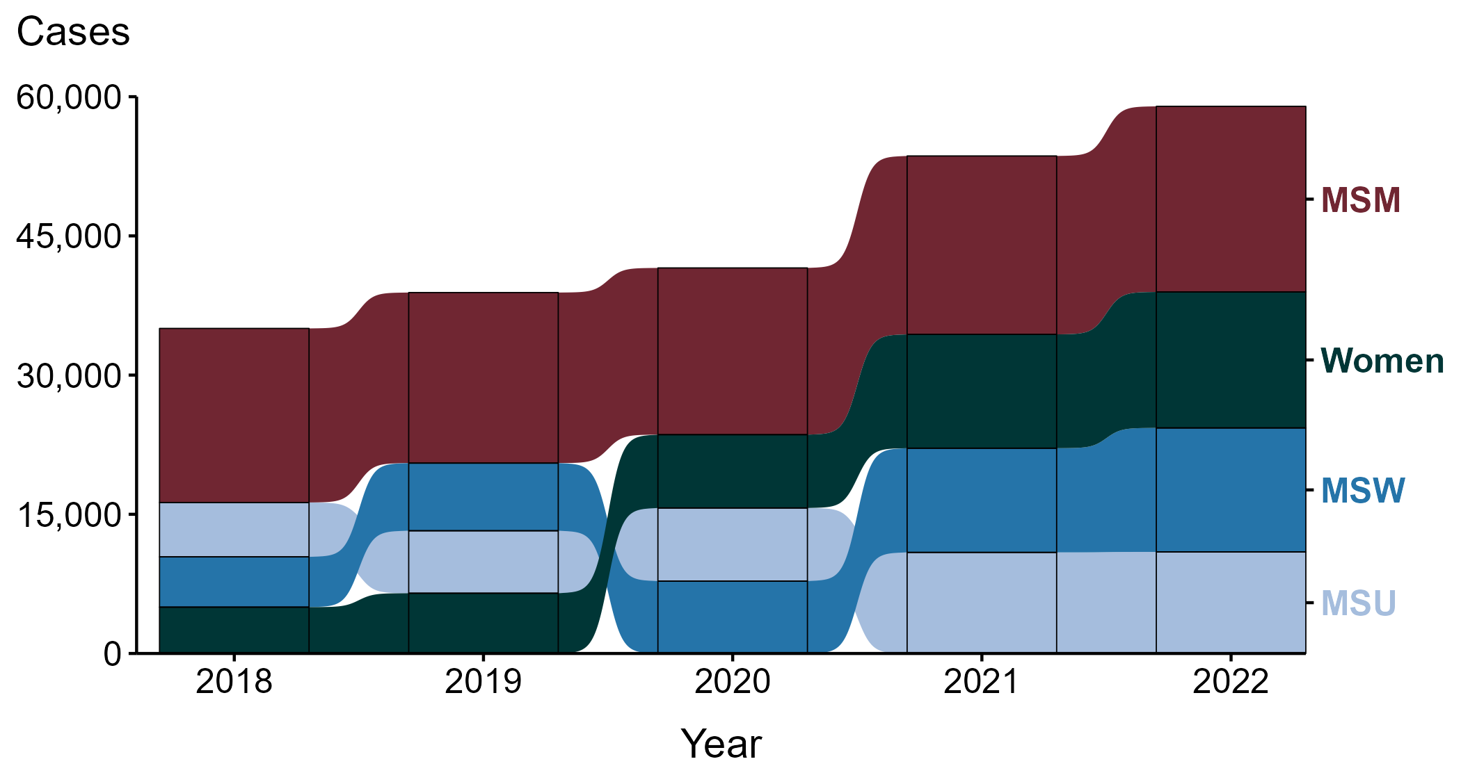
Primary and Secondary Syphilis — Reported Cases by Sex and Sex of Sex Partners, United States, 2018–2022
ACRONYMS: MSM = Men who have sex with men; MSU = Men with unknown sex of sex partners; MSW = Men who have sex with women only
NOTE: Over the five-year period, 0.2% of cases were missing sex and were not included.
Notes:
During 2018 to 2022, a plurality (41.4%) of primary and secondary syphilis cases were among men who have sex with men (MSM; 94,342).
During 2021 to 2022, the number of cases among MSM increased 4.0% (19,229 in 2021 to 20,004 in 2022), while the number of cases increased 19.5% among women (12,265 in 2021 to 14,652 in 2022), increased 19.0% among men who have sex with women only (MSW; 11,228 in 2021 to 13,359 in 2022), and did not change substantially (<1.0% change) among men with unknown sex of sex partners (MSU; 10,892 in 2021 to 10,946 in 2022).
During 2018 to 2022, the number of cases among MSM increased 6.6% (18,760 in 2018 to 20,004 in 2022), while the number of cases increased 193.3% among women (4,995 in 2018 to 14,652 in 2022), increased 146.7% among MSW (5,416 in 2018 to 13,359 in 2022), and increased 86.9% among MSU (5,858 in 2018 to 10,946 in 2022).
This report includes data from years that coincide with the COVID-19 pandemic, which introduced uncertainty and difficulty in interpreting case data. See Impact of COVID-19 on STIs (https://www.cdc.gov/std/statistics/2022/impact.htm) for more information.
This figure presents trends in the proportion of cases reporting one or more selected behaviors. Although rounded percentages are presented in the figure interpretive text, values used for generating the figure may be more precise. Data points for the figures presented in these slides as well as Technical Notes about data sources, data collection and reporting practices, and case definitions are available at https://www.cdc.gov/std/statistics/syphilis-supplement/default.htm.

Slide 3
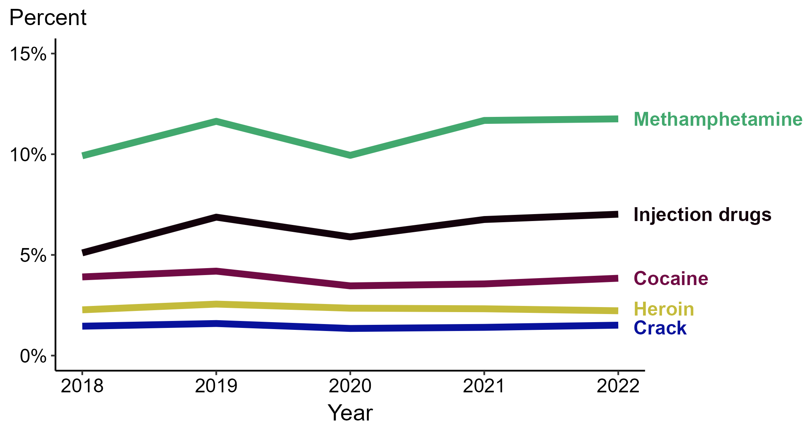
Primary and Secondary Syphilis — Percentage of Cases Reporting Selected Substance Use Behaviors*, United States, 2018–2022
* Proportion reporting injection drug use, methamphetamine use, heroin use, crack use, or cocaine use within the last 12 months calculated among cases with known data (cases with missing or unknown responses were excluded from the denominator).
Notes:
In 2022, 11.8% of primary and secondary (P&S) syphilis cases reported methamphetamine use, 7.0% reported injection drug use, 3.8% reported cocaine use, 2.2% reported heroin use, and 1.5% reported crack use.
During 2018 to 2022, the proportion of P&S syphilis cases that reported injection drug use increased (5.1% to 7.0%), the proportion of P&S syphilis cases that reported methamphetamine use increased (9.9% to 11.8%), the proportion of P&S syphilis cases that reported crack use remained stable (1.5% in both years), the proportion of P&S syphilis cases that reported cocaine use remained stable (3.9% to 3.8%), and the proportion of P&S syphilis cases that reported heroin use remained stable (2.3% to 2.2%).
This report includes data from years that coincide with the COVID-19 pandemic, which introduced uncertainty and difficulty in interpreting case data. See Impact of COVID-19 on STIs (https://www.cdc.gov/std/statistics/2022/impact.htm) for more information.
This figure presents trends in the proportion of cases reporting one or more selected behaviors. Although rounded percentages are presented in the figure interpretive text, values used for generating the figure may be more precise. Data points for the figures presented in these slides as well as Technical Notes about data sources, data collection and reporting practices, and case definitions are available at https://www.cdc.gov/std/statistics/syphilis-supplement/default.htm.

Slide 4
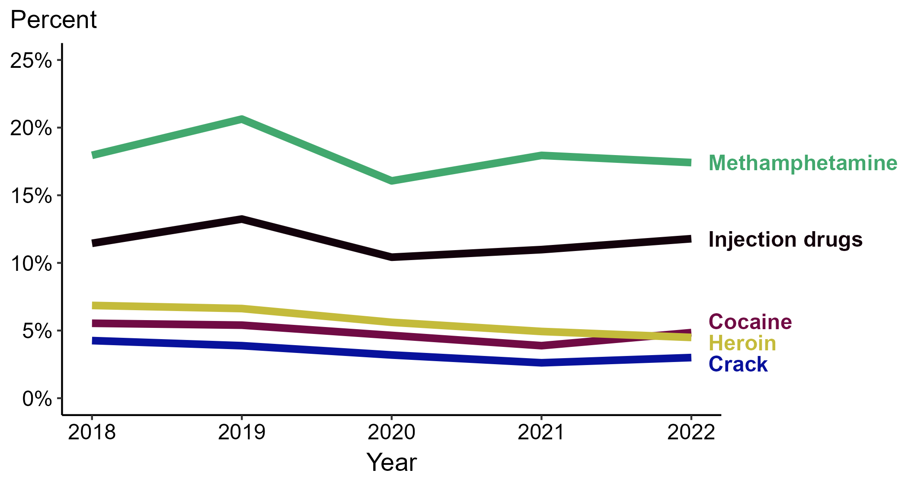
Primary and Secondary Syphilis — Percentage of Cases Reporting Selected Substance Use Behaviors* Among Women, United States, 2018–2022
* Proportion reporting injection drug use, methamphetamine use, heroin use, crack use, or cocaine use within the last 12 months calculated among cases with known data (cases with missing or unknown responses were excluded from the denominator).
Notes:
In 2022, 17.4% of primary and secondary (P&S) syphilis cases among women reported methamphetamine use, 11.8% reported injection drug use, 4.8% reported cocaine use, 4.5% reported heroin use, and 3.0% reported crack use.
During 2018 to 2022, the proportion of P&S syphilis cases among women that reported injection drug use remained stable (11.4% to 11.8%), the proportion of P&S syphilis cases among women that reported methamphetamine use remained stable (18.0% to 17.4%), the proportion of P&S syphilis cases among women that reported cocaine use remained stable (5.5% to 4.8%), the proportion of P&S syphilis cases among women that reported crack use decreased (4.3% to 3.0%), and the proportion of P&S syphilis cases among women that reported heroin use decreased (6.9% to 4.5%).
This report includes data from years that coincide with the COVID-19 pandemic, which introduced uncertainty and difficulty in interpreting case data. See Impact of COVID-19 on STIs (https://www.cdc.gov/std/statistics/2022/impact.htm) for more information.
This figure presents trends in the proportion of cases reporting one or more selected behaviors. Although rounded percentages are presented in the figure interpretive text, values used for generating the figure may be more precise. Data points for the figures presented in these slides as well as Technical Notes about data sources, data collection and reporting practices, and case definitions are available at https://www.cdc.gov/std/statistics/syphilis-supplement/default.htm.

Slide 5
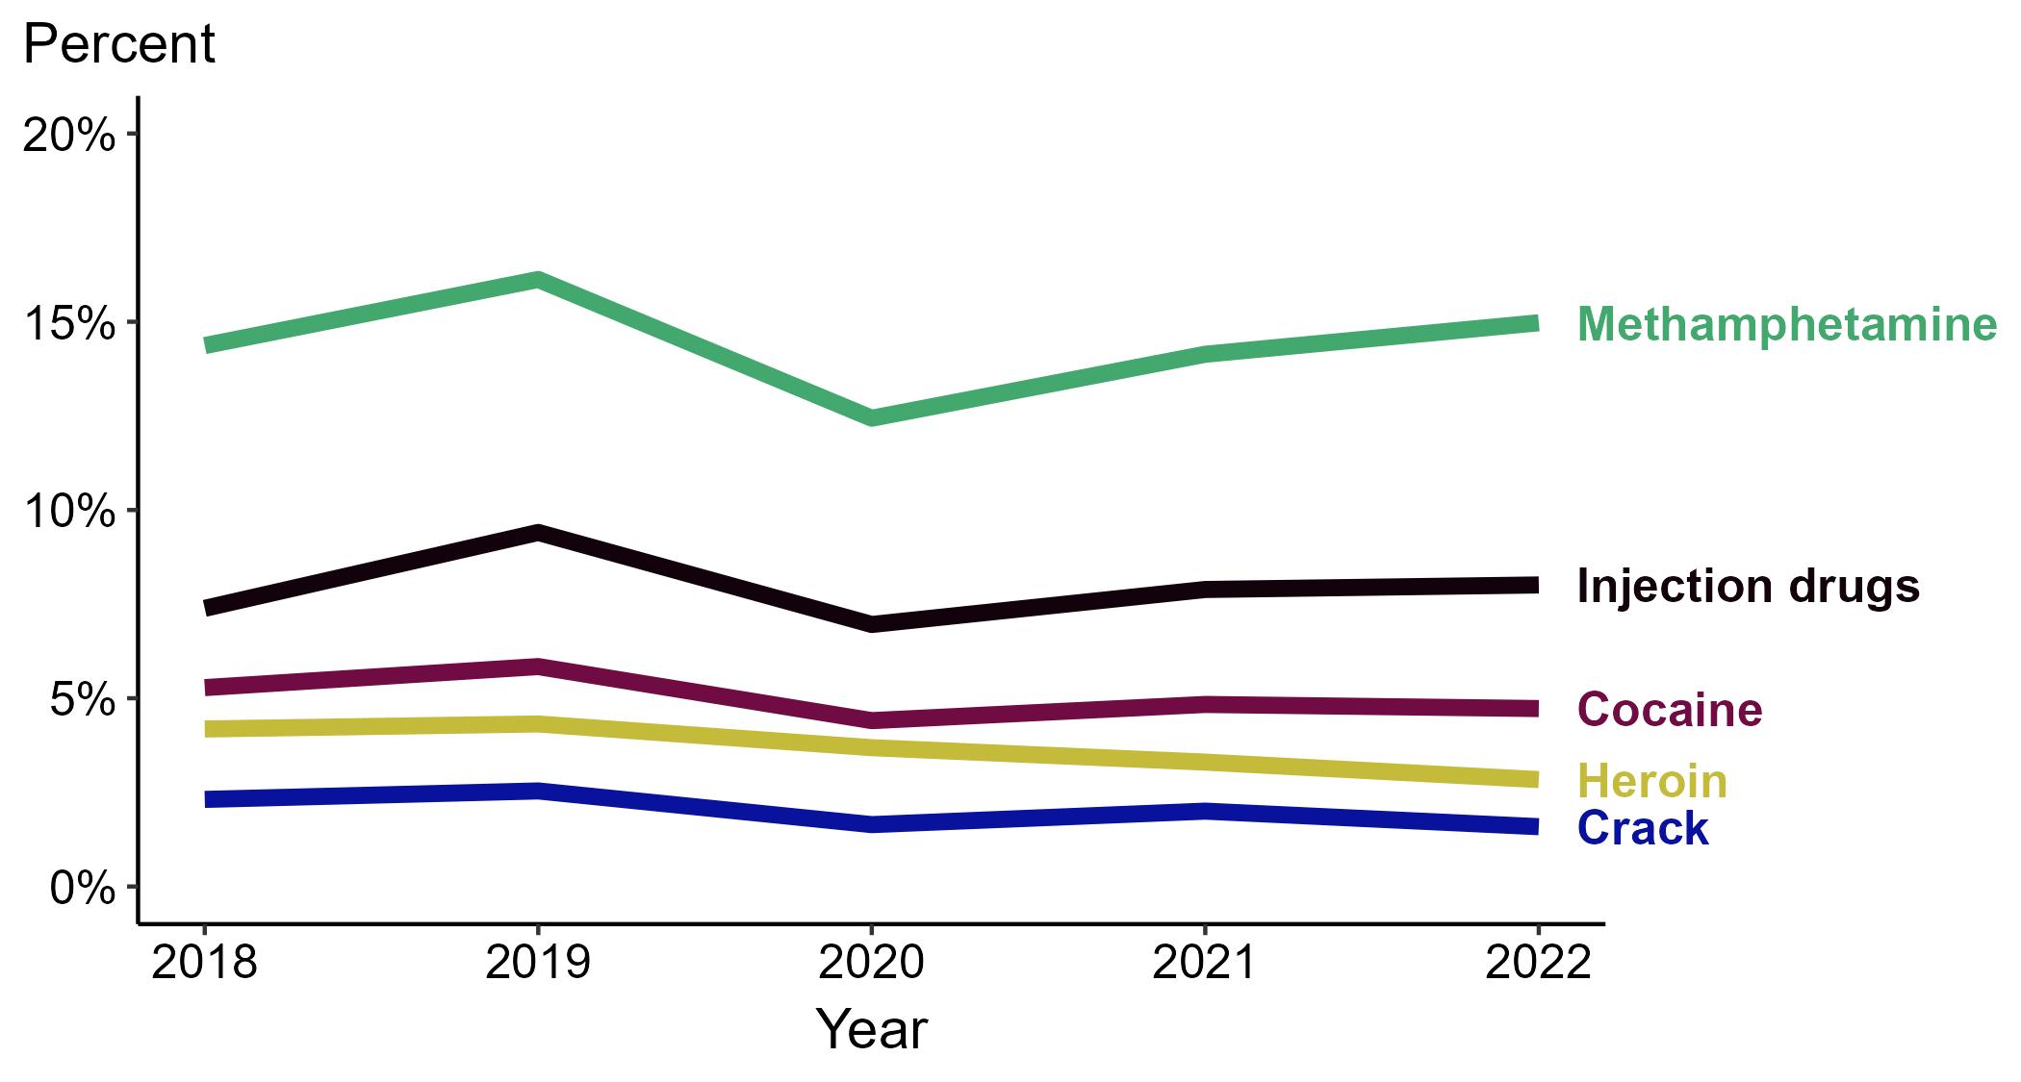
Primary and Secondary Syphilis — Percentage of Cases Reporting Selected Substance Use Behaviors* Among MSW, United States, 2018–2022
* Proportion reporting injection drug use, methamphetamine use, heroin use, crack use, or cocaine use within the last 12 months calculated among cases with known data (cases with missing or unknown responses were excluded from the denominator).
ACRONYMS: MSW = Men who have sex with women only
Notes:
In 2022, 15.0% of primary and secondary (P&S) syphilis cases among MSW reported methamphetamine use, 8.0% reported injection drug use, 4.7% reported cocaine use, 2.8% reported heroin use, and 1.6% reported crack use.
During 2018 to 2022, the proportion of P&S syphilis cases among MSW that reported injection drug use remained stable (7.4% to 8.0%), the proportion of P&S syphilis cases among MSW that reported methamphetamine use remained stable (14.4% to 15.0%), the proportion of P&S syphilis cases among MSW that reported cocaine use remained stable (5.3% to 4.7%), the proportion of P&S syphilis cases among MSW that reported crack use remained stable (2.3% to 1.6%), and the proportion of P&S syphilis cases among MSW that reported heroin use decreased (4.2% to 2.8%).
This report includes data from years that coincide with the COVID-19 pandemic, which introduced uncertainty and difficulty in interpreting case data. See Impact of COVID-19 on STIs (https://www.cdc.gov/std/statistics/2022/impact.htm) for more information.
This figure presents trends in the proportion of cases reporting one or more selected behaviors. Although rounded percentages are presented in the figure interpretive text, values used for generating the figure may be more precise. Data points for the figures presented in these slides as well as Technical Notes about data sources, data collection and reporting practices, and case definitions are available at https://www.cdc.gov/std/statistics/syphilis-supplement/default.htm.

Slide 6
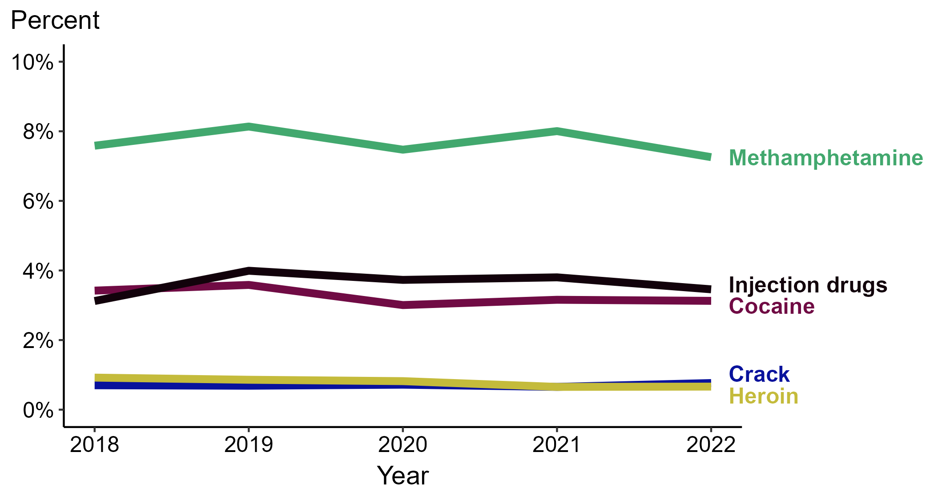
Primary and Secondary Syphilis — Percentage of Cases Reporting Selected Substance Use Behaviors* Among MSM, United States, 2018–2022
* Proportion reporting injection drug use, methamphetamine use, heroin use, crack use, or cocaine use within the last 12 months calculated among cases with known data (cases with missing or unknown responses were excluded from the denominator).
ACRONYMS: MSM = Men who have sex with men
Notes:
In 2022, 7.3% of primary and secondary (P&S) syphilis cases among MSM reported methamphetamine use, 3.5% reported injection drug use, 3.1% reported cocaine use, 0.8% reported crack use, and 0.7% reported heroin use.
During 2018 to 2022, the proportion of P&S syphilis cases among MSM that reported injection drug use remained stable (3.1% to 3.5%), the proportion of P&S syphilis cases among MSM that reported crack use remained stable (0.7% to 0.8%), the proportion of P&S syphilis cases among MSM that reported methamphetamine use remained stable (7.6% to 7.3%), the proportion of P&S syphilis cases among MSM that reported cocaine use remained stable (3.4% to 3.1%), and the proportion of P&S syphilis cases among MSM that reported heroin use remained stable (0.9% to 0.7%).
This report includes data from years that coincide with the COVID-19 pandemic, which introduced uncertainty and difficulty in interpreting case data. See Impact of COVID-19 on STIs (https://www.cdc.gov/std/statistics/2022/impact.htm) for more information.
This figure presents trends in the proportion of cases reporting one or more selected behaviors. Although rounded percentages are presented in the figure interpretive text, values used for generating the figure may be more precise. Data points for the figures presented in these slides as well as Technical Notes about data sources, data collection and reporting practices, and case definitions are available at https://www.cdc.gov/std/statistics/syphilis-supplement/default.htm.

Slide 7
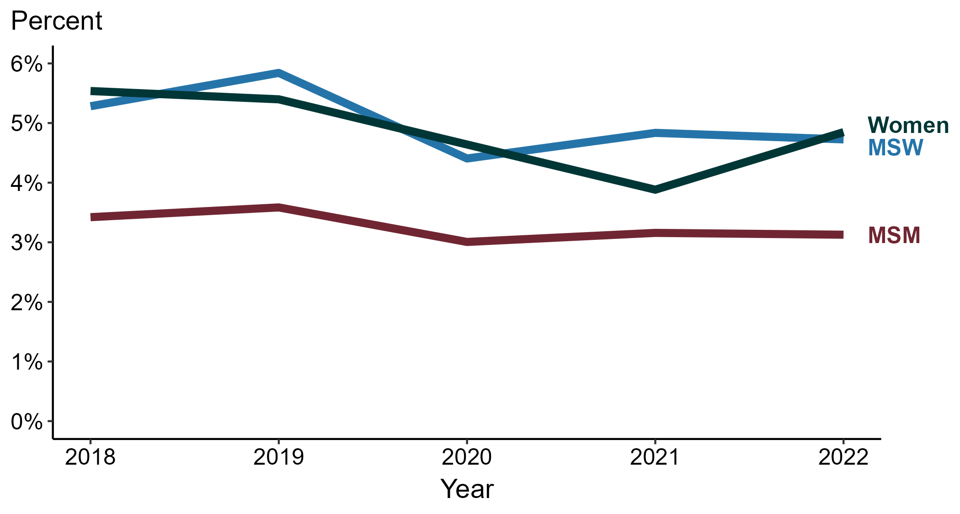
Primary and Secondary Syphilis — Percentage of Cases Reporting Cocaine Use* by Sex and Sex of Sex Partners, United States, 2018–2022
* Proportion reporting cocaine use within the last 12 months calculated among cases with known data (cases with missing or unknown responses were excluded from the denominator).
ACRONYMS: MSM = Men who have sex with men; MSW = Men who have sex with women only
Notes:
Among primary and secondary (P&S) syphilis cases in 2022, cocaine use was most frequently reported among women (4.8%), followed by MSW (4.7%) and MSM (3.1%).
During 2018 to 2022, the proportion of P&S syphilis cases that reported cocaine use remained stable among MSM (3.4% to 3.1%), remained stable among MSW (5.3% to 4.7%), and remained stable among women (5.5% to 4.8%).
This report includes data from years that coincide with the COVID-19 pandemic, which introduced uncertainty and difficulty in interpreting case data. See Impact of COVID-19 on STIs (https://www.cdc.gov/std/statistics/2022/impact.htm) for more information.
This figure presents trends in the proportion of cases reporting one or more selected behaviors. Although rounded percentages are presented in the figure interpretive text, values used for generating the figure may be more precise. Data points for the figures presented in these slides as well as Technical Notes about data sources, data collection and reporting practices, and case definitions are available at https://www.cdc.gov/std/statistics/syphilis-supplement/default.htm.

Slide 8
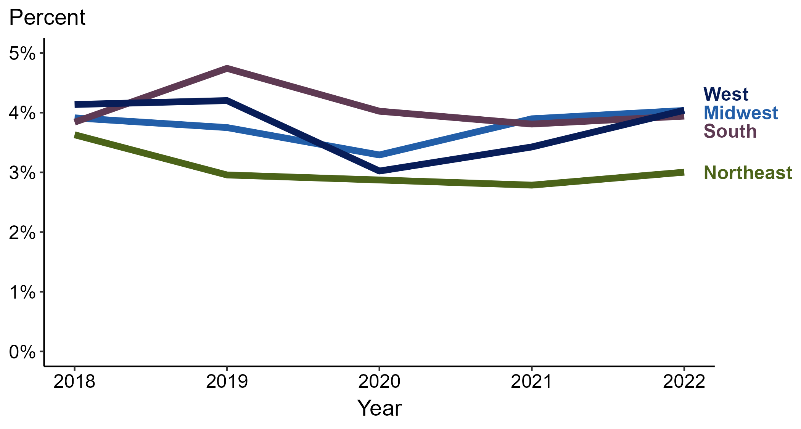
Primary and Secondary Syphilis — Percentage of Cases Reporting Cocaine Use* by Region, United States, 2018–2022
* Proportion reporting cocaine use within the last 12 months calculated among cases with known data (cases with missing or unknown responses were excluded from the denominator).
Notes:
Among primary and secondary (P&S) syphilis cases reported in 2022, cocaine use was most frequently reported in the Midwest and West (4.0% in both regions), followed by the South (3.9%) and Northeast (3.0%).
When examining trends within each region during 2018 to 2022, the proportion of P&S syphilis cases that reported cocaine use remained stable in the Midwest (3.9% to 4.0%), remained stable in the South (3.8% to 3.9%), remained stable in the West (4.1% to 4.0%), and remained stable in the Northeast (3.6% to 3.0%).
This report includes data from years that coincide with the COVID-19 pandemic, which introduced uncertainty and difficulty in interpreting case data. See Impact of COVID-19 on STIs (https://www.cdc.gov/std/statistics/2022/impact.htm) for more information.
This figure presents trends in the proportion of cases reporting one or more selected behaviors. Although rounded percentages are presented in the figure interpretive text, values used for generating the figure may be more precise. Data points for the figures presented in these slides as well as Technical Notes about data sources, data collection and reporting practices, and case definitions are available at https://www.cdc.gov/std/statistics/syphilis-supplement/default.htm.

Slide 9
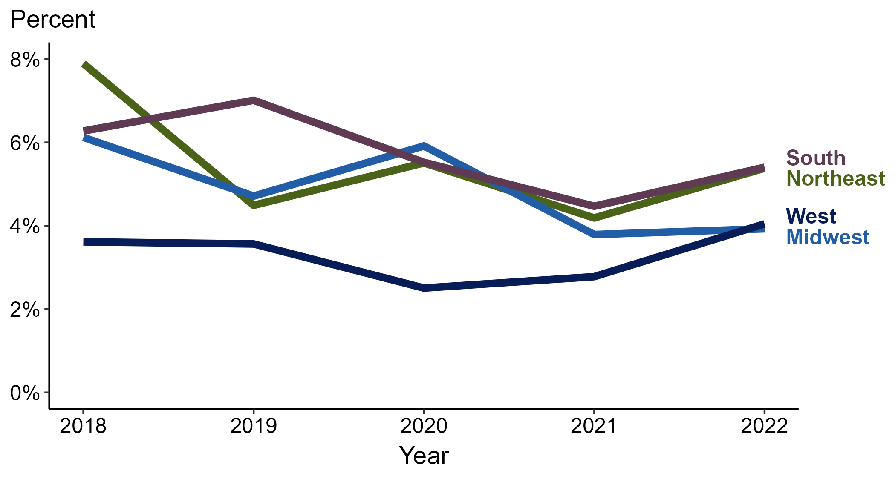
Primary and Secondary Syphilis — Percentage of Cases Reporting Cocaine Use* Among Women by Region, United States, 2018–2022
* Proportion reporting cocaine use within the last 12 months calculated among cases with known data (cases with missing or unknown responses were excluded from the denominator).
Notes:
Among primary and secondary (P&S) syphilis cases reported among women in 2022, cocaine use was most frequently reported in the Northeast and South (5.4% in both regions), followed by the West (4.0%) and Midwest (3.9%).
When examining trends within each region during 2018 to 2022, the proportion of P&S syphilis cases among women that reported cocaine use remained stable in the West (3.6% to 4.0%), remained stable in the South (6.3% to 5.4%), decreased in the Northeast (7.9% to 5.4%), and decreased in the Midwest (6.1% to 3.9%).
This report includes data from years that coincide with the COVID-19 pandemic, which introduced uncertainty and difficulty in interpreting case data. See Impact of COVID-19 on STIs (https://www.cdc.gov/std/statistics/2022/impact.htm) for more information.
This figure presents trends in the proportion of cases reporting one or more selected behaviors. Although rounded percentages are presented in the figure interpretive text, values used for generating the figure may be more precise. Data points for the figures presented in these slides as well as Technical Notes about data sources, data collection and reporting practices, and case definitions are available at https://www.cdc.gov/std/statistics/syphilis-supplement/default.htm.

Slide 10
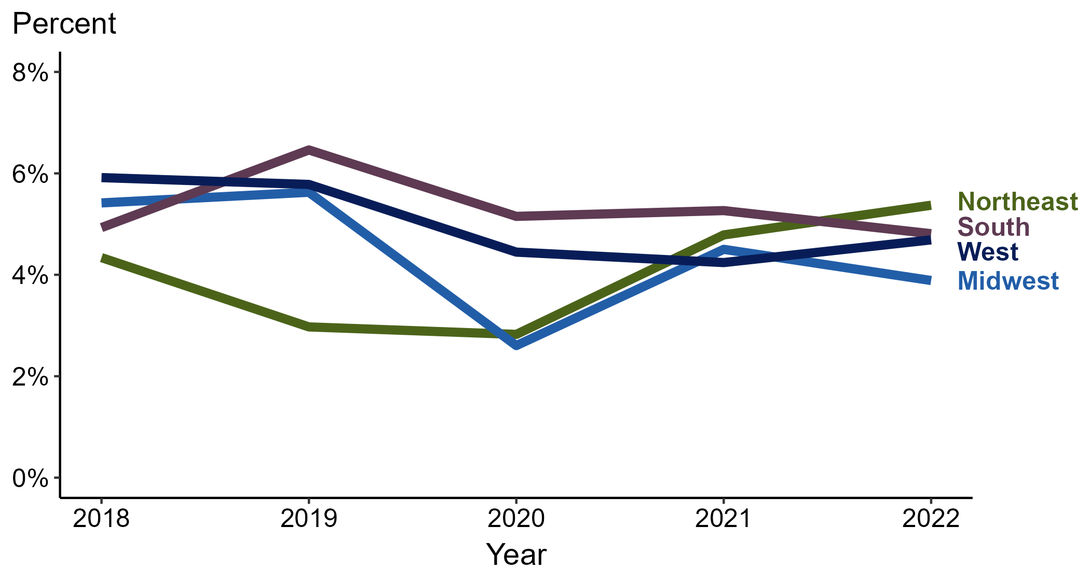
Primary and Secondary Syphilis — Percentage of Cases Reporting Cocaine Use* Among MSW by Region, United States, 2018–2022
* Proportion reporting cocaine use within the last 12 months calculated among cases with known data (cases with missing or unknown responses were excluded from the denominator).
ACRONYMS: MSW = Men who have sex with women only
Notes:
Among primary and secondary (P&S) syphilis cases reported among MSW in 2022, cocaine use was most frequently reported in the Northeast (5.4%), followed by the South (4.8%), West (4.7%), and Midwest (3.9%).
When examining trends within each region during 2018 to 2022, the proportion of P&S syphilis cases among MSW that reported cocaine use increased in the Northeast (4.3% to 5.4%), remained stable in the South (4.9% to 4.8%), decreased in the West (5.9% to 4.7%), and decreased in the Midwest (5.4% to 3.9%).
This report includes data from years that coincide with the COVID-19 pandemic, which introduced uncertainty and difficulty in interpreting case data. See Impact of COVID-19 on STIs (https://www.cdc.gov/std/statistics/2022/impact.htm) for more information.
This figure presents trends in the proportion of cases reporting one or more selected behaviors. Although rounded percentages are presented in the figure interpretive text, values used for generating the figure may be more precise. Data points for the figures presented in these slides as well as Technical Notes about data sources, data collection and reporting practices, and case definitions are available at https://www.cdc.gov/std/statistics/syphilis-supplement/default.htm.

Slide 11
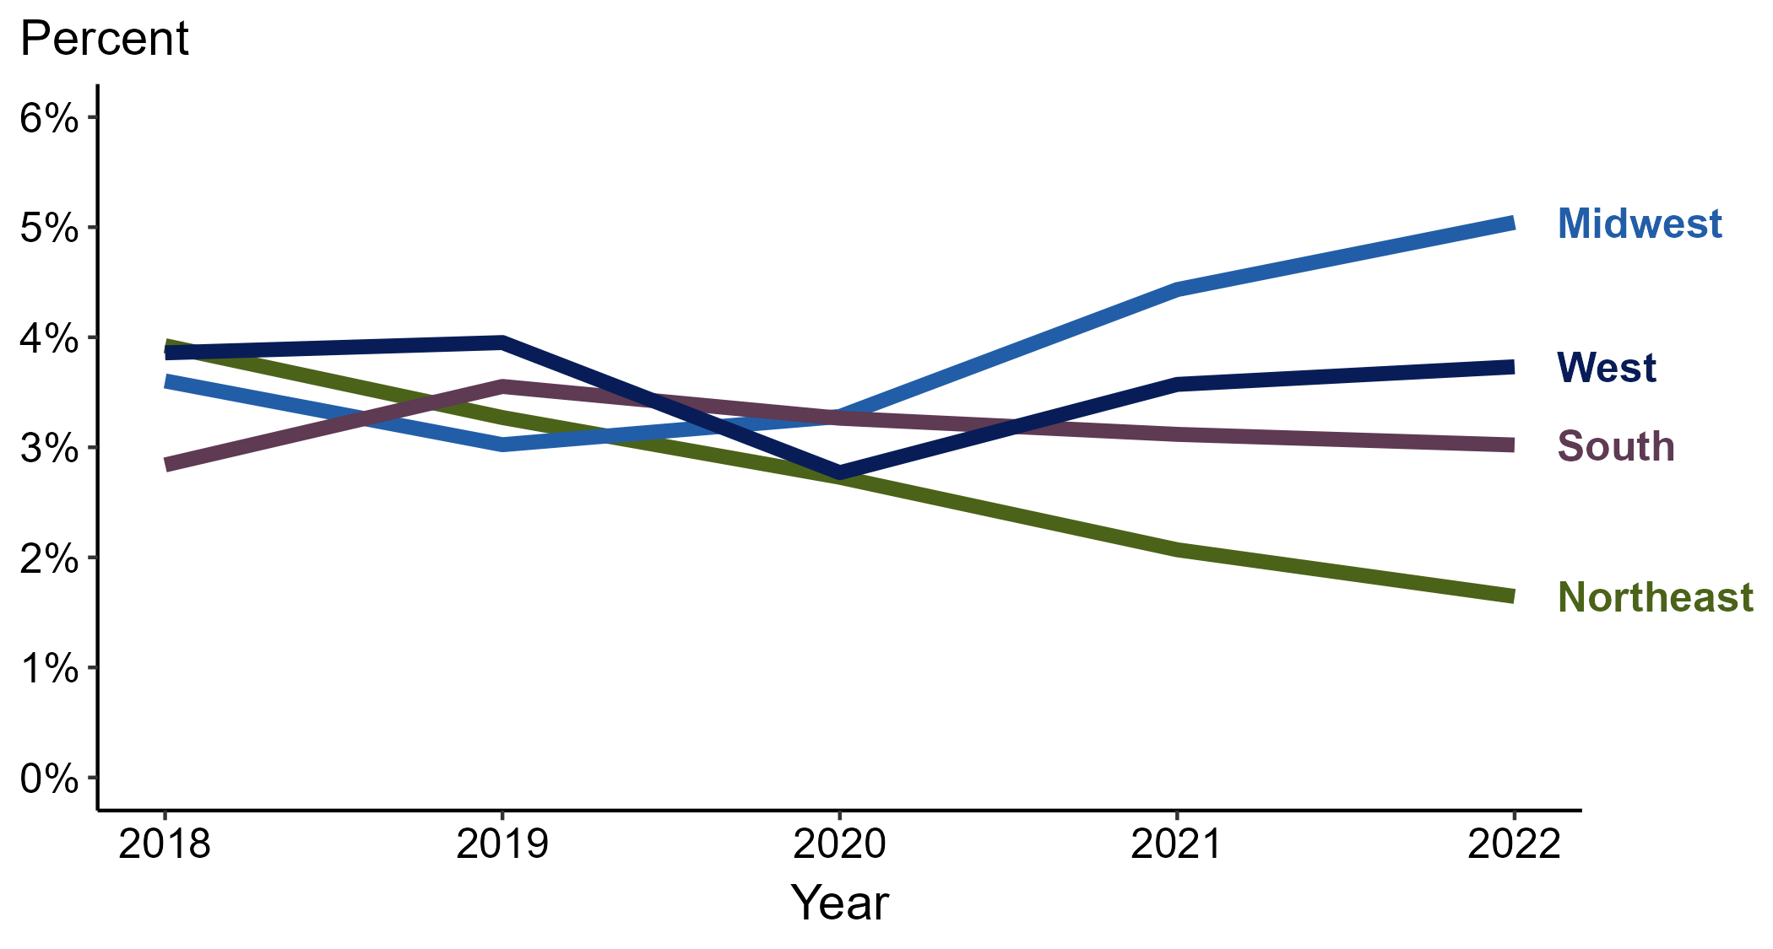
Primary and Secondary Syphilis — Percentage of Cases Reporting Cocaine Use* Among MSM by Region, United States, 2018–2022
* Proportion reporting cocaine use within the last 12 months calculated among cases with known data (cases with missing or unknown responses were excluded from the denominator).
ACRONYMS: MSM = Men who have sex with men
Notes:
Among primary and secondary (P&S) syphilis cases reported among MSM in 2022, cocaine use was most frequently reported in the Midwest (5.0%), followed by the West (3.7%), South (3.0%), and Northeast (1.6%).
When examining trends within each region during 2018 to 2022, the proportion of P&S syphilis cases among MSM that reported cocaine use increased in the Midwest (3.6% to 5.0%), remained stable in the South (2.8% to 3.0%), remained stable in the West (3.9% to 3.7%), and decreased in the Northeast (3.9% to 1.6%).
This report includes data from years that coincide with the COVID-19 pandemic, which introduced uncertainty and difficulty in interpreting case data. See Impact of COVID-19 on STIs (https://www.cdc.gov/std/statistics/2022/impact.htm) for more information.
This figure presents trends in the proportion of cases reporting one or more selected behaviors. Although rounded percentages are presented in the figure interpretive text, values used for generating the figure may be more precise. Data points for the figures presented in these slides as well as Technical Notes about data sources, data collection and reporting practices, and case definitions are available at https://www.cdc.gov/std/statistics/syphilis-supplement/default.htm.

Slide 12
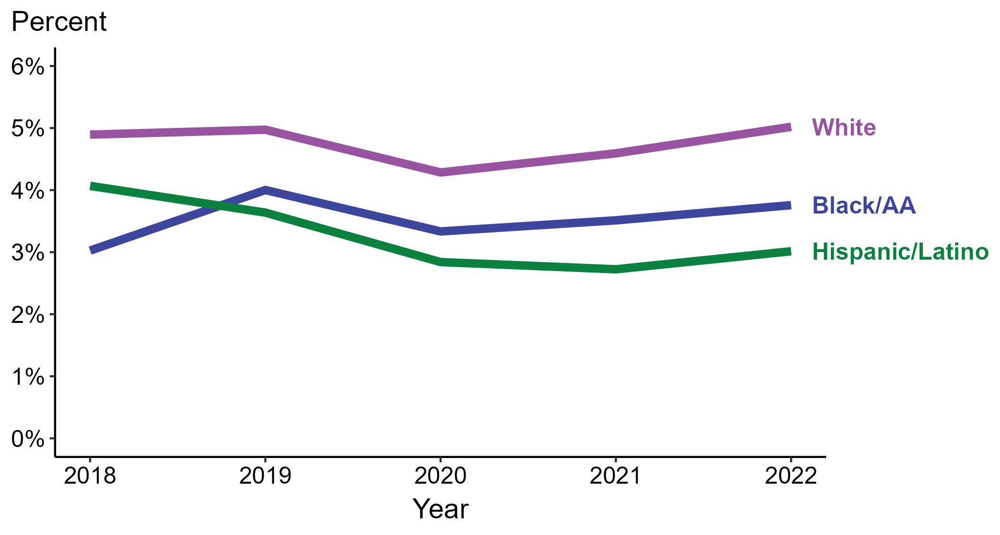
Primary and Secondary Syphilis — Percentage of Cases Reporting Cocaine Use* by Race and Hispanic Ethnicity, United States, 2018–2022
* Proportion reporting cocaine use within the last 12 months calculated among cases with known data (cases with missing or unknown responses were excluded from the denominator).
ACRONYMS: Black/AA = Black or African American
Notes:
Among primary and secondary (P&S) syphilis cases reported in 2022, cocaine use was most frequently reported among non-Hispanic White persons (5.0%), followed by non-Hispanic Black or African American persons (3.8%) and Hispanic or Latino persons (3.0%).
When examining trends within each race and Hispanic ethnicity during 2018 to 2022, the proportion of P&S syphilis cases that reported cocaine use remained stable among non-Hispanic Black or African American persons (3.0% to 3.8%), remained stable among non-Hispanic White persons (4.9% to 5.0%), and decreased among Hispanic or Latino persons (4.1% to 3.0%).
During 2018 to 2022, 87.7% of P&S syphilis cases with information on cocaine use were non-Hispanic White, non-Hispanic Black or African American, or Hispanic or Latino. Because the vast majority of cases fall in those racial and ethnic categories, only data for those groups are displayed in the figure above.
See Technical Notes for information on syphilis case reporting, race/Hispanic ethnicity categorization, and reporting of race/Hispanic ethnicity for STI cases.
This report includes data from years that coincide with the COVID-19 pandemic, which introduced uncertainty and difficulty in interpreting case data. See Impact of COVID-19 on STIs (https://www.cdc.gov/std/statistics/2022/impact.htm) for more information.
This figure presents trends in the proportion of cases reporting one or more selected behaviors. Although rounded percentages are presented in the figure interpretive text, values used for generating the figure may be more precise. Data points for the figures presented in these slides as well as Technical Notes about data sources, data collection and reporting practices, and case definitions are available at https://www.cdc.gov/std/statistics/syphilis-supplement/default.htm.

Slide 13
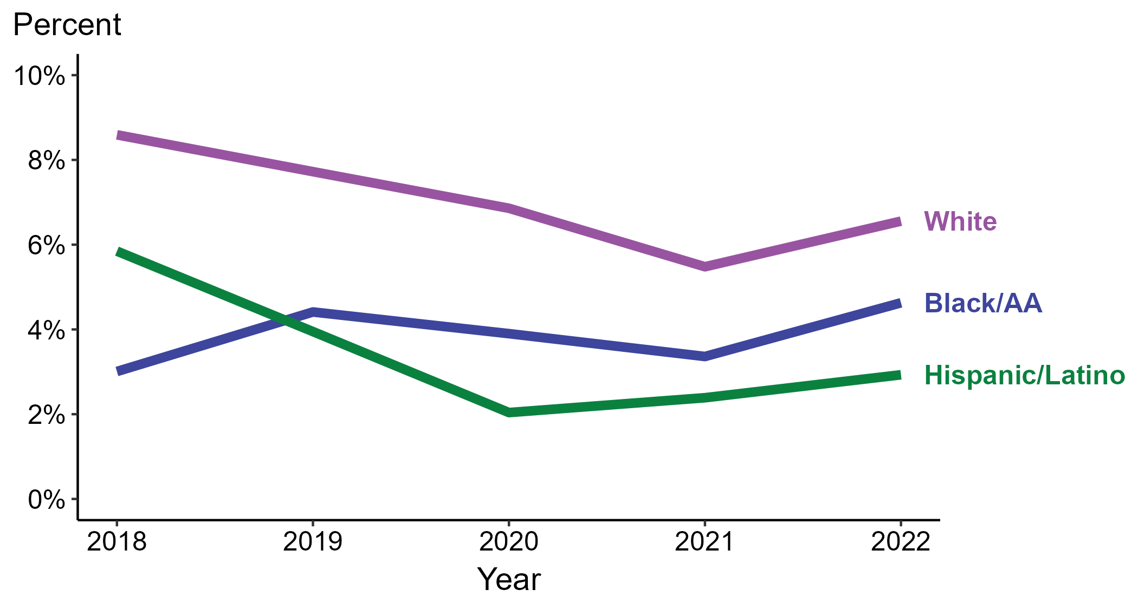
Primary and Secondary Syphilis — Percentage of Cases Reporting Cocaine Use* Among Women by Race and Hispanic Ethnicity, United States, 2018–2022
* Proportion reporting cocaine use within the last 12 months calculated among cases with known data (cases with missing or unknown responses were excluded from the denominator).
ACRONYMS: Black/AA = Black or African American
Notes:
Among primary and secondary (P&S) syphilis cases reported among women in 2022, cocaine use was most frequently reported among non-Hispanic White women (6.6%), followed by non-Hispanic Black or African American women (4.6%) and Hispanic or Latino women (2.9%).
When examining trends within each race and Hispanic ethnicity during 2018 to 2022, the proportion of P&S syphilis cases among women that reported cocaine use increased among non-Hispanic Black or African American women (3.0% to 4.6%), decreased among non-Hispanic White women (8.6% to 6.6%), and decreased among Hispanic or Latino women (5.8% to 2.9%).
During 2018 to 2022, 87.3% of P&S syphilis cases among women with information on cocaine use were non-Hispanic White, non-Hispanic Black or African American, or Hispanic or Latino. Because the vast majority of cases fall in those racial and ethnic categories, only data for those groups are displayed in the figure above.
See Technical Notes for information on syphilis case reporting, race/Hispanic ethnicity categorization, and reporting of race/Hispanic ethnicity for STI cases.
This report includes data from years that coincide with the COVID-19 pandemic, which introduced uncertainty and difficulty in interpreting case data. See Impact of COVID-19 on STIs (https://www.cdc.gov/std/statistics/2022/impact.htm) for more information.
This figure presents trends in the proportion of cases reporting one or more selected behaviors. Although rounded percentages are presented in the figure interpretive text, values used for generating the figure may be more precise. Data points for the figures presented in these slides as well as Technical Notes about data sources, data collection and reporting practices, and case definitions are available at https://www.cdc.gov/std/statistics/syphilis-supplement/default.htm.

Slide 14
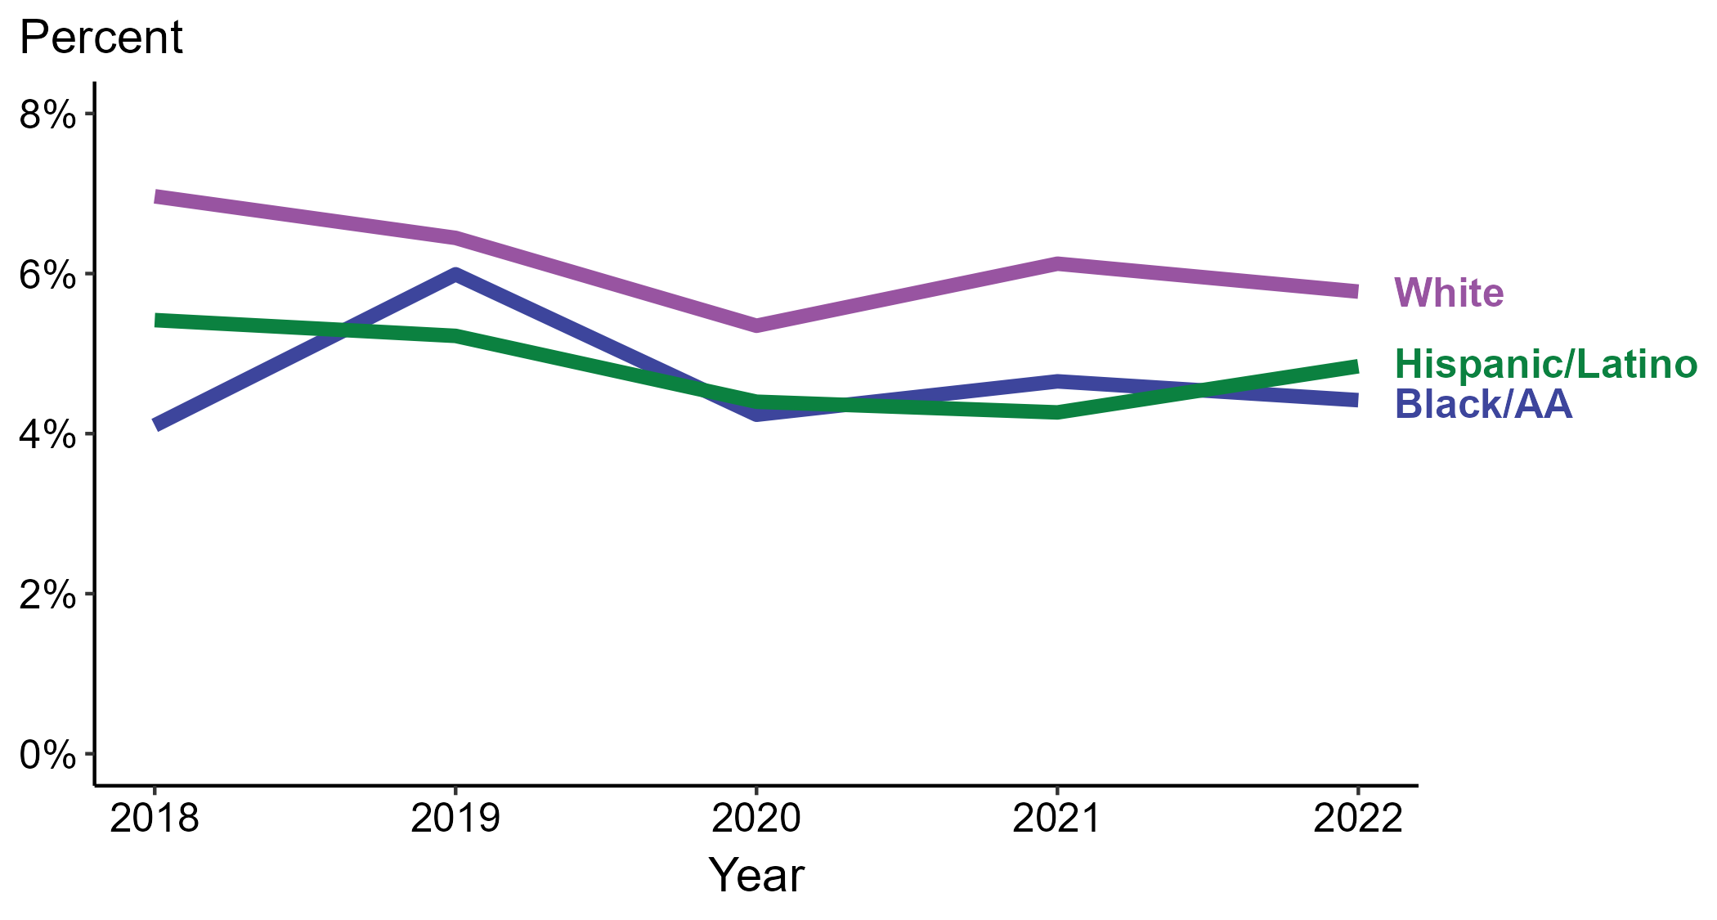
Primary and Secondary Syphilis — Percentage of Cases Reporting Cocaine Use* Among MSW by Race and Hispanic Ethnicity, United States, 2018–2022
* Proportion reporting cocaine use within the last 12 months calculated among cases with known data (cases with missing or unknown responses were excluded from the denominator).
ACRONYMS: Black/AA = Black or African American; MSW = Men who have sex with women only
Notes:
Among primary and secondary (P&S) syphilis cases reported among MSW in 2022, cocaine use was most frequently reported among non-Hispanic White MSW (5.8%), followed by Hispanic or Latino MSW (4.8%) and non-Hispanic Black or African American MSW (4.4%).
When examining trends within each race and Hispanic ethnicity during 2018 to 2022, the proportion of P&S syphilis cases among MSW that reported cocaine use remained stable among non-Hispanic Black or African American MSW (4.1% to 4.4%), remained stable among Hispanic or Latino MSW (5.4% to 4.8%), and decreased among non-Hispanic White MSW (7.0% to 5.8%).
During 2018 to 2022, 88.8% of P&S syphilis cases among MSW with information on cocaine use were non-Hispanic White, non-Hispanic Black or African American, or Hispanic or Latino. Because the vast majority of cases fall in those racial and ethnic categories, only data for those groups are displayed in the figure above.
See Technical Notes for information on syphilis case reporting, race/Hispanic ethnicity categorization, and reporting of race/Hispanic ethnicity for STI cases.
This report includes data from years that coincide with the COVID-19 pandemic, which introduced uncertainty and difficulty in interpreting case data. See Impact of COVID-19 on STIs (https://www.cdc.gov/std/statistics/2022/impact.htm) for more information.
This figure presents trends in the proportion of cases reporting one or more selected behaviors. Although rounded percentages are presented in the figure interpretive text, values used for generating the figure may be more precise. Data points for the figures presented in these slides as well as Technical Notes about data sources, data collection and reporting practices, and case definitions are available at https://www.cdc.gov/std/statistics/syphilis-supplement/default.htm.

Slide 15
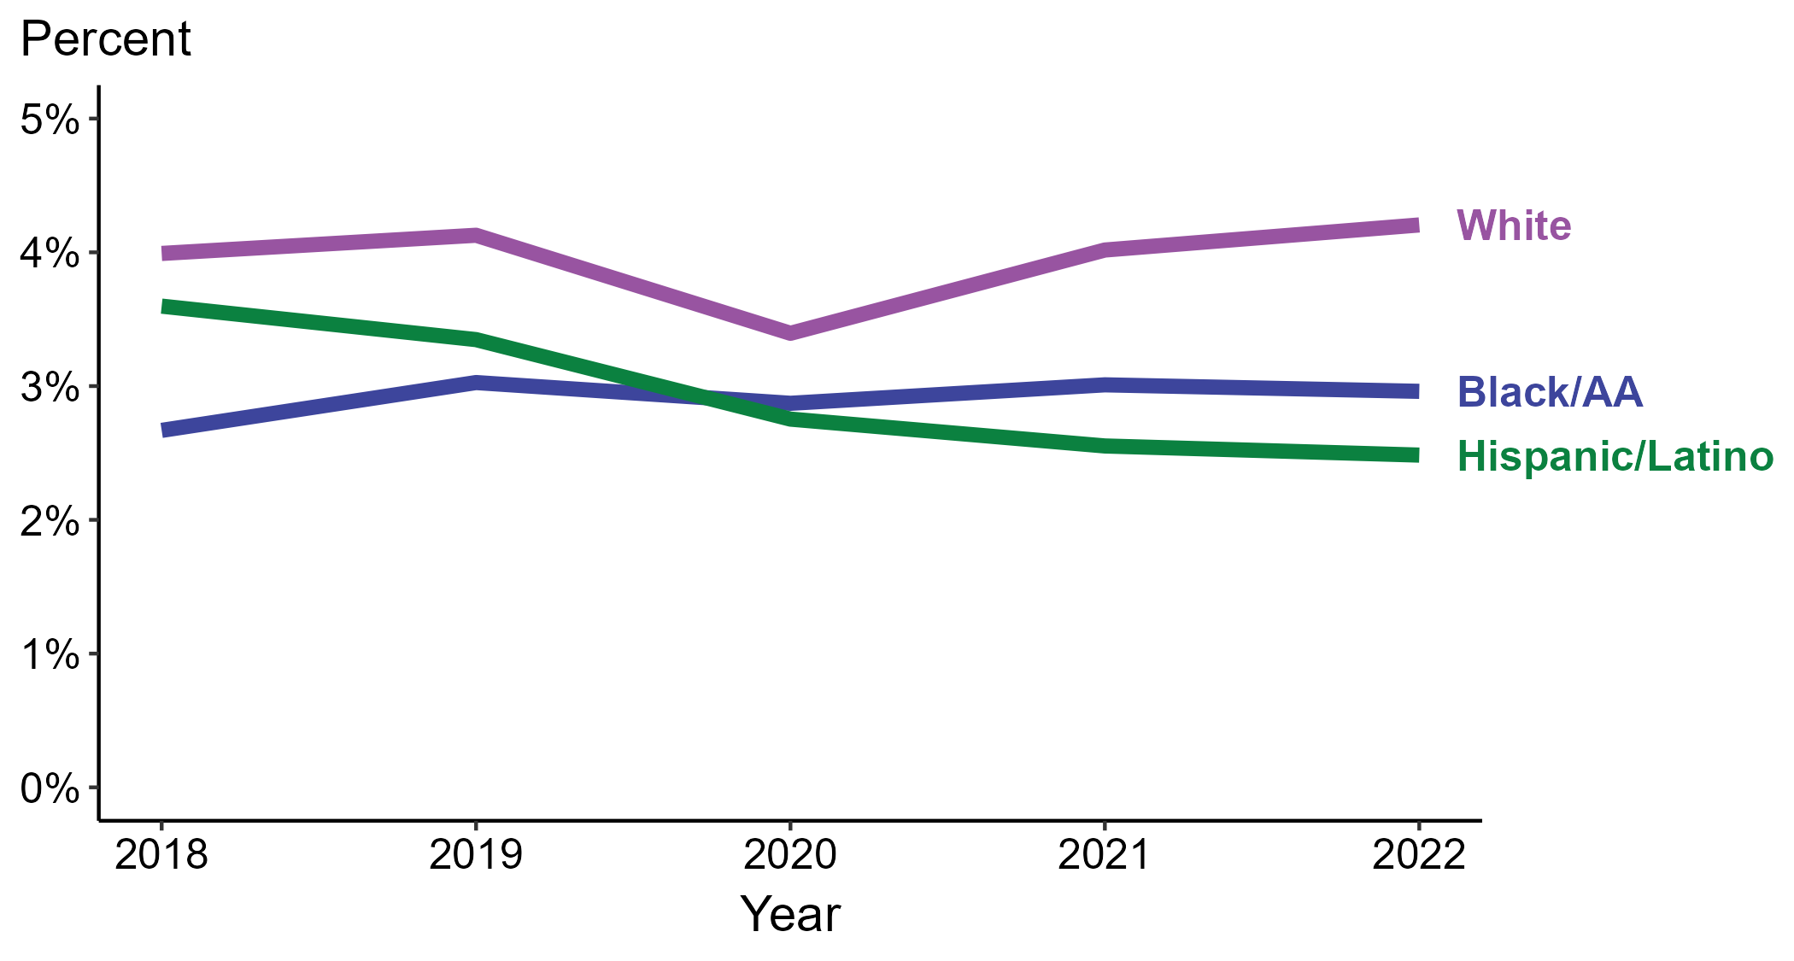
Primary and Secondary Syphilis — Percentage of Cases Reporting Cocaine Use* Among MSM by Race and Hispanic Ethnicity, United States, 2018–2022
* Proportion reporting cocaine use within the last 12 months calculated among cases with known data (cases with missing or unknown responses were excluded from the denominator).
ACRONYMS: Black/AA = Black or African American; MSM = Men who have sex with men
Notes:
Among primary and secondary (P&S) syphilis cases reported among MSM in 2022, cocaine use was most frequently reported among non-Hispanic White MSM (4.2%), followed by non-Hispanic Black or African American MSM (3.0%) and Hispanic or Latino MSM (2.5%).
When examining trends within each race and Hispanic ethnicity during 2018 to 2022, the proportion of P&S syphilis cases among MSM that reported cocaine use remained stable among non-Hispanic Black or African American MSM (2.7% to 3.0%), remained stable among non-Hispanic White MSM (4.0% to 4.2%), and decreased among Hispanic or Latino MSM (3.6% to 2.5%).
During 2018 to 2022, 88.0% of P&S syphilis cases among MSM with information on cocaine use were non-Hispanic White, non-Hispanic Black or African American, or Hispanic or Latino. Because the vast majority of cases fall in those racial and ethnic categories, only data for those groups are displayed in the figure above.
See Technical Notes for information on syphilis case reporting, race/Hispanic ethnicity categorization, and reporting of race/Hispanic ethnicity for STI cases.
This report includes data from years that coincide with the COVID-19 pandemic, which introduced uncertainty and difficulty in interpreting case data. See Impact of COVID-19 on STIs (https://www.cdc.gov/std/statistics/2022/impact.htm) for more information.
This figure presents trends in the proportion of cases reporting one or more selected behaviors. Although rounded percentages are presented in the figure interpretive text, values used for generating the figure may be more precise. Data points for the figures presented in these slides as well as Technical Notes about data sources, data collection and reporting practices, and case definitions are available at https://www.cdc.gov/std/statistics/syphilis-supplement/default.htm.

Slide 16
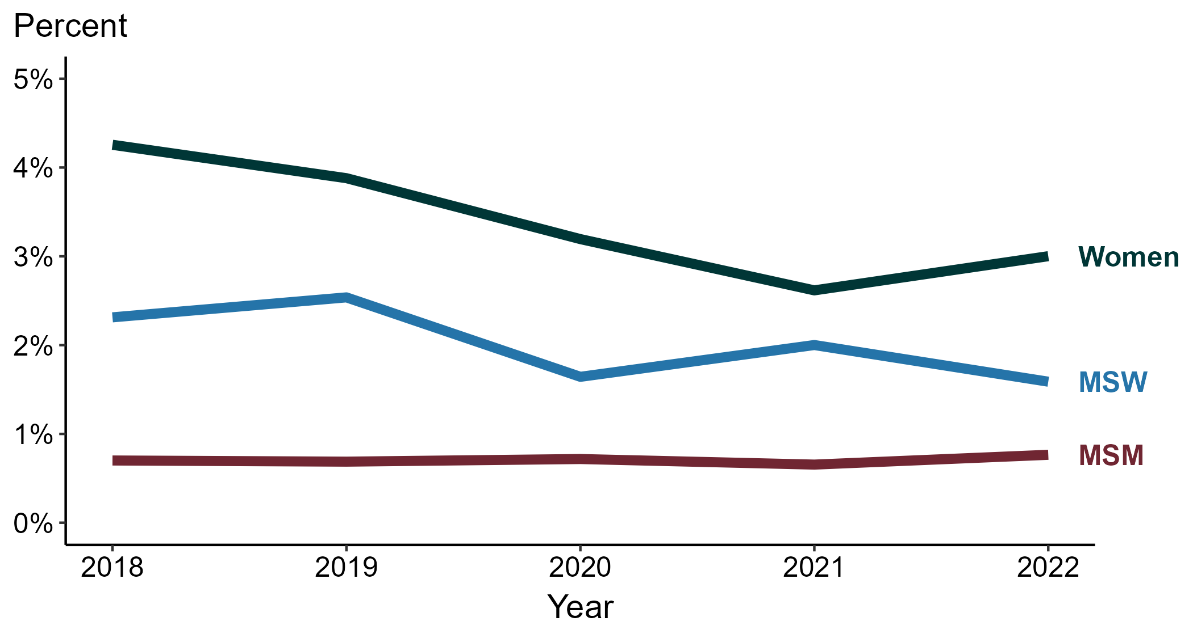
Primary and Secondary Syphilis — Percentage of Cases Reporting Crack Use* by Sex and Sex of Sex Partners, United States, 2018–2022
* Proportion reporting crack use within the last 12 months calculated among cases with known data (cases with missing or unknown responses were excluded from the denominator).
ACRONYMS: MSM = Men who have sex with men; MSW = Men who have sex with women only
Notes:
Among primary and secondary (P&S) syphilis cases in 2022, crack use was most frequently reported among women (3.0%), followed by MSW (1.6%) and MSM (0.8%).
During 2018 to 2022, the proportion of P&S syphilis cases that reported crack use remained stable among MSM (0.7% to 0.8%), decreased among women (4.3% to 3.0%), and remained stable among MSW (2.3% to 1.6%).
This report includes data from years that coincide with the COVID-19 pandemic, which introduced uncertainty and difficulty in interpreting case data. See Impact of COVID-19 on STIs (https://www.cdc.gov/std/statistics/2022/impact.htm) for more information.
This figure presents trends in the proportion of cases reporting one or more selected behaviors. Although rounded percentages are presented in the figure interpretive text, values used for generating the figure may be more precise. Data points for the figures presented in these slides as well as Technical Notes about data sources, data collection and reporting practices, and case definitions are available at https://www.cdc.gov/std/statistics/syphilis-supplement/default.htm.

Slide 17
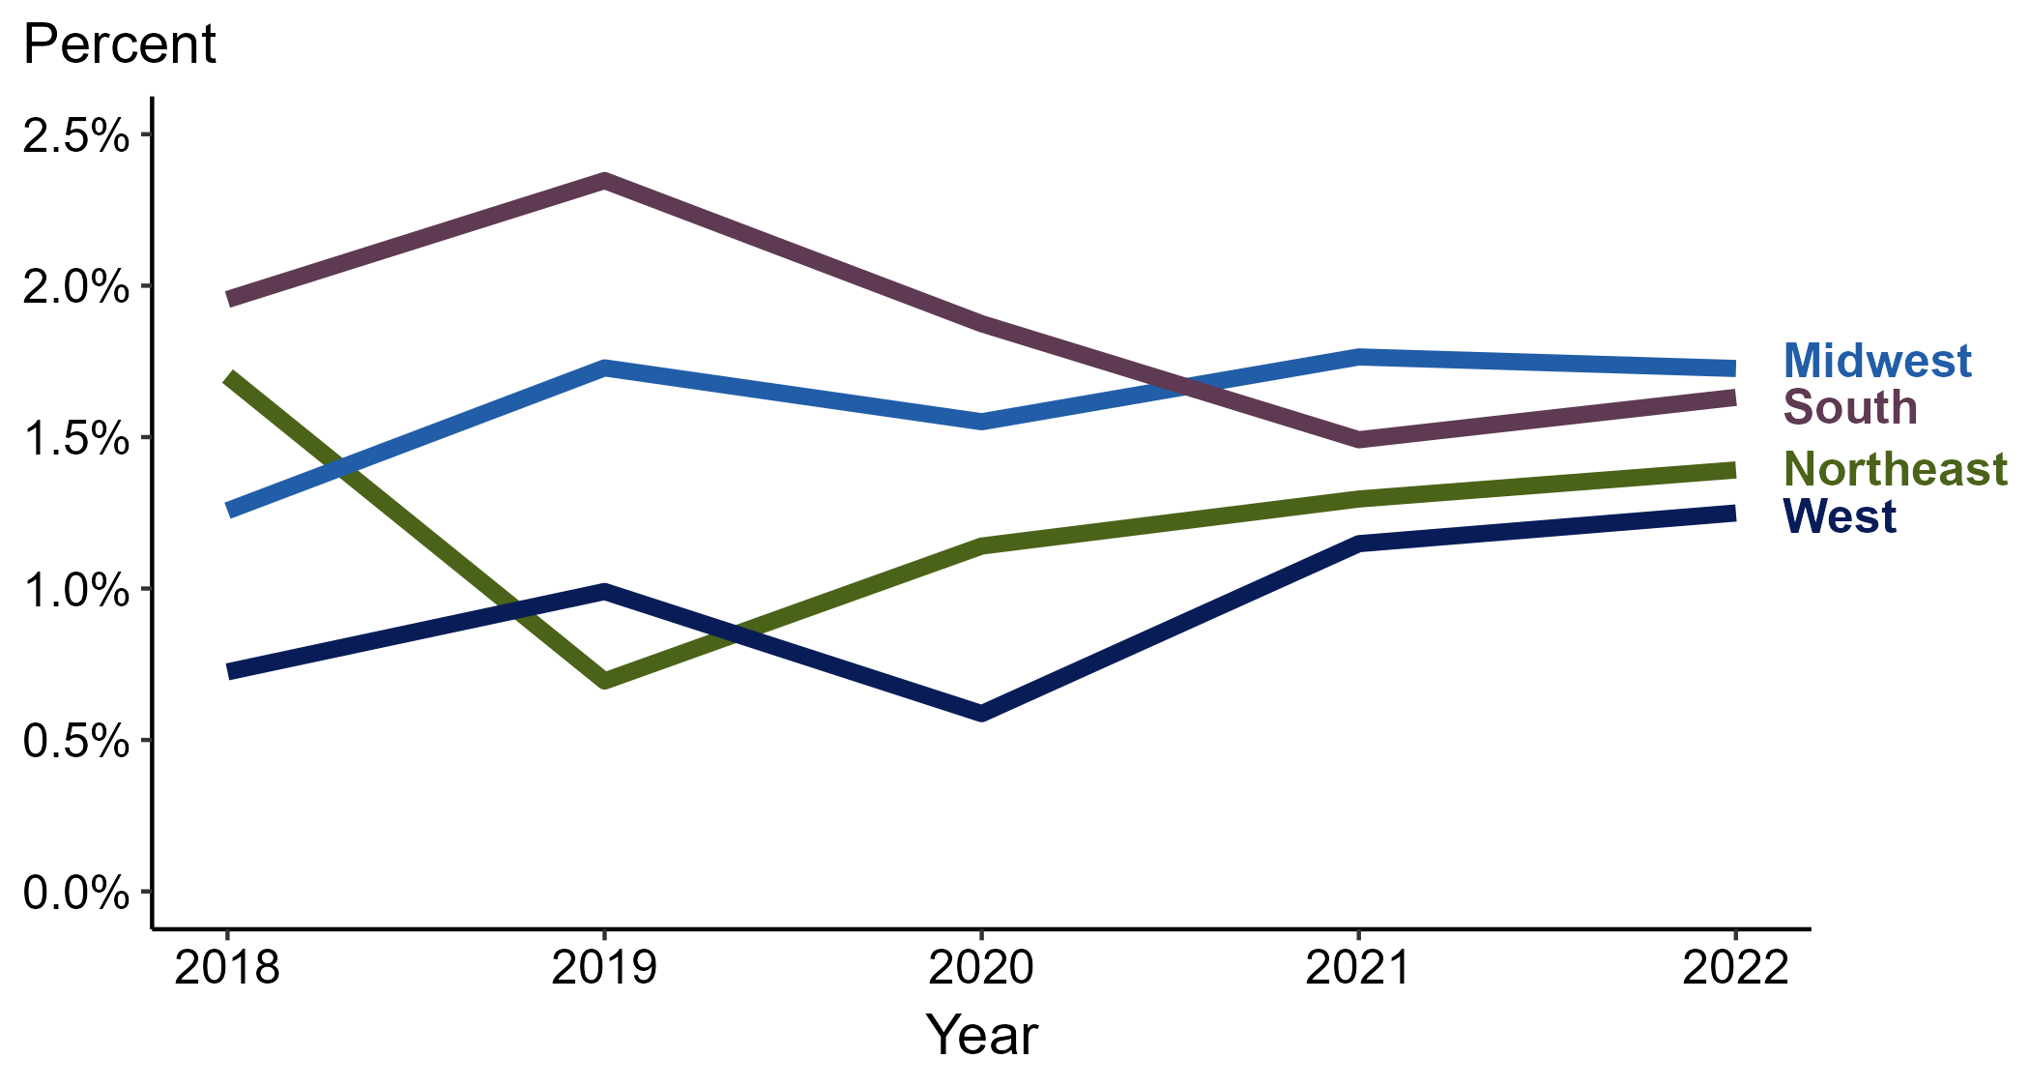
Primary and Secondary Syphilis — Percentage of Cases Reporting Crack Use* by Region, United States, 2018–2022
* Proportion reporting crack use within the last 12 months calculated among cases with known data (cases with missing or unknown responses were excluded from the denominator).
Notes:
Among primary and secondary (P&S) syphilis cases reported in 2022, crack use was most frequently reported in the Midwest (1.7%), followed by the South (1.6%), Northeast (1.4%), and West (1.2%).
When examining trends within each region during 2018 to 2022, the proportion of P&S syphilis cases that reported crack use remained stable in the West (0.7% to 1.2%), remained stable in the Midwest (1.3% to 1.7%), remained stable in the South (2.0% to 1.6%), and remained stable in the Northeast (1.7% to 1.4%).
This report includes data from years that coincide with the COVID-19 pandemic, which introduced uncertainty and difficulty in interpreting case data. See Impact of COVID-19 on STIs (https://www.cdc.gov/std/statistics/2022/impact.htm) for more information.
This figure presents trends in the proportion of cases reporting one or more selected behaviors. Although rounded percentages are presented in the figure interpretive text, values used for generating the figure may be more precise. Data points for the figures presented in these slides as well as Technical Notes about data sources, data collection and reporting practices, and case definitions are available at https://www.cdc.gov/std/statistics/syphilis-supplement/default.htm.

Slide 18
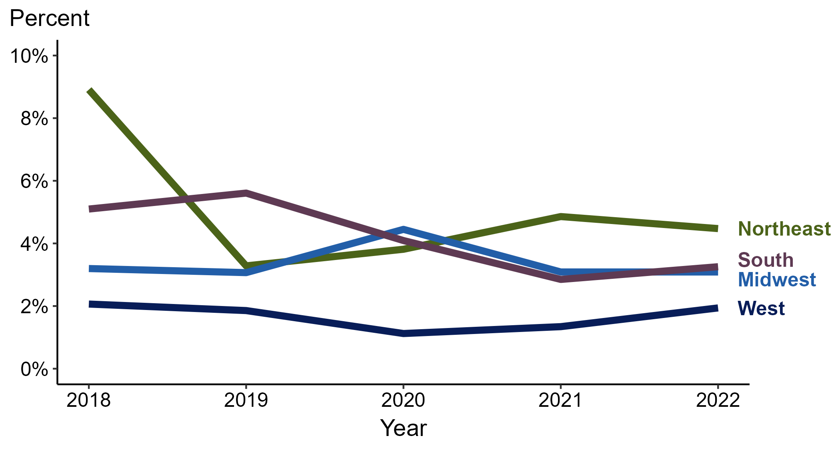
Primary and Secondary Syphilis — Percentage of Cases Reporting Crack Use* Among Women by Region, United States, 2018–2022
* Proportion reporting crack use within the last 12 months calculated among cases with known data (cases with missing or unknown responses were excluded from the denominator).
Notes:
Among primary and secondary (P&S) syphilis cases reported among women in 2022, crack use was most frequently reported in the Northeast (4.5%), followed by the South (3.3%), Midwest (3.1%), and West (1.9%).
When examining trends within each region during 2018 to 2022, the proportion of P&S syphilis cases among women that reported crack use remained stable in the Midwest (3.2% to 3.1%), remained stable in the West (2.1% to 1.9%), decreased in the South (5.1% to 3.3%), and decreased in the Northeast (8.9% to 4.5%).
This report includes data from years that coincide with the COVID-19 pandemic, which introduced uncertainty and difficulty in interpreting case data. See Impact of COVID-19 on STIs (https://www.cdc.gov/std/statistics/2022/impact.htm) for more information.
This figure presents trends in the proportion of cases reporting one or more selected behaviors. Although rounded percentages are presented in the figure interpretive text, values used for generating the figure may be more precise. Data points for the figures presented in these slides as well as Technical Notes about data sources, data collection and reporting practices, and case definitions are available at https://www.cdc.gov/std/statistics/syphilis-supplement/default.htm.

Slide 19
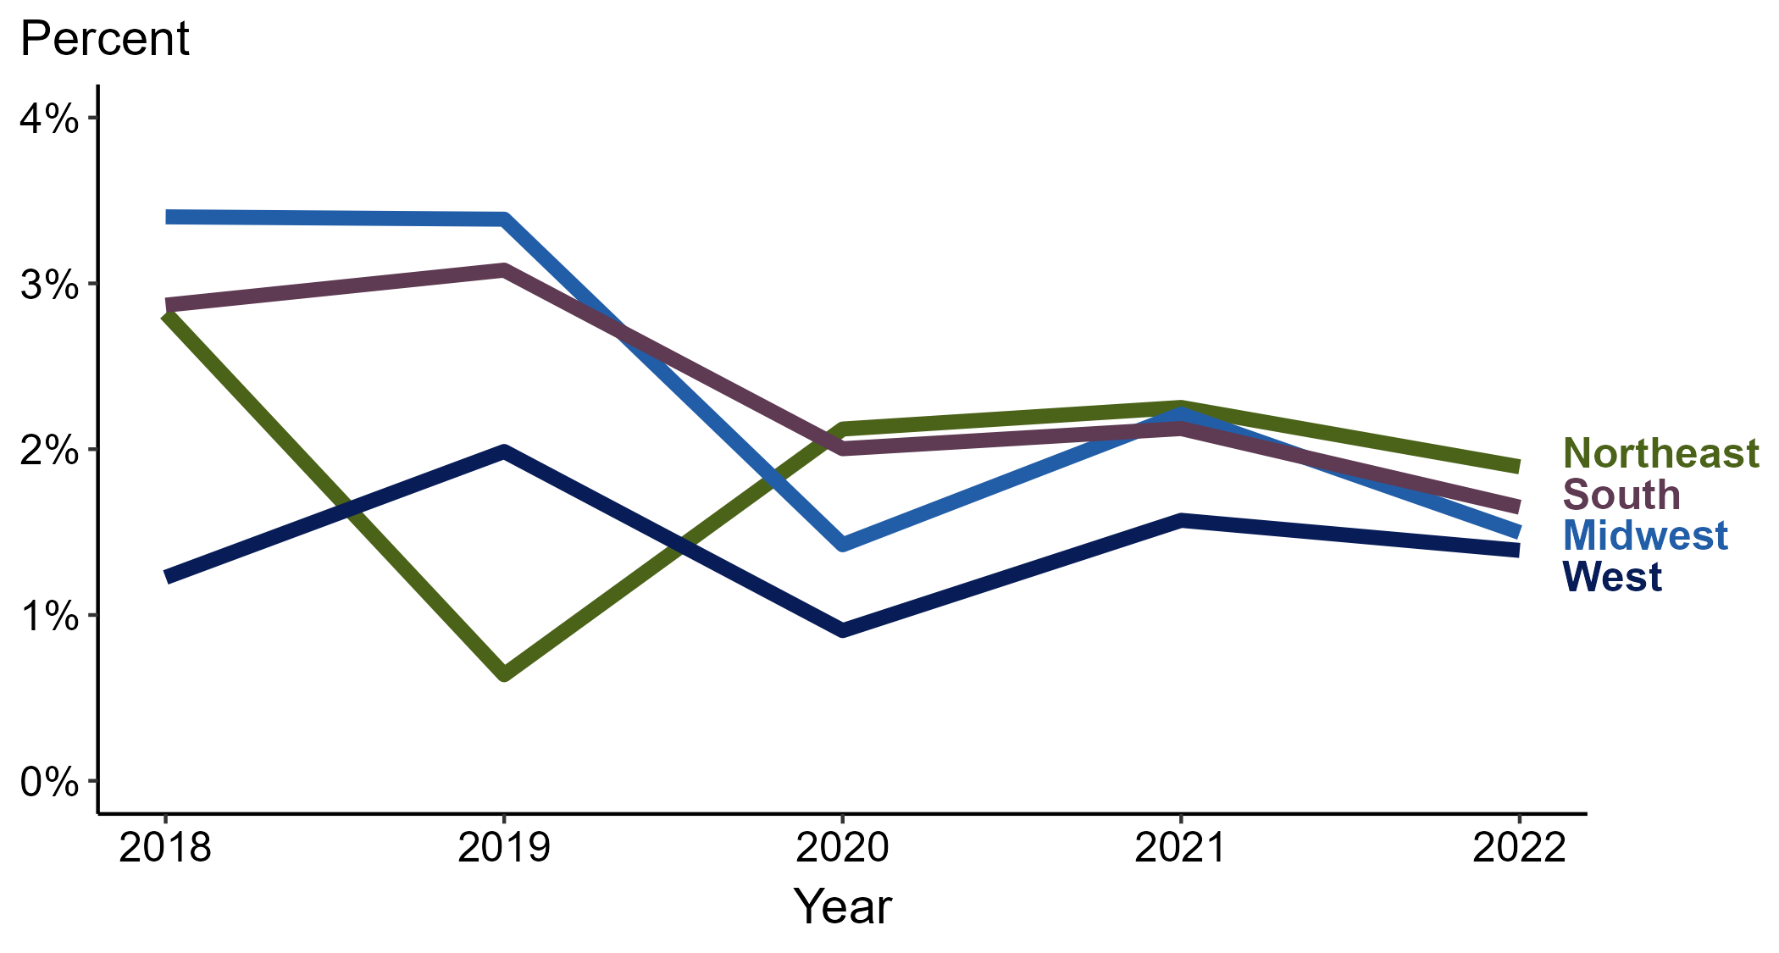
Primary and Secondary Syphilis — Percentage of Cases Reporting Crack Use* Among MSW by Region, United States, 2018–2022
* Proportion reporting crack use within the last 12 months calculated among cases with known data (cases with missing or unknown responses were excluded from the denominator).
ACRONYMS: MSW = Men who have sex with women only
Notes:
Among primary and secondary (P&S) syphilis cases reported among MSW in 2022, crack use was most frequently reported in the Northeast (1.9%), followed by the South (1.7%), Midwest (1.5%), and West (1.4%).
When examining trends within each region during 2018 to 2022, the proportion of P&S syphilis cases among MSW that reported crack use remained stable in the West (1.2% to 1.4%), remained stable in the Northeast (2.8% to 1.9%), decreased in the South (2.9% to 1.7%), and decreased in the Midwest (3.4% to 1.5%).
This report includes data from years that coincide with the COVID-19 pandemic, which introduced uncertainty and difficulty in interpreting case data. See Impact of COVID-19 on STIs (https://www.cdc.gov/std/statistics/2022/impact.htm) for more information.
This figure presents trends in the proportion of cases reporting one or more selected behaviors. Although rounded percentages are presented in the figure interpretive text, values used for generating the figure may be more precise. Data points for the figures presented in these slides as well as Technical Notes about data sources, data collection and reporting practices, and case definitions are available at https://www.cdc.gov/std/statistics/syphilis-supplement/default.htm.

Slide 20
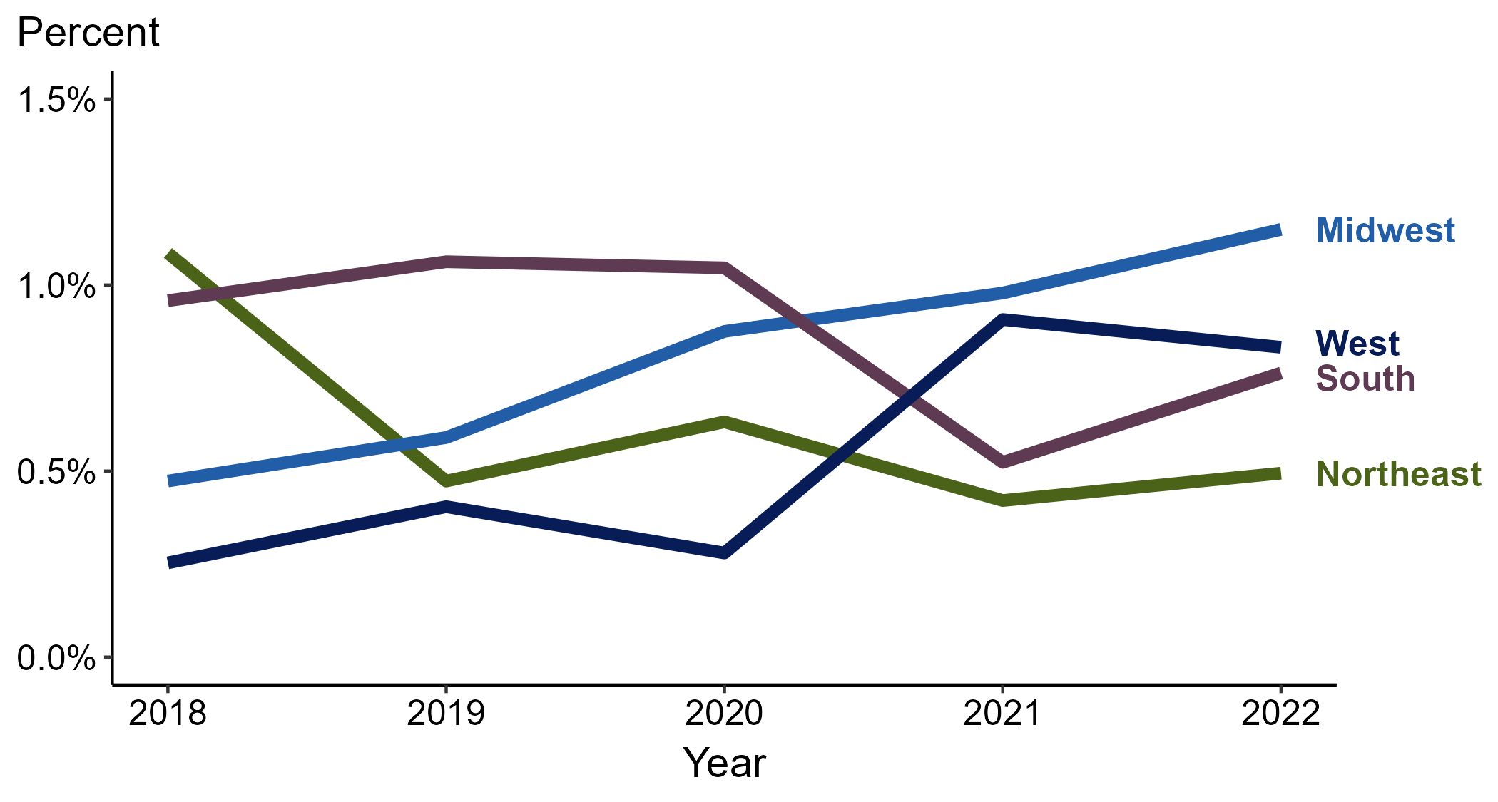
Primary and Secondary Syphilis — Percentage of Cases Reporting Crack Use* Among MSM by Region, United States, 2018–2022
* Proportion reporting crack use within the last 12 months calculated among cases with known data (cases with missing or unknown responses were excluded from the denominator).
ACRONYMS: MSM = Men who have sex with men
Notes:
Among primary and secondary (P&S) syphilis cases reported among MSM in 2022, crack use was most frequently reported in the Midwest (1.1%), followed by the South and West (0.8% in both regions) and Northeast (0.5%).
When examining trends within each region during 2018 to 2022, the proportion of P&S syphilis cases among MSM that reported crack use remained stable in the West (0.3% to 0.8%), remained stable in the Midwest (0.5% to 1.1%), remained stable in the South (1.0% to 0.8%), and remained stable in the Northeast (1.1% to 0.5%).
This report includes data from years that coincide with the COVID-19 pandemic, which introduced uncertainty and difficulty in interpreting case data. See Impact of COVID-19 on STIs (https://www.cdc.gov/std/statistics/2022/impact.htm) for more information.
This figure presents trends in the proportion of cases reporting one or more selected behaviors. Although rounded percentages are presented in the figure interpretive text, values used for generating the figure may be more precise. Data points for the figures presented in these slides as well as Technical Notes about data sources, data collection and reporting practices, and case definitions are available at https://www.cdc.gov/std/statistics/syphilis-supplement/default.htm.

Slide 21
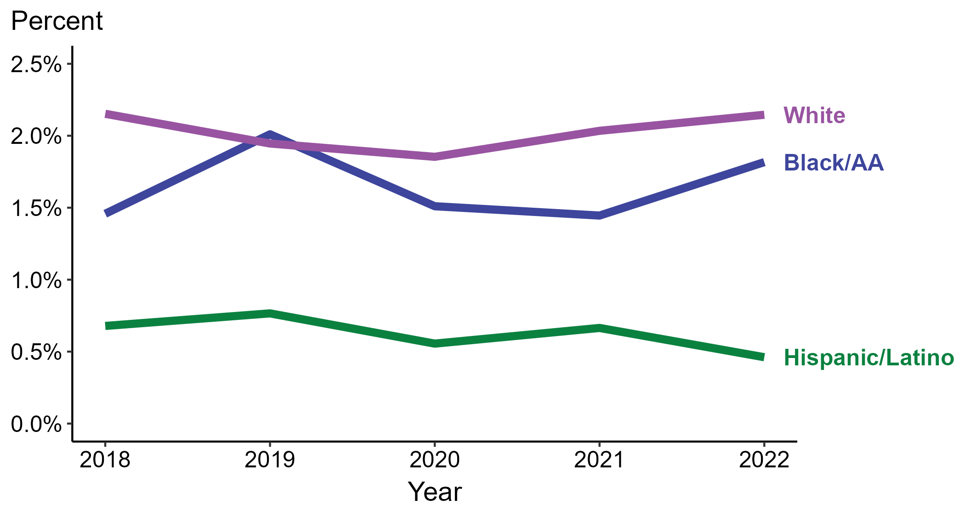
Primary and Secondary Syphilis — Percentage of Cases Reporting Crack Use* by Race and Hispanic Ethnicity, United States, 2018–2022
* Proportion reporting crack use within the last 12 months calculated among cases with known data (cases with missing or unknown responses were excluded from the denominator).
ACRONYMS: Black/AA = Black or African American
Notes:
Among primary and secondary (P&S) syphilis cases reported in 2022, crack use was most frequently reported among non-Hispanic White persons (2.1%), followed by non-Hispanic Black or African American persons (1.8%) and Hispanic or Latino persons (0.5%).
When examining trends within each race and Hispanic ethnicity during 2018 to 2022, the proportion of P&S syphilis cases that reported crack use remained stable among non-Hispanic Black or African American persons (1.5% to 1.8%), remained stable among non-Hispanic White persons (2.2% to 2.1%), and remained stable among Hispanic or Latino persons (0.7% to 0.5%).
During 2018 to 2022, 87.7% of P&S syphilis cases with information on crack use were non-Hispanic White, non-Hispanic Black or African American, or Hispanic or Latino. Because the vast majority of cases fall in those racial and ethnic categories, only data for those groups are displayed in the figure above.
See Technical Notes for information on syphilis case reporting, race/Hispanic ethnicity categorization, and reporting of race/Hispanic ethnicity for STI cases.
This report includes data from years that coincide with the COVID-19 pandemic, which introduced uncertainty and difficulty in interpreting case data. See Impact of COVID-19 on STIs (https://www.cdc.gov/std/statistics/2022/impact.htm) for more information.
This figure presents trends in the proportion of cases reporting one or more selected behaviors. Although rounded percentages are presented in the figure interpretive text, values used for generating the figure may be more precise. Data points for the figures presented in these slides as well as Technical Notes about data sources, data collection and reporting practices, and case definitions are available at https://www.cdc.gov/std/statistics/syphilis-supplement/default.htm.

Slide 22
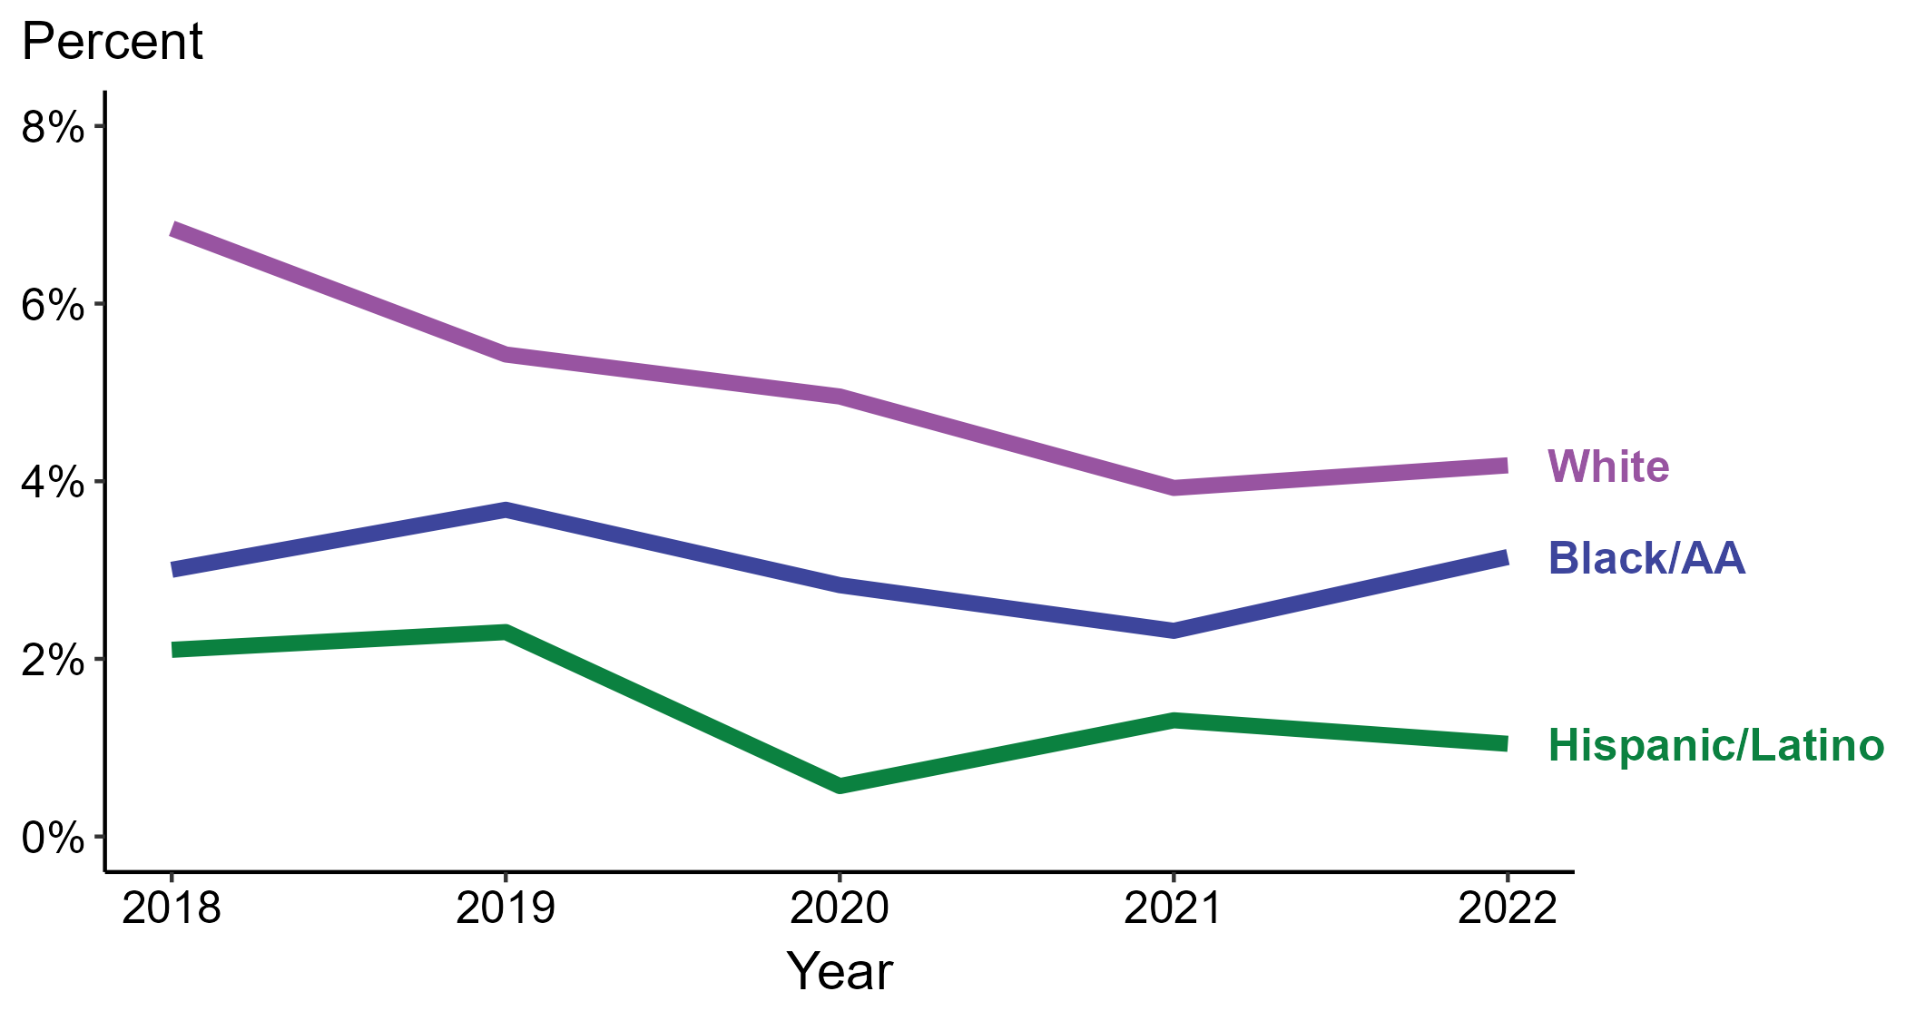
Primary and Secondary Syphilis — Percentage of Cases Reporting Crack Use* Among Women by Race and Hispanic Ethnicity, United States, 2018–2022
* Proportion reporting crack use within the last 12 months calculated among cases with known data (cases with missing or unknown responses were excluded from the denominator).
ACRONYMS: Black/AA = Black or African American
Notes:
Among primary and secondary (P&S) syphilis cases reported among women in 2022, crack use was most frequently reported among non-Hispanic White women (4.2%), followed by non-Hispanic Black or African American women (3.1%) and Hispanic or Latino women (1.0%).
When examining trends within each race and Hispanic ethnicity during 2018 to 2022, the proportion of P&S syphilis cases among women that reported crack use remained stable among non-Hispanic Black or African American women (3.0% to 3.1%), decreased among non-Hispanic White women (6.8% to 4.2%), and decreased among Hispanic or Latino women (2.1% to 1.0%).
During 2018 to 2022, 87.3% of P&S syphilis cases among women with information on crack use were non-Hispanic White, non-Hispanic Black or African American, or Hispanic or Latino. Because the vast majority of cases fall in those racial and ethnic categories, only data for those groups are displayed in the figure above.
See Technical Notes for information on syphilis case reporting, race/Hispanic ethnicity categorization, and reporting of race/Hispanic ethnicity for STI cases.
This report includes data from years that coincide with the COVID-19 pandemic, which introduced uncertainty and difficulty in interpreting case data. See Impact of COVID-19 on STIs (https://www.cdc.gov/std/statistics/2022/impact.htm) for more information.
This figure presents trends in the proportion of cases reporting one or more selected behaviors. Although rounded percentages are presented in the figure interpretive text, values used for generating the figure may be more precise. Data points for the figures presented in these slides as well as Technical Notes about data sources, data collection and reporting practices, and case definitions are available at https://www.cdc.gov/std/statistics/syphilis-supplement/default.htm.

Slide 23
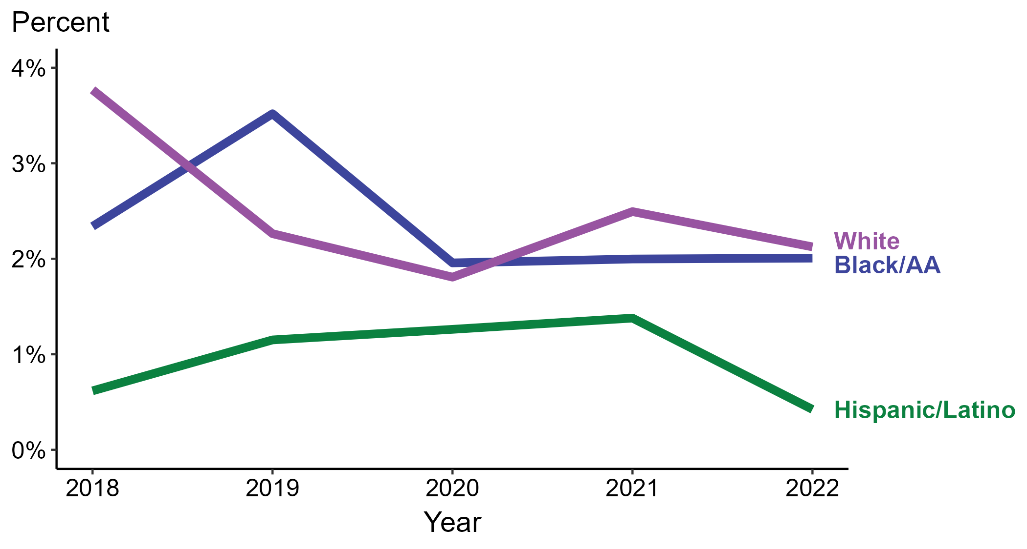
Primary and Secondary Syphilis — Percentage of Cases Reporting Crack Use* Among MSW by Race and Hispanic Ethnicity, United States, 2018–2022
* Proportion reporting crack use within the last 12 months calculated among cases with known data (cases with missing or unknown responses were excluded from the denominator).
ACRONYMS: Black/AA = Black or African American; MSW = Men who have sex with women only
Notes:
Among primary and secondary (P&S) syphilis cases reported among MSW in 2022, crack use was most frequently reported among non-Hispanic White MSW (2.1%), followed by non-Hispanic Black or African American MSW (2.0%) and Hispanic or Latino MSW (0.4%).
When examining trends within each race and Hispanic ethnicity during 2018 to 2022, the proportion of P&S syphilis cases among MSW that reported crack use remained stable among non-Hispanic Black or African American MSW (2.3% to 2.0%), remained stable among Hispanic or Latino MSW (0.6% to 0.4%), and decreased among non-Hispanic White MSW (3.8% to 2.1%).
During 2018 to 2022, 88.9% of P&S syphilis cases among MSW with information on crack use were non-Hispanic White, non-Hispanic Black or African American, or Hispanic or Latino. Because the vast majority of cases fall in those racial and ethnic categories, only data for those groups are displayed in the figure above.
See Technical Notes for information on syphilis case reporting, race/Hispanic ethnicity categorization, and reporting of race/Hispanic ethnicity for STI cases.
This report includes data from years that coincide with the COVID-19 pandemic, which introduced uncertainty and difficulty in interpreting case data. See Impact of COVID-19 on STIs (https://www.cdc.gov/std/statistics/2022/impact.htm) for more information.
This figure presents trends in the proportion of cases reporting one or more selected behaviors. Although rounded percentages are presented in the figure interpretive text, values used for generating the figure may be more precise. Data points for the figures presented in these slides as well as Technical Notes about data sources, data collection and reporting practices, and case definitions are available at https://www.cdc.gov/std/statistics/syphilis-supplement/default.htm.

Slide 24
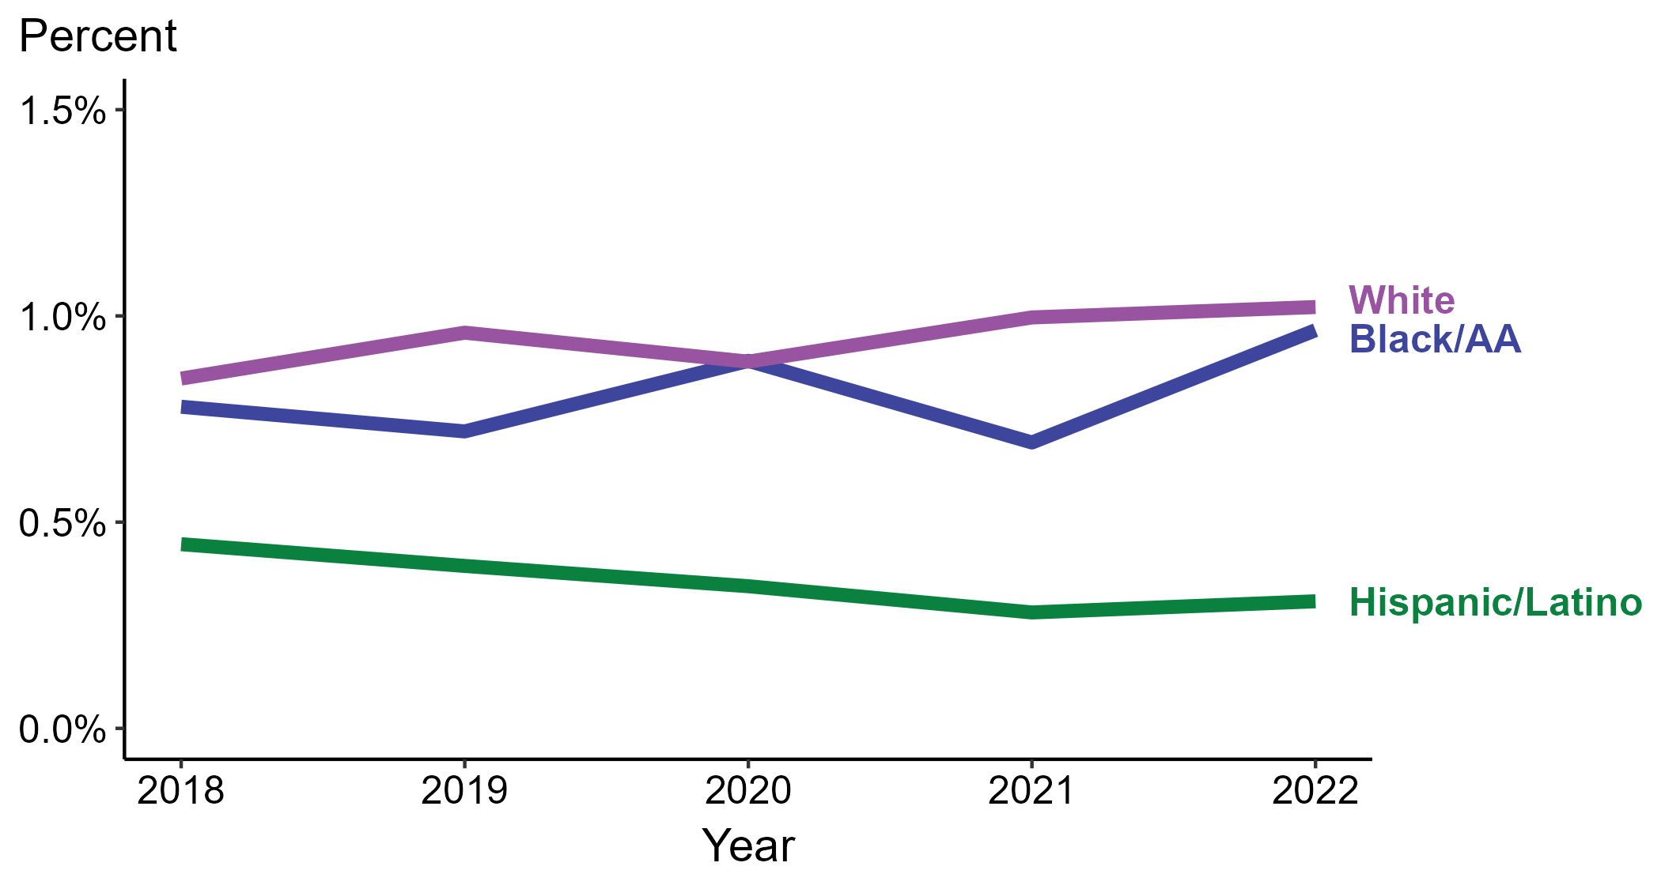
Primary and Secondary Syphilis — Percentage of Cases Reporting Crack Use* Among MSM by Race and Hispanic Ethnicity, United States, 2018–2022
* Proportion reporting crack use within the last 12 months calculated among cases with known data (cases with missing or unknown responses were excluded from the denominator).
ACRONYMS: Black/AA = Black or African American; MSM = Men who have sex with men
Notes:
Among primary and secondary (P&S) syphilis cases reported among MSM in 2022, crack use was most frequently reported among non-Hispanic Black or African American MSM and non-Hispanic White MSM (1.0% in both groups), followed by Hispanic or Latino MSM (0.3%).
When examining trends within each race and Hispanic ethnicity during 2018 to 2022, the proportion of P&S syphilis cases among MSM that reported crack use remained stable among non-Hispanic Black or African American MSM (0.8% to 1.0%), remained stable among non-Hispanic White MSM (0.8% to 1.0%), and remained stable among Hispanic or Latino MSM (0.4% to 0.3%).
During 2018 to 2022, 88.0% of P&S syphilis cases among MSM with information on crack use were non-Hispanic White, non-Hispanic Black or African American, or Hispanic or Latino. Because the vast majority of cases fall in those racial and ethnic categories, only data for those groups are displayed in the figure above.
See Technical Notes for information on syphilis case reporting, race/Hispanic ethnicity categorization, and reporting of race/Hispanic ethnicity for STI cases.
This report includes data from years that coincide with the COVID-19 pandemic, which introduced uncertainty and difficulty in interpreting case data. See Impact of COVID-19 on STIs (https://www.cdc.gov/std/statistics/2022/impact.htm) for more information.
This figure presents trends in the proportion of cases reporting one or more selected behaviors. Although rounded percentages are presented in the figure interpretive text, values used for generating the figure may be more precise. Data points for the figures presented in these slides as well as Technical Notes about data sources, data collection and reporting practices, and case definitions are available at https://www.cdc.gov/std/statistics/syphilis-supplement/default.htm.

Slide 25
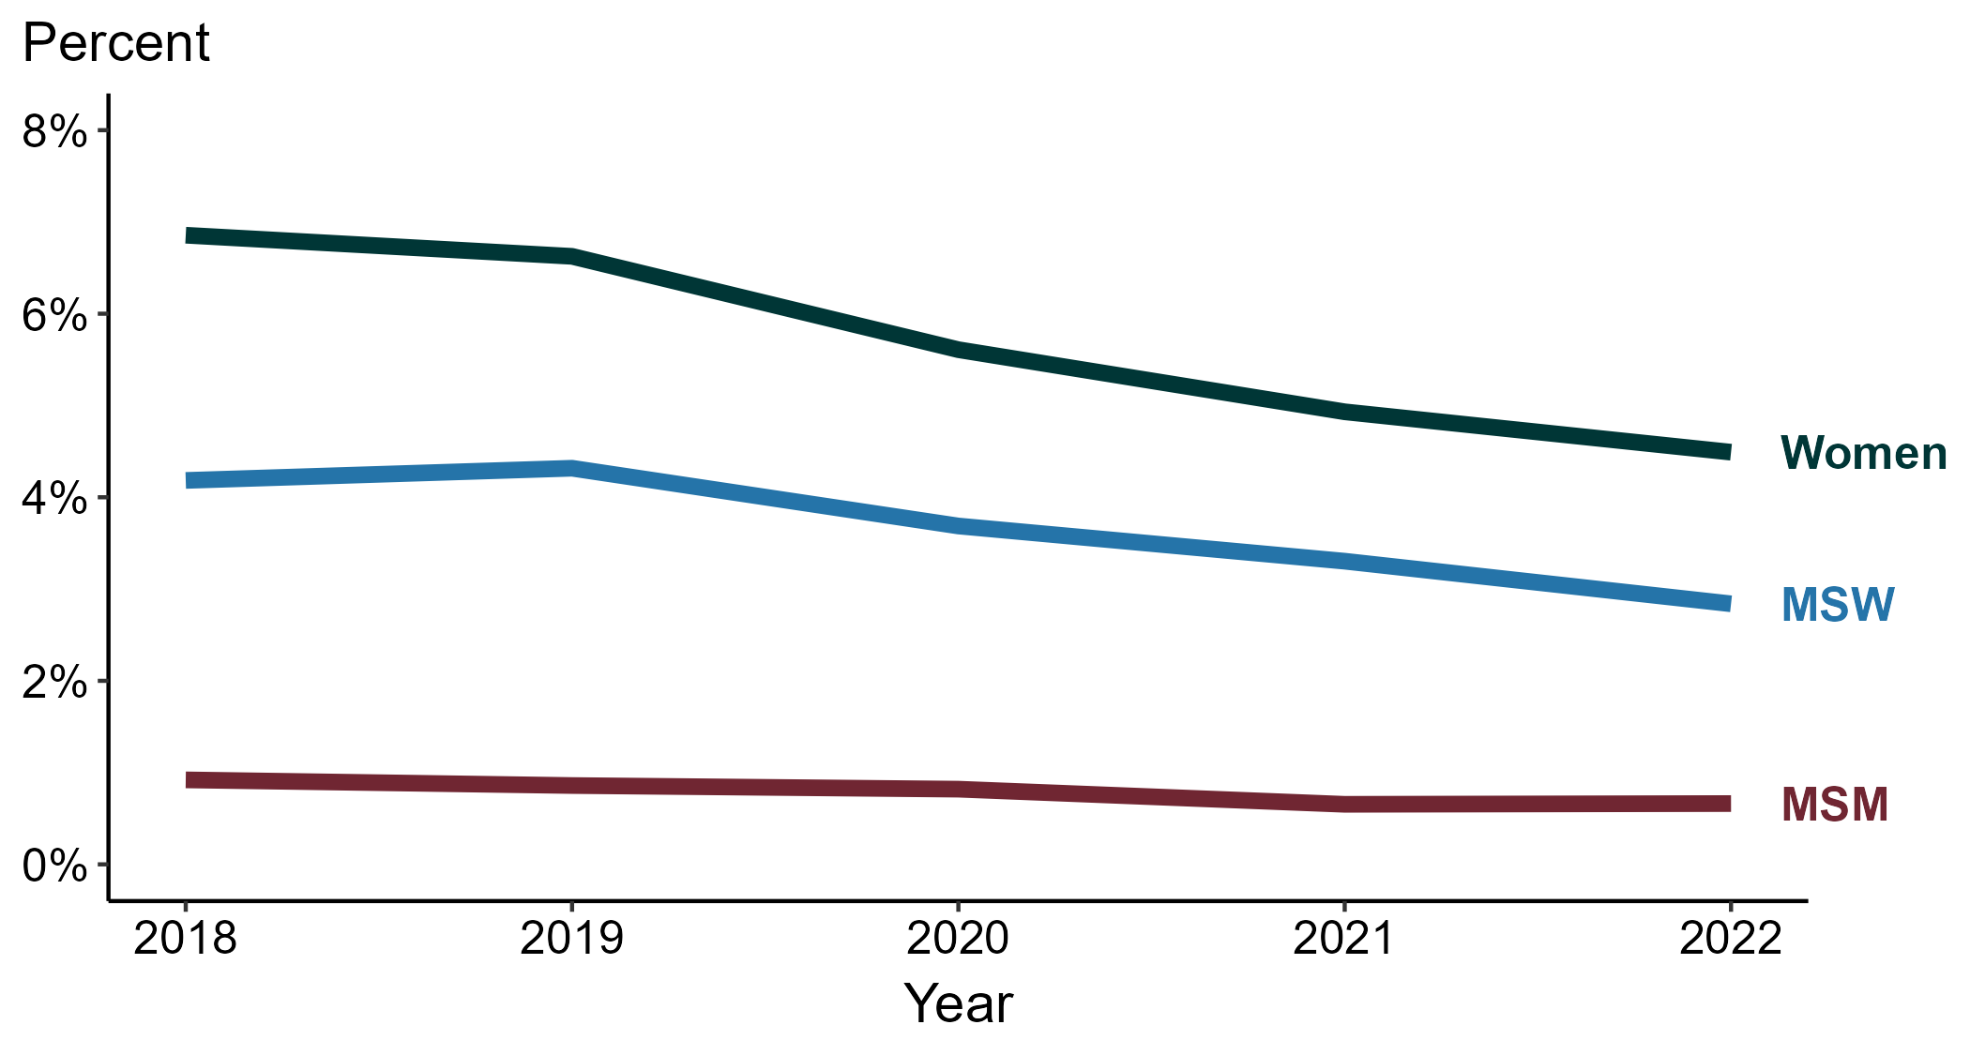
Primary and Secondary Syphilis — Percentage of Cases Reporting Heroin Use* by Sex and Sex of Sex Partners, United States, 2018–2022
* Proportion reporting heroin use within the last 12 months calculated among cases with known data (cases with missing or unknown responses were excluded from the denominator).
ACRONYMS: MSM = Men who have sex with men; MSW = Men who have sex with women only
Notes:
Among primary and secondary (P&S) syphilis cases in 2022, heroin use was most frequently reported among women (4.5%), followed by MSW (2.8%) and MSM (0.7%).
During 2018 to 2022, the proportion of P&S syphilis cases that reported heroin use remained stable among MSM (0.9% to 0.7%), decreased among MSW (4.2% to 2.8%), and decreased among women (6.9% to 4.5%).
This report includes data from years that coincide with the COVID-19 pandemic, which introduced uncertainty and difficulty in interpreting case data. See Impact of COVID-19 on STIs (https://www.cdc.gov/std/statistics/2022/impact.htm) for more information.
This figure presents trends in the proportion of cases reporting one or more selected behaviors. Although rounded percentages are presented in the figure interpretive text, values used for generating the figure may be more precise. Data points for the figures presented in these slides as well as Technical Notes about data sources, data collection and reporting practices, and case definitions are available at https://www.cdc.gov/std/statistics/syphilis-supplement/default.htm.

Slide 26
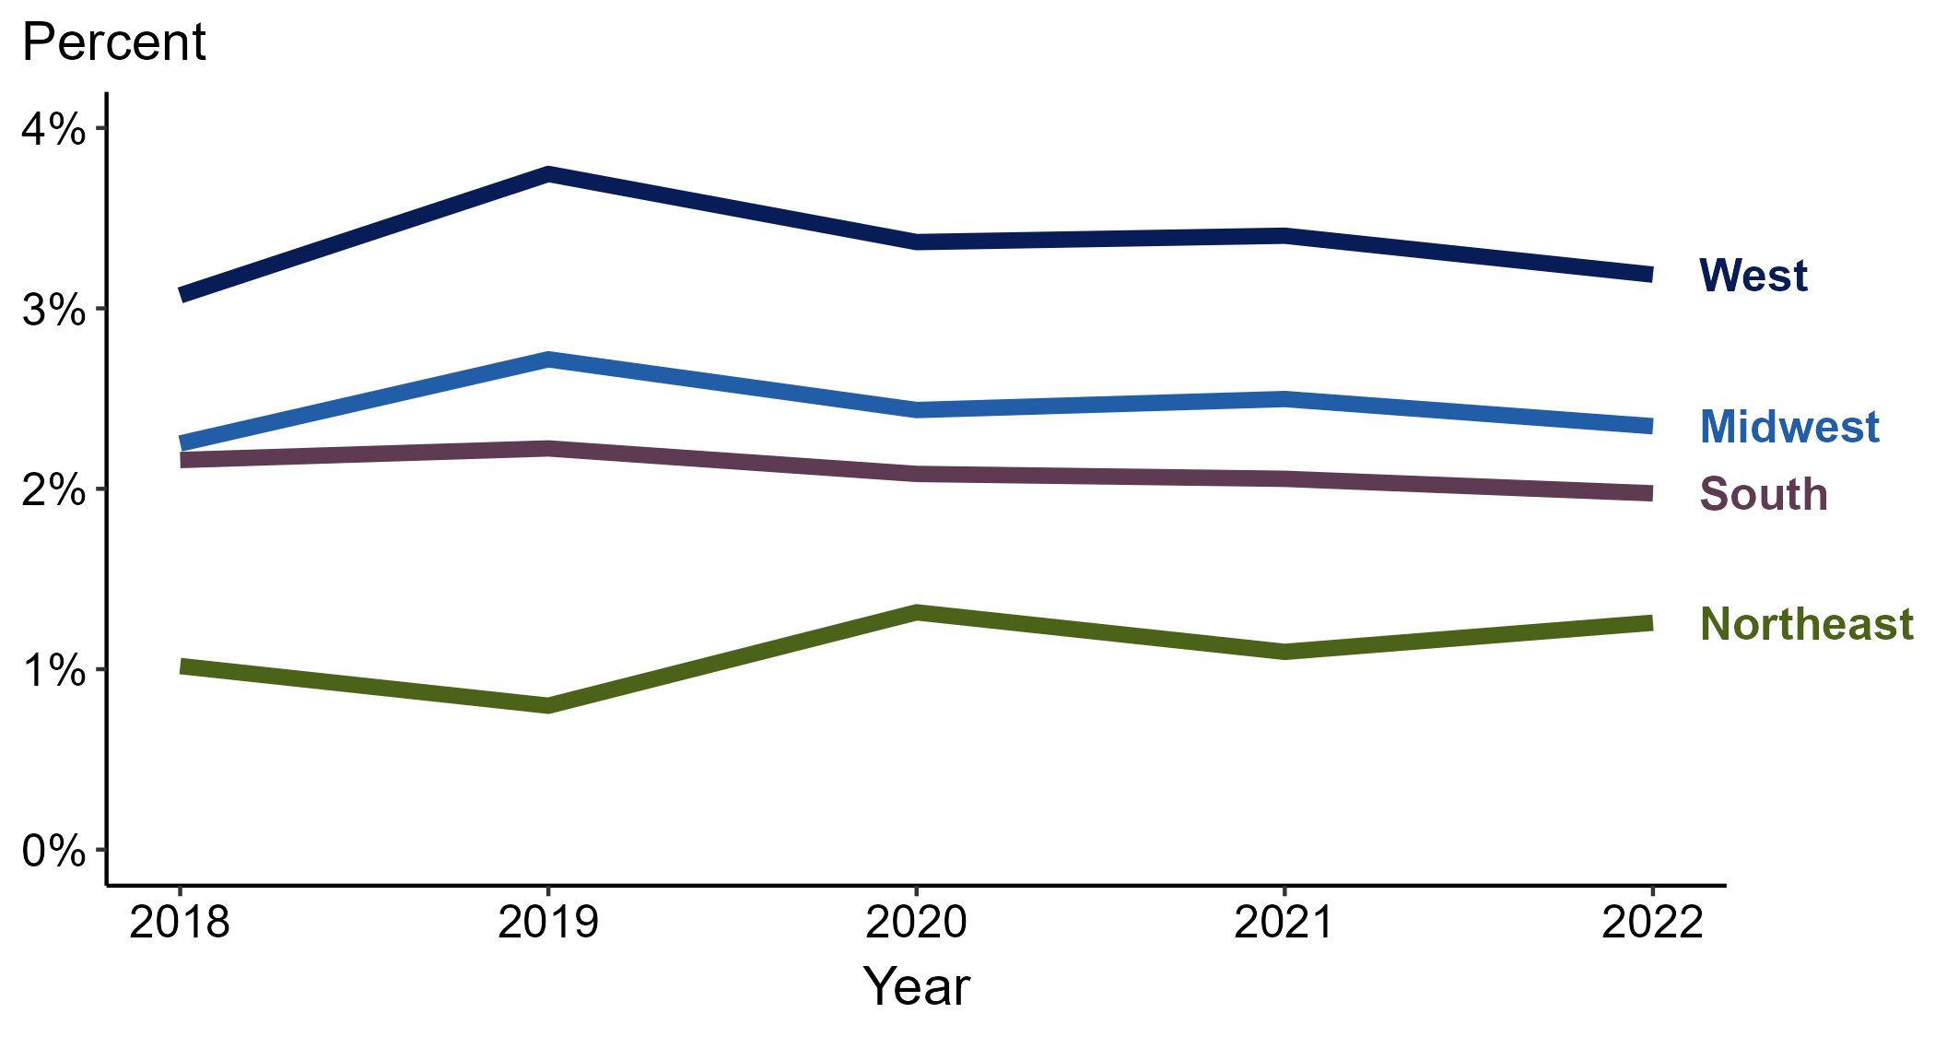
Primary and Secondary Syphilis — Percentage of Cases Reporting Heroin Use* by Region, United States, 2018–2022
* Proportion reporting heroin use within the last 12 months calculated among cases with known data (cases with missing or unknown responses were excluded from the denominator).
Notes:
Among primary and secondary (P&S) syphilis cases reported in 2022, heroin use was most frequently reported in the West (3.2%), followed by the Midwest (2.3%), South (2.0%), and Northeast (1.3%).
When examining trends within each region during 2018 to 2022, the proportion of P&S syphilis cases that reported heroin use remained stable in the Northeast (1.0% to 1.3%), remained stable in the Midwest (2.3% in both years), remained stable in the West (3.1% to 3.2%), and remained stable in the South (2.2% to 2.0%).
This report includes data from years that coincide with the COVID-19 pandemic, which introduced uncertainty and difficulty in interpreting case data. See Impact of COVID-19 on STIs (https://www.cdc.gov/std/statistics/2022/impact.htm) for more information.
This figure presents trends in the proportion of cases reporting one or more selected behaviors. Although rounded percentages are presented in the figure interpretive text, values used for generating the figure may be more precise. Data points for the figures presented in these slides as well as Technical Notes about data sources, data collection and reporting practices, and case definitions are available at https://www.cdc.gov/std/statistics/syphilis-supplement/default.htm.

Slide 27
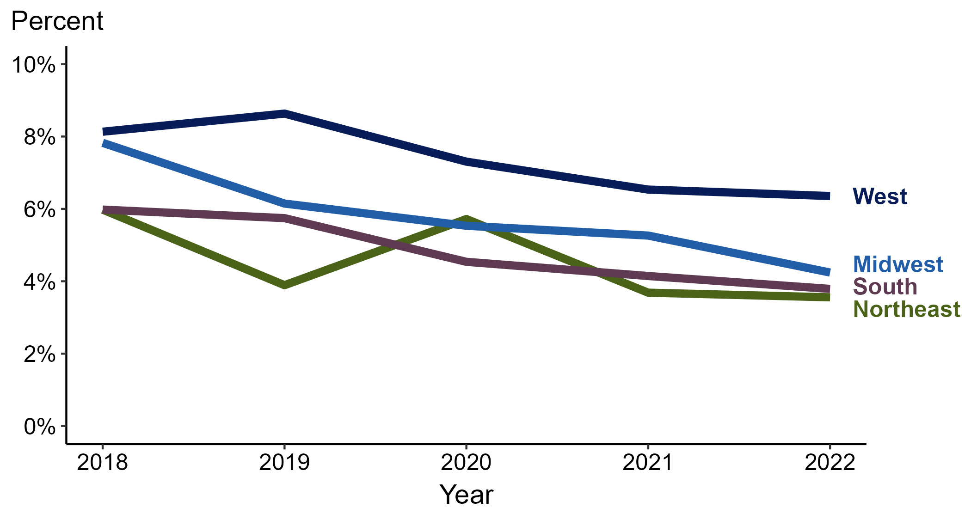
Primary and Secondary Syphilis — Percentage of Cases Reporting Heroin Use* Among Women by Region, United States, 2018–2022
* Proportion reporting heroin use within the last 12 months calculated among cases with known data (cases with missing or unknown responses were excluded from the denominator).
Notes:
Among primary and secondary (P&S) syphilis cases reported among women in 2022, heroin use was most frequently reported in the West (6.4%), followed by the Midwest (4.2%), South (3.8%), and Northeast (3.6%).
When examining trends within each region during 2018 to 2022, the proportion of P&S syphilis cases among women that reported heroin use decreased in the West (8.1% to 6.4%), decreased in the South (6.0% to 3.8%), decreased in the Northeast (6.0% to 3.6%), and decreased in the Midwest (7.8% to 4.2%).
This report includes data from years that coincide with the COVID-19 pandemic, which introduced uncertainty and difficulty in interpreting case data. See Impact of COVID-19 on STIs (https://www.cdc.gov/std/statistics/2022/impact.htm) for more information.
This figure presents trends in the proportion of cases reporting one or more selected behaviors. Although rounded percentages are presented in the figure interpretive text, values used for generating the figure may be more precise. Data points for the figures presented in these slides as well as Technical Notes about data sources, data collection and reporting practices, and case definitions are available at https://www.cdc.gov/std/statistics/syphilis-supplement/default.htm.

Slide 28
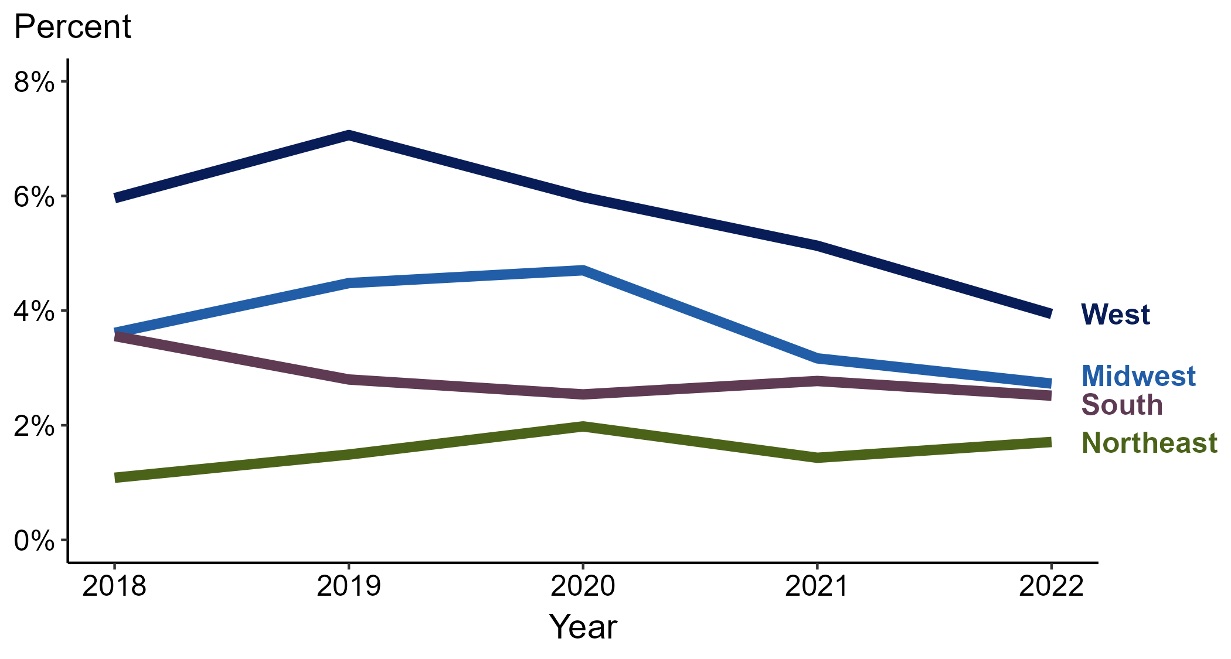
Primary and Secondary Syphilis — Percentage of Cases Reporting Heroin Use* Among MSW by Region, United States, 2018–2022
* Proportion reporting heroin use within the last 12 months calculated among cases with known data (cases with missing or unknown responses were excluded from the denominator).
ACRONYMS: MSW = Men who have sex with women only
Notes:
Among primary and secondary (P&S) syphilis cases reported among MSW in 2022, heroin use was most frequently reported in the West (3.9%), followed by the Midwest (2.7%), South (2.5%), and Northeast (1.7%).
When examining trends within each region during 2018 to 2022, the proportion of P&S syphilis cases among MSW that reported heroin use remained stable in the Northeast (1.1% to 1.7%), remained stable in the Midwest (3.6% to 2.7%), decreased in the South (3.6% to 2.5%), and decreased in the West (6.0% to 3.9%).
This report includes data from years that coincide with the COVID-19 pandemic, which introduced uncertainty and difficulty in interpreting case data. See Impact of COVID-19 on STIs (https://www.cdc.gov/std/statistics/2022/impact.htm) for more information.
This figure presents trends in the proportion of cases reporting one or more selected behaviors. Although rounded percentages are presented in the figure interpretive text, values used for generating the figure may be more precise. Data points for the figures presented in these slides as well as Technical Notes about data sources, data collection and reporting practices, and case definitions are available at https://www.cdc.gov/std/statistics/syphilis-supplement/default.htm.

Slide 29
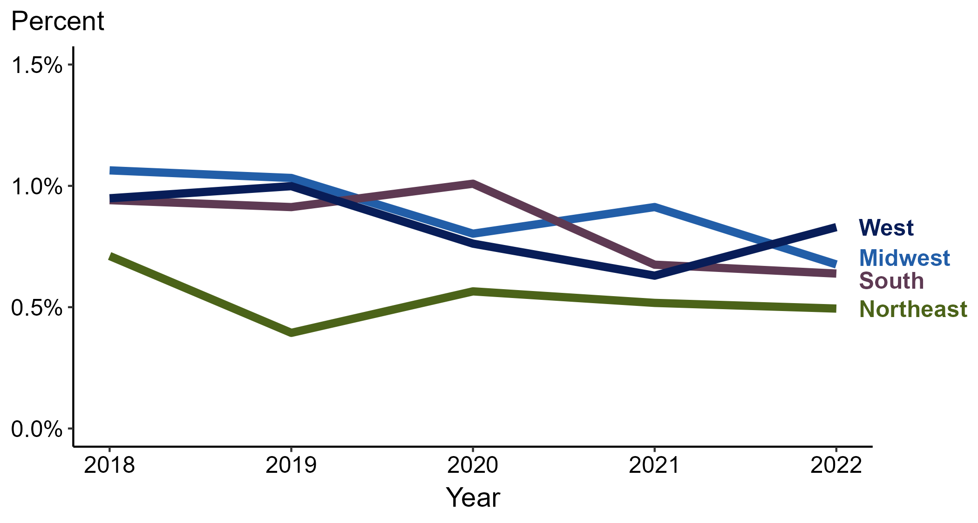
Primary and Secondary Syphilis — Percentage of Cases Reporting Heroin Use* Among MSM by Region, United States, 2018–2022
* Proportion reporting heroin use within the last 12 months calculated among cases with known data (cases with missing or unknown responses were excluded from the denominator).
ACRONYMS: MSM = Men who have sex with men
Notes:
Among primary and secondary (P&S) syphilis cases reported among MSM in 2022, heroin use was most frequently reported in the West (0.8%), followed by the Midwest (0.7%), South (0.6%), and Northeast (0.5%).
When examining trends within each region during 2018 to 2022, the proportion of P&S syphilis cases among MSM that reported heroin use remained stable in the West (0.9% to 0.8%), remained stable in the Northeast (0.7% to 0.5%), remained stable in the South (0.9% to 0.6%), and remained stable in the Midwest (1.1% to 0.7%).
This report includes data from years that coincide with the COVID-19 pandemic, which introduced uncertainty and difficulty in interpreting case data. See Impact of COVID-19 on STIs (https://www.cdc.gov/std/statistics/2022/impact.htm) for more information.
This figure presents trends in the proportion of cases reporting one or more selected behaviors. Although rounded percentages are presented in the figure interpretive text, values used for generating the figure may be more precise. Data points for the figures presented in these slides as well as Technical Notes about data sources, data collection and reporting practices, and case definitions are available at https://www.cdc.gov/std/statistics/syphilis-supplement/default.htm.

Slide 30
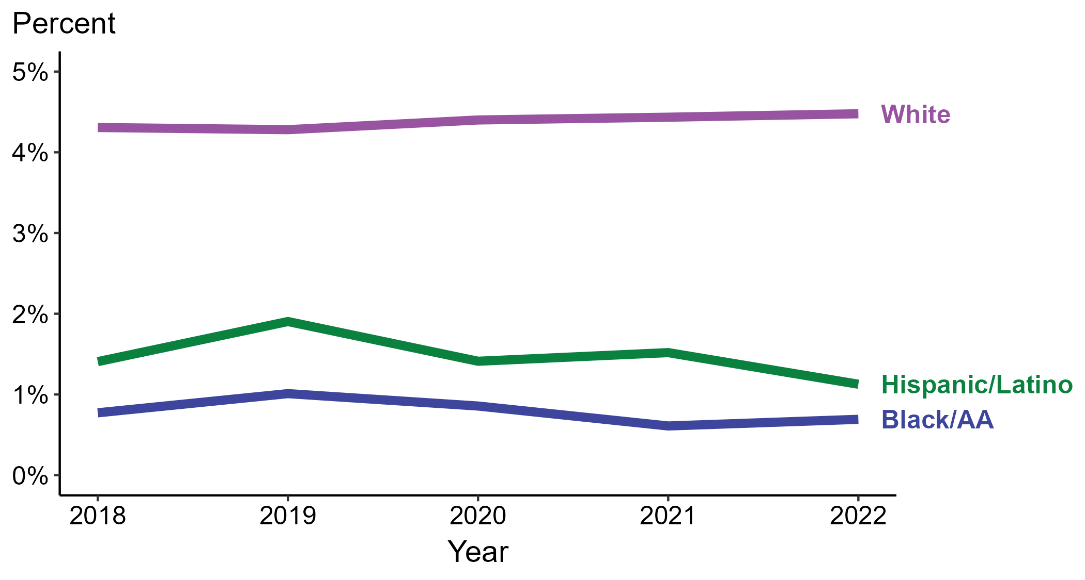
Primary and Secondary Syphilis — Percentage of Cases Reporting Heroin Use* by Race and Hispanic Ethnicity, United States, 2018–2022
* Proportion reporting heroin use within the last 12 months calculated among cases with known data (cases with missing or unknown responses were excluded from the denominator).
ACRONYMS: Black/AA = Black or African American
Notes:
Among primary and secondary (P&S) syphilis cases reported in 2022, heroin use was most frequently reported among non-Hispanic White persons (4.5%), followed by Hispanic or Latino persons (1.1%) and non-Hispanic Black or African American persons (0.7%).
When examining trends within each race and Hispanic ethnicity during 2018 to 2022, the proportion of P&S syphilis cases that reported heroin use remained stable among non-Hispanic White persons (4.3% to 4.5%), remained stable among non-Hispanic Black or African American persons (0.8% to 0.7%), and remained stable among Hispanic or Latino persons (1.4% to 1.1%).
During 2018 to 2022, 87.7% of P&S syphilis cases with information on heroin use were non-Hispanic White, non-Hispanic Black or African American, or Hispanic or Latino. Because the vast majority of cases fall in those racial and ethnic categories, only data for those groups are displayed in the figure above.
See Technical Notes for information on syphilis case reporting, race/Hispanic ethnicity categorization, and reporting of race/Hispanic ethnicity for STI cases.
This report includes data from years that coincide with the COVID-19 pandemic, which introduced uncertainty and difficulty in interpreting case data. See Impact of COVID-19 on STIs (https://www.cdc.gov/std/statistics/2022/impact.htm) for more information.
This figure presents trends in the proportion of cases reporting one or more selected behaviors. Although rounded percentages are presented in the figure interpretive text, values used for generating the figure may be more precise. Data points for the figures presented in these slides as well as Technical Notes about data sources, data collection and reporting practices, and case definitions are available at https://www.cdc.gov/std/statistics/syphilis-supplement/default.htm.

Slide 31
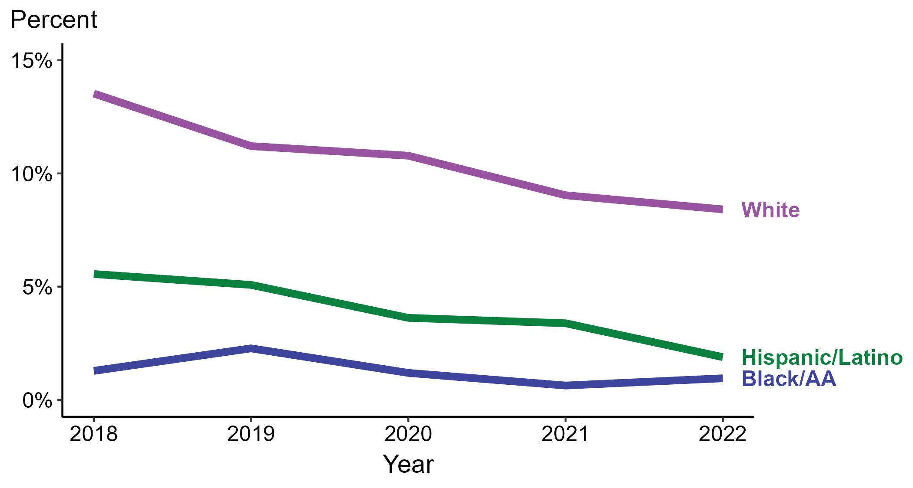
Primary and Secondary Syphilis — Percentage of Cases Reporting Heroin Use* Among Women by Race and Hispanic Ethnicity, United States, 2018–2022
* Proportion reporting heroin use within the last 12 months calculated among cases with known data (cases with missing or unknown responses were excluded from the denominator).
ACRONYMS: Black/AA = Black or African American
Notes:
Among primary and secondary (P&S) syphilis cases reported among women in 2022, heroin use was most frequently reported among non-Hispanic White women (8.4%), followed by Hispanic or Latino women (1.9%) and non-Hispanic Black or African American women (1.0%).
When examining trends within each race and Hispanic ethnicity during 2018 to 2022, the proportion of P&S syphilis cases among women that reported heroin use remained stable among non-Hispanic Black or African American women (1.3% to 1.0%), decreased among non-Hispanic White women (13.5% to 8.4%), and decreased among Hispanic or Latino women (5.6% to 1.9%).
During 2018 to 2022, 87.2% of P&S syphilis cases among women with information on heroin use were non-Hispanic White, non-Hispanic Black or African American, or Hispanic or Latino. Because the vast majority of cases fall in those racial and ethnic categories, only data for those groups are displayed in the figure above.
See Technical Notes for information on syphilis case reporting, race/Hispanic ethnicity categorization, and reporting of race/Hispanic ethnicity for STI cases.
This report includes data from years that coincide with the COVID-19 pandemic, which introduced uncertainty and difficulty in interpreting case data. See Impact of COVID-19 on STIs (https://www.cdc.gov/std/statistics/2022/impact.htm) for more information.
This figure presents trends in the proportion of cases reporting one or more selected behaviors. Although rounded percentages are presented in the figure interpretive text, values used for generating the figure may be more precise. Data points for the figures presented in these slides as well as Technical Notes about data sources, data collection and reporting practices, and case definitions are available at https://www.cdc.gov/std/statistics/syphilis-supplement/default.htm.

Slide 32
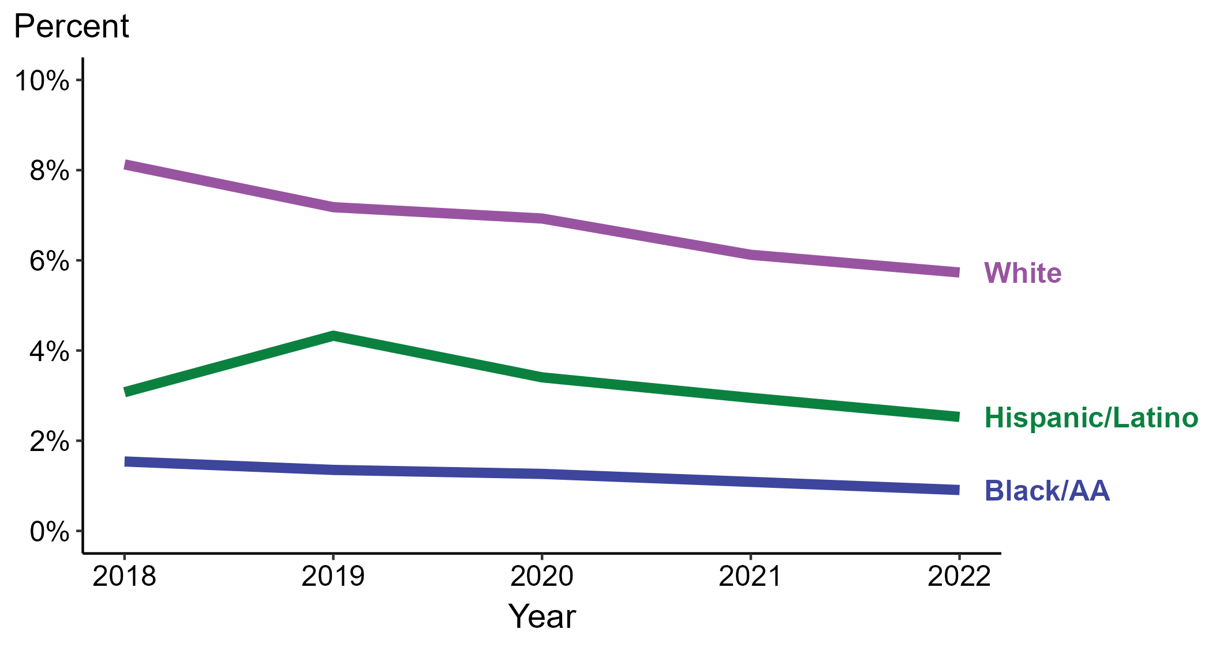
Primary and Secondary Syphilis — Percentage of Cases Reporting Heroin Use* Among MSW by Race and Hispanic Ethnicity, United States, 2018–2022
* Proportion reporting heroin use within the last 12 months calculated among cases with known data (cases with missing or unknown responses were excluded from the denominator).
ACRONYMS: Black/AA = Black or African American; MSW = Men who have sex with women only
Notes:
Among primary and secondary (P&S) syphilis cases reported among MSW in 2022, heroin use was most frequently reported among non-Hispanic White MSW (5.7%), followed by Hispanic or Latino MSW (2.5%) and non-Hispanic Black or African American MSW (0.9%).
When examining trends within each race and Hispanic ethnicity during 2018 to 2022, the proportion of P&S syphilis cases among MSW that reported heroin use remained stable among Hispanic or Latino MSW (3.1% to 2.5%), decreased among non-Hispanic White MSW (8.1% to 5.7%), and remained stable among non-Hispanic Black or African American MSW (1.5% to 0.9%).
During 2018 to 2022, 88.8% of P&S syphilis cases among MSW with information on heroin use were non-Hispanic White, non-Hispanic Black or African American, or Hispanic or Latino. Because the vast majority of cases fall in those racial and ethnic categories, only data for those groups are displayed in the figure above.
See Technical Notes for information on syphilis case reporting, race/Hispanic ethnicity categorization, and reporting of race/Hispanic ethnicity for STI cases.
This report includes data from years that coincide with the COVID-19 pandemic, which introduced uncertainty and difficulty in interpreting case data. See Impact of COVID-19 on STIs (https://www.cdc.gov/std/statistics/2022/impact.htm) for more information.
This figure presents trends in the proportion of cases reporting one or more selected behaviors. Although rounded percentages are presented in the figure interpretive text, values used for generating the figure may be more precise. Data points for the figures presented in these slides as well as Technical Notes about data sources, data collection and reporting practices, and case definitions are available at https://www.cdc.gov/std/statistics/syphilis-supplement/default.htm.

Slide 33
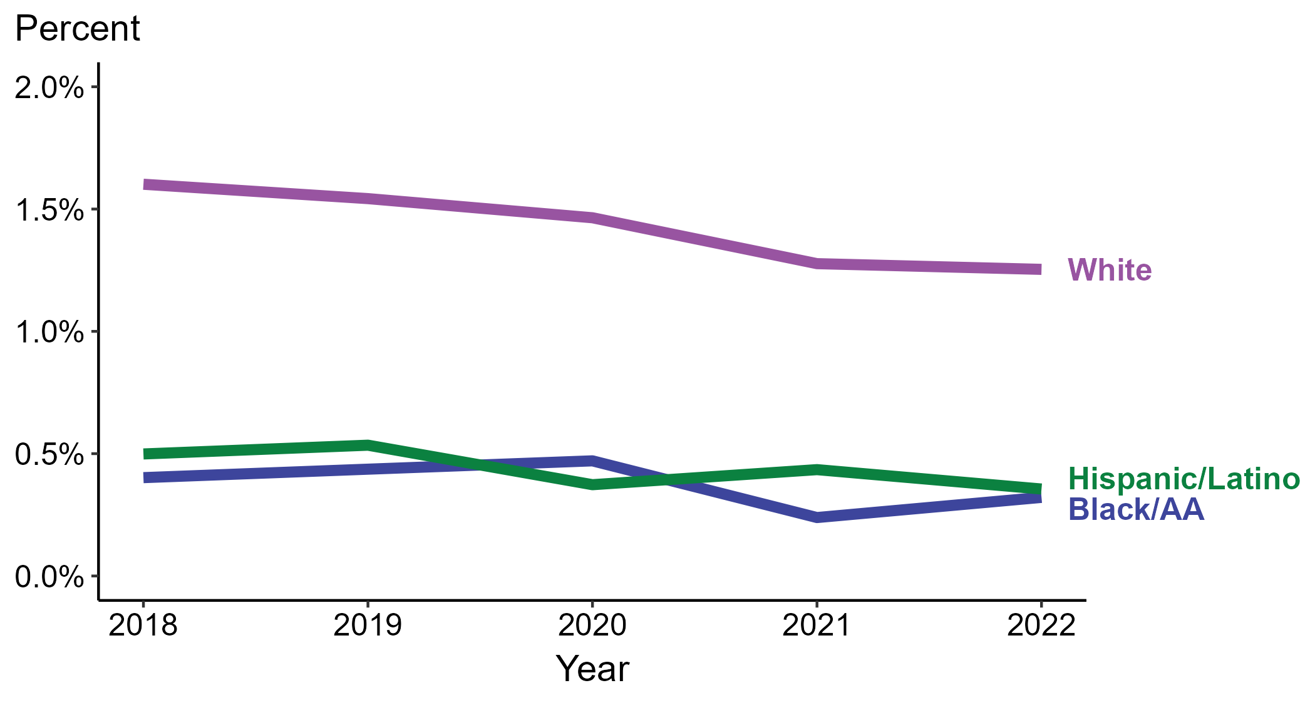
Primary and Secondary Syphilis — Percentage of Cases Reporting Heroin Use* Among MSM by Race and Hispanic Ethnicity, United States, 2018–2022
* Proportion reporting heroin use within the last 12 months calculated among cases with known data (cases with missing or unknown responses were excluded from the denominator).
ACRONYMS: Black/AA = Black or African American; MSM = Men who have sex with men
Notes:
Among primary and secondary (P&S) syphilis cases reported among MSM in 2022, heroin use was most frequently reported among non-Hispanic White MSM (1.3%), followed by Hispanic or Latino MSM (0.4%) and non-Hispanic Black or African American MSM (0.3%).
When examining trends within each race and Hispanic ethnicity during 2018 to 2022, the proportion of P&S syphilis cases among MSM that reported heroin use remained stable among non-Hispanic Black or African American MSM (0.4% to 0.3%), remained stable among non-Hispanic White MSM (1.6% to 1.3%), and remained stable among Hispanic or Latino MSM (0.5% to 0.4%).
During 2018 to 2022, 88.0% of P&S syphilis cases among MSM with information on heroin use were non-Hispanic White, non-Hispanic Black or African American, or Hispanic or Latino. Because the vast majority of cases fall in those racial and ethnic categories, only data for those groups are displayed in the figure above.
See Technical Notes for information on syphilis case reporting, race/Hispanic ethnicity categorization, and reporting of race/Hispanic ethnicity for STI cases.
This report includes data from years that coincide with the COVID-19 pandemic, which introduced uncertainty and difficulty in interpreting case data. See Impact of COVID-19 on STIs (https://www.cdc.gov/std/statistics/2022/impact.htm) for more information.
This figure presents trends in the proportion of cases reporting one or more selected behaviors. Although rounded percentages are presented in the figure interpretive text, values used for generating the figure may be more precise. Data points for the figures presented in these slides as well as Technical Notes about data sources, data collection and reporting practices, and case definitions are available at https://www.cdc.gov/std/statistics/syphilis-supplement/default.htm.

Slide 34
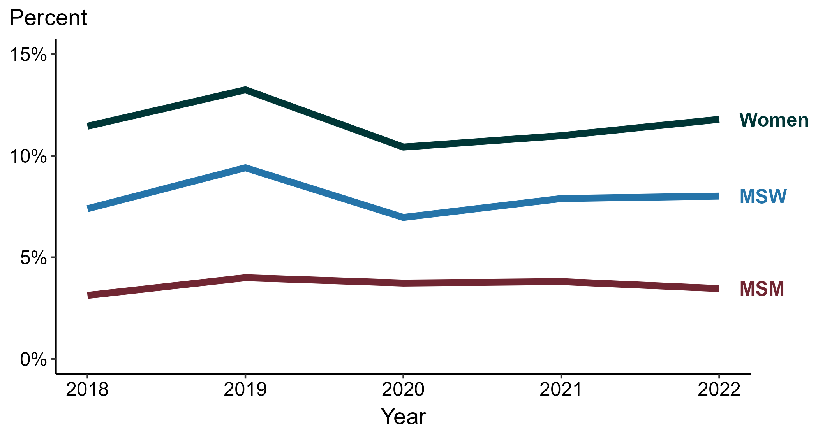
Primary and Secondary Syphilis — Percentage of Cases Reporting Injection Drug Use* by Sex and Sex of Sex Partners, United States, 2018–2022
* Proportion reporting injection drug use within the last 12 months calculated among cases with known data (cases with missing or unknown responses were excluded from the denominator).
ACRONYMS: MSM = Men who have sex with men; MSW = Men who have sex with women only
Notes:
Among primary and secondary (P&S) syphilis cases in 2022, injection drug use was most frequently reported among women (11.8%), followed by MSW (8.0%) and MSM (3.5%).
During 2018 to 2022, the proportion of P&S syphilis cases that reported injection drug use remained stable among MSM (3.1% to 3.5%), remained stable among MSW (7.4% to 8.0%), and remained stable among women (11.4% to 11.8%).
This report includes data from years that coincide with the COVID-19 pandemic, which introduced uncertainty and difficulty in interpreting case data. See Impact of COVID-19 on STIs (https://www.cdc.gov/std/statistics/2022/impact.htm) for more information.
This figure presents trends in the proportion of cases reporting one or more selected behaviors. Although rounded percentages are presented in the figure interpretive text, values used for generating the figure may be more precise. Data points for the figures presented in these slides as well as Technical Notes about data sources, data collection and reporting practices, and case definitions are available at https://www.cdc.gov/std/statistics/syphilis-supplement/default.htm.

Slide 35
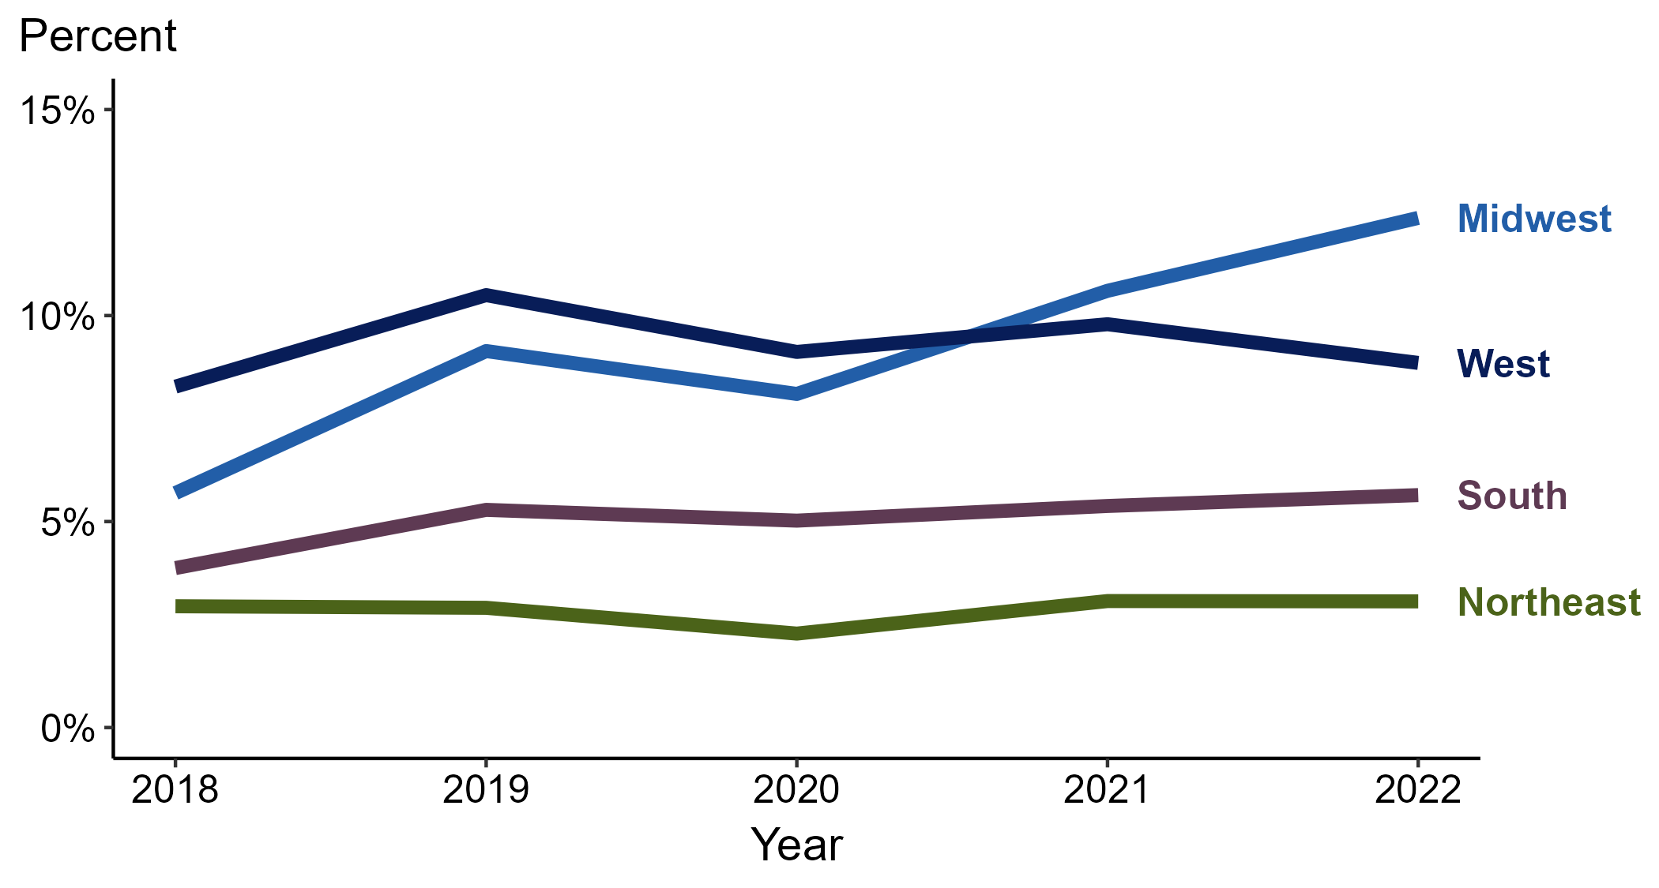
Primary and Secondary Syphilis — Percentage of Cases Reporting Injection Drug Use* by Region, United States, 2018–2022
* Proportion reporting injection drug use within the last 12 months calculated among cases with known data (cases with missing or unknown responses were excluded from the denominator).
Notes:
Among primary and secondary (P&S) syphilis cases reported in 2022, injection drug use was most frequently reported in the Midwest (12.4%), followed by the West (8.9%), South (5.6%), and Northeast (3.1%).
When examining trends within each region during 2018 to 2022, the proportion of P&S syphilis cases that reported injection drug use increased in the Midwest (5.7% to 12.4%), increased in the South (3.9% to 5.6%), remained stable in the West (8.3% to 8.9%), and remained stable in the Northeast (2.9% to 3.1%).
This report includes data from years that coincide with the COVID-19 pandemic, which introduced uncertainty and difficulty in interpreting case data. See Impact of COVID-19 on STIs (https://www.cdc.gov/std/statistics/2022/impact.htm) for more information.
This figure presents trends in the proportion of cases reporting one or more selected behaviors. Although rounded percentages are presented in the figure interpretive text, values used for generating the figure may be more precise. Data points for the figures presented in these slides as well as Technical Notes about data sources, data collection and reporting practices, and case definitions are available at https://www.cdc.gov/std/statistics/syphilis-supplement/default.htm.

Slide 36
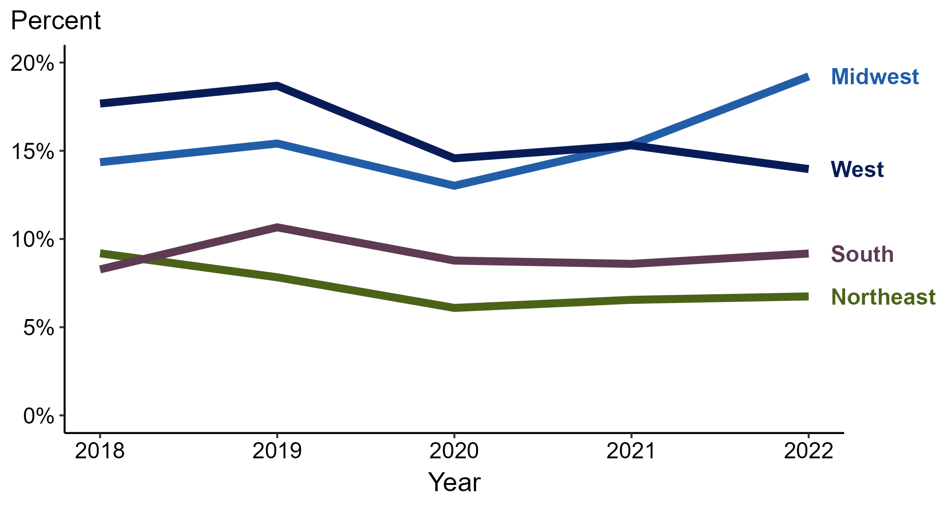
Primary and Secondary Syphilis — Percentage of Cases Reporting Injection Drug Use* Among Women by Region, United States, 2018–2022
* Proportion reporting injection drug use within the last 12 months calculated among cases with known data (cases with missing or unknown responses were excluded from the denominator).
Notes:
Among primary and secondary (P&S) syphilis cases reported among women in 2022, injection drug use was most frequently reported in the Midwest (19.2%), followed by the West (14.0%), South (9.2%), and Northeast (6.7%).
When examining trends within each region during 2018 to 2022, the proportion of P&S syphilis cases among women that reported injection drug use increased in the Midwest (14.4% to 19.2%), remained stable in the South (8.3% to 9.2%), decreased in the West (17.7% to 14.0%), and decreased in the Northeast (9.2% to 6.7%).
This report includes data from years that coincide with the COVID-19 pandemic, which introduced uncertainty and difficulty in interpreting case data. See Impact of COVID-19 on STIs (https://www.cdc.gov/std/statistics/2022/impact.htm) for more information.
This figure presents trends in the proportion of cases reporting one or more selected behaviors. Although rounded percentages are presented in the figure interpretive text, values used for generating the figure may be more precise. Data points for the figures presented in these slides as well as Technical Notes about data sources, data collection and reporting practices, and case definitions are available at https://www.cdc.gov/std/statistics/syphilis-supplement/default.htm.

Slide 37
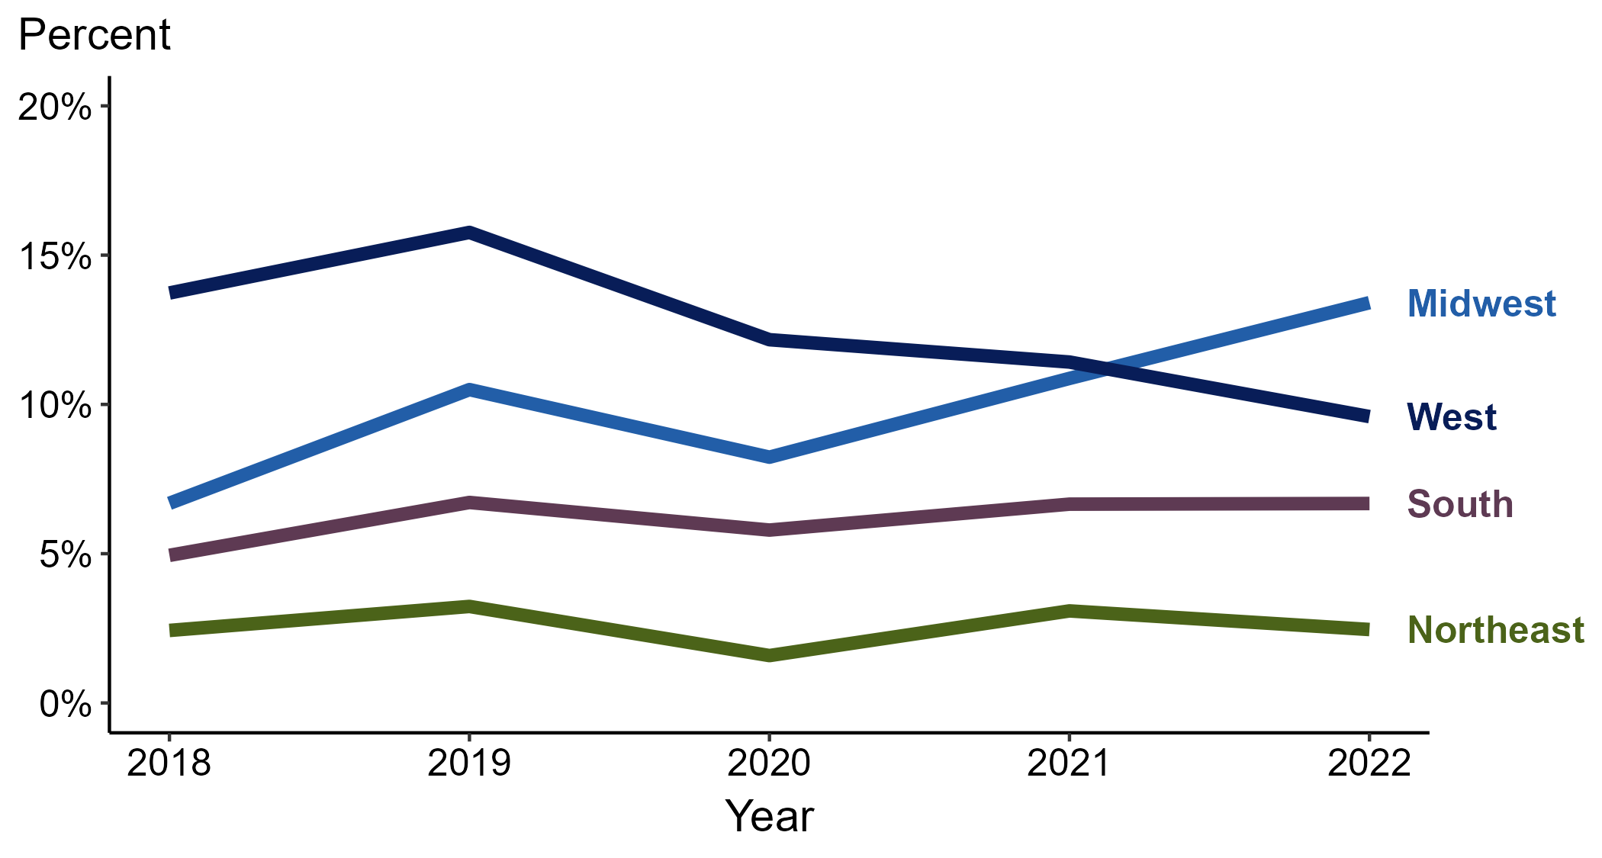
Primary and Secondary Syphilis — Percentage of Cases Reporting Injection Drug Use* Among MSW by Region, United States, 2018–2022
* Proportion reporting injection drug use within the last 12 months calculated among cases with known data (cases with missing or unknown responses were excluded from the denominator).
ACRONYMS: MSW = Men who have sex with women only
Notes:
Among primary and secondary (P&S) syphilis cases reported among MSW in 2022, injection drug use was most frequently reported in the Midwest (13.4%), followed by the West (9.6%), South (6.7%), and Northeast (2.5%).
When examining trends within each region during 2018 to 2022, the proportion of P&S syphilis cases among MSW that reported injection drug use increased in the Midwest (6.7% to 13.4%), increased in the South (4.9% to 6.7%), remained stable in the Northeast (2.4% to 2.5%), and decreased in the West (13.7% to 9.6%).
This report includes data from years that coincide with the COVID-19 pandemic, which introduced uncertainty and difficulty in interpreting case data. See Impact of COVID-19 on STIs (https://www.cdc.gov/std/statistics/2022/impact.htm) for more information.
This figure presents trends in the proportion of cases reporting one or more selected behaviors. Although rounded percentages are presented in the figure interpretive text, values used for generating the figure may be more precise. Data points for the figures presented in these slides as well as Technical Notes about data sources, data collection and reporting practices, and case definitions are available at https://www.cdc.gov/std/statistics/syphilis-supplement/default.htm.

Slide 38
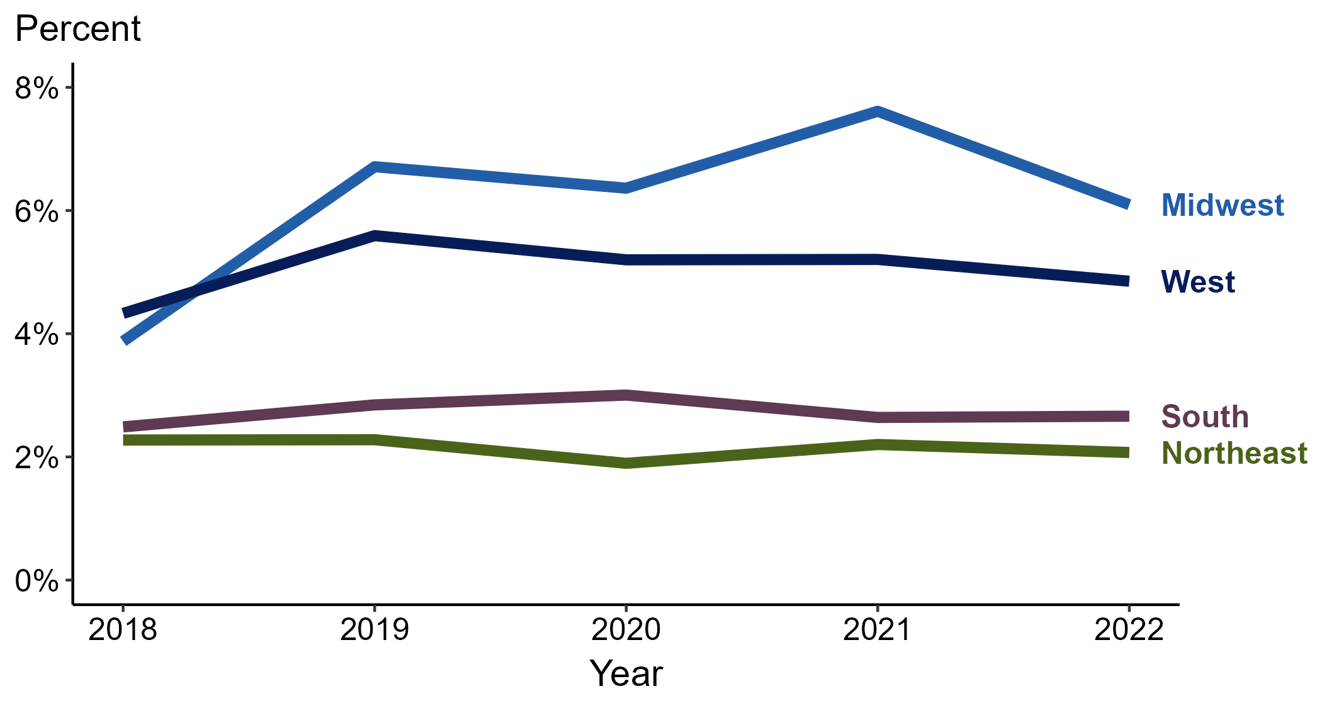
Primary and Secondary Syphilis — Percentage of Cases Reporting Injection Drug Use* Among MSM by Region, United States, 2018–2022
* Proportion reporting injection drug use within the last 12 months calculated among cases with known data (cases with missing or unknown responses were excluded from the denominator).
ACRONYMS: MSM = Men who have sex with men
Notes:
Among primary and secondary (P&S) syphilis cases reported among MSM in 2022, injection drug use was most frequently reported in the Midwest (6.1%), followed by the West (4.9%), South (2.7%), and Northeast (2.1%).
When examining trends within each region during 2018 to 2022, the proportion of P&S syphilis cases among MSM that reported injection drug use increased in the Midwest (3.9% to 6.1%), remained stable in the West (4.3% to 4.9%), remained stable in the South (2.5% to 2.7%), and remained stable in the Northeast (2.3% to 2.1%).
This report includes data from years that coincide with the COVID-19 pandemic, which introduced uncertainty and difficulty in interpreting case data. See Impact of COVID-19 on STIs (https://www.cdc.gov/std/statistics/2022/impact.htm) for more information.
This figure presents trends in the proportion of cases reporting one or more selected behaviors. Although rounded percentages are presented in the figure interpretive text, values used for generating the figure may be more precise. Data points for the figures presented in these slides as well as Technical Notes about data sources, data collection and reporting practices, and case definitions are available at https://www.cdc.gov/std/statistics/syphilis-supplement/default.htm.

Slide 39
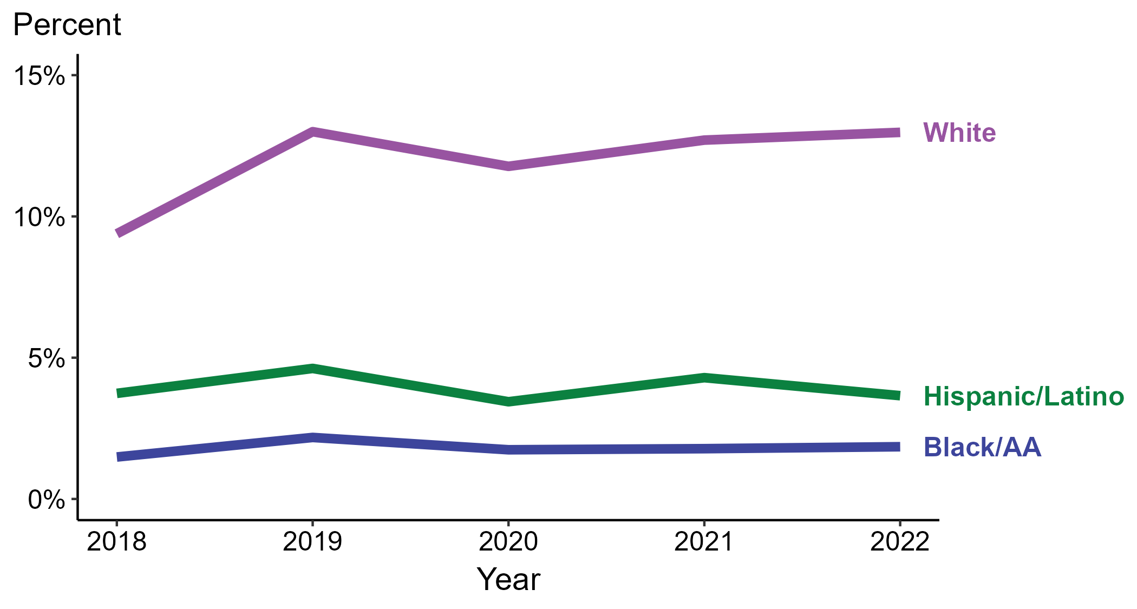
Primary and Secondary Syphilis — Percentage of Cases Reporting Injection Drug Use* by Race and Hispanic Ethnicity, United States, 2018–2022
* Proportion reporting injection drug use within the last 12 months calculated among cases with known data (cases with missing or unknown responses were excluded from the denominator).
ACRONYMS: Black/AA = Black or African American
Notes:
Among primary and secondary (P&S) syphilis cases reported in 2022, injection drug use was most frequently reported among non-Hispanic White persons (13.0%), followed by Hispanic or Latino persons (3.7%) and non-Hispanic Black or African American persons (1.8%).
When examining trends within each race and Hispanic ethnicity during 2018 to 2022, the proportion of P&S syphilis cases that reported injection drug use increased among non-Hispanic White persons (9.4% to 13.0%), remained stable among non-Hispanic Black or African American persons (1.5% to 1.8%), and remained stable among Hispanic or Latino persons (3.7% in both years).
During 2018 to 2022, 89.3% of P&S syphilis cases with information on injection drug use were non-Hispanic White, non-Hispanic Black or African American, or Hispanic or Latino. Because the vast majority of cases fall in those racial and ethnic categories, only data for those groups are displayed in the figure above.
See Technical Notes for information on syphilis case reporting, race/Hispanic ethnicity categorization, and reporting of race/Hispanic ethnicity for STI cases.
This report includes data from years that coincide with the COVID-19 pandemic, which introduced uncertainty and difficulty in interpreting case data. See Impact of COVID-19 on STIs (https://www.cdc.gov/std/statistics/2022/impact.htm) for more information.
This figure presents trends in the proportion of cases reporting one or more selected behaviors. Although rounded percentages are presented in the figure interpretive text, values used for generating the figure may be more precise. Data points for the figures presented in these slides as well as Technical Notes about data sources, data collection and reporting practices, and case definitions are available at https://www.cdc.gov/std/statistics/syphilis-supplement/default.htm.

Slide 40
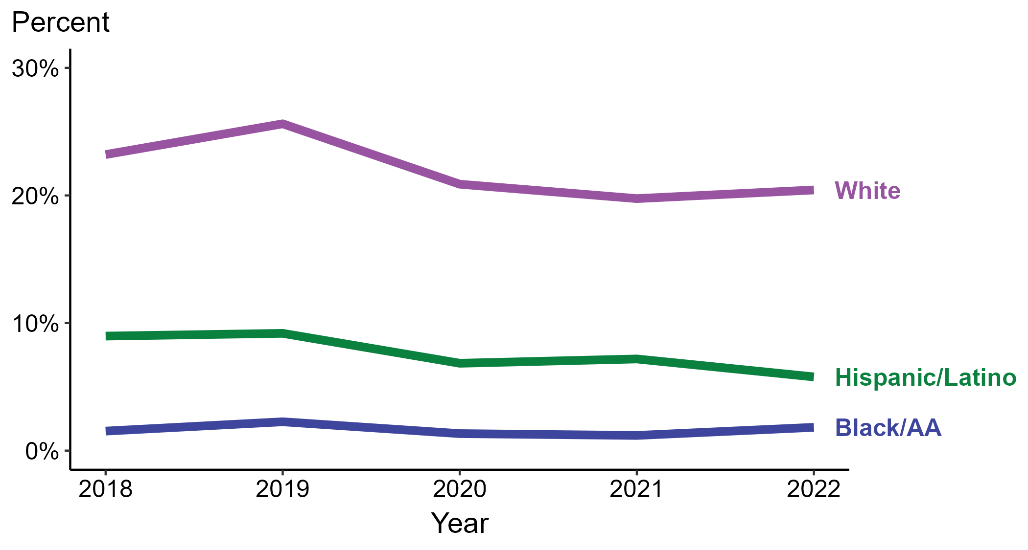
Primary and Secondary Syphilis — Percentage of Cases Reporting Injection Drug Use* Among Women by Race and Hispanic Ethnicity, United States, 2018–2022
* Proportion reporting injection drug use within the last 12 months calculated among cases with known data (cases with missing or unknown responses were excluded from the denominator).
ACRONYMS: Black/AA = Black or African American
Notes:
Among primary and secondary (P&S) syphilis cases reported among women in 2022, injection drug use was most frequently reported among non-Hispanic White women (20.4%), followed by Hispanic or Latino women (5.8%) and non-Hispanic Black or African American women (1.8%).
When examining trends within each race and Hispanic ethnicity during 2018 to 2022, the proportion of P&S syphilis cases among women that reported injection drug use remained stable among non-Hispanic Black or African American women (1.5% to 1.8%), decreased among non-Hispanic White women (23.2% to 20.4%), and decreased among Hispanic or Latino women (9.0% to 5.8%).
During 2018 to 2022, 88.4% of P&S syphilis cases among women with information on injection drug use were non-Hispanic White, non-Hispanic Black or African American, or Hispanic or Latino. Because the vast majority of cases fall in those racial and ethnic categories, only data for those groups are displayed in the figure above.
See Technical Notes for information on syphilis case reporting, race/Hispanic ethnicity categorization, and reporting of race/Hispanic ethnicity for STI cases.
This report includes data from years that coincide with the COVID-19 pandemic, which introduced uncertainty and difficulty in interpreting case data. See Impact of COVID-19 on STIs (https://www.cdc.gov/std/statistics/2022/impact.htm) for more information.
This figure presents trends in the proportion of cases reporting one or more selected behaviors. Although rounded percentages are presented in the figure interpretive text, values used for generating the figure may be more precise. Data points for the figures presented in these slides as well as Technical Notes about data sources, data collection and reporting practices, and case definitions are available at https://www.cdc.gov/std/statistics/syphilis-supplement/default.htm.

Slide 41
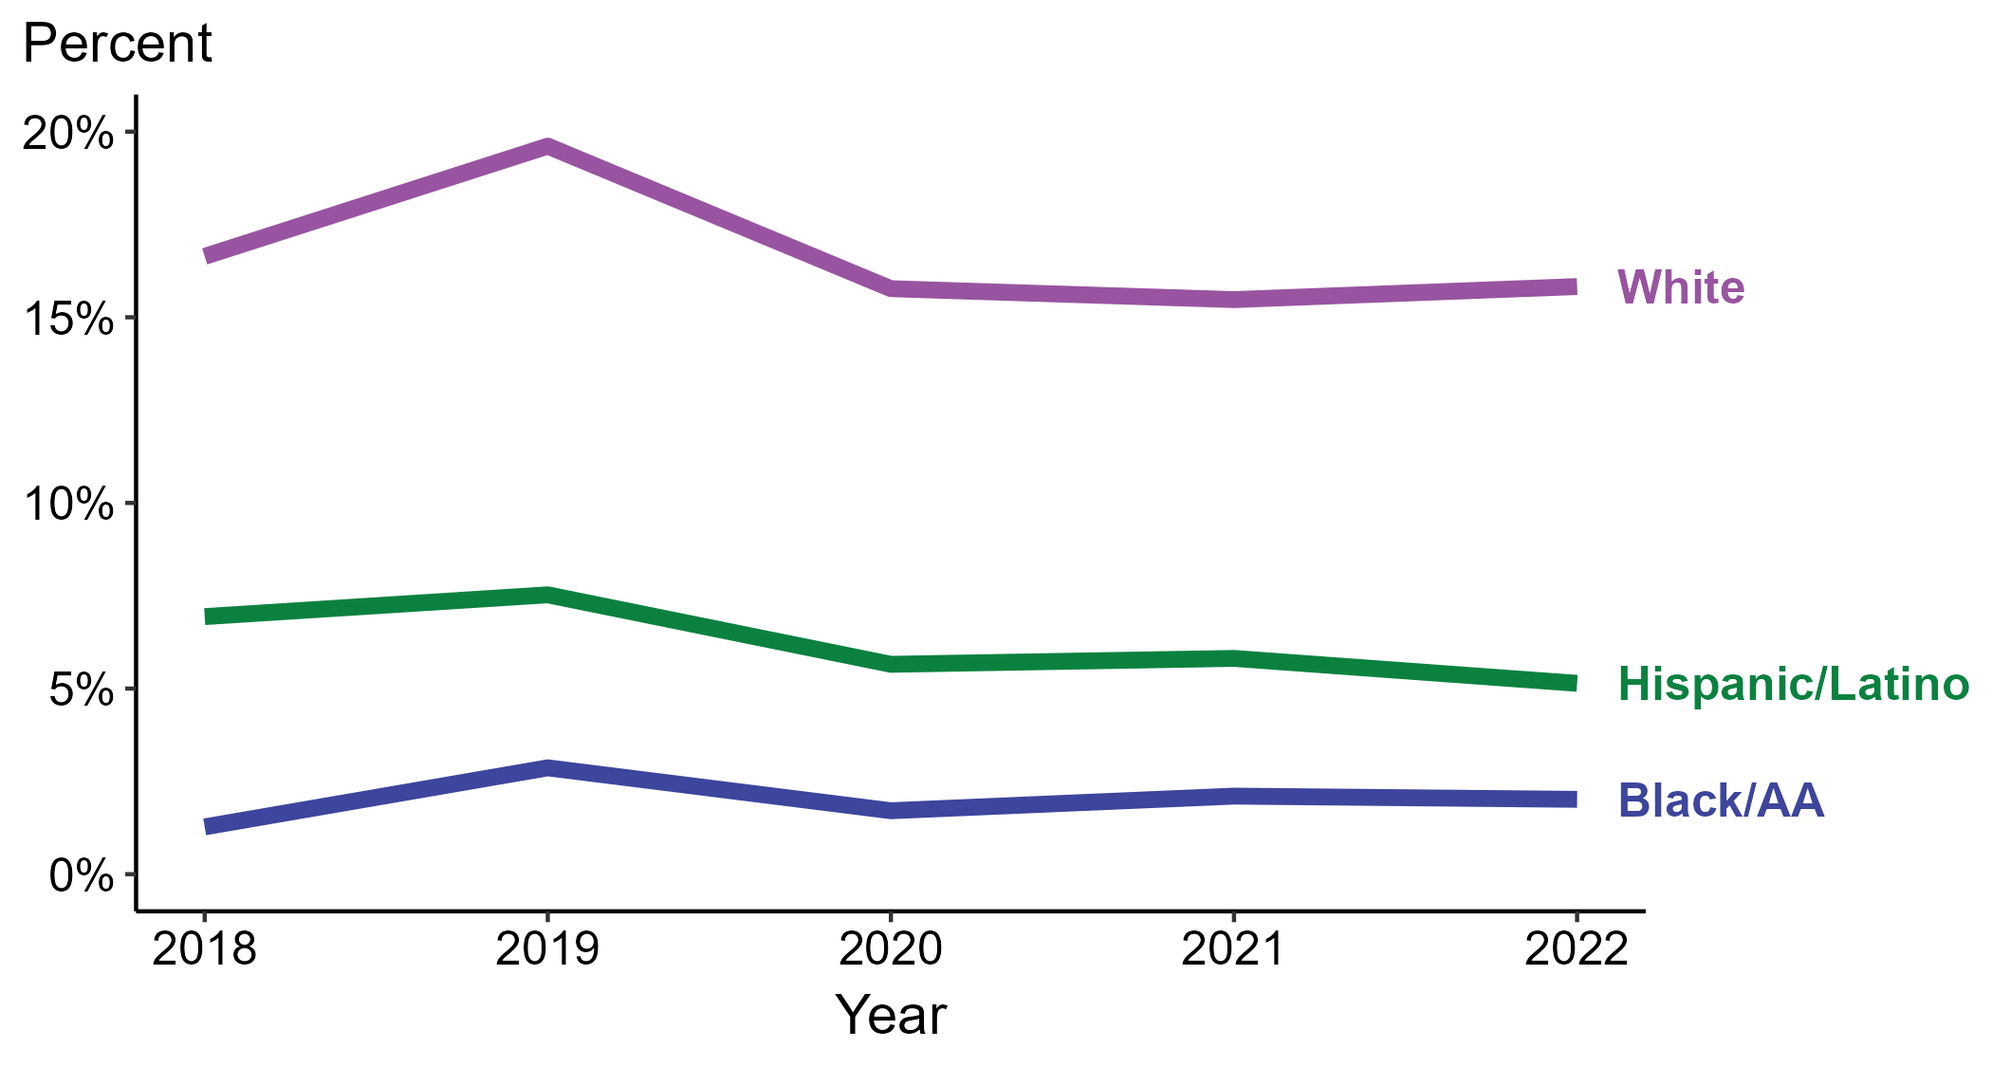
Primary and Secondary Syphilis — Percentage of Cases Reporting Injection Drug Use* Among MSW by Race and Hispanic Ethnicity, United States, 2018–2022
* Proportion reporting injection drug use within the last 12 months calculated among cases with known data (cases with missing or unknown responses were excluded from the denominator).
ACRONYMS: Black/AA = Black or African American; MSW = Men who have sex with women only
Notes:
Among primary and secondary (P&S) syphilis cases reported among MSW in 2022, injection drug use was most frequently reported among non-Hispanic White MSW (15.8%), followed by Hispanic or Latino MSW (5.1%) and non-Hispanic Black or African American MSW (2.0%).
When examining trends within each race and Hispanic ethnicity during 2018 to 2022, the proportion of P&S syphilis cases among MSW that reported injection drug use remained stable among non-Hispanic Black or African American MSW (1.3% to 2.0%), remained stable among non-Hispanic White MSW (16.6% to 15.8%), and decreased among Hispanic or Latino MSW (6.9% to 5.1%).
During 2018 to 2022, 89.7% of P&S syphilis cases among MSW with information on injection drug use were non-Hispanic White, non-Hispanic Black or African American, or Hispanic or Latino. Because the vast majority of cases fall in those racial and ethnic categories, only data for those groups are displayed in the figure above.
See Technical Notes for information on syphilis case reporting, race/Hispanic ethnicity categorization, and reporting of race/Hispanic ethnicity for STI cases.
This report includes data from years that coincide with the COVID-19 pandemic, which introduced uncertainty and difficulty in interpreting case data. See Impact of COVID-19 on STIs (https://www.cdc.gov/std/statistics/2022/impact.htm) for more information.
This figure presents trends in the proportion of cases reporting one or more selected behaviors. Although rounded percentages are presented in the figure interpretive text, values used for generating the figure may be more precise. Data points for the figures presented in these slides as well as Technical Notes about data sources, data collection and reporting practices, and case definitions are available at https://www.cdc.gov/std/statistics/syphilis-supplement/default.htm.

Slide 42
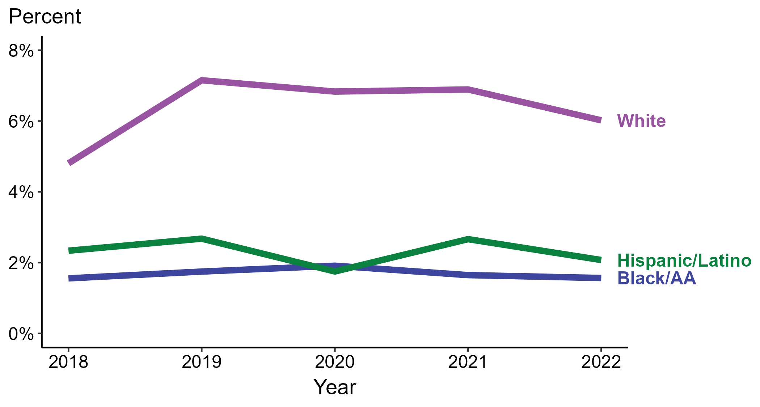
Primary and Secondary Syphilis — Percentage of Cases Reporting Injection Drug Use* Among MSM by Race and Hispanic Ethnicity, United States, 2018–2022
* Proportion reporting injection drug use within the last 12 months calculated among cases with known data (cases with missing or unknown responses were excluded from the denominator).
ACRONYMS: Black/AA = Black or African American; MSM = Men who have sex with men
Notes:
Among primary and secondary (P&S) syphilis cases reported among MSM in 2022, injection drug use was most frequently reported among non-Hispanic White MSM (6.0%), followed by Hispanic or Latino MSM (2.1%) and non-Hispanic Black or African American MSM (1.6%).
When examining trends within each race and Hispanic ethnicity during 2018 to 2022, the proportion of P&S syphilis cases among MSM that reported injection drug use increased among non-Hispanic White MSM (4.8% to 6.0%), remained stable among non-Hispanic Black or African American MSM (1.6% in both years), and remained stable among Hispanic or Latino MSM (2.3% to 2.1%).
During 2018 to 2022, 89.5% of P&S syphilis cases among MSM with information on injection drug use were non-Hispanic White, non-Hispanic Black or African American, or Hispanic or Latino. Because the vast majority of cases fall in those racial and ethnic categories, only data for those groups are displayed in the figure above.
See Technical Notes for information on syphilis case reporting, race/Hispanic ethnicity categorization, and reporting of race/Hispanic ethnicity for STI cases.
This report includes data from years that coincide with the COVID-19 pandemic, which introduced uncertainty and difficulty in interpreting case data. See Impact of COVID-19 on STIs (https://www.cdc.gov/std/statistics/2022/impact.htm) for more information.
This figure presents trends in the proportion of cases reporting one or more selected behaviors. Although rounded percentages are presented in the figure interpretive text, values used for generating the figure may be more precise. Data points for the figures presented in these slides as well as Technical Notes about data sources, data collection and reporting practices, and case definitions are available at https://www.cdc.gov/std/statistics/syphilis-supplement/default.htm.

Slide 43
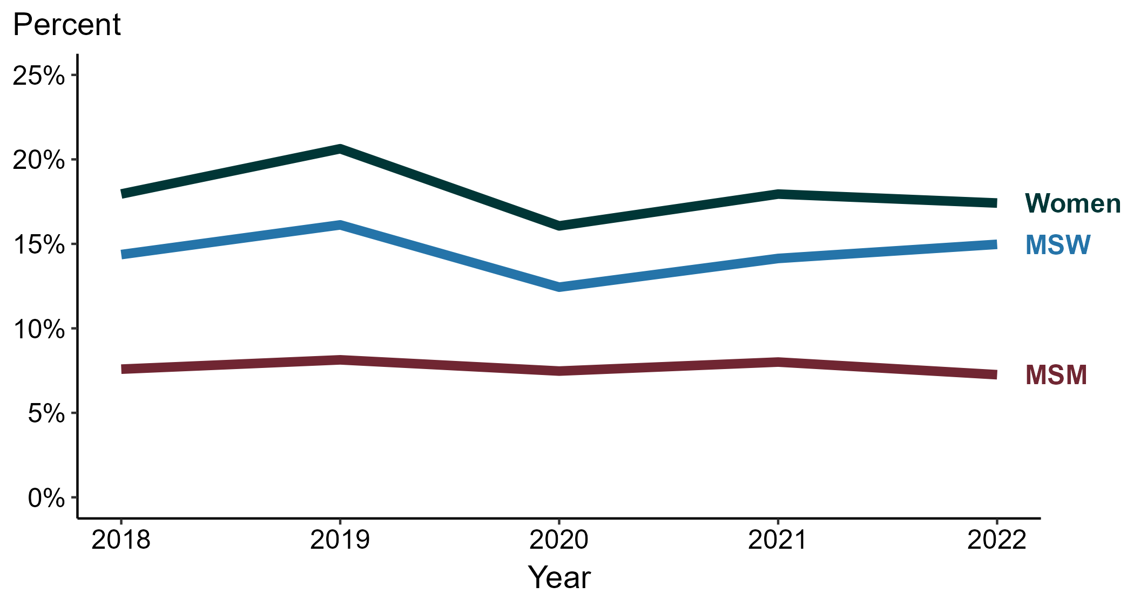
Primary and Secondary Syphilis — Percentage of Cases Reporting Methamphetamine Use* by Sex and Sex of Sex Partners, United States, 2018–2022
* Proportion reporting methamphetamine use within the last 12 months calculated among cases with known data (cases with missing or unknown responses were excluded from the denominator).
ACRONYMS: MSM = Men who have sex with men; MSW = Men who have sex with women only
Notes:
Among primary and secondary (P&S) syphilis cases in 2022, methamphetamine use was most frequently reported among women (17.4%), followed by MSW (15.0%) and MSM (7.3%).
During 2018 to 2022, the proportion of P&S syphilis cases that reported methamphetamine use remained stable among MSW (14.4% to 15.0%), remained stable among women (18.0% to 17.4%), and remained stable among MSM (7.6% to 7.3%).
This report includes data from years that coincide with the COVID-19 pandemic, which introduced uncertainty and difficulty in interpreting case data. See Impact of COVID-19 on STIs (https://www.cdc.gov/std/statistics/2022/impact.htm) for more information.
This figure presents trends in the proportion of cases reporting one or more selected behaviors. Although rounded percentages are presented in the figure interpretive text, values used for generating the figure may be more precise. Data points for the figures presented in these slides as well as Technical Notes about data sources, data collection and reporting practices, and case definitions are available at https://www.cdc.gov/std/statistics/syphilis-supplement/default.htm.

Slide 44
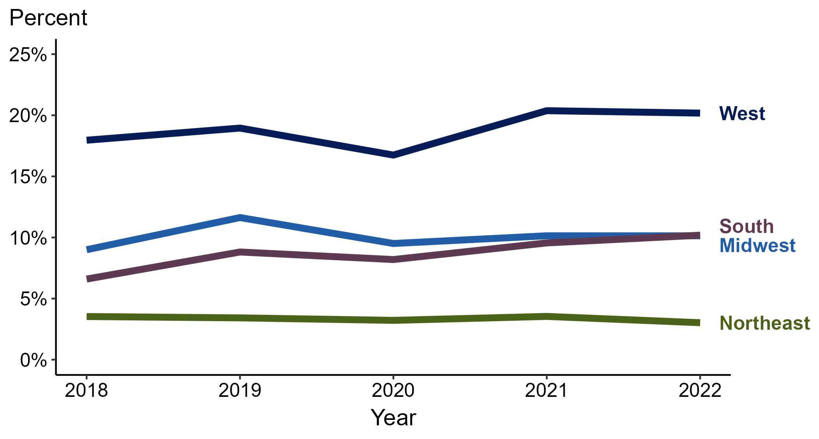
Primary and Secondary Syphilis — Percentage of Cases Reporting Methamphetamine Use* by Region, United States, 2018–2022
* Proportion reporting methamphetamine use within the last 12 months calculated among cases with known data (cases with missing or unknown responses were excluded from the denominator).
Notes:
Among primary and secondary (P&S) syphilis cases reported in 2022, methamphetamine use was most frequently reported in the West (20.2%), followed by the South (10.2%), Midwest (10.1%), and Northeast (3.0%).
When examining trends within each region during 2018 to 2022, the proportion of P&S syphilis cases that reported methamphetamine use increased in the South (6.6% to 10.2%), increased in the Midwest (9.0% to 10.1%), increased in the West (18.0% to 20.2%), and remained stable in the Northeast (3.5% to 3.0%).
This report includes data from years that coincide with the COVID-19 pandemic, which introduced uncertainty and difficulty in interpreting case data. See Impact of COVID-19 on STIs (https://www.cdc.gov/std/statistics/2022/impact.htm) for more information.
This figure presents trends in the proportion of cases reporting one or more selected behaviors. Although rounded percentages are presented in the figure interpretive text, values used for generating the figure may be more precise. Data points for the figures presented in these slides as well as Technical Notes about data sources, data collection and reporting practices, and case definitions are available at https://www.cdc.gov/std/statistics/syphilis-supplement/default.htm.

Slide 45
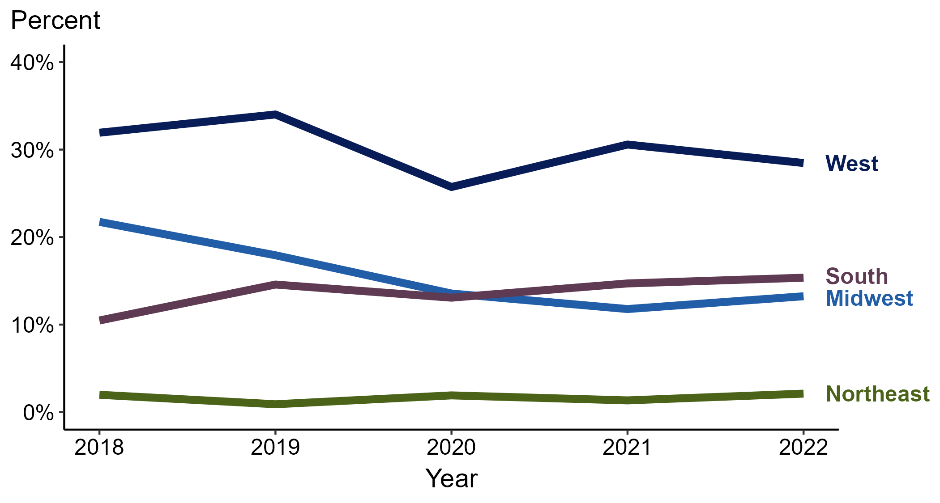
Primary and Secondary Syphilis — Percentage of Cases Reporting Methamphetamine Use* Among Women by Region, United States, 2018–2022
* Proportion reporting methamphetamine use within the last 12 months calculated among cases with known data (cases with missing or unknown responses were excluded from the denominator).
Notes:
Among primary and secondary (P&S) syphilis cases reported among women in 2022, methamphetamine use was most frequently reported in the West (28.5%), followed by the South (15.4%), Midwest (13.2%), and Northeast (2.1%).
When examining trends within each region during 2018 to 2022, the proportion of P&S syphilis cases among women that reported methamphetamine use increased in the South (10.5% to 15.4%), remained stable in the Northeast (2.0% to 2.1%), decreased in the West (31.9% to 28.5%), and decreased in the Midwest (21.7% to 13.2%).
This report includes data from years that coincide with the COVID-19 pandemic, which introduced uncertainty and difficulty in interpreting case data. See Impact of COVID-19 on STIs (https://www.cdc.gov/std/statistics/2022/impact.htm) for more information.
This figure presents trends in the proportion of cases reporting one or more selected behaviors. Although rounded percentages are presented in the figure interpretive text, values used for generating the figure may be more precise. Data points for the figures presented in these slides as well as Technical Notes about data sources, data collection and reporting practices, and case definitions are available at https://www.cdc.gov/std/statistics/syphilis-supplement/default.htm.

Slide 46
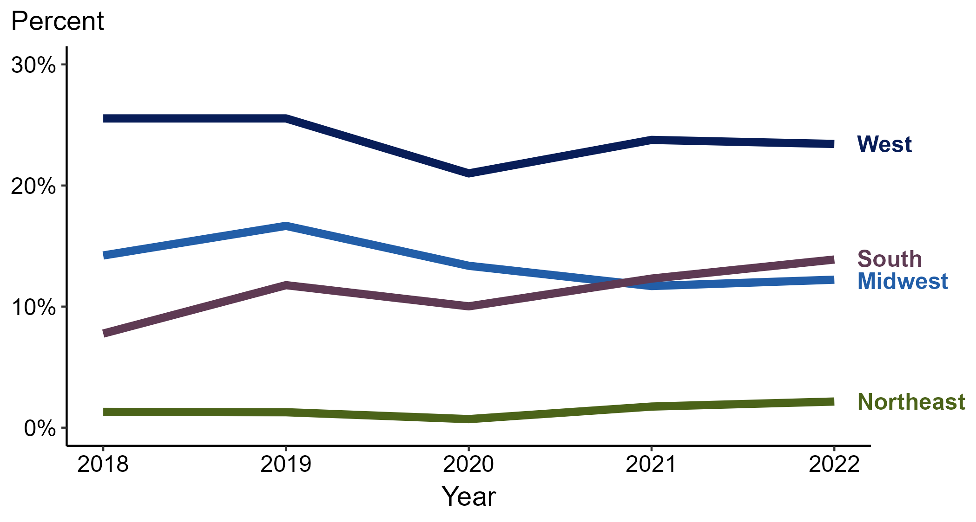
Primary and Secondary Syphilis — Percentage of Cases Reporting Methamphetamine Use* Among MSW by Region, United States, 2018–2022
* Proportion reporting methamphetamine use within the last 12 months calculated among cases with known data (cases with missing or unknown responses were excluded from the denominator).
ACRONYMS: MSW = Men who have sex with women only
Notes:
Among primary and secondary (P&S) syphilis cases reported among MSW in 2022, methamphetamine use was most frequently reported in the West (23.4%), followed by the South (13.9%), Midwest (12.2%), and Northeast (2.2%).
When examining trends within each region during 2018 to 2022, the proportion of P&S syphilis cases among MSW that reported methamphetamine use increased in the South (7.8% to 13.9%), remained stable in the Northeast (1.3% to 2.2%), decreased in the West (25.5% to 23.4%), and decreased in the Midwest (14.2% to 12.2%).
This report includes data from years that coincide with the COVID-19 pandemic, which introduced uncertainty and difficulty in interpreting case data. See Impact of COVID-19 on STIs (https://www.cdc.gov/std/statistics/2022/impact.htm) for more information.
This figure presents trends in the proportion of cases reporting one or more selected behaviors. Although rounded percentages are presented in the figure interpretive text, values used for generating the figure may be more precise. Data points for the figures presented in these slides as well as Technical Notes about data sources, data collection and reporting practices, and case definitions are available at https://www.cdc.gov/std/statistics/syphilis-supplement/default.htm.

Slide 47
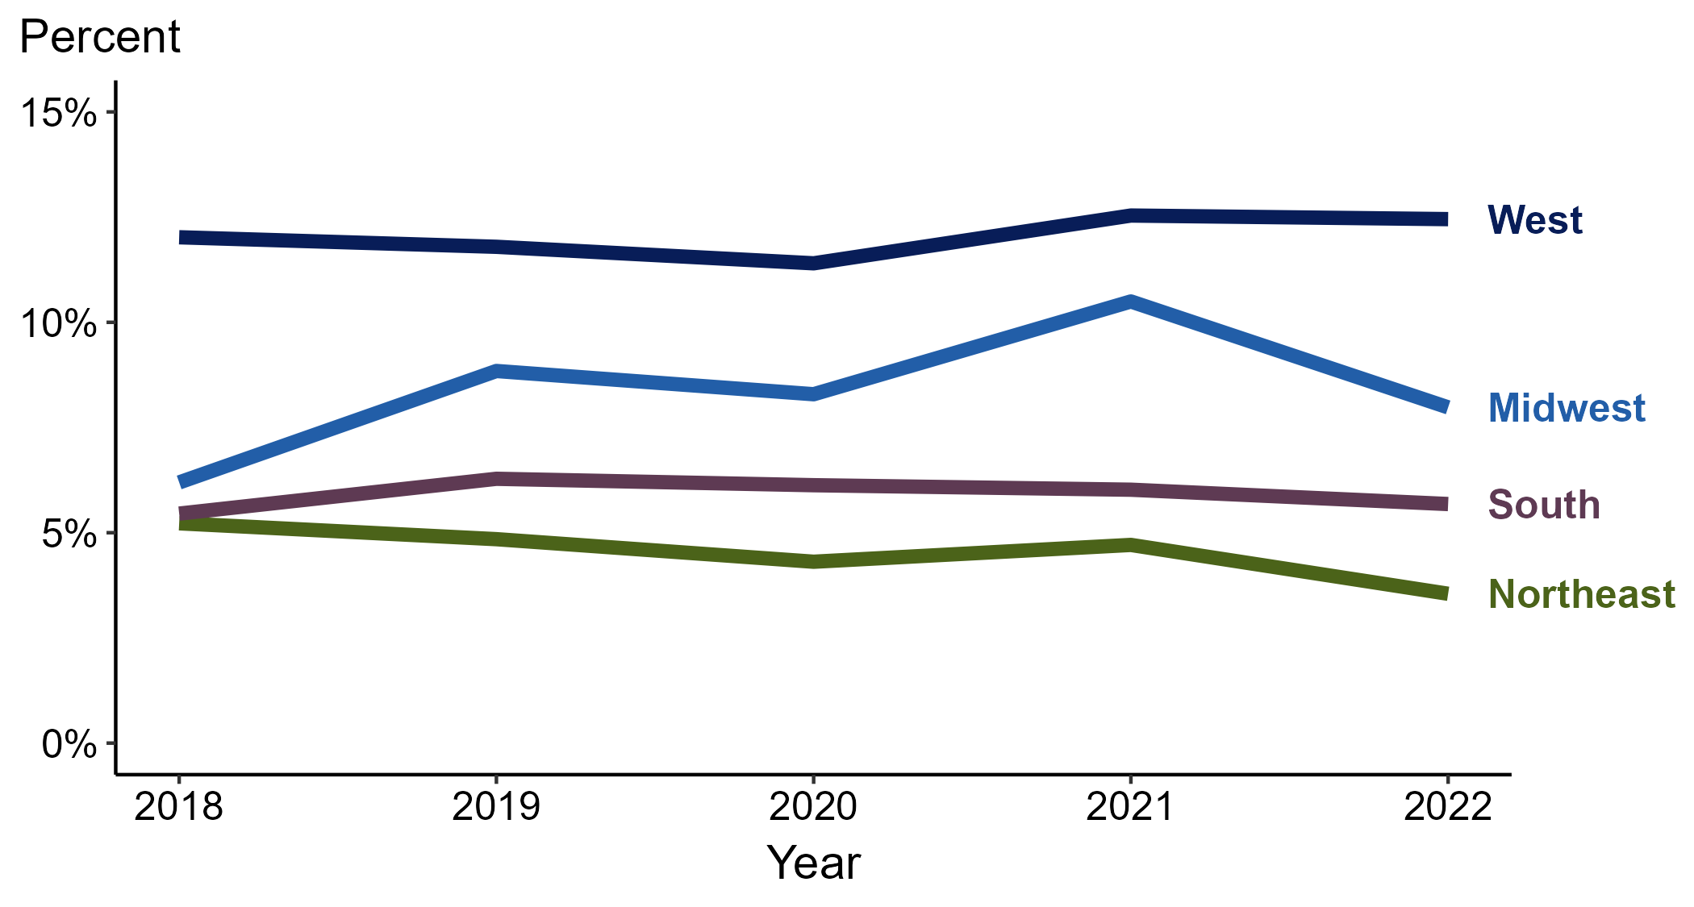
Primary and Secondary Syphilis — Percentage of Cases Reporting Methamphetamine Use* Among MSM by Region, United States, 2018–2022
* Proportion reporting methamphetamine use within the last 12 months calculated among cases with known data (cases with missing or unknown responses were excluded from the denominator).
ACRONYMS: MSM = Men who have sex with men
Notes:
Among primary and secondary (P&S) syphilis cases reported among MSM in 2022, methamphetamine use was most frequently reported in the West (12.5%), followed by the Midwest (8.0%), South (5.7%), and Northeast (3.5%).
When examining trends within each region during 2018 to 2022, the proportion of P&S syphilis cases among MSM that reported methamphetamine use increased in the Midwest (6.2% to 8.0%), remained stable in the South (5.5% to 5.7%), remained stable in the West (12.0% to 12.5%), and decreased in the Northeast (5.2% to 3.5%).
This report includes data from years that coincide with the COVID-19 pandemic, which introduced uncertainty and difficulty in interpreting case data. See Impact of COVID-19 on STIs (https://www.cdc.gov/std/statistics/2022/impact.htm) for more information.
This figure presents trends in the proportion of cases reporting one or more selected behaviors. Although rounded percentages are presented in the figure interpretive text, values used for generating the figure may be more precise. Data points for the figures presented in these slides as well as Technical Notes about data sources, data collection and reporting practices, and case definitions are available at https://www.cdc.gov/std/statistics/syphilis-supplement/default.htm.

Slide 48
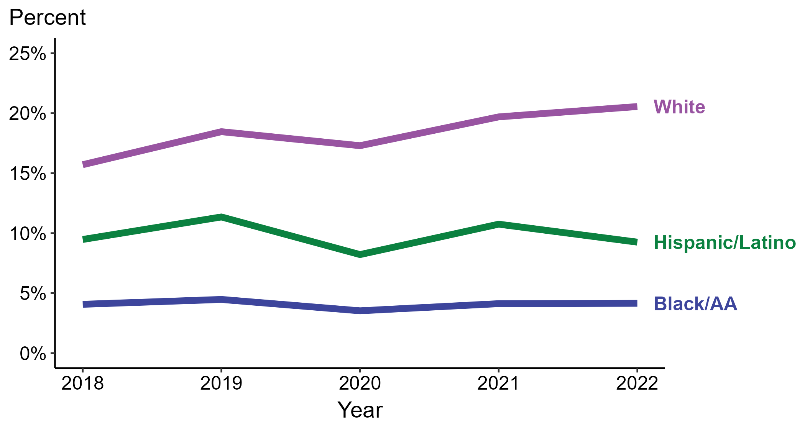
Primary and Secondary Syphilis — Percentage of Cases Reporting Methamphetamine Use* by Race and Hispanic Ethnicity, United States, 2018–2022
* Proportion reporting methamphetamine use within the last 12 months calculated among cases with known data (cases with missing or unknown responses were excluded from the denominator).
ACRONYMS: Black/AA = Black or African American
Notes:
Among primary and secondary (P&S) syphilis cases reported in 2022, methamphetamine use was most frequently reported among non-Hispanic White persons (20.6%), followed by Hispanic or Latino persons (9.2%) and non-Hispanic Black or African American persons (4.2%).
When examining trends within each race and Hispanic ethnicity during 2018 to 2022, the proportion of P&S syphilis cases that reported methamphetamine use increased among non-Hispanic White persons (15.7% to 20.6%), remained stable among non-Hispanic Black or African American persons (4.1% to 4.2%), and remained stable among Hispanic or Latino persons (9.5% to 9.2%).
During 2018 to 2022, 87.6% of P&S syphilis cases with information on methamphetamine use were non-Hispanic White, non-Hispanic Black or African American, or Hispanic or Latino. Because the vast majority of cases fall in those racial and ethnic categories, only data for those groups are displayed in the figure above.
See Technical Notes for information on syphilis case reporting, race/Hispanic ethnicity categorization, and reporting of race/Hispanic ethnicity for STI cases.
This report includes data from years that coincide with the COVID-19 pandemic, which introduced uncertainty and difficulty in interpreting case data. See Impact of COVID-19 on STIs (https://www.cdc.gov/std/statistics/2022/impact.htm) for more information.
This figure presents trends in the proportion of cases reporting one or more selected behaviors. Although rounded percentages are presented in the figure interpretive text, values used for generating the figure may be more precise. Data points for the figures presented in these slides as well as Technical Notes about data sources, data collection and reporting practices, and case definitions are available at https://www.cdc.gov/std/statistics/syphilis-supplement/default.htm.

Slide 49
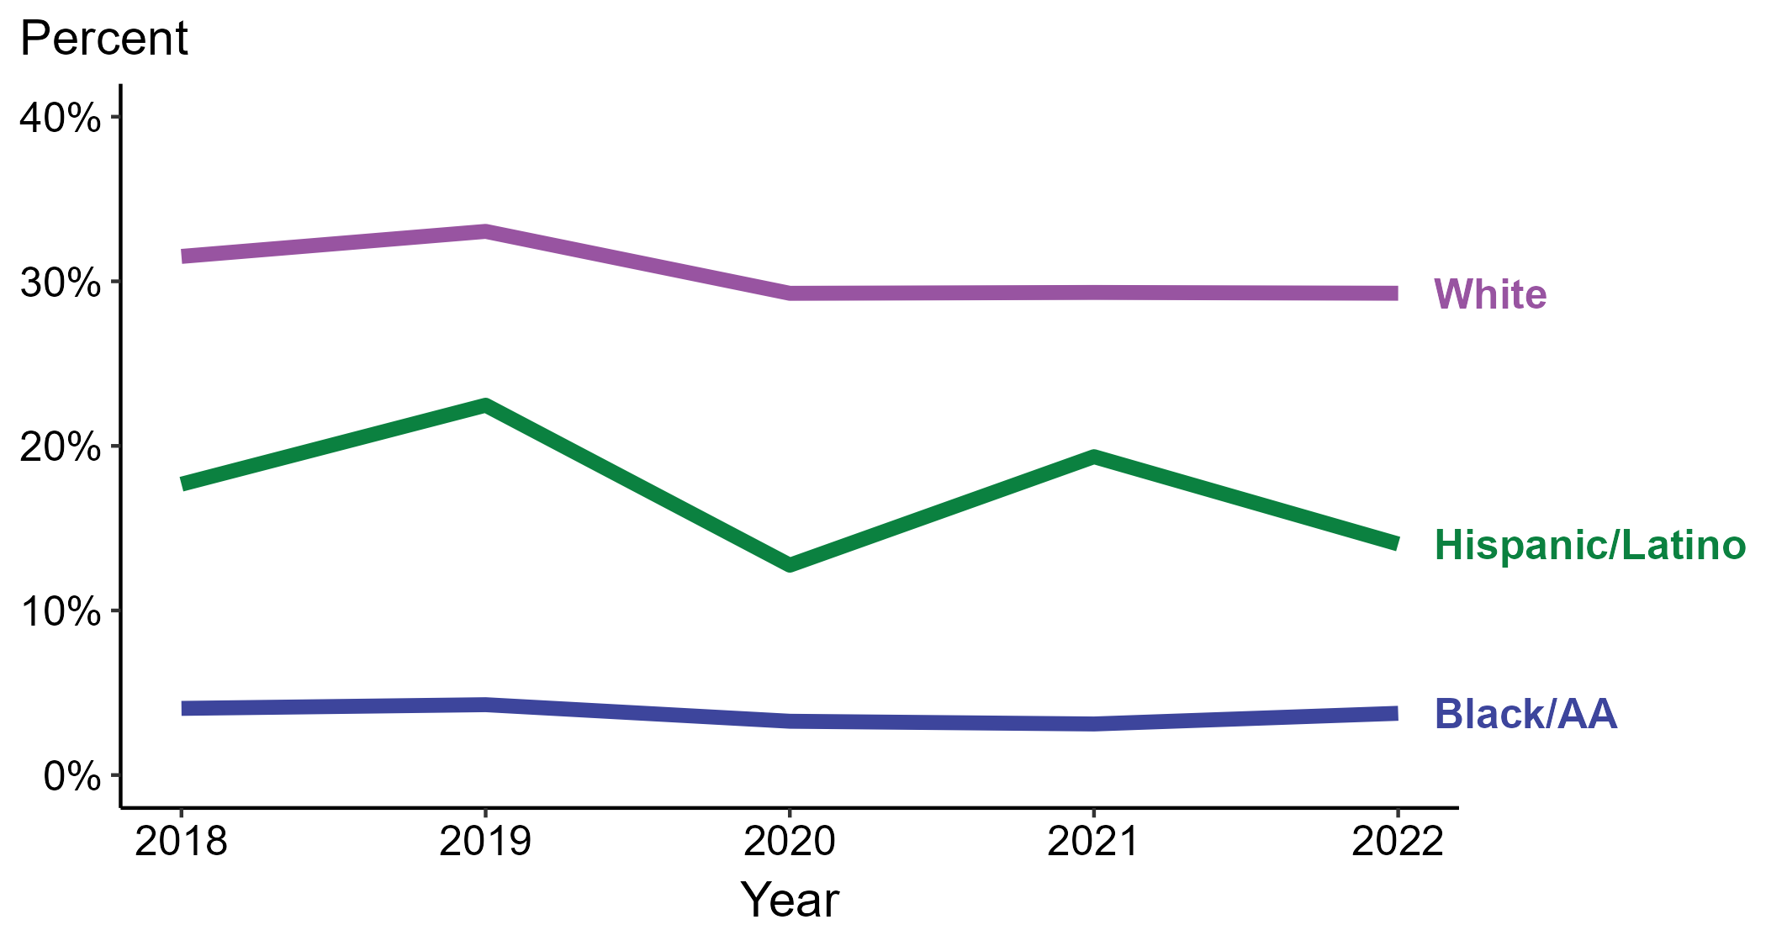
Primary and Secondary Syphilis — Percentage of Cases Reporting Methamphetamine Use* Among Women by Race and Hispanic Ethnicity, United States, 2018–2022
* Proportion reporting methamphetamine use within the last 12 months calculated among cases with known data (cases with missing or unknown responses were excluded from the denominator).
ACRONYMS: Black/AA = Black or African American
Notes:
Among primary and secondary (P&S) syphilis cases reported among women in 2022, methamphetamine use was most frequently reported among non-Hispanic White women (29.3%), followed by Hispanic or Latino women (14.0%) and non-Hispanic Black or African American women (3.8%).
When examining trends within each race and Hispanic ethnicity during 2018 to 2022, the proportion of P&S syphilis cases among women that reported methamphetamine use decreased among non-Hispanic White women (31.5% to 29.3%), remained stable among non-Hispanic Black or African American women (4.1% to 3.8%), and decreased among Hispanic or Latino women (17.7% to 14.0%).
During 2018 to 2022, 87.1% of P&S syphilis cases among women with information on methamphetamine use were non-Hispanic White, non-Hispanic Black or African American, or Hispanic or Latino. Because the vast majority of cases fall in those racial and ethnic categories, only data for those groups are displayed in the figure above.
See Technical Notes for information on syphilis case reporting, race/Hispanic ethnicity categorization, and reporting of race/Hispanic ethnicity for STI cases.
This report includes data from years that coincide with the COVID-19 pandemic, which introduced uncertainty and difficulty in interpreting case data. See Impact of COVID-19 on STIs (https://www.cdc.gov/std/statistics/2022/impact.htm) for more information.
This figure presents trends in the proportion of cases reporting one or more selected behaviors. Although rounded percentages are presented in the figure interpretive text, values used for generating the figure may be more precise. Data points for the figures presented in these slides as well as Technical Notes about data sources, data collection and reporting practices, and case definitions are available at https://www.cdc.gov/std/statistics/syphilis-supplement/default.htm.

Slide 50
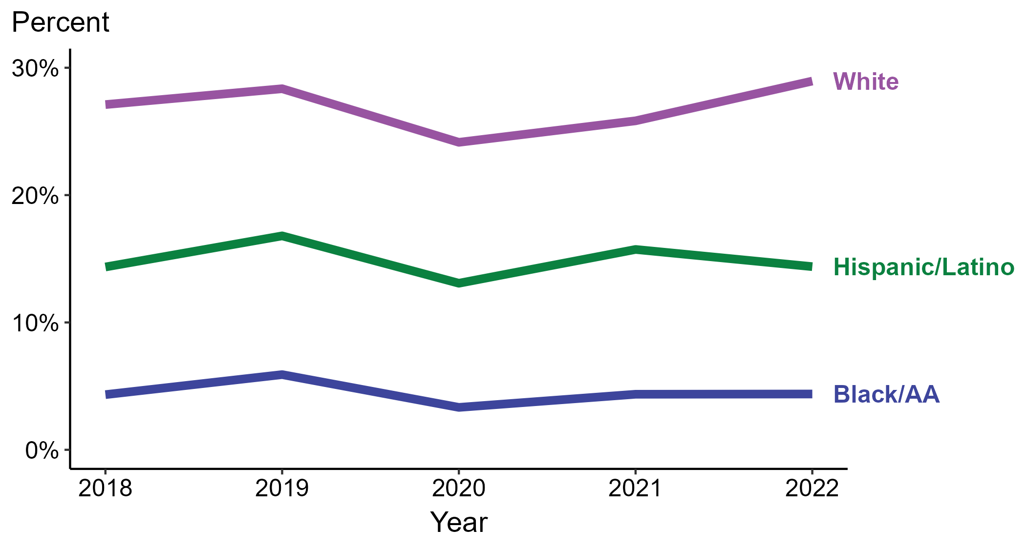
Primary and Secondary Syphilis — Percentage of Cases Reporting Methamphetamine Use* Among MSW by Race and Hispanic Ethnicity, United States, 2018–2022
* Proportion reporting methamphetamine use within the last 12 months calculated among cases with known data (cases with missing or unknown responses were excluded from the denominator).
ACRONYMS: Black/AA = Black or African American; MSW = Men who have sex with women only
Notes:
Among primary and secondary (P&S) syphilis cases reported among MSW in 2022, methamphetamine use was most frequently reported among non-Hispanic White MSW (29.0%), followed by Hispanic or Latino MSW (14.4%) and non-Hispanic Black or African American MSW (4.4%).
When examining trends within each race and Hispanic ethnicity during 2018 to 2022, the proportion of P&S syphilis cases among MSW that reported methamphetamine use increased among non-Hispanic White MSW (27.1% to 29.0%), remained stable among non-Hispanic Black or African American MSW (4.3% to 4.4%), and remained stable among Hispanic or Latino MSW (14.4% in both years).
During 2018 to 2022, 88.8% of P&S syphilis cases among MSW with information on methamphetamine use were non-Hispanic White, non-Hispanic Black or African American, or Hispanic or Latino. Because the vast majority of cases fall in those racial and ethnic categories, only data for those groups are displayed in the figure above.
See Technical Notes for information on syphilis case reporting, race/Hispanic ethnicity categorization, and reporting of race/Hispanic ethnicity for STI cases.
This report includes data from years that coincide with the COVID-19 pandemic, which introduced uncertainty and difficulty in interpreting case data. See Impact of COVID-19 on STIs (https://www.cdc.gov/std/statistics/2022/impact.htm) for more information.
This figure presents trends in the proportion of cases reporting one or more selected behaviors. Although rounded percentages are presented in the figure interpretive text, values used for generating the figure may be more precise. Data points for the figures presented in these slides as well as Technical Notes about data sources, data collection and reporting practices, and case definitions are available at https://www.cdc.gov/std/statistics/syphilis-supplement/default.htm.

Slide 51
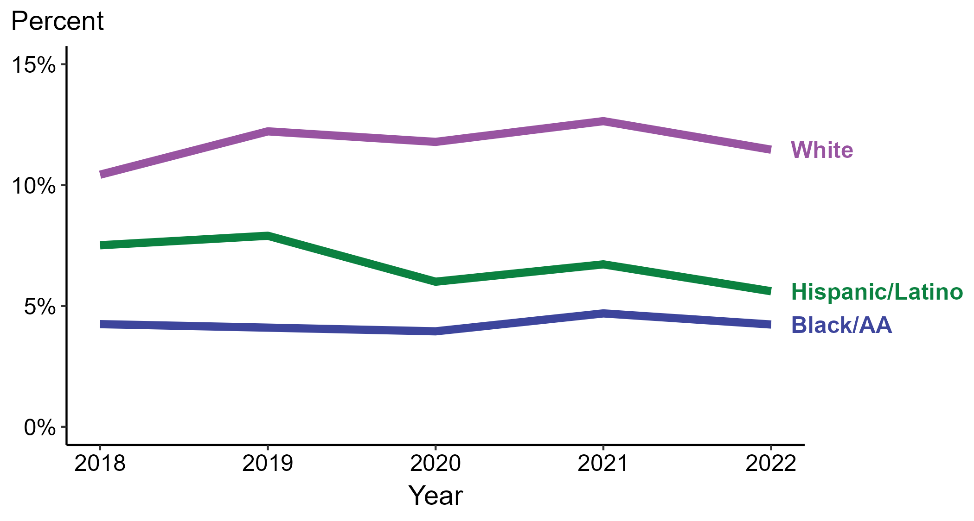
Primary and Secondary Syphilis — Percentage of Cases Reporting Methamphetamine Use* Among MSM by Race and Hispanic Ethnicity, United States, 2018–2022
* Proportion reporting methamphetamine use within the last 12 months calculated among cases with known data (cases with missing or unknown responses were excluded from the denominator).
ACRONYMS: Black/AA = Black or African American; MSM = Men who have sex with men
Notes:
Among primary and secondary (P&S) syphilis cases reported among MSM in 2022, methamphetamine use was most frequently reported among non-Hispanic White MSM (11.5%), followed by Hispanic or Latino MSM (5.6%) and non-Hispanic Black or African American MSM (4.2%).
When examining trends within each race and Hispanic ethnicity during 2018 to 2022, the proportion of P&S syphilis cases among MSM that reported methamphetamine use increased among non-Hispanic White MSM (10.4% to 11.5%), remained stable among non-Hispanic Black or African American MSM (4.2% in both years), and decreased among Hispanic or Latino MSM (7.5% to 5.6%).
During 2018 to 2022, 88.0% of P&S syphilis cases among MSM with information on methamphetamine use were non-Hispanic White, non-Hispanic Black or African American, or Hispanic or Latino. Because the vast majority of cases fall in those racial and ethnic categories, only data for those groups are displayed in the figure above.
See Technical Notes for information on syphilis case reporting, race/Hispanic ethnicity categorization, and reporting of race/Hispanic ethnicity for STI cases.
This report includes data from years that coincide with the COVID-19 pandemic, which introduced uncertainty and difficulty in interpreting case data. See Impact of COVID-19 on STIs (https://www.cdc.gov/std/statistics/2022/impact.htm) for more information.
This figure presents trends in the proportion of cases reporting one or more selected behaviors. Although rounded percentages are presented in the figure interpretive text, values used for generating the figure may be more precise. Data points for the figures presented in these slides as well as Technical Notes about data sources, data collection and reporting practices, and case definitions are available at https://www.cdc.gov/std/statistics/syphilis-supplement/default.htm.

Slide 52
Primary and Secondary Syphilis — Percentage of Cases Reporting Selected Sexual Behaviors*, United States, 2018–2022
* Proportion reporting sex with PWID, sex with anonymous partners, sex while intoxicated/high on drugs, or exchanging drugs or money for sex within the last 12 months calculated among cases with known data (cases with missing or unknown responses were excluded from the denominator).
ACRONYMS: PWID = Person who injects drugs
Notes:
In 2022, 42.8% of primary and secondary (P&S) syphilis cases reported sex with anonymous partners, 35.1% reported sex while intoxicated and/or high on drugs, 8.7% reported sex with a person who injects drugs, and 5.4% reported exchanging sex for drugs or money.
During 2018 to 2022, the proportion of P&S syphilis cases that reported sex with a person who injects drugs increased (6.3% to 8.7%), the proportion of P&S syphilis cases that reported sex while intoxicated and/or high on drugs increased (31.4% to 35.1%), the proportion of P&S syphilis cases that reported exchanging sex for drugs or money remained stable (5.1% to 5.4%), and the proportion of P&S syphilis cases that reported sex with anonymous partners decreased (48.9% to 42.8%).
This report includes data from years that coincide with the COVID-19 pandemic, which introduced uncertainty and difficulty in interpreting case data. See Impact of COVID-19 on STIs (https://www.cdc.gov/std/statistics/2022/impact.htm) for more information.
This figure presents trends in the proportion of cases reporting one or more selected behaviors. Although rounded percentages are presented in the figure interpretive text, values used for generating the figure may be more precise. Data points for the figures presented in these slides as well as Technical Notes about data sources, data collection and reporting practices, and case definitions are available at https://www.cdc.gov/std/statistics/syphilis-supplement/default.htm.

Slide 53
Primary and Secondary Syphilis — Percentage of Cases Reporting Selected Sexual Behaviors* Among Women, United States, 2018–2022
* Proportion reporting sex with PWID, sex with anonymous partners, sex while intoxicated/high on drugs, or exchanging drugs or money for sex within the last 12 months calculated among cases with known data (cases with missing or unknown responses were excluded from the denominator).
ACRONYMS: PWID = Person who injects drugs; MSM = Men who have sex with men
Notes:
In 2022, 37.9% of primary and secondary (P&S) syphilis cases among women reported sex while intoxicated and/or high on drugs, 20.1% reported sex with anonymous partners, 13.4% reported sex with a person who injects drugs, 7.5% reported exchanging sex for drugs or money, and 6.0% reported sex with a man who has sex with men.
During 2018 to 2022, the proportion of P&S syphilis cases among women that reported sex with a man who has sex with men increased (4.7% to 6.0%), the proportion of P&S syphilis cases among women that reported sex while intoxicated and/or high on drugs increased (34.7% to 37.9%), the proportion of P&S syphilis cases among women that reported sex with a person who injects drugs remained stable (12.6% to 13.4%), the proportion of P&S syphilis cases among women that reported sex with anonymous partners remained stable (19.9% to 20.1%), and the proportion of P&S syphilis cases among women that reported exchanging sex for drugs or money decreased (9.5% to 7.5%).
This report includes data from years that coincide with the COVID-19 pandemic, which introduced uncertainty and difficulty in interpreting case data. See Impact of COVID-19 on STIs (https://www.cdc.gov/std/statistics/2022/impact.htm) for more information.
This figure presents trends in the proportion of cases reporting one or more selected behaviors. Although rounded percentages are presented in the figure interpretive text, values used for generating the figure may be more precise. Data points for the figures presented in these slides as well as Technical Notes about data sources, data collection and reporting practices, and case definitions are available at https://www.cdc.gov/std/statistics/syphilis-supplement/default.htm.

Slide 54
Primary and Secondary Syphilis — Percentage of Cases Reporting Selected Sexual Behaviors* Among MSW, United States, 2018–2022
* Proportion reporting sex with PWID, sex with anonymous partners, sex while intoxicated/high on drugs, or exchanging drugs or money for sex within the last 12 months calculated among cases with known data (cases with missing or unknown responses were excluded from the denominator).
ACRONYMS: PWID = Person who injects drugs; MSW = Men who have sex with women only
Notes:
In 2022, 41.0% of primary and secondary (P&S) syphilis cases among MSW reported sex while intoxicated and/or high on drugs, 38.7% reported sex with anonymous partners, 10.3% reported sex with a person who injects drugs, and 6.3% reported exchanging sex for drugs or money.
During 2018 to 2022, the proportion of P&S syphilis cases among MSW that reported sex with a person who injects drugs remained stable (9.8% to 10.3%), the proportion of P&S syphilis cases among MSW that reported sex while intoxicated and/or high on drugs decreased (42.6% to 41.0%), the proportion of P&S syphilis cases among MSW that reported sex with anonymous partners decreased (41.9% to 38.7%), and the proportion of P&S syphilis cases among MSW that reported exchanging sex for drugs or money decreased (9.2% to 6.3%).
This report includes data from years that coincide with the COVID-19 pandemic, which introduced uncertainty and difficulty in interpreting case data. See Impact of COVID-19 on STIs (https://www.cdc.gov/std/statistics/2022/impact.htm) for more information.
This figure presents trends in the proportion of cases reporting one or more selected behaviors. Although rounded percentages are presented in the figure interpretive text, values used for generating the figure may be more precise. Data points for the figures presented in these slides as well as Technical Notes about data sources, data collection and reporting practices, and case definitions are available at https://www.cdc.gov/std/statistics/syphilis-supplement/default.htm.

Slide 55
Primary and Secondary Syphilis — Percentage of Cases Reporting Selected Sexual Behaviors* Among MSM, United States, 2018–2022
* Proportion reporting sex with PWID, sex with anonymous partners, sex while intoxicated/high on drugs, or exchanging drugs or money for sex within the last 12 months calculated among cases with known data (cases with missing or unknown responses were excluded from the denominator).
ACRONYMS: PWID = Person who injects drugs; MSM = Men who have sex with men
Notes:
In 2022, 59.7% of primary and secondary (P&S) syphilis cases among MSM reported sex with anonymous partners, 30.1% reported sex while intoxicated and/or high on drugs, 5.0% reported sex with a person who injects drugs, and 3.6% reported exchanging sex for drugs or money.
During 2018 to 2022, the proportion of P&S syphilis cases among MSM that reported sex with a person who injects drugs remained stable (4.2% to 5.0%), the proportion of P&S syphilis cases among MSM that reported exchanging sex for drugs or money remained stable (3.1% to 3.6%), the proportion of P&S syphilis cases among MSM that reported sex while intoxicated and/or high on drugs increased (29.0% to 30.1%), and the proportion of P&S syphilis cases among MSM that reported sex with anonymous partners remained stable (59.1% to 59.7%).
This report includes data from years that coincide with the COVID-19 pandemic, which introduced uncertainty and difficulty in interpreting case data. See Impact of COVID-19 on STIs (https://www.cdc.gov/std/statistics/2022/impact.htm) for more information.
This figure presents trends in the proportion of cases reporting one or more selected behaviors. Although rounded percentages are presented in the figure interpretive text, values used for generating the figure may be more precise. Data points for the figures presented in these slides as well as Technical Notes about data sources, data collection and reporting practices, and case definitions are available at https://www.cdc.gov/std/statistics/syphilis-supplement/default.htm.

Slide 56
Primary and Secondary Syphilis — Percentage of Cases Reporting Exchanging Sex for Drugs or Money* by Sex and Sex of Sex Partners, United States, 2018–2022
* Proportion reporting exchanging drugs or money for sex within the last 12 months calculated among cases with known data (cases with missing or unknown responses were excluded from the denominator).
ACRONYMS: MSM = Men who have sex with men; MSW = Men who have sex with women only
Notes:
Among primary and secondary (P&S) syphilis cases in 2022, exchanging sex for drugs or money was most frequently reported among women (7.5%), followed by MSW (6.3%) and MSM (3.6%).
During 2018 to 2022, the proportion of P&S syphilis cases that reported exchanging sex for drugs or money remained stable among MSM (3.1% to 3.6%), decreased among women (9.5% to 7.5%), and decreased among MSW (9.2% to 6.3%).
This report includes data from years that coincide with the COVID-19 pandemic, which introduced uncertainty and difficulty in interpreting case data. See Impact of COVID-19 on STIs (https://www.cdc.gov/std/statistics/2022/impact.htm) for more information.
This figure presents trends in the proportion of cases reporting one or more selected behaviors. Although rounded percentages are presented in the figure interpretive text, values used for generating the figure may be more precise. Data points for the figures presented in these slides as well as Technical Notes about data sources, data collection and reporting practices, and case definitions are available at https://www.cdc.gov/std/statistics/syphilis-supplement/default.htm.

Slide 57
Primary and Secondary Syphilis — Percentage of Cases Reporting Exchanging Sex for Drugs or Money* by Region, United States, 2018–2022
* Proportion reporting exchanging drugs or money for sex within the last 12 months calculated among cases with known data (cases with missing or unknown responses were excluded from the denominator).
Notes:
Among primary and secondary (P&S) syphilis cases reported in 2022, exchanging sex for drugs or money was most frequently reported in the Midwest (6.3%), followed by the Northeast (5.4%), South (5.3%), and West (5.0%).
When examining trends within each region during 2018 to 2022, the proportion of P&S syphilis cases that reported exchanging sex for drugs or money increased in the Midwest (4.7% to 6.3%), remained stable in the Northeast (4.7% to 5.4%), remained stable in the South (5.1% to 5.3%), and remained stable in the West (5.5% to 5.0%).
This report includes data from years that coincide with the COVID-19 pandemic, which introduced uncertainty and difficulty in interpreting case data. See Impact of COVID-19 on STIs (https://www.cdc.gov/std/statistics/2022/impact.htm) for more information.
This figure presents trends in the proportion of cases reporting one or more selected behaviors. Although rounded percentages are presented in the figure interpretive text, values used for generating the figure may be more precise. Data points for the figures presented in these slides as well as Technical Notes about data sources, data collection and reporting practices, and case definitions are available at https://www.cdc.gov/std/statistics/syphilis-supplement/default.htm.

Slide 58
Primary and Secondary Syphilis — Percentage of Cases Reporting Exchanging Sex for Drugs or Money* Among Women by Region, United States, 2018–2022
* Proportion reporting exchanging drugs or money for sex within the last 12 months calculated among cases with known data (cases with missing or unknown responses were excluded from the denominator).
Notes:
Among primary and secondary (P&S) syphilis cases reported among women in 2022, exchanging sex for drugs or money was most frequently reported in the Northeast (8.2%), followed by the Midwest (8.1%), South (7.4%), and West (7.1%).
When examining trends within each region during 2018 to 2022, the proportion of P&S syphilis cases among women that reported exchanging sex for drugs or money remained stable in the Midwest (8.1% in both years), decreased in the South (8.8% to 7.4%), decreased in the West (9.8% to 7.1%), and decreased in the Northeast (14.5% to 8.2%).
This report includes data from years that coincide with the COVID-19 pandemic, which introduced uncertainty and difficulty in interpreting case data. See Impact of COVID-19 on STIs (https://www.cdc.gov/std/statistics/2022/impact.htm) for more information.
This figure presents trends in the proportion of cases reporting one or more selected behaviors. Although rounded percentages are presented in the figure interpretive text, values used for generating the figure may be more precise. Data points for the figures presented in these slides as well as Technical Notes about data sources, data collection and reporting practices, and case definitions are available at https://www.cdc.gov/std/statistics/syphilis-supplement/default.htm.

Slide 59
Primary and Secondary Syphilis — Percentage of Cases Reporting Exchanging Sex for Drugs or Money* Among MSW by Region, United States, 2018–2022
* Proportion reporting exchanging drugs or money for sex within the last 12 months calculated among cases with known data (cases with missing or unknown responses were excluded from the denominator).
ACRONYMS: MSW = Men who have sex with women only
Notes:
Among primary and secondary (P&S) syphilis cases reported among MSW in 2022, exchanging sex for drugs or money was most frequently reported in the Northeast (8.5%), followed by the Midwest (7.0%), South (6.0%), and West (4.9%).
When examining trends within each region during 2018 to 2022, the proportion of P&S syphilis cases among MSW that reported exchanging sex for drugs or money remained stable in the Northeast (8.4% to 8.5%), decreased in the Midwest (9.4% to 7.0%), decreased in the West (7.6% to 4.9%), and decreased in the South (10.6% to 6.0%).
This report includes data from years that coincide with the COVID-19 pandemic, which introduced uncertainty and difficulty in interpreting case data. See Impact of COVID-19 on STIs (https://www.cdc.gov/std/statistics/2022/impact.htm) for more information.
This figure presents trends in the proportion of cases reporting one or more selected behaviors. Although rounded percentages are presented in the figure interpretive text, values used for generating the figure may be more precise. Data points for the figures presented in these slides as well as Technical Notes about data sources, data collection and reporting practices, and case definitions are available at https://www.cdc.gov/std/statistics/syphilis-supplement/default.htm.

Slide 60
Primary and Secondary Syphilis — Percentage of Cases Reporting Exchanging Sex for Drugs or Money* Among MSM by Region, United States, 2018–2022
* Proportion reporting exchanging drugs or money for sex within the last 12 months calculated among cases with known data (cases with missing or unknown responses were excluded from the denominator).
ACRONYMS: MSM = Men who have sex with men
Notes:
Among primary and secondary (P&S) syphilis cases reported among MSM in 2022, exchanging sex for drugs or money was most frequently reported in the Midwest (4.4%), followed by the West (3.9%), South (3.5%), and Northeast (2.9%).
When examining trends within each region during 2018 to 2022, the proportion of P&S syphilis cases among MSM that reported exchanging sex for drugs or money increased in the Midwest (2.8% to 4.4%), remained stable in the South (2.9% to 3.5%), remained stable in the Northeast (2.7% to 2.9%), and remained stable in the West (3.7% to 3.9%).
This report includes data from years that coincide with the COVID-19 pandemic, which introduced uncertainty and difficulty in interpreting case data. See Impact of COVID-19 on STIs (https://www.cdc.gov/std/statistics/2022/impact.htm) for more information.
This figure presents trends in the proportion of cases reporting one or more selected behaviors. Although rounded percentages are presented in the figure interpretive text, values used for generating the figure may be more precise. Data points for the figures presented in these slides as well as Technical Notes about data sources, data collection and reporting practices, and case definitions are available at https://www.cdc.gov/std/statistics/syphilis-supplement/default.htm.

Slide 61
Primary and Secondary Syphilis — Percentage of Cases Reporting Exchanging Sex for Drugs or Money* by Race and Hispanic Ethnicity, United States, 2018–2022
* Proportion reporting exchanging drugs or money for sex within the last 12 months calculated among cases with known data (cases with missing or unknown responses were excluded from the denominator).
ACRONYMS: Black/AA = Black or African American
Notes:
Among primary and secondary (P&S) syphilis cases reported in 2022, exchanging sex for drugs or money was most frequently reported among non-Hispanic White persons (6.6%), followed by non-Hispanic Black or African American persons (5.5%) and Hispanic or Latino persons (3.6%).
When examining trends within each race and Hispanic ethnicity during 2018 to 2022, the proportion of P&S syphilis cases that reported exchanging sex for drugs or money remained stable among non-Hispanic Black or African American persons (5.0% to 5.5%), remained stable among non-Hispanic White persons (6.2% to 6.6%), and remained stable among Hispanic or Latino persons (3.8% to 3.6%).
During 2018 to 2022, 89.1% of P&S syphilis cases with information on exchanging sex for drugs or money were non-Hispanic White, non-Hispanic Black or African American, or Hispanic or Latino. Because the vast majority of cases fall in those racial and ethnic categories, only data for those groups are displayed in the figure above.
See Technical Notes for information on syphilis case reporting, race/Hispanic ethnicity categorization, and reporting of race/Hispanic ethnicity for STI cases.
This report includes data from years that coincide with the COVID-19 pandemic, which introduced uncertainty and difficulty in interpreting case data. See Impact of COVID-19 on STIs (https://www.cdc.gov/std/statistics/2022/impact.htm) for more information.
This figure presents trends in the proportion of cases reporting one or more selected behaviors. Although rounded percentages are presented in the figure interpretive text, values used for generating the figure may be more precise. Data points for the figures presented in these slides as well as Technical Notes about data sources, data collection and reporting practices, and case definitions are available at https://www.cdc.gov/std/statistics/syphilis-supplement/default.htm.

Slide 62
Primary and Secondary Syphilis — Percentage of Cases Reporting Exchanging Sex for Drugs or Money* Among Women by Race and Hispanic Ethnicity, United States, 2018–2022
* Proportion reporting exchanging drugs or money for sex within the last 12 months calculated among cases with known data (cases with missing or unknown responses were excluded from the denominator).
ACRONYMS: Black/AA = Black or African American
Notes:
Among primary and secondary (P&S) syphilis cases reported among women in 2022, exchanging sex for drugs or money was most frequently reported among non-Hispanic White women (10.8%), followed by non-Hispanic Black or African American women (5.4%) and Hispanic or Latino women (4.5%).
When examining trends within each race and Hispanic ethnicity during 2018 to 2022, the proportion of P&S syphilis cases among women that reported exchanging sex for drugs or money remained stable among non-Hispanic Black or African American women (6.1% to 5.4%), decreased among non-Hispanic White women (14.6% to 10.8%), and decreased among Hispanic or Latino women (6.7% to 4.5%).
During 2018 to 2022, 88.5% of P&S syphilis cases among women with information on exchanging sex for drugs or money were non-Hispanic White, non-Hispanic Black or African American, or Hispanic or Latino. Because the vast majority of cases fall in those racial and ethnic categories, only data for those groups are displayed in the figure above.
See Technical Notes for information on syphilis case reporting, race/Hispanic ethnicity categorization, and reporting of race/Hispanic ethnicity for STI cases.
This report includes data from years that coincide with the COVID-19 pandemic, which introduced uncertainty and difficulty in interpreting case data. See Impact of COVID-19 on STIs (https://www.cdc.gov/std/statistics/2022/impact.htm) for more information.
This figure presents trends in the proportion of cases reporting one or more selected behaviors. Although rounded percentages are presented in the figure interpretive text, values used for generating the figure may be more precise. Data points for the figures presented in these slides as well as Technical Notes about data sources, data collection and reporting practices, and case definitions are available at https://www.cdc.gov/std/statistics/syphilis-supplement/default.htm.

Slide 63
Primary and Secondary Syphilis — Percentage of Cases Reporting Exchanging Sex for Drugs or Money* Among MSW by Race and Hispanic Ethnicity, United States, 2018–2022
* Proportion reporting exchanging drugs or money for sex within the last 12 months calculated among cases with known data (cases with missing or unknown responses were excluded from the denominator).
ACRONYMS: Black/AA = Black or African American; MSW = Men who have sex with women only
Notes:
Among primary and secondary (P&S) syphilis cases reported among MSW in 2022, exchanging sex for drugs or money was most frequently reported among non-Hispanic Black or African American MSW (7.2%), followed by non-Hispanic White MSW (6.5%) and Hispanic or Latino MSW (4.7%).
When examining trends within each race and Hispanic ethnicity during 2018 to 2022, the proportion of P&S syphilis cases among MSW that reported exchanging sex for drugs or money decreased among non-Hispanic Black or African American MSW (9.2% to 7.2%), decreased among non-Hispanic White MSW (10.3% to 6.5%), and decreased among Hispanic or Latino MSW (7.4% to 4.7%).
During 2018 to 2022, 89.7% of P&S syphilis cases among MSW with information on exchanging sex for drugs or money were non-Hispanic White, non-Hispanic Black or African American, or Hispanic or Latino. Because the vast majority of cases fall in those racial and ethnic categories, only data for those groups are displayed in the figure above.
See Technical Notes for information on syphilis case reporting, race/Hispanic ethnicity categorization, and reporting of race/Hispanic ethnicity for STI cases.
This report includes data from years that coincide with the COVID-19 pandemic, which introduced uncertainty and difficulty in interpreting case data. See Impact of COVID-19 on STIs (https://www.cdc.gov/std/statistics/2022/impact.htm) for more information.
This figure presents trends in the proportion of cases reporting one or more selected behaviors. Although rounded percentages are presented in the figure interpretive text, values used for generating the figure may be more precise. Data points for the figures presented in these slides as well as Technical Notes about data sources, data collection and reporting practices, and case definitions are available at https://www.cdc.gov/std/statistics/syphilis-supplement/default.htm.

Slide 64
Primary and Secondary Syphilis — Percentage of Cases Reporting Exchanging Sex for Drugs or Money* Among MSM by Race and Hispanic Ethnicity, United States, 2018–2022
* Proportion reporting exchanging drugs or money for sex within the last 12 months calculated among cases with known data (cases with missing or unknown responses were excluded from the denominator).
ACRONYMS: Black/AA = Black or African American; MSM = Men who have sex with men
Notes:
Among primary and secondary (P&S) syphilis cases reported among MSM in 2022, exchanging sex for drugs or money was most frequently reported among non-Hispanic Black or African American MSM (4.2%), followed by non-Hispanic White MSM (3.9%) and Hispanic or Latino MSM (2.9%).
When examining trends within each race and Hispanic ethnicity during 2018 to 2022, the proportion of P&S syphilis cases among MSM that reported exchanging sex for drugs or money remained stable among non-Hispanic Black or African American MSM (3.3% to 4.2%), remained stable among non-Hispanic White MSM (3.5% to 3.9%), and remained stable among Hispanic or Latino MSM (2.8% to 2.9%).
During 2018 to 2022, 89.1% of P&S syphilis cases among MSM with information on exchanging sex for drugs or money were non-Hispanic White, non-Hispanic Black or African American, or Hispanic or Latino. Because the vast majority of cases fall in those racial and ethnic categories, only data for those groups are displayed in the figure above.
See Technical Notes for information on syphilis case reporting, race/Hispanic ethnicity categorization, and reporting of race/Hispanic ethnicity for STI cases.
This report includes data from years that coincide with the COVID-19 pandemic, which introduced uncertainty and difficulty in interpreting case data. See Impact of COVID-19 on STIs (https://www.cdc.gov/std/statistics/2022/impact.htm) for more information.
This figure presents trends in the proportion of cases reporting one or more selected behaviors. Although rounded percentages are presented in the figure interpretive text, values used for generating the figure may be more precise. Data points for the figures presented in these slides as well as Technical Notes about data sources, data collection and reporting practices, and case definitions are available at https://www.cdc.gov/std/statistics/syphilis-supplement/default.htm.

Slide 65
Primary and Secondary Syphilis — Percentage of Cases Reporting Sex with Anonymous Partners* by Sex and Sex of Sex Partners, United States, 2018–2022
* Proportion reporting sex with anonymous partners within the last 12 months calculated among cases with known data (cases with missing or unknown responses were excluded from the denominator).
ACRONYMS: MSM = Men who have sex with men; MSW = Men who have sex with women only
Notes:
Among primary and secondary (P&S) syphilis cases in 2022, sex with anonymous partners was most frequently reported among MSM (59.7%), followed by MSW (38.7%) and women (20.1%).
During 2018 to 2022, the proportion of P&S syphilis cases that reported sex with anonymous partners remained stable among MSM (59.1% to 59.7%), remained stable among women (19.9% to 20.1%), and decreased among MSW (41.9% to 38.7%).
This report includes data from years that coincide with the COVID-19 pandemic, which introduced uncertainty and difficulty in interpreting case data. See Impact of COVID-19 on STIs (https://www.cdc.gov/std/statistics/2022/impact.htm) for more information.
This figure presents trends in the proportion of cases reporting one or more selected behaviors. Although rounded percentages are presented in the figure interpretive text, values used for generating the figure may be more precise. Data points for the figures presented in these slides as well as Technical Notes about data sources, data collection and reporting practices, and case definitions are available at https://www.cdc.gov/std/statistics/syphilis-supplement/default.htm.

Slide 66
Primary and Secondary Syphilis — Percentage of Cases Reporting Sex with Anonymous Partners* by Region, United States, 2018–2022
* Proportion reporting sex with anonymous partners within the last 12 months calculated among cases with known data (cases with missing or unknown responses were excluded from the denominator).
Notes:
Among primary and secondary (P&S) syphilis cases reported in 2022, sex with anonymous partners was most frequently reported in the South (45.6%), followed by the Northeast (45.4%), West (38.8%), and Midwest (38.4%).
When examining trends within each region during 2018 to 2022, the proportion of P&S syphilis cases that reported sex with anonymous partners remained stable in the South (45.9% to 45.6%), decreased in the Northeast (53.2% to 45.4%), decreased in the West (49.7% to 38.8%), and decreased in the Midwest (50.7% to 38.4%).
This report includes data from years that coincide with the COVID-19 pandemic, which introduced uncertainty and difficulty in interpreting case data. See Impact of COVID-19 on STIs (https://www.cdc.gov/std/statistics/2022/impact.htm) for more information.
This figure presents trends in the proportion of cases reporting one or more selected behaviors. Although rounded percentages are presented in the figure interpretive text, values used for generating the figure may be more precise. Data points for the figures presented in these slides as well as Technical Notes about data sources, data collection and reporting practices, and case definitions are available at https://www.cdc.gov/std/statistics/syphilis-supplement/default.htm.

Slide 67
Primary and Secondary Syphilis — Percentage of Cases Reporting Sex with Anonymous Partners* Among Women by Region, United States, 2018–2022
* Proportion reporting sex with anonymous partners within the last 12 months calculated among cases with known data (cases with missing or unknown responses were excluded from the denominator).
Notes:
Among primary and secondary (P&S) syphilis cases reported among women in 2022, sex with anonymous partners was most frequently reported in the South (22.5%), followed by the Northeast (21.2%), Midwest (18.5%), and West (15.8%).
When examining trends within each region during 2018 to 2022, the proportion of P&S syphilis cases among women that reported sex with anonymous partners increased in the South (18.0% to 22.5%), remained stable in the Northeast (21.0% to 21.2%), decreased in the Midwest (21.5% to 18.5%), and decreased in the West (21.7% to 15.8%).
This report includes data from years that coincide with the COVID-19 pandemic, which introduced uncertainty and difficulty in interpreting case data. See Impact of COVID-19 on STIs (https://www.cdc.gov/std/statistics/2022/impact.htm) for more information.
This figure presents trends in the proportion of cases reporting one or more selected behaviors. Although rounded percentages are presented in the figure interpretive text, values used for generating the figure may be more precise. Data points for the figures presented in these slides as well as Technical Notes about data sources, data collection and reporting practices, and case definitions are available at https://www.cdc.gov/std/statistics/syphilis-supplement/default.htm.

Slide 68
Primary and Secondary Syphilis — Percentage of Cases Reporting Sex with Anonymous Partners* Among MSW by Region, United States, 2018–2022
* Proportion reporting sex with anonymous partners within the last 12 months calculated among cases with known data (cases with missing or unknown responses were excluded from the denominator).
ACRONYMS: MSW = Men who have sex with women only
Notes:
Among primary and secondary (P&S) syphilis cases reported among MSW in 2022, sex with anonymous partners was most frequently reported in the Northeast (43.1%), followed by the South (40.9%), Midwest (36.3%), and West (34.0%).
When examining trends within each region during 2018 to 2022, the proportion of P&S syphilis cases among MSW that reported sex with anonymous partners remained stable in the Northeast (42.9% to 43.1%), decreased in the South (43.8% to 40.9%), decreased in the Midwest (41.4% to 36.3%), and decreased in the West (39.6% to 34.0%).
This report includes data from years that coincide with the COVID-19 pandemic, which introduced uncertainty and difficulty in interpreting case data. See Impact of COVID-19 on STIs (https://www.cdc.gov/std/statistics/2022/impact.htm) for more information.
This figure presents trends in the proportion of cases reporting one or more selected behaviors. Although rounded percentages are presented in the figure interpretive text, values used for generating the figure may be more precise. Data points for the figures presented in these slides as well as Technical Notes about data sources, data collection and reporting practices, and case definitions are available at https://www.cdc.gov/std/statistics/syphilis-supplement/default.htm.

Slide 69
Primary and Secondary Syphilis — Percentage of Cases Reporting Sex with Anonymous Partners* Among MSM by Region, United States, 2018–2022
* Proportion reporting sex with anonymous partners within the last 12 months calculated among cases with known data (cases with missing or unknown responses were excluded from the denominator).
ACRONYMS: MSM = Men who have sex with men
Notes:
Among primary and secondary (P&S) syphilis cases reported among MSM in 2022, sex with anonymous partners was most frequently reported in the South (64.3%), followed by the Midwest (56.4%), West (56.1%), and Northeast (55.4%).
When examining trends within each region during 2018 to 2022, the proportion of P&S syphilis cases among MSM that reported sex with anonymous partners increased in the South (57.9% to 64.3%), decreased in the Midwest (59.2% to 56.4%), decreased in the Northeast (59.5% to 55.4%), and decreased in the West (60.3% to 56.1%).
This report includes data from years that coincide with the COVID-19 pandemic, which introduced uncertainty and difficulty in interpreting case data. See Impact of COVID-19 on STIs (https://www.cdc.gov/std/statistics/2022/impact.htm) for more information.
This figure presents trends in the proportion of cases reporting one or more selected behaviors. Although rounded percentages are presented in the figure interpretive text, values used for generating the figure may be more precise. Data points for the figures presented in these slides as well as Technical Notes about data sources, data collection and reporting practices, and case definitions are available at https://www.cdc.gov/std/statistics/syphilis-supplement/default.htm.

Slide 70
Primary and Secondary Syphilis — Percentage of Cases Reporting Sex with Anonymous Partners* by Race and Hispanic Ethnicity, United States, 2018–2022
* Proportion reporting sex with anonymous partners within the last 12 months calculated among cases with known data (cases with missing or unknown responses were excluded from the denominator).
ACRONYMS: Black/AA = Black or African American
Notes:
Among primary and secondary (P&S) syphilis cases reported in 2022, sex with anonymous partners was most frequently reported among Hispanic or Latino persons (46.7%), followed by non-Hispanic White persons (43.7%) and non-Hispanic Black or African American persons (40.7%).
When examining trends within each race and Hispanic ethnicity during 2018 to 2022, the proportion of P&S syphilis cases that reported sex with anonymous partners decreased among non-Hispanic Black or African American persons (43.5% to 40.7%), decreased among Hispanic or Latino persons (51.2% to 46.7%), and decreased among non-Hispanic White persons (51.9% to 43.7%).
During 2018 to 2022, 88.7% of P&S syphilis cases with information on sex with anonymous partners were non-Hispanic White, non-Hispanic Black or African American, or Hispanic or Latino. Because the vast majority of cases fall in those racial and ethnic categories, only data for those groups are displayed in the figure above.
See Technical Notes for information on syphilis case reporting, race/Hispanic ethnicity categorization, and reporting of race/Hispanic ethnicity for STI cases.
This report includes data from years that coincide with the COVID-19 pandemic, which introduced uncertainty and difficulty in interpreting case data. See Impact of COVID-19 on STIs (https://www.cdc.gov/std/statistics/2022/impact.htm) for more information.
This figure presents trends in the proportion of cases reporting one or more selected behaviors. Although rounded percentages are presented in the figure interpretive text, values used for generating the figure may be more precise. Data points for the figures presented in these slides as well as Technical Notes about data sources, data collection and reporting practices, and case definitions are available at https://www.cdc.gov/std/statistics/syphilis-supplement/default.htm.

Slide 71
Primary and Secondary Syphilis — Percentage of Cases Reporting Sex with Anonymous Partners* Among Women by Race and Hispanic Ethnicity, United States, 2018–2022
* Proportion reporting sex with anonymous partners within the last 12 months calculated among cases with known data (cases with missing or unknown responses were excluded from the denominator).
ACRONYMS: Black/AA = Black or African American
Notes:
Among primary and secondary (P&S) syphilis cases reported among women in 2022, sex with anonymous partners was most frequently reported among non-Hispanic White women (23.1%), followed by Hispanic or Latino women (18.4%) and non-Hispanic Black or African American women (18.1%).
When examining trends within each race and Hispanic ethnicity during 2018 to 2022, the proportion of P&S syphilis cases among women that reported sex with anonymous partners increased among Hispanic or Latino women (16.7% to 18.4%), increased among non-Hispanic Black or African American women (16.8% to 18.1%), and decreased among non-Hispanic White women (24.2% to 23.1%).
During 2018 to 2022, 87.9% of P&S syphilis cases among women with information on sex with anonymous partners were non-Hispanic White, non-Hispanic Black or African American, or Hispanic or Latino. Because the vast majority of cases fall in those racial and ethnic categories, only data for those groups are displayed in the figure above.
See Technical Notes for information on syphilis case reporting, race/Hispanic ethnicity categorization, and reporting of race/Hispanic ethnicity for STI cases.
This report includes data from years that coincide with the COVID-19 pandemic, which introduced uncertainty and difficulty in interpreting case data. See Impact of COVID-19 on STIs (https://www.cdc.gov/std/statistics/2022/impact.htm) for more information.
This figure presents trends in the proportion of cases reporting one or more selected behaviors. Although rounded percentages are presented in the figure interpretive text, values used for generating the figure may be more precise. Data points for the figures presented in these slides as well as Technical Notes about data sources, data collection and reporting practices, and case definitions are available at https://www.cdc.gov/std/statistics/syphilis-supplement/default.htm.

Slide 72
Primary and Secondary Syphilis — Percentage of Cases Reporting Sex with Anonymous Partners* Among MSW by Race and Hispanic Ethnicity, United States, 2018–2022
* Proportion reporting sex with anonymous partners within the last 12 months calculated among cases with known data (cases with missing or unknown responses were excluded from the denominator).
ACRONYMS: Black/AA = Black or African American; MSW = Men who have sex with women only
Notes:
Among primary and secondary (P&S) syphilis cases reported among MSW in 2022, sex with anonymous partners was most frequently reported among non-Hispanic Black or African American MSW (41.1%), followed by Hispanic or Latino MSW (37.6%) and non-Hispanic White MSW (36.7%).
When examining trends within each race and Hispanic ethnicity during 2018 to 2022, the proportion of P&S syphilis cases among MSW that reported sex with anonymous partners remained stable among non-Hispanic Black or African American MSW (41.8% to 41.1%), decreased among Hispanic or Latino MSW (42.3% to 37.6%), and decreased among non-Hispanic White MSW (42.3% to 36.7%).
During 2018 to 2022, 89.2% of P&S syphilis cases among MSW with information on sex with anonymous partners were non-Hispanic White, non-Hispanic Black or African American, or Hispanic or Latino. Because the vast majority of cases fall in those racial and ethnic categories, only data for those groups are displayed in the figure above.
See Technical Notes for information on syphilis case reporting, race/Hispanic ethnicity categorization, and reporting of race/Hispanic ethnicity for STI cases.
This report includes data from years that coincide with the COVID-19 pandemic, which introduced uncertainty and difficulty in interpreting case data. See Impact of COVID-19 on STIs (https://www.cdc.gov/std/statistics/2022/impact.htm) for more information.
This figure presents trends in the proportion of cases reporting one or more selected behaviors. Although rounded percentages are presented in the figure interpretive text, values used for generating the figure may be more precise. Data points for the figures presented in these slides as well as Technical Notes about data sources, data collection and reporting practices, and case definitions are available at https://www.cdc.gov/std/statistics/syphilis-supplement/default.htm.

Slide 73
Primary and Secondary Syphilis — Percentage of Cases Reporting Sex with Anonymous Partners* Among MSM by Race and Hispanic Ethnicity, United States, 2018–2022
* Proportion reporting sex with anonymous partners within the last 12 months calculated among cases with known data (cases with missing or unknown responses were excluded from the denominator).
ACRONYMS: Black/AA = Black or African American; MSM = Men who have sex with men
Notes:
Among primary and secondary (P&S) syphilis cases reported among MSM in 2022, sex with anonymous partners was most frequently reported among non-Hispanic White MSM (63.1%), followed by Hispanic or Latino MSM (61.1%) and non-Hispanic Black or African American MSM (55.4%).
When examining trends within each race and Hispanic ethnicity during 2018 to 2022, the proportion of P&S syphilis cases among MSM that reported sex with anonymous partners increased among non-Hispanic Black or African American MSM (53.7% to 55.4%), increased among non-Hispanic White MSM (61.5% to 63.1%), and remained stable among Hispanic or Latino MSM (61.2% to 61.1%).
During 2018 to 2022, 88.9% of P&S syphilis cases among MSM with information on sex with anonymous partners were non-Hispanic White, non-Hispanic Black or African American, or Hispanic or Latino. Because the vast majority of cases fall in those racial and ethnic categories, only data for those groups are displayed in the figure above.
See Technical Notes for information on syphilis case reporting, race/Hispanic ethnicity categorization, and reporting of race/Hispanic ethnicity for STI cases.
This report includes data from years that coincide with the COVID-19 pandemic, which introduced uncertainty and difficulty in interpreting case data. See Impact of COVID-19 on STIs (https://www.cdc.gov/std/statistics/2022/impact.htm) for more information.
This figure presents trends in the proportion of cases reporting one or more selected behaviors. Although rounded percentages are presented in the figure interpretive text, values used for generating the figure may be more precise. Data points for the figures presented in these slides as well as Technical Notes about data sources, data collection and reporting practices, and case definitions are available at https://www.cdc.gov/std/statistics/syphilis-supplement/default.htm.

Slide 74
Primary and Secondary Syphilis — Percentage of Cases Reporting Sex while Intoxicated/High on Drugs* by Sex and Sex of Sex Partners, United States, 2018–2022
* Proportion reporting sex while intoxicated/high on drugs within the last 12 months calculated among cases with known data (cases with missing or unknown responses were excluded from the denominator).
ACRONYMS: MSM = Men who have sex with men; MSW = Men who have sex with women only
Notes:
Among primary and secondary (P&S) syphilis cases in 2022, sex while intoxicated and/or high on drugs was most frequently reported among MSW (41.0%), followed by women (37.9%) and MSM (30.1%).
During 2018 to 2022, the proportion of P&S syphilis cases that reported sex while intoxicated and/or high on drugs increased among women (34.7% to 37.9%), increased among MSM (29.0% to 30.1%), and decreased among MSW (42.6% to 41.0%).
This report includes data from years that coincide with the COVID-19 pandemic, which introduced uncertainty and difficulty in interpreting case data. See Impact of COVID-19 on STIs (https://www.cdc.gov/std/statistics/2022/impact.htm) for more information.
This figure presents trends in the proportion of cases reporting one or more selected behaviors. Although rounded percentages are presented in the figure interpretive text, values used for generating the figure may be more precise. Data points for the figures presented in these slides as well as Technical Notes about data sources, data collection and reporting practices, and case definitions are available at https://www.cdc.gov/std/statistics/syphilis-supplement/default.htm.

Slide 75
Primary and Secondary Syphilis — Percentage of Cases Reporting Sex while Intoxicated/High on Drugs* by Region, United States, 2018–2022
* Proportion reporting sex while intoxicated/high on drugs within the last 12 months calculated among cases with known data (cases with missing or unknown responses were excluded from the denominator).
Notes:
Among primary and secondary (P&S) syphilis cases reported in 2022, sex while intoxicated and/or high on drugs was most frequently reported in the Midwest (43.4%), followed by the South (35.6%), West (33.5%), and Northeast (25.5%).
When examining trends within each region during 2018 to 2022, the proportion of P&S syphilis cases that reported sex while intoxicated and/or high on drugs increased in the South (29.0% to 35.6%), increased in the West (30.0% to 33.5%), remained stable in the Midwest (42.8% to 43.4%), and decreased in the Northeast (30.0% to 25.5%).
This report includes data from years that coincide with the COVID-19 pandemic, which introduced uncertainty and difficulty in interpreting case data. See Impact of COVID-19 on STIs (https://www.cdc.gov/std/statistics/2022/impact.htm) for more information.
This figure presents trends in the proportion of cases reporting one or more selected behaviors. Although rounded percentages are presented in the figure interpretive text, values used for generating the figure may be more precise. Data points for the figures presented in these slides as well as Technical Notes about data sources, data collection and reporting practices, and case definitions are available at https://www.cdc.gov/std/statistics/syphilis-supplement/default.htm.

Slide 76
Primary and Secondary Syphilis — Percentage of Cases Reporting Sex while Intoxicated/High on Drugs* Among Women by Region, United States, 2018–2022
* Proportion reporting sex while intoxicated/high on drugs within the last 12 months calculated among cases with known data (cases with missing or unknown responses were excluded from the denominator).
Notes:
Among primary and secondary (P&S) syphilis cases reported among women in 2022, sex while intoxicated and/or high on drugs was most frequently reported in the Midwest (45.0%), followed by the South (37.6%), West (37.1%), and Northeast (26.4%).
When examining trends within each region during 2018 to 2022, the proportion of P&S syphilis cases among women that reported sex while intoxicated and/or high on drugs increased in the South (29.5% to 37.6%), decreased in the West (38.8% to 37.1%), decreased in the Midwest (48.5% to 45.0%), and decreased in the Northeast (29.5% to 26.4%).
This report includes data from years that coincide with the COVID-19 pandemic, which introduced uncertainty and difficulty in interpreting case data. See Impact of COVID-19 on STIs (https://www.cdc.gov/std/statistics/2022/impact.htm) for more information.
This figure presents trends in the proportion of cases reporting one or more selected behaviors. Although rounded percentages are presented in the figure interpretive text, values used for generating the figure may be more precise. Data points for the figures presented in these slides as well as Technical Notes about data sources, data collection and reporting practices, and case definitions are available at https://www.cdc.gov/std/statistics/syphilis-supplement/default.htm.

Slide 77
Primary and Secondary Syphilis — Percentage of Cases Reporting Sex while Intoxicated/High on Drugs* Among MSW by Region, United States, 2018–2022
* Proportion reporting sex while intoxicated/high on drugs within the last 12 months calculated among cases with known data (cases with missing or unknown responses were excluded from the denominator).
ACRONYMS: MSW = Men who have sex with women only
Notes:
Among primary and secondary (P&S) syphilis cases reported among MSW in 2022, sex while intoxicated and/or high on drugs was most frequently reported in the Midwest (45.8%), followed by the South (41.7%), West (41.4%), and Northeast (30.4%).
When examining trends within each region during 2018 to 2022, the proportion of P&S syphilis cases among MSW that reported sex while intoxicated and/or high on drugs remained stable in the South (41.6% to 41.7%), remained stable in the West (42.2% to 41.4%), decreased in the Midwest (49.7% to 45.8%), and decreased in the Northeast (38.4% to 30.4%).
This report includes data from years that coincide with the COVID-19 pandemic, which introduced uncertainty and difficulty in interpreting case data. See Impact of COVID-19 on STIs (https://www.cdc.gov/std/statistics/2022/impact.htm) for more information.
This figure presents trends in the proportion of cases reporting one or more selected behaviors. Although rounded percentages are presented in the figure interpretive text, values used for generating the figure may be more precise. Data points for the figures presented in these slides as well as Technical Notes about data sources, data collection and reporting practices, and case definitions are available at https://www.cdc.gov/std/statistics/syphilis-supplement/default.htm.

Slide 78
Primary and Secondary Syphilis — Percentage of Cases Reporting Sex while Intoxicated/High on Drugs* Among MSM by Region, United States, 2018–2022
* Proportion reporting sex while intoxicated/high on drugs within the last 12 months calculated among cases with known data (cases with missing or unknown responses were excluded from the denominator).
ACRONYMS: MSM = Men who have sex with men
Notes:
Among primary and secondary (P&S) syphilis cases reported among MSM in 2022, sex while intoxicated and/or high on drugs was most frequently reported in the Midwest (40.7%), followed by the South (30.8%), West (27.0%), and Northeast (23.0%).
When examining trends within each region during 2018 to 2022, the proportion of P&S syphilis cases among MSM that reported sex while intoxicated and/or high on drugs increased in the South (27.4% to 30.8%), increased in the West (25.0% to 27.0%), remained stable in the Midwest (40.4% to 40.7%), and decreased in the Northeast (28.5% to 23.0%).
This report includes data from years that coincide with the COVID-19 pandemic, which introduced uncertainty and difficulty in interpreting case data. See Impact of COVID-19 on STIs (https://www.cdc.gov/std/statistics/2022/impact.htm) for more information.
This figure presents trends in the proportion of cases reporting one or more selected behaviors. Although rounded percentages are presented in the figure interpretive text, values used for generating the figure may be more precise. Data points for the figures presented in these slides as well as Technical Notes about data sources, data collection and reporting practices, and case definitions are available at https://www.cdc.gov/std/statistics/syphilis-supplement/default.htm.

Slide 79
Primary and Secondary Syphilis — Percentage of Cases Reporting Sex while Intoxicated/High on Drugs* by Race and Hispanic Ethnicity, United States, 2018–2022
* Proportion reporting sex while intoxicated/high on drugs within the last 12 months calculated among cases with known data (cases with missing or unknown responses were excluded from the denominator).
ACRONYMS: Black/AA = Black or African American
Notes:
Among primary and secondary (P&S) syphilis cases reported in 2022, sex while intoxicated and/or high on drugs was most frequently reported among non-Hispanic White persons (40.2%), followed by non-Hispanic Black or African American persons (35.4%) and Hispanic or Latino persons (27.4%).
When examining trends within each race and Hispanic ethnicity during 2018 to 2022, the proportion of P&S syphilis cases that reported sex while intoxicated and/or high on drugs increased among non-Hispanic White persons (35.6% to 40.2%), increased among non-Hispanic Black or African American persons (32.1% to 35.4%), and increased among Hispanic or Latino persons (26.2% to 27.4%).
During 2018 to 2022, 88.9% of P&S syphilis cases with information on sex while intoxicated and/or high on drugs were non-Hispanic White, non-Hispanic Black or African American, or Hispanic or Latino. Because the vast majority of cases fall in those racial and ethnic categories, only data for those groups are displayed in the figure above.
See Technical Notes for information on syphilis case reporting, race/Hispanic ethnicity categorization, and reporting of race/Hispanic ethnicity for STI cases.
This report includes data from years that coincide with the COVID-19 pandemic, which introduced uncertainty and difficulty in interpreting case data. See Impact of COVID-19 on STIs (https://www.cdc.gov/std/statistics/2022/impact.htm) for more information.
This figure presents trends in the proportion of cases reporting one or more selected behaviors. Although rounded percentages are presented in the figure interpretive text, values used for generating the figure may be more precise. Data points for the figures presented in these slides as well as Technical Notes about data sources, data collection and reporting practices, and case definitions are available at https://www.cdc.gov/std/statistics/syphilis-supplement/default.htm.

Slide 80
Primary and Secondary Syphilis — Percentage of Cases Reporting Sex while Intoxicated/High on Drugs* Among Women by Race and Hispanic Ethnicity, United States, 2018–2022
* Proportion reporting sex while intoxicated/high on drugs within the last 12 months calculated among cases with known data (cases with missing or unknown responses were excluded from the denominator).
ACRONYMS: Black/AA = Black or African American
Notes:
Among primary and secondary (P&S) syphilis cases reported among women in 2022, sex while intoxicated and/or high on drugs was most frequently reported among non-Hispanic White women (47.2%), followed by non-Hispanic Black or African American women (31.0%) and Hispanic or Latino women (27.0%).
When examining trends within each race and Hispanic ethnicity during 2018 to 2022, the proportion of P&S syphilis cases among women that reported sex while intoxicated and/or high on drugs increased among non-Hispanic Black or African American women (25.3% to 31.0%), increased among Hispanic or Latino women (25.8% to 27.0%), and decreased among non-Hispanic White women (48.4% to 47.2%).
During 2018 to 2022, 88.4% of P&S syphilis cases among women with information on sex while intoxicated and/or high on drugs were non-Hispanic White, non-Hispanic Black or African American, or Hispanic or Latino. Because the vast majority of cases fall in those racial and ethnic categories, only data for those groups are displayed in the figure above.
See Technical Notes for information on syphilis case reporting, race/Hispanic ethnicity categorization, and reporting of race/Hispanic ethnicity for STI cases.
This report includes data from years that coincide with the COVID-19 pandemic, which introduced uncertainty and difficulty in interpreting case data. See Impact of COVID-19 on STIs (https://www.cdc.gov/std/statistics/2022/impact.htm) for more information.
This figure presents trends in the proportion of cases reporting one or more selected behaviors. Although rounded percentages are presented in the figure interpretive text, values used for generating the figure may be more precise. Data points for the figures presented in these slides as well as Technical Notes about data sources, data collection and reporting practices, and case definitions are available at https://www.cdc.gov/std/statistics/syphilis-supplement/default.htm.

Slide 81
Primary and Secondary Syphilis — Percentage of Cases Reporting Sex while Intoxicated/High on Drugs* Among MSW by Race and Hispanic Ethnicity, United States, 2018–2022
* Proportion reporting sex while intoxicated/high on drugs within the last 12 months calculated among cases with known data (cases with missing or unknown responses were excluded from the denominator).
ACRONYMS: Black/AA = Black or African American; MSW = Men who have sex with women only
Notes:
Among primary and secondary (P&S) syphilis cases reported among MSW in 2022, sex while intoxicated and/or high on drugs was most frequently reported among non-Hispanic White MSW (46.0%), followed by non-Hispanic Black or African American MSW (40.0%) and Hispanic or Latino MSW (34.8%).
When examining trends within each race and Hispanic ethnicity during 2018 to 2022, the proportion of P&S syphilis cases among MSW that reported sex while intoxicated and/or high on drugs decreased among non-Hispanic White MSW (48.0% to 46.0%), decreased among non-Hispanic Black or African American MSW (42.0% to 40.0%), and decreased among Hispanic or Latino MSW (37.3% to 34.8%).
During 2018 to 2022, 89.7% of P&S syphilis cases among MSW with information on sex while intoxicated and/or high on drugs were non-Hispanic White, non-Hispanic Black or African American, or Hispanic or Latino. Because the vast majority of cases fall in those racial and ethnic categories, only data for those groups are displayed in the figure above.
See Technical Notes for information on syphilis case reporting, race/Hispanic ethnicity categorization, and reporting of race/Hispanic ethnicity for STI cases.
This report includes data from years that coincide with the COVID-19 pandemic, which introduced uncertainty and difficulty in interpreting case data. See Impact of COVID-19 on STIs (https://www.cdc.gov/std/statistics/2022/impact.htm) for more information.
This figure presents trends in the proportion of cases reporting one or more selected behaviors. Although rounded percentages are presented in the figure interpretive text, values used for generating the figure may be more precise. Data points for the figures presented in these slides as well as Technical Notes about data sources, data collection and reporting practices, and case definitions are available at https://www.cdc.gov/std/statistics/syphilis-supplement/default.htm.

Slide 82
Primary and Secondary Syphilis — Percentage of Cases Reporting Sex while Intoxicated/High on Drugs* Among MSM by Race and Hispanic Ethnicity, United States, 2018–2022
* Proportion reporting sex while intoxicated/high on drugs within the last 12 months calculated among cases with known data (cases with missing or unknown responses were excluded from the denominator).
ACRONYMS: Black/AA = Black or African American; MSM = Men who have sex with men
Notes:
Among primary and secondary (P&S) syphilis cases reported among MSM in 2022, sex while intoxicated and/or high on drugs was most frequently reported among non-Hispanic Black or African American MSM (34.6%), followed by non-Hispanic White MSM (32.4%) and Hispanic or Latino MSM (24.4%).
When examining trends within each race and Hispanic ethnicity during 2018 to 2022, the proportion of P&S syphilis cases among MSM that reported sex while intoxicated and/or high on drugs increased among non-Hispanic Black or African American MSM (31.7% to 34.6%), increased among non-Hispanic White MSM (31.0% to 32.4%), and remained stable among Hispanic or Latino MSM (25.2% to 24.4%).
During 2018 to 2022, 88.9% of P&S syphilis cases among MSM with information on sex while intoxicated and/or high on drugs were non-Hispanic White, non-Hispanic Black or African American, or Hispanic or Latino. Because the vast majority of cases fall in those racial and ethnic categories, only data for those groups are displayed in the figure above.
See Technical Notes for information on syphilis case reporting, race/Hispanic ethnicity categorization, and reporting of race/Hispanic ethnicity for STI cases.
This report includes data from years that coincide with the COVID-19 pandemic, which introduced uncertainty and difficulty in interpreting case data. See Impact of COVID-19 on STIs (https://www.cdc.gov/std/statistics/2022/impact.htm) for more information.
This figure presents trends in the proportion of cases reporting one or more selected behaviors. Although rounded percentages are presented in the figure interpretive text, values used for generating the figure may be more precise. Data points for the figures presented in these slides as well as Technical Notes about data sources, data collection and reporting practices, and case definitions are available at https://www.cdc.gov/std/statistics/syphilis-supplement/default.htm.

Slide 83
Primary and Secondary Syphilis — Percentage of Cases Reporting Sex with PWID* by Sex and Sex of Sex Partners, United States, 2018–2022
* Proportion reporting sex with PWID within the last 12 months calculated among cases with known data (cases with missing or unknown responses were excluded from the denominator).
ACRONYMS: PWID = Person who injects drugs; MSM = Men who have sex with men; MSW = Men who have sex with women only
Notes:
Among primary and secondary (P&S) syphilis cases in 2022, sex with a person who injects drugs was most frequently reported among women (13.4%), followed by MSW (10.3%) and MSM (5.0%).
During 2018 to 2022, the proportion of P&S syphilis cases that reported sex with a person who injects drugs remained stable among MSM (4.2% to 5.0%), remained stable among women (12.6% to 13.4%), and remained stable among MSW (9.8% to 10.3%).
This report includes data from years that coincide with the COVID-19 pandemic, which introduced uncertainty and difficulty in interpreting case data. See Impact of COVID-19 on STIs (https://www.cdc.gov/std/statistics/2022/impact.htm) for more information.
This figure presents trends in the proportion of cases reporting one or more selected behaviors. Although rounded percentages are presented in the figure interpretive text, values used for generating the figure may be more precise. Data points for the figures presented in these slides as well as Technical Notes about data sources, data collection and reporting practices, and case definitions are available at https://www.cdc.gov/std/statistics/syphilis-supplement/default.htm.

Slide 84
Primary and Secondary Syphilis — Percentage of Cases Reporting Sex with PWID* by Region, United States, 2018–2022
* Proportion reporting sex with PWID within the last 12 months calculated among cases with known data (cases with missing or unknown responses were excluded from the denominator).
ACRONYMS: PWID = Person who injects drugs
Notes:
Among primary and secondary (P&S) syphilis cases reported in 2022, sex with a person who injects drugs was most frequently reported in the Midwest (13.4%), followed by the West (11.3%), South (7.2%), and Northeast (5.0%).
When examining trends within each region during 2018 to 2022, the proportion of P&S syphilis cases that reported sex with a person who injects drugs increased in the Midwest (8.2% to 13.4%), increased in the South (4.8% to 7.2%), increased in the West (9.2% to 11.3%), and remained stable in the Northeast (4.2% to 5.0%).
This report includes data from years that coincide with the COVID-19 pandemic, which introduced uncertainty and difficulty in interpreting case data. See Impact of COVID-19 on STIs (https://www.cdc.gov/std/statistics/2022/impact.htm) for more information.
This figure presents trends in the proportion of cases reporting one or more selected behaviors. Although rounded percentages are presented in the figure interpretive text, values used for generating the figure may be more precise. Data points for the figures presented in these slides as well as Technical Notes about data sources, data collection and reporting practices, and case definitions are available at https://www.cdc.gov/std/statistics/syphilis-supplement/default.htm.

Slide 85
Primary and Secondary Syphilis — Percentage of Cases Reporting Sex with PWID* Among Women by Region, United States, 2018–2022
* Proportion reporting sex with PWID within the last 12 months calculated among cases with known data (cases with missing or unknown responses were excluded from the denominator).
ACRONYMS: PWID = Person who injects drugs
Notes:
Among primary and secondary (P&S) syphilis cases reported among women in 2022, sex with a person who injects drugs was most frequently reported in the Midwest (19.5%), followed by the West (17.8%), South (11.0%), and Northeast (6.5%).
When examining trends within each region during 2018 to 2022, the proportion of P&S syphilis cases among women that reported sex with a person who injects drugs increased in the South (8.1% to 11.0%), increased in the Midwest (18.4% to 19.5%), decreased in the West (20.6% to 17.8%), and decreased in the Northeast (8.1% to 6.5%).
This report includes data from years that coincide with the COVID-19 pandemic, which introduced uncertainty and difficulty in interpreting case data. See Impact of COVID-19 on STIs (https://www.cdc.gov/std/statistics/2022/impact.htm) for more information.
This figure presents trends in the proportion of cases reporting one or more selected behaviors. Although rounded percentages are presented in the figure interpretive text, values used for generating the figure may be more precise. Data points for the figures presented in these slides as well as Technical Notes about data sources, data collection and reporting practices, and case definitions are available at https://www.cdc.gov/std/statistics/syphilis-supplement/default.htm.

Slide 86
Primary and Secondary Syphilis — Percentage of Cases Reporting Sex with PWID* Among MSW by Region, United States, 2018–2022
* Proportion reporting sex with PWID within the last 12 months calculated among cases with known data (cases with missing or unknown responses were excluded from the denominator).
ACRONYMS: PWID = Persons who injects drugs; MSW = Men who have sex with women only
Notes:
Among primary and secondary (P&S) syphilis cases reported among MSW in 2022, sex with a person who injects drugs was most frequently reported in the Midwest (15.5%), followed by the West (12.9%), South (8.4%), and Northeast (6.0%).
When examining trends within each region during 2018 to 2022, the proportion of P&S syphilis cases among MSW that reported sex with a person who injects drugs increased in the Midwest (10.8% to 15.5%), remained stable in the Northeast (5.5% to 6.0%), remained stable in the South (8.5% to 8.4%), and remained stable in the West (13.2% to 12.9%).
This report includes data from years that coincide with the COVID-19 pandemic, which introduced uncertainty and difficulty in interpreting case data. See Impact of COVID-19 on STIs (https://www.cdc.gov/std/statistics/2022/impact.htm) for more information.
This figure presents trends in the proportion of cases reporting one or more selected behaviors. Although rounded percentages are presented in the figure interpretive text, values used for generating the figure may be more precise. Data points for the figures presented in these slides as well as Technical Notes about data sources, data collection and reporting practices, and case definitions are available at https://www.cdc.gov/std/statistics/syphilis-supplement/default.htm.

Slide 87
Primary and Secondary Syphilis — Percentage of Cases Reporting Sex with PWID* Among MSM by Region, United States, 2018–2022
* Proportion reporting sex with PWID within the last 12 months calculated among cases with known data (cases with missing or unknown responses were excluded from the denominator).
ACRONYMS: PWID = Person who injects drugs; MSM = Men who have sex with men
Notes:
Among primary and secondary (P&S) syphilis cases reported among MSM in 2022, sex with a person who injects drugs was most frequently reported in the Midwest (6.9%), followed by the West (6.6%), Northeast (4.1%), and South (4.0%).
When examining trends within each region during 2018 to 2022, the proportion of P&S syphilis cases among MSM that reported sex with a person who injects drugs remained stable in the South (3.2% to 4.0%), increased in the West (5.3% to 6.6%), increased in the Midwest (5.7% to 6.9%), and remained stable in the Northeast (3.6% to 4.1%).
This report includes data from years that coincide with the COVID-19 pandemic, which introduced uncertainty and difficulty in interpreting case data. See Impact of COVID-19 on STIs (https://www.cdc.gov/std/statistics/2022/impact.htm) for more information.
This figure presents trends in the proportion of cases reporting one or more selected behaviors. Although rounded percentages are presented in the figure interpretive text, values used for generating the figure may be more precise. Data points for the figures presented in these slides as well as Technical Notes about data sources, data collection and reporting practices, and case definitions are available at https://www.cdc.gov/std/statistics/syphilis-supplement/default.htm.

Slide 88
Primary and Secondary Syphilis — Percentage of Cases Reporting Sex with PWID* by Race and Hispanic Ethnicity, United States, 2018–2022
* Proportion reporting sex with PWID within the last 12 months calculated among cases with known data (cases with missing or unknown responses were excluded from the denominator).
ACRONYMS: Black/AA = Black or African American; PWID = Persons who injects drugs
Notes:
Among primary and secondary (P&S) syphilis cases reported in 2022, sex with a person who injects drugs was most frequently reported among non-Hispanic White persons (15.6%), followed by Hispanic or Latino persons (4.6%) and non-Hispanic Black or African American persons (3.1%).
When examining trends within each race and Hispanic ethnicity during 2018 to 2022, the proportion of P&S syphilis cases that reported sex with a person who injects drugs increased among non-Hispanic White persons (11.2% to 15.6%), remained stable among non-Hispanic Black or African American persons (2.8% to 3.1%), and remained stable among Hispanic or Latino persons (4.3% to 4.6%).
During 2018 to 2022, 89.5% of P&S syphilis cases with information on sex with a person who injects drugs were non-Hispanic White, non-Hispanic Black or African American, or Hispanic or Latino. Because the vast majority of cases fall in those racial and ethnic categories, only data for those groups are displayed in the figure above.
See Technical Notes for information on syphilis case reporting, race/Hispanic ethnicity categorization, and reporting of race/Hispanic ethnicity for STI cases.
This report includes data from years that coincide with the COVID-19 pandemic, which introduced uncertainty and difficulty in interpreting case data. See Impact of COVID-19 on STIs (https://www.cdc.gov/std/statistics/2022/impact.htm) for more information.
This figure presents trends in the proportion of cases reporting one or more selected behaviors. Although rounded percentages are presented in the figure interpretive text, values used for generating the figure may be more precise. Data points for the figures presented in these slides as well as Technical Notes about data sources, data collection and reporting practices, and case definitions are available at https://www.cdc.gov/std/statistics/syphilis-supplement/default.htm.

Slide 89
Primary and Secondary Syphilis — Percentage of Cases Reporting Sex with PWID* Among Women by Race and Hispanic Ethnicity, United States, 2018–2022
* Proportion reporting sex with PWID within the last 12 months calculated among cases with known data (cases with missing or unknown responses were excluded from the denominator).
ACRONYMS: Black/AA = Black or African American; PWID = Persons who injects drugs
Notes:
Among primary and secondary (P&S) syphilis cases reported among women in 2022, sex with a person who injects drugs was most frequently reported among non-Hispanic White women (23.5%), followed by Hispanic or Latino women (6.8%) and non-Hispanic Black or African American women (2.1%).
When examining trends within each race and Hispanic ethnicity during 2018 to 2022, the proportion of P&S syphilis cases among women that reported sex with a person who injects drugs remained stable among non-Hispanic Black or African American women (2.1% in both years), decreased among non-Hispanic White women (25.8% to 23.5%), and decreased among Hispanic or Latino women (9.5% to 6.8%).
During 2018 to 2022, 88.8% of P&S syphilis cases among women with information on sex with a person who injects drugs were non-Hispanic White, non-Hispanic Black or African American, or Hispanic or Latino. Because the vast majority of cases fall in those racial and ethnic categories, only data for those groups are displayed in the figure above.
See Technical Notes for information on syphilis case reporting, race/Hispanic ethnicity categorization, and reporting of race/Hispanic ethnicity for STI cases.
This report includes data from years that coincide with the COVID-19 pandemic, which introduced uncertainty and difficulty in interpreting case data. See Impact of COVID-19 on STIs (https://www.cdc.gov/std/statistics/2022/impact.htm) for more information.
This figure presents trends in the proportion of cases reporting one or more selected behaviors. Although rounded percentages are presented in the figure interpretive text, values used for generating the figure may be more precise. Data points for the figures presented in these slides as well as Technical Notes about data sources, data collection and reporting practices, and case definitions are available at https://www.cdc.gov/std/statistics/syphilis-supplement/default.htm.

Slide 90
Primary and Secondary Syphilis — Percentage of Cases Reporting Sex with PWID* Among MSW by Race and Hispanic Ethnicity, United States, 2018–2022
* Proportion reporting sex with PWID within the last 12 months calculated among cases with known data (cases with missing or unknown responses were excluded from the denominator).
ACRONYMS: Black/AA = Black or African American; PWID = Persons who injects drugs; MSW = Men who have sex with women only
Notes:
Among primary and secondary (P&S) syphilis cases reported among MSW in 2022, sex with a person who injects drugs was most frequently reported among non-Hispanic White MSW (18.6%), followed by Hispanic or Latino MSW (6.6%) and non-Hispanic Black or African American MSW (4.3%).
When examining trends within each race and Hispanic ethnicity during 2018 to 2022, the proportion of P&S syphilis cases among MSW that reported sex with a person who injects drugs remained stable among non-Hispanic Black or African American MSW (4.3% in both years), decreased among non-Hispanic White MSW (20.0% to 18.6%), and decreased among Hispanic or Latino MSW (7.6% to 6.6%).
During 2018 to 2022, 90.0% of P&S syphilis cases among MSW with information on sex with a person who injects drugs were non-Hispanic White, non-Hispanic Black or African American, or Hispanic or Latino. Because the vast majority of cases fall in those racial and ethnic categories, only data for those groups are displayed in the figure above.
See Technical Notes for information on syphilis case reporting, race/Hispanic ethnicity categorization, and reporting of race/Hispanic ethnicity for STI cases.
This report includes data from years that coincide with the COVID-19 pandemic, which introduced uncertainty and difficulty in interpreting case data. See Impact of COVID-19 on STIs (https://www.cdc.gov/std/statistics/2022/impact.htm) for more information.
This figure presents trends in the proportion of cases reporting one or more selected behaviors. Although rounded percentages are presented in the figure interpretive text, values used for generating the figure may be more precise. Data points for the figures presented in these slides as well as Technical Notes about data sources, data collection and reporting practices, and case definitions are available at https://www.cdc.gov/std/statistics/syphilis-supplement/default.htm.

Slide 91
Primary and Secondary Syphilis — Percentage of Cases Reporting Sex with PWID* Among MSM by Race and Hispanic Ethnicity, United States, 2018–2022
* Proportion reporting sex with PWID within the last 12 months calculated among cases with known data (cases with missing or unknown responses were excluded from the denominator).
ACRONYMS: Black/AA = Black or African American; PWID = Persons who injects drugs; MSM = Men who have sex with men
Notes:
Among primary and secondary (P&S) syphilis cases reported among MSM in 2022, sex with a person who injects drugs was most frequently reported among non-Hispanic White MSM (8.3%), followed by Hispanic or Latino MSM (3.1%) and non-Hispanic Black or African American MSM (2.7%).
When examining trends within each race and Hispanic ethnicity during 2018 to 2022, the proportion of P&S syphilis cases among MSM that reported sex with a person who injects drugs increased among non-Hispanic White MSM (6.3% to 8.3%), remained stable among non-Hispanic Black or African American MSM (2.5% to 2.7%), and remained stable among Hispanic or Latino MSM (3.0% to 3.1%).
During 2018 to 2022, 89.7% of P&S syphilis cases among MSM with information on sex with a person who injects drugs were non-Hispanic White, non-Hispanic Black or African American, or Hispanic or Latino. Because the vast majority of cases fall in those racial and ethnic categories, only data for those groups are displayed in the figure above.
See Technical Notes for information on syphilis case reporting, race/Hispanic ethnicity categorization, and reporting of race/Hispanic ethnicity for STI cases.
This report includes data from years that coincide with the COVID-19 pandemic, which introduced uncertainty and difficulty in interpreting case data. See Impact of COVID-19 on STIs (https://www.cdc.gov/std/statistics/2022/impact.htm) for more information.
This figure presents trends in the proportion of cases reporting one or more selected behaviors. Although rounded percentages are presented in the figure interpretive text, values used for generating the figure may be more precise. Data points for the figures presented in these slides as well as Technical Notes about data sources, data collection and reporting practices, and case definitions are available at https://www.cdc.gov/std/statistics/syphilis-supplement/default.htm.

Slide 92
Primary and Secondary Syphilis — Percentage of Cases Reporting Sex with an MSM* Among Women, United States, 2018–2022
* Proportion reporting sex with MSM within the last 12 months calculated among cases with known data (cases with missing or unknown responses were excluded from the denominator).
ACRONYMS: MSM = Men who have sex with men
Notes:
In 2022, 6.0% of primary and secondary (P&S) syphilis cases among women reported sex with a man who has sex with men.
During 2018 to 2022, the proportion of P&S syphilis cases among women that reported sex with a man who has sex with men increased (4.7% to 6.0%).
This report includes data from years that coincide with the COVID-19 pandemic, which introduced uncertainty and difficulty in interpreting case data. See Impact of COVID-19 on STIs (https://www.cdc.gov/std/statistics/2022/impact.htm) for more information.
This figure presents trends in the proportion of cases reporting one or more selected behaviors. Although rounded percentages are presented in the figure interpretive text, values used for generating the figure may be more precise. Data points for the figures presented in these slides as well as Technical Notes about data sources, data collection and reporting practices, and case definitions are available at https://www.cdc.gov/std/statistics/syphilis-supplement/default.htm.

Slide 93
Primary and Secondary Syphilis — Percentage of Cases Reporting Sex with an MSM* Among Women by Region, United States, 2018–2022
* Proportion reporting sex with MSM within the last 12 months calculated among cases with known data (cases with missing or unknown responses were excluded from the denominator).
ACRONYMS: MSM = Men who have sex with men
Notes:
Among primary and secondary (P&S) syphilis cases reported among women in 2022, sex with a man who has sex with men was most frequently reported in the South (7.3%), followed by the West (5.4%), Midwest (4.1%), and Northeast (3.9%).
When examining trends within each region during 2018 to 2022, the proportion of P&S syphilis cases among women that reported sex with a man who has sex with men increased in the South (4.4% to 7.3%), remained stable in the West (5.1% to 5.4%), remained stable in the Midwest (4.1% in both years), and decreased in the Northeast (5.4% to 3.9%).
This report includes data from years that coincide with the COVID-19 pandemic, which introduced uncertainty and difficulty in interpreting case data. See Impact of COVID-19 on STIs (https://www.cdc.gov/std/statistics/2022/impact.htm) for more information.
This figure presents trends in the proportion of cases reporting one or more selected behaviors. Although rounded percentages are presented in the figure interpretive text, values used for generating the figure may be more precise. Data points for the figures presented in these slides as well as Technical Notes about data sources, data collection and reporting practices, and case definitions are available at https://www.cdc.gov/std/statistics/syphilis-supplement/default.htm.

Slide 94
Primary and Secondary Syphilis — Percentage of Cases Reporting Sex with an MSM* Among Women by Race and Hispanic Ethnicity, United States, 2018–2022
* Proportion reporting sex with MSM within the last 12 months calculated among cases with known data (cases with missing or unknown responses were excluded from the denominator).
ACRONYMS: Black/AA = Black or African American; MSM = Men who have sex with men
Notes:
Among primary and secondary (P&S) syphilis cases reported among women in 2022, sex with a man who has sex with men was most frequently reported among Hispanic or Latino women (7.8%), followed by non-Hispanic White women (7.2%) and non-Hispanic Black or African American women (4.1%).
When examining trends within each race and Hispanic ethnicity during 2018 to 2022, the proportion of P&S syphilis cases among women that reported sex with a man who has sex with men increased among Hispanic or Latino women (5.2% to 7.8%), remained stable among non-Hispanic Black or African American women (3.2% to 4.1%), and increased among non-Hispanic White women (6.2% to 7.2%).
During 2018 to 2022, 88.4% of P&S syphilis cases among women with information on sex with a man who has sex with men were non-Hispanic White, non-Hispanic Black or African American, or Hispanic or Latino. Because the vast majority of cases fall in those racial and ethnic categories, only data for those groups are displayed in the figure above.
See Technical Notes for information on syphilis case reporting, race/Hispanic ethnicity categorization, and reporting of race/Hispanic ethnicity for STI cases.
This report includes data from years that coincide with the COVID-19 pandemic, which introduced uncertainty and difficulty in interpreting case data. See Impact of COVID-19 on STIs (https://www.cdc.gov/std/statistics/2022/impact.htm) for more information.
This figure presents trends in the proportion of cases reporting one or more selected behaviors. Although rounded percentages are presented in the figure interpretive text, values used for generating the figure may be more precise. Data points for the figures presented in these slides as well as Technical Notes about data sources, data collection and reporting practices, and case definitions are available at https://www.cdc.gov/std/statistics/syphilis-supplement/default.htm.

Slide 95
Primary and Secondary Syphilis — Percentage of Cases Reporting Incarceration* by Sex and Sex of Sex Partners, United States, 2018–2022
* Proportion reporting being incarcerated within the last 12 months calculated among cases with known data (cases with missing or unknown responses were excluded from the denominator).
ACRONYMS: MSM = Men who have sex with men; MSW = Men who have sex with women only
Notes:
Among primary and secondary (P&S) syphilis cases in 2022, incarceration was most frequently reported among MSW (22.6%), followed by women (16.7%) and MSM (4.7%).
During 2018 to 2022, the proportion of P&S syphilis cases that reported incarceration increased among MSW (20.8% to 22.6%), remained stable among women (16.6% to 16.7%), and remained stable among MSM (5.0% to 4.7%).
This report includes data from years that coincide with the COVID-19 pandemic, which introduced uncertainty and difficulty in interpreting case data. See Impact of COVID-19 on STIs (https://www.cdc.gov/std/statistics/2022/impact.htm) for more information.
This figure presents trends in the proportion of cases reporting one or more selected behaviors. Although rounded percentages are presented in the figure interpretive text, values used for generating the figure may be more precise. Data points for the figures presented in these slides as well as Technical Notes about data sources, data collection and reporting practices, and case definitions are available at https://www.cdc.gov/std/statistics/syphilis-supplement/default.htm.

Slide 96
Primary and Secondary Syphilis — Percentage of Cases Reporting Incarceration* by Region, United States, 2018–2022
* Proportion reporting being incarcerated within the last 12 months calculated among cases with known data (cases with missing or unknown responses were excluded from the denominator).
Notes:
Among primary and secondary (P&S) syphilis cases reported in 2022, incarceration was most frequently reported in the West (18.2%), followed by the Midwest (16.2%), South (13.0%), and Northeast (6.6%).
When examining trends within each region during 2018 to 2022, the proportion of P&S syphilis cases that reported incarceration increased in the Midwest (8.8% to 16.2%), increased in the Northeast (4.2% to 6.6%), increased in the West (12.9% to 18.2%), and increased in the South (11.0% to 13.0%).
This report includes data from years that coincide with the COVID-19 pandemic, which introduced uncertainty and difficulty in interpreting case data. See Impact of COVID-19 on STIs (https://www.cdc.gov/std/statistics/2022/impact.htm) for more information.
This figure presents trends in the proportion of cases reporting one or more selected behaviors. Although rounded percentages are presented in the figure interpretive text, values used for generating the figure may be more precise. Data points for the figures presented in these slides as well as Technical Notes about data sources, data collection and reporting practices, and case definitions are available at https://www.cdc.gov/std/statistics/syphilis-supplement/default.htm.

Slide 97
Primary and Secondary Syphilis — Percentage of Cases Reporting Incarceration* Among Women by Region, United States, 2018–2022
* Proportion reporting being incarcerated within the last 12 months calculated among cases with known data (cases with missing or unknown responses were excluded from the denominator).
Notes:
Among primary and secondary (P&S) syphilis cases reported among women in 2022, incarceration was most frequently reported in the West (22.1%), followed by the Midwest (19.4%), South (15.1%), and Northeast (7.9%).
When examining trends within each region during 2018 to 2022, the proportion of P&S syphilis cases among women that reported incarceration increased in the Midwest (17.2% to 19.4%), increased in the West (20.7% to 22.1%), remained stable in the South (14.8% to 15.1%), and decreased in the Northeast (12.1% to 7.9%).
This report includes data from years that coincide with the COVID-19 pandemic, which introduced uncertainty and difficulty in interpreting case data. See Impact of COVID-19 on STIs (https://www.cdc.gov/std/statistics/2022/impact.htm) for more information.
This figure presents trends in the proportion of cases reporting one or more selected behaviors. Although rounded percentages are presented in the figure interpretive text, values used for generating the figure may be more precise. Data points for the figures presented in these slides as well as Technical Notes about data sources, data collection and reporting practices, and case definitions are available at https://www.cdc.gov/std/statistics/syphilis-supplement/default.htm.

Slide 98
Primary and Secondary Syphilis — Percentage of Cases Reporting Incarceration* Among MSW by Region, United States, 2018–2022
* Proportion reporting being incarcerated within the last 12 months calculated among cases with known data (cases with missing or unknown responses were excluded from the denominator).
ACRONYMS: MSW = Men who have sex with women only
Notes:
Among primary and secondary (P&S) syphilis cases reported among MSW in 2022, incarceration was most frequently reported in the West (27.8%), followed by the Midwest (24.7%), South (22.1%), and Northeast (12.5%).
When examining trends within each region during 2018 to 2022, the proportion of P&S syphilis cases among MSW that reported incarceration increased in the Northeast (9.7% to 12.5%), increased in the Midwest (19.4% to 24.7%), increased in the South (20.2% to 22.1%), and increased in the West (25.9% to 27.8%).
This report includes data from years that coincide with the COVID-19 pandemic, which introduced uncertainty and difficulty in interpreting case data. See Impact of COVID-19 on STIs (https://www.cdc.gov/std/statistics/2022/impact.htm) for more information.
This figure presents trends in the proportion of cases reporting one or more selected behaviors. Although rounded percentages are presented in the figure interpretive text, values used for generating the figure may be more precise. Data points for the figures presented in these slides as well as Technical Notes about data sources, data collection and reporting practices, and case definitions are available at https://www.cdc.gov/std/statistics/syphilis-supplement/default.htm.

Slide 99
Primary and Secondary Syphilis — Percentage of Cases Reporting Incarceration* Among MSM by Region, United States, 2018–2022
* Proportion reporting being incarcerated within the last 12 months calculated among cases with known data (cases with missing or unknown responses were excluded from the denominator).
ACRONYMS: MSM = Men who have sex with men
Notes:
Among primary and secondary (P&S) syphilis cases reported among MSM in 2022, incarceration was most frequently reported in the Midwest (5.7%), followed by the West (5.0%), South (4.9%), and Northeast (3.1%).
When examining trends within each region during 2018 to 2022, the proportion of P&S syphilis cases among MSM that reported incarceration remained stable in the Northeast (2.2% to 3.1%), increased in the Midwest (4.4% to 5.7%), remained stable in the West (4.9% to 5.0%), and decreased in the South (6.3% to 4.9%).
This report includes data from years that coincide with the COVID-19 pandemic, which introduced uncertainty and difficulty in interpreting case data. See Impact of COVID-19 on STIs (https://www.cdc.gov/std/statistics/2022/impact.htm) for more information.
This figure presents trends in the proportion of cases reporting one or more selected behaviors. Although rounded percentages are presented in the figure interpretive text, values used for generating the figure may be more precise. Data points for the figures presented in these slides as well as Technical Notes about data sources, data collection and reporting practices, and case definitions are available at https://www.cdc.gov/std/statistics/syphilis-supplement/default.htm.

Slide 100
Primary and Secondary Syphilis — Percentage of Cases Reporting Incarceration* by Race and Hispanic Ethnicity, United States, 2018–2022
* Proportion reporting being incarcerated within the last 12 months calculated among cases with known data (cases with missing or unknown responses were excluded from the denominator).
ACRONYMS: Black/AA = Black or African American
Notes:
Among primary and secondary (P&S) syphilis cases reported in 2022, incarceration was most frequently reported among non-Hispanic White persons (17.2%), followed by non-Hispanic Black or African American persons (10.7%) and Hispanic or Latino persons (10.1%).
When examining trends within each race and Hispanic ethnicity during 2018 to 2022, the proportion of P&S syphilis cases that reported incarceration increased among non-Hispanic White persons (11.1% to 17.2%), remained stable among non-Hispanic Black or African American persons (10.1% to 10.7%), and remained stable among Hispanic or Latino persons (10.0% to 10.1%).
During 2018 to 2022, 89.1% of P&S syphilis cases with information on incarceration were non-Hispanic White, non-Hispanic Black or African American, or Hispanic or Latino. Because the vast majority of cases fall in those racial and ethnic categories, only data for those groups are displayed in the figure above.
See Technical Notes for information on syphilis case reporting, race/Hispanic ethnicity categorization, and reporting of race/Hispanic ethnicity for STI cases.
This report includes data from years that coincide with the COVID-19 pandemic, which introduced uncertainty and difficulty in interpreting case data. See Impact of COVID-19 on STIs (https://www.cdc.gov/std/statistics/2022/impact.htm) for more information.
This figure presents trends in the proportion of cases reporting one or more selected behaviors. Although rounded percentages are presented in the figure interpretive text, values used for generating the figure may be more precise. Data points for the figures presented in these slides as well as Technical Notes about data sources, data collection and reporting practices, and case definitions are available at https://www.cdc.gov/std/statistics/syphilis-supplement/default.htm.

Slide 101
Primary and Secondary Syphilis — Percentage of Cases Reporting Incarceration* Among Women by Race and Hispanic Ethnicity, United States, 2018–2022
* Proportion reporting being incarcerated within the last 12 months calculated among cases with known data (cases with missing or unknown responses were excluded from the denominator).
ACRONYMS: Black/AA = Black or African American
Notes:
Among primary and secondary (P&S) syphilis cases reported among women in 2022, incarceration was most frequently reported among non-Hispanic White women (23.6%), followed by Hispanic or Latino women (11.9%) and non-Hispanic Black or African American women (7.4%).
When examining trends within each race and Hispanic ethnicity during 2018 to 2022, the proportion of P&S syphilis cases among women that reported incarceration remained stable among non-Hispanic White women (22.7% to 23.6%), decreased among non-Hispanic Black or African American women (10.0% to 7.4%), and decreased among Hispanic or Latino women (17.3% to 11.9%).
During 2018 to 2022, 88.4% of P&S syphilis cases among women with information on incarceration were non-Hispanic White, non-Hispanic Black or African American, or Hispanic or Latino. Because the vast majority of cases fall in those racial and ethnic categories, only data for those groups are displayed in the figure above.
See Technical Notes for information on syphilis case reporting, race/Hispanic ethnicity categorization, and reporting of race/Hispanic ethnicity for STI cases.
This report includes data from years that coincide with the COVID-19 pandemic, which introduced uncertainty and difficulty in interpreting case data. See Impact of COVID-19 on STIs (https://www.cdc.gov/std/statistics/2022/impact.htm) for more information.
This figure presents trends in the proportion of cases reporting one or more selected behaviors. Although rounded percentages are presented in the figure interpretive text, values used for generating the figure may be more precise. Data points for the figures presented in these slides as well as Technical Notes about data sources, data collection and reporting practices, and case definitions are available at https://www.cdc.gov/std/statistics/syphilis-supplement/default.htm.

Slide 102
Primary and Secondary Syphilis — Percentage of Cases Reporting Incarceration* Among MSW by Race and Hispanic Ethnicity, United States, 2018–2022
* Proportion reporting being incarcerated within the last 12 months calculated among cases with known data (cases with missing or unknown responses were excluded from the denominator).
ACRONYMS: Black/AA = Black or African American; MSW = Men who have sex with women only
Notes:
Among primary and secondary (P&S) syphilis cases reported among MSW in 2022, incarceration was most frequently reported among non-Hispanic White MSW (28.0%), followed by Hispanic or Latino MSW (20.8%) and non-Hispanic Black or African American MSW (17.0%).
When examining trends within each race and Hispanic ethnicity during 2018 to 2022, the proportion of P&S syphilis cases among MSW that reported incarceration increased among non-Hispanic White MSW (23.8% to 28.0%), remained stable among Hispanic or Latino MSW (20.0% to 20.8%), and decreased among non-Hispanic Black or African American MSW (19.4% to 17.0%).
During 2018 to 2022, 89.7% of P&S syphilis cases among MSW with information on incarceration were non-Hispanic White, non-Hispanic Black or African American, or Hispanic or Latino. Because the vast majority of cases fall in those racial and ethnic categories, only data for those groups are displayed in the figure above.
See Technical Notes for information on syphilis case reporting, race/Hispanic ethnicity categorization, and reporting of race/Hispanic ethnicity for STI cases.
This report includes data from years that coincide with the COVID-19 pandemic, which introduced uncertainty and difficulty in interpreting case data. See Impact of COVID-19 on STIs (https://www.cdc.gov/std/statistics/2022/impact.htm) for more information.
This figure presents trends in the proportion of cases reporting one or more selected behaviors. Although rounded percentages are presented in the figure interpretive text, values used for generating the figure may be more precise. Data points for the figures presented in these slides as well as Technical Notes about data sources, data collection and reporting practices, and case definitions are available at https://www.cdc.gov/std/statistics/syphilis-supplement/default.htm.

Slide 103
Primary and Secondary Syphilis — Percentage of Cases Reporting Incarceration* Among MSM by Race and Hispanic Ethnicity, United States, 2018–2022
* Proportion reporting being incarcerated within the last 12 months calculated among cases with known data (cases with missing or unknown responses were excluded from the denominator).
ACRONYMS: Black/AA = Black or African American; MSM = Men who have sex with men
Notes:
Among primary and secondary (P&S) syphilis cases reported among MSM in 2022, incarceration was most frequently reported among non-Hispanic Black or African American MSM (6.1%), followed by non-Hispanic White MSM (5.0%) and Hispanic or Latino MSM (3.1%).
When examining trends within each race and Hispanic ethnicity during 2018 to 2022, the proportion of P&S syphilis cases among MSM that reported incarceration remained stable among non-Hispanic Black or African American MSM (5.6% to 6.1%), remained stable among non-Hispanic White MSM (5.0% in both years), and decreased among Hispanic or Latino MSM (5.0% to 3.1%).
During 2018 to 2022, 89.4% of P&S syphilis cases among MSM with information on incarceration were non-Hispanic White, non-Hispanic Black or African American, or Hispanic or Latino. Because the vast majority of cases fall in those racial and ethnic categories, only data for those groups are displayed in the figure above.
See Technical Notes for information on syphilis case reporting, race/Hispanic ethnicity categorization, and reporting of race/Hispanic ethnicity for STI cases.
This report includes data from years that coincide with the COVID-19 pandemic, which introduced uncertainty and difficulty in interpreting case data. See Impact of COVID-19 on STIs (https://www.cdc.gov/std/statistics/2022/impact.htm) for more information.
This figure presents trends in the proportion of cases reporting one or more selected behaviors. Although rounded percentages are presented in the figure interpretive text, values used for generating the figure may be more precise. Data points for the figures presented in these slides as well as Technical Notes about data sources, data collection and reporting practices, and case definitions are available at https://www.cdc.gov/std/statistics/syphilis-supplement/default.htm.

Slide 104
Reference Map of US Census Regions

